Slide 1

感恩遇见，相互成就，本课件资料仅供您个人参考、教学使用，严禁自行在网络传播，违者依知识产权法追究法律责任。
更多教学资源请关注
公众号：溯恩高中英语
知识产权声明

Slide 2
新人教必修Book 3
Unit 3 Diverse Cultures
Reading and Thinking
Learn about a city that has diverse cultures

Slide 3
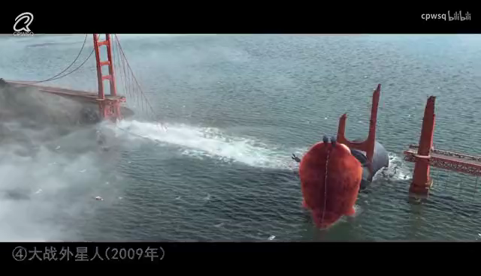

Slide 4
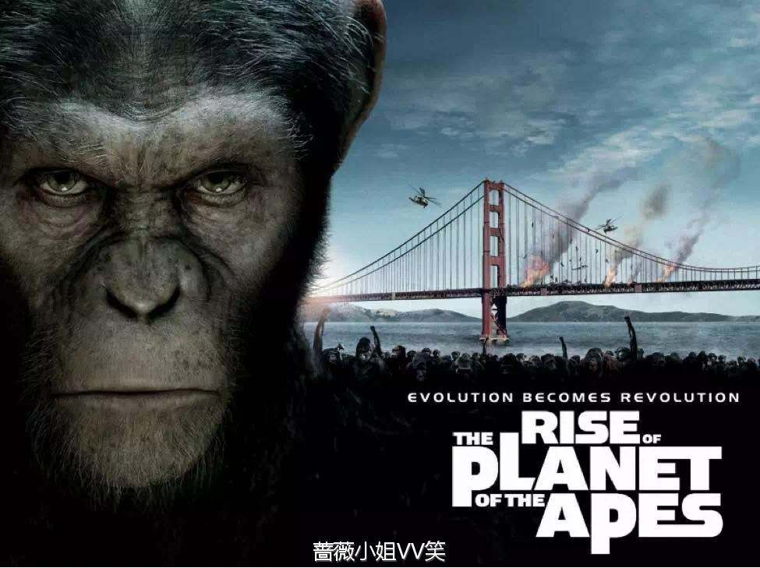
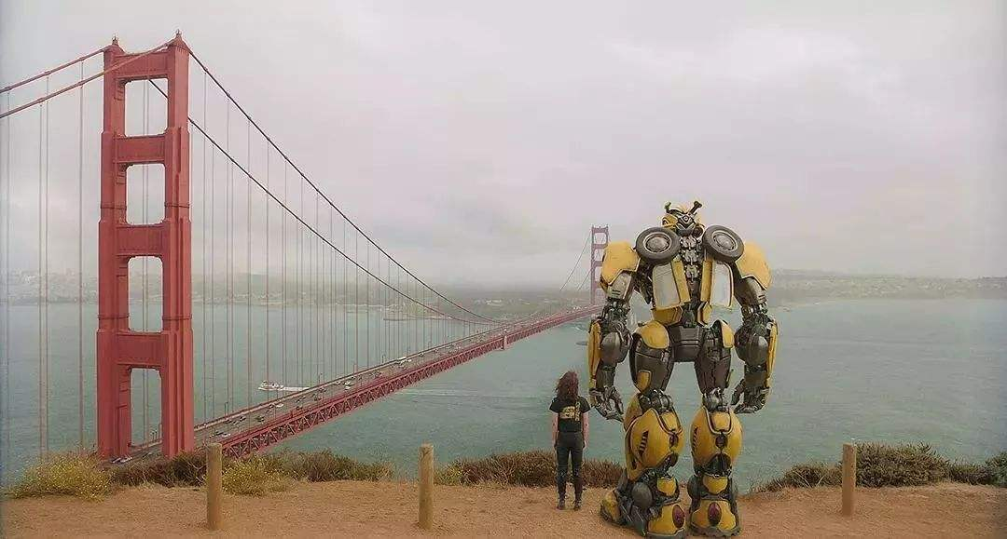
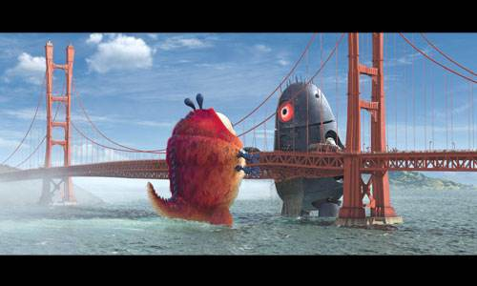
Where were these scenes filmed?
Bumblebee
Monsters vs Aliens
The Golden Gate Bridge is an iconic structure (标志性的建筑) connecting the city of San Francisco and California,which is famous for its plendid view.
The Golden Gate Bridge has seen many ups and downs (兴衰浮沉）of the city. Besides, it is considered a landmark(地标） and an engineering marvel(工程奇迹）
The Golden Gate Bridge
A suspension bridge serves as the symbol of SF.

Slide 5
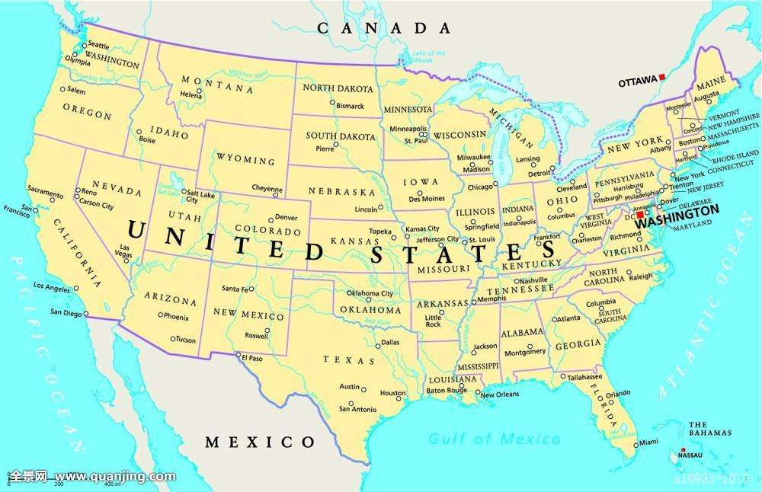
Please find San Francisco on the map
CALIFORNIA
SAN FRANCISCO
It’s a beautiful coastal city in California on the West Coast of USA.

Slide 6
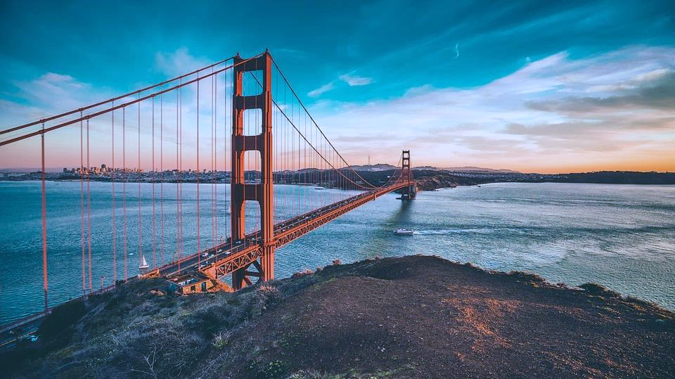
A Travel Journal of Li Lan
San Francisco
A travel journal is personal record of one’s travels, which may be kept ina diary or in a blog online. It is usually organized in time order or space order.

Slide 7
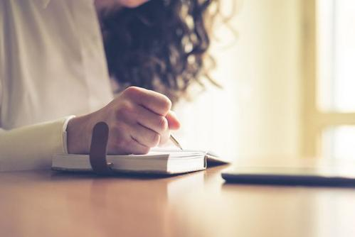
Prediction
What do you think Li Lan might write in the travel journal?

Slide 8
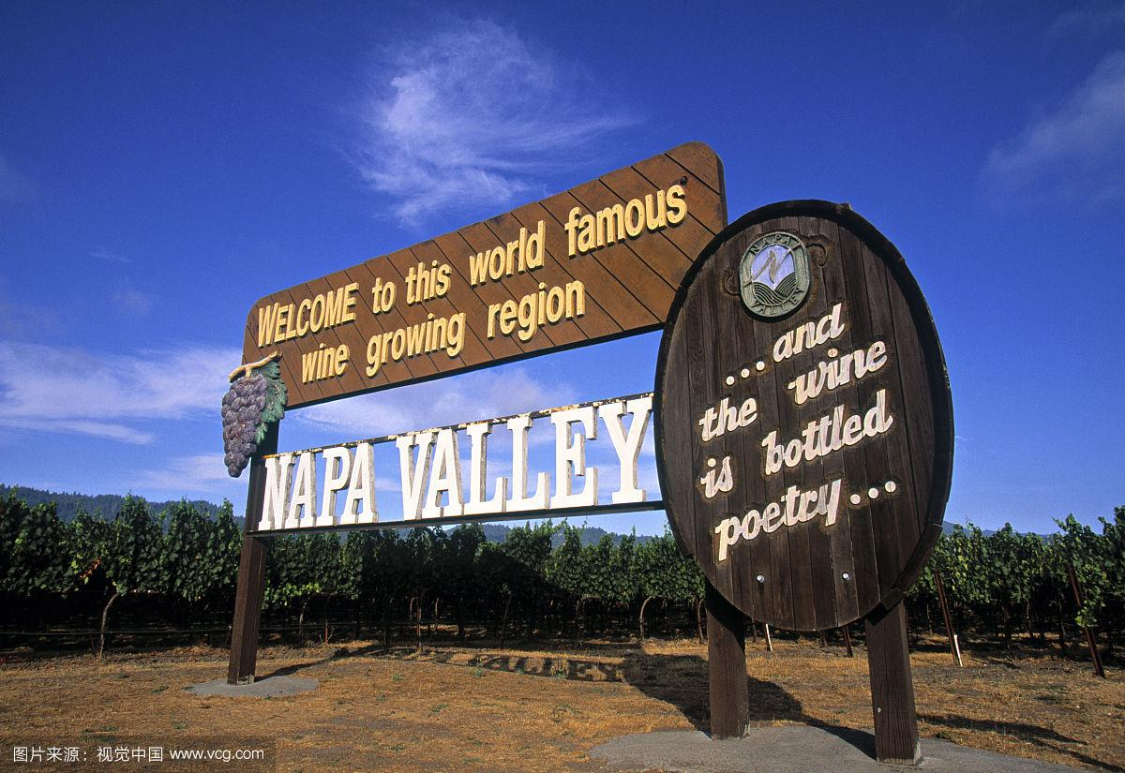
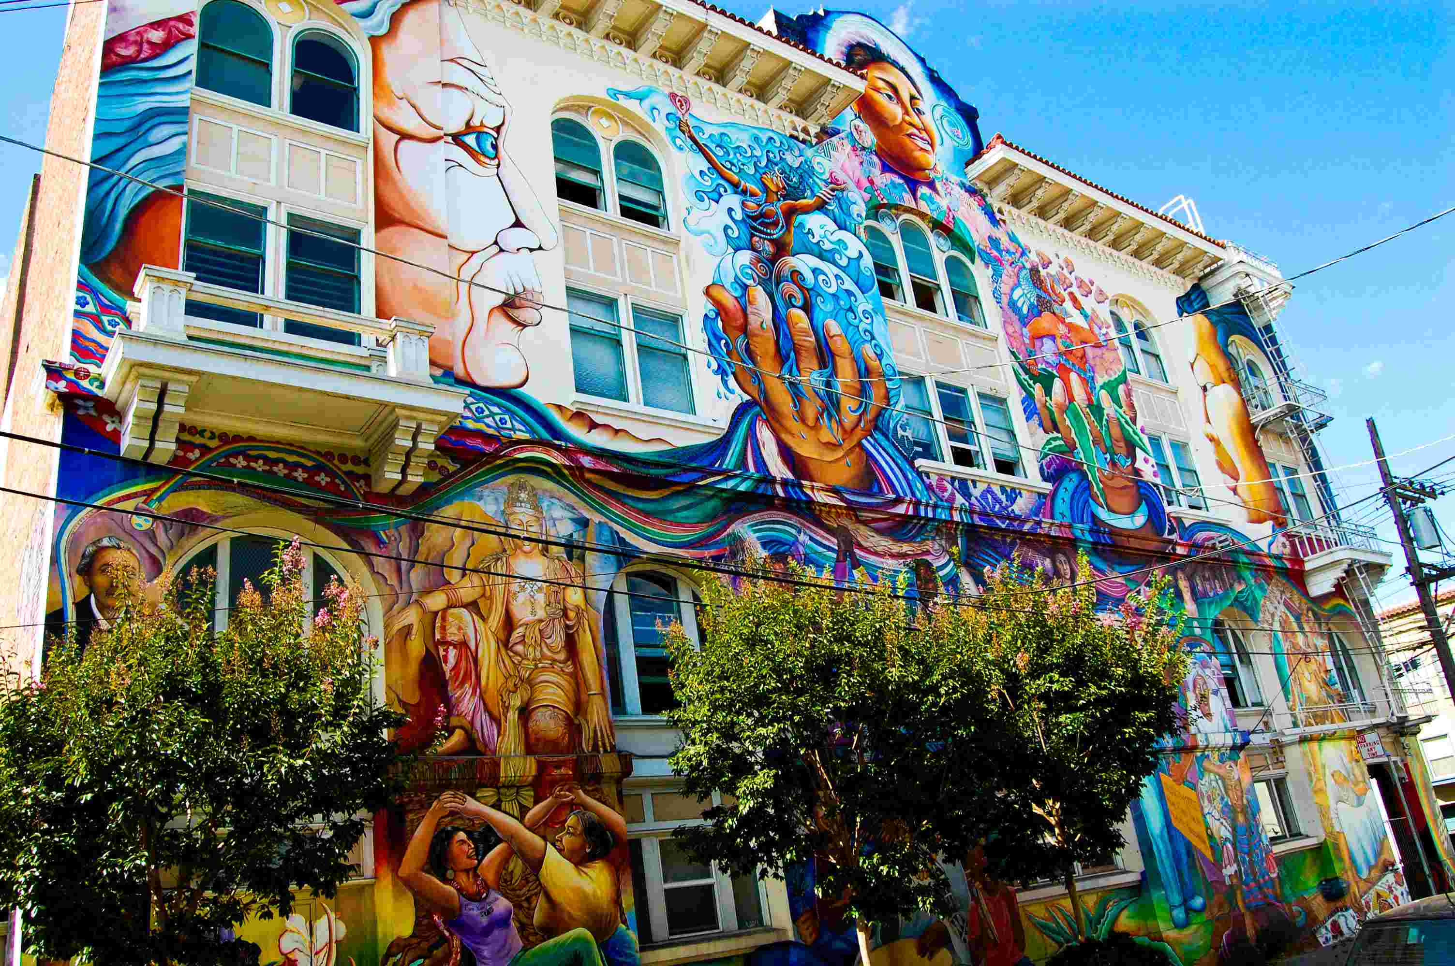
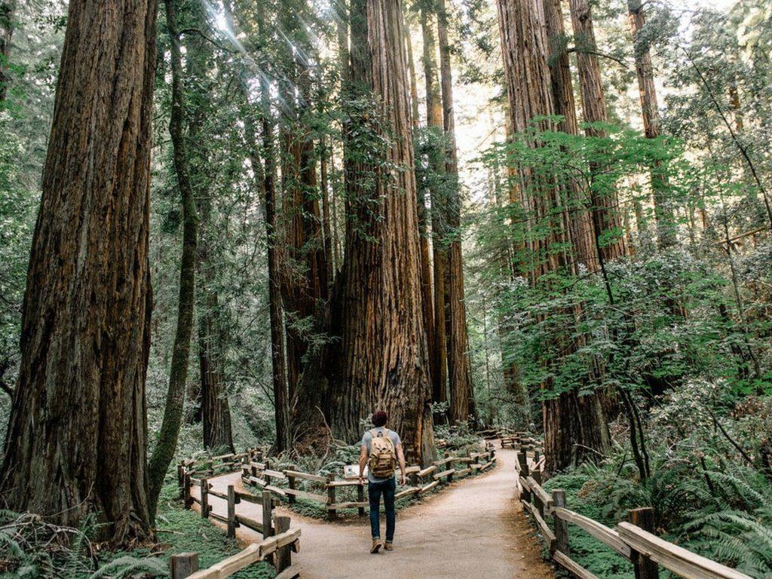
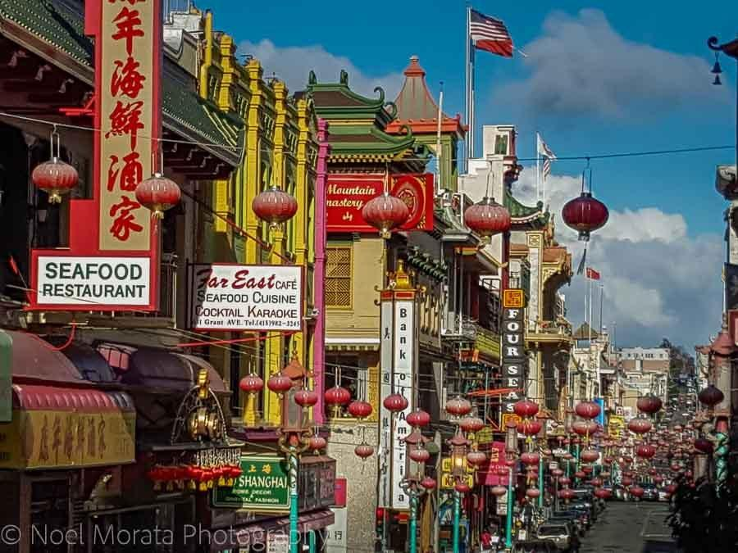
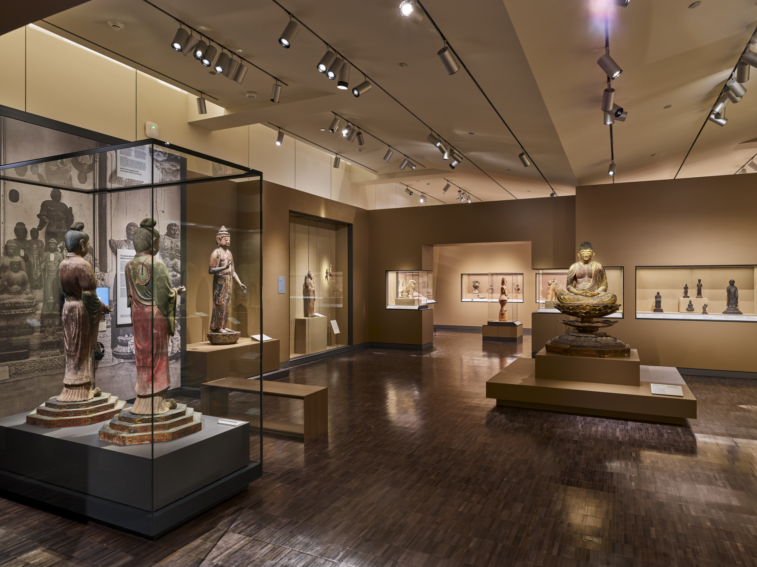
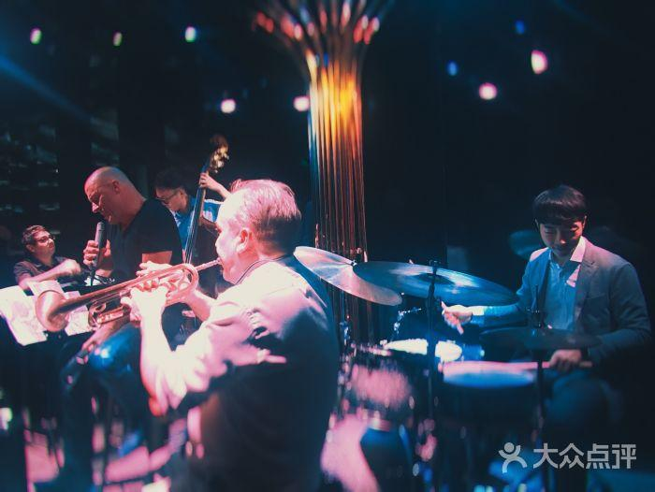
Scanning :Look at these photos and match them with the contents in the passage.
Napa Valley
Mission District
The Redwood Forest
Chinatown
a local museum
jazz bar

Slide 9
Read and sort out the agenda.
Li Lan's travel journal
Before coming to SF
• camped in the Redwood Forest
• visited _____________
Napa Valley
Mexico
• many people from ______ or Central America
• a centre for ____, music, and food (Mission
School--influenced by ______ and ______ art)
• ate _______________ noodles
in the morning
(in the Mission District)
art
graffiti
comic
Mexican-Chinese
Mexico
• in 1848, got it from _________
• in 1848, __________ started
• people from all over the world to
___________________
• Chinese immigrants arrived
(opened up ______ and restaurants;
found jobs ________; joined the
________; went to build the _______)
learnt the historical changes in California
gold rush
in the afternoon
(in a local museum)
seek their fortune
to earn a living
shops
on farms
gold rush
railway
in the evening
(Chinatown)
restaurants
What did she do and plan to do?
• many cafés and ____________
• selected a ____________________
Cantonese restaurant
tomorrow evening
(in the Richmond District)
jazz bar
• will go to a _________

Slide 10
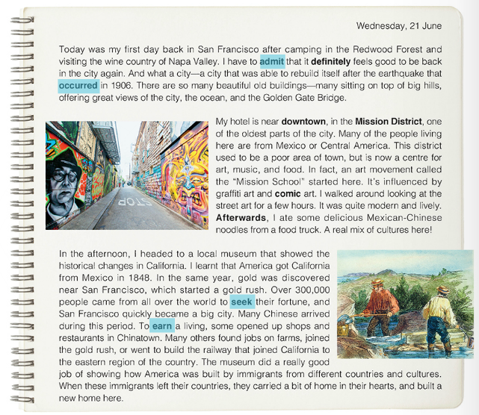
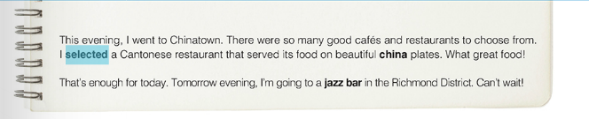
What did she learn？
ethnic and cultural cultures
1. What impressed the writer
first about San Francisco?
2. What is so special about
the Mission District?
3. Why did Chinese
immigrants go to San
Francisco?
4.What examples of ethnic and cultural diversity can you find in the journal?
ethnic diversity
cultural diversity
music originated from black people

Slide 11
Read and analyze
Did Li Lan enjoy her trip in San Francisco? Can you find some evidence to support your idea?
Parts | Feelings | evidence
Para 1: city of San Francisco
Para 2: Mission District
Para 3: local museum
Para 4: Chinatown
Para 5: Richmond District
amazed,
What a city…rebuild itself after the earthquake…so many beautiful old buildings
I walked around looking at the street art for a few hours…quite modern and lively
interested
The museum did a really good job…immigrants left their own country…
touched
happy,satisfied
So many good cafes and restaurants … beautiful china plates…what good food!
eager to know
Can’t wait !

Slide 12
Think and Share
Your impressions?
What kind of city is San Francisco?
tough/ strong；beautiful /spectacular.
a modern ,open, tolerant,vibrant city of art, mixed culture and ethnic diversity
historical
SF is a city that has diverse cultures

Slide 13
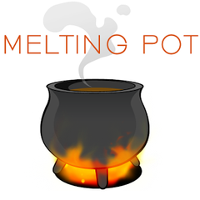
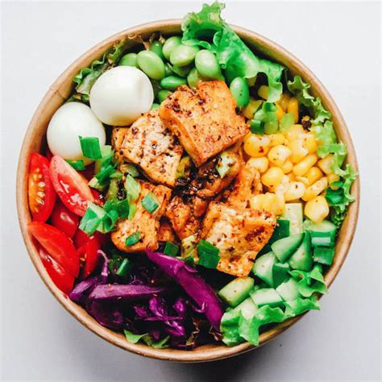
Post reading——critical thinking
San Francisco is called “ melting pot”.However, someone thinks it is better to call it “a salad bowl”. What’s the difference?

Slide 14
melting pot (大熔炉）：heating metals（金属）in a container. When they melt(融化），the metals unite and become something new and stronger.
melting pot : is a place where people of different backgrounds live together and gradually get mixed together. (melts different cultures into one culture)
salad bowl : accept different cultures but they keep their own identity.

Slide 15
What can we learn from San Francisco while treating different cultures.
To embrace To appreciate To respect To accept
cherish
We should (珍惜）our own traditional culture and ___________（尊重）cultural diversity，and thus live in
(和睦）with each other.
respect
harmony

Slide 16
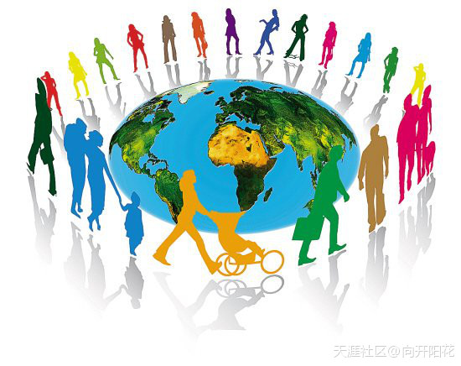
The beauty of the world lies in the diversity of its people and cultures.

