Slide 1

感恩遇见，相互成就，本课件资料仅供您个人参考、教学使用，严禁自行在网络传播，违者依知识产权法追究法律责任。
更多教学资源请关注
公众号：溯恩高中英语
知识产权声明

Slide 2

Unit 5 Music
Listening & Speaking
When words fail, music speaks.

Slide 3


Enjoy the show

Slide 4



Slide 5
Gives us confidence
Raises our_________ in learning English
Improves our ____________
interest
pronunciation
Brings people together
(Gives us a sense of __________)
Power of music
belonging
Keeps us ________
(so that we feel less ________and _________)
company
bored
lonely
Enables us to stay _________and __________
motivated
energetic

Slide 6
Pop music
Chinese traditional
Rock-and-Roll
Types of Music
Classical
Country music
Hip-hop
Jazz, blues,
folk music...

Slide 7
How can we distinguish different types o f music?
Check
The way the musicians are singing, how the music makes us feel
Hip-hop
Classical
Chinese
traditional
Country
music
pop
Rock&roll
wear casual clothes
Play the guitar
Love for nature, life
Chinese musical instruments:
Guqin, guzheng, pipa
(Stringed instrument)
Dressed in traditional clothes
powerful , stir up our emotions easily
Dance to the music
Musical instruments
The way performers dress themselves

Slide 8
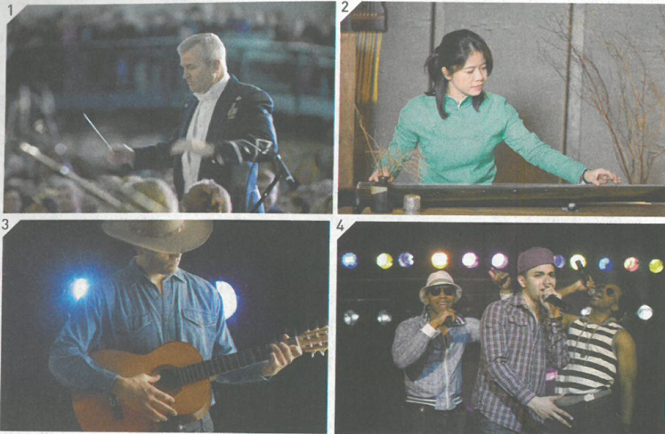
Match the pictures with the correct types of music.
conducting a choir
playing guzheng
Chinese traditional
classical
country music
hip-hop
1 ______
B
2 ______
A
3 ______
C
D
4
playing the guitar
Singing happily

Slide 9
Listening skills
predict according to questions&choices
2. focus on key words
A reporter is interviewing three students about their
_____________for music
preferences
Focus on verbs

Slide 10
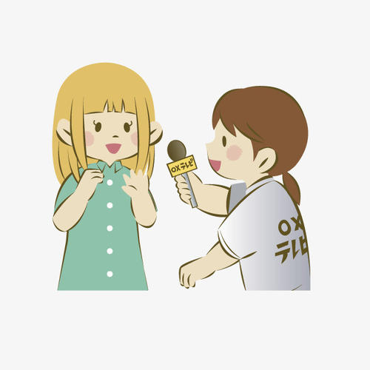
Let's listen and choose the right answers
A reporter from the school newspaper is interviewing students about music.
The first student likes to
The second student likes to
The third student likes to
Chinese traditional songs.
classical music.
hip-pop music.
country music.
dance to
listen to
play
sing

Slide 11
Paraphrase: use easier words to explain something difficult to others or to confirm what you hear
Example
A: I am not quite myself today.
B: So you want to have a rest?
A: I’m looking for the Confucius Temple, but maps are my Achille’s heel.
B: So you mean _________________________?
you are not good at maps
If you find some words in the listening text is difficult to understand. Don’t be nervous, the following sentences may tell you.

Slide 12

Listening
Let's listen and finish the explanation
Country music touches my heart.
So you like music that’s ________ of __________?
full feeling
When I listen to hip-hop, I just have to move!
So it makes you want to ___________?
dance
peaceful
Classical music makes me feel like I’m sitting beside a quiet stream and enjoying nature.
So to you, it’s _______ and __________?
beautiful

Slide 13
Listening text
R: What kind of music do you like?
S1: I like _____________. I really love Billy James.
R: Why?
S1: His music _______________.
R: So you like music that' s _____________.
S1: Yes that's what country music is all about.
R: Do you like ________?
S2: I love it!
R: What makes it so special to you?
S2: When I listen to hip-hop, I just ____________!
country music
touches my heart
full of feeling
hip-hop
have to move

Slide 14
R: Oh, so it makes you want to dance?
S2: That's right! I just can't stop.
R: And what kind of music do you like?
S3: I play the piano, so I like ______________.
R: What do you like about it?
S3: When I play, I get carried away. I feel like I'm sitting beside a quiet stream and enjoying nature.
R: So, to you, it's _____________________?
S3: Yes.
classical music
peaceful and beautiful

Slide 15
Talking--Interview
Different types of music make us feel differently
What kind of music do you prefer, why? What type of music do you not like, and how does it make you feel?
Example
A: What kind of music do you like?
B: I like techno music
A: What makes it so special to you?
B: I like to listen to it when I exercise. It gives me energy.

Slide 16

A: What kind of music do you like/prefer?
B: I like ....
A: Why?/What makes it so special to you?
B: I like it when I ....
Because it ....
A: Are you a fan of...?
C: Definitely not. Actually, ...is my favourite.
types of music:
country music
classical music
hip-hop
Chinese traditional music
pop music
rap
rock'nd roll
Reasons for liking music:
touches my heart/soul
sounds peaceful/beautiful
makes me happy or want to dance
gives me energy/hope/courage
remind me of home/family/friends
keep me company
remove my tiredness
helps exercise/study

Slide 17
Share
Music does bring us fun, energy, hope and courage, but it does more than that.
Read the following two articles and find out more about the role (benefits ) of music.

Slide 18
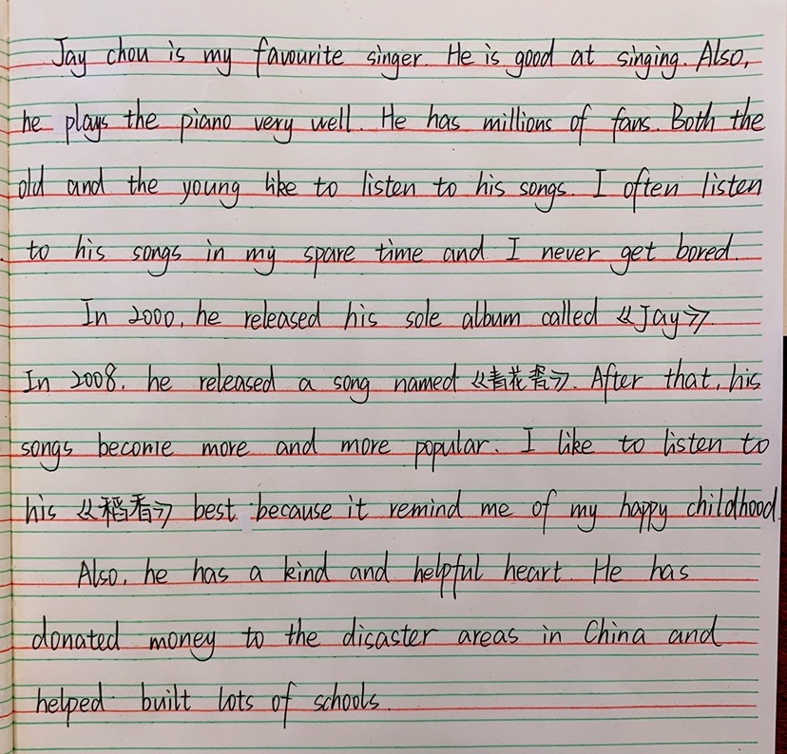
Music narrows the generation gap between people.

Slide 19
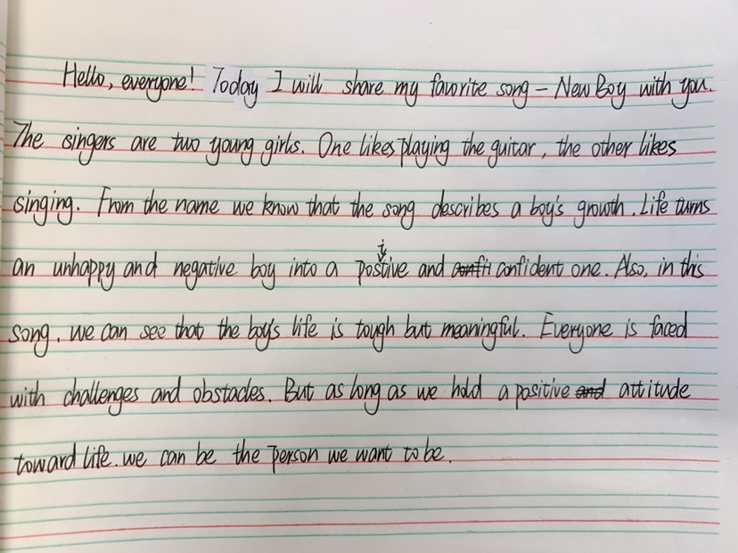
In music, we see the past as well as the present.

Slide 20
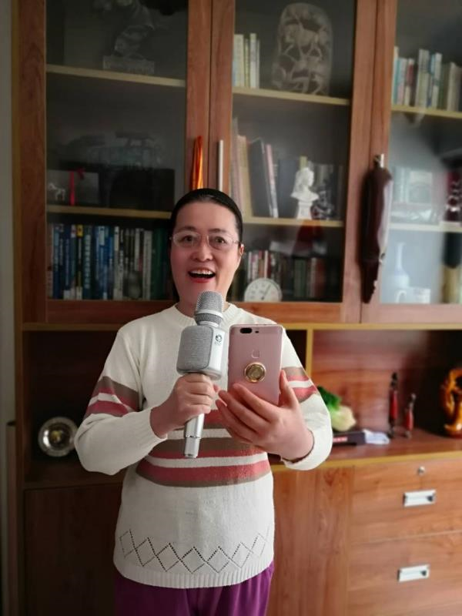
Thinking
When war breaks out or a disease hits a place, cities are locked down, people are stuck at home, how can they sing together?
The Internet
How Internet changed the way we enjoy music?

Slide 21
Homework
Disscus with your groupmates and complete the form
 | In the past | Nowadays
Ways for people to experience music
How people create and perform music
Who can join a choir or become a singer
……

Slide 22
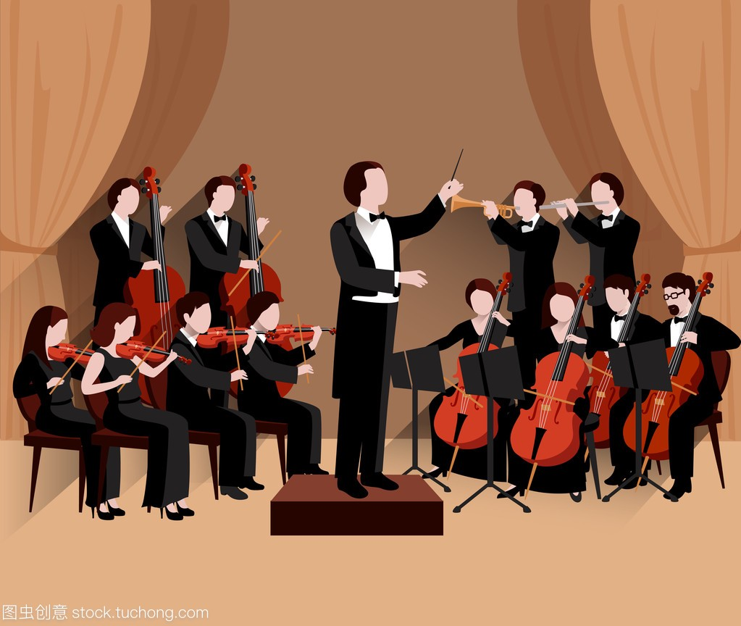
conductor
Musicians are playing different instruments, such as violin, cello大提琴 and trumpet小号.
They dress formally.
Mozart, Beethoven

