Slide 1

感恩遇见，相互成就，本课件资料仅供您个人参考、教学使用，严禁自行在网络传播，违者依知识产权法追究法律责任。
更多教学资源请关注
公众号：溯恩高中英语
知识产权声明

Slide 2
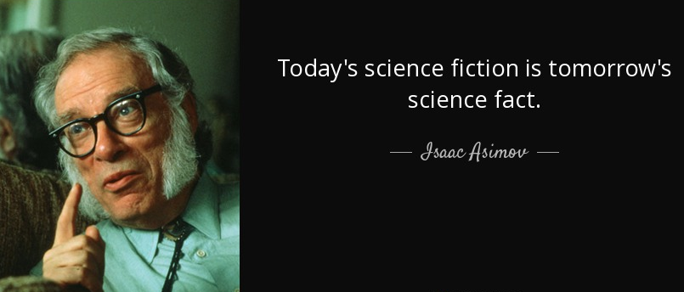
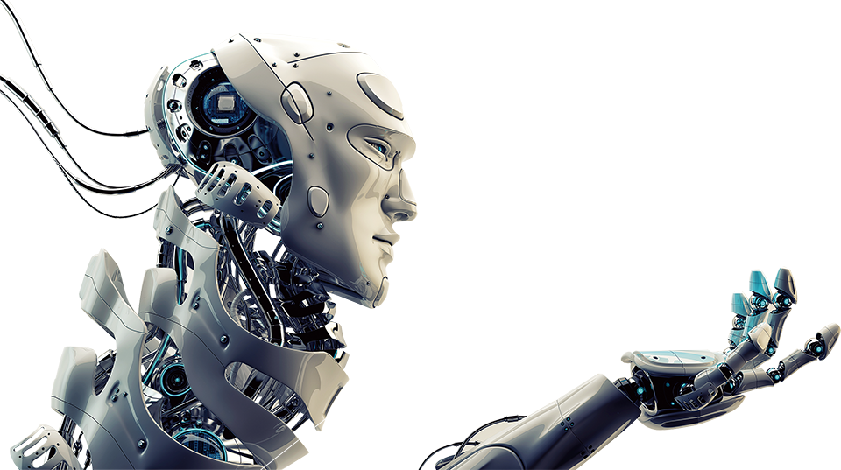

Unit 1 Science Fiction
Reading and thinking

Slide 3
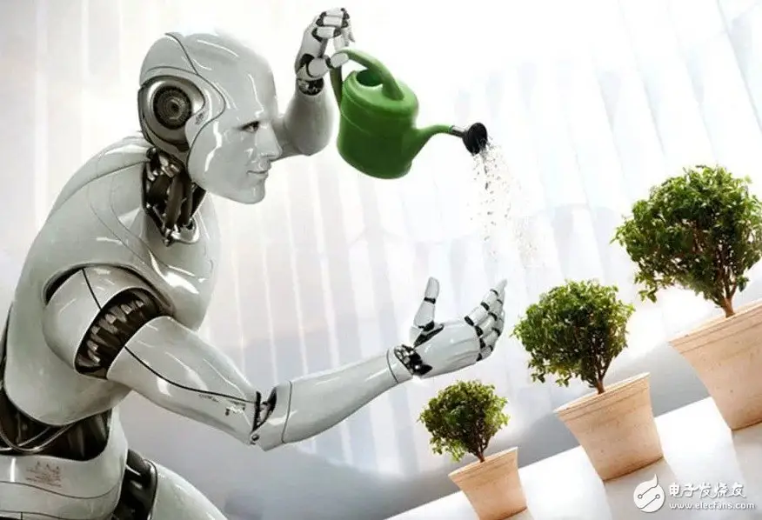
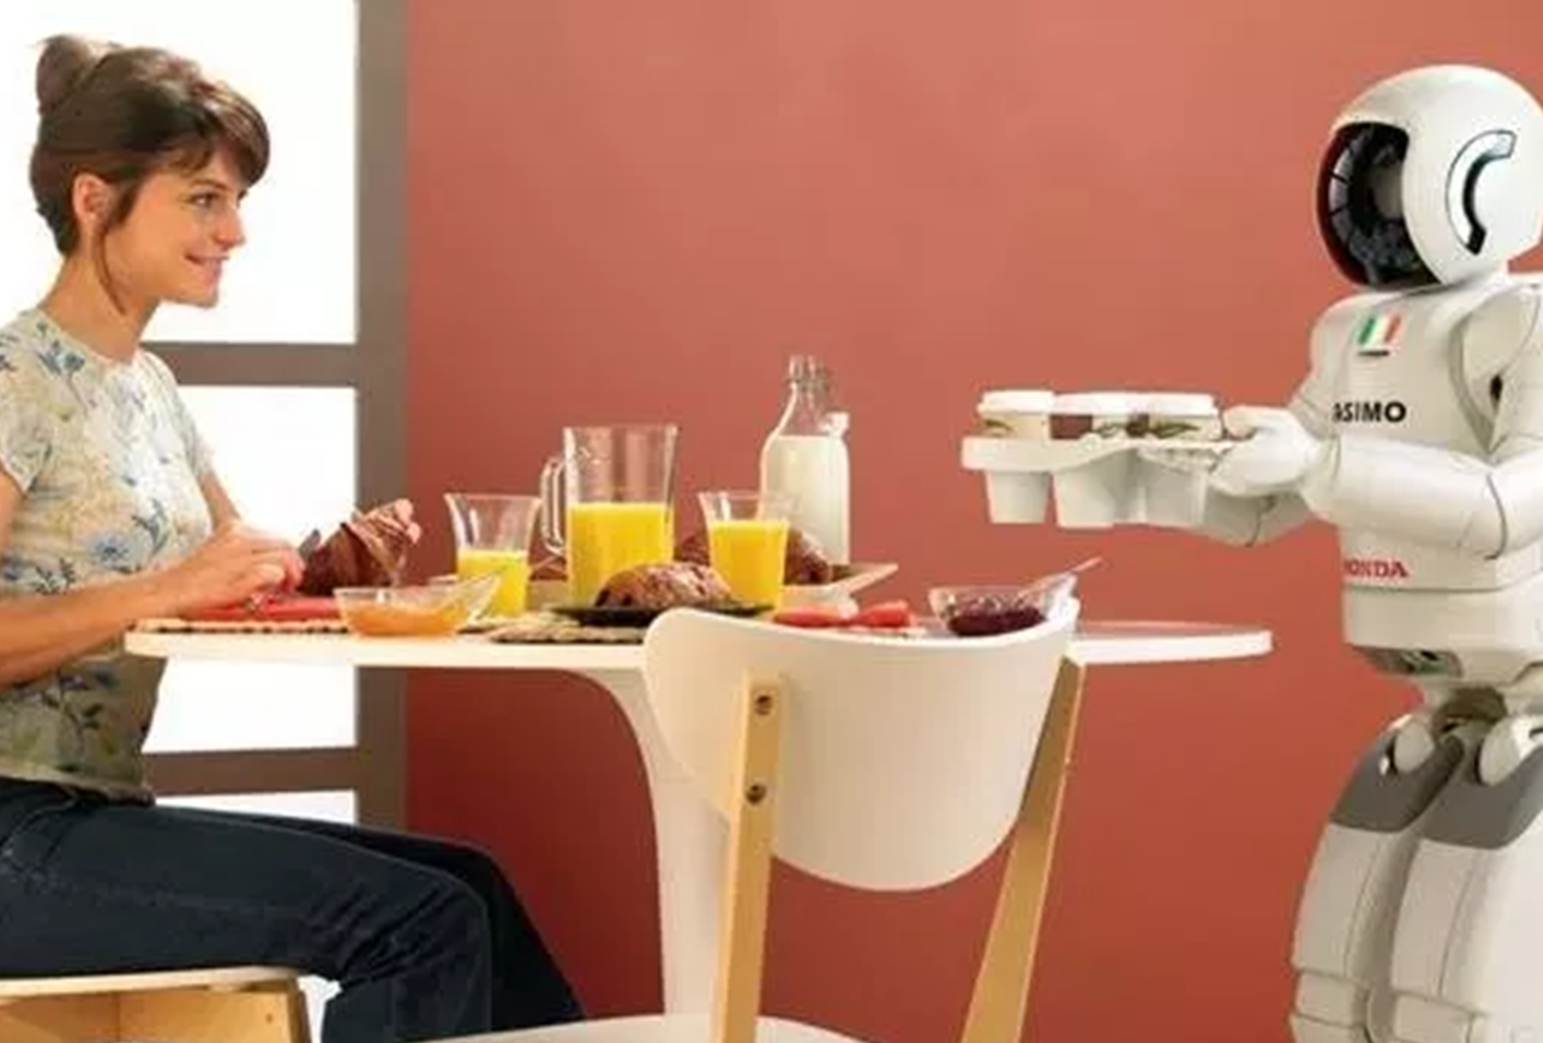
Explore the relationship between humans and robots
Period 1
How do they get on with each other?

Slide 4


Step 1 Pre-reading
What’s the genre（体裁）of this text?
A. Narration 记叙文
B. Exposition 说明文
C. Argumentation 议论文

Slide 5
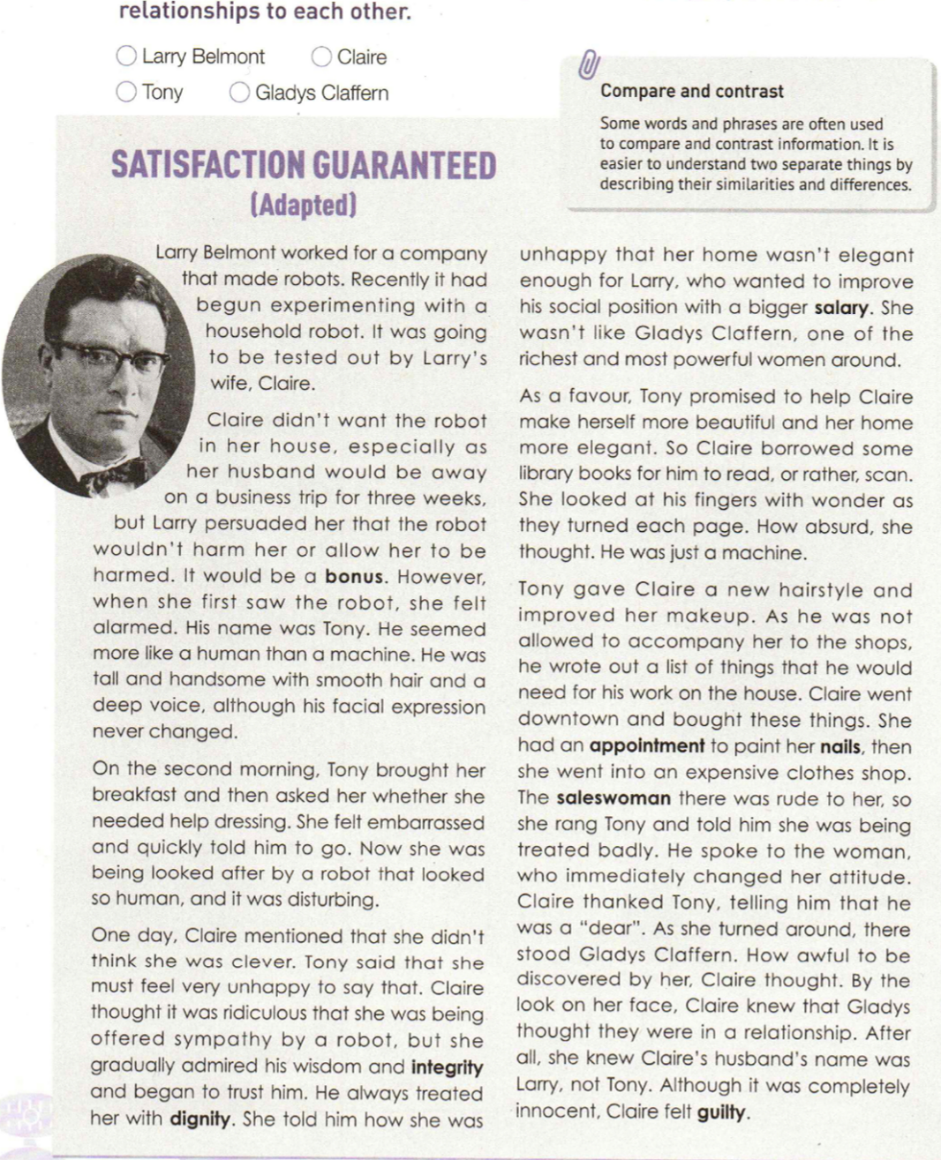
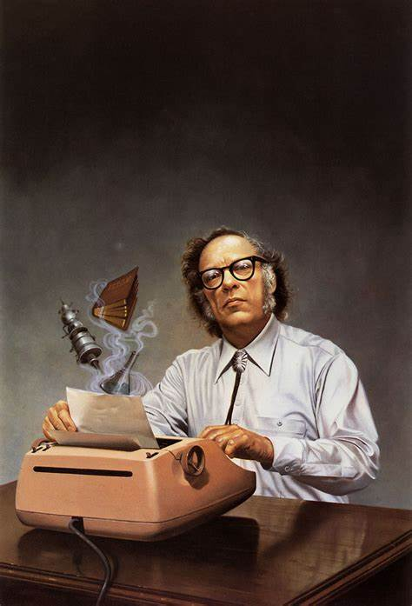

Step 1 Pre-reading
Satisfaction Guaranteed
Whose satisfaction do you
think will be guaranteed?
How do you understand
the word “adapted”?

Slide 6
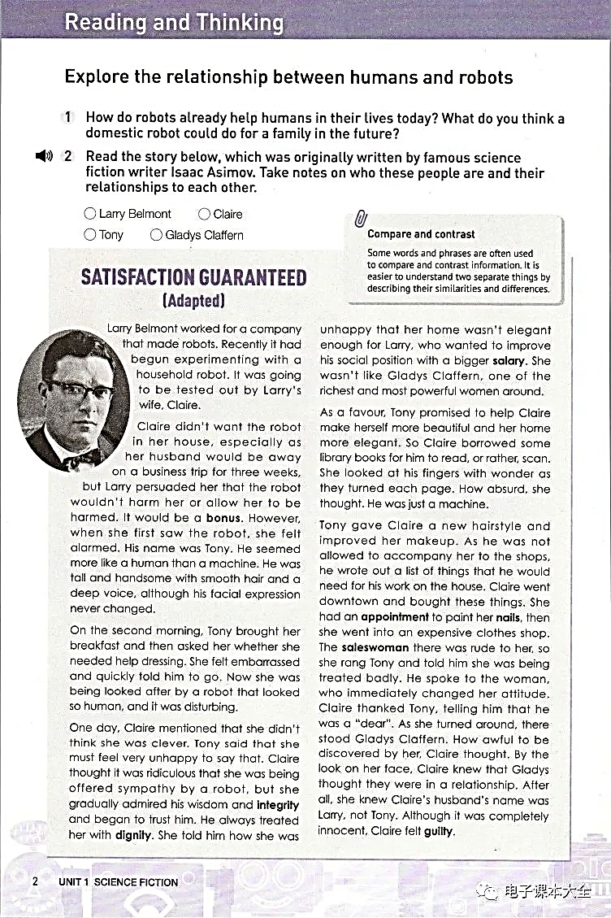
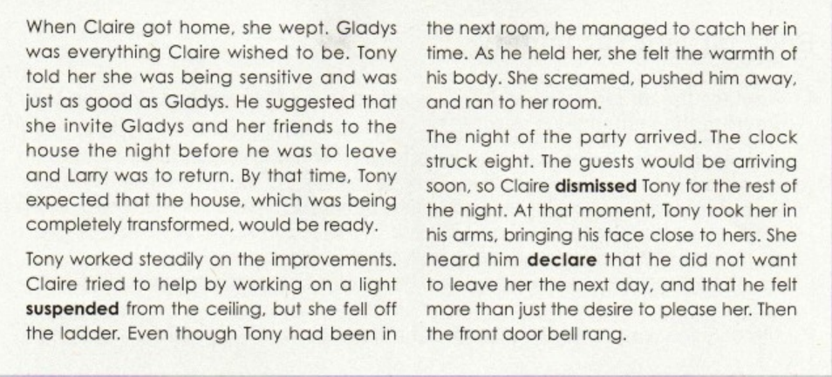
Step 2 Reading for the main idea and the structure
7
1
9
Part3 The result of Tony living with Claire.
2
5
8
Part1 Tony’s arrival at Claire’s home.
6
Main idea: It is mainly about
how a household _________ was
_________ ________ in a family.
robot
3
tested
out
4
Part2 (Para.2-8) The process of Tony helping Claire.

Slide 7
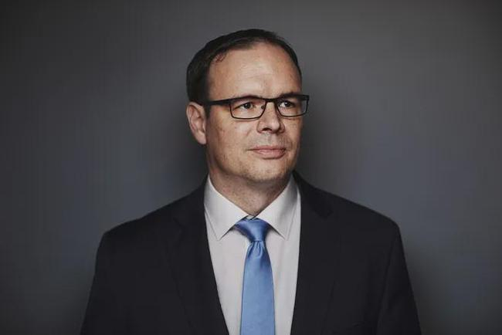
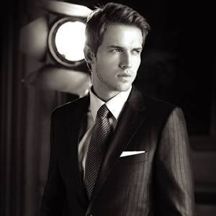

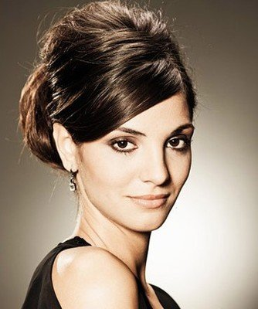
Step 3 Reading for the characters
Read the story originally written by famous science fiction writer Isaac Asimov. Take notes on main characters and their relationships to each other.
made
a household robot
Larry
Belmont
Tony
test out
couple
friends
Gladys
Claffern
Claire
Claire wished to be

Slide 8

Step 4 Reading for details—Part 2
Read the story carefully and pay attention to the changes of Claire’s feelings towards Tony as the story developed.
Claire’s
feelings
Para. 2 Claire didn' t want the robot in her house, especialy as her husband would be away on a business trip for three weeks, but Larry persuaded her that the robot wouldn’ t harm her or allow her to be harmed. It would be a bonus. However, when she first saw the robot, she felt alarmed.His name was Tony. He seemed more like a human than a machine. He was tall and handsome with smooth hair and a deep voice, although his facial expresion never changed.
alarmed
dislike
添加题
添加标题
Before Tony arrived
when she first saw him
Occasion
why?

Slide 9
Step 4 Reading for details—Part 2
Read the story carefully and pay attention to the changes of Claire’s feelings towards Tony as the story developed.
Claire’s
feelings
Para 3 On the second moning,Tony brought her breakfast and then asked her whether she needed help dressing. She felt embarrassed and quickly told him to go. Now she was being looked after by a robot that looked so human, and it was disturbing.
alarmed
embarrassed
dislike
添加题
添加标题
Before Tony arrived
when she first saw him
when Tony asked...
help her get dressed
Occasion

Slide 10
Step 4 Reading for details—Part 2
Read the story carefully and pay attention to the changes of Claire’s feelings towards Tony as the story developed.
Para 4 One day, Claire mentioned that she didn't think she was clever. Tony said that she must feel very unhappy to say that.Claire thought it was ridiculous that she was being offered sympathy by a robot, but she gradully admired his wisdom and integrity and began to trust him. He always treated her with dignity. she told him how she was unhappy that her home wasn' t elegant enough for Larry, who wanted to improve his social position with a bigger salary. She wasn' t like Gladys Claffern,one of the richest and most powerful women around.
Claire’s
feelings
alarmed
embarrassed
dislike
添加题
添加标题
Before Tony arrived
when she first saw him
when Tony asked...
help her get dressed
when Tony offered sympathy
Occasion
why?

Slide 11
Step 4 Reading for details—Part 2
Read the story carefully and pay attention to the changes of Claire’s feelings towards Tony as the story developed.
how?
Claire’s
feelings
Para 5 As a favour,Tony promised to help Claire make herself more beautiful and her home more elegant. So Claire borrowed some library books for him to read, or rather, scan. She looked at his fingers with wonder as they turned each page. How absurd, she thought. He was just a machine.
admiring trusting
alarmed
embarrassed
dislike
添加题
添加标题
Before Tony arrived
when she first saw him
when Tony asked...
help her get dressed
when Tony offered sympathy
Occasion

Slide 12
Step 4 Reading for details—Part 2
Read the story carefully and pay attention to the changes of Claire’s feelings towards Tony as the story developed.
how?
Para 6 Tony gave Claire a new hairstyle and improved her makeup. As he was not allowed to accompany her to the shops, he wrote out a list of things that he would need for his work on the house. Claire went downtown and bought these things. She had an appointment to paint her nails, then she went into an expensive clothes shop. The saleswoman there was rude to her, so she rang Tony and told him she was being treated badly He spoke to the woman who immediately changed her attitude. Claire thanked Tony, telling him that he was a "dear" .As she turned around, there stood Gladys Claffern. How awful to be discovered by her, Claire thought. By the look on her face, Claire knew that Gladys thought they were in a relationship. After all, she knew Claire’s husband’s name was Larry, not Tony. Although it was completely innocent, Claire felt guilty.
Claire’s
feelings
admiring trusting
alarmed
embarrassed
dislike
添加题
添加标题
Before Tony arrived
when she first saw him
when Tony asked...
help her get dressed
when Tony offered sympathy
Occasion
why?

Slide 13
Step 4 Reading for details—Part 2
Read the story carefully and pay attention to the changes of Claire’s feelings towards Tony as the story developed.
why?
Claire’s
feelings
Para 7 When Claire got home, she wept. Gladys was everything Claire wished to be. Tony told her she was being sensitive and was just as good as Gladys. He suggested that she invite Gladys and her friends to the house the night before he was to leave and Larry was to return. By that time, Tony expected that the house, which was being completely transformed, would be ready.
admiring trusting
thankful
alarmed
embarrassed
dislike
添加题
添加标题
Before Tony arrived
when she first saw him
when Tony asked...
help her get dressed
when Tony offered sympathy
when Tony ... talk
to the saleswoman
Occasion
How did Tony comfort Claire?
What might Clair think of Tony?
considerate concerned satisfying

Slide 14
Step 4 Reading for details—Part 2
Read the story carefully and pay attention to the changes of Claire’s feelings towards Tony as the story developed.
Claire’s
feelings
Para 8 Tony worked steadily on the improvements. Clare tried to help by working on a light suspended from the ceiling, but she fell off the ladder. Even though Tony had been in the next room, he managed to catch her in time. As he held her, she felt the warmth of his body. She screamed, pushed him away, and ran to her room.
admiring trusting
thankful
alarmed
embarrassed
dislike
添加题
添加标题
Before Tony arrived
when she first saw him
when Tony asked...
help her get dressed
when Tony offered sympathy
when Tony ... talk
to the saleswoman
shy & nervous
Occasion

Slide 15
Step 4 Reading for details—Part 2
Read the story carefully and pay attention to the changes of Claire’s feelings towards Tony as the story developed.
Claire’s
feelings
shy
nervous
admiring trusting
thankful
alarmed
embarrassed
dislike
添加题
添加标题
Before Tony arrived
when she first saw him
when Tony asked...
help her get dressed
when Tony offered sympathy
when Tony ... talk
to the saleswoman
when Claire fell and Tony held her
Occasion

Slide 16
Step 4 Reading for details—Part 3
Part 3 The result of Claire living with the robot
What happened before the party began?
Para 9 The night of the party arrived. The clock struck eight. The guests would be arriving soon, so Claire dismissed Tony for the rest of the night. At that moment, Tony took her in his arms, bringing his face close to hers. she heard him declare that he did not want to leave her the next day, and that he felt more than just the desire to please her. Then the front door bell rang.
添加题
添加标题
What would happen?

Slide 17
Step 5 Discussing and writing—Part 4
Part 4 The ending of the story
Then the front door bell rang. ________________________________________
__________________________________________________________________________________________________________________________________________________________________________________________________________________________________________________________________________________________________________________________________________________________________________________________________________________
● What would happen at the party?
● What would happen between Claire and Tony?
添加题
● What would happen between Claire and Gladys?
Claire
Tony
添加标题
Gladys
Claffern
Work in groups and come up with a reasonable ending.

Slide 18
Step 5 Discussing and writing—Part 4
Part 4 The ending of the story
The next morning a car drove up and took Tony away. ______________
________________________________________________________________________________________________________________________________________________________________________________________________________________________________________________________________________________________________________________________________________________________________________
● What would happen to Claire?
Was she eventually satisfied?
添加题
添加标题
● What would happen to Tony?
Did he pass the test?
happy ending?
sad ending?
surprising ending?
Work in groups and come up with a reasonable ending.

Slide 19
Period 1 Assignment
Write down the ending of the story
Then the front door bell rang. ___________________________________
__________________________________________________________________________________________________________________________________________________________________________________________
The next morning a car drove up and took Tony away. _________________
____________________________________________________________________________________________________________________________________________________________________________________________________________________
添加题
添加标题

Slide 20

Period 2
Step 6 Listening and discussing
Listen to the rest of the story and discuss with your deskmate about how different is it from your ending.
Then the front door bell rang. Tony let her go and disappeared from sight. It was then that Claire realized that Tony had opened the curtains of the front window. Her guests had seen everything! The women were impressed by Claire, the house and the delicious cuisine. Just before they left, Claire heard Gladys whispering to another woman that she had never seen anyone so handsome as Tony. What a sweet victory to be envied by those women! She might not be as beautiful as them, but none of them had such a handsome lover. Then she remembered — Tony was just a machine. She shouted "Leave me alone" and ran to her bed. She cried all night.
The next morning a car drove up and took Tony away. The company was very pleased with Tony's report on his three weeks with Claire. Tony had protected a human being from harm when he prevented Claire from falling off a ladder. He had also opened the curtains that night so that the other women would see him and Claire, which would make them envy Claire. But even though Tony had been so clever, he would have to be rebuilt — you cannot have women falling in love with machines.
添加题
添加标题

Slide 21
Step 6 Listening and discussing
Continue to complete the changes of Claire’s feelings towards Tony as the story developed.
Claire’s
feelings
superior
proud
admiring trusting
thankful
shy
nervous
alarmed
embarrassed
sad
dislike
添加题
添加标题
Before Tony arrived
when she first saw him
when Tony asked...
help her get dressed
when Tony offered sympathy
when Tony ... talk to the saleswoman
when Claire fell and Tony held her
when the
guests saw Tony holding Claire
after Claire remembered Tony was a machine
Occasion

Slide 22

Step 7 Thinking
What are the similarities and differences between Tony and human being?
Tony
Human being
comparison:
the same as, similar to,
similarly, more like,
just as, in comparison,
in the same way
· facial expression never changes;
· facial expression changes often;
smooth hair
添加题
添加标题
offers sympathy
· programmed to appear sensitive;
treats people kindly;
· can show true sensitivity and care
warm body
contrast:
different from, but, while, whereas, although,
however, in contrast,
on the other hand
· always the same
· emotions can change

Slide 23
Step 7 Thinking
Discuss in groups.
Nowadays the application of the robots has already become an irresistible trend.
Is it a challenge or an opportunity for the future development of mankind?Why?
What relationship do you think will develop between humans and robots in the future?
添加题
添加标题

Slide 24
Thank you

