Slide 1

感恩遇见，相互成就，本课件资料仅供您个人参考、教学使用，严禁自行在网络传播，违者依知识产权法追究法律责任。
更多教学资源请关注
公众号：溯恩高中英语
知识产权声明

Slide 2


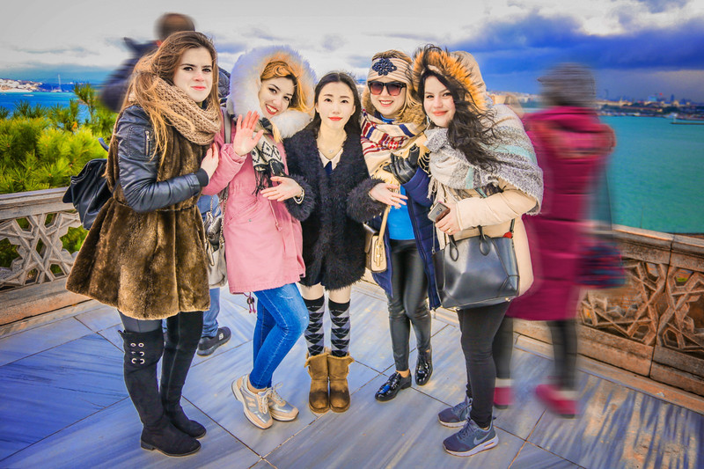
必修三 UNIT 3 DIVERSE CULTURES
Section Ⅲ Discovering Structures
Understand the use of ellipsis

Slide 3


Lead in——Ellipsis in our daily life
Pardon?
Haven’t seen you for ages.
Sorry to hear that.
Coming swimming?
More tea?
Doesn’t matter.
Pity you couldn’t come.
Sounds fine to me.

Slide 4
Read the sentences from the unit and find the words that have been omitted to avoid repetition.
➢ And what a city—a city that was able to rebuild itself after
the earthquake that occurred in 1906.
^
adj.
an amazing city
➢ A real mix of cultures here!
^
It is
S. + P.
➢ When these immigrants left their countries, they carried a bit of home in their hearts, and built a new home here.
^
➢ What great food!
S.
S. + P.
^
they
➢ Can’t wait!
it is
^
S.
I

Slide 5
The usage of ellipsis
Ellipsis in signs/labels
No photos./Roadworks ahead./Children crossing ahead.
Easy to read
Ellipsis in postcards/diaries
Best wishes.(I give you my best wishes.)
Informal letters
Ellipsis in newspaper headlines
Millionaire poisoned(in Beverly Hills home) Plane crash claimed 15 lives.
to save space and money

Slide 6
The usage of ellipsis
Ellipsis in Q&A
To avoid repetition
➢ Has he arrived? —— Yes, he has (arrived).
➢ When did you finish it? —— (I finished it) Last night.
➢ Who broke the window? —— Mike (broke the window).
Ellipsis in exclamatory sentences
➢ (It/That) Sounds great!
➢ What a (smart) boy (he is)!
➢ What a bright star (it is)!
➢ How brave (they are)!
Based on mutual understanding / For effect

Slide 7
The usage of ellipsis
Ellipsis in imperative sentences
(Jane,) Give me some food.
(Honey,) Come back soon please.
(You) Sit down please.
Based on mutual understanding
Ellipsis in a comparison
John cooks better pizza than his wife (cooks/does).
John is taller than his wife (is).
His eyes are bigger than his mother’s (eyes).
To avoid repetition

Slide 8
The usage of ellipsis in clauses
Ellipsis in clauses
They say [that] you are going to Europe soon.
This is the only pencil [that] I have
Why did he come here? --- He didn’t tell me (why he came here)
Is he the boy [whom] I hired yesterday?
Were I you, I would take her advice.
If I were you,...
Had I known about the lecture, I would have taken it.
If I had known about the lecture,...
allowed in English grammar

Slide 9
Ellipsis in attributive and object clause
(1) In the object clause,
that can be omitted in
most cases,but if there
are two or more than two
clauses,the first that in the
clause is usually left out.
(2) In the attributive clause,
that/which/ who/ whom can
be omitted if they serves as
object in the sentence.
Examples
①He said [that] the text was very important and that we should learn it by heart.
②The book [that] I borrowed yesterday was hers.

Slide 10
Ellipsis in adverbial clause
①She looks older than my mother (does)②You can ask me questions if (there are) any (questions).
③I would have come yesterday (if I had wanted to).④After half an hour, she becamequieter (than she had been).⑤When (you are) crossing the road, you'd better look at both sides.⑥Unless (I am) invited I will not go.
(1) 状语从句出现在句末时，一般都可以省略句尾。
(2) 有时条件从句可以完全省去，只剩下 主句。
(3) 以as, than引导的比较状语从句可以全部 或部分省去。
(4) 在表示时间、地点、条件、让步等的状语从句中，从句的主语如与主句的主语相同，常省略从句的主语和谓语。

Slide 11
Exercises
◆When still a boy of six, Bob was sent away from home. ◆虽然他们累了，但他们继续工作。
__________________________, they went on working.
◆ 除非你被邀请，否则你不应该参加他的生日聚会。
You shouldn't attend his birthday party ______________________.
◆按照计划安排，我们参加了几个有指导意义的活动。
As____________ (schedule)，we participated in several instructive activities.
◆加热的时候冰可以变成水。
_____________________, ice can be turned into water.
◆只要有可能，他们就让他停下并问他这三个问题。
_____________________, they would stop him and ask him the three questions.
Though tired
unless invited
scheduled
When heated
Whenever possible

Slide 12
Summary
Ellipsis can help
To avoid repetition.
Leave out unnecessary and unimportant information or less relevant information.
Pause for effect.
Save space.
Writing with more condensed sentence structures
....

Slide 13
Summary
Different cases of ellipsis
Compound sentences: and; but...
Complex sentences: Adverbial clauses; Object clauses; Ommiting the main clause.
Simple sentences: Questions and anwers; Exclamatory sentences ; Imperative sentences...
Set phrases: Not at all; What if ...; Why not...; If only...;

Slide 14
Exercises 1
Match the questions to the most likely answers.
Do you think it’s going to rain this afternoon?
We were quite surprised after we saw the paintings in the gallery.
Will you join our trip to South Africa?
Will the flight to Rome take off on time?
Would you mind using a diagram to explain these percentages to me?
Has Lily ever been to the Louvre Museum?
A. Why so?
B. Not at all.
C. I hope not.
D. I’m afraid not.
E. Maybe not.
F. I’d love to.

Slide 15

Exercises 2
Change the sentences into elliptical sentences.
1. She likes singing and she likes dancing.
2. Is this the driver that you talked about
yesterday?
3. The man who is sitting by the window is Mr. Smith.
4. He could not decide whether to buy the car or not to buy the car.
5. When it is heated, the metal expands.
6. You can do it if you want to do it.
7. My father designed all these houses and
my father built all these houses.

Slide 16
8. He is the last person that I want to see.
9. He worked hard but his brother did not
work hard.
10. While he was reading the newspaper, grandpa
nodded from time to time.
11. He went to the doctor because he had to
go to the doctor.
12. The reference books which were ordered last
month haven't arrived yet.
13. We tested the depth of the water and the
temperature of the water.
14. Although he is very busy, he will do it for us.
15. You may leave if you wish to leave.

Slide 17
Exercises 3
Rewrite the sentences by taking out the unnecessary parts.
Before:
After：
1.You mean you are planning a trip across the Atlantic for a holiday? It sounds like a good idea.
2.He tried to solve his financial problems, but he couldn’t solve the problems.
1.You mean you are planning a trip across the Atlantic for a holiday? Good idea.
2.He tried to solve his financial problems, but couldn’t.

Slide 18
Before:
After:
3.If it is necessary, I’ll finish my report on American poetry as soon as it is possible.
4.Are you going to dress like that? Wearing a dress might be better than wearing jeans and boots.
5.Some wild mushrooms are poisonous and some are not poisonous.
6.I really like that paper folding book, and my son likes that paper folding book, too.
3.If necessary, I’ll finish my report on American poetry as soon as possible.
4.Are you going to dress like that? A dress might be better than jeans and boots.
5.Some wild mushrooms are poisonous and some are not.
6.I really like that paper folding book, and my son, too.

Slide 19
Exercises 4
Read the conversation. Find out which words have been left out.
Do you have
Justin: Linlin, I'm going to Guizhou Province next month. I'm super excited! Any recommendations for places to visit?
Linlin: Wow, cool! Guizhou is a province with a lot of cultural diversity. Places to visit... well, definitely the Huangguoshu Waterfall first.
Justin: What's special about the waterfall?
that’s
in Guizhou Province
What are some
is the
place to visit in Guizhou Province

Slide 20
heard of the Chinese novel Journey to the West.
Linlin: Well, have you ever heard of the Chinese novel Journey to the West?
Justin: Yes, I have. Why?
Linlin: In the back of the waterfall, you wil find a cave, which is the home of the Monkey King.
Justin: Really? Cool! I'll definitely check it out.
Linlin: And I strongly recommend the ethnic minority villages. You'll find Chinese culture is much more diverse than you thought.
Justin: Sounds great, thanks!
do you ask if I have heard of the novel
Huangguoshu
on your trip to Guizhou Province
from Journey to the West.
That’s
true
it’s
it was
This all

