Slide 1

感恩遇见，相互成就，本课件资料仅供您个人参考、教学使用，严禁自行在网络传播，违者依知识产权法追究法律责任。
更多教学资源请关注
公众号：溯恩高中英语
知识产权声明

Slide 2





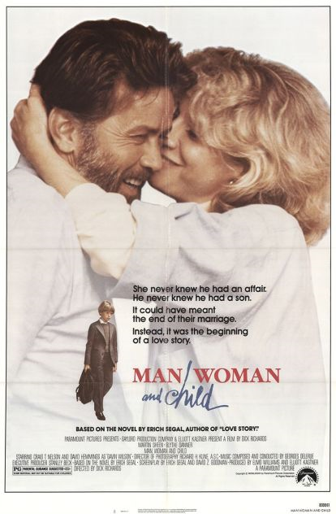
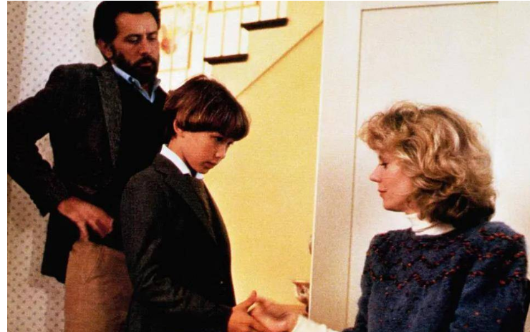




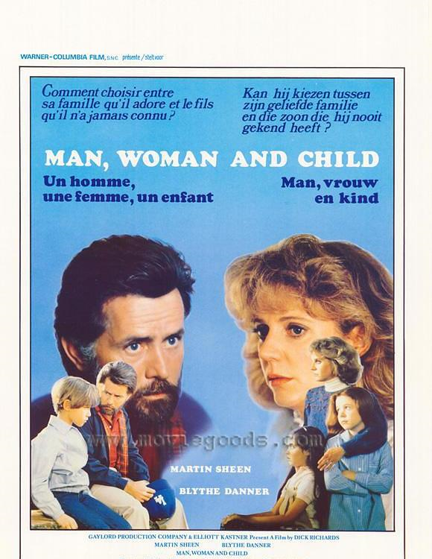


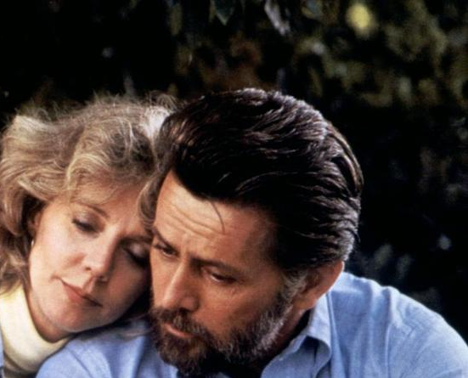





看狗血美剧 学交际修辞
英语修辞学的概念突破 | 选择就是修辞 | 交际修辞的作用
浙江省常山县第一中学
吴俊峰

Slide 3

你喜欢这样的表达吗？
A
假如你是李华，你们学校的外教Mr. Hall寒假不回国。你打算邀请他去你家里一起过春节。 内容需包含以下要点： 1. 时间 2. 一同过节的家人 3. 春节活动。_{（2017年11月浙江高考应用文写作）}
1. It’s platitudinous that we are going to stick picture…
2. I’ll be in wild gaiety if you could come.
3.Some intriguing activities are also meticulously planned.

Slide 4
你喜欢这样的表达吗？
B
假如你是李华，你校英语协会招聘志愿者，接待来访的外国中学生。请你写信应聘，内容包括：1.口语能力；2.相关经验；3.应聘目的。_{（2018年6月浙江高考应用文）}
1. Driven by deep curiosity and interest, and to have a further exploration about foreign culture, I was desperate for the volunteer work.
2. With persisting dedication and long-time exposure to pure English, I have fostered decent capabilities in oral English as well as full-assurance to meet your standards, which enable me to eliminate the linguistic barrier.

Slide 5
了解“交际修辞与美学修辞”
交际修辞
在内容的表达上偏重于炼字锻句、明确流畅，在形式的结构上偏重于平匀缜密、严谨妥贴，总体上讲究逻辑思维，叙述准确，鞭辟入里，以有效地发挥语言的交际功能。
美学修辞
在运用逻辑思维的同时，偏重于随景应情，运用想像和联想，通过修辞格_{（figures of speech）}唤起生动的意象，使语言文字新鲜活泼，意蕴优美，发挥更大的感染力和说服力，取得艺术性的表达效果。

Slide 6
两种错误的看法
只有运用辞格（比喻、借代、提喻、拟人、讽喻、代换、婉言、迂回、对照、反义、与张、曲言、双关等）才是修辞，修辞就是美学修辞，交际修辞应被排斥在外。
交际修辞是存在的，但属于低级阶段；美学修辞才属于高级阶段，高低有别，泾渭分明。
交际修辞属于低级阶段
修辞就是美学修辞

Slide 7
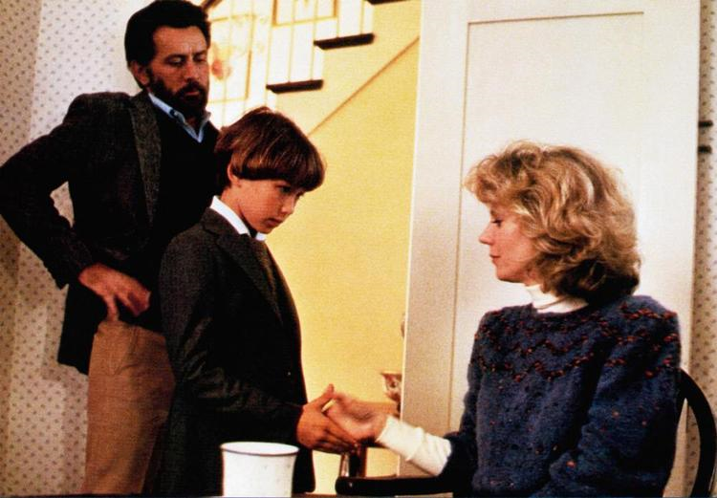
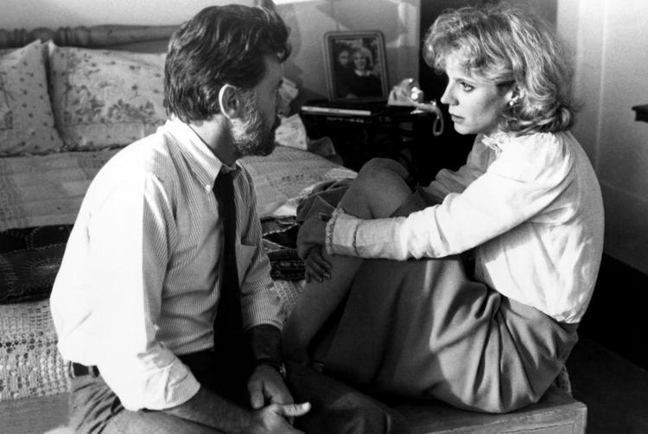

Man,Woman and Child 剧情
由美国著名作家、耶鲁大学教授西格尔（Erich Segal)的小说 Man,Woman and Child 改编成的社会家庭伦理片《巴黎来的私生子》，在艺术上有强烈的感染力，取得了极大的成功，引起了社会巨大反响。
剧情说到贝克威思夫妇婚后度过了十八年幸福美满的家庭生活，有一天丈夫突然承认，在出差法国期间，他有过段短暂的婚外私情，妻子感到如雷击顶，夫妻关系顿时濒临崩溃。以下是原文节录：

Slide 8

看美剧 学交际修辞
H: Honey, I gotta talk to you.¹
W: Sure. Is something wrong?²
H: Well, sort of. Yes.³
W: Bob, something in your voice scares me. Have I done
anything?
H: No. It's me. I've done it. Sheila, remember when you were
pregnant with Paula?
W:Yes?
H: I had to fly to Europe – Montpellier–-to give that paper…
W:And?
H:I had an affair.
W: No. This is some terrible joke. Isn't it?
问题思考
1.为什么用gotta不用have got to？
2.为什么用something 不用anything？
3.Well, sort of. Yes. 三个语气词表达了丈夫什么样的内心活动？
Husband (H):
Wife (W):

Slide 9
看美剧 学交际修辞
H: Honey, I gotta talk to you.¹
W: Sure. Is something wrong?²
H: Well, sort of. Yes.³
W: Bob, something in your voice scares me. Have I done
anything?
H: No. It's me. I've done it. Sheila, remember when you were
pregnant with Paula?
W:Yes?
H: I had to fly to Europe – Montpellier–-to give that paper…
W:And?
H:I had an affair.
W: No. This is some terrible joke. Isn't it?
遣词的选择就是修辞
1.用gotta不用have got to表示亲密，随便。
2.遣词准确。
用something 不用anything, 因为丈夫说“我一定要跟你谈谈”，妻子预感有事。另例：
Is there anything to eat?
（=I'm hungry!）无预期。
Is there something to eat?
(=I can smell food!）有预期。
3.心情复杂、措词困难的谈话开始了，所以用Well开始；先想淡化一下气氛.
用sort of，后一想，事情是严重的，不容躲闪，不如爽快地正视现实，用…个严肃的Yes.
Husband (H):
Wife (W):

Slide 10
看美剧 学交际修辞
H: Honey, I gotta talk to you.¹
W: Sure. Is something wrong?²
H: Well, sort of. Yes.³
W: Bob, something in your voice scares me. Have I done
anything?⁴
H: No. It's me. I've done it. Sheila, remember when you were
pregnant with Paula?
W:Yes?
H: I had to fly to Europe – Montpellier–-to give that paper…
W:And?
H:I had an affair.
W: No. This is some terrible joke. Isn't it?
问题思考
4.为什么用scare，不用frighten、terrify等同义词？
anything用得好吗？为什么？
Husband (H):
Wife (W):

Slide 11
看美剧 学交际修辞
H: Honey, I gotta talk to you.¹
W: Sure. Is something wrong?²
H: Well, sort of. Yes.³
W: Bob, something in your voice scares me. Have I done
anything?⁴
H: No. It's me. I've done it. Sheila, remember when you were
pregnant with Paula?
W:Yes?
H: I had to fly to Europe – Montpellier–-to give that paper…
W:And?
H:I had an affair.
W: No. This is some terrible joke. Isn't it?
遣词的选择就是修辞
4.表示吃惊、惶恐、不安，用scare，不用frighten、terrify等同义词，因为scare比较informal and mild,分寸最恰当。
anything用得好。“我做了什么严重事情了？”此处anything不是“任何事情”，而是“严重事情”。
如: I was cut a little in the fight,but it wasn't anything.
我在搏斗时破了一点皮，不严重。
He isn't anything in the local government.
他在当地政府中不是什么举定轻重的人。
Husband (H):
Wife (W):

Slide 12
看美剧 学交际修辞
H: Honey, I gotta talk to you.¹
W: Sure. Is something wrong?²
H: Well, sort of. Yes.³
W: Bob, something in your voice scares me. Have I done
anything?⁴
H: No. It's me. I've done it. Sheila, remember when you were
pregnant with Paula?⁵
W:Yes?⁶
H: I had to fly to Europe – Montpellier–-to give that paper…⁷
W:And?
H:I had an affair.
W: No. This is some terrible joke. Isn't it?
问题思考
5.No. It's me. I've done it. 三个短句，三个句点，为什么这样措辞？
6.yes是用升调还是降调？。
7.在提到事件发生的具体地点时，前后用了两个破折号，起到什么修辞作用？
Husband (H):
Wife (W):

Slide 13
看美剧 学交际修辞
H: Honey, I gotta talk to you.¹
W: Sure. Is something wrong?²
H: Well, sort of. Yes.³
W: Bob, something in your voice scares me. Have I done
anything?⁴
H: No. It's me. I've done it. Sheila, remember when you were
pregnant with Paula?⁵
W:Yes?⁶
H: I had to fly to Europe – Montpellier–-to give that paper…⁷
W:And?
H:I had an affair.
W: No. This is some terrible joke. Isn't it?
遣词的选择就是修辞
5.三个短句，三个句点，
表示丈夫无可推诿、急于认过的心情。转入回忆中的背景。
6.让他说下去。必是上升语调。
7.当时我必得飞去欧洲——蒙彼利埃-—-去宣读论文。
注意，在提到事件发生的具体地点时，前后用了两个破折号，表示在回忆中一步步走近婚外恋的现场，甜蜜、苦涩、歉疚、悔恨，真是百感交集，不知如何措词才能把事件的冲击波减小到最低限度。种种迟疑与犹豫，用破折号表现出来了。
Husband (H):
Wife (W):

Slide 14
看美剧 学交际修辞
H: Honey, I gotta talk to you.¹
W: Sure. Is something wrong?²
H: Well, sort of. Yes.³
W: Bob, something in your voice scares me. Have I done
anything?⁴
H: No. It's me. I've done it. Sheila, remember when you were
pregnant with Paula?
W:Yes?
H: I had to fly to Europe – Montpellier–-to give that paper…
W:And?⁸
H:I had an affair.⁹
W: No. This is some terrible joke. Isn't it?¹⁰
问题思考
8.妻子为什么只用一个词敦促交？
9.affair 表达什么意思？
10. 此处No是否定词吗？表达了妻子什么心情？
Husband (H):
Wife (W):

Slide 15
看美剧 学交际修辞
H: Honey, I gotta talk to you.¹
W: Sure. Is something wrong?²
H: Well, sort of. Yes.³
W: Bob, something in your voice scares me. Have I done
anything?⁴
H: No. It's me. I've done it. Sheila, remember when you were
pregnant with Paula?
W:Yes?
H: I had to fly to Europe – Montpellier–-to give that paper…
W:And?⁸
H:I had an affair.⁹
W: No. This is some terrible joke. Isn't it?¹⁰
遣词的选择就是修辞
8.妻子情知不妙，急于了解真相，不暇多说，只用一个词敦促交代。
9.伸头一刀，缩头一刀，不如咬咬牙，一语道破。句子贵在短，因为阵痛难熬。注意：英语中的affair（事务）与法语中的affaire（风流韵事、短期私通）出自同根。“恋爱/桃色事件”完整的说法是love affair（英），所以,I had an affair. 用词准确。。
10. 此处No不是否定词，而是感叹词，表示惊讶、怀疑、惶感（astonishment，skepticism, bewilderment).
Husband (H):
Wife (W):

Slide 16

看美剧 学交际修辞
H: No. It's true. I-I'm sorry¹¹.
W:Who?¹²
H: Nobody. Nobody special.¹³
W: Who,Robert?¹⁴
H: Her–her name was Nicole Guirin. She was
a doctor.¹⁵
W: And how long did it last?¹⁶
H:Two,three days.¹⁷
W: Two days or three days? I want to know.¹⁸
H:Three days. Does all this matter?¹⁹
W: Everything matters.I thought our marriage
was based on total honesty. Why didn't you
ever tell me?²⁰
问题思考
11.此处No是否定词还是感叹词？。破折号表示什么情绪？
12.Who? 该句补充完整怎么说？哪个更好？
13.Nobody改为Somebody会是什么效果？
14.此处Bob为什么改称Robert？
15.说出名学前用破折号，为什么选择这样的表达方式？

Slide 17
看美剧 学交际修辞
H: No. It's true. I-I'm sorry¹¹.
W:Who?¹²
H: Nobody. Nobody special.¹³
W: Who,Robert?¹⁴
H: Her–her name was Nicole Guirin. She was
a doctor.¹⁵
W: And how long did it last?¹⁶
H:Two,three days.¹⁷
W: Two days or three days? I want to know.¹⁸
H:Three days. Does all this matter?¹⁹
W: Everything matters.I thought our marriage
was based on total honesty. Why didn't you
ever tell me?²⁰
遣词的选择就是修辞
11.此处No是否定词。不是开玩笑。破折号表示感情沉重。不能设想没有这个停顿。
12.完整的句子应是 Who was the woman that you committed adultery with?
13.普通的人，没什么与众不同的。如说Somebody，则表示此人在自己心中很有份量，那就必定使得妻子更加妒火中烧。现在用了Nobody表示露水之情，不足介意。
14.一见丈夫支吾，妻子急了，再追问一声，谁。并且把亲昵的Bob改称Robert，以示感情的变化。
15.说出名学前用破折号，表示和盘托出还是有痛苦的。

Slide 18
看美剧 学交际修辞
H: No. It's true. I-I'm sorry¹¹.
W:Who?¹²
H: Nobody. Nobody special.¹³
W: Who,Robert?¹⁴
H: Her–her name was Nicole Guirin. She was
a doctor.¹⁵
W: And how long did it last?¹⁶
H:Two, three days.¹⁷
W: Two days or three days? I want to know.¹⁸
H:Three days. Does all this matter?¹⁹
W: Everything matters.I thought our marriage
was based on total honesty. Why didn't you
ever tell me?²⁰
问题思考
16.And how long did it last? 很普通的白话，怎样理解在此特定情景中的语气？
17.two和three之间，为什么省了个or？
18.妻子问话中为什么or没有省，还要补足两个days？

Slide 19
看美剧 学交际修辞
H: No. It's true. I-I'm sorry¹¹.
W:Who?¹²
H: Nobody. Nobody special.¹³
W: Who,Robert?¹⁴
H: Her–her name was Nicole Guirin. She was
a doctor.¹⁵
W: And how long did it last?¹⁶
H:Two,three days.¹⁷
W: Two days or three days? I want to know.¹⁸
H:Three days. Does all this matter?¹⁹
W: Everything matters.I thought our marriage
was based on total honesty. Why didn't you
ever tell me?²⁰
遣词的选择就是修辞
16.持续多久？普通的白话，但在此特定情景中，盘话的口吻显而无疑。
17.two和three之间，省了个or，表示小事-一椿，无须深究。力图轻描淡写。
18.妻子认真，细节必究，or就不能省。非但不省，还要补足两个days。
这是家庭道德法庭上的审讯，该严肃，所以问Two days or three days?一丝不苟。接着是一字一顿、掷地有声的 I want to know，一听全是白描词句，属于交际修辞，但是远远胜于任何精心雕琢的辞格。

Slide 20
看美剧 学交际修辞
H: No. It's true. I-I'm sorry¹¹.
W:Who?¹²
H: Nobody. Nobody special.¹³
W: Who,Robert?¹⁴
H: Her–her name was Nicole Guirin. She was
a doctor.¹⁵
W: And how long did it last?¹⁶
H:Two,three days.¹⁷
W: Two days or three days? I want to know.¹⁸
H:Three days. Does all this matter?¹⁹
W: Everything matters.I thought our marriage
was based on total honesty. Why didn't you
ever tell me?²⁰
问题思考
19.Does all this matter的言外之意是什么？
20.Everything matters.一主一谓，怎样理解这个短句？
I thought 过去时想表达什么？
ever一词的使用有哪些精美之处？

Slide 21
看美剧 学交际修辞
H: No. It's true. I-I'm sorry¹¹.
W:Who?¹²
H: Nobody. Nobody special.¹³
W: Who,Robert?¹⁴
H: Her–her name was Nicole Guirin. She was
a doctor.¹⁵
W: And how long did it last?¹⁶
H:Two,three days.¹⁷
W: Two days or three days? I want to know.¹⁸
H:Three days. Does all this matter?¹⁹
W: Everything matters.I thought our marriage
was based on total honesty. Why didn't you
ever tell me?²⁰
遣词的选择就是修辞
19.言下之意是：细微末节，何必追究。
20.一主一谓，全句两个词。越短越有力。表现出妻子的愤怒、威严、锋利。
不说你不忠贞，而说我原以为我们之间是赤诚相待的。从正面表示过去的误解，代替从反面发泄当前的怨恨，显示出知识分子家庭关系中的素养，符合人物的特征。
满腔委屈见于ever一词。

Slide 22
看美剧 学交际修辞
问题思考
H: I was waiting for the right moment.²¹
W: And ten years later was the right moment? No doubt
you thought it would be easier. On whom?²²
H: I didn't want to hurt you, Sheila. If it's any consolation,
that's the only time.²³
W: No, it isn't any consolation. Once is more than never.²⁴
H: Sheila, that was so long ago. I had to tell you now
because —I mean… She's dead.²⁵
W: For God's sake. Bob ,why are you telling me all this?²⁶
H: Sheila, I am telling you because she had a child.²⁷
W: And we have two — so what?²⁸
H: He's mine. The boy is mine.²⁹
W:Oh,no,it can't be true.³⁰
H: Yes, it's true. I didn't know about him. Sheila. Please
believe me.³¹
W: Why? Why should I believe anything you tell me now?³²
H: Sheila, listen—³³
W: No. I've heard enough.³⁴
21.waiting for the right moment是合理的解释吗？
22.怎样理解On whom?
23.consolation _{/ˌkɒnsəˈleɪʃ(ə)n/} n. 安慰，起安慰作用的人（物）
if和any 在句中的使用表达丈夫怎样的心情？

Slide 23
看美剧 学交际修辞
遣词的选择就是修辞
H: I was waiting for the right moment.²¹
W: And ten years later was the right moment? No doubt
you thought it would be easier. On whom?²²
H: I didn't want to hurt you, Sheila. If it's any consolation,
that's the only time.²³
W: No, it isn't any consolation. Once is more than never.²⁴
H: Sheila, that was so long ago. I had to tell you now
because —I mean… She's dead.²⁵
W: For God's sake. Bob ,why are you telling me all this?²⁶
H: Sheila, I am telling you because she had a child.²⁷
W: And we have two — so what?²⁸
H: He's mine. The boy is mine.²⁹
W:Oh,no,it can't be true.³⁰
H: Yes, it's true. I didn't know about him. Sheila. Please
believe me.³¹
W: Why? Why should I believe anything you tell me now?³²
H: Sheila, listen—³³
W: No. I've heard enough.³⁴
21.苍白无力的辩解。
22.十年之后时机就恰当了？
有了第三者，必须揭开疮疤。对你，对我，对她？对谁好受些？（Easier on whom?)
23.有罪的丈夫竭力想安慰妻子，但说出来的只可能是像前一句那样的废话。
第二句中if和any都用得好、“倘若”、“万一”“任何”--姑念只此一次，能否稍有宽慰？

Slide 24
看美剧 学交际修辞
问题思考
H: I was waiting for the right moment.²¹
W: And ten years later was the right moment? No doubt
you thought it would be easier. On whom?²²
H: I didn't want to hurt you, Sheila. If it's any consolation,
that's the only time.²³
W: No, it isn't any consolation. Once is more than never.²⁴
H: Sheila, that was so long ago. I had to tell you now
because —I mean… She's dead.²⁵
W: For God's sake. Bob ,why are you telling me all this?²⁶
H: Sheila, I am telling you because she had a child.²⁷
W: And we have two — so what?²⁸
H: He's mine. The boy is mine.²⁹
W:Oh,no,it can't be true.³⁰
H: Yes, it's true. I didn't know about him. Sheila. Please
believe me.³¹
W: Why? Why should I believe anything you tell me now?³²
H: Sheila, listen—³³
W: No. I've heard enough.³⁴
24.通常说more than ever比以往任何时候都更多.如：I love you more than ever.
为什么此处用到了Once is more than never？
25. —I mean… 前后的标点起什么作用？
26.此处称呼又从Robert回到现称Bob，暗示妻子怎样的心理变化？

Slide 25
看美剧 学交际修辞
遣词的选择就是修辞
H: I was waiting for the right moment.²¹
W: And ten years later was the right moment? No doubt
you thought it would be easier. On whom?²²
H: I didn't want to hurt you, Sheila. If it's any consolation,
that's the only time.²³
W: No, it isn't any consolation. Once is more than never.²⁴
H: Sheila, that was so long ago. I had to tell you now
because —I mean… She's dead.²⁵
W: For God's sake. Bob ,why are you telling me all this?²⁶
H: Sheila, I am telling you because she had a child.²⁷
W: And we have two — so what?²⁸
H: He's mine. The boy is mine.²⁹
W:Oh,no,it can't be true.³⁰
H: Yes, it's true. I didn't know about him. Sheila. Please
believe me.³¹
W: Why? Why should I believe anything you tell me now?³²
H: Sheila, listen—³³
W: No. I've heard enough.³⁴
24.断然粉碎幻想。这种事本该从不发生，一次也不能原谅。
通常说more than ever.如：I love you more than ever.
现在，处于特定情境，Once is more than never. 应景生情，增加一个字母，满腔愤慨就溢于言表了。用词精当，给小小一词，加上千钧份量，这就是交际修辞渗透于美学修辞。
25.借助标点，表示心知下文更加难以启齿。她已死了。一主语一谓语，表示a cold fact.
26.如释重负，松了一口气。称呼又从Robert回到现称Bob。

Slide 26
看美剧 学交际修辞
问题思考
H: I was waiting for the right moment.²¹
W: And ten years later was the right moment? No doubt
you thought it would be easier. On whom?²²
H: I didn't want to hurt you, Sheila. If it's any consolation,
that's the only time.²³
W: No, it isn't any consolation. Once is more than never.²⁴
H: Sheila, that was so long ago. I had to tell you now
because —I mean… She's dead.²⁵
W: For God's sake. Bob ,why are you telling me all this?²⁶
H: Sheila, I am telling you because she had a child.²⁷
W: And we have two — so what?²⁸
H: He's mine. The boy is mine.²⁹
W:Oh,no,it can't be true.³⁰
H: Yes, it's true. I didn't know about him. Sheila. Please
believe me.³¹
W: Why? Why should I believe anything you tell me now?³²
H: Sheila, listen—³³
W: No. I've heard enough.³⁴
27.为什么此处用了I am telling you…,而不是I'm telling you？
28.上句中,丈夫说She had a child，妻子反问We have two又有什么含义？
29.The boy和He指称对象同一，同义重复；为什么用is,不用’s？
30.妻子第一次，也是唯一一次用了感叹词Oh，表达了怎样的心情？

Slide 27
看美剧 学交际修辞
遣词的选择就是修辞
添加文字
H: I was waiting for the right moment.²¹
W: And ten years later was the right moment? No doubt
you thought it would be easier. On whom?²²
H: I didn't want to hurt you, Sheila. If it's any consolation,
that's the only time.²³
W: No, it isn't any consolation. Once is more than never.²⁴
H: Sheila, that was so long ago. I had to tell you now
because —I mean… She's dead.²⁵
W: For God's sake. Bob ,why are you telling me all this?²⁶
H: Sheila, I am telling you because she had a child.²⁷
W: And we have two — so what?²⁸
H: He's mine. The boy is mine.²⁹
W:Oh,no,it can't be true.³⁰
H: Yes, it's true. I didn't know about him. Sheila. Please
believe me.³¹
W: Why? Why should I believe anything you tell me now?³²
H: Sheila, listen—³³
W: No. I've heard enough.³⁴
27.主题出现。注意：I am telling you…,而不是I'm telling you.表示我现在郑重相告，一旦用了缩略形式，就显得心情轻松了。只差一个字母，但口吻、气氛迥然不同。
28.注意a的精妙。上句中,丈夫说She had a child,他是以属概念(generic use) 来理解和使用a的，表示同类事物中非特指的一个；妻子则把a理解为基数概念one。因此，反问We have two.那又有什么呢？一个不定冠词，加强了戏剧性。
29.主题出现。The boy和He指称对象同一，同义重复；用is,不用’s,以示严肃。
30.在事件严重性的震撼下，妻子第一次，也是唯一一次用了感叹词Oh.

Slide 28
看美剧 学交际修辞
问题思考
H: I was waiting for the right moment.²¹
W: And ten years later was the right moment? No doubt
you thought it would be easier. On whom?²²
H: I didn't want to hurt you, Sheila. If it's any consolation,
that's the only time.²³
W: No, it isn't any consolation. Once is more than never.²⁴
H: Sheila, that was so long ago. I had to tell you now
because —I mean… She's dead.²⁵
W: For God's sake. Bob ,why are you telling me all this?²⁶
H: Sheila, I am telling you because she had a child.²⁷
W: And we have two — so what?²⁸
H: He's mine. The boy is mine.²⁹
W:Oh,no,it can't be true.³⁰
H: Yes, it's true. I didn't know about him. Sheila. Please
believe me.³¹
W: Why? Why should I believe anything you tell me now?³²
H: Sheila, listen—³³
W: No. I've heard enough.³⁴
31.为什么用know about, 不用know of 两者有什么区别？遣词的选择有什么诀窍吗？

Slide 29
看美剧 学交际修辞
遣词的选择就是修辞
添加文字
H: I was waiting for the right moment.²¹
W: And ten years later was the right moment? No doubt
you thought it would be easier. On whom?²²
H: I didn't want to hurt you, Sheila. If it's any consolation,
that's the only time.²³
W: No, it isn't any consolation. Once is more than never.²⁴
H: Sheila, that was so long ago. I had to tell you now
because —I mean… She's dead.²⁵
W: For God's sake. Bob ,why are you telling me all this?²⁶
H: Sheila, I am telling you because she had a child.²⁷
W: And we have two — so what?²⁸
H: He's mine. The boy is mine.²⁹
W:Oh,no,it can't be true.³⁰
H: Yes, it's true. I didn't know about him. Sheila. Please
believe me.³¹
W: Why? Why should I believe anything you tell me now?³²
H: Sheila, listen—³³
W: No. I've heard enough.³⁴
31.用know about, 不用know of。前者表示“知道关于……的情况”，后者意为“更深入一些的了解”。如：
The police know of his activities, and are watching him.
What do you know of this theater company?
As I know more of mankind l expect less of them, and am now ready to call a man a good man more easily than formerly. 随着我对人类了解越多，期望越低，现在说人家是好人，比过去容易多了。
在剧本中，选用know about，不用know of, 表示一无所知。既符合事实，也可能易于得到谅解和宽恕。这表明，遣词的选择就是修辞。

Slide 30
看美剧 学交际修辞
问题思考
H: I was waiting for the right moment.²¹
W: And ten years later was the right moment? No doubt
you thought it would be easier. On whom?²²
H: I didn't want to hurt you, Sheila. If it's any consolation,
that's the only time.²³
W: No, it isn't any consolation. Once is more than never.²⁴
H: Sheila, that was so long ago. I had to tell you now
because —I mean… She's dead.²⁵
W: For God's sake. Bob ,why are you telling me all this?²⁶
H: Sheila, I am telling you because she had a child.²⁷
W: And we have two — so what?²⁸
H: He's mine. The boy is mine.²⁹
W:Oh,no,it can't be true.³⁰
H: Yes, it's true. I didn't know about him. Sheila. Please
believe me.³¹
W: Why? Why should I believe anything you tell me now?³²
H: Sheila, listen—³³
W: No. I've heard enough.³⁴
32.情态动词should表示什么样的感情？
33.破折号起什么作用？
34.丈夫说listen，妻子说hear，这样的遣词达到了怎样的交际功能？

Slide 31
看美剧 学交际修辞
遣词的选择就是修辞
添加文字
H: I was waiting for the right moment.²¹
W: And ten years later was the right moment? No doubt
you thought it would be easier. On whom?²²
H: I didn't want to hurt you, Sheila. If it's any consolation,
that's the only time.²³
W: No, it isn't any consolation. Once is more than never.²⁴
H: Sheila, that was so long ago. I had to tell you now
because —I mean… She's dead.²⁵
W: For God's sake. Bob ,why are you telling me all this?²⁶
H: Sheila, I am telling you because she had a child.²⁷
W: And we have two — so what?²⁸
H: He's mine. The boy is mine.²⁹
W:Oh,no,it can't be true.³⁰
H: Yes, it's true. I didn't know about him. Sheila. Please
believe me.³¹
W: Why? Why should I believe anything you tell me now?³²
H: Sheila, listen—³³
W: No. I've heard enough.³⁴
32.should带虚拟语气，表示感情上难以接受。
33.还想解释。
34.断然关门。丈夫说listen，妻子说hear。前者是听的过程，后者是闻的结果。这是英语中的ABC，但用得恰到好处。

Slide 32
看美剧 学交际修辞
W: Bob,why 'd you have to tell me? Why?³⁵
H: Because I don't know what to do. And because I somehow
thought you'd help.³⁶
W: You can't know how it hurts.I trusted you. I trusted. —³⁷
H: Please, honey. I'll do anything to make it right.³⁸
W: You can't.³⁹
H: You don't mean that you want to split…?⁴⁰
W: Robert, I don't have the strength right now. For anything.
You could do me a big favor.⁴¹
H: Anything?⁴²
W: Sleep in your study, please.⁴³
问题思考
35.此处选择使用have to的修饰功能？
36.丈夫前一句用现在时态，后一句用过去时态的表达目的有哪些？两个because的句际关系？
37. 妻子重复trusted有什么修辞功能？接着删节号表达什么语境？
Husband (H):
Wife (W):

Slide 33
看美剧 学交际修辞
W: Bob,why 'd you have to tell me? Why?³⁵
H: Because I don't know what to do. And because I somehow
thought you'd help.³⁶
W: You can't know how it hurts.I trusted you. I trusted. —³⁷
H: Please, honey. I'll do anything to make it right.³⁸
W: You can't.³⁹
H: You don't mean that you want to split…?⁴⁰
W: Robert, I don't have the strength right now. For anything.
You could do me a big favor.⁴¹
H: Anything?⁴²
W: Sleep in your study, please.⁴³
遣词的选择就是修辞
35.妻子疑窦丛生。—have to触及实质性问题。
36.前一句用现在时态，后一句用过去时态，转得好极了。前者表示现在自己还是不知所措，语言文字毫无虚饰，易于获得怜悯。后者表示你不会帮助我了，不寄希望了，反尔激上一将。
37. 激将的结果，现在轮到妻子辩白了。妻子述怀，重复trusted，表示方寸已乱，不能从容表达了，因为妻子也是知识份子。重复用词，修辞之忌。现在顾不得叠用一词，预示女人色厉内存，阵脚动摇了。接着是删节号，可能涕泪俱下，痛哭失声了。
Husband (H):
Wife (W):

Slide 34
看美剧 学交际修辞
W: Bob,why 'd you have to tell me? Why?³⁵
H: Because I don't know what to do. And because I somehow
thought you'd help.³⁶
W: You can't know how it hurts.I trusted you. I trusted. —³⁷
H: Please, honey. I'll do anything to make it right.³⁸
W: You can't.³⁹
H: You don't mean that you want to split…?⁴⁰
W: Robert, I don't have the strength right now. For anything.
You could do me a big favor.⁴¹
H: Anything?⁴²
W: Sleep in your study, please.⁴³
问题思考
38.丈夫do anything想表达什么？
39.can’t表达了什么样的可能性？
40. 为什么此处指离婚用了split，而没有直接用divorce？
41.妻子转口又称大名Robert表现出什么样感情波动和心理变化？
For anything和Do me a big favor的意念功能和修辞功能？
Husband (H):
Wife (W):

Slide 35
看美剧 学交际修辞
W: Bob,why 'd you have to tell me? Why?³⁵
H: Because I don't know what to do. And because I somehow
thought you'd help.³⁶
W: You can't know how it hurts.I trusted you. I trusted. —³⁷
H: Please, honey. I'll do anything to make it right.³⁸
W: You can't.³⁹
H: You don't mean that you want to split…?⁴⁰
W: Robert, I don't have the strength right now. For anything.
You could do me a big favor.⁴¹
H: Anything?⁴²
W: Sleep in your study, please.⁴³
遣词的选择就是修辞
38.丈夫保证do anything。可称坚决。
39.can’t不是指你能力不行，而是指没有可能性。
丈夫尽管主观上努力想挽回，但妻子的感情创伤难以愈合。所以丈夫的保证Make it right客观上不可能实现了。
40. split指离婚，divorce说不出口。
41.转口又称大名Robert.表现出妻子经过感情波动，又冷静下来，重新考虑两人关系。所以不用呢称Bob。精神几乎崩溃，无力应付了。
For anything，含蓄得好，可以理解为：暂无精力提出离婚诉讼。
事态似乎突然出现转折的可能。
Do me a big favor.帮我大忙。
Husband (H):
Wife (W):

Slide 36
看美剧 学交际修辞
W: Bob,why 'd you have to tell me? Why?³⁵
H: Because I don't know what to do. And because I somehow
thought you'd help.³⁶
W: You can't know how it hurts.I trusted you. I trusted. —³⁷
H: Please, honey. I'll do anything to make it right.³⁸
W: You can't.³⁹
H: You don't mean that you want to split…?⁴⁰
W: Robert, I don't have the strength right now. For anything.
You could do me a big favor.⁴¹
H: Anything?⁴²
W: Sleep in your study, please.⁴³
问题思考
42.43.你能读懂深层的潜台词吗？
Husband (H):
Wife (W):

Slide 37
看美剧 学交际修辞
W: Bob,why 'd you have to tell me? Why?³⁵
H: Because I don't know what to do. And because I somehow
thought you'd help.³⁶
W: You can't know how it hurts.I trusted you. I trusted. —³⁷
H: Please, honey. I'll do anything to make it right.³⁸
W: You can't.³⁹
H: You don't mean that you want to split…?⁴⁰
W: Robert, I don't have the strength right now. For anything.
You could do me a big favor.⁴¹
H: Anything?⁴²
W: Sleep in your study, please.⁴³
遣词的选择就是修辞
42.急切之至。
43.卧室分开。丈夫一听a big favor，原以为有机会可以表示悔改，不料分居就是妻子最大的渴求。裂痕终难弥合。此章戛然而止。
Husband (H):
Wife (W):

Slide 38
课堂小结：交际修辞中的遣词造句是基础，是前提
01
通过以上剧本引文的学习，引起我们思考：认为 “只有唤起联想、运用辞格才算修辞，才有艺术感染力”的看法是错误的。
02
这段剧情引文都是简言白语，平铺直叙，不修词藻，不设譬喻，但是在炼字锻句、标点、句型上准确有力，流畅精当，这就是发挥了交际修辞的功能。遣词造句本来就有个选择的问题，选择就是修辞。
04
03

Slide 39
课堂小结：交际修辞中的遣词造句是基础，是前提
01
02
交际修辞不同于美学修辞，并不存在孰高孰低的提法。一切服从于特定的题目情境，舍此就无标准可言。
以上引文中的词句，用在别处可能淡而无味，但是用在上述特定的情境（丈夫坦白外遇）中，却一段精采纷呈的对话。人物的性格、处境、表层的说白、深层的潜台词、如闻其声，如见其人。
那么、交际修辞的作用是不是仅限于传情达意呢？不止于此。只要紧扣情景题旨，遣词造句朴素、坦率、准确、流畅，就有美，就有很大的艺术感染力。设想上述对话中，如运用了什么明喻、隐喻、婉语、曲言之类的美学修辞手段，浓厚的生活气息就会荡然尤存，这悲剧就会变成一场闹剧！
04
03
本堂课的结论：交际修辞与美学修辞是修辞的两大分野，两者各有侧重，不能替代，却又相辅相成，相互渗透。
但交际修辞中的遣词造句是基础，是前提。语言的基本功即在此锤炼！

