Slide 1

感恩遇见，相互成就，本课件资料仅供您个人参考、教学使用，严禁自行在网络传播，违者依知识产权法追究法律责任。
更多教学资源请关注
公众号：溯恩高中英语
知识产权声明

Slide 2
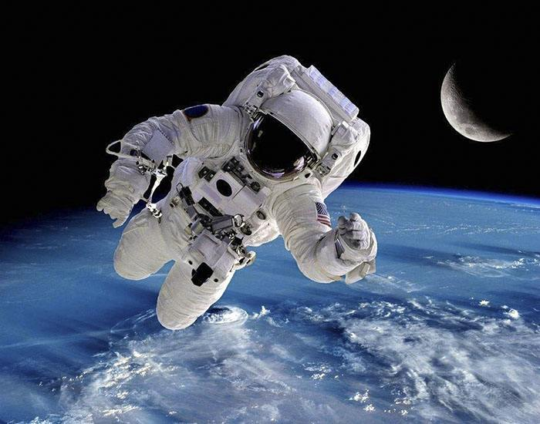
Space: The Final Frontier
-- Reading and Thinking
青田中学 陈贤玲

Slide 3
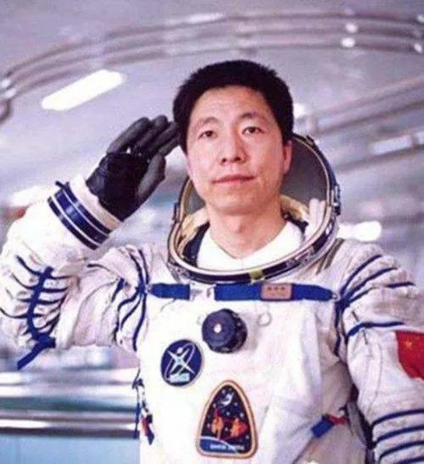
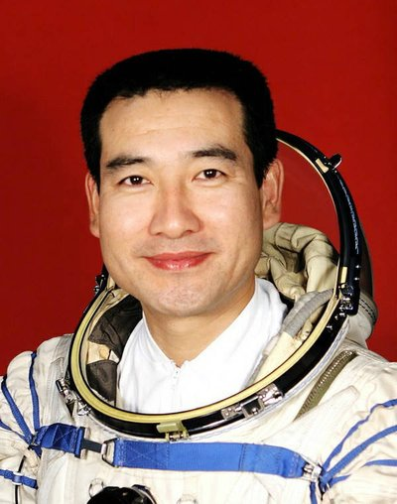
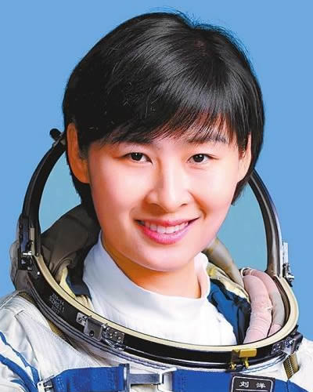
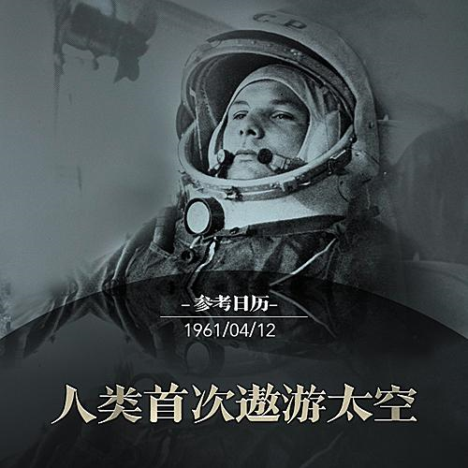
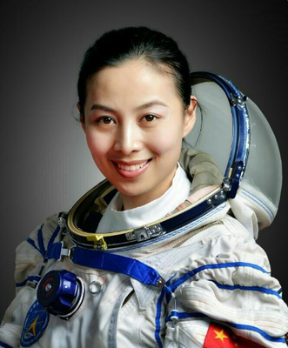
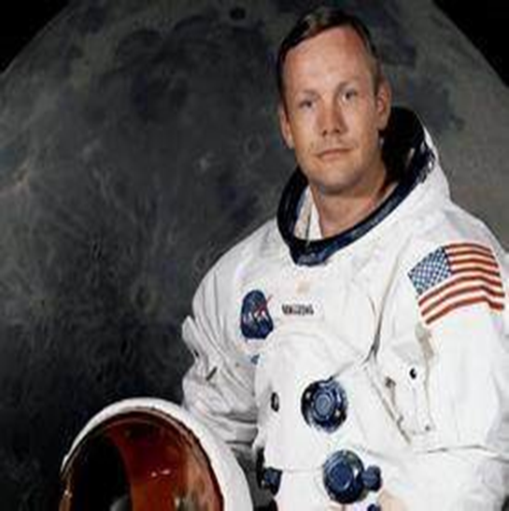
Warming up
What do you know about the astronauts?
Yuri Gagarin the USSR

Slide 4
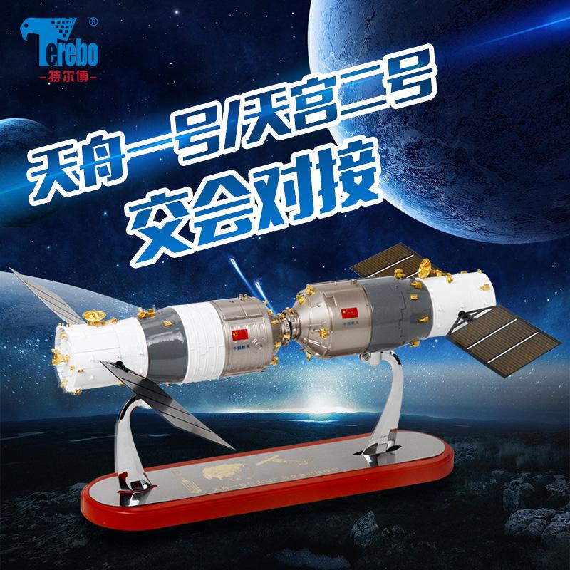
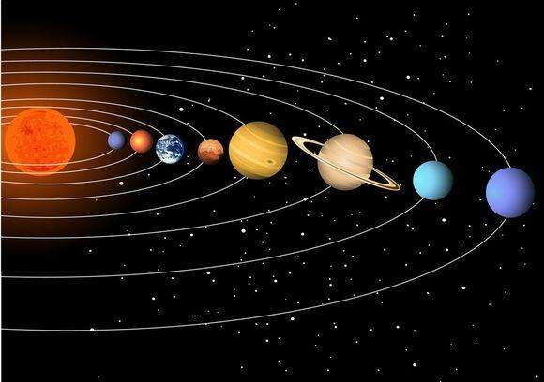
orbit around
dock with

Slide 5
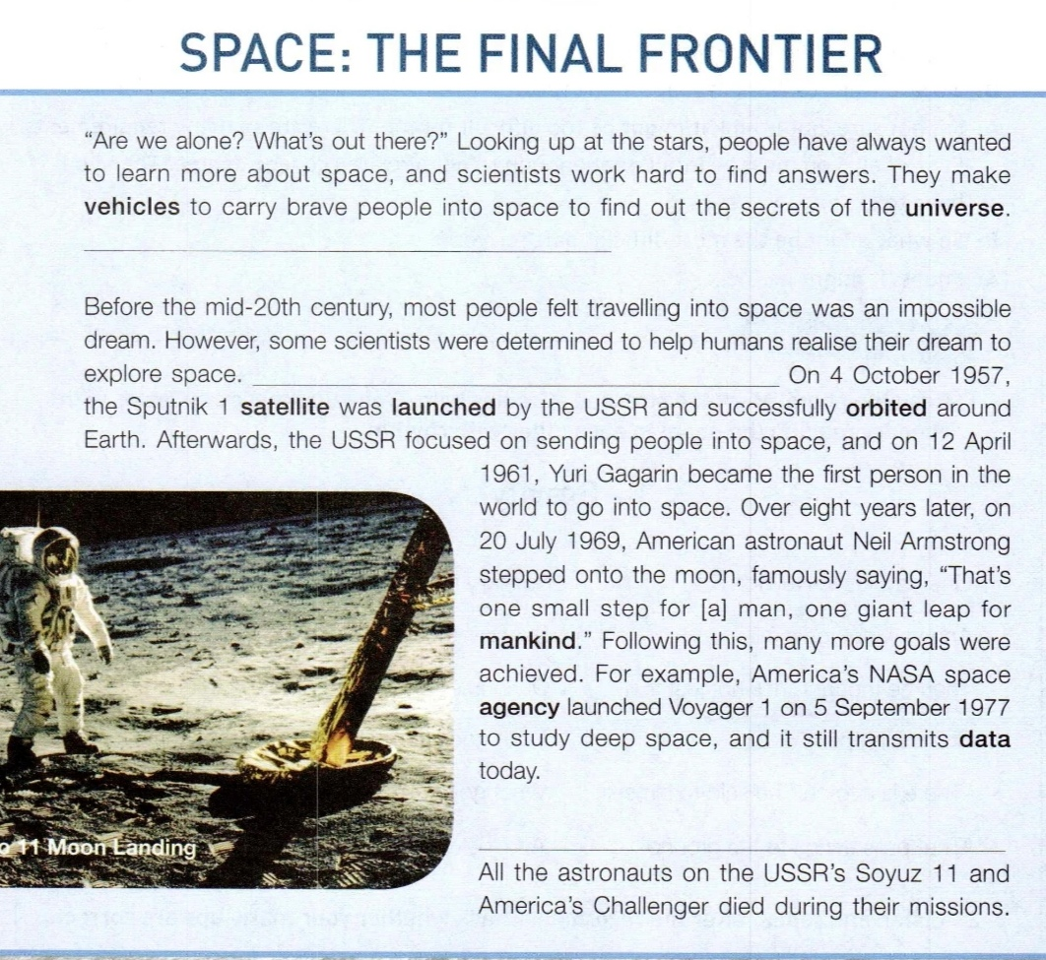
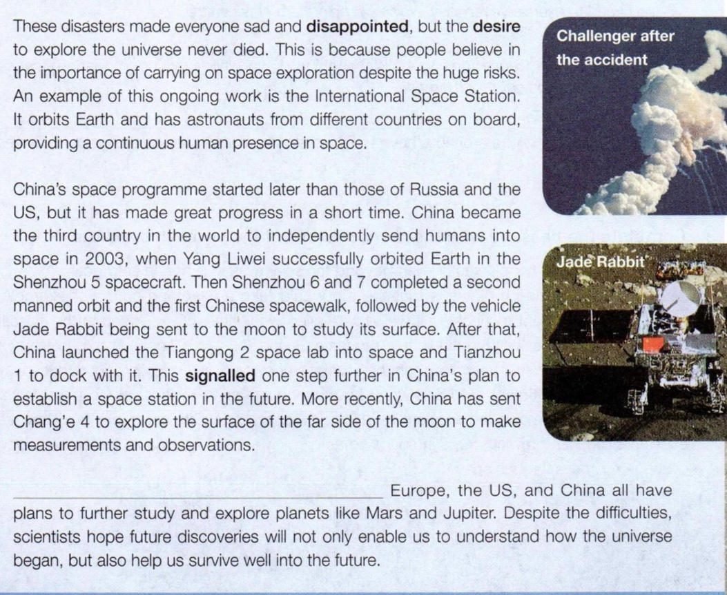
Prediction
A. a border between two countries
B. an area that is unknown
What is the text
about?
The _______________of space exploration

Slide 6
Choose the correct sentence
Although scientists try to make sure nothing goes wrong, accidents can still happen.
They also really wish to discover other planets that are suitable enough to support life.
The future of space exploration remains bright.
After many experiments, they succeeded in making rockets that could escape Earth’s gravity.
Para1
Para2
Learning tips:
1. Focus on the linking words:however, also,
although, etc.
2. Focus on the position of the missing sentences.
3. Focus on the
pronouns( they, it...)
4. Focus on the repeated words or ideas.
Para3
Para4
Para5

Slide 7
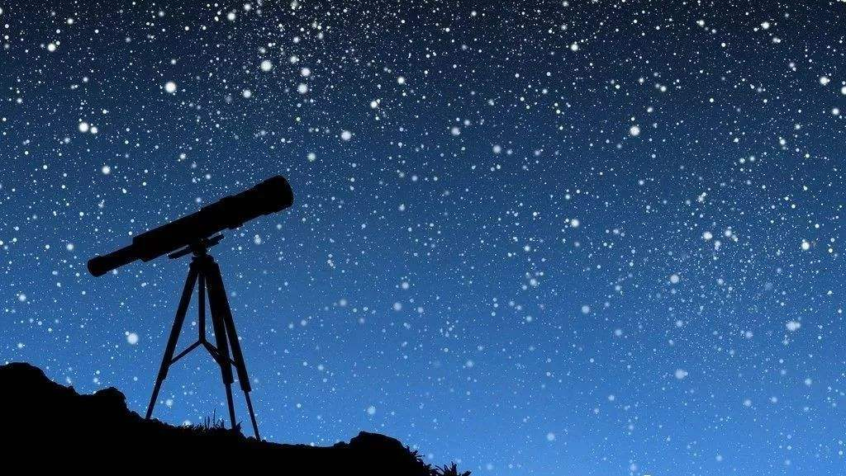
Although scientists try to make sure nothing goes wrong, accidents can still happen.
They also really wish to discover other planets that are suitable enough to support life.
The future of space exploration remains bright.
After many experiments, they succeeded in making rockets that could escape Earth’s gravity.
They also
discover
Para1
“Are we alone? What’s out there?” Looking up at the stars, people have always wanted to learn more about space, and scientists work hard to find answers. They make vehicles to carry brave people into space to find out the secrets of the universe. _____________
They
find out
B

Slide 8
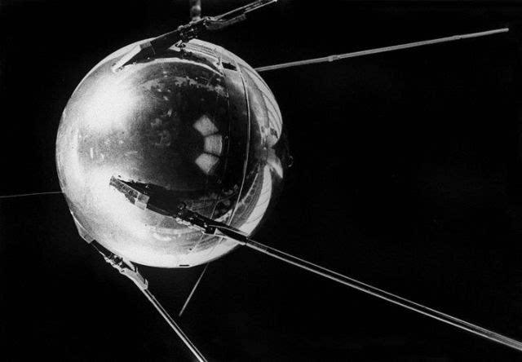
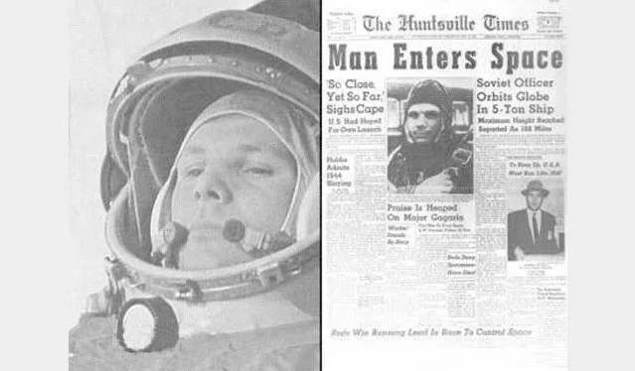
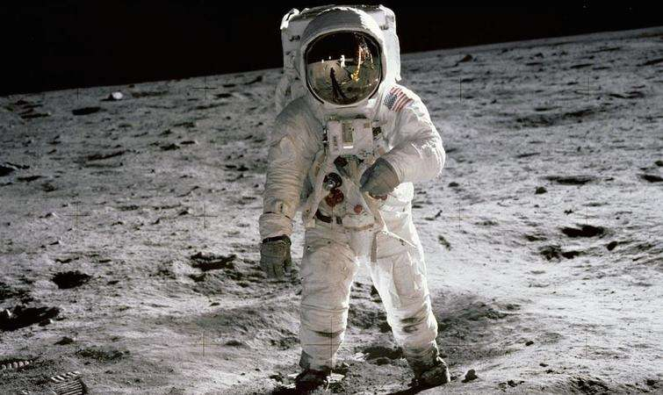
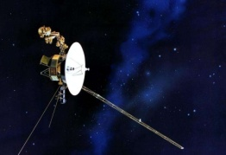
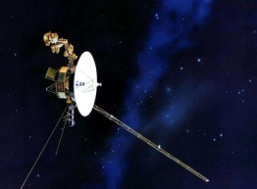
Although scientists try to make sure nothing goes wrong, accidents can still happen.
C. The future of space exploration remains bright.
D. After many experiments, they succeeded in making rockets that could escape
Earth’s gravity.
they
succeeded in
Para2
Before the mid-20th century, most people felt travelling into space was an impossible dream. However, some scientists were determined to help humans realise their dream to explore space. __________________ On 4 October 1957, the Sputnik 1 satellite was launched by the USSR and successfully orbited around Earth. Afterwards, the USSR focused on sending people into space, and on 12 April 1961, Yuri Gagarin became the first person in the world to go into space. Over eight years later, on 20 July 1969, American astronaut Neil Armstrong stepped onto the moon, famously saying, “That’s one small step for [a] man, one giant leap for mankind.” Following this, many more goals were achieved. For example, America’s NASA space agency launched Voyager 1 on 5 September 1977 to study deep space, and it still transmits data today.
However
scientists
D
realize

Slide 9
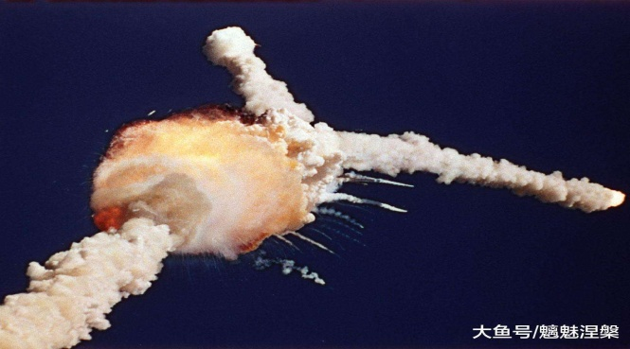
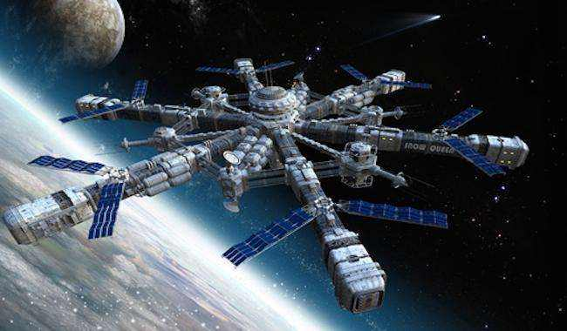
Although scientists try to make sure nothing goes wrong, accidents can still happen.
C. The future of space exploration remains bright.
accidents
Para3
A
_____________________ All the astronauts on the USSR’s Soyuz 11 and America’s Challenger died during their missions. These disasters made everyone sad and disappointed , but the desire to explore the universe never died. This is because people believe in the importance of carrying on space exploration despite the huge risks. An example of this ongoing work is the International Space Station. It orbits Earth and has astronauts from different countries on board, providing a continuous human presence in space.
died
disasters

Slide 10
C. The future of space exploration remains bright.
future
Para5
C
_____________________. Europe, the US, and China all have plans to further study and explore planets like Mars and Jupiter. Despite the difficulties, scientists hope future discoveries will not only enable us to understand how the universe began, but also help us survive well into the future.
plans
future
future

Slide 11
Text type
features | popular science article (科普文) | scientific paper (科学论文)
target readers
language
words
non-specialist
readers
specialist
readers
simple
serious
few technical
terms
many technical
terms

Slide 12
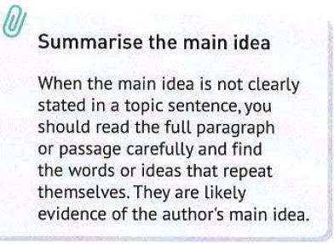
Main idea of each paragraph
Para1
topic sentence/
main idea for each paragraph:
Para2
Para3
Para4
Para5

Slide 13
Para. 1
“Are we alone? What’s out there?” Looking up at the stars, people have always wanted to learn more about space, and scientists work hard to find answers. They make vehicles to carry brave people into space to find out the secrets of the universe.They also really wish to discover other planets that are suitable enough to support life.
people have always wanted to
They also really wish to
long-lasting dream
People have always had a _______ to explore space.
dream

Slide 14
Para2
Before the mid-20th century, most people felt travelling into space was an impossible dream. However, some scientists were determined to help humans realise their dream to explore space. After many experiments, they succeeded in making rockets that could escape Earth’s gravity.On 4 October 1957, the Sputnik 1 satellite was launched by the USSR and successfully orbited around Earth. Afterwards, the USSR focused on sending people into space, and on 12 April 1961, Yuri Gagarin became the first person in the world to go into space. Over eight years later, on 20 July 1969, American astronaut Neil Armstrong stepped onto the moon, famously saying, “That’s one small step for [a] man, one giant leap for mankind.” Following this, many more goals were achieved. For example, America’s NASA space agency launched Voyager 1 on 5 September 1977 to study deep space, and it still transmits data today.
come true
People’s dream of space exploration _____ _______
after the mid-20th century.
impossible dream
possible dream(reality)

Slide 15
Para3
Although scientists try to make sure nothing goes wrong, accidents can still happen.All the astronauts on the USSR’s Soyuz 11 and America’s Challenger died during their missions. These disasters made everyone sad and disappointed , but the desire to explore the universe never died. This is because people believe in the importance of carrying on space exploration despite the huge risks. An example of this ongoing work is the International Space Station. It orbits Earth and has astronauts from different countries on board, providing a continuous human presence in space.
________ the accidents and risks, the dream to explore the universe
universe never _____ ________.
ongoing dream
Despite
fade away

Slide 16
Para. 4
China’s space programme started later than those of Russia and the US, but it has made great progress in a short time. China became the third country in the world to independently send humans into space in 2003, when Yang Liwei successfully orbited Earth in the Shenzhou 5 spacecraft. Then Shenzhou 6 and 7 completed a second manned orbit and the first Chinese spacewalk, followed by the vehicle Jade Rabbit being sent to the moon to study its surface. After that, China launched the Tiangong 2 space lab into space and Tianzhou1 to dock with it. This signalled one step further in China’s plan to establish a space station in the future. More recently, China has sent Chang’e 4 to explore the surface of the far side of the moon to make measurements and observations.
China's space dream
China has made great progress in ________
the space dream in a short time.
realizing

Slide 17
Para5
The future of space exploration remains bright. Europe, the US, and China all have plans to further study and explore planets like Mars and Jupiter. Despite the difficulties, scientists hope future discoveries will not only enable us to understand how the universe began, but also help us survive well into the future.
Future dream

Slide 18
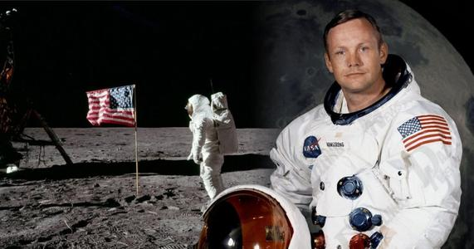

Read for details
para2:How does the writer support the main idea?
The Sputnik（旅伴一号）
the first satellite to be launched
orbited around..
Orient 1(东方一号）
Yuri Gagarin
the first person to space
That’s one small step for a man,
a giant leap for mankind.
.
The USSR
The USA
VS
Sep 5, 1977
Oct 4, 1957
Apr 12, 1961
July 20, 1969
Apollo 11(阿波罗 11号）
Neil Armstrong
stepped onto the moon firstly
Voyager 1（旅行者1号）
to study deep space
and still transmits data
By giving examples
Vehicle, astronaut, significance

Slide 19
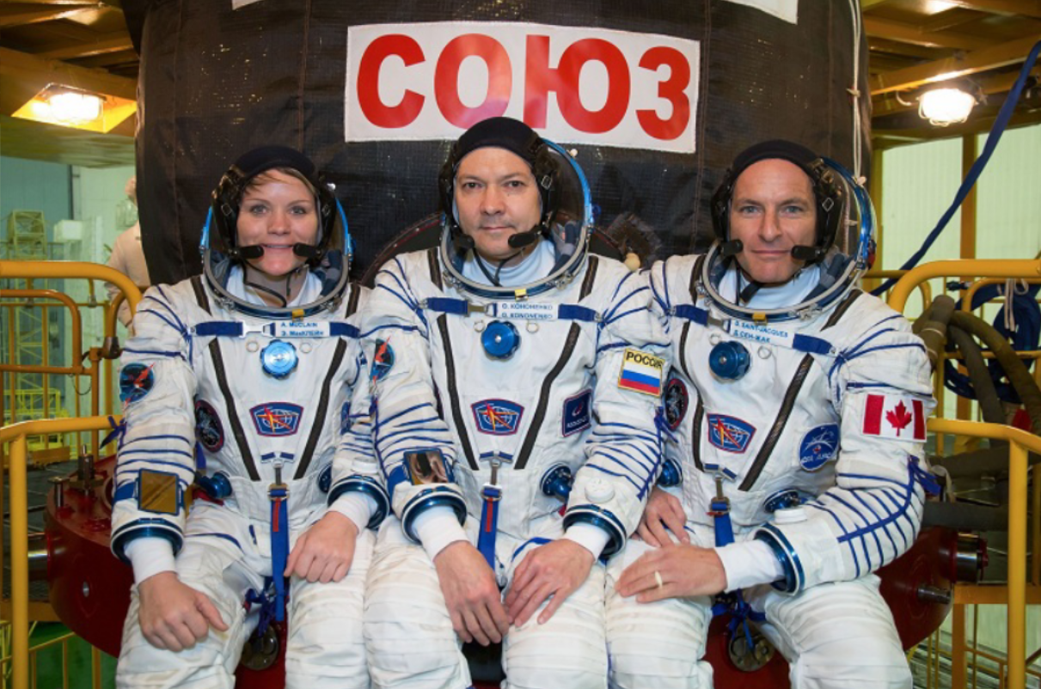
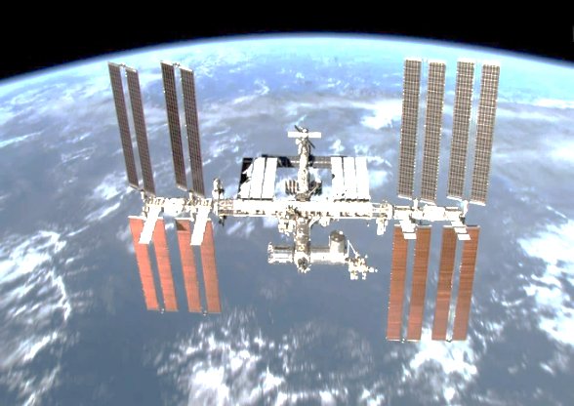
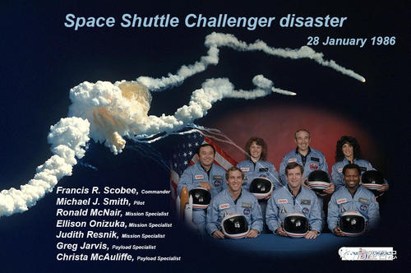
para3: accidents
the USSR's Soyuz 11(联盟11号）
The International Space Station
America's Challenger (挑战者号）
Disasters
Desire
…died
never died

Slide 20
Para. 4
time
This paragraph develops in the order of ___________.
China’s space programme started later than those of Russia and the US, but it has made great progress in a short time. China became the third country in the world to independently send humans into space in 2003, when Yang Liwei successfully orbited Earth in the Shenzhou 5 spacecraft. Then Shenzhou 6 and 7 completed a second manned orbit and the first Chinese spacewalk, followed by the vehicle Jade Rabbit being sent to the moon to study its surface. After that, China launched the Tiangong 2 space lab into space and Tianzhou1 to dock with it. This signalled one step further in China’s plan to establish a space station in the future. More recently, China has sent Chang’e 4 to explore the surface of the far side of the moon to make measurements and observations.

Slide 21
time | vehicle | astronaut(s) | significance
In 2003
Then
followed by…
After that, / Afterwards
More recently
key words

Slide 22
time | vehicle | astronaut(s) | significance
In 2003 | Shenzhou 5
Then | Shenzhou 6(2005) Shenzhou 7(2006)
the third country
to independently
send humans into
space, orbited
Earth
Yang Liwei
Fei Junlong,
Nie Haisheng
the first to send
two astronauts
into space for
several days
Zhai Zhigang, Liu Boming, Jing
Haipeng
Zhai Zhigang
(the first Chinese spacewalk)
completed...

Slide 23
Time | vehicle | astronaut(s) | significance
followed by… | Jade Rabbit(月球车) (2013) | /
After that, / Afterwards | Tiangong 2 space lab (2016) Tianzhou 1(2017) (dock) | /
More recently | Chang'e 4(2019) | /
study the surface
of the moon
one step further
to establish a
space station
in the future
remarkable achievements
explore the
surface of ...to
make measurements
and observations

Slide 24
Further thinking
What makes it possible for humans to realize the dream?
Firstly, it is_______that contributes to our space
dream. Moreover, what greatly matters is ________.
Besides, _________ enables us to realize the dream.

Slide 25
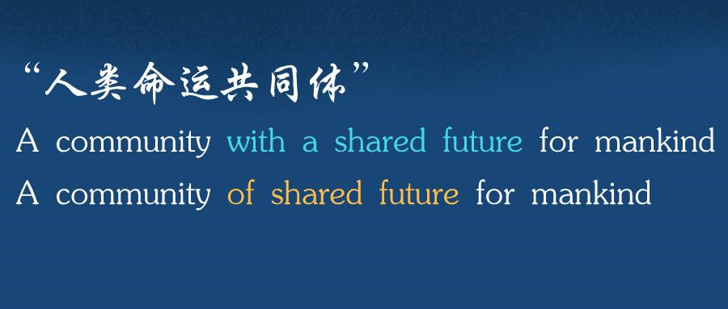
study
persevere(坚持)
anticipate(期待)
cost
explore
space

Slide 26
Homework
Search online for information about China’s achievements in space exploration, Organize the information into a table like the one below.
Spacecraft | time | astronaunts | Mission
Shenzhou1
shenzhou2
shenzhou3
shenzhou4
shenzhou8
shenzhou9
shenzhou10
shenzhou11
shenzhou12
shenzhou13

Slide 27
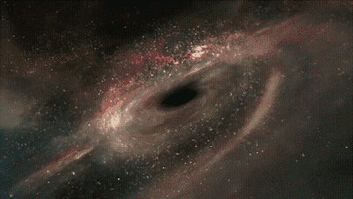
Thank you!

