Slide 1

感恩遇见，相互成就，本课件资料仅供您个人参考、教学使用，严禁自行在网络传播，违者依知识产权法追究法律责任。
更多教学资源请关注
公众号：溯恩高中英语
知识产权声明

Slide 2
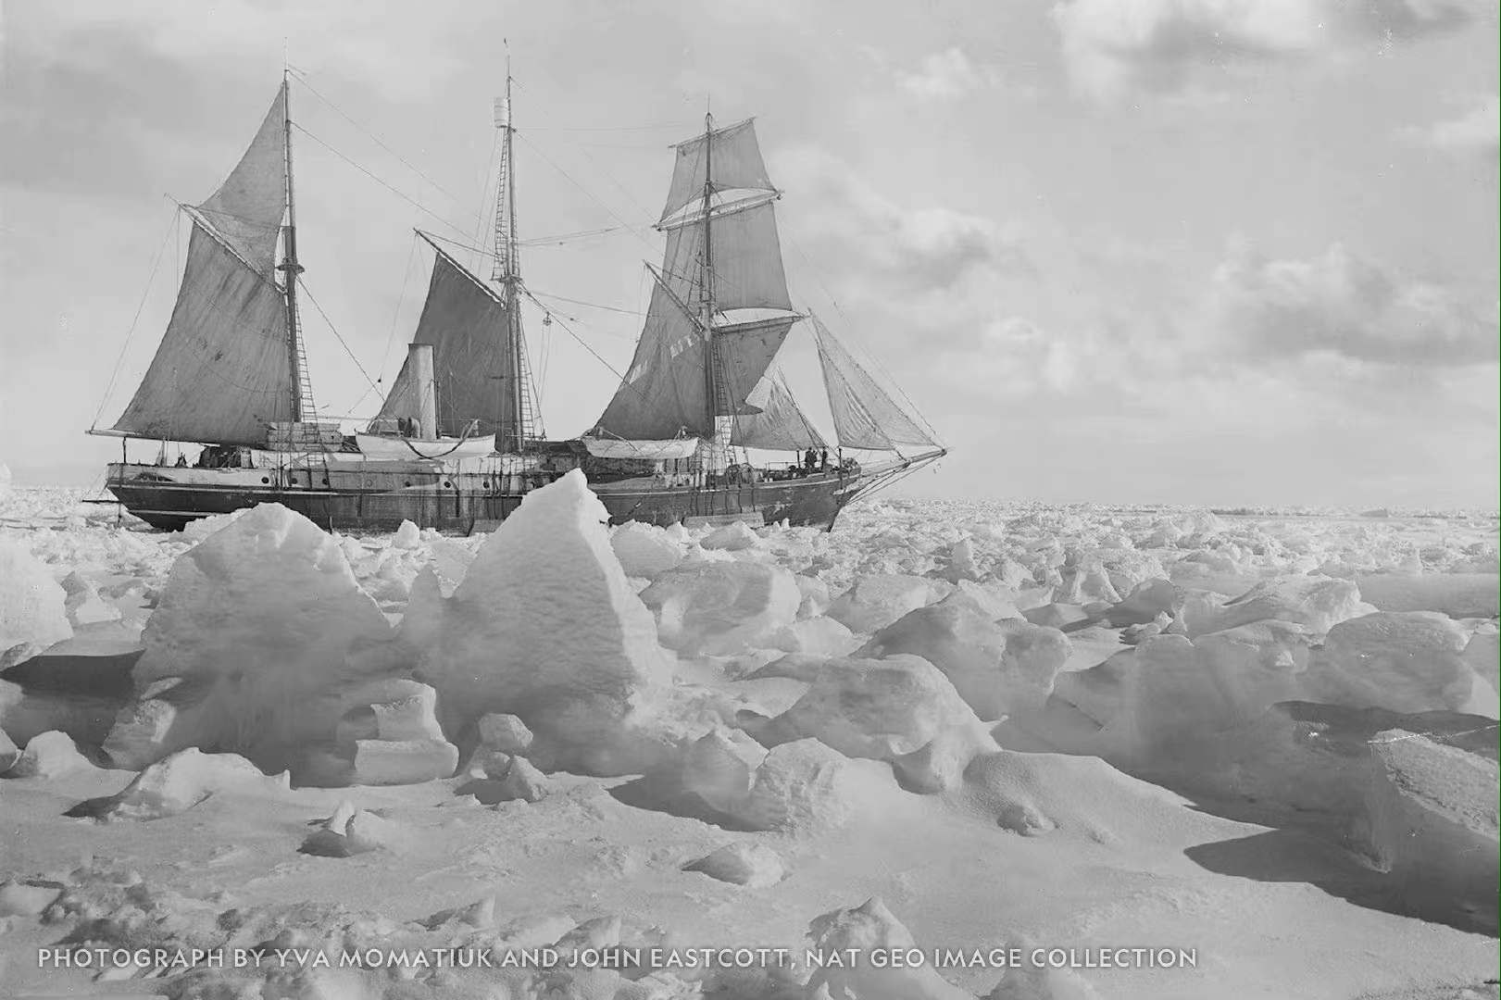
Reading and Thinking
UNIT 4 ADVERSITY AND COURAGE

Slide 3

Pre-reading
What is the news mainly about?
The famous polar explorer Ernest Shackleton's ship, named Endurance, was discovered on the ocean floor near Antarctica in March, 2022, which sank in the dangerous and icy Weddell Sea in 1915.

Slide 4
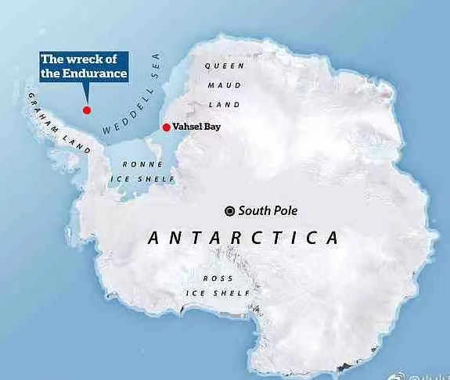
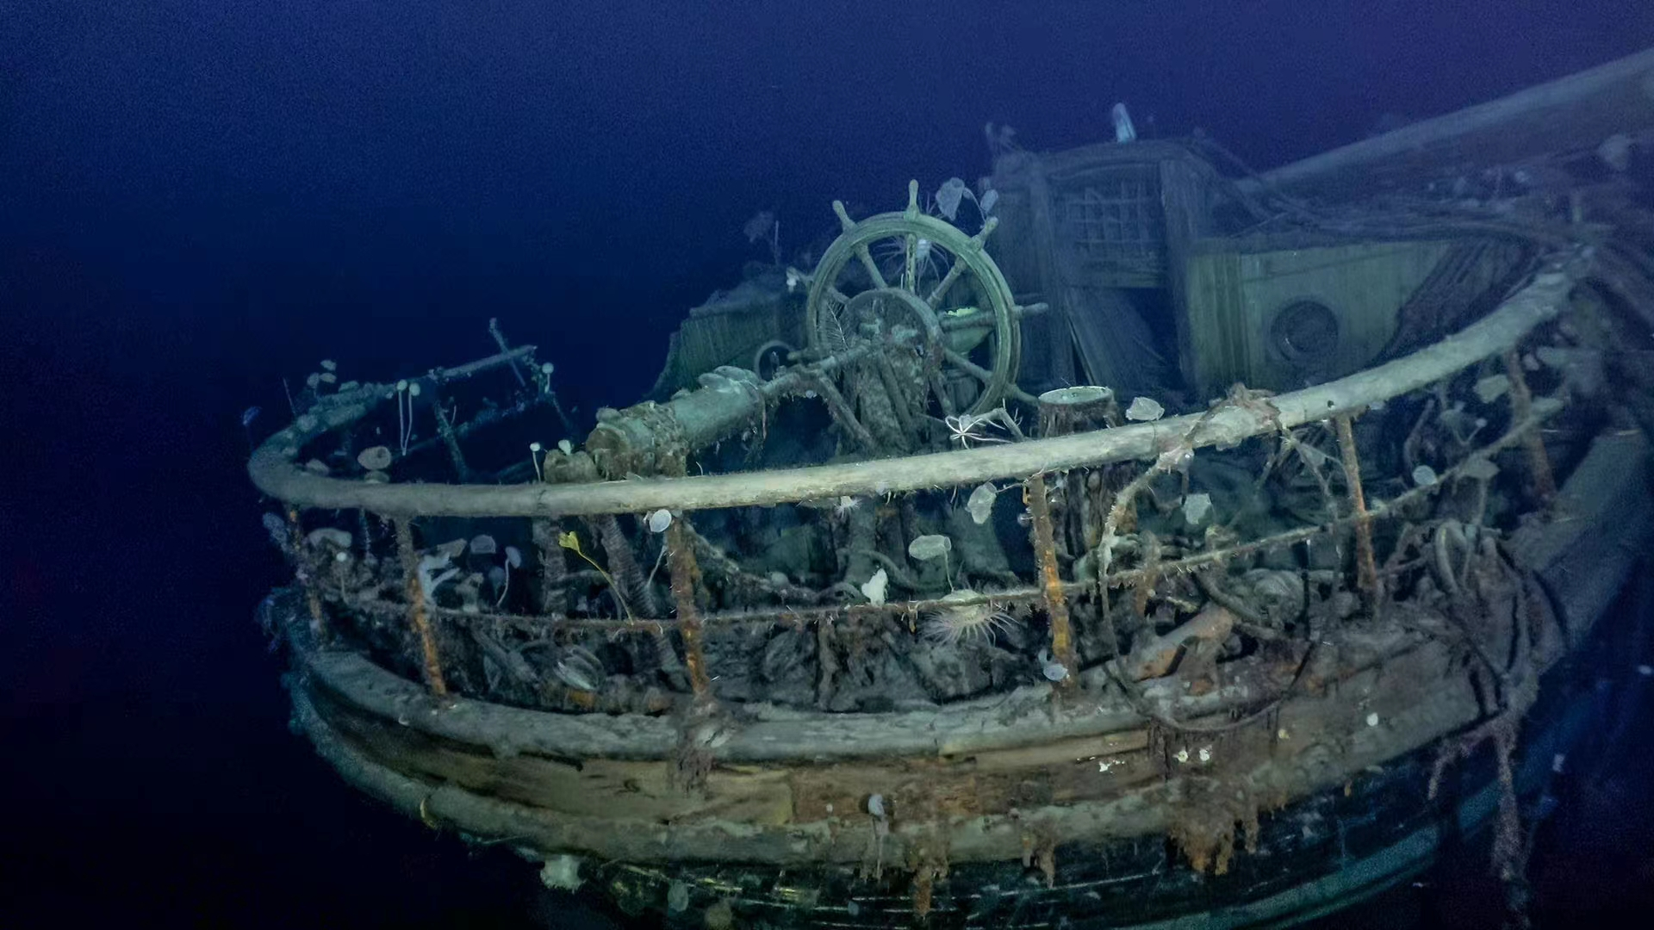
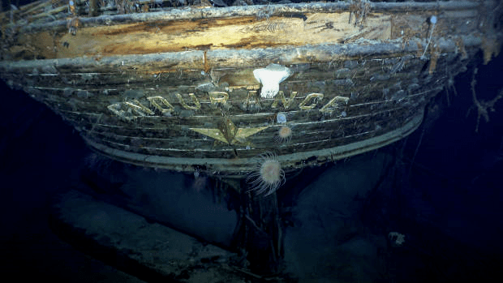
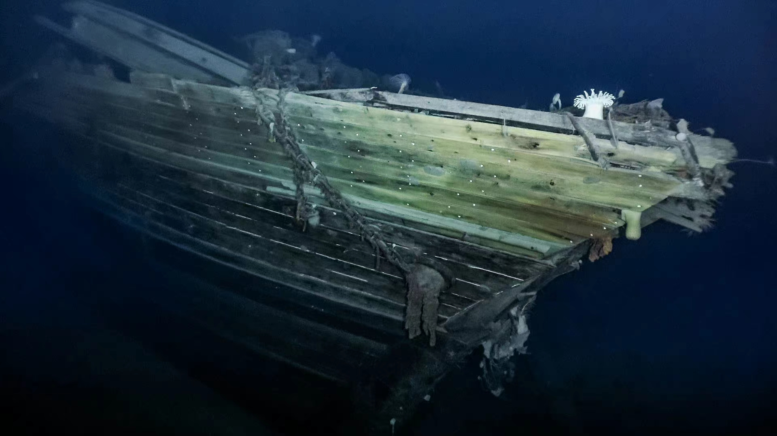
the wooden shipwreck Endurance

Slide 5
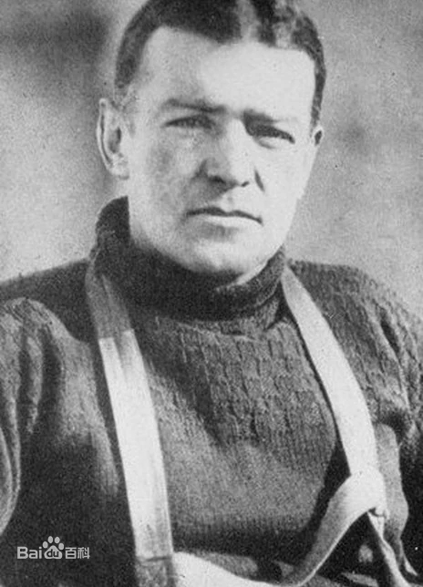
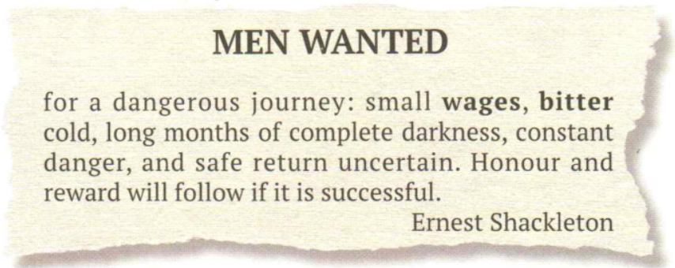
Read this advertisement that was posted by a famous British explorer.
According to the advertisement, what kind of men was Ernest Shackleton looking for?
Ernest Shackleton

Slide 6

Conditions | Requirements
small wages
bitter cold
long months of complete darkness
constant danger
safe return uncertain
Are you qualified?
not care much about money
accustomed to the extreme weather conditions, healthy
show perseverance, not afraid of loneliness
have courage, cooperate with others, be experienced
be optimistic, be positive

Slide 7
Reading for the text type
Q1. What is the text type of this passage?
◆ Keep a record of personal activities, thoughts and feelings.
◆ Focus on the real, meaningful, memorable and important experiences.
Diaries.
Q2. In what person is the passage written?
◆ To get closer to the readers.
◆ To make the narration authentic, impressive and convincing.
The first person.

Slide 8
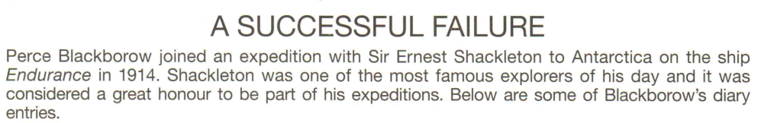
Reading for the structure
Title
Introduction
Diary 1
Diary 2
Diary 3

Slide 9
Reading for the information
Basic information about the expedition
Time
Destination
Leader
The author’s name
The ship
Oct. 31, 1914 → Nov. 21, 1915 → May 20, 1916
To Antarctica
Sir Ernest Shackleton
Perce Blackborow
Endurance

Slide 10
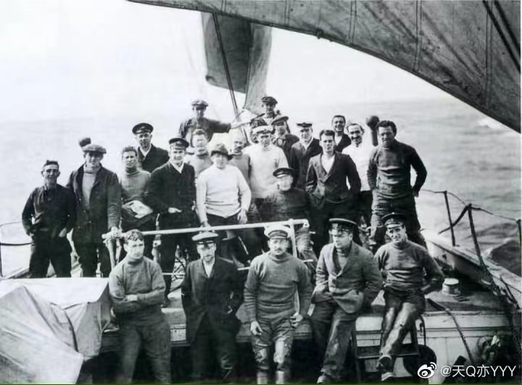
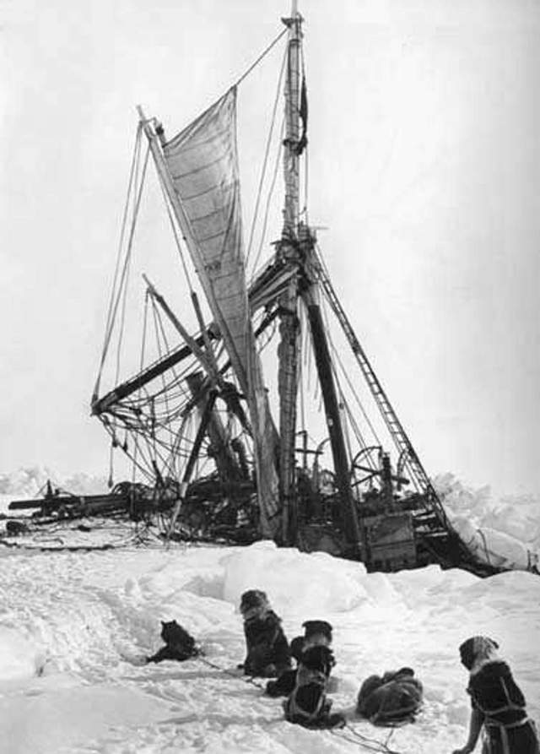
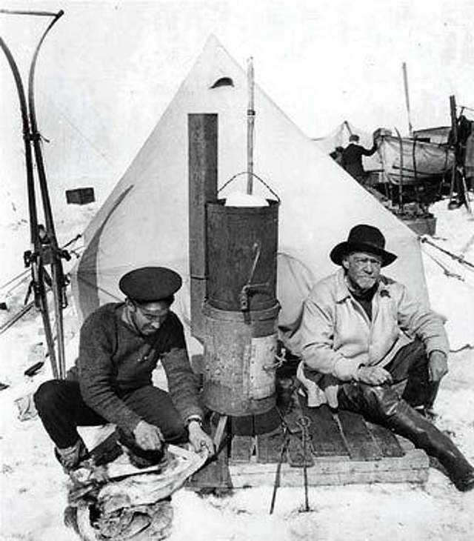
Main ideas
Dairy 1：The author joined the ______________.
Diary 2：Shackleton and his crew ______________________ .
Diary 3：The crew members’ life on __________________.
expedition
abandoned the ship Endurance
Elephant Island

Slide 11
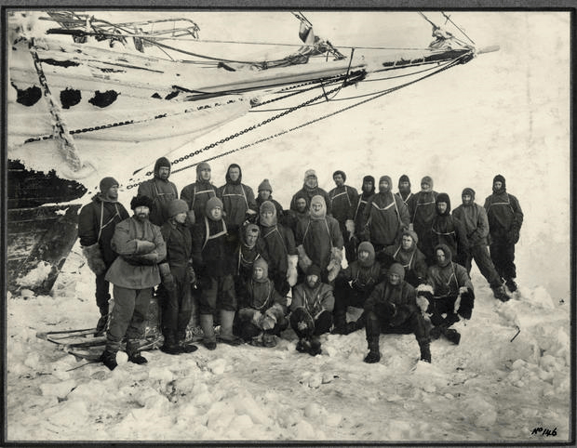
Dairy 1：The author joined the expedition.
How did Blackborow come to join the expedition?
◆At the very beginning, Perce Blackborow _________________________________________________________.
◆Then he __________________________. However, he ________________________ because _____________________.
◆Later he _________________________, but he ______________.
◆Finally he ________________________________________________.
bought a newspaper and read the advertisement about the expedition
applied to join the expedition
was turned down by Shackleton
he was too young and not qualified
secretly went aboard Endurance
was discovered
was assigned to be a steward and serve meals for the crew

Slide 12
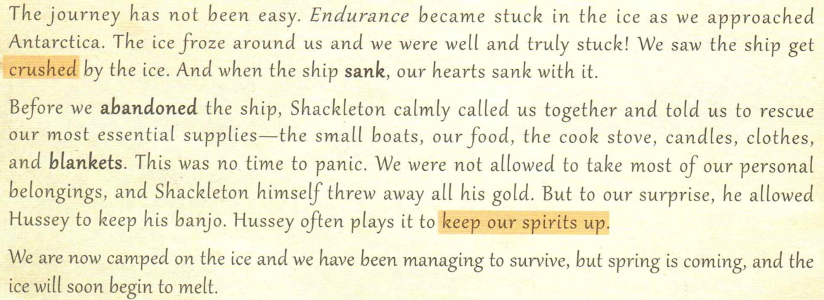
Diary 2：Shackleton and his crew abandoned the ship Endurance.
To set an example and show leadership.
Why？
To keep the crew members’ spirits up and stay positive.
1. What happened to Endurance?
2. What did the crew members have to do?

Slide 13
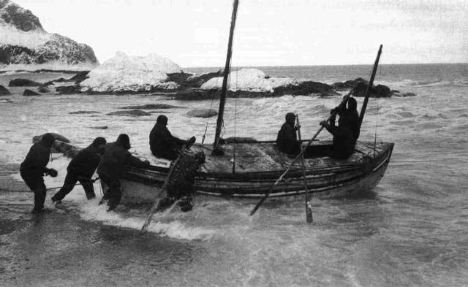
Diary 3：The crew members’ life on Elephant Island
Survive
What did they do to make sure they could survive?
Shackleton
He left to seek help on South Georgia Island.
the crew members
They had to catch seals or penguins for food.
Stay positive/ Be full of bright hope.

Slide 14
Analyzing the characters
Members of the expedition:
Ernest Shackleton
Perce Blackborow
Hussey
Frank Wild
Thomas Orde-Lees, Tom
Characters' words and actions can mirror their qualities and feelings.
◆How did Blackborow’s feelings about being on the expedition change?
◆What personal qualities did Shackleton, Wild and Blackborow exhibit? Give supporting evidence.

Slide 15
How did Blackborow’s feelings change?
Occasions | Clues | Blackborow’s feelings
After he read the advertisement about the expedition
After his application was turned down
After he became a steward on board
When Endurance sank
Before the crew settled on Elephant Island
After Shackleton left to find help
When he thought about the living conditions on the island
When his happy memories were interrupted by cold air
After Frank Wild replied to him

Slide 16
Occasions | Clues | Blackborow’s feelings
1. After he read the advertisement about the expedition
2. After his application was turned down
3. After he became a steward on board
4. When Endurance sank
5. Before the crew settled on Elephant Island
… this is the adventure that I have been dreaming of. And I was ready for it… I am fit and full of vigour.
excited, happy, full of expectations
But I was so enthusiastic about the idea of going along with them that I secretly went aboard his ship, the Endurance, and hid in a small cupboard.
enthusiastic, determined
How everyone will envy me when I come back and tell them about the amazing places I have been to!
satisfied, excited, hopeful
…we were well and truly stuck! … our hearts sank with it.
worried, terrified, panic, heartbroken
This was no time to panic.
no time to panic

Slide 17
Occasions | Clues | Blackborow’s feelings
6. After Shackleton left to find help
7. When he thought about the living conditions on the island
8. When his happy memories were interrupted by cold air
9. After Frank Wild replied to him
… but spring is coming, and the ice will soon begin to melt.
If Shackleton fails, will we have any hope of rescue?
worried, uncertain
We have been struggling for days, but things on Elephant Island are going from bad to worse. We are now crowded together … this miserable place.
I feel low.
low, miserable
angry, impatient
I shouted, “Shut the door!”
Bless Frank Wild, the kindest man there is after our leader Ernest Shackleton.
grateful

Slide 18
What personal qualities did Shackleton, Wild and Blackborow exhibit?
Ernest Shackleton
Clues (words, actions, surroundings… ) | Qualities
Shackleton turned me down because he thought I was too young and wasn’t qualified.
responsible
Shackleton calmly called us together and told us to rescue our most essential supplies
calm, rational
Shackleton himself threw away all his gold
decisive, fair
…he allowed Hussey to keep his banjo. Hussey often plays it to keep our spirits up
considerate, thoughtful
Shackleton left us to find help on South Georgia Island, 1, 320 kilometres away-the voyage was too dangerous and difficult for all of us to make it in our small boats
selfless, brave, fearless, courageous, responsible, reliable, trusty

Slide 19
Perce Blackborow
Clues | Qualities
this is the adventure that I have been dreaming of
But I was so enthusiastic about the idea of…
I secretly went aboard his ship, the Endurance, and hid in a small cupboard
I try to think of happier things: decent food, warm and dry clothes, a cozy bedroom, sunny days and my mother’s face…
Perhaps there is a chance we will return home
brave, adventurous, bold
enthusiastic
fearless, strong-willed, determined, persistent in pursuing his dream
optimistic
hopeful, optimistic
inner thoughts

Slide 20
Frank Wild
◆ “Hold on now, Perce. Don't you go turning into another Tom,” came the reply. “We’ve caught another penguin, so it’s penguin soup tonight!”
◆ Bless Frank Wild, the kindest man there is after our leader…
kind, caring, considerate

Slide 21
learning new words
What do the highlighted words mean? Use your own words to explain them.
vigour
turn…down
crush
keep our spirits up
miserable
cozy
… I am fit and full of vigor…
health, energy, enthusiasm
… Shackleton turned me down because he thought I was too young and wasn’t qualified…
reject, refuse
… We saw the ship get crushed by the ice.
be squeezed until damaged
… keep his banjo. He often plays it to keep our spirits up.
stay positive usually in a bad situation
… struggling for days…going form bad to worse…this miserable place.
very unhappy or uncomfortable
I try to think of happier things: decent food, warm and dry clothes, a cozy bedroom, sunny days…
comfortable, safe and warm

Slide 22
Appreciating the language
1. And when the ship sank, our hearts sank with it.
（形容伤心）当船沉没时，我们的心也随之沉没。
2. However, these happy memories are soon interrupted by a sudden cold rush of air.
然而，这些美好的回忆很快就被突如其来的冷风打断了。
3. Their genuine concern for others, their perseverance, and their resolve fill me with hope.
（名词化）他们对他人的真诚关心，他们的毅力和决心使我充满希望。

Slide 23
Critical thinking
A SUCCESSFUL FAILURE
What is the figure of speech in the title? How do you understand the title?
Definition: Apparently contradictory terms are combined.
Functions: To create humour, to make the narration surprising and impressive, or to deepen the readers’ understanding of the text.
Oxymoron (矛盾修辞法)
courage adversity
theme: ________ and______
◆ overcome difficulties
◆ survive in the awful conditions
◆ develop teamwork spirits and friendship
◆ adopt a positive attitude to life…
◆The ship Endurance: be stuck→ be crushed by the ice → sank
◆ The crew: be trapped in the ice→ failed to realize their goals of crossing the Antarctic continent…

Slide 24
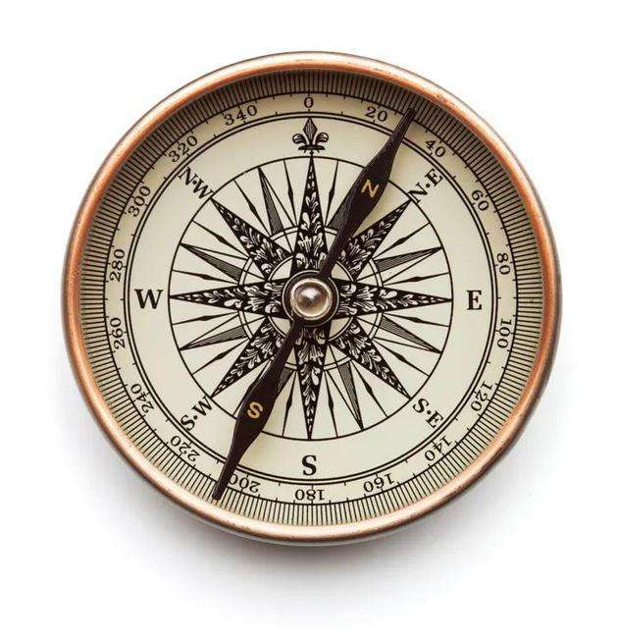
Critical thinking
Group discussion:
How did Blackborow feel on the deserted island? Would writing a diary help him deal with his feelings?
What could Blackborow do to kill time on the island? How do people keep track of date on a deserted island?
Why did Blackborow write diaries?

Slide 25
summary
Complete the passage with the correct forms of the words in the box.
abandon, aboard, assign, crew, cupboard, resolve, set off, sink, turn...down, voyage
resolved
After seeing the advertisement in the newspaper, Perce Blackborow ________ to join Antarctic expedition led by Sir Ernest Shackleton no matter what challenges might lie ahead. Unfortunately, his application _________________ because he was too young and not qualified enough. However, he managed to get _______ the Endurance with his friend's help. He hid in a __________, but was soon discovered and brought to Shackleton. Although the captain was angry, he _________ the boy the job of cooking for the ________. Their ________ did not go smoothly, and the Endurance became stuck in the ice. Before the Endurance was crushed and __________ into the sea, Shackleton gave the order to __________ ship, and the crew had to camp on ice. They then sailed to Elephant Island. Soon after that, Shackleton selected a boat party and _________ for South Georgia Island to get help.
was turned down
aboard
cupboard
assigned
crew
voyage
sank
abandon
set off

Slide 26
How to read diaries?
Background information
The plot (when/where/who/what/how/why)
Analyzing the characters (feelings & qualities)
Learning new words
Appreciating the language
Critical thinking

Slide 27
Post-reading
Have an interview! One student acts as a journalist to interview another student who acts as Perce Blackborow, talking about the expedition to Antarctic. Work in groups.
Journalist: Good morning, Mr. Blackborow! I am the journalist from The Times(泰晤士报). My name is …Great to meet you. I hope we can have an in-depth interview about your expedition to Antarctic.
Blackborow:
Journalist: Can you introduce yourself first?
Blackborow:
Journalist: Well, let’s move on to the next point. How did you go aboard the ship Endurance?
Blackborow:
Journalist: Can you tell us what happened to Endurance?
Blackborow:
Journalist: My next question is, what problems did you face on Elephant Island? And how did you feel about the life there?
…
Journalist: It’s a great honour to be here and especially to interview you today. Thank you!

Slide 28
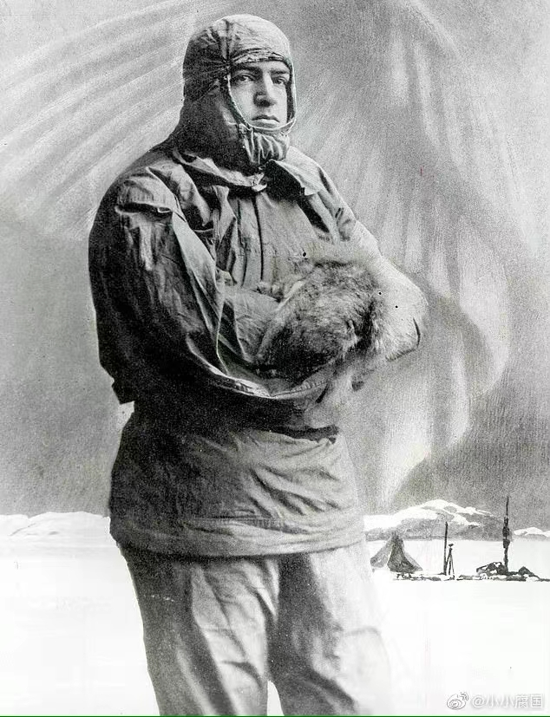
“I believe it is in our nature to explore, to reach out into the unknown. The only true failure would be not to explore at all.”
---- Ernest Shackleton
Thank you for your attention.

