Slide 1

感恩遇见，相互成就，本课件资料仅供您个人参考、教学使用，严禁自行在网络传播，违者依知识产权法追究法律责任。
更多教学资源请关注
公众号：溯恩高中英语
知识产权声明

Slide 2
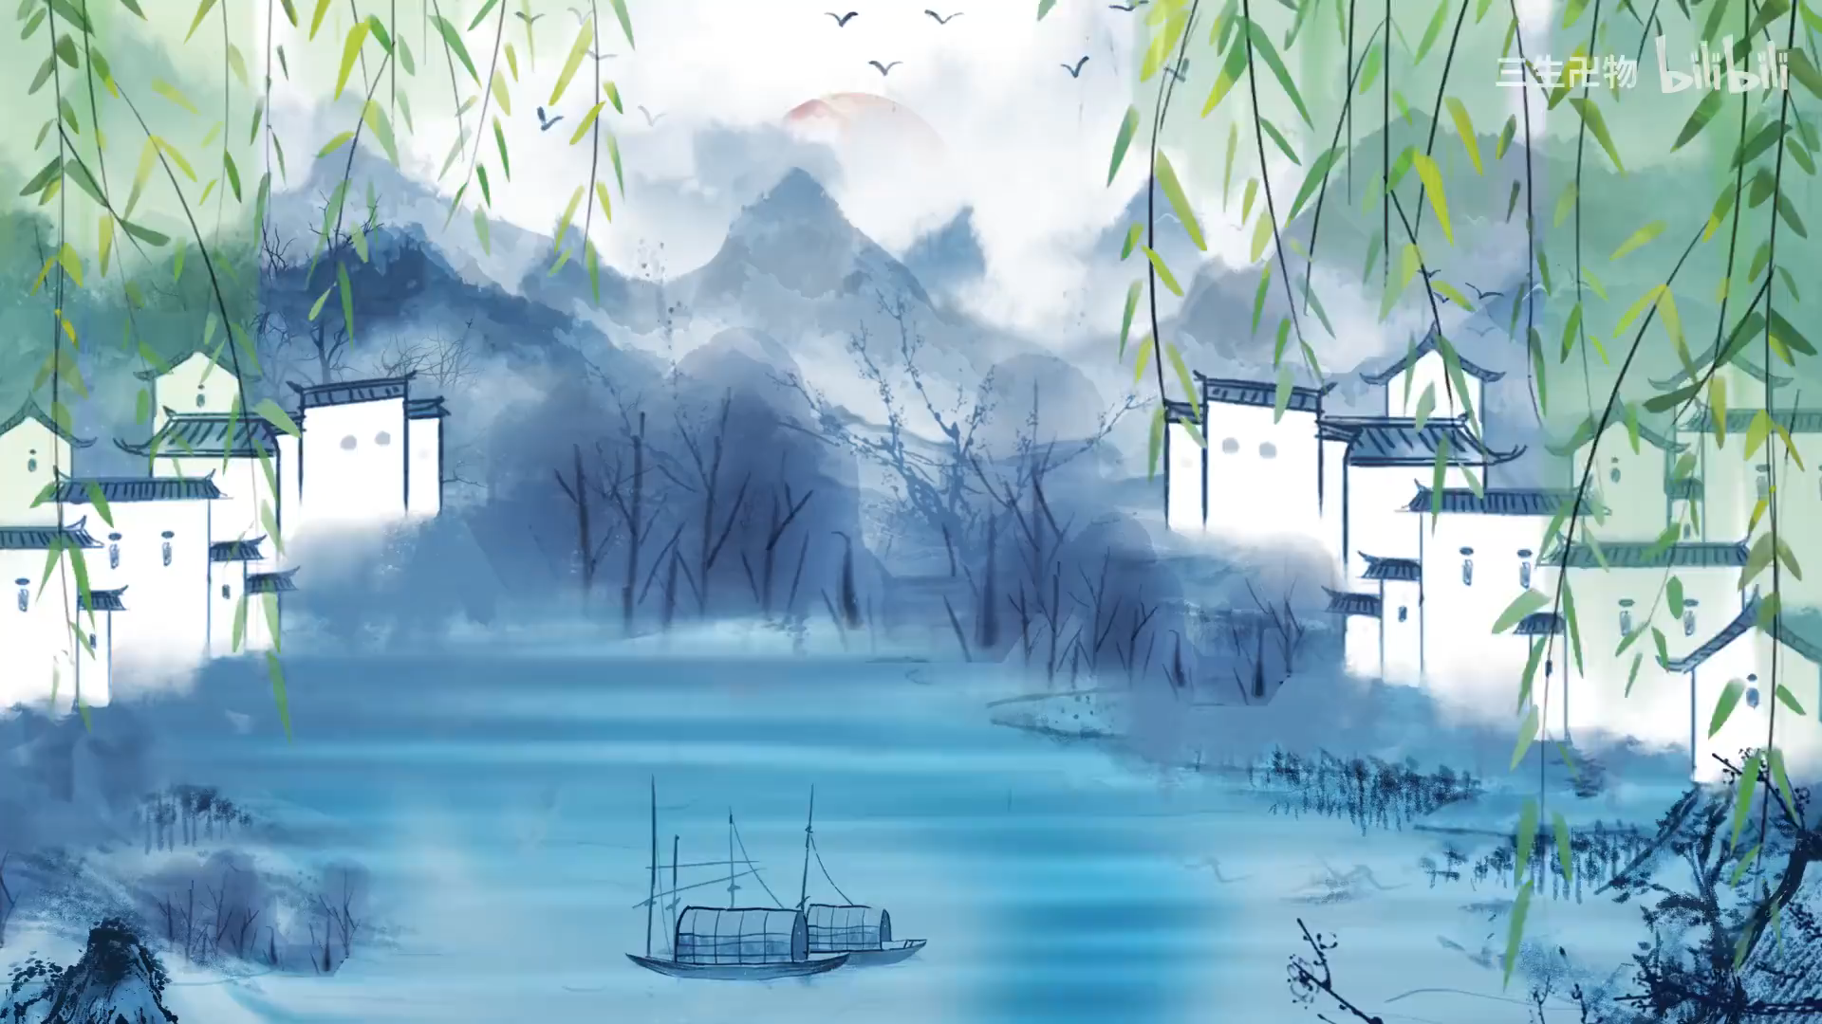
选修三Unit1Art Listening and Talking Talk about works of art
ink wash animation films
-by Lily

Slide 3
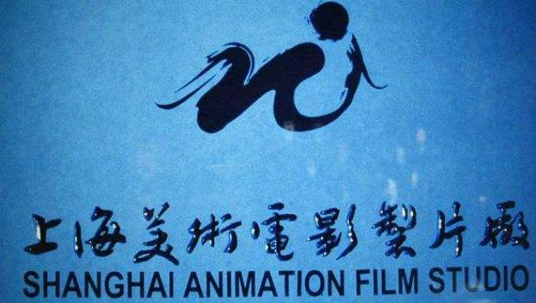
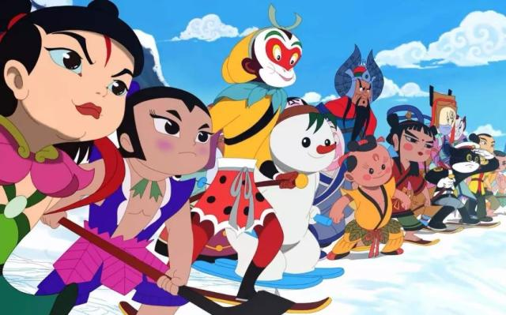
Who made the ink wash anamation films firstly?

Slide 4
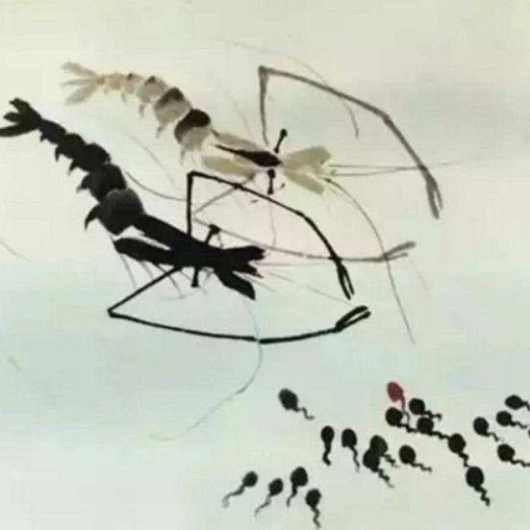
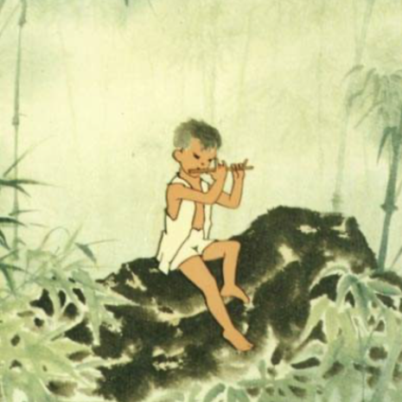
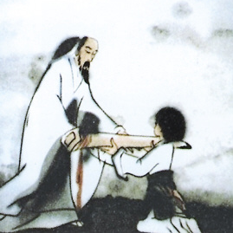
What do you know about ink wash animation films ?
representatives of ink wash animation films
Tadpoles Looking For Their Mother
The Cowboy’s Flute《牧笛》
Feeling from Mountain and Water 《山水情》
a lyrical masterpiece
an elderly musician and his disciple/dɪˈsaɪp(ə)l/
(门生)

Slide 5

Listen for the structure and main idea.
_________ the background of ink wash animation films
_________ a short review of the film
_________ introduction to the topic of the presentation
_________ a description of the story in the film
_________ an explanation of the decline in ink wash animation
2
4
1
3
5

Slide 6


Listen again and tick the signpost words that you hear.
Listen for signpost markers
Signpost markers are phrases and expressions that are used to tell a listener what is going to be talked about next. Speakers use signpost markers when they want to introduce a new topic, to start a new point, to give an example, to summarize, etc. By listening for signposts, you will be able to follow what is being said.

Slide 7
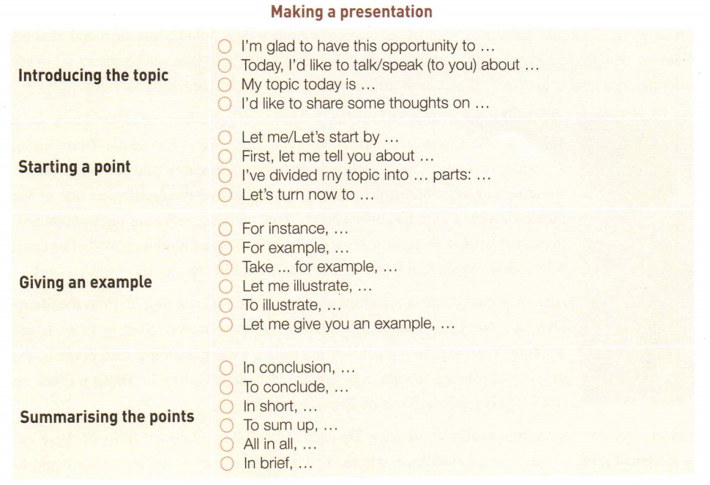
Listen for the signpost markers.
A presentation about works of art
structure
function
signpost markers
introduction
Today, I'd like to talk (to you) about…
To lead to the topic
the background of ink wash animation films
a description of the story
a short review of the film
an explanation of the decline
in ink wash animation

Slide 8
Listen for the signpost markers.
A presentation about works of art
structure | function | signpost markers
Let me/Let's start by…;
in the late 1950s, inspired by...,
...began to...;
Following this,...
to explain the origin of
ink washing paint
animation
the background of ink wash animation films
body part
to illustrate the topic
with a specific example
a description of the story
Let’s turn now to…;
The film tells...;
In the film,...
to describe the content
In short, it is like...
make the film not only... but also..
Therefore,...
a short review of the film
to explain its features
and significance

Slide 9
Listen for the signpost markers.
A presentation about works of art
structure | function | signpost markers
after late 1980s,... caused...
too much work, as...had to ...
However, in 2016, ...have begun to...
an explanation of the decline in ink wash animation
to explain the recent development of it.
conclusion

Slide 10
Listen for details.
a review of the film
Q1: Which film does the speaker mainly talk about?
Q2: When were the three ink wash animation films produced?
Q3: Why is the film regarded as a masterpiece of Chinese ink wash animation?
Q4: What is the speaker's attitude towards the ink wash animation style?
Feeling from Mountain and Water.
It was produced in 1988.
Tadpoles Searching for Mother was produced in 1960.
The Cowboy’s Flute was in 1963.
Because it is like a fine ink wash painting brought to life.
positive and supportive

Slide 11
How can you know the speaker’s attitude to ink wash paint animation?
A short review of the film (para 3):
The film has no dialogue.And,unlike typical cartoons, the film has no bright colours. In short, it is like a fine ink wash painting which has been brought to life --- a painting with movement. The animation and the music make the film not only appealing to the eyes and ears but also rich in emotion. Therefore, this 18-minute film is regarded by many as a masterpiece of Chinese ink wash animation.
A short review of the film (para 3):
The film has no dialogue.And,unlike typical cartoons, the film has no bright colours. In short, it is like a fine ink wash painting which has been brought to life --- a painting with movement. The animation and the music make the film not only appealing to the eyes and ears but also rich in emotion. Therefore, this 18-minute film is regarded by many as a masterpiece of Chinese ink wash animation.
opinion adjectives and descriptive language
intonation语调
a positive attitude

Slide 12
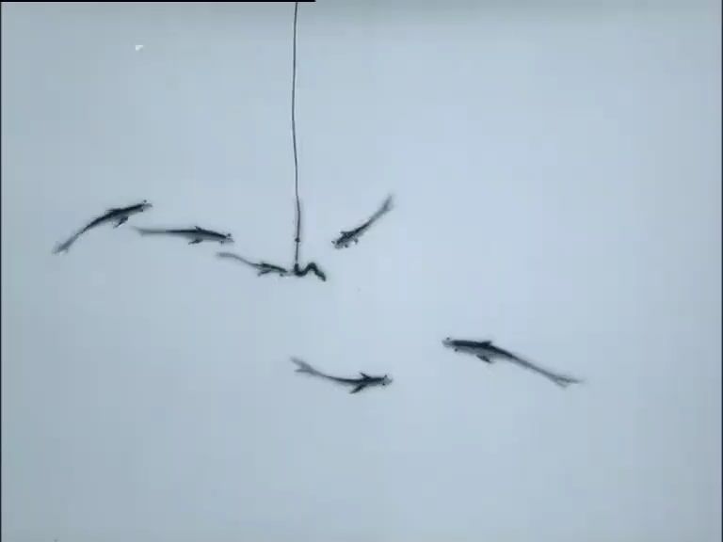
Feeling from Mountain
ink wash animation films-
all of nature joins him in
a visual symphony

Slide 13

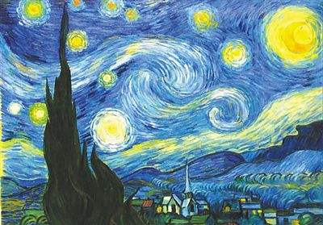
Group Work: Introduce a painting
Introduction |  | Welcome the audience: Introduce the subject:
Main body | Background of the work of art
 | Description of the work of art
 | Review of the work of art
Conclusion

Slide 14

How to make a presentation?
Introducing the topic | I'm glad to have this opportunity to… Today, I'd like to talk/speak (to you) about… My topic today is… I'd like to share some thoughts on…
Starting a point | Let me/Let's start by…;First, let me tell you about…;I’ve divided my topic into…parts: … Let’s turn now to…
Giving an example | For instance, …; For example, …;Take…. for example, ...; Let me illustrate…; To illustrate, … Let me give you an example, …
Summarizing the points | In conclusion, …; To conclude, …; In short, … To sum up, …; All in all, …; In brief, …

Slide 15
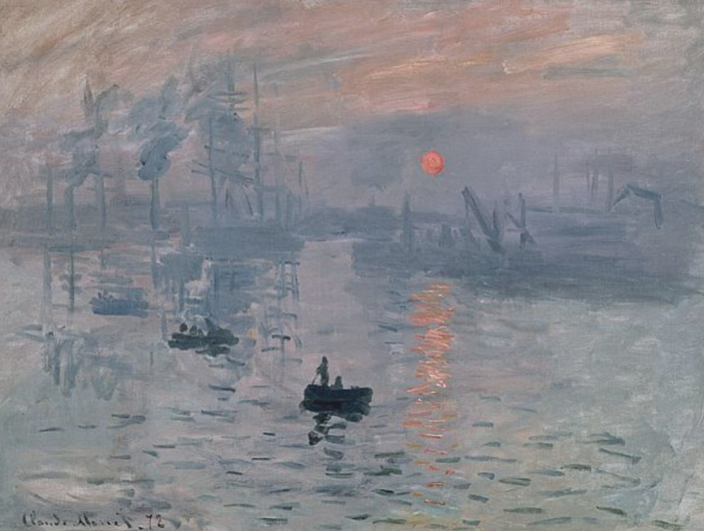
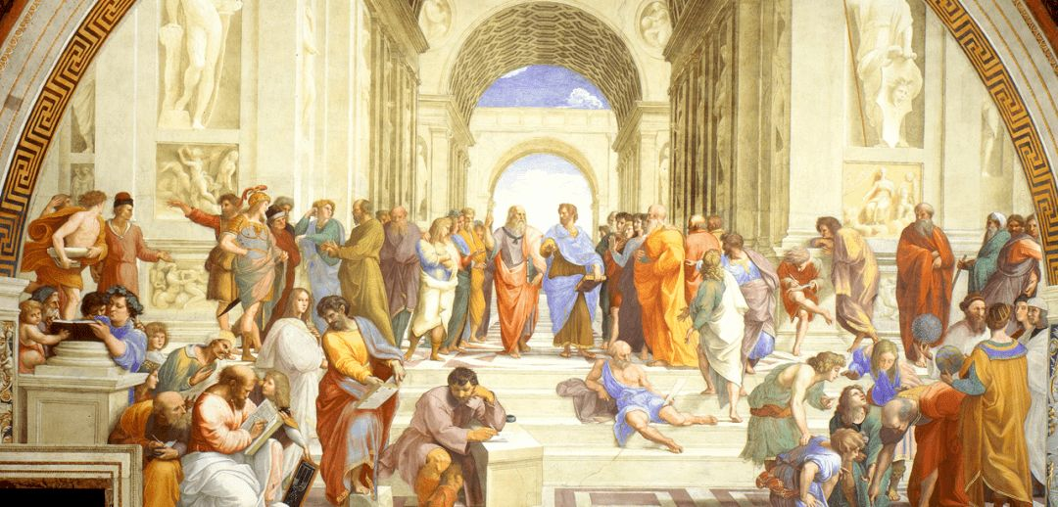
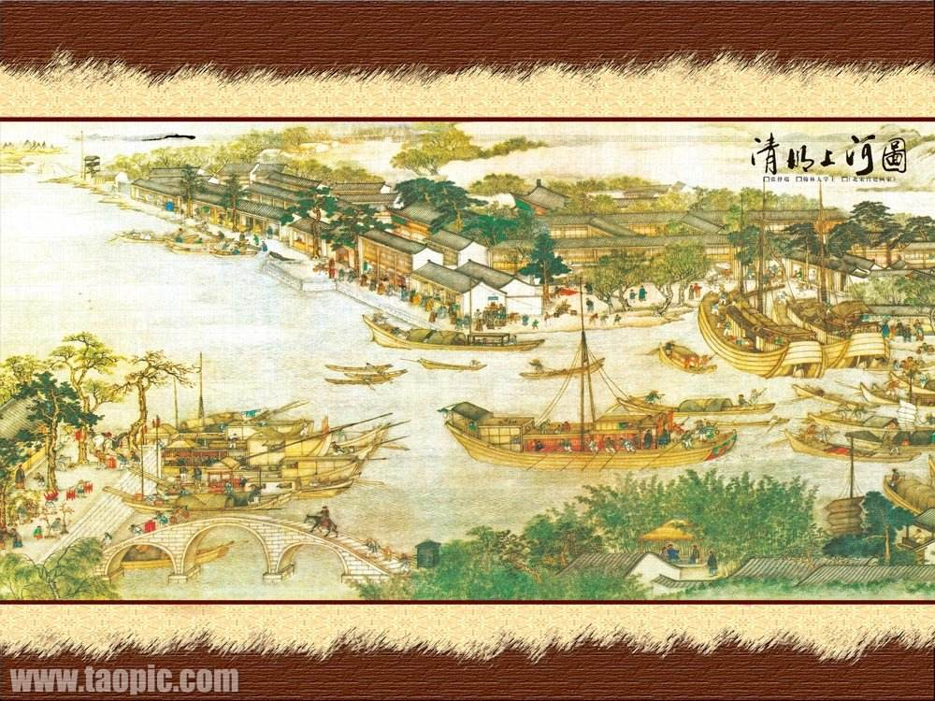
Works of Art

Slide 16
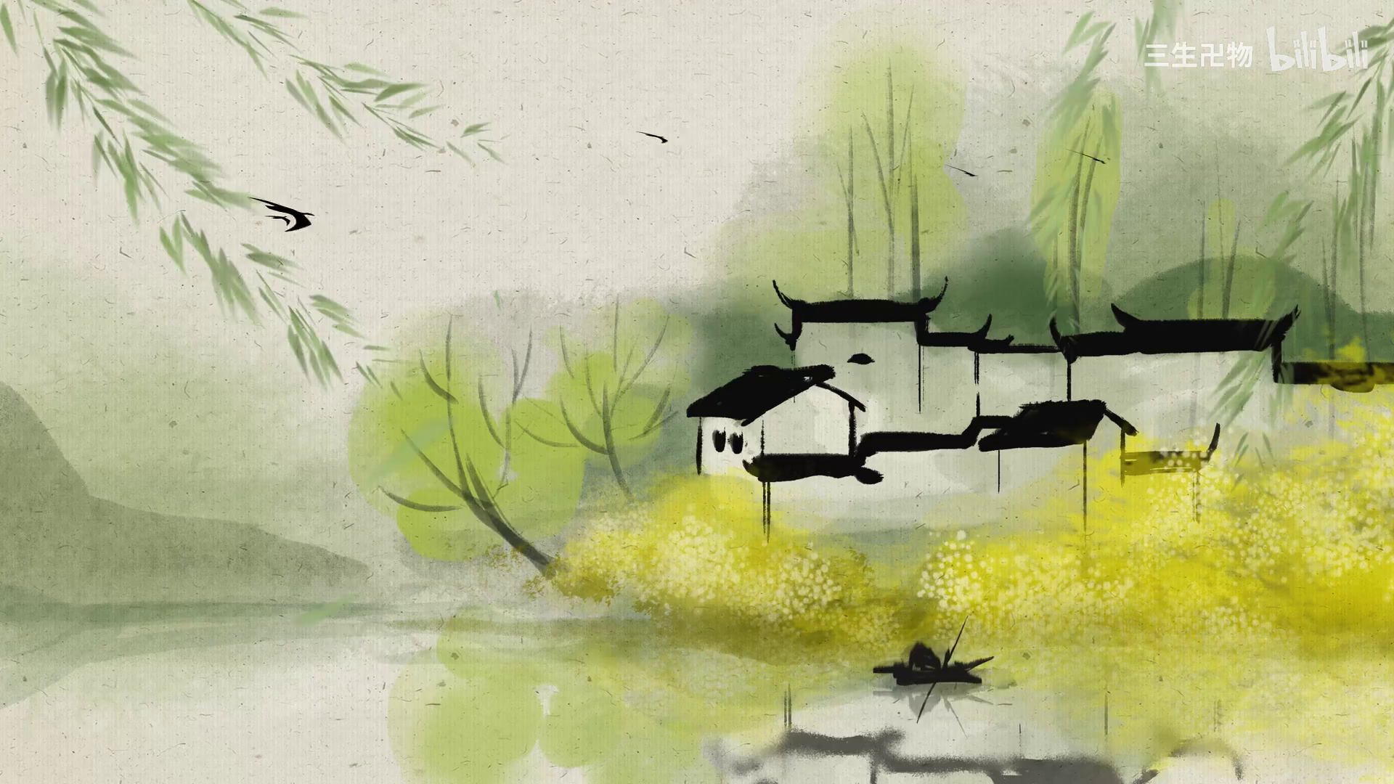
Thank You! Love Art, Love life!

Slide 17

Introduction
Welcome the audience:
Good morning, everybody. Welcome to my presentation.
Introduce the subject:
I’m very excited to have this opportunity to talk about one of my favorite pieces of art. It is called The Starry Night and was painted by Vincent van Gogh in 1889.

Slide 18
Main body
Background of the work of art
First, let me tell you about the background of this painting. It shows the French town, Saint-Remy-de-Provence at night. It is based on the view from a window in a hospital where Van Gogh was a patient. Sadly, he suffered from health issues throughout his life, and his work only found fame(获得名气) after his death. Although it shows the view at night, Van Gogh painted it during the day from memory. He also painted other versions at different times of day.

Slide 19
Description of the work of art
This is an oil painting on canvas(画布). One can immediately tell from its features that it is a Van Gogh painting. For example, the swirls (旋动) in the sky show Van Gogh‘s distinctive painting style. The curled dashes of bold color(清晰明显的色彩) can be seen in many of his works. The moon and stars are big and yellow. This was Van Gogh’s favorite color.

Slide 20
Review of the work of art
Although Van Gogh did not think the painting was very good, it is considered a masterpiece and is one of the most recognized paintings in the history of Western art. It really captures the viewers’ attention and draws them in. It gives the viewer an idea of the state of mind of Van Gogh at this difficult time in his life.

Slide 21
Conclusion
All in all, I think this is a great example of Van Gogh’s style. It is a magical painting, and a piece of work of a troubled genius.

