Slide 1

感恩遇见，相互成就，本课件资料仅供您个人参考、教学使用，严禁自行在网络传播，违者依知识产权法追究法律责任。
更多教学资源请关注
公众号：溯恩高中英语
知识产权声明

Slide 2
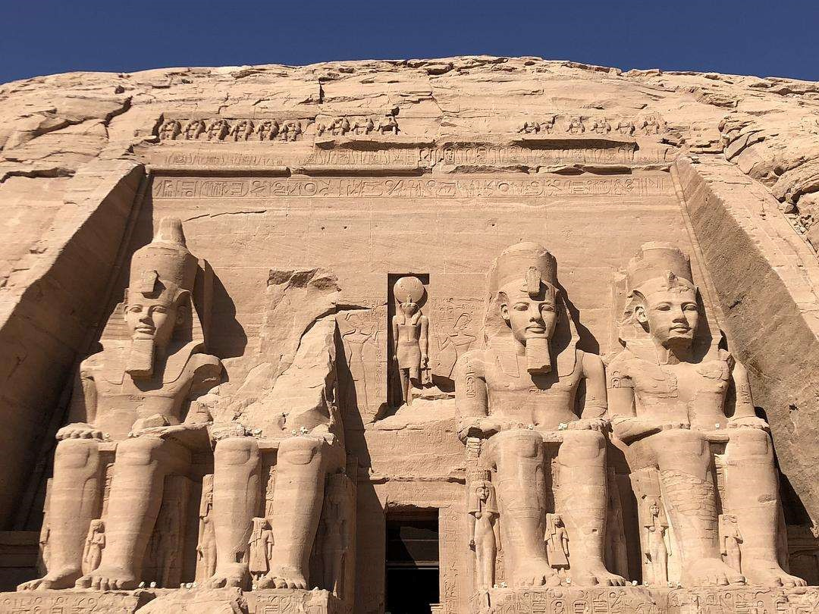

新人教版 Book2 Unit 1
CULTURAL HERITAGE
Reading and Thinking
杭州二中许丽君

Slide 3


Learning objectives
By the end of this class, students will be able to:
1. understand the whole passage and learn to analyze it;
2. understand how a problem is solved, taking Aswan Dam as an example;
3. strengthen your awareness of heritage protection and cultivate the spirit of teamwork;
4. think about the value of the protection of cultural heritage and team spirit.
5. express your ideas clearly through critical thinking;
6. enjoy the pleasure of learning English through self-directed study and cooperation
7. apply different reading strategies: predicting the content, reading for structure or detailed information, making a timeline and summarizing;

Slide 4
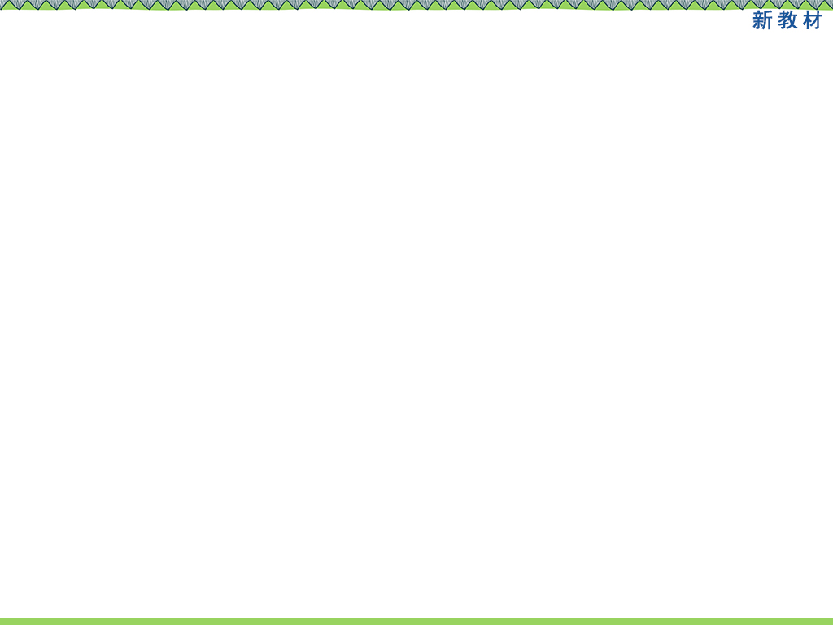
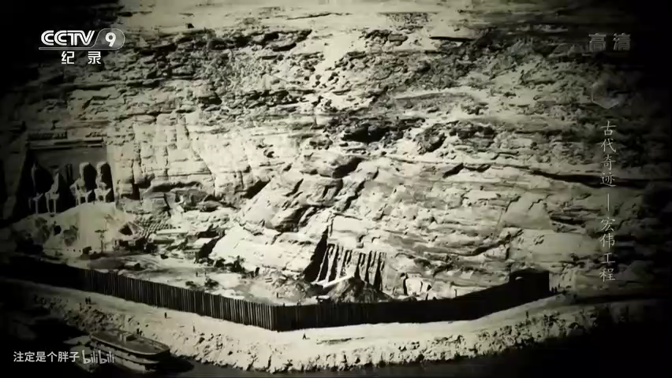
Lead in
Enjoy a video
pre-reading
Let’s watch a video about Abu simbel Temple.

Slide 5
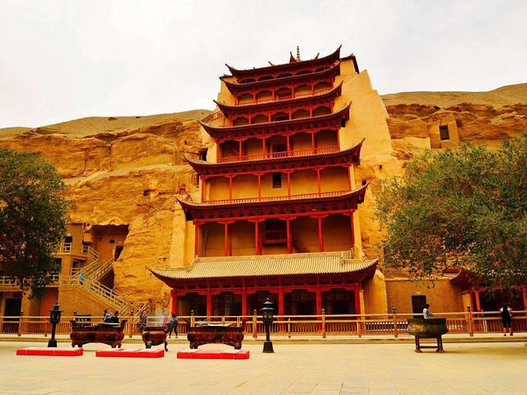
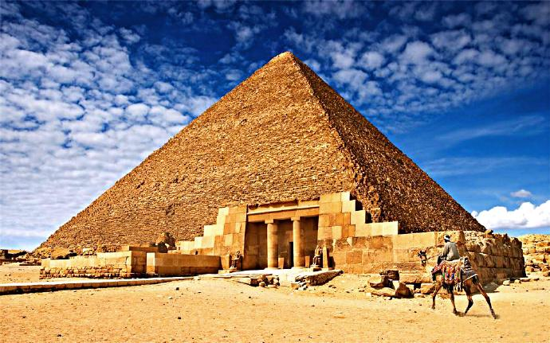
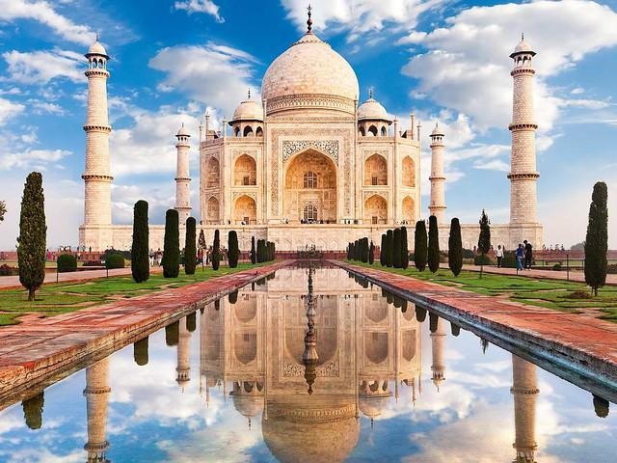
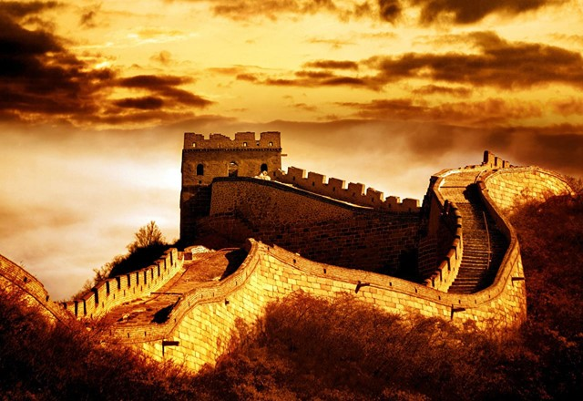
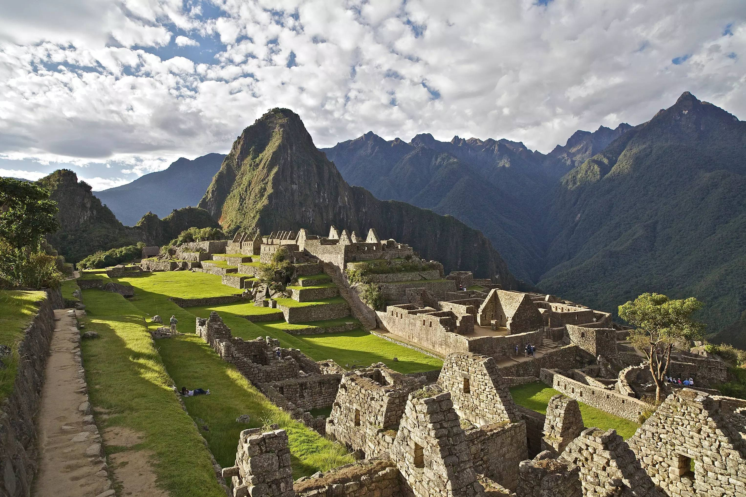
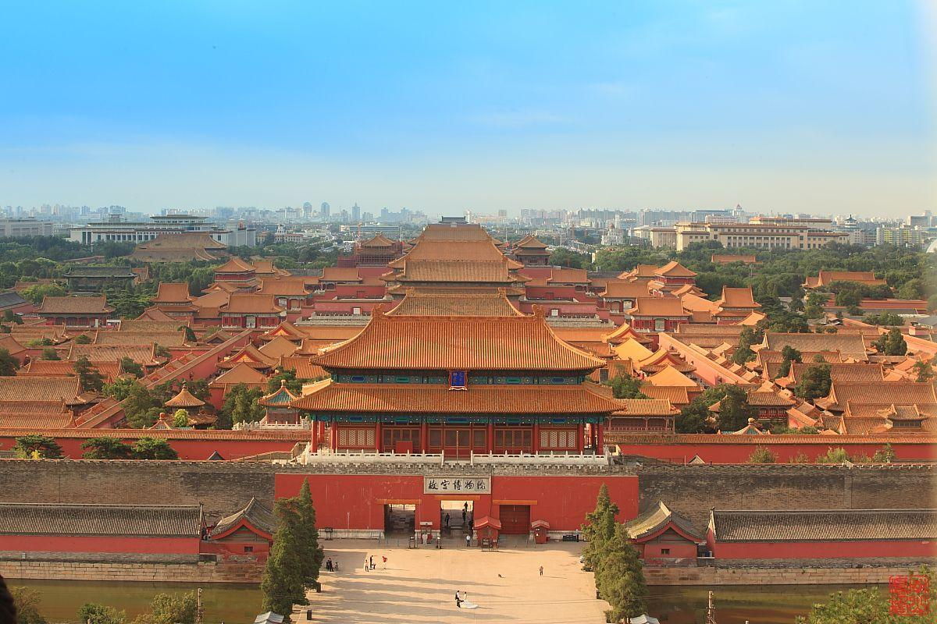
Lead in
pre-reading
What are these cultural relics/heritages?
Where are they?
Taj Mahal
India
the Great Pyramid
Egypt
Mogao Caves of Dunhuang
China
the Great Wall
China
Machu Picchu
Peru
the Forbidden City
China

Slide 6

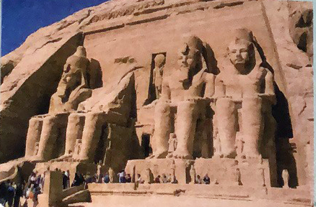
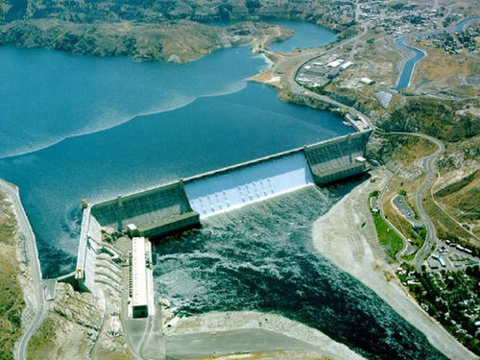
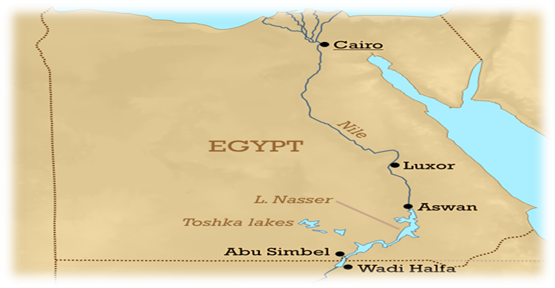
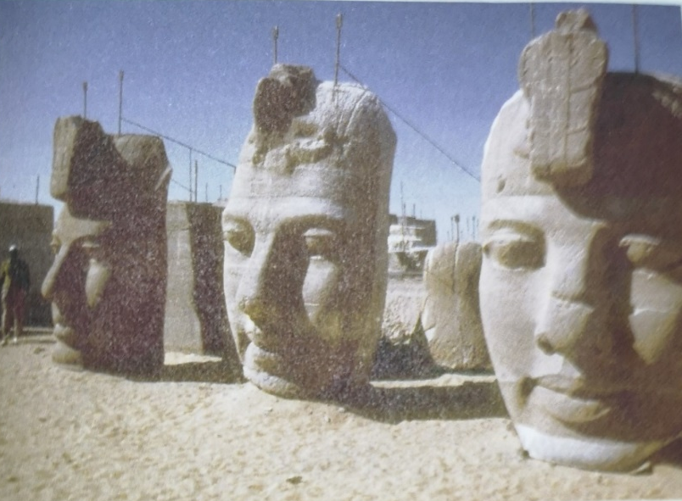
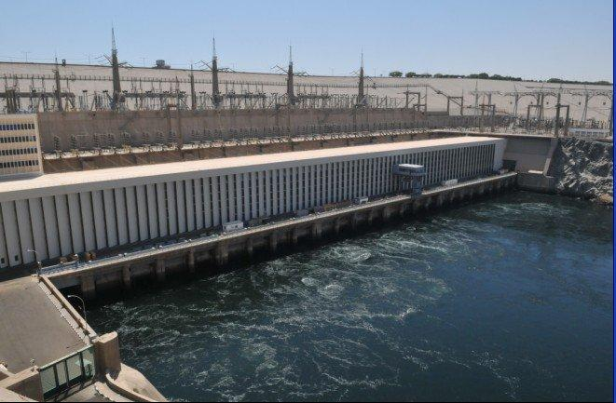
Abu simbel Temple
Look at the pictures. Which country do you think the images in the pictures can be found?
How are they related?
The Nile
Aswan Dam
Aswan High Dam
Egypt

Slide 7
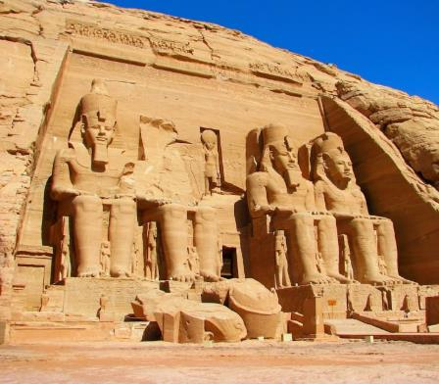
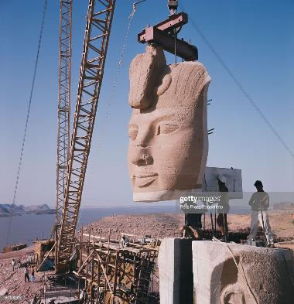
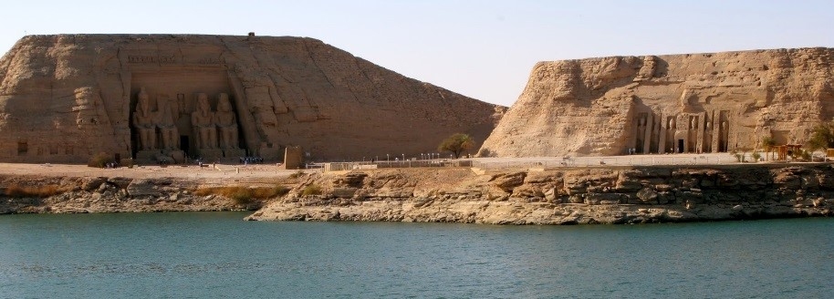
pre-reading
Prediction
Q1: How are the title and the pictures connected?
Q2: What do you think the text is about?
Based on the title and pictures, predict what the text will be about.
FROM PROBLEMS TO SOLUTIONS
The title suggests the text is about how people have solved problems, because they are going “from” the problems “to solutions”. The pictures show some ancient statues. They might be from Egypt. The large faces look as though they have been moved from where they first were. Perhaps the problem is related to this.

Slide 8


Task 1
Draw the structure of the text according to the main idea of each Paragraph.
Introduction
Para1
Para 2
Body
Para 3
Para 4
Para 5
Para 6
conclusion

Slide 9

Task 2
Fast Reading-read for main idea
Activity 1:skim the whole text and get the main idea of it.
How the Egyptian government successfully solved the problem of building Aswan project.
The project of Aswan Dam damaged some relics.
It introduces cultural relics in Egypt.
The Egyptian government turned to UN for help when in trouble.
What is the main idea of the text ?

Slide 10
Task 2
Fast Reading- read for main idea
Activity 2: skim the whole text and match each paragraph with its topic sentence.
A
A committee was established to limit the damage and to prevent the loss of cultural relics.
Para.1
Para.2
Para.3
Para. 4
Para. 5
Para. 6
The project brought together governments and environmentalists from around the world.
B
C
Finding and keeping the balance between progress and heritage protection is a challenge.
D
The project was considered a great success.
E
The spirit of the Aswan Dam project is still alive.
F
Big challenges can lead to great solutions.
.

Slide 11

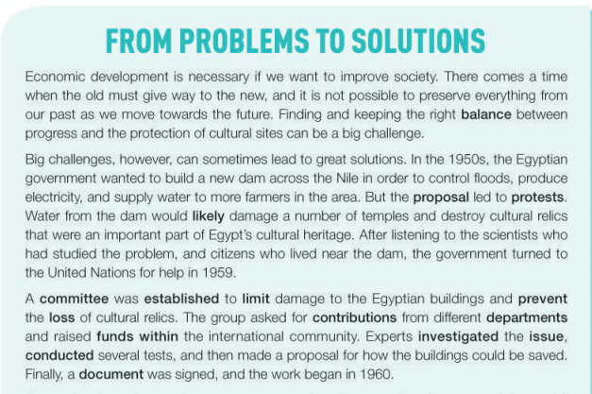

Task 3
Read for structure
Q：What is the topic sentence in each paragraph? And what are the key words?
Tips:
pay more attention to the first or last sentece in each paragraph.
Passage Structure Analysis
①
Problems
②
③
Solutions

Slide 12
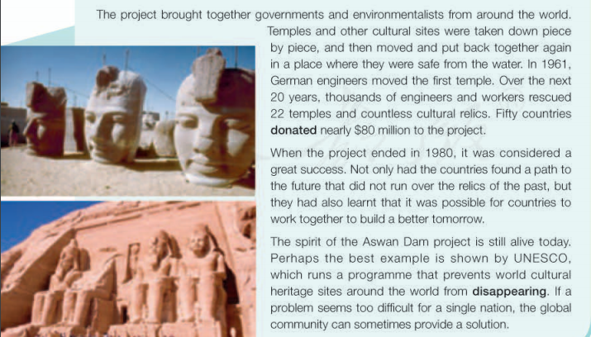
Task 3
Read for structure
④
Problems
Solutions
⑤
Inspiration
⑥

Slide 13


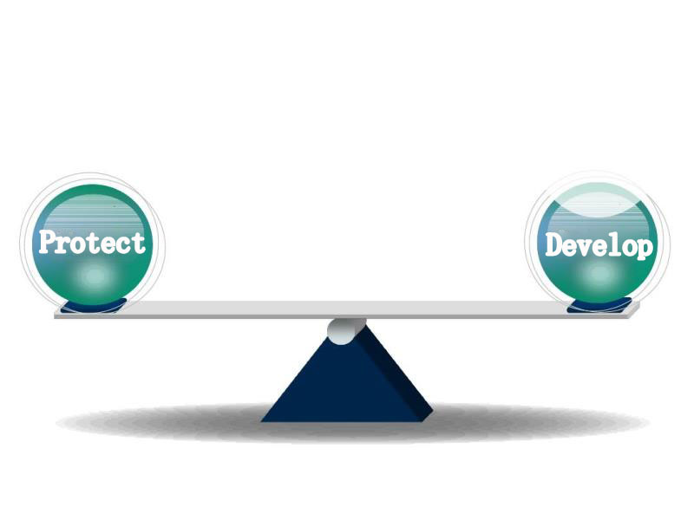
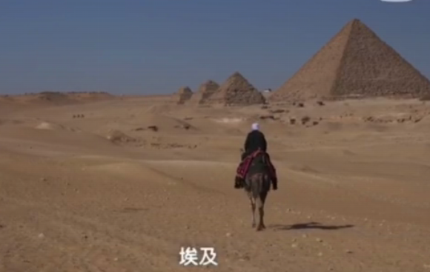
Task 4
Read for details （para 1）
Finding and keeping the right balance between progress and the protection of cultural sites can be a big challenge.
To build a new dam to develop its economy
Protection of
cultural sites
A balance
?
?

Slide 14
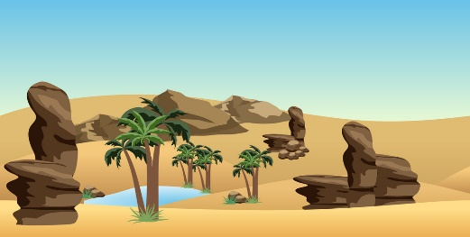
Task 4
Read for details （para 2）
Q: Can you sort out the advantages of building the new dam?
Advantages （pros） | Disadvantages/effects（cons）
1.Control floods | 1.Damage Abu Simbel and other temples
2.Produce electricity | 2.Destroy cultural relics and heritage
3. Supply water to more farmers

Slide 15

Task 4
Read for details （para 2）
Control
floods
Supply
water
Produce
electricity
Analyze
turn to
UN for help
Protest the proposal
how
to develop
economy
what
why

Slide 16
Task 4
Read for details （para 3）
Para 3： Q：Can you sort out UN’s specific ways to solve the problem with a mind map?
1. asked for contributions
UN's help
establish a
committee
2. raised funds
the
group
3. investigated the issue
the experts
conducted several tests
4. _____________________________________
5. ______________________________________
____________
made a proposal
6.signed a document

Slide 17
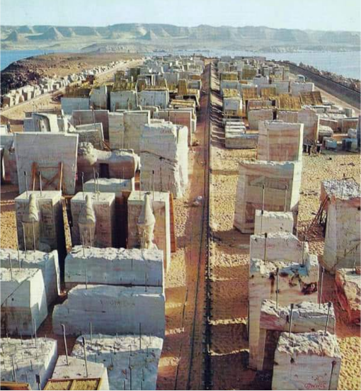
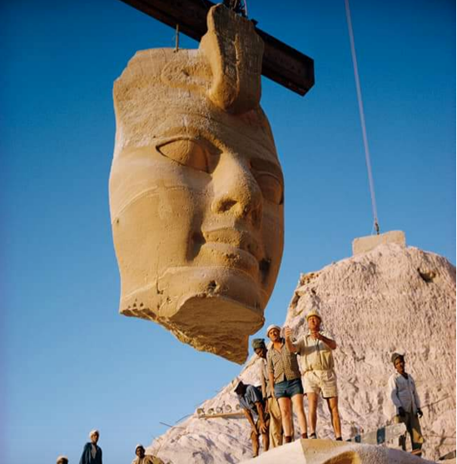
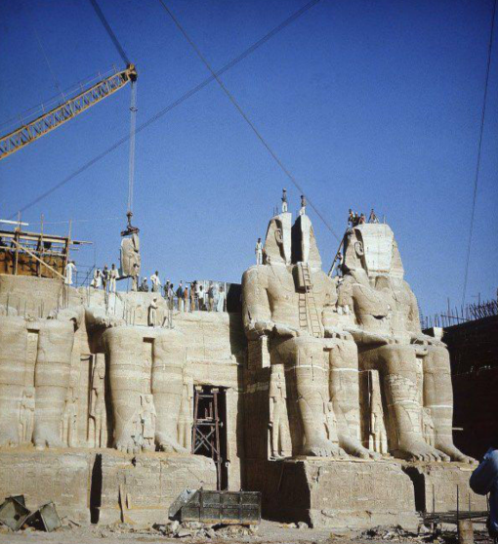
Task 4
Read for details （para 4）
Para 4. Q：How were the temples and other cultural sites saved?
Temples and cultural sites taken down
together again
moved
put back
piece by piece
to other places

Slide 18
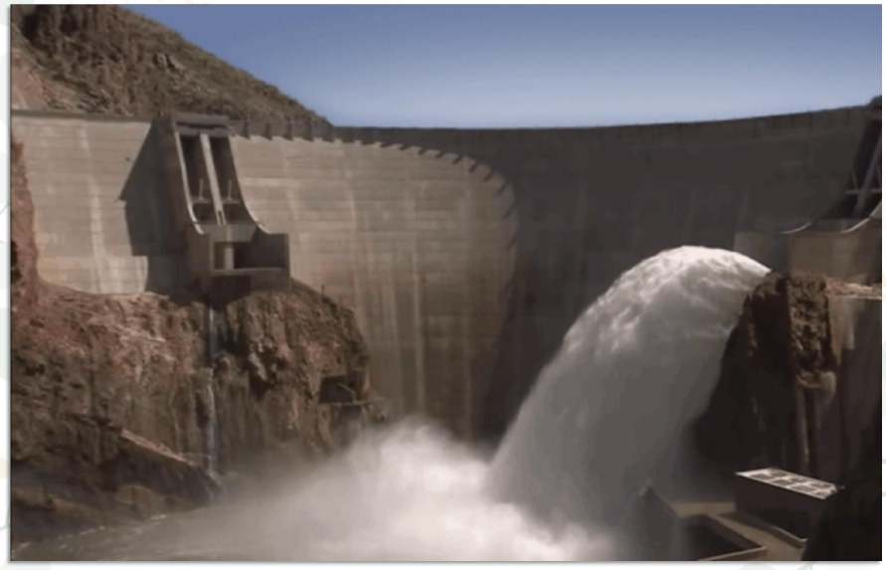

Task 4
Read for details （para 6）
Inspiration
What’s the spirit of the Aswan Dam Project?
Spirit still alive
cultural heritage protection
International cooperation

Slide 19
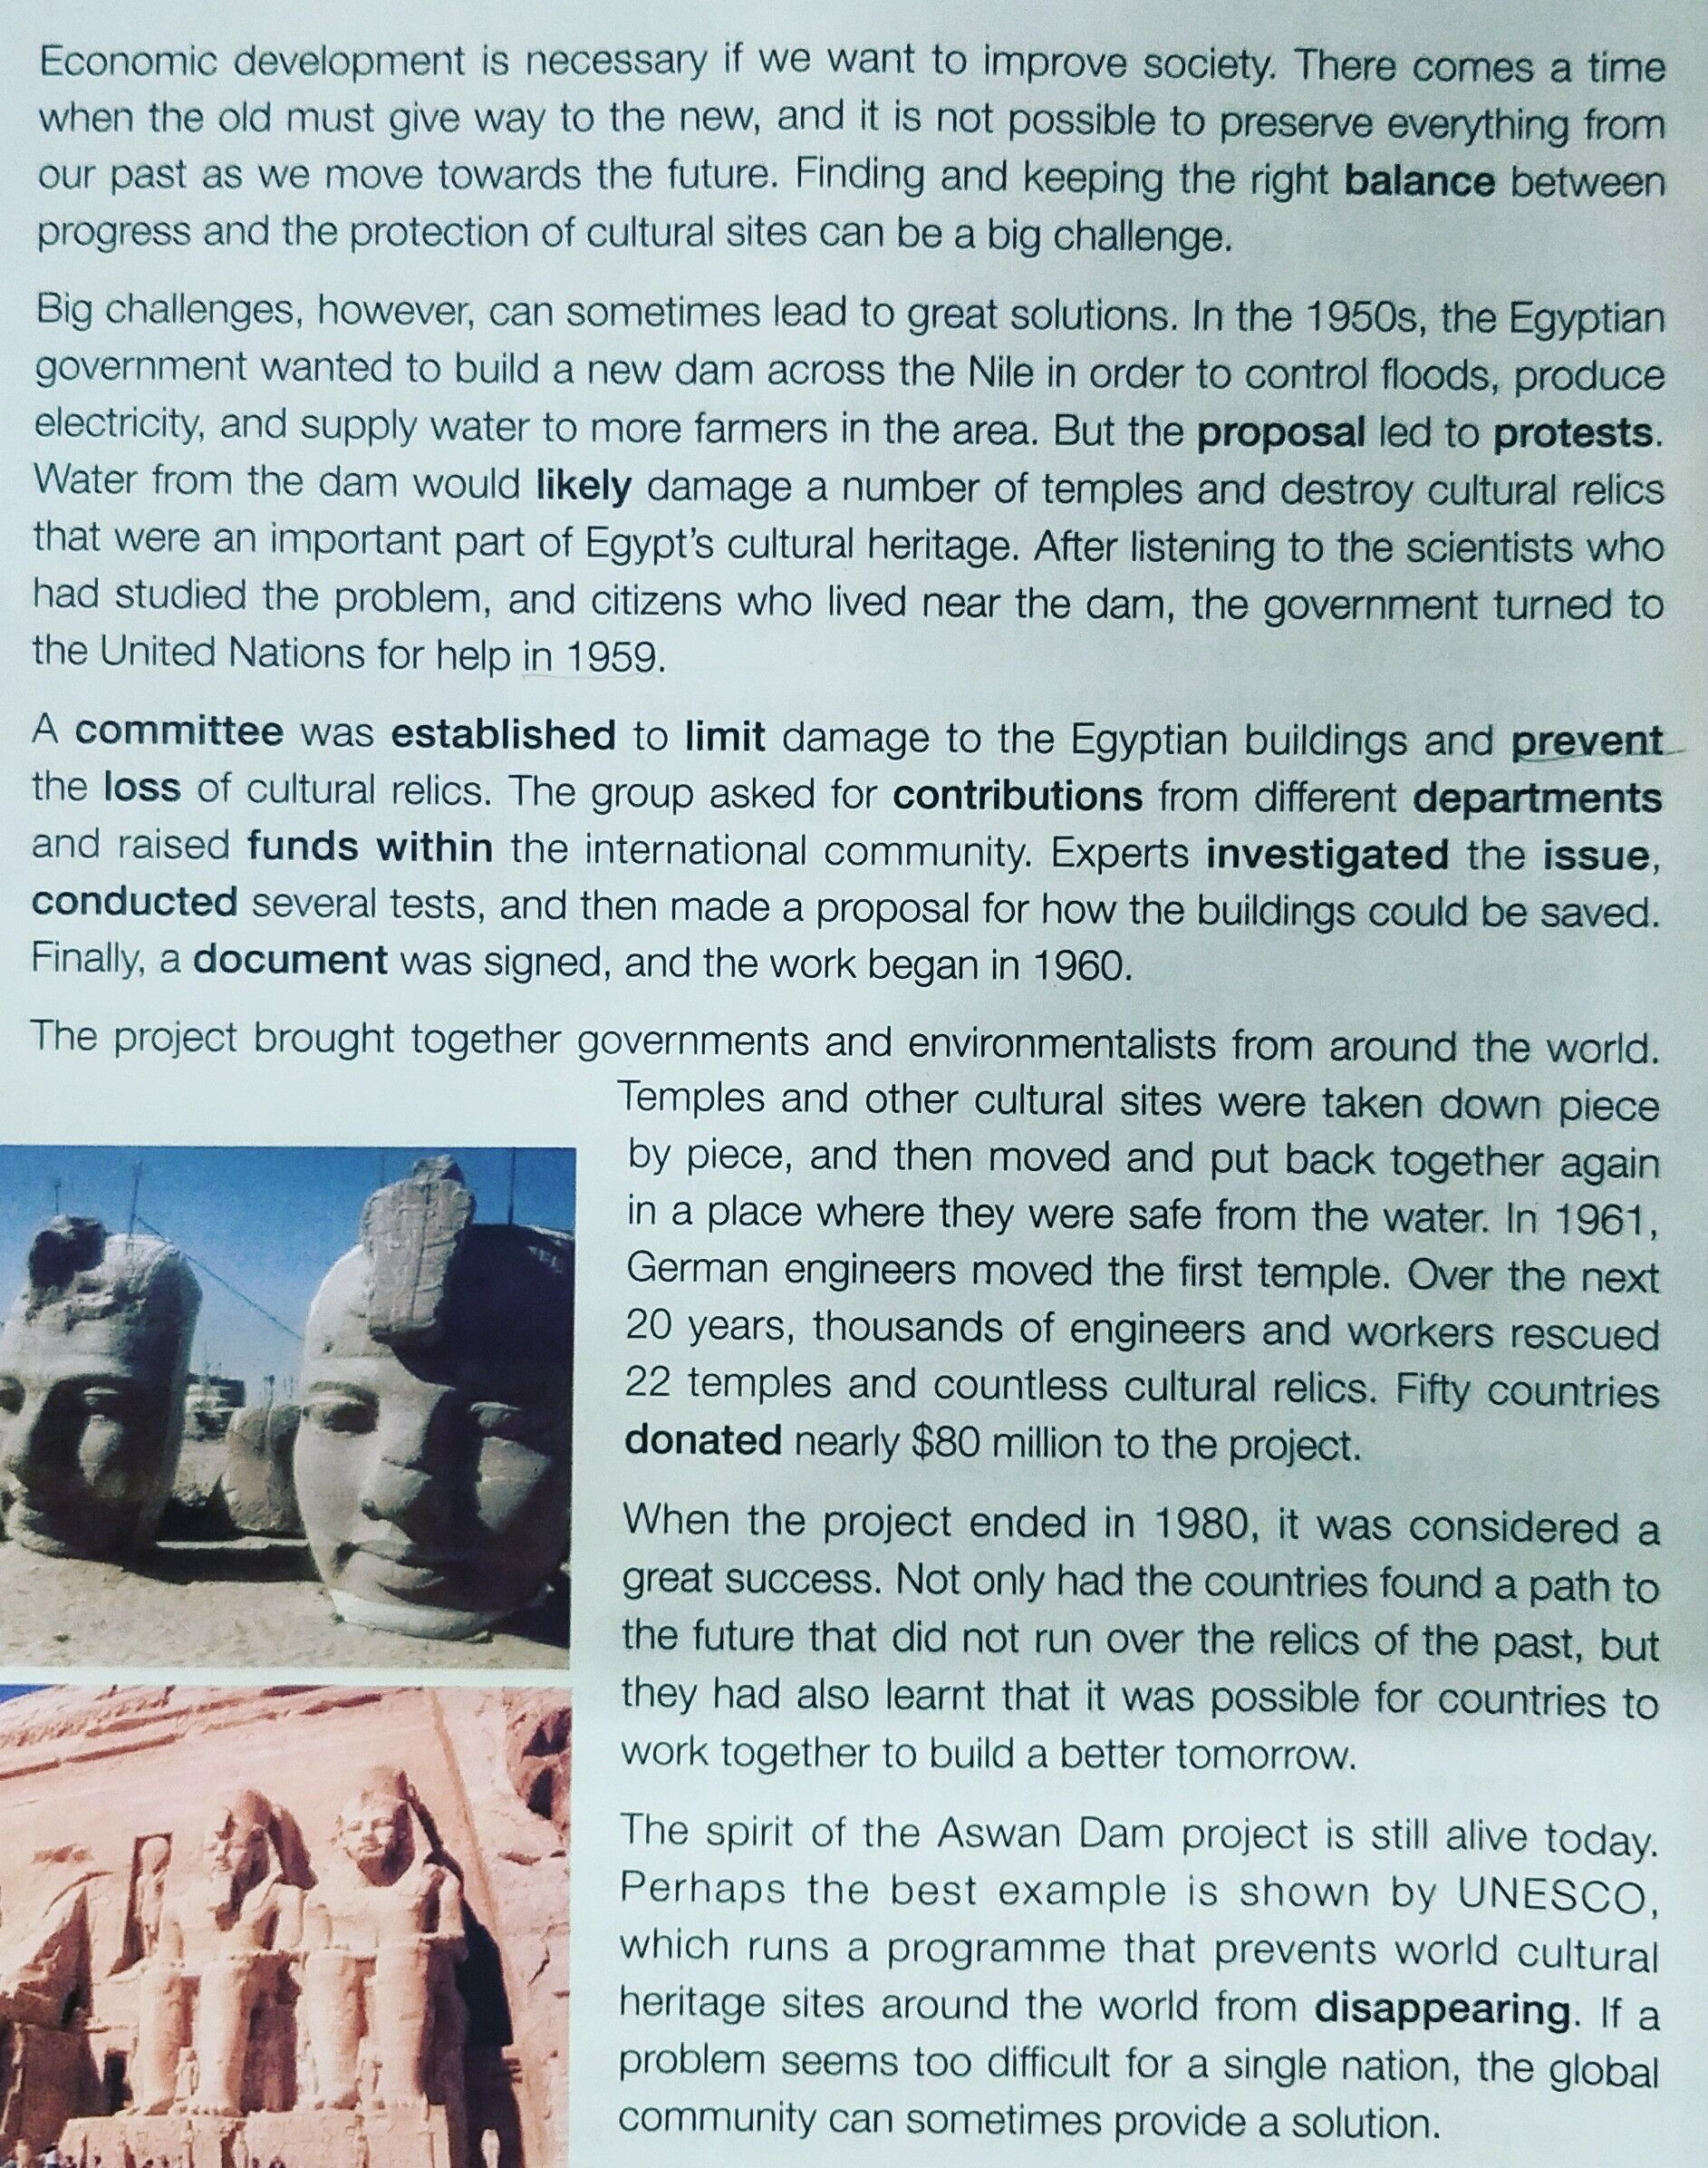
Task 5
Read for information
Introduction
1. What is the challenge in paragraph 1?
2. What does the proposal refer to in paragraph 2?
To build a new dam across the Nile
3. What does protests mean?
agreements
B. objections
C. actions
D. choices
4. What did the Egyptian government decide to do to solve the problem?
5. What help did the UN offer?
6. How did they save the temples and other cultural sites ?
7. Why is the project a great success?
8. What is the spirit of the Aswan Dam project?
Problems
Solutions
Body
Conclusion

Slide 20
Task 5
Read for information： （para 1- 4）
What’s the best way to solve the problem according to para1?
Who had the problem?
Why did the government want to do it?
What did the government want to do?
the problem ?
What’s the problem of building a new dam?
What’s the solution
to the problem?
Can you infer what problems did the Nile river bring to the Egyptians before building the dam?

Slide 21
Task 5
Read for information： （para 2- 4）
Para 2
The government turned to the UN for help to build the new dam.
A committee was established to limit damage and to prevent the loss of cultural relics.
Solutions
Para 3
The project brought together governments and environmentalists from around the world.
Para 4

Slide 22
Task 5
Read for information： （para 1- 6）
Conclusion
Divide the text into three parts and find the topic sentence.
From Problems to solutions
Para 1: hard to keep balance
Para 2: build a new dam vs. damage temples ＆ cultural heritage
Problems
Finding and keeping the right balance between _____ and ____is an _____problem.
solutions
Turn to UN for help
Cooperate with other countries
Take down piece by piece. Then move and put back together.
Inspiration
Global community
Team spirit

Slide 23
Review the process:
Task 6
Complete the timeline with the information from the text.
The project starts.
The temples and cultural relics are being rescued.
The project is completed.
The first temple is moved.
The government asks the UN for help.
1959
1960
1961
1961-1980
1980
B
B
C
C
C
The govern-ment asks the UN for help.
The first temple is moved.
The project is completed.
The project starts.
The temples and cultural relics are being rescued.

Slide 24

Structure of the text
What are the problems and solutions according to the text？
1. There comes a time when the old must give way to the new.
Abu Simbel Temples gives way to Aswan Dam
Problems
It is impossible to preserve Abu Simbel Temples if we want to build the Aswan Dam
2. Finding and keeping the right balance between progress and the protection of cultural sites can be a big challenge.
3. Build a new dam VS damage temples & cultural heritage
Hard to keep balance
4. and it is not possible to preserve everything from our past as we move towards the future.
After listening to the scientists who had studied the problem, and citizens who lived near the dam, the government turned to the United Nations for help in 1959.
Turn to UN for help
Solutions
Cooperate with other countries
Take down piece by piece, then move and put back together
The project brought together governments and environmentalists from around the world. ……Fifty countries donated ……
global community
Inspiration
Temples and other cultural sites were taken down piece by piece, and then moved and put back together again in a place where they were safe from the water.
team spirit

Slide 25


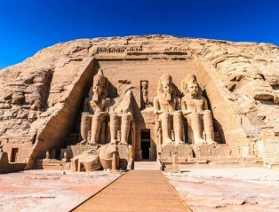
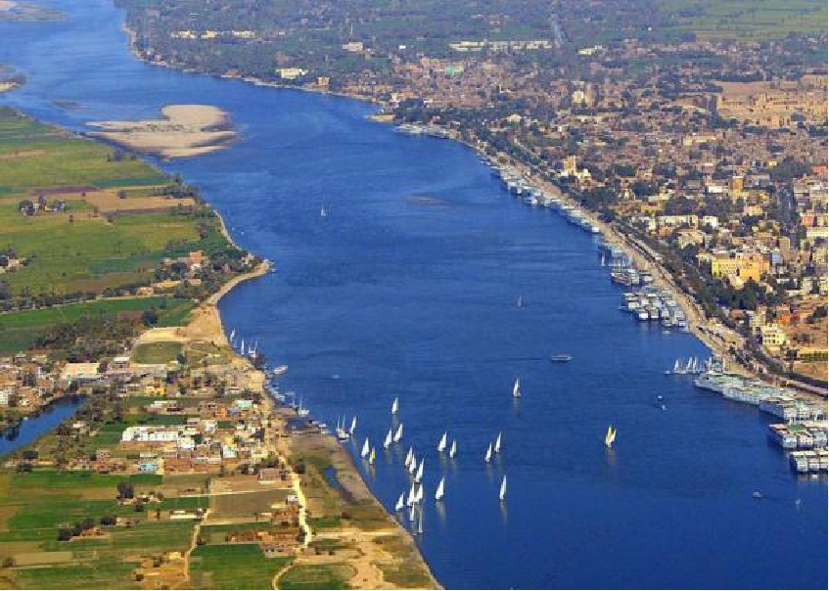

Summary for structure and pattern
Summarize the text with a mind map.
How a problem is solved
raise the problem
hard to keep balance
Problems
building a dam vs protection of cultural relics
analyze the problem
Does the writer only want to introduce the building of Aswan Dam?
From problems to solutions
ask UN for help
cooperate with other countries
come up with a solution
Solutions
carry out the solution
move temples and cultural relics
Inspiration
evaluate（评价）the results
team spirit within global community

Slide 26

Q: Why do you think so many countries contributed funds and offered help to the Egyptian project?
1
1
raise the problem
Problem
Solution
2
Proposal led to protests.
2
3/4
3/4
the solution to the problem
5
5
the result/effect of the problem
5/6
5/6
Inspiration

Slide 27


Assignment：
1. Polish your summary and add it to your notes. “
2. Try to practice the skills about summary writing after class.
3. Make a poster about how to protect cultural relics and world heritage.
4. Write a letter to share some ideas about protecting cultural heritage.

Slide 28
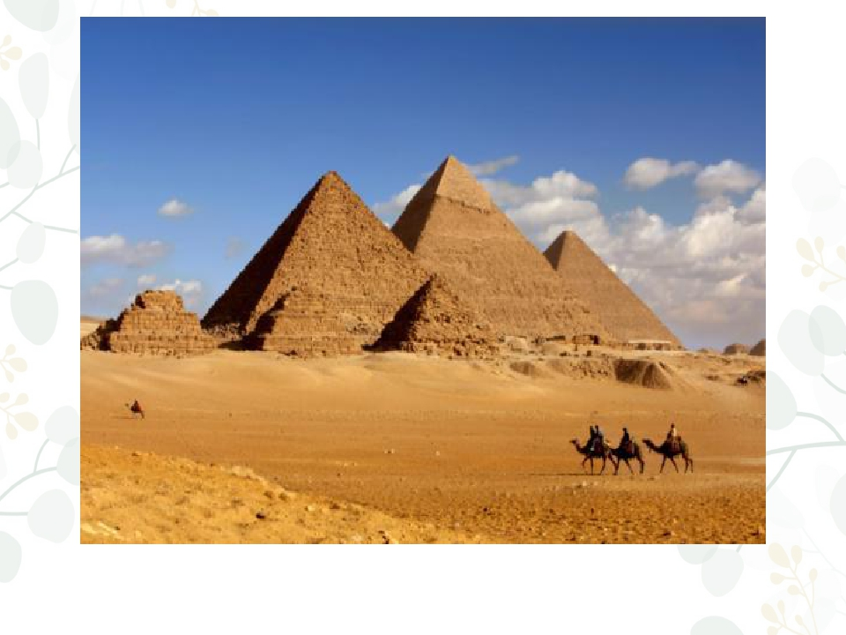
Thank you!

