Slide 1

感恩遇见，相互成就，本课件资料仅供您个人参考、教学使用，严禁自行在网络传播，违者依知识产权法追究法律责任。
更多教学资源请关注
公众号：溯恩高中英语
知识产权声明

Slide 2






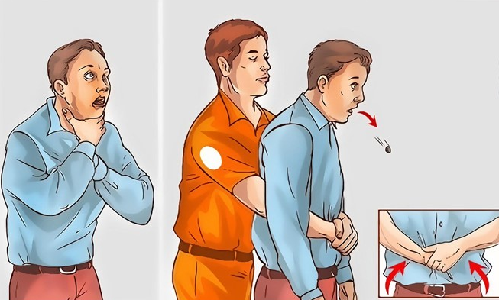

Unit 5 Using Language
Share your story about providing first aid

Slide 3
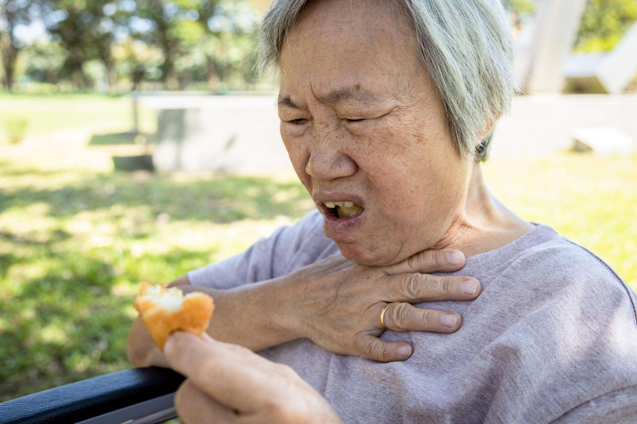
What happened to the old granny?
What do you think she is suffering from?
She is suffering from choking.

Slide 4
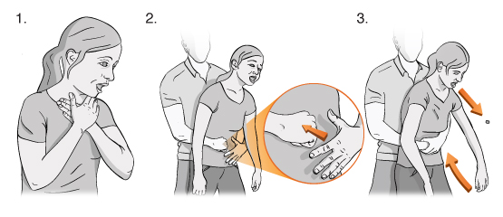
What do you know about Heimlich Manoeuvre?
It is a way to help the choking victim. Chocking can be very dangerous. To solve the problem, Henry Heimlic created the Heimlich manoeuvre in 1974.

Slide 5
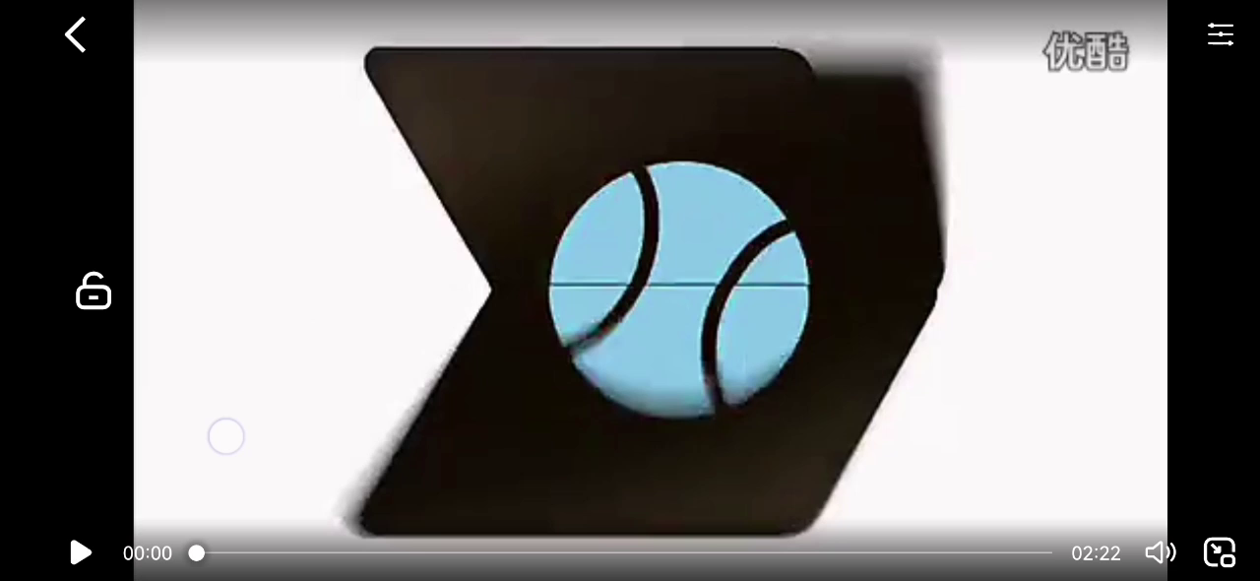
Video Time: How to perform Heimlich Manoeuvre?

Slide 6

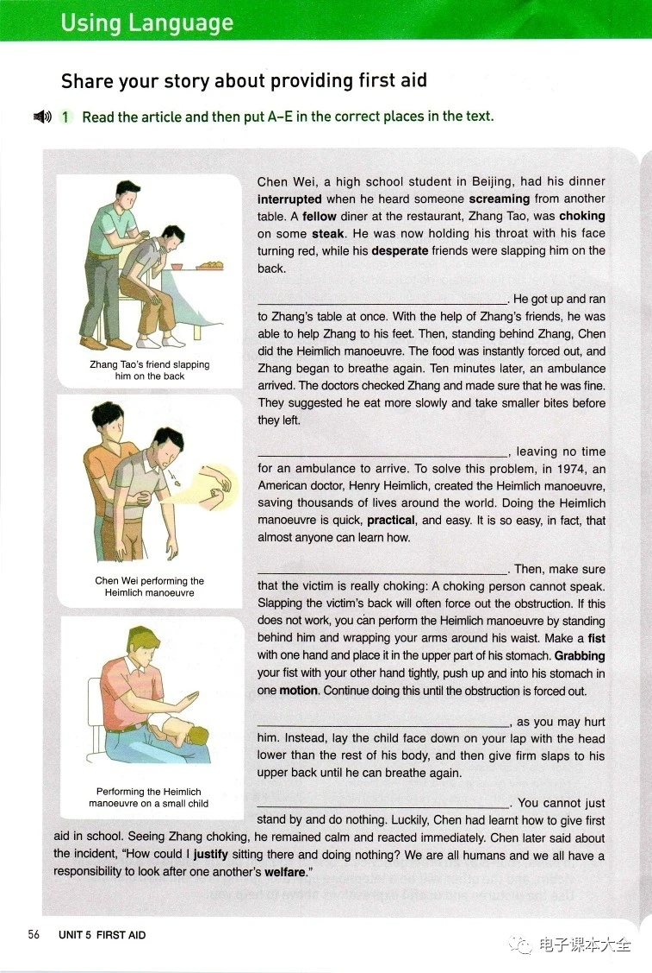
Activity 1: Read and put A-E in the correct order.
A. Choking victims usually have only about four minutes before they collapse and sometimes die.
B. If you see someone choking, first call the emergency services.
C. Chen wasted no time.
D. With choking victims, every minute counts.
E. Doing the Heimlich manoeuvre on a small child is not recommended.
C
A
B
E
D

Slide 7
Activity 2: Read for different parts and main idea
a first aid story
Para 1-2
C
A
B
an introduction of
the Heimlich manoeuvre
Para 3-5
E
D
the conclusion of the story
Para 6

Slide 8
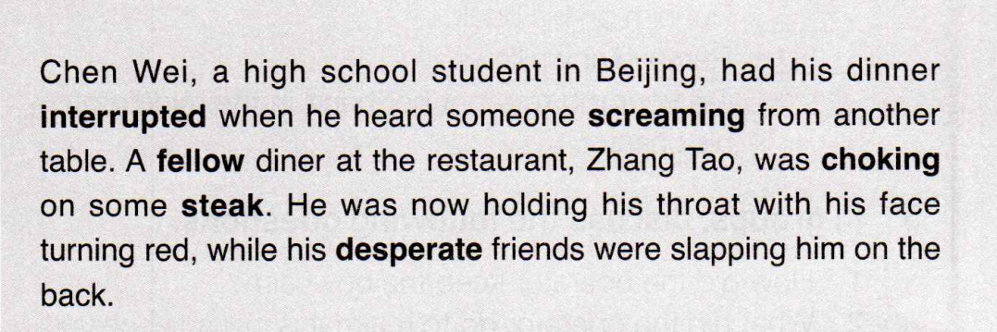
Activity 3: Read for detailed information
What are the elements mentioned in Para. 1? ( 5W 1H )
Who:
When:
Where:
What:
Why:
How:
Chen Wei, Zhang Tao, & Zhang Tao's friend
have dinner when...
at the restaurant
Zhang Tao, was choking on some steak.

Slide 9
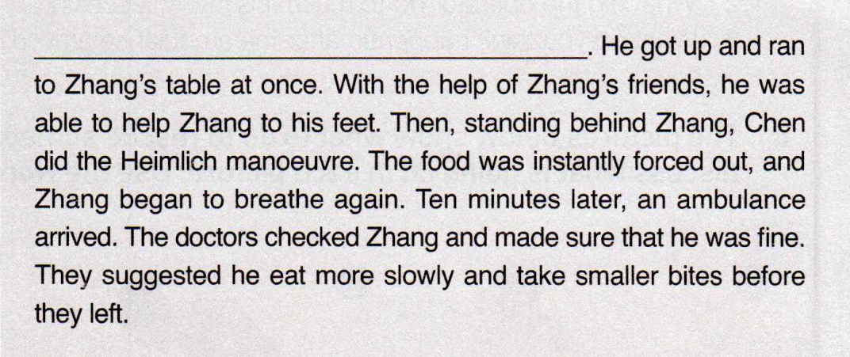
Activity 3: Read for detailed information in Para. 2
How did Chen help Zhang? What did Chen and Zhang’s friend do?
got up and ran to
C. Chen wasted no time.
helped to his feet
stood behind
did the Heimlich
forced out
A series of Verbs
Time order

Slide 10
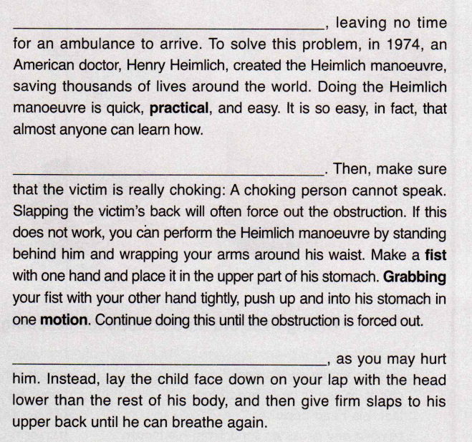
Activity 3: Read for detailed information in Para. 3-5
1. Read and choose the correct words.
The Heimlich manoeuvre is quite
easy / difficult to do.
You will know that the victim is choking if he cannot speaks / stops breathing.
To help a small child who is choking, you need to lay the child face up / down on your lap and slap his upper back.

Slide 11
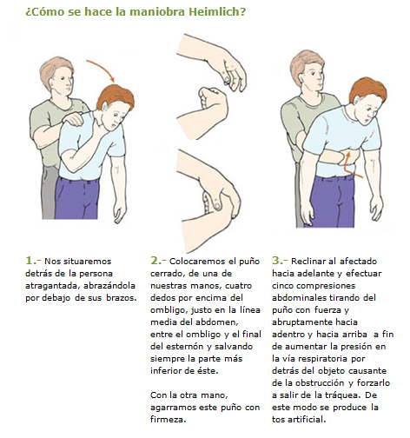
Activity 3: Read for detailed information in Para. 3-5
2. How to perform the Heimlich manoeuvre on adult
Grab your fist with your other hand tightly
push up and into his/her stomach in one motion
stand behind him/her
wrap your arms around his/her waist
make a fist with one hand
place it in the upper part of his/her stomach

Slide 12
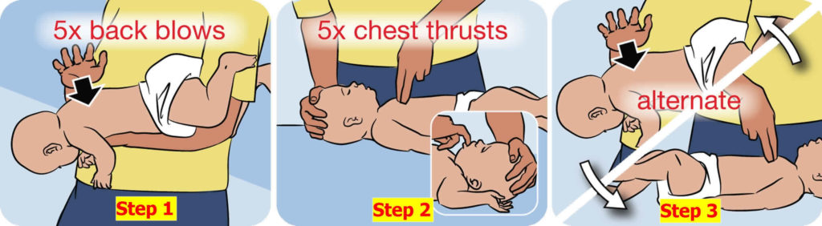
Activity 3: Read for detailed information in Para. 3-5
3. How to perform the Heimlich manoeuvre on small child
lay the child face down
head lower than his/her body
give firm slaps to his/her
upper back

Slide 13
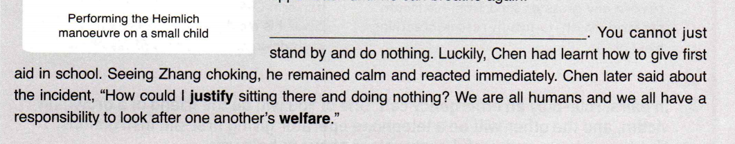
Activity 3: Read for detailed information in Para. 6
Why did Chen help Zhang?
If you were Chen Wei, would you choose to help Zhang Tao?
It provides a good way to wrap up the essay. It also tells the reader about Chen Wei’s emotions and opinions, and gives unique insight into his character.
quotation
Every minute counts.
Had learnt how to ...
Have a responsibility to...

Slide 14
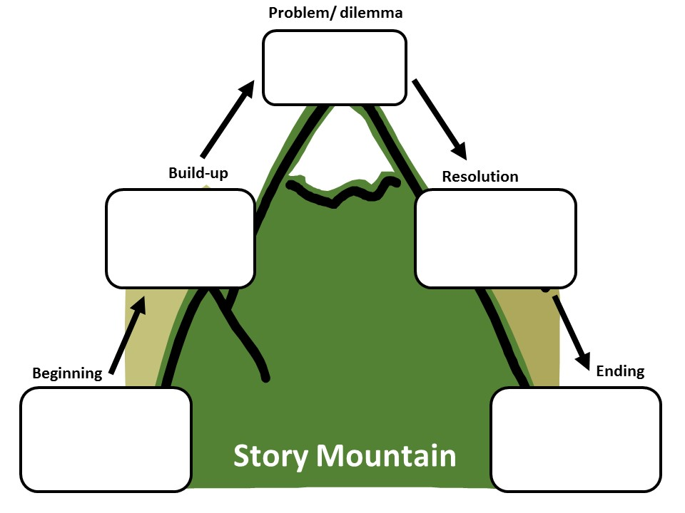
Activity 4: Summary --- Story Plot Map
(a narrative essay)
Climax (involves a challenge or difficulty)
Rising action
Falling action
Background
(includes 5W1H)
Conclusion (how things
end up in the story)

Slide 15
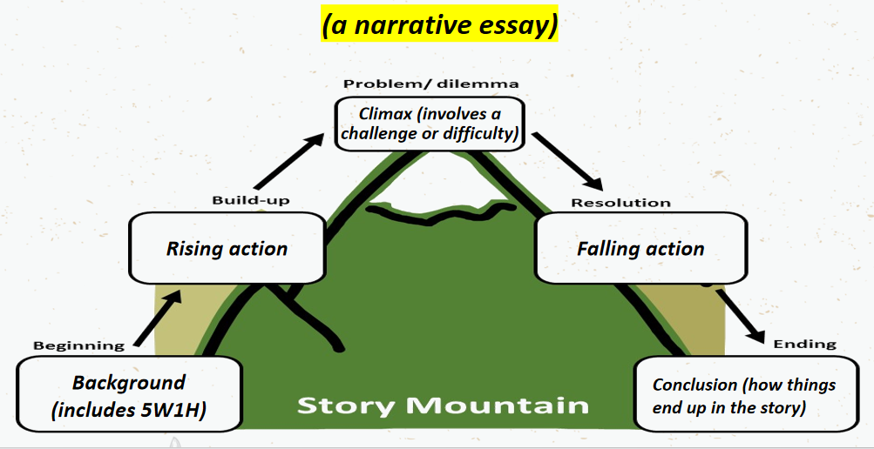
Activity 4: Summary --- Story Plot Map
(a narrative essay)
Time order
Chen did the Heimlich manoeuvre to save Zhang.
A series of Verbs
ChenWei had his dinner interrupted by a person who was choked.
The chocked person was saved in time.
Use quotation

Slide 16
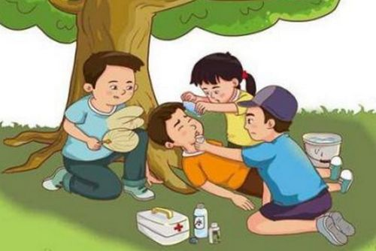
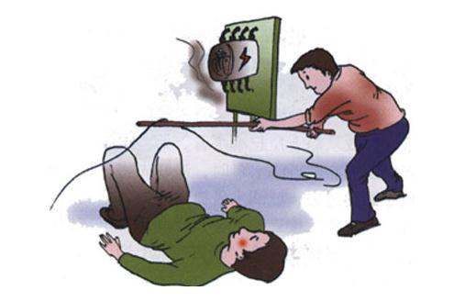
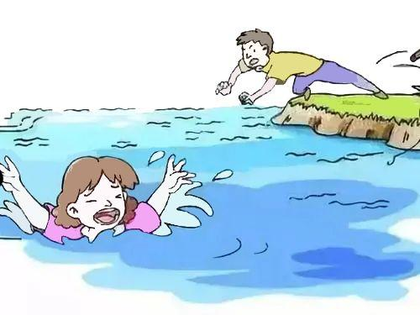
Activity 5: Write a narrative essay
1. Work in pairs. Discuss your experience of giving first aid in an emergency. Or discuss stories you have read or heard about or think up a situation.
2. Write the structure and plot of your story.
3. Think of a good quote to sum things up.

Slide 17
Example
Last Sunday, I went to the park with Tony for a picnic. Unfortunately, Tony's left foot got injured on our way to the park. Luckily,I'd just learmed about first aid in our school. So I dialed 120 immediately and performed first aid before the doctor came.
First, I put his left foot in a more comfortable position. Then I rushed to a shop nearby and fetched bags of ice, and carefully applied the ice to the injury. Fifteen minutes later, the swelling seemed to have gone down a little. And I covered the injury with a clean and dry bandage. Ten minutes later, an ambulance arrived and took Tony to the hospital.
Only then was I aware of what a difference a basic knowledge of first aid could make, especially in such a case.

