Slide 1

感恩遇见，相互成就，本课件资料仅供您个人参考、教学使用，严禁自行在网络传播，违者依知识产权法追究法律责任。
更多教学资源请关注
公众号：溯恩高中英语
知识产权声明

Slide 2

The World
August 1st-15th, 2022

Slide 3
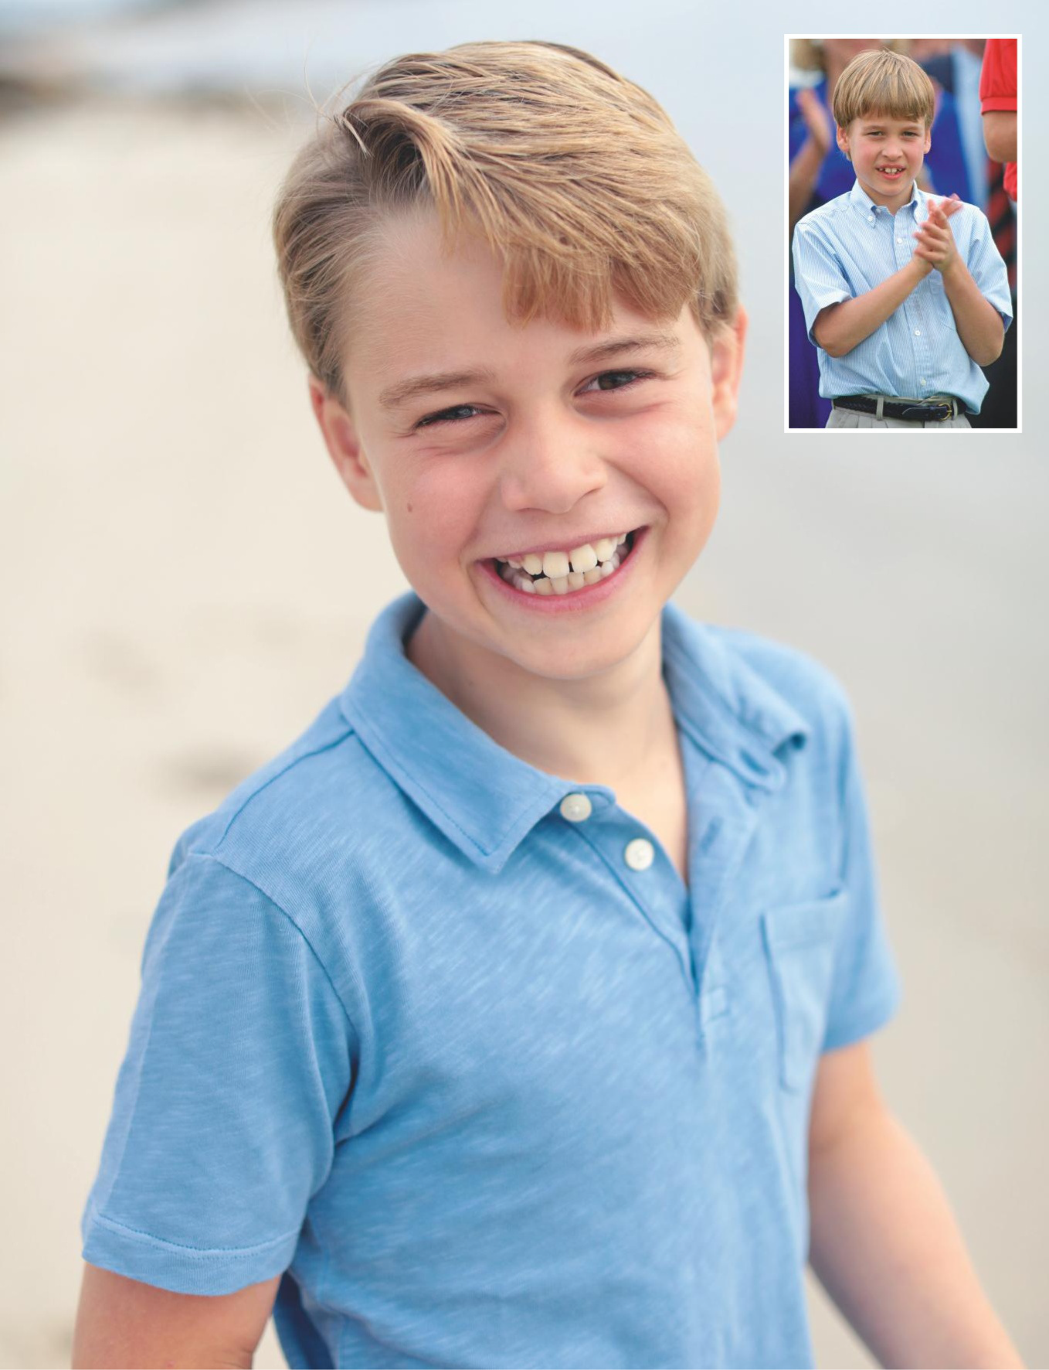
1. HAPPY 9TH BIRTHDAY! PRINCE GEORGE
乔治王子，9周岁生日快乐！
George looks relaxed in the official birthday portrait (left), resembling his father the Duke of Cambridge, who as a young Prince around the same age in 1990 (above) wears a blue shirt while watching a match at Guards Polo Club in Windsor.

Slide 4
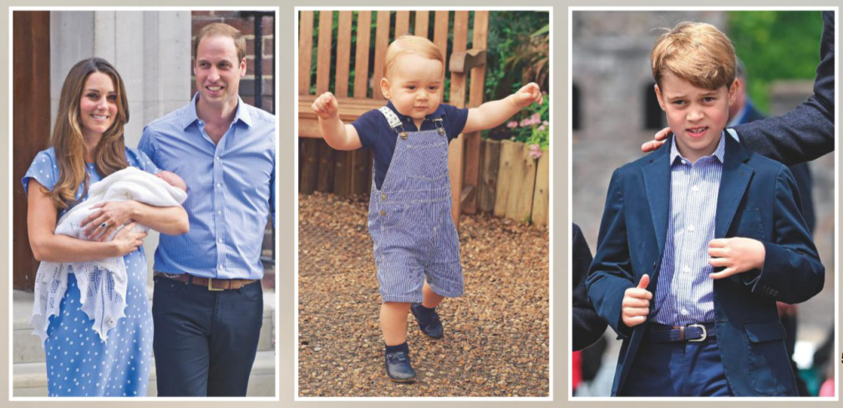
George is William and Kate’s first child and was presented to the world outside St Mary’s Hospital in London (left). His portrait to mark his first birthday (centre) and visiting Cardiff Castle in June (right).

Slide 5

语篇填空
（《Hello！》 2022年8月1日刊 59页）
broadly
Grinning _______ (broad) at the camera as he plays on the beach, Prince George is full of fun in this beautiful new portrait _____ (take) by the Duchess of Cambridge to mark his ninth birthday ___ 22 July.
Wearing a simple blue polo shirt during a family holiday in the UK, the Duke and Duchess’s eldest son looks a world away from some of his recent public __________ (appear). In the past couple of months, the third in line to the throne ____________ (see) wearing a suit and tie to join his parents on _______ (office) engagements. But as this sweet photograph shows, he still has plenty of time for carefree outdoor play away from the spotlight, especially during the long summer break ____ school.
______ (early) in July, Prince William and Kate were spotted leaving Kensington Palace by helicopter with George, Princess Charlotte, seven, and Prince Louis, four-plus their pet dog Orla-at the start of their holidays.
Geroge’s growing public role mirrors ____ of his father as a child, even down to the clothes he wears. The shorts and long socks he wore when younger have been swapped for a blazer, shirt and tie for official appearances, echoing William’s outfits at ___ same age.
taken
on
appearances
has been seen
official
from
Earlier
that
the

Slide 6
熟词生义
1. mirror: 常见义→ n.镜子
生义 → v.反映 (= reflect)
The music of the time mirrored the feeling of optimism in the country. 这个时期的音乐反映出这个国家的乐观精神。
2. echo: 常见义→ n.回声；回音
生义 → v.与……相呼应
The design of the church echoes that of St. Paul’s Cathedral. 这座教堂的设计与圣保罗大教堂的设计相呼应。
翻译句子
我们的报纸旨在反映普通民众的意见。
Our newspaper aims to mirror the opinions of ordinary people.
翻译句子
粉色和米色被选来与天花板的颜色相呼应。
Pinks and beiges were chosen to echo the colours of the ceiling.

Slide 7
句子翻译
Grinning broadly at the camera as he plays on the beach, Prince George is full of fun in this beautiful new portrait taken by the Duchess of Cambridge to mark his ninth birthday on 22 July.
7月22日，剑桥公爵夫人为庆祝乔治王子9岁生日而拍摄了这张美丽的新照片，照片中乔治王子在海滩上玩耍，对着镜头笑得很开心。
翻译
Geroge’s growing public role mirrors that of his father as a child, even down to the clothes he wears. The shorts and long socks he wore when younger have been swapped for a blazer, shirt and tie for official appearances, echoing William’s outfits at the same age.
乔治越来越多的公众角色反映了他父亲小时候的形象，甚至连他穿的衣服都是如此。他年幼时穿的短裤和长袜子已经被换成了正式场合穿的西装、衬衫和领带，与威廉王子在同一年龄时的着装相呼应。
翻译

Slide 8
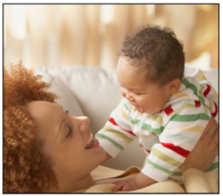
2. The “language” that is universal
父母语：一种通用语言
Parentese: a lingua franca

Slide 9

语篇填空
（《周刊报道》 2022年8月6日刊 15页）
Parentese – better ______ (know) as “baby talk” – may be the closest thing we have to a lingua franca (通用语), a new study has found. Researchers gathered and analysed recordings of 410 parents in ___________ (community) around the world – ranging from hunter-gatherers in Tanzania and farm workers in Poland __ city dwellers in China – and found that the ________ (tend) for adults to adopt a special voice for talking and singing to their babies is near ________ (universe); moreover, wherever you go, “baby talk” has similar traits. “We tend to speak in this higher pitch, high variability, like, ‘Ohh, heeelloo, you’re a baaybee!’ ” said study author Dr Courtney Hilton, of Yale University.
In __ separate strand of the research, the psychologists also found that adults can tell, with about 70% accuracy, when they are listening to “baby talk”, regardless ___ the language being spoken. _________, some versions of baby talk were more pronounced than others: the people of Wellington, in New Zealand, _________ (find) to coo to their babies in a __________ (particular) high pitch, making their “parentese” the easiest to distinguish from adult conversation.
known
communities
to
tendency
universal
a
of
However
were found
particularly

Slide 10
词汇讲解
1. trait: a particular quality in your personality （人的个性的）特征，特性
It’s a human trait to joke about subjects that make us uncomfortable. 开让人不适的玩笑是人类的一个特点。
2. strand: one of the different parts of an idea, a plan, a story, etc. （观点、计划、故事等的）部分，方面
The author draws the different strands of the plot together in the final chapter. 作者在最后一章把不同的情节线索归拢到了一起。
翻译句子
攻击性决不是男性独有的特征。
Aggression is by no means a male-only trait.
翻译句子
各派的政治观点我们都听到了。
We heard every strand of political opinion.

Slide 11
句子翻译
Researchers gathered and analysed recordings of 410 parents in communities around the world – ranging from hunter-gatherers in Tanzania and farm workers in Poland to city dwellers in China – and found that the tendency for adults to adopt a special voice for talking and singing to their babies is near universal.
研究人员收集并分析了来自世界各地社区的410位父母的录音——从坦桑尼亚的狩猎采集者、波兰的农场工人到中国的城市居民——他们发现，成年人用一种特殊的声音对他们的婴儿说话和唱歌的趋势几乎是普遍的。
翻译
In a separate strand of the research, the psychologists also found that adults can tell, with about 70% accuracy, when they are listening to “baby talk”, regardless of the language being spoken.
在另一项研究中，心理学家还发现，成年人在听“儿语 ”时，无论说的是什么语言，都能以约70%的准确率分辨出来。
翻译

Slide 12
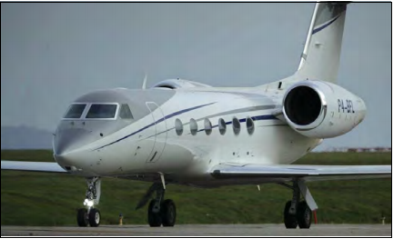
3. It’s time to ban private jets – or at least tax
them to the ground
私人飞机要征税?

Slide 13
语篇填空
（《卫报》2022年8月6日 17页）
In the last few decades, private jets ____________ (become) an increasing source of global flight emissions, while providing very little value for most humans on earth.
At the same time, the working class has carried the burden of daily sacrifices for the climate crisis, with the poorest of the global working class even _______(force) to flee their homes. It is time that we ____ (go) after the egregious lifestyles of the wealthy, and invest in public infrastructure _____ can fill the gaps and provide both the wealthy and the masses ____ fast and clean transportation.While private jet usage doesn’t rank as highly as an emission source as do, say, the beef industry or the American military, private jets feel ___________ (particular) pointless and tasteless – the kind of private carbon indulgence we ought to rid ourselves of on principle. While private jets for ________ (event) like climate summits may be somewhat justified, it is easy to assume that most other flights aren’t as vital ___ meetings about the future of the planet.
_________ (ban), restricting, or at least heavily taxing private jets is one basic, common sense step that a country can take in erasing the lines between how the __________ (wealth) and poorest of us will weather the crises ahead.
have become
forced
go
that
with
particularly
events
as
Banning
wealthiest

Slide 14
词汇讲解
1. egregious: shocking;extremely bad 令人震惊的；极糟的；极坏的
One particularly egregious case occurred in late 2008 in Pennsylvania.
2008年末宾夕法尼亚发生了一起特别令人震惊的案例。
2. weather: to come safely through a difficult period or experience 经受住，平安地渡过（困难）
The company just managed to weather the recession.
这家公司勉强渡过了衰退期。
翻译句子
这些问题在最盛产石油的尼日尔三角洲更加令人震惊。
These problems are most egregious in the oil-rich Niger Delta.
翻译句子
她拒绝辞职，想要经受住这次风暴的考验。
She refuses to resign, intending to weather the storm.

Slide 15
句子翻译
At the same time, the working class has carried the burden of daily sacrifices for the climate crisis, with the poorest of the global working class even forced to flee their homes.
与此同时，工人阶级每天都要为气候危机做出牺牲，全球最贫穷的工人阶级甚至被迫逃离家园。
翻译
While private jet usage doesn’t rank as highly as an emission source as do, say, the beef industry or the American military, private jets feel particularly pointless and tasteless – the kind of private carbon indulgence we ought to rid ourselves of on principle.
虽然私人飞机的使用不像牛肉工业或美国军队那样被列为排放源，但私人飞机让人感觉特别没有意义和无味——这是我们应该从原则上摆脱的私人碳嗜好。
翻译

Slide 16
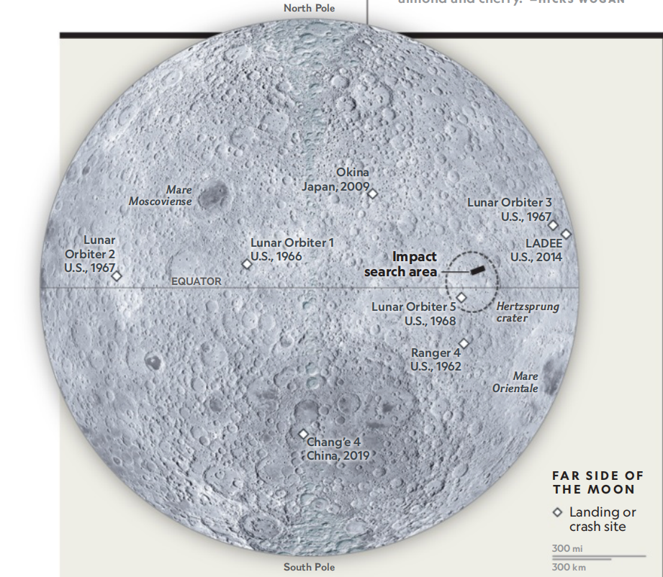
4. Lunar Trash Landing 太空垃圾撞击月球
A bus-size hunk of space junk hit our moon. Pinpointing the location is no small feat.

Slide 17

语篇填空
（《国家地理》2022年8月刊 23页）
Pow! When a wayward chunk of space junk slammed into the moon’s back side on March 4, it _________ (blow) to smithereens while adding a fresh crater to ___ already considerable collection. We know that much _______ space-watchers could track the errant rocket booster with enough precision to predict its final ______ (rest) place: Hertzsprung crater. But ________ (precise) where the space trash crashed in that 354-mile-wide pockmark wasn’t immediately clear. Of the few spacecraft circling the moon, one well suited to search—NASA’s Lunar Reconnaissance Orbiter—could take up to 12 months to find a new gouge ________ (estimate) to be between 16 and 98 feet wide. As lunar exploration revs up, experts see a need for better tracking of ______ (object) in deep space and regulations for disposing ___ used rocket parts. “At some point in the future, an event like this isn’t just going to be a curious thing _________ (observe),” says space archaeologist Alice Gorman of Australia’s Flinders University. “It’s going to be something ____ people in lunar orbit or on the surface of the moon are going to be really worried about.”
was blown
an
because
resting
precisely
estimated
objects
of
to observe
that

Slide 18
词汇讲解
1. wayward: difficult to control 难以控制的；任性的；倔强的
They are wayward children with a history of severe emotional problems.
他们是出现过严重情绪问题的任性的孩子。
2. rev up: If you rev something up, or if it revs up, it becomes more intense or more active. (使)更激烈；(使)更活跃
The temptation to rev up the arms race with high-tech weapons is especially dangerous.
通过研发高科技武器加速军备竞赛的诱惑尤其危险。
翻译句子
他年青、任性，但骨子里是个好人。
He’s young, very wayward, but he’s a good man underneath.
翻译句子
现在他准备通过开展地区性的媒体活动加大宣传力度。
Now he plans to rev up publicity with a regional media campaign.

Slide 19
句子翻译
When a wayward chunk of space junk slammed into the moon’s back side on March 4, it was blown to smithereens while adding a fresh crater to an already considerable collection.
3月4日，当一块任性的太空垃圾猛烈撞击月球背面时，它被炸成碎片，同时在已经规模庞大的陨石坑阵中增加了一个新的坑。
翻译
Of the few spacecraft circling the moon, one well suited to search—NASA’s Lunar Reconnaissance Orbiter—could take up to 12 months to find a new gouge estimated to be between 16 and 98 feet wide.
在少数环绕月球的航天器中，一个非常适合搜索任务的航天器——美国宇航局的月球勘测轨道器——可能需要长达12个月的时间才能找到一个大约6到98英尺宽的新坑。
翻译

Slide 20
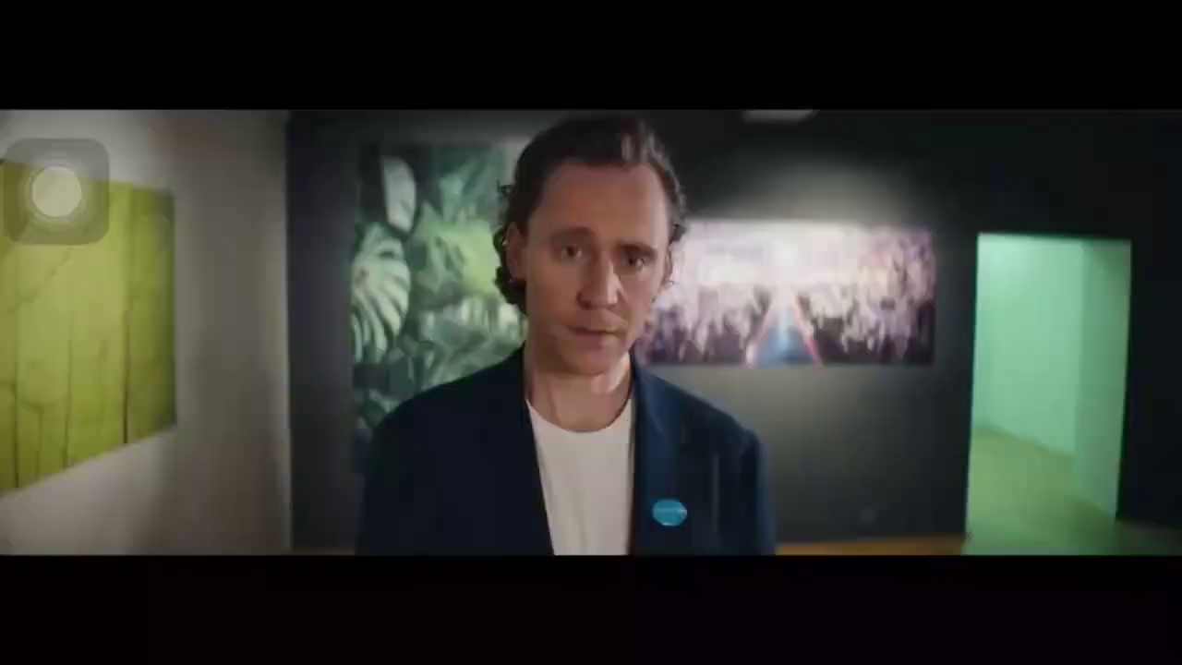
5. Accelerating Change with UNICEF: Take A Breath
抖森联合国儿童基金会宣传片

Slide 21

听力填空
Take a breath. That’s where it all starts. From our very first to our _______. “Two billion children are currently affected by ___________.” Air is life and must be protected for our children. It powers their ________, their hopes and their dreams. How important this thing we cannot see. But as pollution levels rise and spike, it’s our children that will pay the greatest _____. With every breath, their future is affected. And it’s _______ to protect it. Take a single idea alone, grown, from the air we breathe into a _____ of a cleaner World. “The climate crisis is a child’s rights crisis.” We enter a time where futures can’t be determined by the past. Where every breath is as important as the last. In this moment, we will inspire and ________. Releasing the minds of the next generation. _______ creation and innovation. Acceleration towards _____________. That idea, that spark of cleaner air for every child. All starts with a breath.
I’m Tom Hiddleston, UNICEF ambassador. Formula E is supporting UNICEF’s environmental work. Together, we’re ______ better futures for every child. Please follow the link to find out more.
very last
air pollution
ambitions
price
up to us
vision
empower
Igniting
positive change
driving

Slide 22
词汇讲解
1. spike: (especially North American English) to rise quickly and reach a high value 迅速升值；急剧增值
Traffic to the website spiked after the scandal broke.
丑闻爆发后，该网站的访问量猛增。
2. acceleration: an increase in how fast sth happens 加速；加快
an acceleration in the rate of economic growth 经济增长加速
翻译句子
美元猛然升值到三个月来的最高价。
The US dollar spiked to a three-month high.
翻译句子
他同时呼吁加快政治改革的步伐。
He has also called for an acceleration of political reforms.

