Slide 1

感恩遇见，相互成就，本课件资料仅供您个人参考、教学使用，严禁自行在网络传播，违者依知识产权法追究法律责任。
更多教学资源请关注
公众号：溯恩高中英语
知识产权声明

Slide 2


希君生羽翼，一化北溟鱼
2022年秋季
开
学
第
一
课
杭州二中树兰高级中学 郭合英

Slide 3


contents
1
New term New goal 新学期新目标
2
The power of examples 榜样的力量
3
The stronger the youths are ,the stronger the nation will be 少年强则国强
4
Set-off in time 扬帆启航正当时

Slide 4
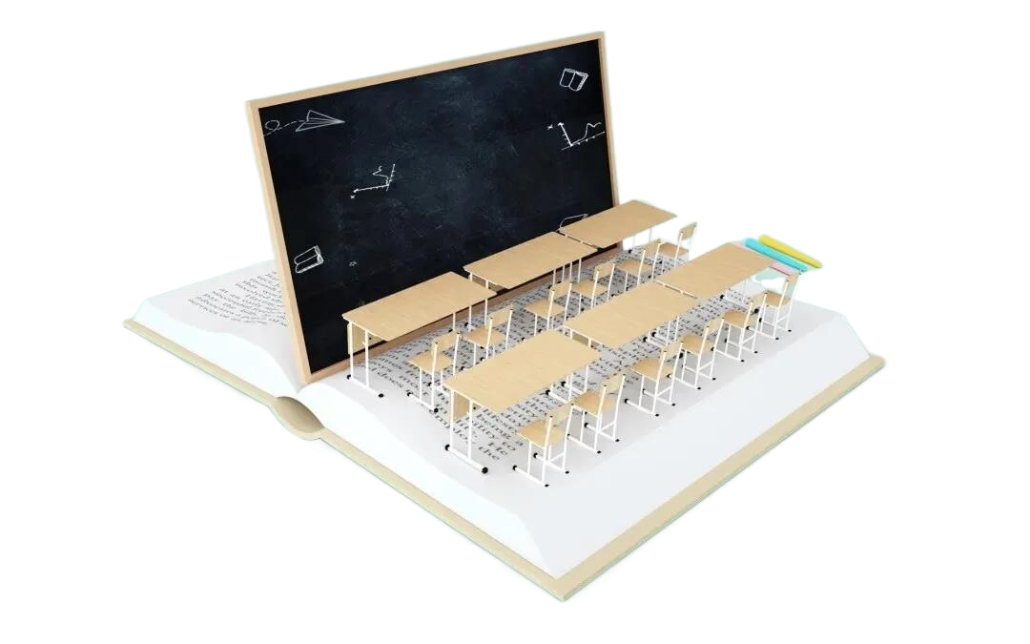


1. New term New goal

Slide 5


Slide 6
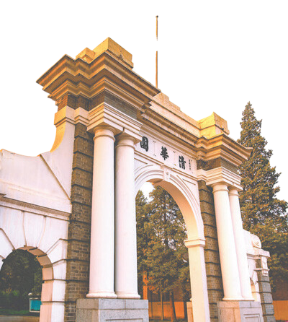
Located in the northwestern suburbs of Beijing, Tsinghua University was established in 1911. Tsinghua University is one of the state "Project 211" universities, which is also the one _______________________
_______________________________ _ . (无数学子梦寐以求的大学)
The university's motto of " " (in chinese ) has inspired many generations of Tsinghua teachers and students to struggle for the prosperity of China.
which countless students
long for / yearn for / look forward to
Self-discipline and Social Commitment
(自强不息、厚德载物)
Striving to build Tsinghua University into a world-class university has become _____________ of each member of the teaching staff and the student body.
Tsinghua University has its own objective, what about yours?
the objective

Slide 7
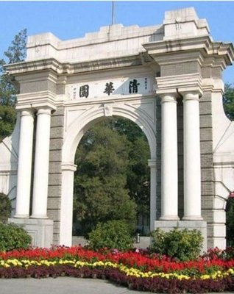

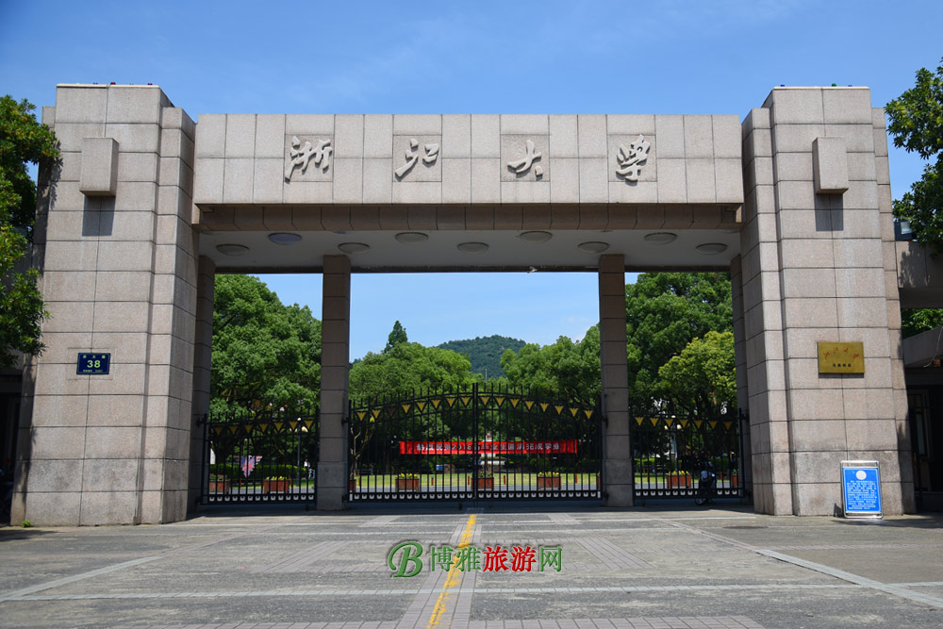
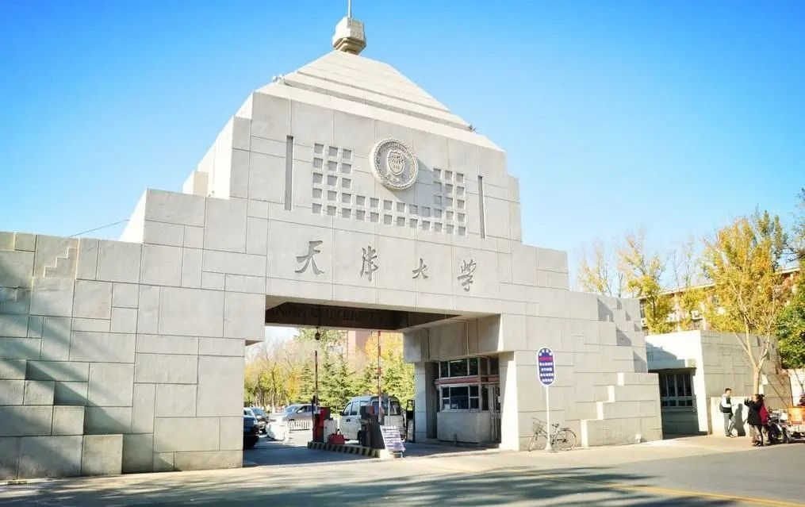
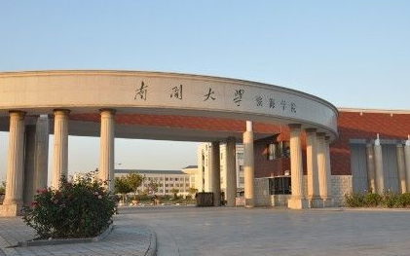
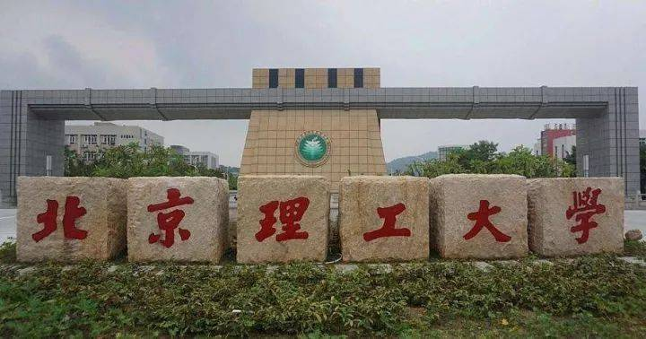
Which university is your goal ?

Slide 8
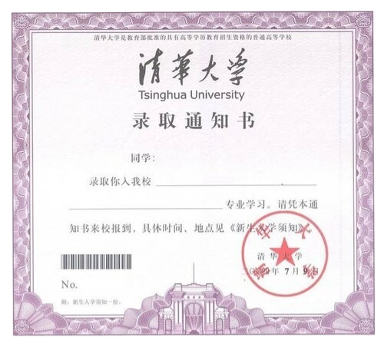

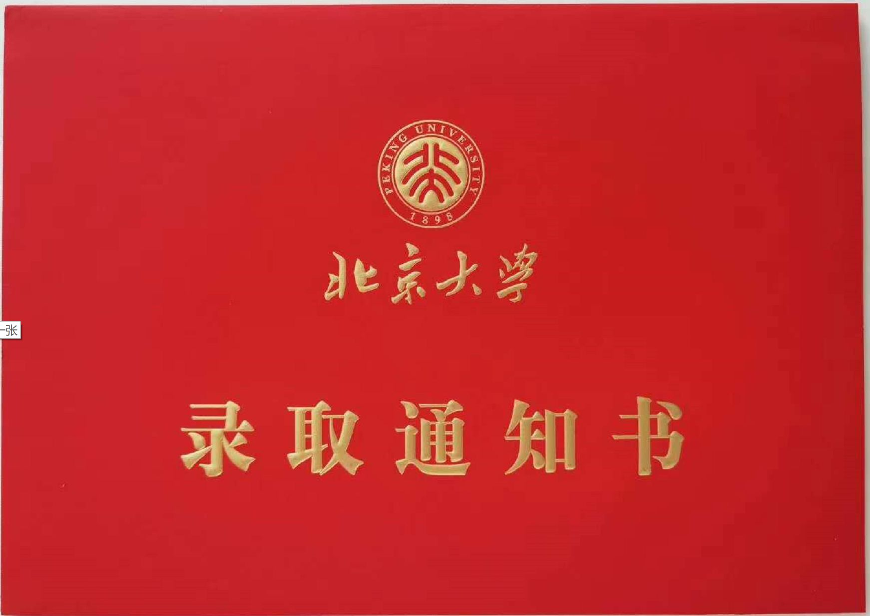
Would you like to receive such a admission letter from some (某一) university?
Discuss
If you want to be admitted to your ideal university, what should you do from now on?
settle down to your studies (收心)
work out your plan
制定计划
show willpower
（需要毅力）
challenge difficulties
(挑战困难)

Slide 9
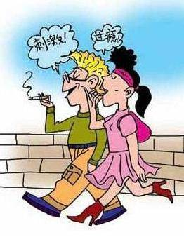

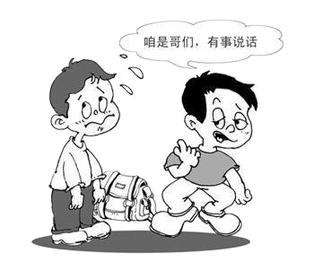
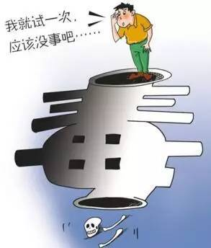
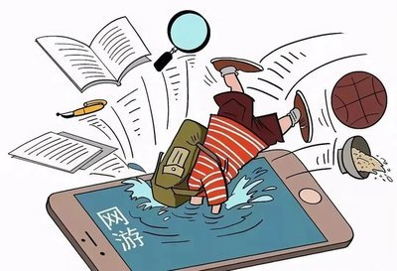
settle down to your studies (收心)
It’s time for you to reject all bad habits and temptations and focus your attention on study.

Slide 10
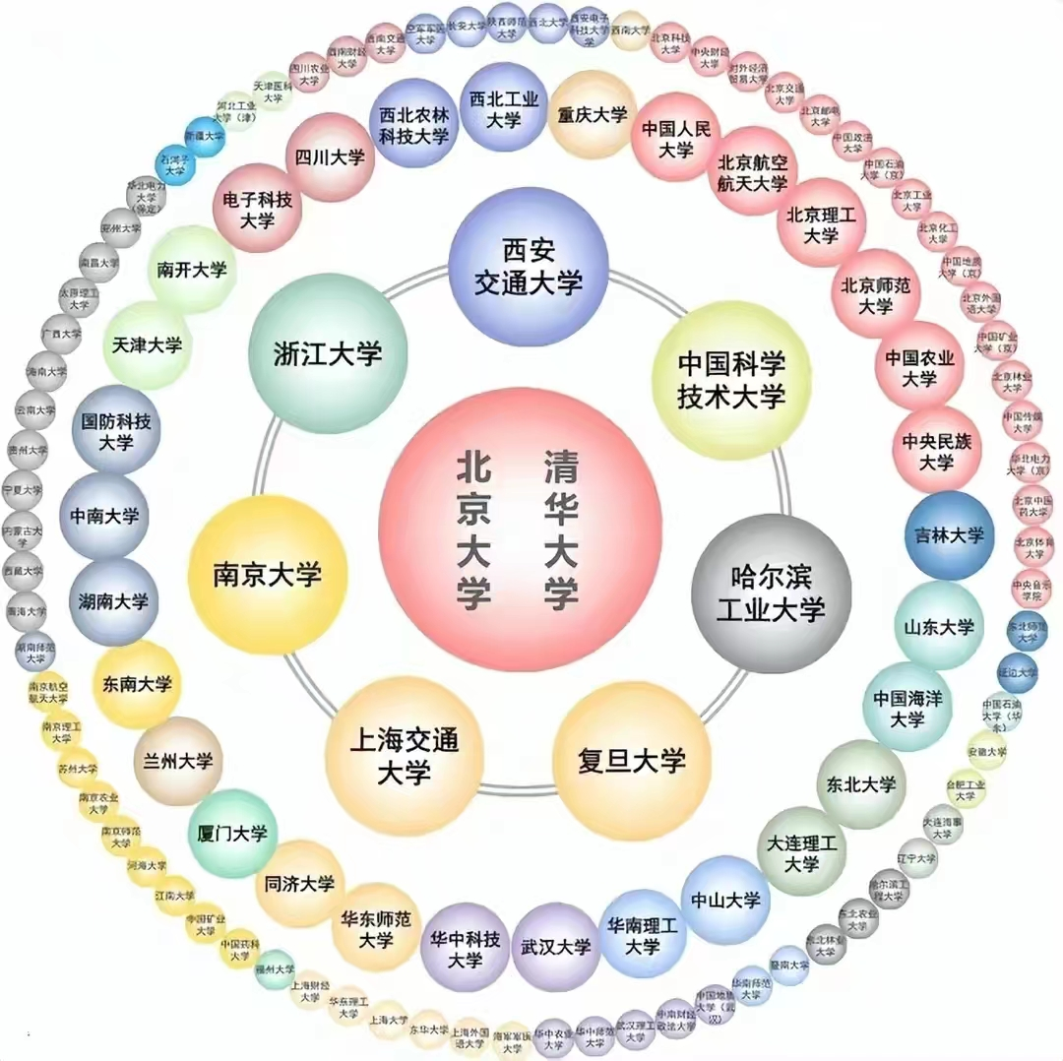
work out your plan (制定计划)
“985 Project”, announced by Chinese President Jiang Zemin at the 100th anniversary of Peking University on May 4, 1998, is a project aimed at increasing the development speed and gaining more reputation for China’s universities. Through the 985 project, China demonstrated its ambition to build world-class universities in the 21st century.
“211 Project“ was initiated in 1995 by the Ministry of Education of the People's Republic of China, it is a project aimed at enhancing research standards of high-level universities and cultivating strategies for socio-economic development. So far, China has more than 118 institutions of higher education that were designated as 211 Project institutions.
What is 211 and 985 ?
If you want to be admittd to a university of and
, you need to get ; To enter , and you need to get in the college entrance examination.
Project 211
Project 985
135+
a key university
125+

Slide 11

Discuss: How to learn English?
Preview: Preview your lesson before each class.
Review after class: Review what you have learned in class in time.
methods
Listen more: Listen to English songs, English tapes, or pick up English programme on the radio.
Read more: Read different material, especially foreign articles to build up authentic English, paving a way for writing.
Write more: Don’t be afraid of writing, and you should form a good habit of writing. Do remember: Practice makes perfect!

Slide 12

How to achieve your ambitious goal?
A | B | C | D | E | F | G | H | I | J | K | L | M | N | O | P | Q | R | S | T | U | V | W | X | Y | Z
1 | 2 | 3 | 4 | 5 | 6 | 7 | 8 | 9 | 10 | 11 | 12 | 13 | 14 | 15 | 16 | 17 | 18 | 19 | 20 | 21 | 22 | 23 | 24 | 25 | 26
If the letter is equal to the following number, the word “attitude = ?”
=
attitude
1+20+20+9+20+21+4+5 =
100
Attitude is everything!
It is that makes our goal 100%!
our attitude to study

Slide 13
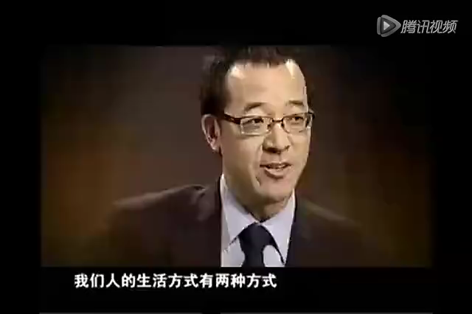

Slide 14
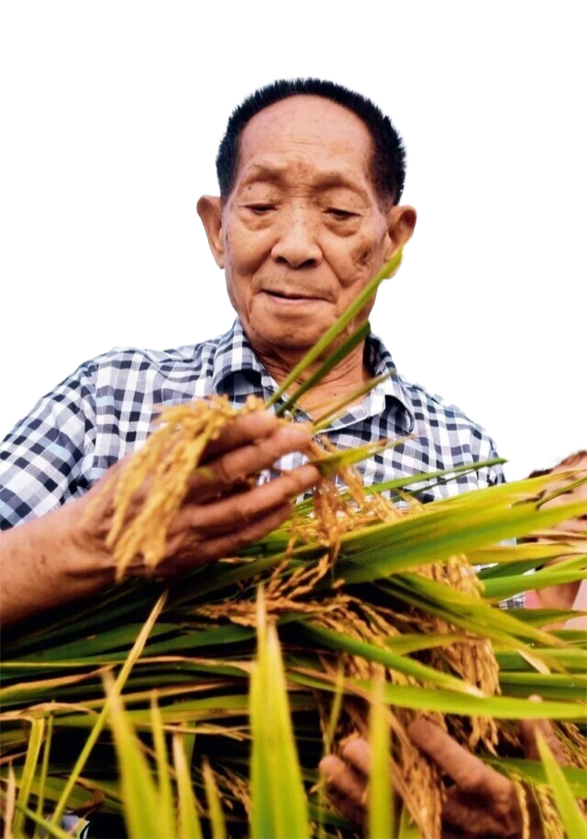

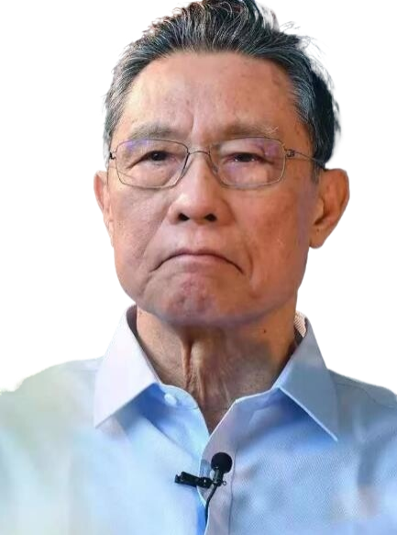
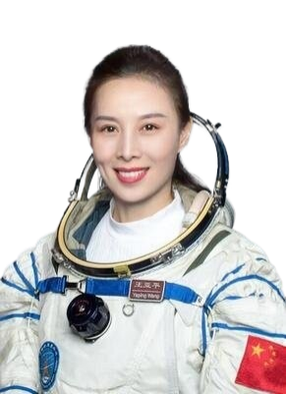
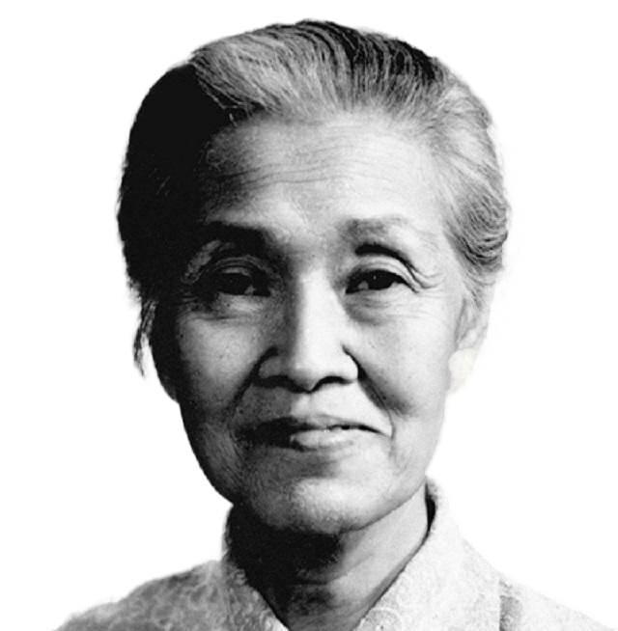
2. The power of examples 榜样的力量

Slide 15

The power of examples
Sow a thought reap an act, sow an action reap a habit,sow a habit reap a character,sow a character, reap a destiny. Through the spread of a model, we can always see the targets of struggle and reference. Example is an upward force, is a mirror, is a flag.
榜样的力量
播撒一种思想收获一种行为,播撒一种行为收获一种习惯,播撒一种习惯收获一种性格,播撒一种性格收获一种命运。散播一种榜样,我们能够时时看到奋斗的目标和参照物.榜样是一种向上的力量,是一面镜子,是一面旗帜。

Slide 16
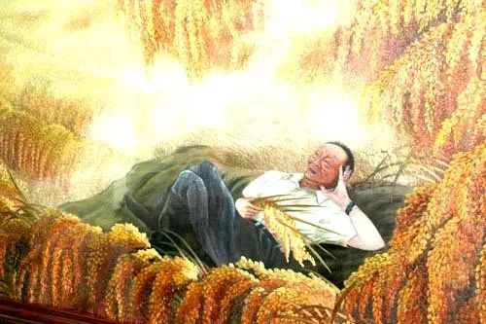
Who is the man?
Yuan Longping, the father of hybrid rice.
What is his two dreams?
1. To enjoy the cool under the rice crops taller than men.
2. Hybrid rice could be grown all over the world to help solve the global
food scarcity.
China now feeds around 20 percent of the world's population with less than 9 percent of the world's arable land.
中国现在用全球不到9%的耕地养活全世界约20%的人口。

Slide 17
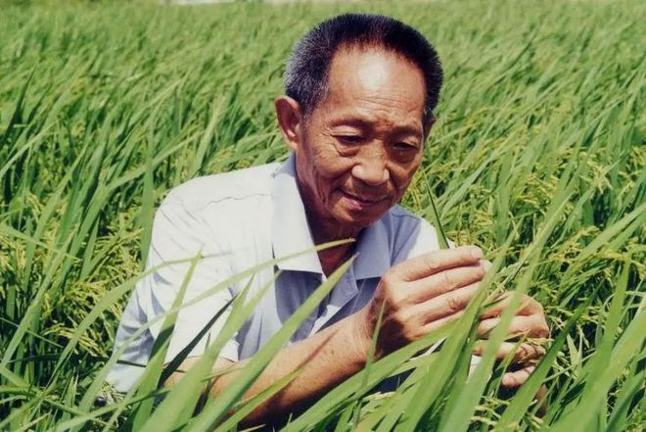
What is Yuan’s secret to success?
“There’s no secret to it; my experience can be summed in four words: knowledge, sweat, inspiration and opportunity,” Mr. Yuan said in a video message encouraging young Chinese to go into science. In English, he quoted the scientist Louis Pasteur: “ Chance favors the prepared mind.”
Mr Yuan’s reaearch made him a national hero and a symbol of dogged scientific pursuit in China. His discoveries in hybrid rice cultivation helped create the Green Revolution of steeply rising harvests and an end to famine in most of the world.

Slide 18

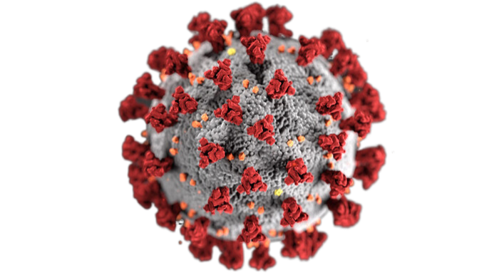
Who is the man?
Zhong Nanshan, a state scholar of no equal.
(国士无双)
Zhong first came to international attention in 2003 when he led efforts against Sars. He was awarded one of the top ten people moving China in 2004.
2003年，钟南山第一次引起国际关注，当时他领导抗击非典。2004年，他被评为“感动中国2003年度”十大人物之一。
The outbreak of the novel coronavirus in Wuhan in December 2019, Zhong Nanshan, 84 years old, led his team to fight the illness.

Slide 19
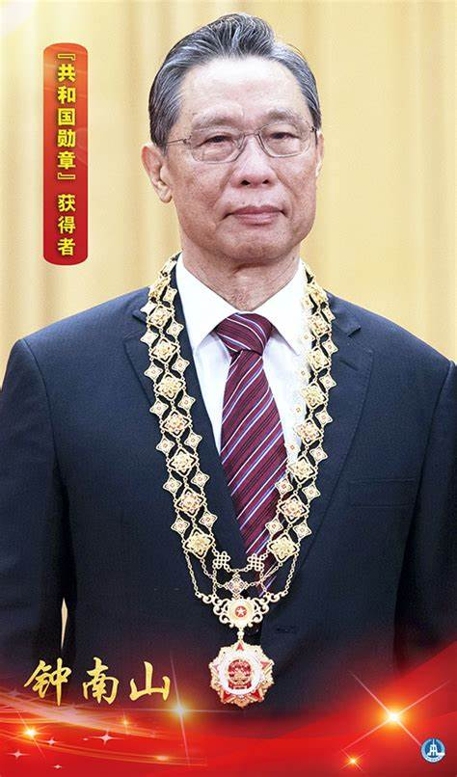
In September, 2020, the Medal of the Republic （共和国勋章）was conferred on renowned respiratory disease expert Zhong Nanshan due to his contribution to the treatment of the coronavirus。
【相关词汇】
病毒携带者 virus carrier
无症状携带者 asymptomatic carrier
超级传播者 super spreader
治愈率 recovery rate
传染性 transmissibility; infectivity
致病性 pathogenicity
输入病例 imported cases
出入境防疫 epidemic prevention at borders
防范疫情跨境传播 curb the cross-border spread of the epidemic

Slide 20
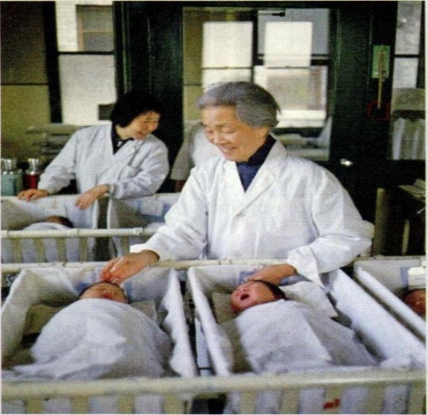
“Life is precious. ... To a person nothing is more precious than their life, and if they entrust me with that life, how could I refuse that trust, saying I’m cold, hungry, or tired?”
-----Lin Qiaozhi
She responded, “I’d rather stay single to study all my life!” she also said, “As doctors, we should be respinsible for the patients and treat them as our sisters.”
Through Lin never married, she was known as the “Mother of ten thousand babies”, having delivered over 50,000 babies in her lifetime.
From what she said, what was Dr Lin’s main life pursuit ?
She always put others first.
“Why should girls learn so much, Finding a good husband should be their final goal! ” her brother complained.
Did Lin give up? How did she make her choice?

Slide 21
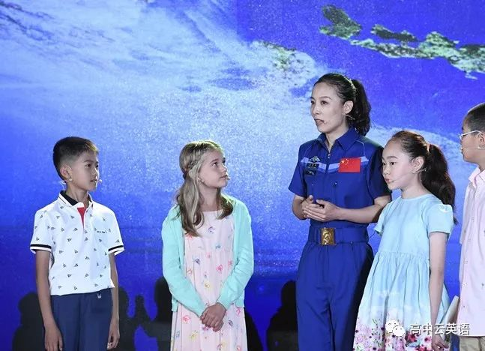
Wang Yaping, 41, has become China's first female astronaut to conduct a spacewalk, and China's second female astronaut to go to space.
In June 2013, Wang and her two other crewmates, Nie Haisheng and Zhang Xiaoguang, were sent to space aboard Shenzhou-10. She gave a lecture about space during the mission via live broadcast, a first for China, reaching and inspiring millions of school children across the country.

Slide 22
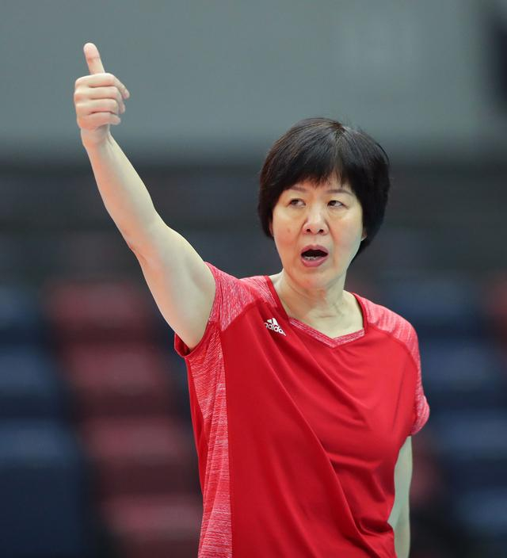
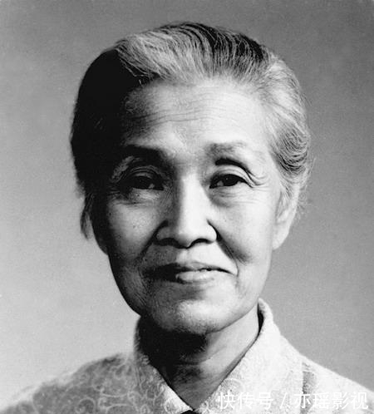
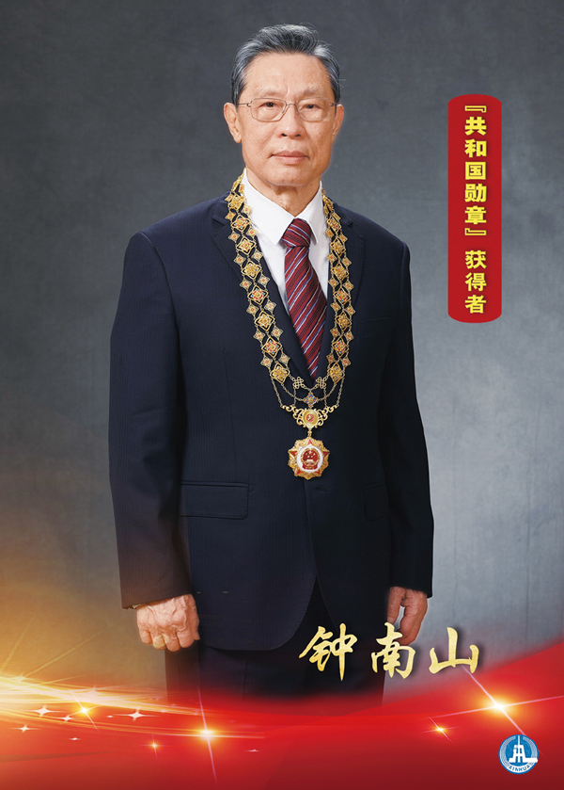
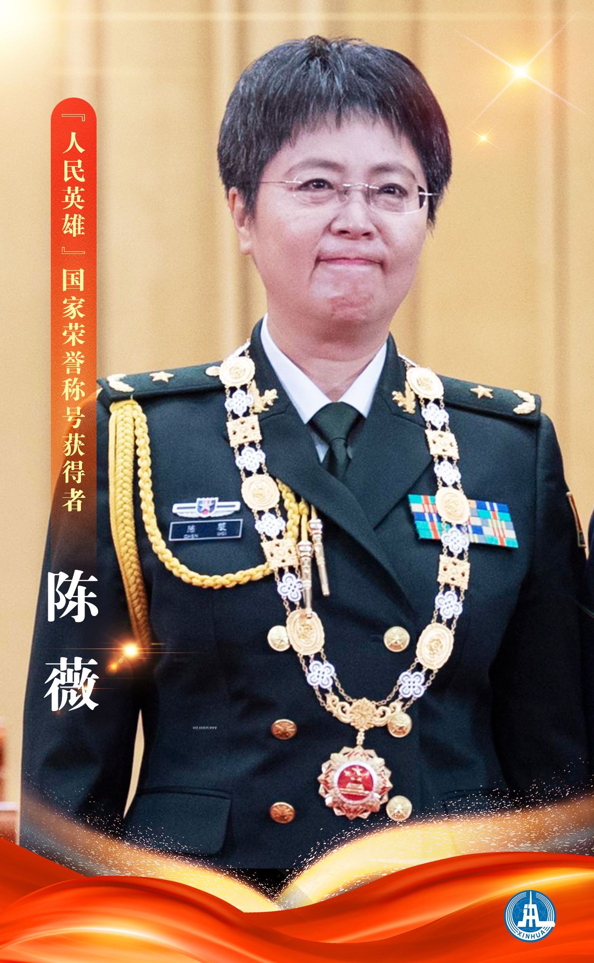
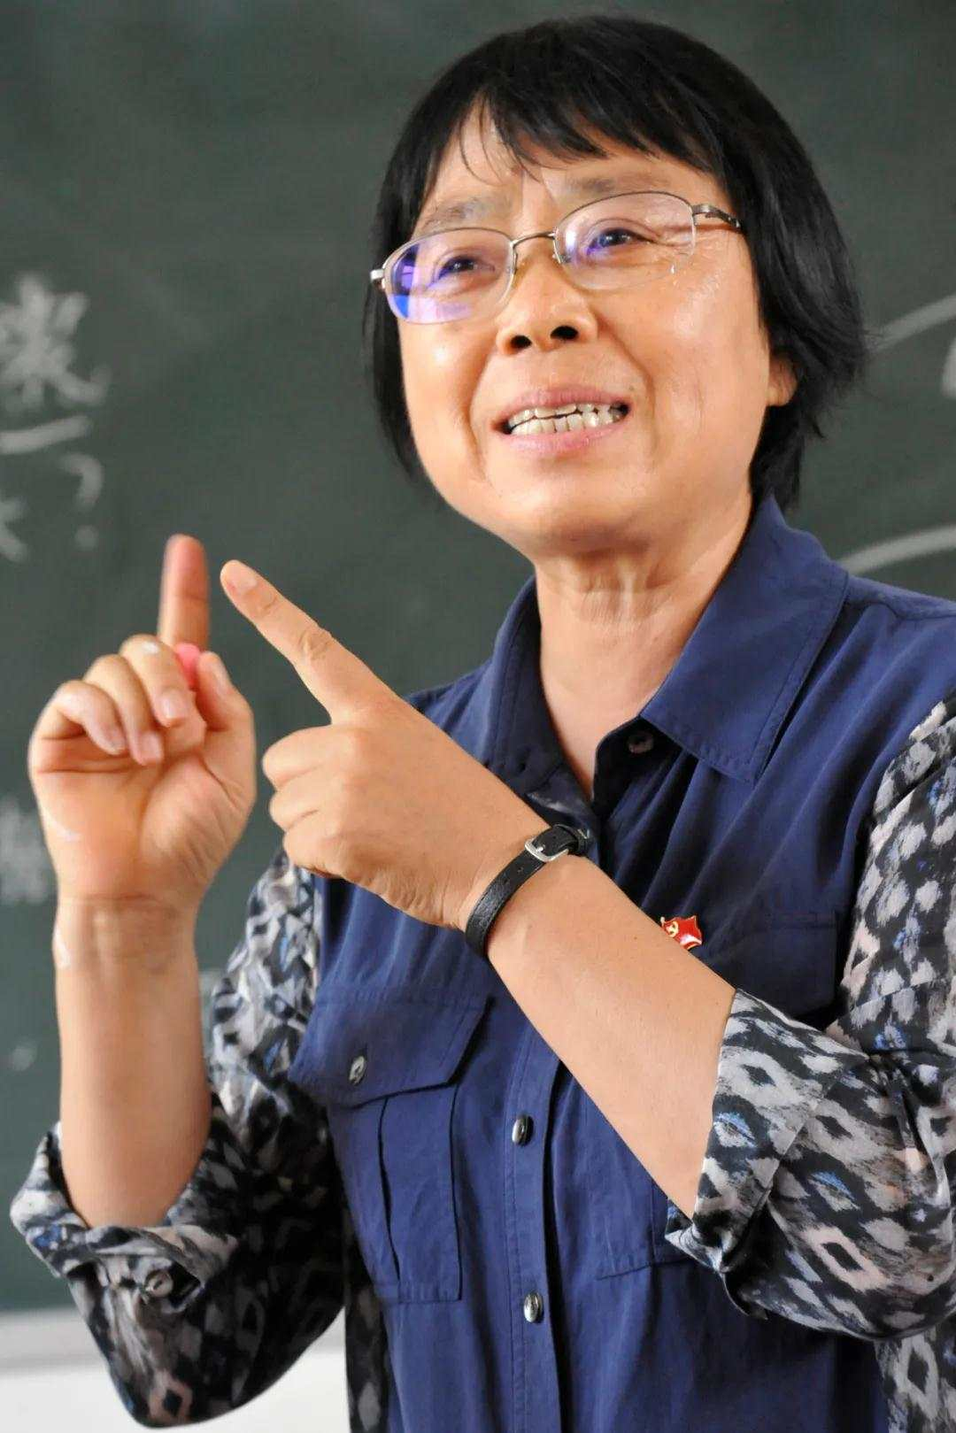
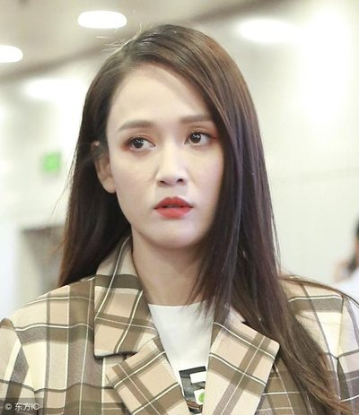




Discuss: Who is your idol? Why?

Slide 23

3. The stronger the youths are ,the stronger the nation will be 少年强则国强

Slide 24
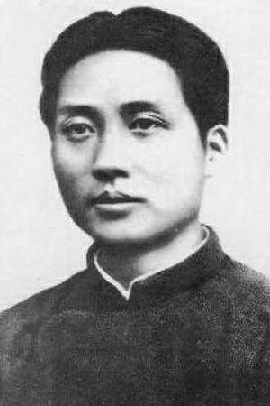
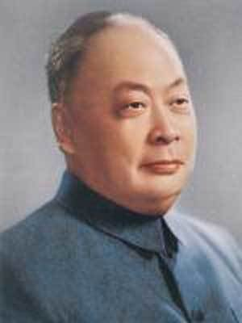
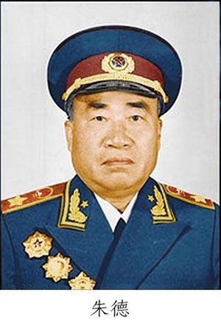


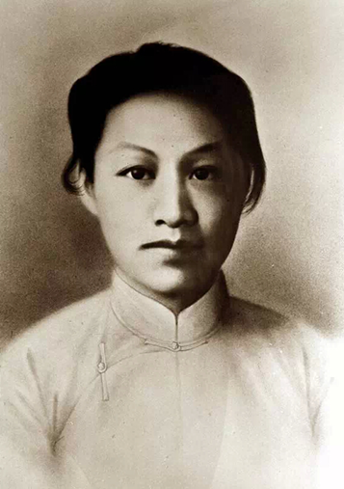
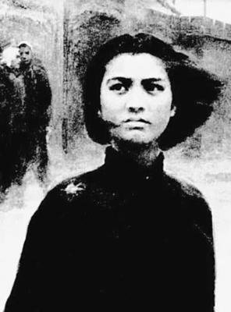
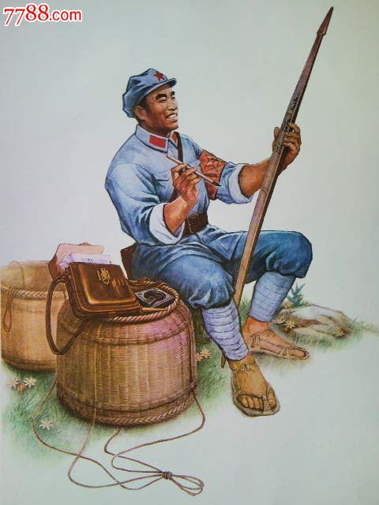
Our happy life today is what countless revolutionary martyrs have paid for with their blood and lives
董存瑞
毛泽东
陈毅
赵一曼
刘胡兰

Slide 25
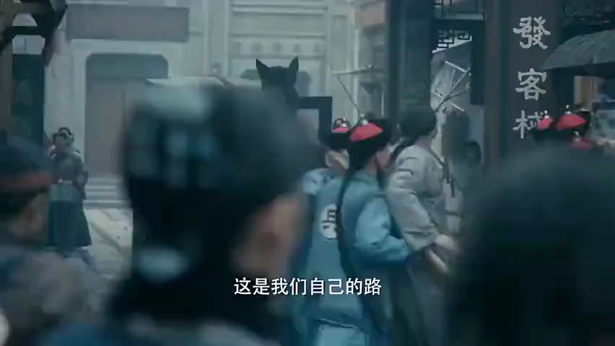

Slide 26
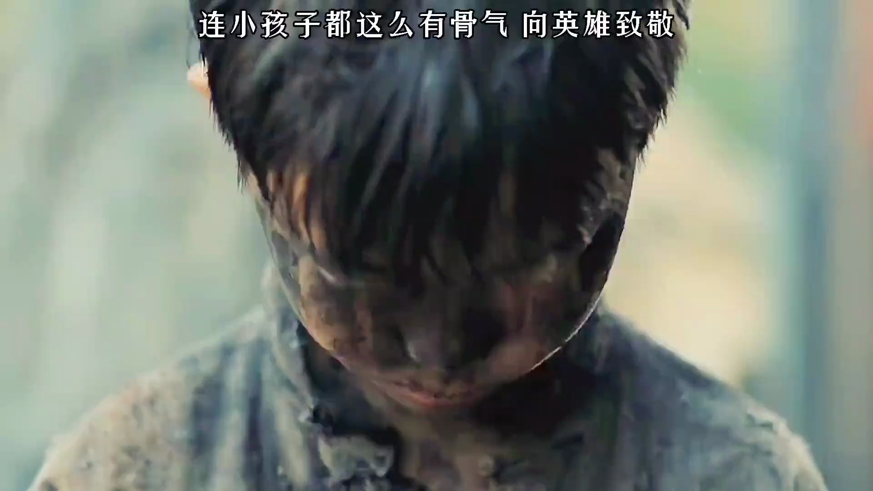

Slide 27
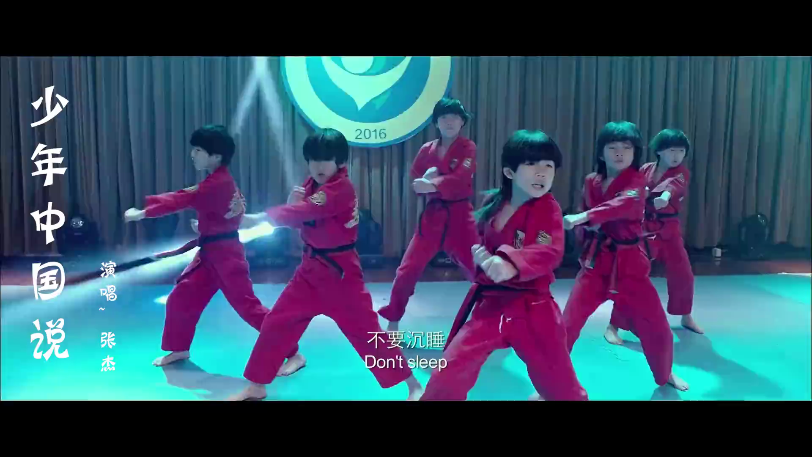

Slide 28


Slide 29
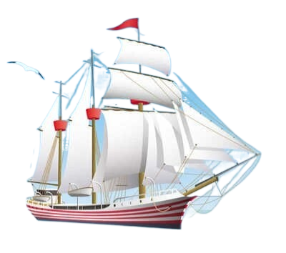
4. Set-off in time
杨帆启航正当时
扬帆起航
筑梦前行

Slide 30
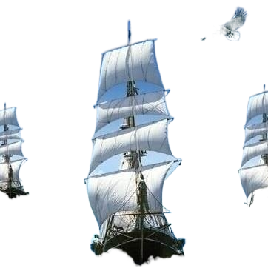

With your goal set in the new term,
With the examples admired by yourself,
It’s time for you to set off.
Are you ready? Let’s go!

Slide 31

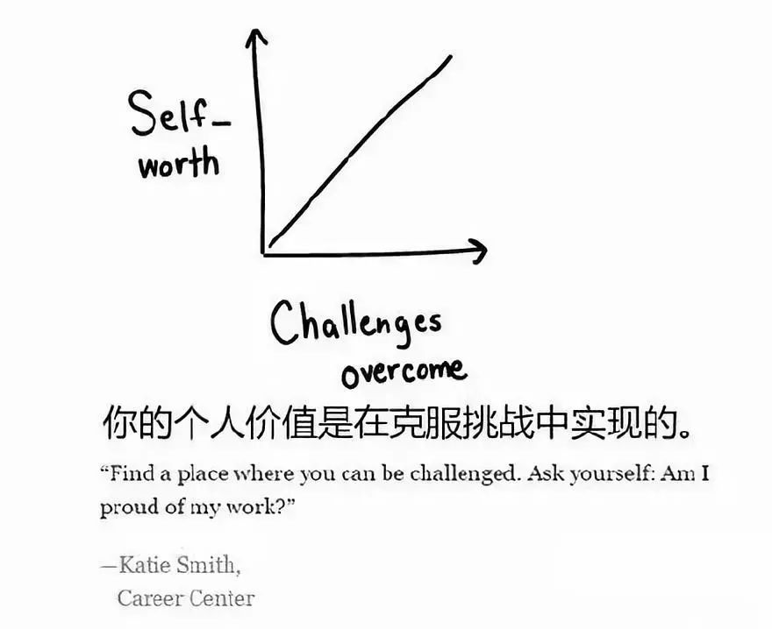
The journey to success is not smooth. It is full of challenges and difficulties. We should be brave to face them. As long as we don’t give up hope and make an effort to overcome all the difficulties, we will surely achieve our goal in time.

Slide 32


Enjoy an ancient Chinese poem
《江夏使君叔席上赠史郎中》
唐 李白
凤凰丹禁里，衔出紫泥书。
昔放三湘去，今还万死馀。
仙郎久为别，客舍问何如。
涸辙思流水，浮云失旧居。
多惭华省贵，不以逐臣疏。
复如竹林下，叨陪芳宴初。
希君生羽翼，一化北溟鱼。

Slide 33
“希君生羽翼，一化北溟鱼”怎么理解？
意思是：希望你长出翅膀一化做前程远大的北溟鱼。
但是，随着时间流逝，人们在用李白这两句诗时，已经有所变通，不再严格按照原意，而是用变通之意——把两者合二为一，变成对一个人的祝福和勉励，即由原来的“希君生羽翼，（助我）一化北溟鱼”，变为“希君生羽翼，（希君）一化北溟鱼”。
翻译成白话文，就是：
希望你能化为海里的鲲鱼，长出翅膀，然后乘风而起，抟摇直上九万里。

Slide 34
Wish every student
希君生羽翼, 一化北溟鱼

Slide 35
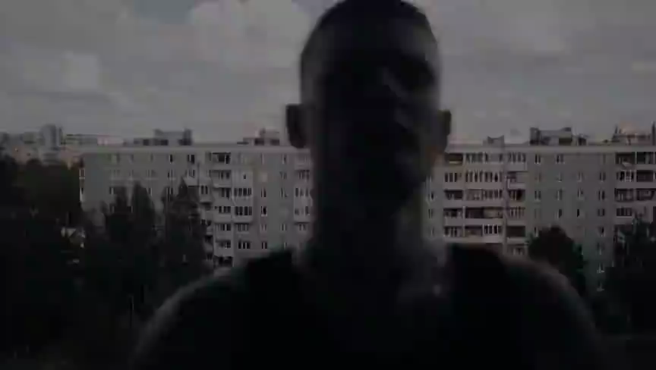

Slide 36

The future you must thank to the present hard working one.
将来的你，一定会感谢现在拼命努力的你！

Slide 37


