Slide 1

感恩遇见，相互成就，本课件资料仅供您个人参考、教学使用，严禁自行在网络传播，违者依知识产权法追究法律责任。
更多教学资源请关注
公众号：溯恩高中英语
知识产权声明

Slide 2



Z20名校联盟
2022年8月高三第一次联考
读后续写讲评

Slide 3

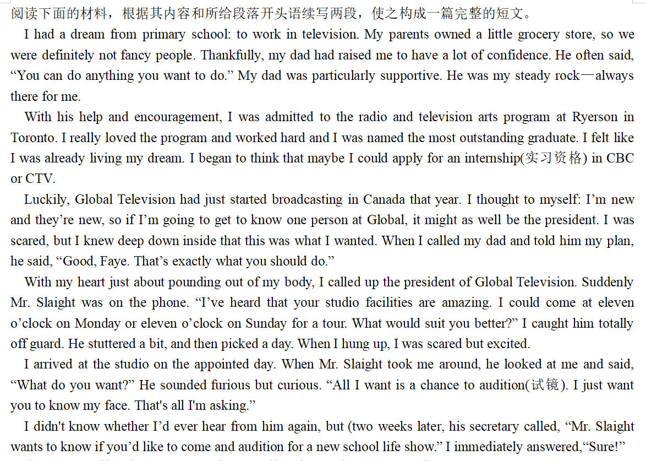

Analysis of the Plots
Background
①
②
③
④
Plots
⑤
⑥

Slide 4
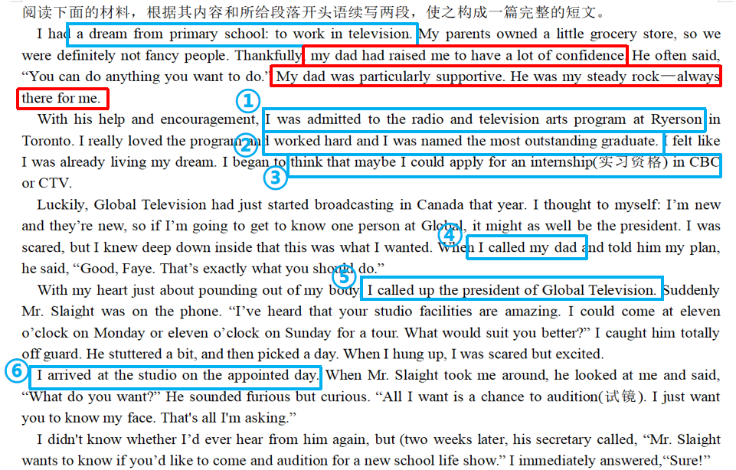
Analysis of the Emotion
Change
confident
scared but eager
scared but daring
scared but
excited and hopeful

Slide 5
Personality
Analysis of the foreshadowing
I had a dream from primary school: to work in television. My parents owned a little grocery store, so we were definitely not fancy people. Thankfully, my dad had raised me to have a lot of confidence. He often said, “You can do anything you want to do.” My dad was particularly supportive. He was my steady rock—always there for me. With his help and encouragement, I was admitted to the radio and television arts program at Ryerson in Toronto. I really loved the program and worked hard and I was named the most outstanding graduate. I felt like I was already living my dream. I began to think that maybe I could apply for an internship(实习资格) in CBC or CTV.
Luckily, Global Television had just started broadcasting in Canada that year. I thought to myself: I’m new and they’re new, so if I’m going to get to know one person at Global, it might as well be the president. I was scared, but I knew deep down inside that this was what I wanted. When I called my dad and told him my plan, he said, “Good, Faye. That’s exactly what you should do.”
伏笔1
伏笔2
persistent
perseverant
confident
daring/bold
伏笔3

Slide 6

Analysis of the foreshadowing
With my heart just about pounding out of my body, I called up the president of Global Television. Suddenly Mr. Slaight was on the phone. “I’ve heard that your studio facilities are amazing. I could come at eleven o’clock on Monday or eleven o’clock on Sunday for a tour. What would suit you better?” I caught him totally off guard. He stuttered a bit, and then picked a day. When I hung up, I was scared but excited.
I arrived at the studio on the appointed day. When Mr. Slaight took me around, he looked at me and said, “What do you want?” He sounded furious but curious. “All I want is a chance to audition(试镜). I just want you to know my face. That's all I'm asking.”
I didn't know whether I’d ever hear from him again, but (two weeks later, his secretary called, “Mr. Slaight wants to know if you’d like to come and audition for a new school life show.” I immediately answered,“Sure!”
伏笔4
confident
daring/bold

Slide 7
Clarifying Plots and Theme
Climax
I called up the president of Global Television and visited the studio.
I got the chance of audition and ...
confident
daring/bold
I began to think of applying for an internship in CBC or CTV and called up my dad for advice.
Theme
father’s support
I worked hard and was named the most outstanding graduate.
Rising action
?
my steady rock
Falling action
I was admitted to the radio and television arts program ...
confident
I had a dream from primary school to work in television.
persistent
perseverant
Ending
Setting
Story mountain

Slide 8
Analysis of the Plot Development
confident and daring/bold
Paragraph 1:
When I arrived at the station, I went direct into the audition and began my short performance. __________________________________________________________
_____________________________________________________________________
_____________________________________________________________________
Paragraph 2:
Finally came the day of my first public appearance on live TV with my parents at home watching. ________________________________________________________
_____________________________________________________________________
_____________________________________________________________________
Q.1 What about my performance while I was auditioning?
Q.2 Did I get the internship in Global Television?
Q.3 How did my parents and I feel?
proud but nervous
Q.1 How did I feel?
Q.2 How was my first appearance on live TV going on?
Q.3 What’s the result?
Tip：适时加入危机冲突（conflict）推动情节发展，注意首尾呼应，升华主题。

Slide 9
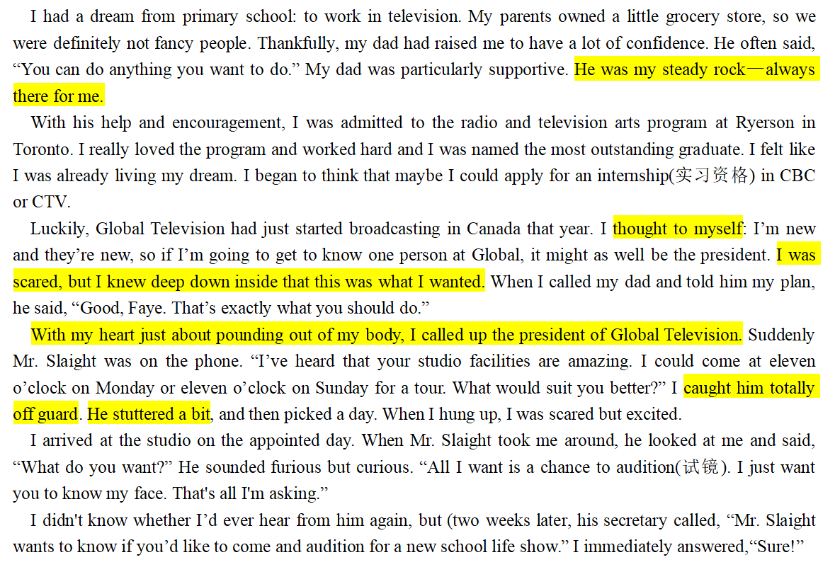
Analysis of the Language
1. He was my steady rock. 他是我坚强的后盾
2. think to myself 自言自语
3. I was scared, but I knew deep down inside that this was what I wanted.
我很害怕，但我内心深处知道这就是我想要的。
4. With my heart just about pounding out of my body, ...
我的心就快跳出来了，......
5. catch him totally off guard 让他放松警惕，猝不及防
6. He stuttered a bit. 他有点结巴。
metaphor
contrast
Exaggeration

Slide 10

Accumulation of Language
害怕紧张
直接描写：scared, nervous, anxious, full of anxiety, grow increasingly worried
神态和动作: Frowning at sb, she nervously backed away.
With a worried look on one’s face, ...
With his heart beating wildly and his legs trembling, ....
..., his face white and his hands sweaty
With butterflies in my stomach, I took a deep breath.
A flood of tension welled up in her.
Nervousness flooded over her.
So nervous was she that she felt her throat tight and
her palms sweating.

Slide 11
Accumulation of Language
自信大胆
直接描写：confident, self-assured, daring, bold, full of confidence
feel comfortable in one's own skin
pride oneself on something
神态和动作: He standing there without turning an eyelash/without batting an eyelid.
With eyes shining and head holding high, he strode onto the stage.

Slide 12
Accumulation of Language
开心兴奋
直接描写：delighted, thrilled, overjoyed, full of happiness, pleased beyond description
神态和动作: Tears of joy welled up in his eyes.
He could hardly wait to ..., eyes twinkling and face glowing with delight.
A trace of joy can be obviously noticed in his voice.
She was overflowing with happiness/excitement.
She tried to contain her excitement, but the glittering tears failed her.
环境：The air was filled with laughter, everyone was in the best of moods.

Slide 13
Accumulation of Language
主题升华
1. 毫不夸张地说，正式父亲的爱一路支持我成为一名杰出的演员。
It was literally dad’s love that supported me along my way to be an outstanding actor.
2. 就在那一刻，我感到真的很幸运父亲的爱和支持一直沐浴着我，陪伴着我度过艰难时期。
At that moment, I felt really blessed that my father’s love and support were always showered on me and stayed with me through hard times.
3. 沉浸在极度的喜悦中，好像父亲面带慈祥的微笑就站在那儿，我突然意识到若没有父亲的爱和鼓励，我不会走那么远。
Bathed in extreme joy, seemingly father with a kind smile standing there, I was aware that without father’s love and encouragement,
I wouldn’t have gone so far.

Slide 14
Samples from teachers
Paragraph1
When I arrived at the station, I went direct into the audition and began my short performance. Nervous as I was, I clearly feel it in my bones that the audition was sure to be a success. Standing there, even without turning an eyelash, I finished the performance smoothly. As I had expected, the intern job, a school life show, was assigned to me. There would be my first public appearance on TV in five days. Hearing the thrilling news, my parents were overflowing with happiness and couldn’t wait to watch my performance. To live up to their expectations, I worked around the clock, trying to give a perfect performce.

Slide 15
Samples from teachers
Paragraph 2
Finally came the day of my first public appearance on live TV with my parents at home watching. Feeling fully prepared, with eyes shining and head up high, I strode onto the stage. Seeing so many audience sitting in neat rows, I felt extremely proud but instantly it was replaced by a flood of tension. My palms sweating and my legs trembling, my mind went blank almost at once. It seemed that I totally forgot my lines. “You can do anything you want to do.” a voice ringing in my ears, picturing my father smile a little smile, I felt myself again and made up for the clumsy moment with a joke. As a thunder of applause split the air, the show ended perfectly. At that moment, I felt really blessed that my father’s love and support were always showered on me and stayed with me through hard times.

Slide 16
Samples from teachers
Paragraph1
When I arrived at the station, I went direct into the audition and began my short performance. Mr. Slaight sat on the chair waiting for me with several staffs busy with the setting. Confident and courageous, I began my performance. Having practicing for many times, all the movements and lines were carved in my mind firmly. Focusing on the stage, I could show all my passion smoothly without any distraction. I was totally satisfied with my audition and prepared to accept the praise. However, nobody applauded. Rising from the seat, Mr. Slaight went out of the room directly with a poker face. Numb with terror, I began to feel flurried. Pacing back and forth in the aisle for a while, I was told that I got the chance. Feeling a sense of relief, I rushed home to share the thrilling news with my parents.

Slide 17
Samples from teachers
Paragraph 2
Finally came the day of my first public appearance on live TV with my parents at home watching. Due to my experience in the audition room, I felt uneasy at this very moment.How ridiculous! I, who was always confident, began to distrust myself. Faced with the camera, I pictured millions of audience watching my performance in front of the TV. So nervous was I that all the lines escaped me for the moment! Knees wobbling and palms sweating, I felt almost fainted. Just at that moment, father’s words echoed in my mind, “Believe in yourself, and you will make it!” . My mind racing, I struggled to immerse myself in the show. Eventually, the performance turned out a great success. But I knew I would never have received the applause without the support from my father.

Slide 18
Possible version
Paragraph1
When I arrived at the station, I went direct into the audition and began my short performance. With boldness I finished my performance relatively smoothly though palms were sweating. Never in my wildest dream did l imagine that I was indeed assigned the intern job to act on a school life show and my first public appearance on TV was in five days. After sharing the thrilling news with my dad, I received the warmest congratulations and expectations from my family.Picturing my families eagerly waiting for my performance,l worked day and night as busy as a bee for fear that I would make a fool of myself live on TV.

Slide 19
Possible version
Paragraph 2
Finally came the day of my first public appearance on live TV with my parents at home watching.Wearing fancy dress and delicate make up, I was so proud but nervous that my show would be watched by so many audience. My mind suddenly went blank as I was immersed in my thoughts and totally forgot mylines. Deep frowns gradually climbed on my partners' face, with whose sudden vigorous pull, I was driven back to the reality. I soon came up with a little trick to make up for the embarrassing blank. As the show went on, so concentrated was I that I hardly dared to even blink my eyes. After my debut, I rang my dad with frustration and disappointment, only to reap his trust and encouragement again. It was literally dad's love that supported me along my way to be an outstanding actor.

Slide 20
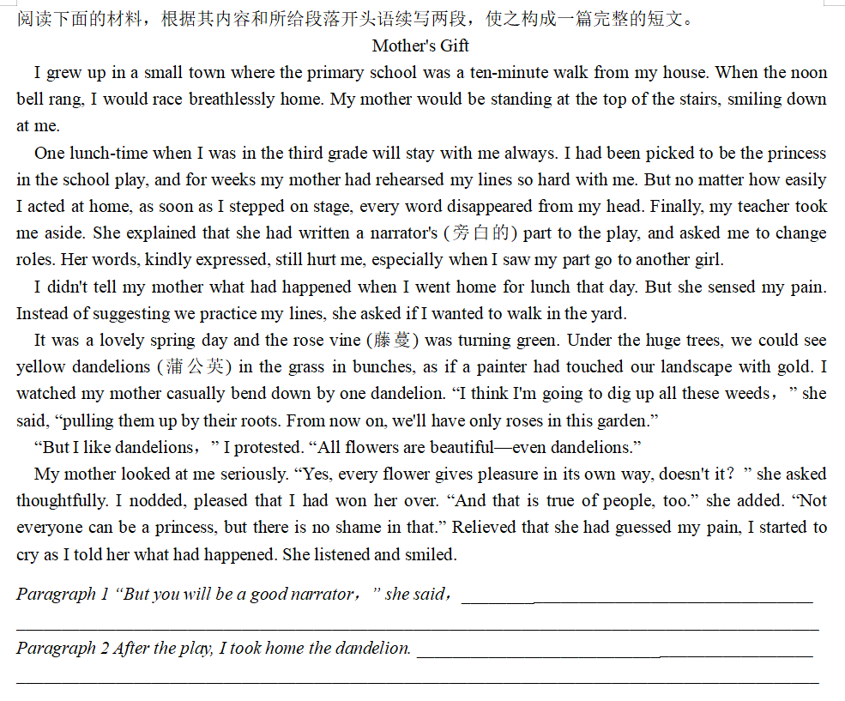
同类主题情境拓展
Extended writing

Slide 21
Possible version
Paragraph 1
“But you will be a good narrator，” she said, encouraging and comforting me as always as she did. My beloved mom, wearing a shining smile on her scarlet face, added, “The narrator’s part is important, too.” Thanks to her encouragement, which calmed me down gradually, I began to accept the narrator part was of vital. Time went fast and then came the performance day. At first, I was still nervous, but it was at that very moment that I found a dandelion in my pocket. I knew my mom passed the flower to me, which meant to be in company with me.

Slide 22
Possible version
Paragraph 2
After the play, I took home the dandelion. Mom carefully gazed at the dandelion, gently pressed it into the dictionary and grinned happily as she did. “We were perhaps the only people who would press a dandelion.” Though decades have passed, I still have the dandelion in the dictionary. I constantly recall the precious lunch time with my mother. For this, I am forever grateful, because smiles on mother’s face and her kind act foster me to become who I am today!

Slide 23
Thank you!

