Slide 1

感恩遇见，相互成就，本课件资料仅供您个人参考、教学使用，严禁自行在网络传播，违者依知识产权法追究法律责任。
更多教学资源请关注
公众号：溯恩高中英语
知识产权声明

Slide 2
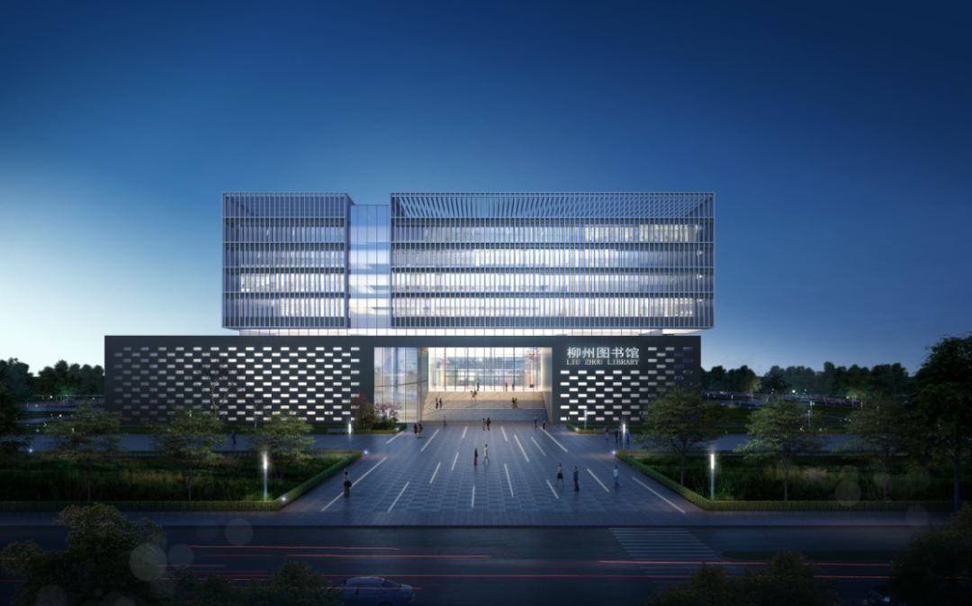
“山水联盟”高三开学考应用文讲评
告知图书馆事宜
余智良
2022.8.31
Notes:
更多模板亮亮图文旗舰店：https://liangliangtuwen.tmall.com

Slide 3
假定你是某国际学校学生李华。你的留学生朋友David发邮件向你咨询学校图书馆事宜。请你给他回复邮件，内容包括：
1.馆藏分布；
2.借阅须知。
注意：
1.词数80左右；
2.可适当增加细节，
以使行文连贯。
审题
体裁：
写信对象：
时态：
人称：
要点：
A reply to the enquiry
Friend-David
The present tense
The third person
locations of various books
functional areas like reading room, self-study room
rules

Slide 4
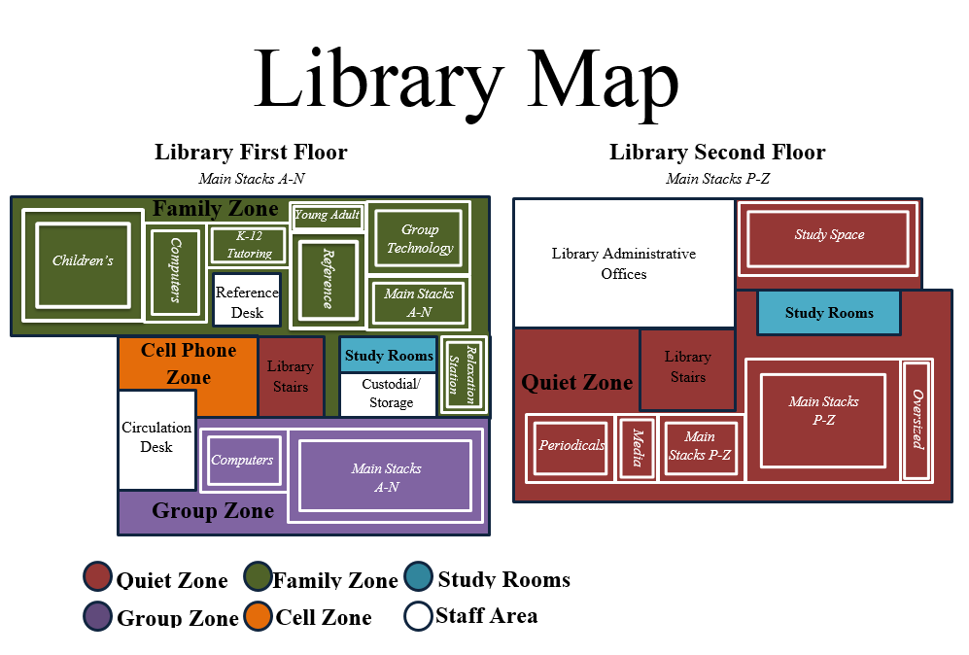
the stacks [plural ] the part of a library, sometimes not open to the public, where books that are not often needed are stored
（图书馆中贮藏使用频率较低的书的）书库
Library layout(布局)

Slide 5
Questions to think about:
Will it be possible for a high school to own a large library or different libraries?
How to connect the two points? 馆藏分布+借阅须知
A library with two or three storeys will make it much easier to introduce.
As for/ regarding/with regard to the rules about borrowing books
By the way
In case+从句

Slide 6
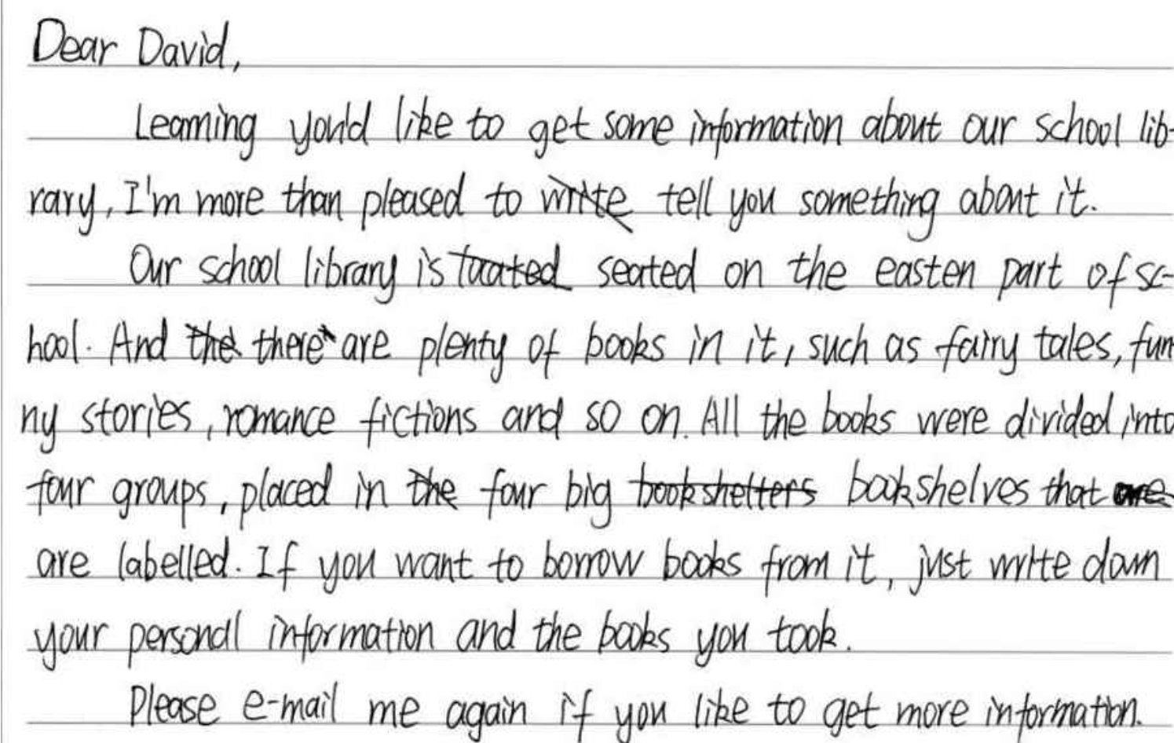
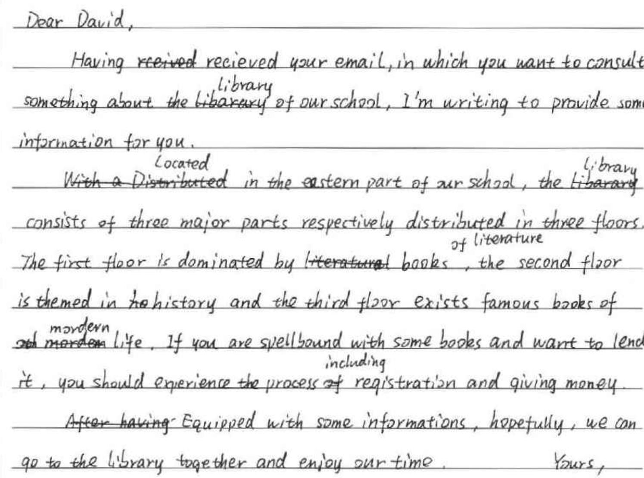
Problem 1：scribble(乱涂乱画) on the paper

Slide 7
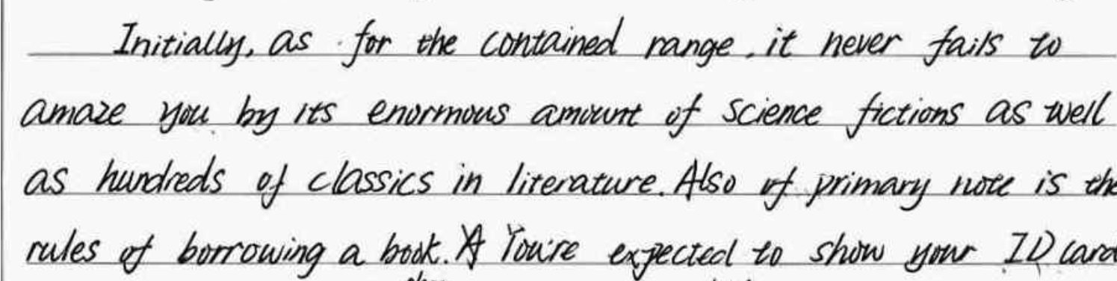
Problem2: vivid expressions like “It never fails to---” are not appropriate for an introduction

Slide 8
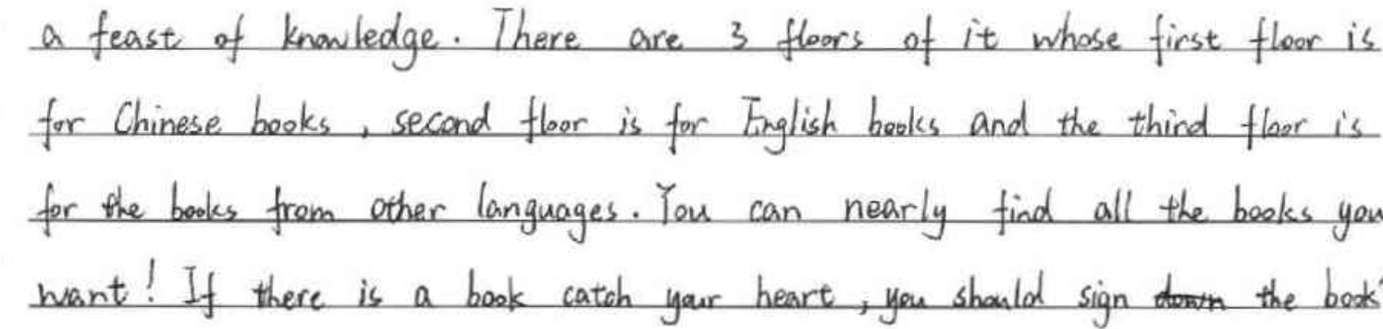
Problem 3：Is it a school library?

Slide 9
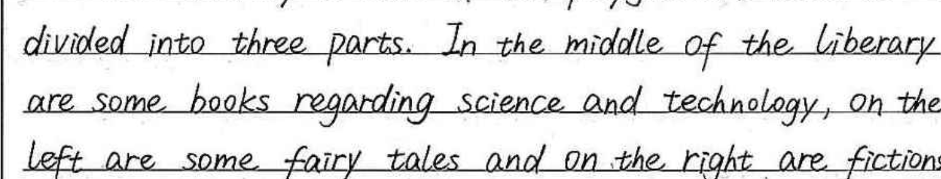
Problem 4：The introduction of the location is confusing.

Slide 10
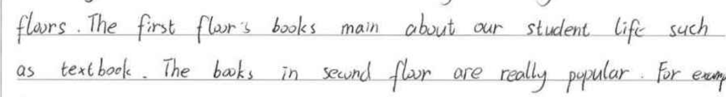
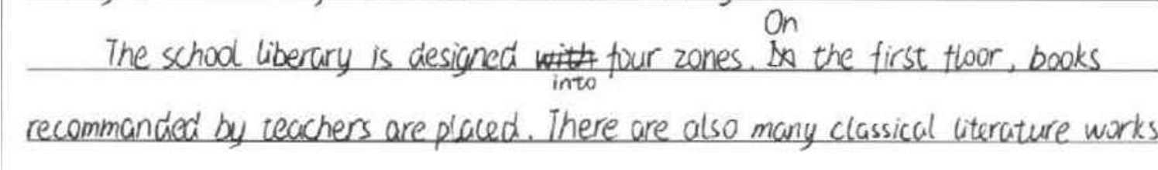
Problem 5: incorrect expressions
Inaccurate choice of words

Slide 11
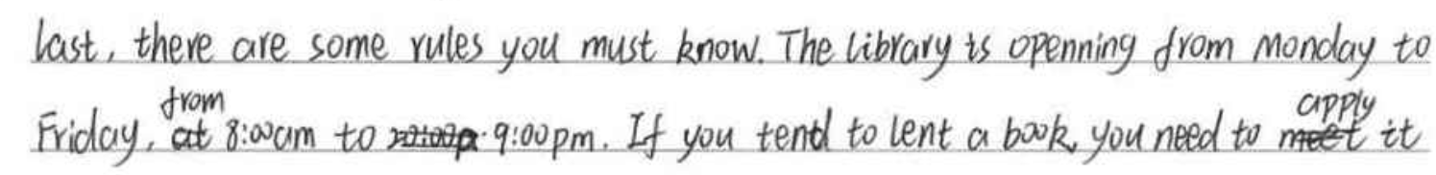
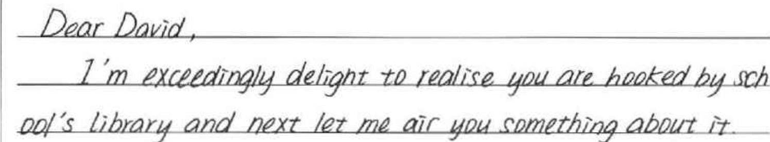
Problem 5: incorrect expressions
Opening hours does not belong to rules.
Be careful about the advanced words or expressions

Slide 12
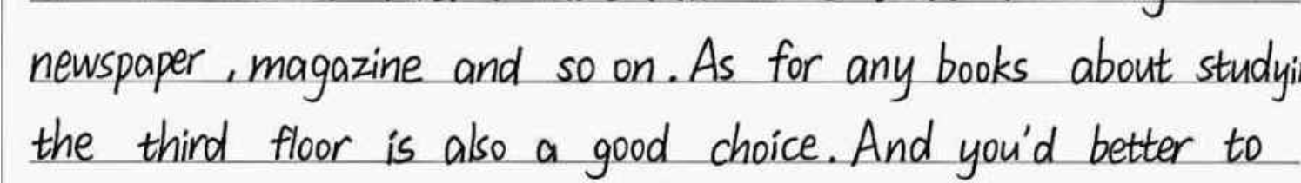

Problem 5: incorrect expressions
It is a piece of suggestion, not an introduction.
They are suggestions, not rules.

Slide 13
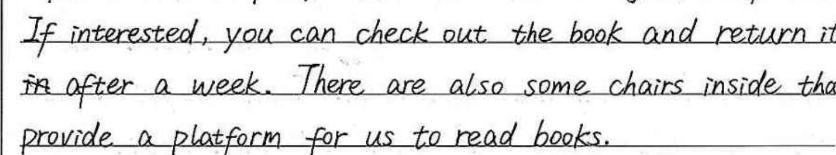
Problem 6: logical mistake

Slide 14
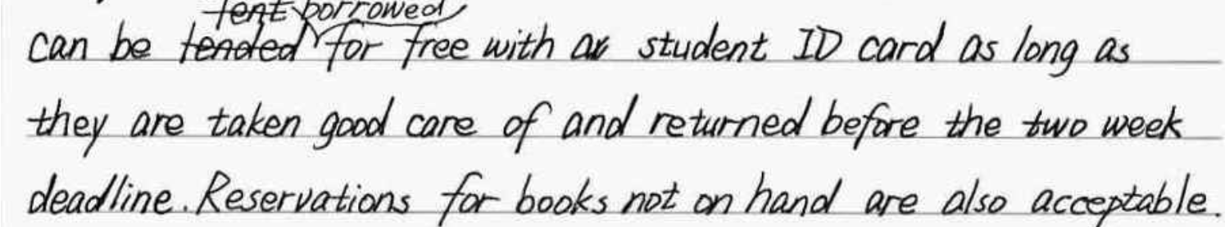
Tip：When introducing rules, the passive voice(被动语态) is more objective and so appropriate.

Slide 15
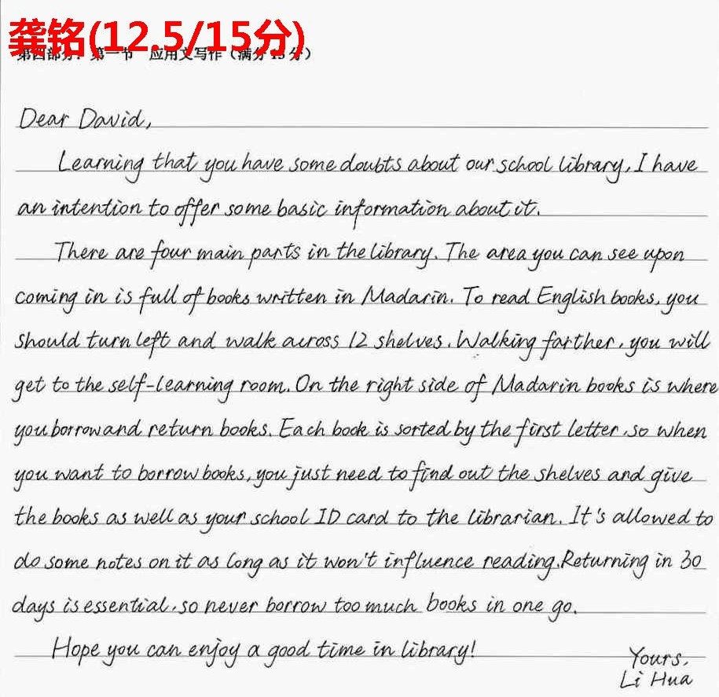
2
优点：
书写漂亮
内容完整，涵盖所有要点
句式丰富、表达多样化；（非谓语、定语从句、被动语态的使用得心应手）
不足：
严重超字数
部分内容表达不够简洁明了，如对English books的介绍；
rules部分写得太多；
4. 表达错误：walk across
Do some notes;

Slide 16
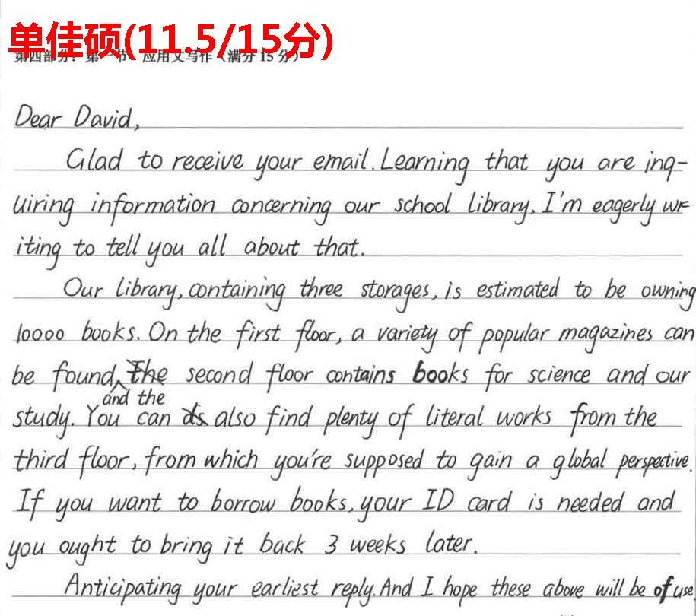
优点：
基本完成了试题的任务；
语言得体
表达多样化；
不足：
漏了一个次要点：功能区
词汇使用不当或者拼错：
storage—storey
be owning---own
literal---literary
3. 介绍rules部分词汇太简单；
4. 内容错误：gain a global perspective
5. 卷面不整洁

Slide 17
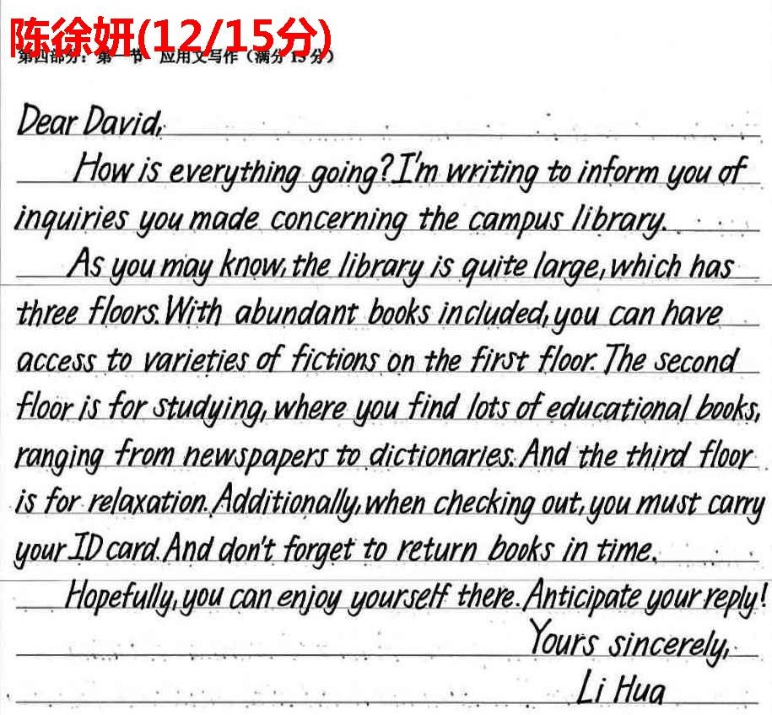
优点：
书写漂亮
内容完整，涵盖所有要点
句式丰富、表达多样化；（非谓语、定语从句、被动语态的使用得心应手）
语言简洁而地道
不足：
部分短语随意乱用，如：inform sb of; as you may know
不是所有信件都需要回复

Slide 18
优点：
内容完整，结构清晰，详略得当；
词汇和语法结构丰富；语言地道
范文展示：
Dear David,
I’m writing in answer to your enquiry about our school library.
The library is a modern-equipped building with 3 floors_{(general introduction).} The first functions as the book lending area, providing access to an abundant collection of books. The reading room on the second floor is definitely a quiet venue to study with hundreds of magazines, reference books and newspapers available. The third is an electronic library, preserving comprehensive digital resources. You can borrow 5 books at a time and must return books in due time. Never scribble on them.
Sincerely hope the library will bring you academical benefit! (96)
Yours, Li Hua
Venue：a place where people meet for an organized event, for example a concert, sporting event or conference 活动场地（如音乐厅、体育比赛场馆、会场）

Slide 19
优点：
内容完整，详略得当，要点间的衔接自然；
词汇使用准确和语法结构丰富，句式多样；
下水作文：
Dear David,
I’m writing this email in response to your enquiry about our school library. (13)
Located near the lake in our school, the two-storey library houses more than 100,000 books of various categories. The first floor is where you can check out and return books. The reading rooms on the second floor are equipped with books like literary classics, reference books, magazines, and even comprehensive digital resources respectively, (thus providing quiet environment for students either to read or study). In case you feel like borrowing some books, your student card is required and they need to be returned without damage in three weeks. (88)
Hope you can find my introduction beneficial. (7)
Yours, Li Hua

Slide 20


