Slide 1


感恩遇见，相互成就，本课件资料仅供您个人参考、教学使用，严禁自行在网络传播，违者依知识产权法追究法律责任。
更多教学资源请关注
公众号：溯恩高中英语
知识产权声明

Slide 2
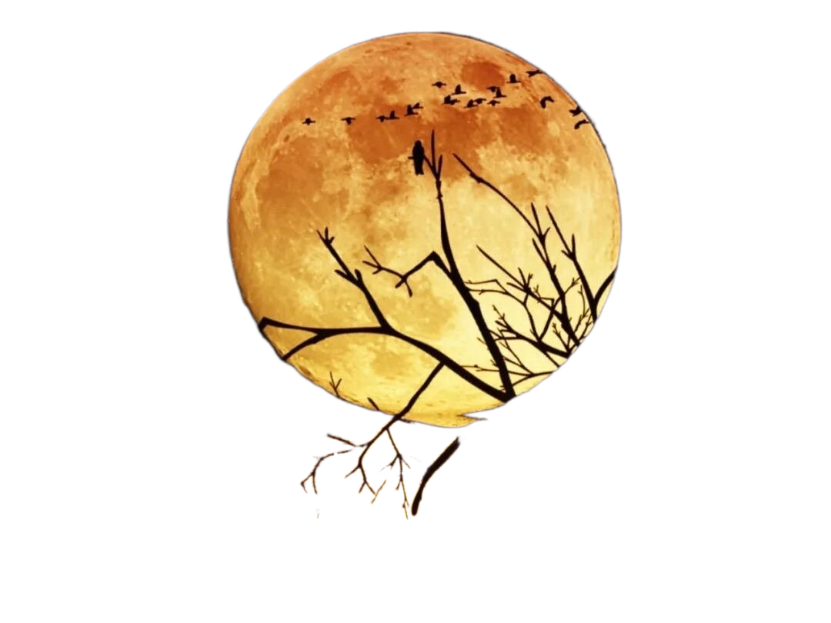
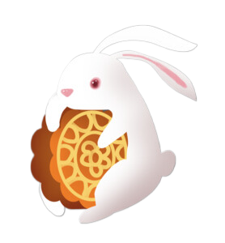
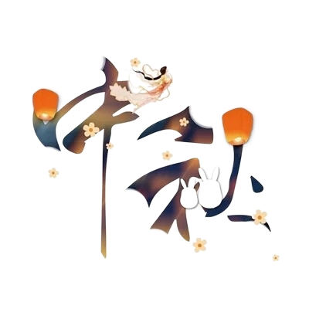
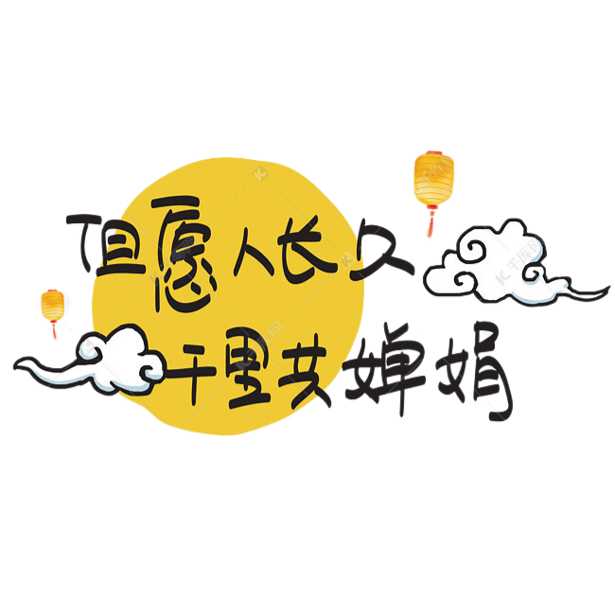
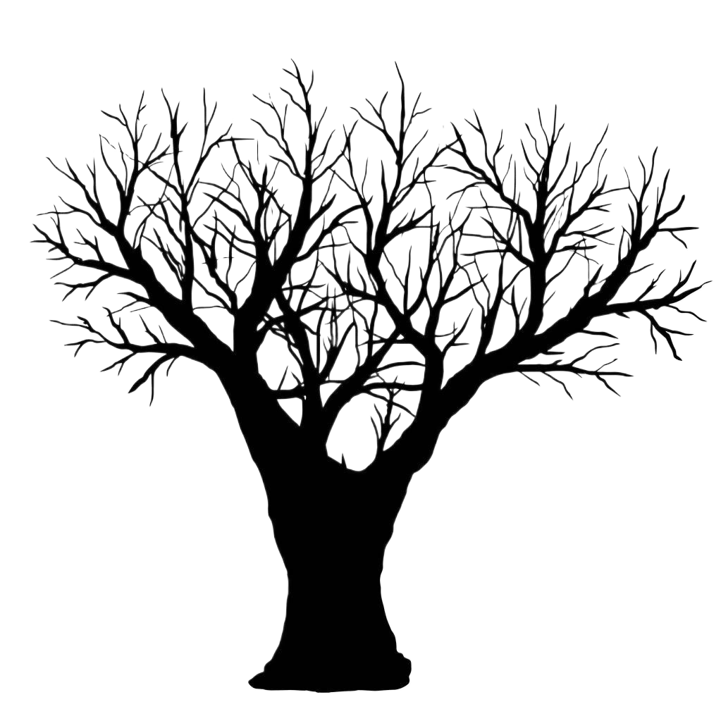
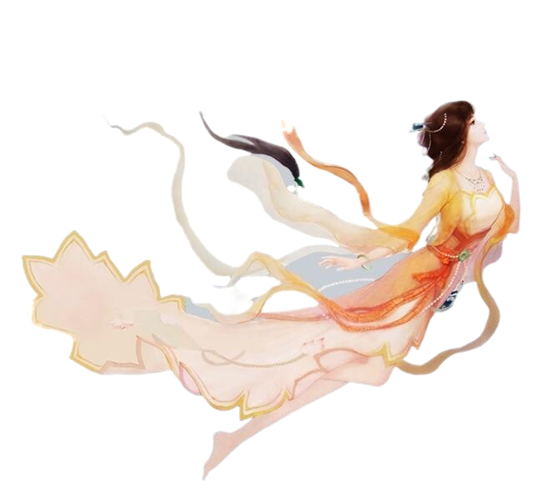
杭州二中树兰高级中学 郭合英

Slide 3
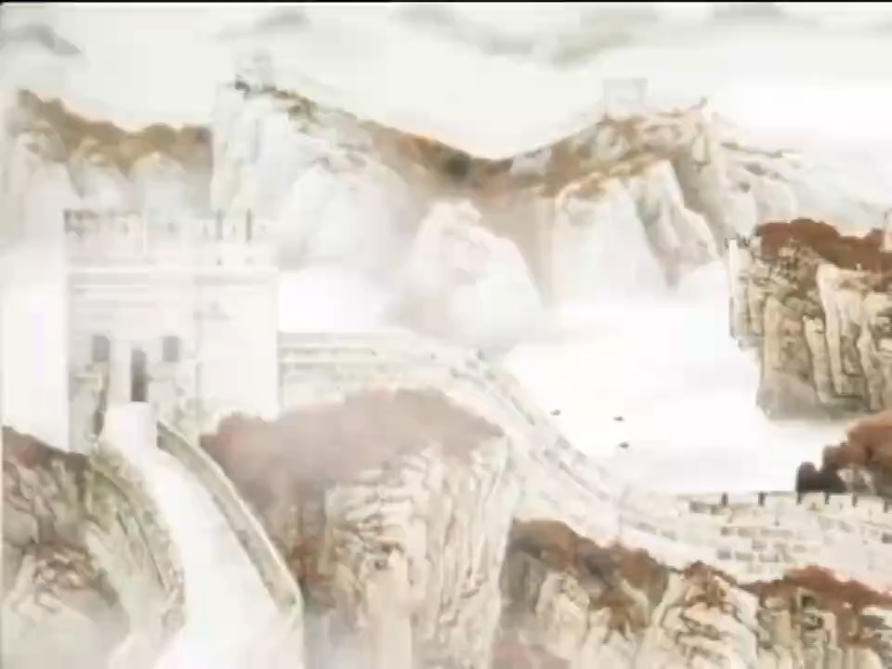

Slide 4
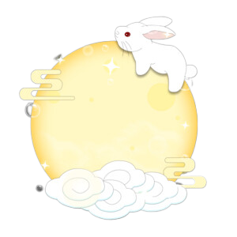
Contents
1
The introduction to the Mid-Autumn Festival
2
The development of the Mid-Autumn Festival
3
The legends of the Mid-Autumn Festival
4
The customs of the Mid-Autumn Festival
5
The poems about the Mid-Autumn Festival
6
The blessings about the Mid-Autumn Festival

Slide 5
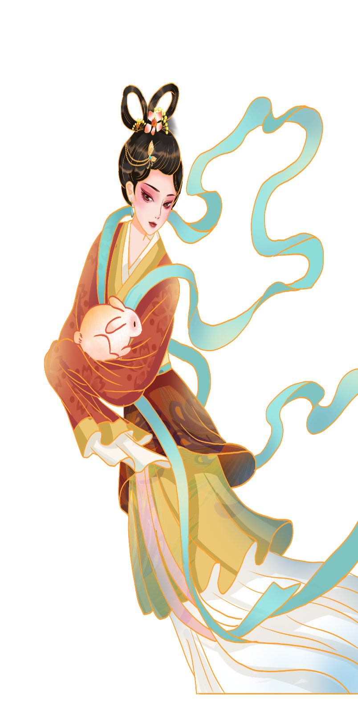
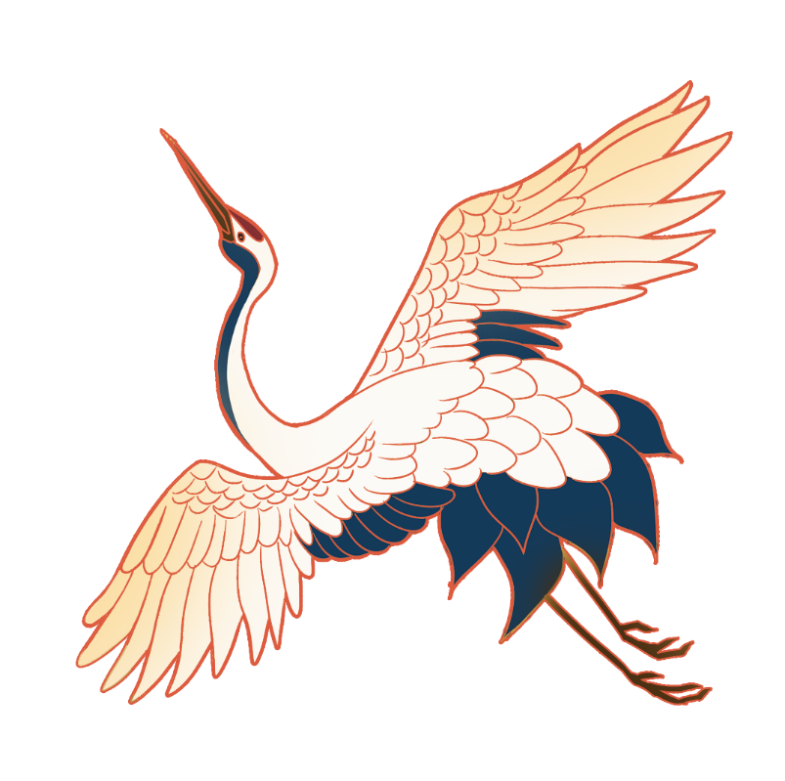
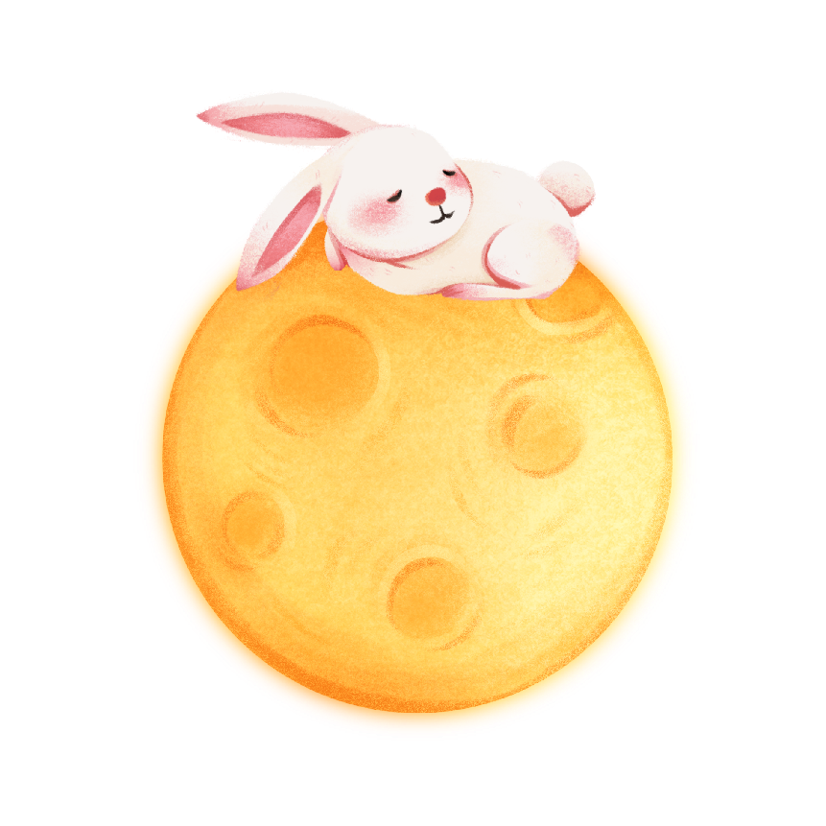
1
The introduction to the Mid-Autumn Festival
(中秋介绍)

Slide 6
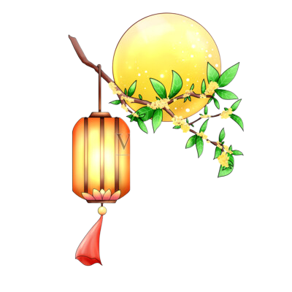
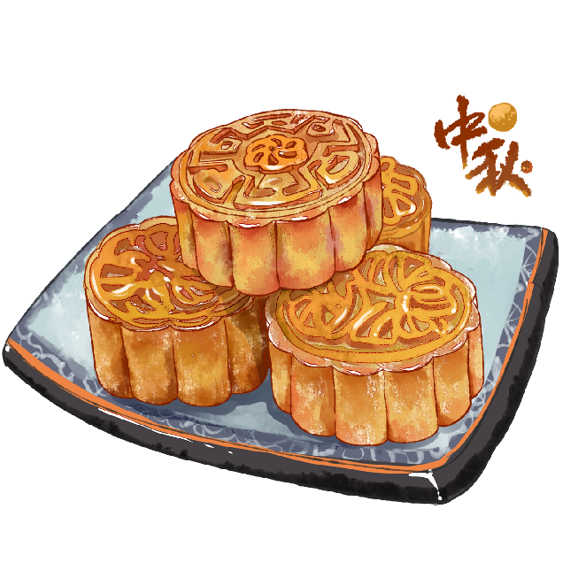
When is the Mid-Autumn Festival?
The Mid-Autumn Festival falls on
the 15th day of the 8th lunar month.
Discuss: Do you know several names of the Mid-Autumn Festival?
the Mid-Autumn Festival
the Moon Festival
the Mooncake Festival
Zhongqiu Festival

Slide 7
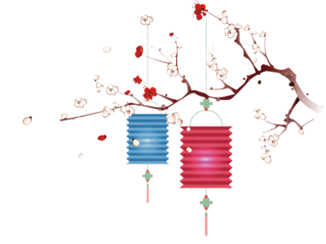
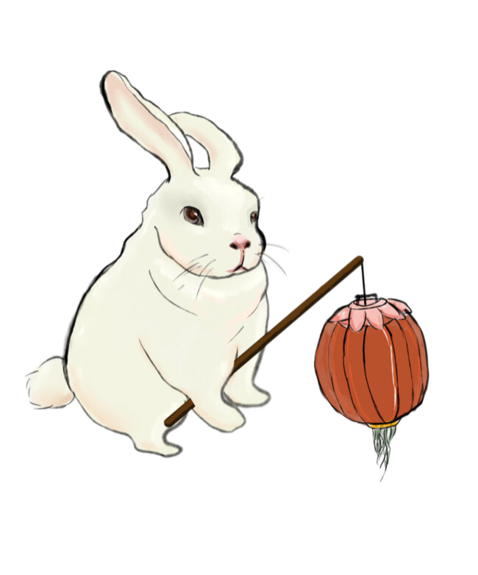
Discuss:Why is this festival called the Mid-Autumn Festival?
The word “zhongqiu” first appeared in Zhou Li. According to the ancient Chinese calendar, there are four seasons in a year, and each season has three months, which are respectively called Mengyue, zhongyue and qiyue, because the second month of autumn is called zhongyue, and because the 15th day of the eighth month in the lunar calendar is in the middle of August, it is called“Mid-Autumn Festival”. In the early Tang dynasty, the Mid-Autumn Festival became a fixed holiday.
“中秋”一词，最早见于《周礼》。根据我国古代历法，一年有四季，每季三个月，分别被称为孟月、仲月、季月三部分，因为秋季的第二月叫仲月，且又因农历八月十五日在八月中旬，故称“中秋”。到了唐朝初年，中秋节才成为了固定的节日。

Slide 8
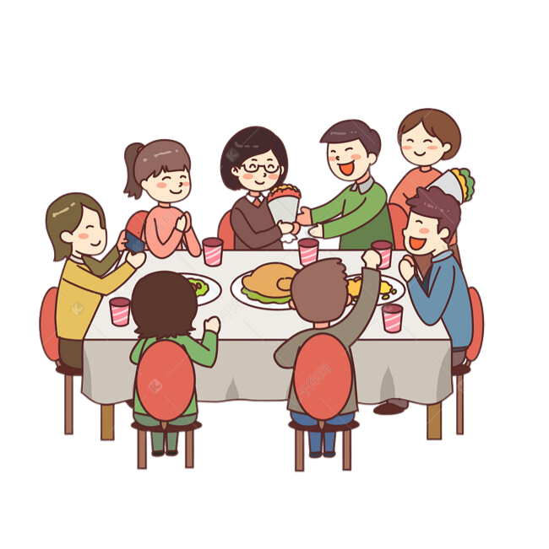
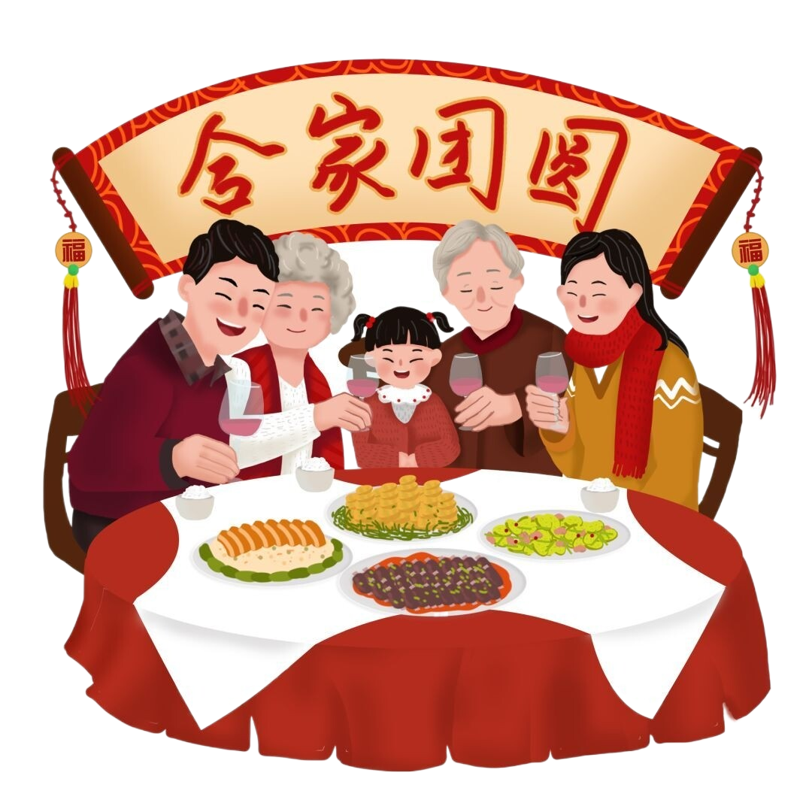
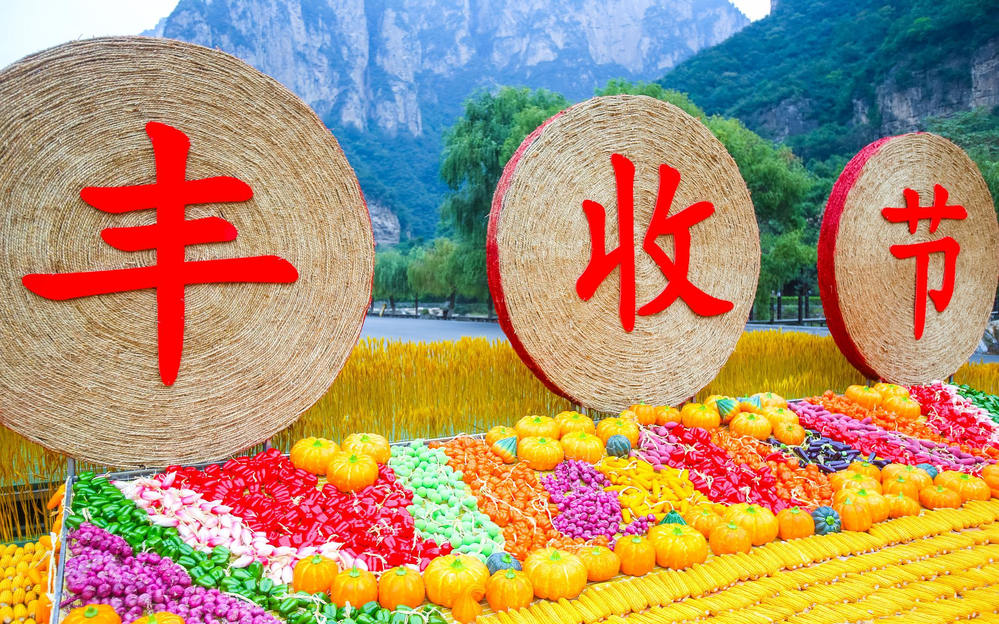
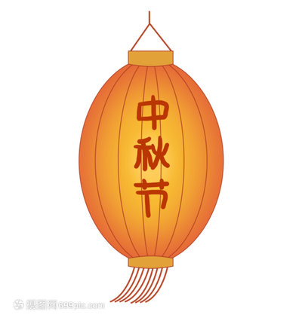
Discuss: What is the purpose of the Mid-Autumn Festival?
Originally, the word “autumn” is interpreted as “crops’ mature”. August is a time when many crops are ripening. To express their gratitude for the year’s supply of food, farmers celebrate the harvest on August 15. They will also pray for good weather in the coming year. Therefore, the Mid-Autumn Festival is a harvest festival.
The Moon on August 15 is fuller and brighter than the full moons of other months. When people look up to the bright moon, the round shape for Chinese people means family reunion. The wanderers always use it to express the feelings of homesickness and loved ones, so the Mid-Autumn Festival is also known as the Reunion Festival. On that day, sons and daughters will bring their family members back to their parents’ house for a reunion.

Slide 9
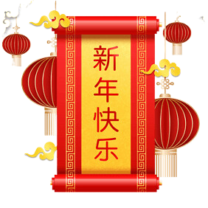
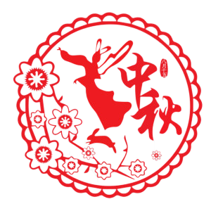
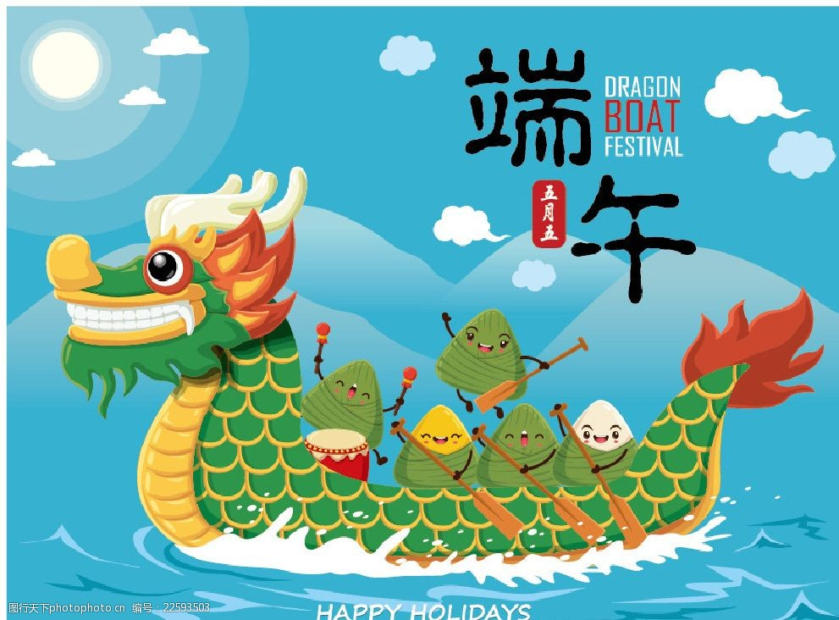
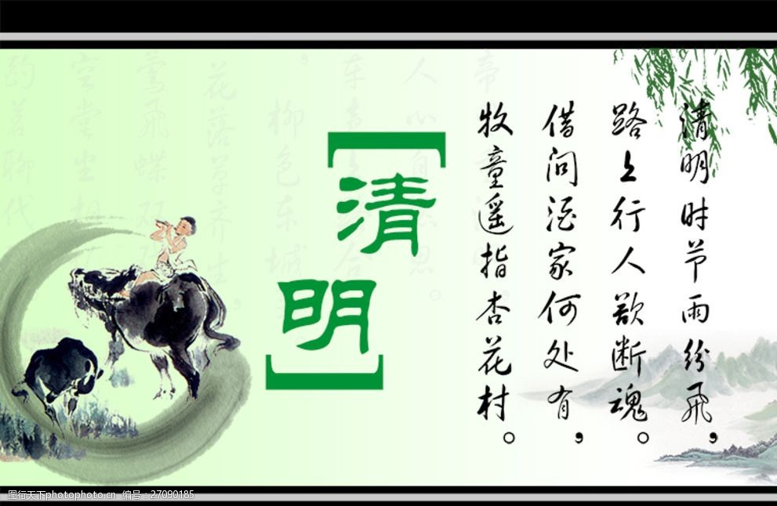
Which festivals of these are the four festivals of our country ?
Chinese New Year, Tomb-Sweeping Day, Dragon Boat Festival, and Mid-Autumn Festival are four major traditional Chinese festivals.
中秋节与春节、清明节、端午节并称为中国四大传统节日。
Chinese New Year
The Double Ninth Festival
The Mid-Autumn Festival is China's second largest after the traditional Spring Festival.
The Chinese Saint Valentine's Day
Cold Food Festival
The Mid-Autumn Festival
Dragon Boat Festival
Hungry Ghost Festival （双元节）
Community Day (社日节)
winter solstice (冬至)
Lantern Festival
Tomb-Sweeping Day
New Year's Eve
The Longtaitou Festival

Slide 10
2
The development of the Mid-Autumn Festival
(中秋的发展)

Slide 11
The development of the Mid-Autumn Day
语篇填空
The Mid-Autumn Festival has a long history of over 3,000 years. In ancient
1 （time), emperors followed the rite of 2 ( offer) sacrifices to the sun in the spring and to the moon in autumn. Later aristocrats [əˈrɪstəˌkræt] (贵族) and literary figures (文学人士) helped expand the ceremony 3 common people. They
4 (worship) the full moon and expressed their feelings.
By the Tang Dynasty, the Mid-autumn Festival 5 (fix), which became
even 6 (grand) in the Song Dynasty. In the Ming and Qing dynasties, it was
7 major festival of China.
The Mid-autumn Day 8 (originate) from the moon-worshipping in the Pre-Qin Period.
According to the textual research, the first Festival of Sacrifice to the Moon fell on the “Autumn equinox” of the solar term. 9 , due to calendar integration, the lunar calendar 10 (adopt). The Festival of Sacrifice to the Moon was adjusted from the “Autumn equinox” of the gan-zhi calendar to the 15th day of the 8th month of the lunar calendar.
times
offering
to
worshipped/whorhiped
had been fixed
grander
a
originated
However
was adopted

Slide 12
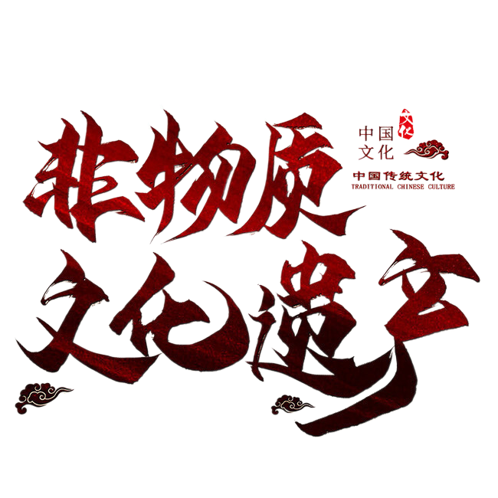
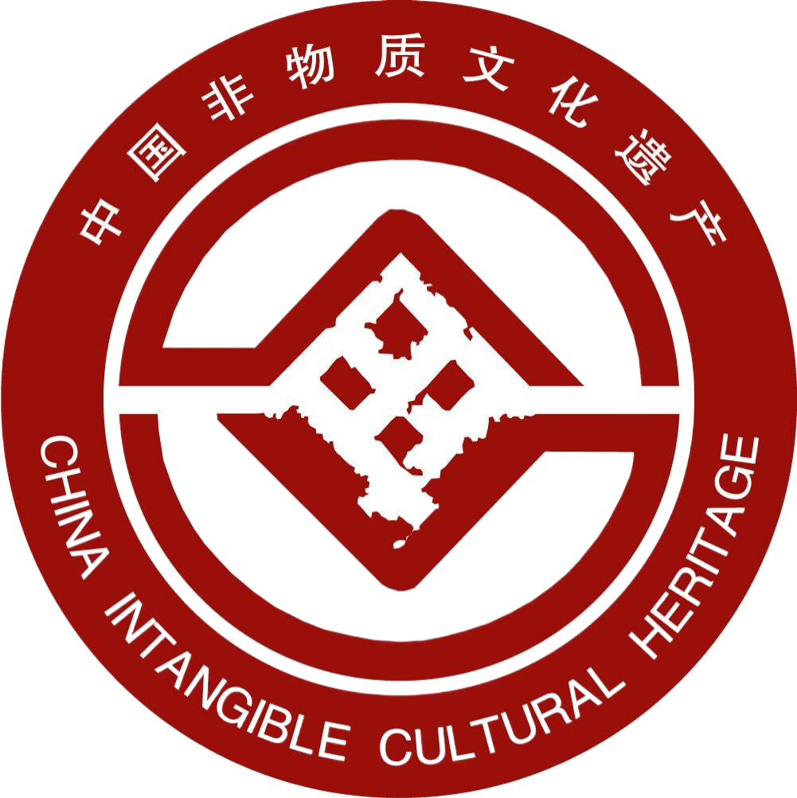
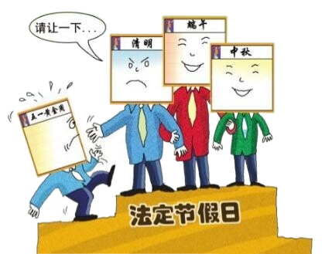
Since 2008, the Mid-Autumn Festival has been listed as a national statutory holiday.
自2008年起中秋节被
列为国家法定节假日。
On 20 May 2006, the State Council of the People's Republic of China added it to the First National Intangible Cultural Heritage List.
2006年5月20日，中华人民共和国国务院将其列入首批国家级非物质文化遗产名录。

Slide 13
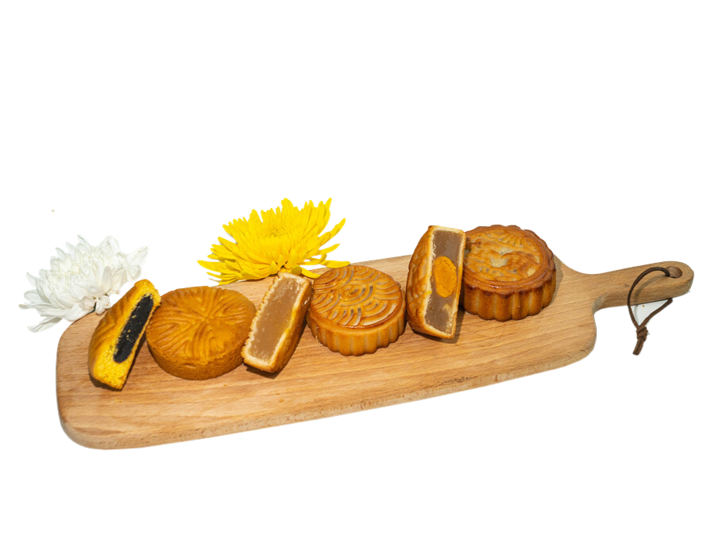
The brief history to the Mid-Autumn Day
In 2008
a public holiday
Ming and Qin Dynasties
fashionable peak
Yuan Dynasty
mooncakes eaten
Song Dynasty
popular
Early Tang Dynasty
a fixed festival
Han Dynasty
prevalent
Zhou Dynasty
origination

Slide 14
3
Legend 1 --- Chang'e flying to
the moon
(中秋传说之---
嫦娥奔月)

Slide 15


Slide 16
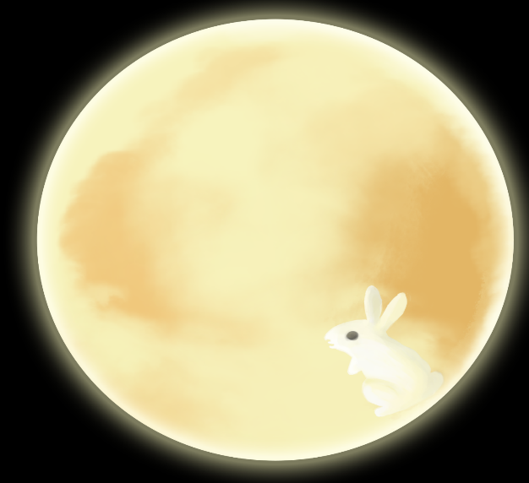
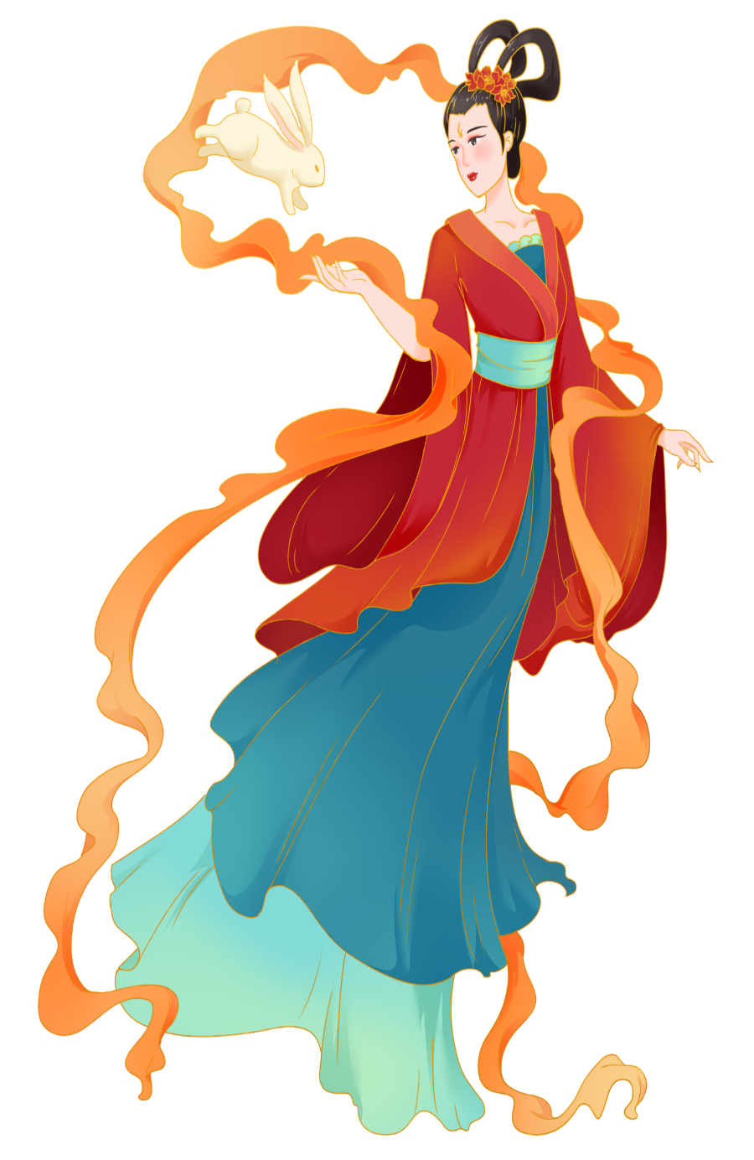
In ancient times, there were ten suns in the sky, which made all crops scorched and drove people into poverty. A hero named Hou Yi shot down the nine superfluous suns. For this reason, he was respected and loved by persons. Many a person learned martial arts from him, including a person named Peng Meng.
One day, on his way to the Kunlun Mountain
he came across the Empress Wangmu who was
passing by. EmpressWangmu presented him with a
parcel of elixir, by taking which, one would ascend immediately to heaven and become a celestial being.
However, Hou Yi hated to part with Chang E, his
beautiful wife. So he gave the elixir to her to keep it away. Unexpectedly, it was seen by Peng Meng.

Slide 17
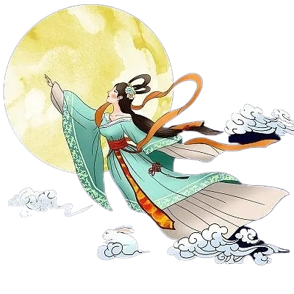
One day, after Hou Yi went hunting, Peng Meng burst into the room, forcing Chang’e to hand over the
elixir. In case of emergency, Chang’e took the elixir
and swallowed it in no time. Her body floated off the
ground, dashed out of the window and flew to the heaven.
Hou Yi had no choice but to have an incense table
arranged in the back garden, putting sweetmeats and
fresh fruits Chang’e enjoyed most on it. He held a
ceremony for Chang’e in the palace of the moon.
When people heard of the story, they arranged the incense table in the moonlight, praying Chang’e
for good fortune and peace. Since then, the custom
of worshiping the moon has been spread among the people.

Slide 18
3
Legend 2 ---
Zhu Yuanzhang and cakes uprising
(中秋传说之---
朱元璋和月饼起义)

Slide 19
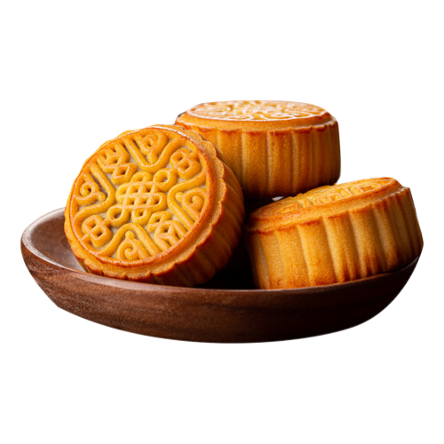
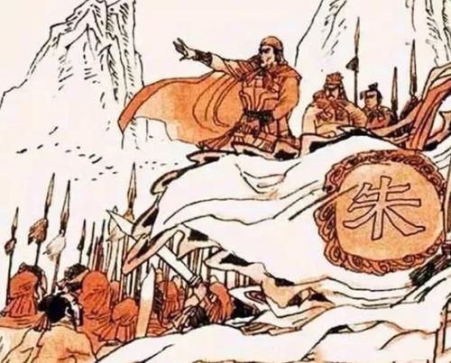
In 1368, the broad masses of the people were unable to bear the cruel rule of the Yuan Dynasty, and they revolted against the yuan. Zhu Yuanzhang joined forces of resistance to prepare for the uprising.
But it was very difficult to pass the news of "August
fifteen night uprising". Zhu’s advicer, Liu Bowen, put forward a plan to have the rallying message hidden
in sweetpastries and sent it to the rebel army.
ZhuYuanzhang successfully overthrew the Yuan emperors and founded the Ming Dynasty (1368-1644).
Later on, the custom of eating mooncakes on the
Mid-Autumn Festival was spread among the people.

Slide 20
3
Legend 3 ---
Wu Gang chopping the tree
(中秋传说之---
吴刚伐桂)

Slide 21
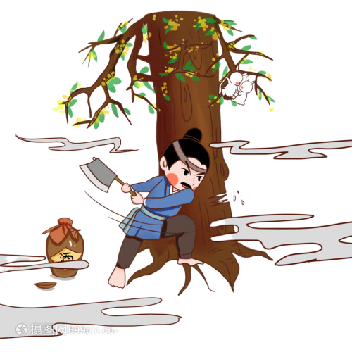
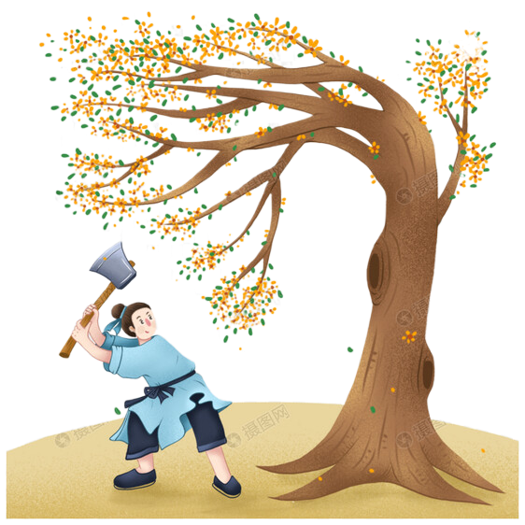
There was a person called Wu Gang in Han dynasty. He was a shiftless fellow who changed apprenticeships all the time. One day he wanted to be an immortal, so he importuned an immortal to teach him. First the immortal taught him how to use the herbs to cure sickness, but after three days, his characteristic restlessness returned and he asked the immortal to teach him something else. So the immortal taught him to play chess, but after a short while, his enthusiasm again waned. Then Wu Gang was given the books of immortality to study. Of course, he became bored within a few days, and asked if they could travel to some new and exciting places. Angered with Wu Gang's impatience, the master banished Wu Gang to the Moon Palace, telling him that he must cut down a huge cassia tree before he could return to earth. Though Wu Kang chopped day and night, the magical tree restored itself with each blow, and thus he is up there chopping still.

Slide 22
3
Legend 4 ---
Jade Rabbits Mashing Herbs
(中秋传说之---
玉兔捣药)

Slide 23
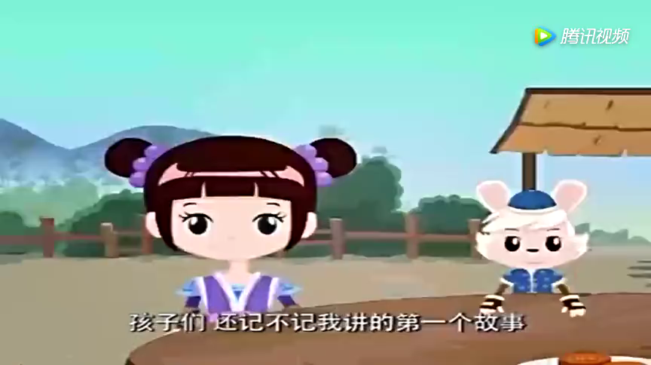

Slide 24
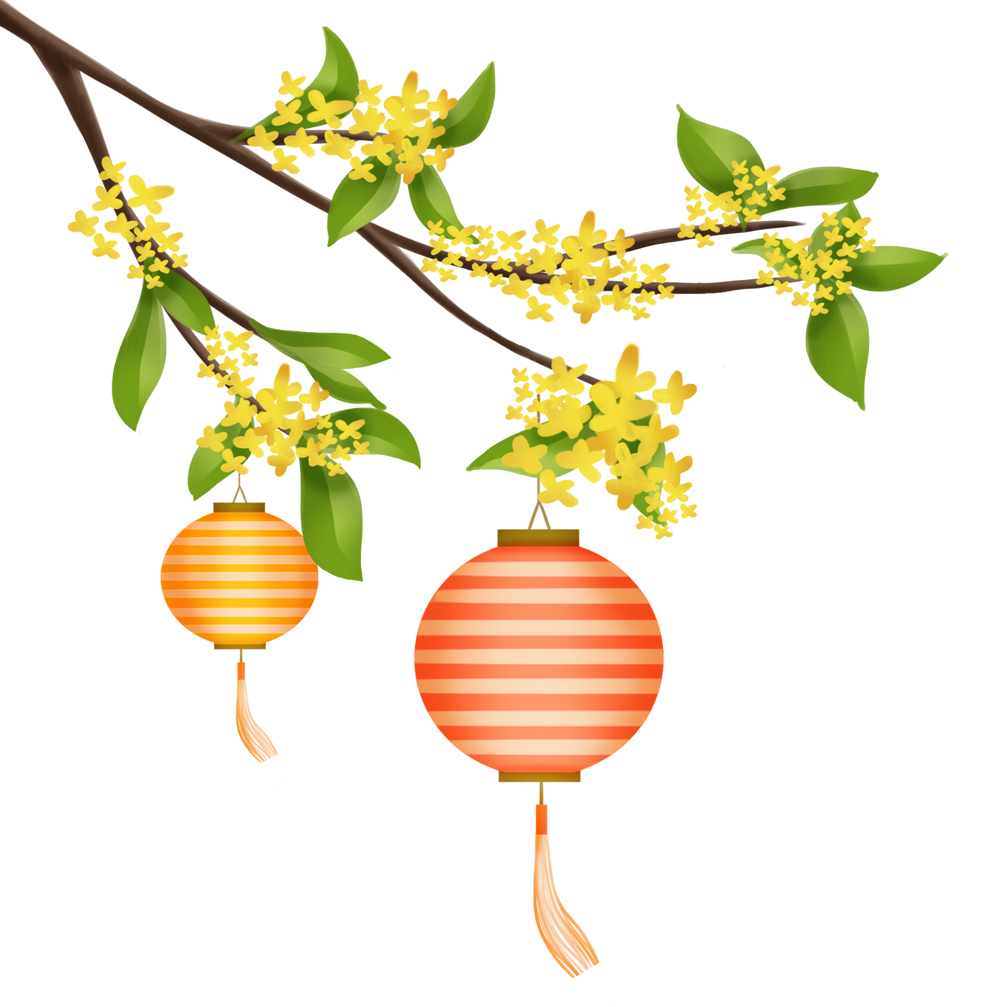

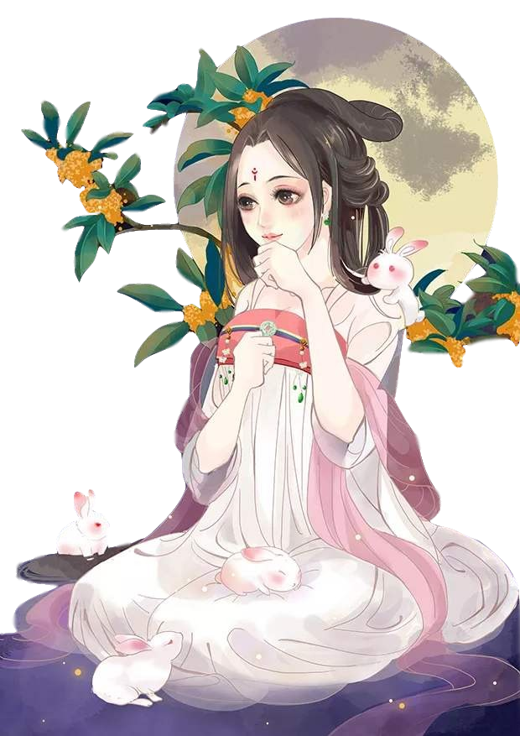
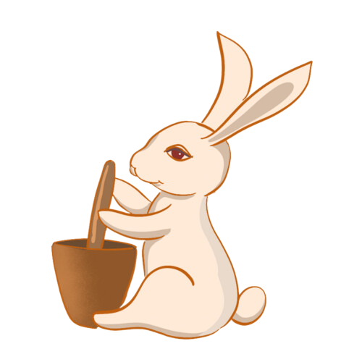
It is said that there was a god disguising himself
as a poor man. He begged separately for food from a fox, a monkey and a rabbit.
The first version
Both the monkey and the fox gave the god something to eat, but the rabbit gave him nothing. In order not to make the poor man hungry, the rabbit said: "you eat my flesh!"
With the words, it was about to jump into the fire. Moved by the kindness of the habit, the god sent the rabbit to the palace of the moon to accompany Chang'e to make the elixir.

Slide 25
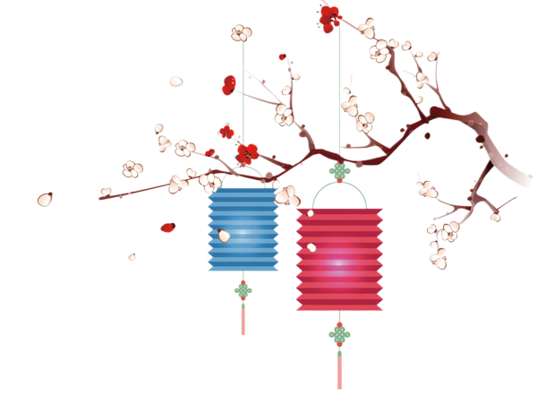
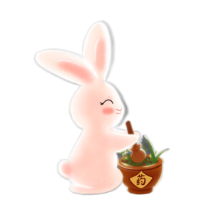
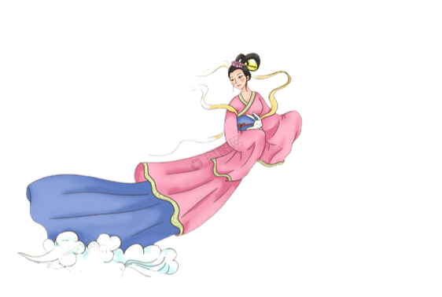
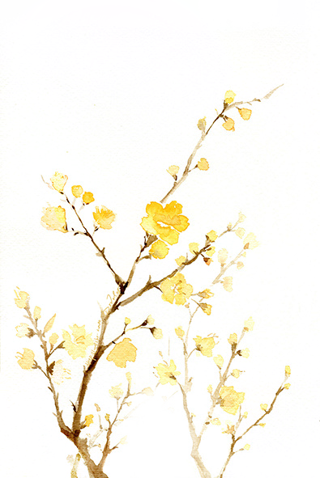
Legend has it that a long time ago, a couple of rabbits who had practiced Millennium became immortal. They had four lovely daughters, all born to pure cute.
The second version
One day, the emperor summoned the male rabbit to heaven. The male rabbit reluctantly left his wife and children, stepping on the clouds to heaven. When he came to the Southern Gate of Heaven, he saw Chang’e held by the Venus as well as the divine troops from heaven(天兵天将). The rabbit fairy didn't know what had happened, so he asked the God who was guarding the Gate of Heaven. Chang'e loneliness and sadness in the Moon Palace filled the bunny with grief after hearing her story. If only someone were to accompany Chang'e. Suddenly, he thought of his four daughters, he immediately rushed home.

Slide 26
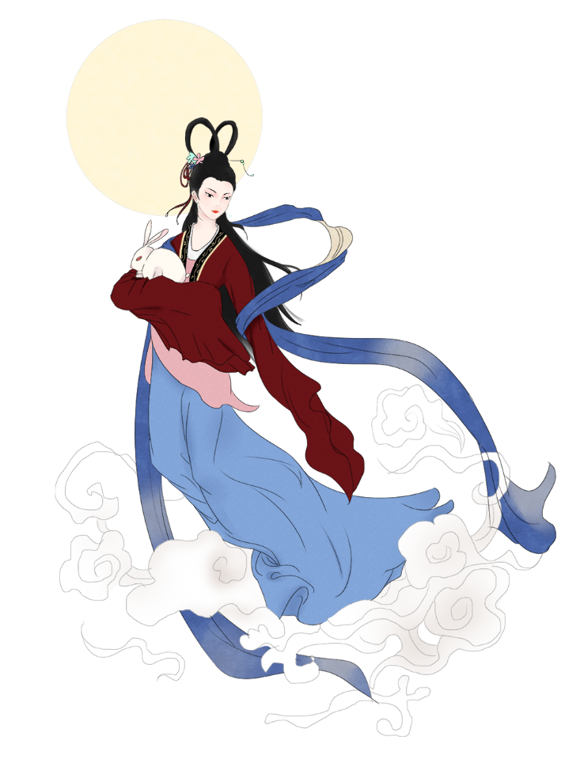
The male rabbit told the female about Chang'e story, saying he wanted to send a child to accompany her. Although the female rabbit deeply sympathized with Chang'e, but she didn’t want to give up her precious daughter, which was equivalent to cutting off her meat! Four daughters were reluctant to leave their parents, with tears streaming down their faces. “If I were locked up alone, would you stay with me?” said the male. “Can’t we feel sorry for Chang'e who has suffered in order to save the people? We can not think only of ourselves, my children.”
The children read the father's mind and expressed their willingness to go. The male and female rabbits smiled with tears in their eyes. They decided to let the youngest daughter go.
Little Jade Rabbit bid farewell to his parents and sisters, flying to the Moon Palace to live with Chang'e!

Slide 27
4
(The customs about
the Mid-Autumn Festival)

Slide 28
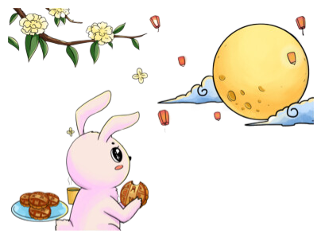
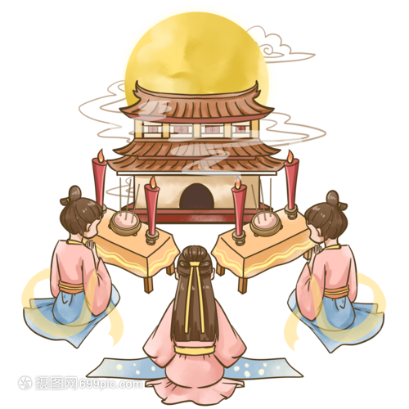
Worshiping the Moon
（祭月）
Offering to the moon is a very ancient custom. In fact, it is an activity for worshipping the moon god .
According to the legend of the Mid-Autumn Festival, Chang’e lives on the moon with a rabbit. On the night of the Moon Festival, people usually set a table with mooncakes, fruits and a pair of lighted candles on it. People believe that Chang’e may fulfill their wishes by worshiping the moon.

Slide 29
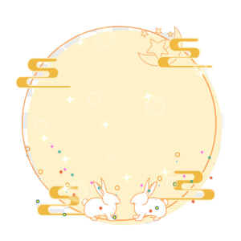
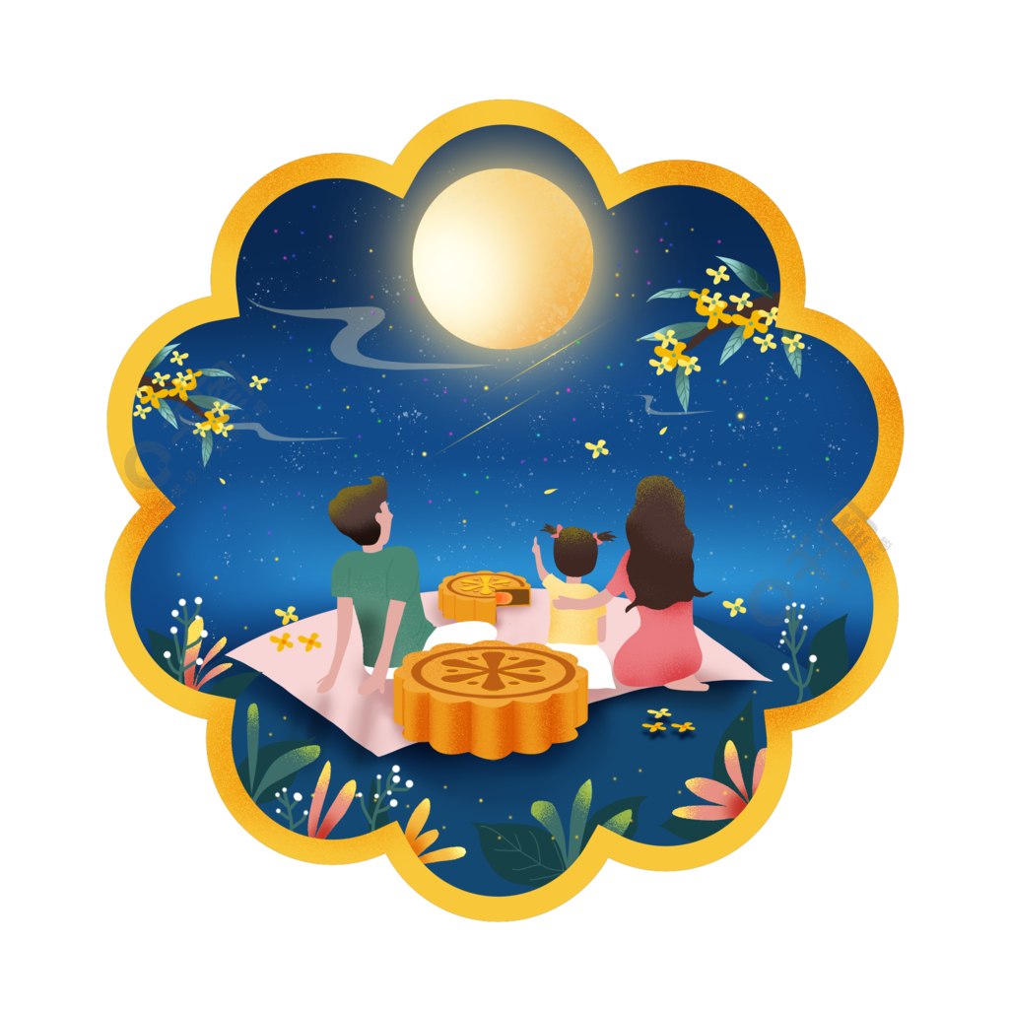
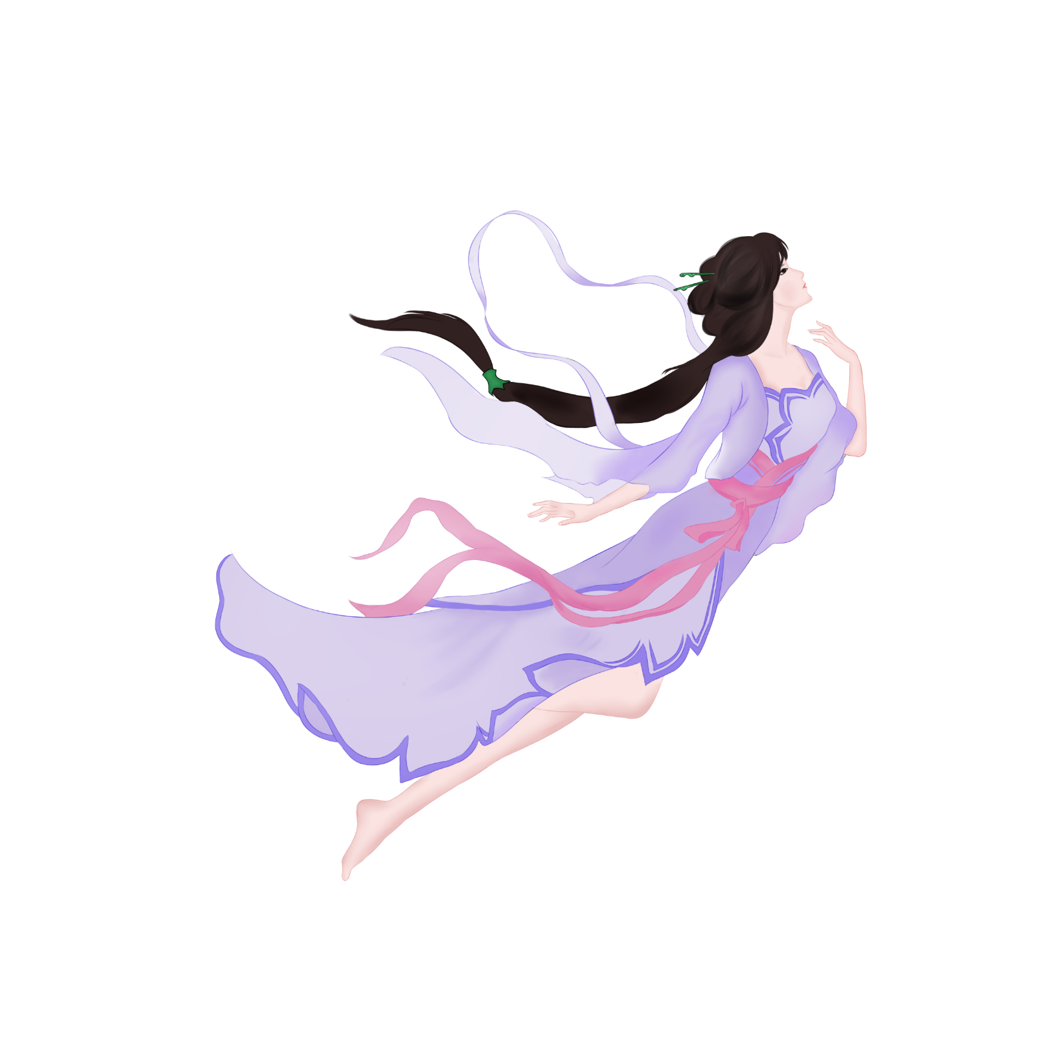
Appreciating the Moon
（赏月）
The custom of appreciating the moon comes from offering sacrifices to the moon. It is said that the moon on the night of Mid-Autumn Festival is the brightest and the most beautiful. The full moon is the symbol of family reunions in Chinese culture.

Slide 30
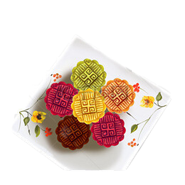
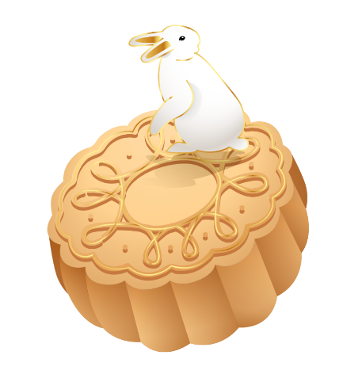

Eating Mooncakes
（吃月饼）
各种月饼的英文说法
月饼： Mooncake
冰皮月饼：Snow Skin Mooncake
豆沙月饼：Red Bean Paste Mooncake
五仁月饼：Five-nuts Mooncakes
蛋黄月饼：Egg Yolk Mooncake
莲蓉月饼：Lotus Seed Paste Mooncake
鲜肉月饼：Pork Mooncake
Mooncakes are the most representative food for the Mooncake Festival, because of their round shape and sweet flavor. Family members usually gather round and cut a mooncake into pieces and share its sweetness.

Slide 31





Enjoying Family Reunions（全家团圆）
The roundness of the moon represents the reunion of the family in China. Families will have dinner together on the evening of the Mooncake Festival.

Slide 32


Playing Rabbit Figurine
（玩兔儿爷）
Rabbit Figurines stems from a legend. One year, there was a plague in Beijing. Someone was sick in almost every family, and there was no cure for the plague. Seeing such a scene, Chang'e was very sad , so she sent jade rabbit to treat the people. The rabbit went from door to door, curing many people. After eliminating the plague, the Jade Rabbit went back to the Moon Palace. With gratitude, people used mud to create the image of the Jade Rabbit, which was affectionately known as the“Rabbit Figurine”.
在古时候，忽有一年，北京城里闹起了瘟疫。几乎每家都有人得了病，可就治不好。月中的嫦娥看到人间如此情景，心里十分难过，就派身边的玉兔去为百姓们治病。玉兔挨家挨户治好了很多人的病。消除了京城的瘟疫之后，玉兔就回到月宫中去了。人们为了感谢玉兔，就用泥塑造了玉兔的形象，被民间亲切地称为“兔儿爷”。
Now many people refer to it as a mascot for the friends and relatives. Its significance is to pray for good luck and happiness.

Slide 33




Burning lamps
（燃灯）
A few days before the Mid-Autumn Festival, everyone in the family will help to make beautiful lanterns. On the evening of the festival, people will light the lanterns that are bright and round. In modern Mid-Autumn Festival, the burning of lights is more popular.

Slide 34



Drinking wine fermented with osmanthus flowers
（饮桂花酒）
The legend of the osmanthus-flavored wine
Osmanthus is a symbol of prosperity and good fortune, and the osmanthus-flavored wine is very popular. The history of the osmanthus-flavored wine is as long as the mid-autumn Festival.
桂花酒有一段美好的传说：古时候两英山下住着一个仙酒娘子，她酿出的酒，味醇甘美。一年冬天，娘子发现门外躺着一个快要冻死的汉子，便好心背他回家照料。一日，那汉子不辞而别，仙酒娘子放心不下到处去找，在山坡遇一白发老人，表示喊渴，她便咬破中指伸到老人嘴边。此时，一阵清风，天上飞来一个黄布袋，袋中装满许多桂子，附带一张纸条：月宫赐桂子，奖赏善人家。原来，汉子和白发老人，都是吴刚变的。这桂子种下长出桂树，开出桂花，满院香甜。
In ancient times, at the foot of the Two Yingshan Mountain lived a fairy lady who brewed osmanthus-flavored wine. The wine she brewed was pure and scented. One winter, the lady found a man lying outside the door to be frozen to death, she kindly carried him home to take care. One day, the man left without saying good-bye. The lady was worried to look for him everywhere. She met an old man with grey hair on the hillside, biting her middle finger and reaching out to the old man's mouth when he cried because of thirst. At this time, a yellow bag filled with a lot of cinnamon came flying with a note “月宫赐桂子，奖赏善人家”. It turned out that the man and the old man with grey hair were both disguised by Wu Gang. The seed of Osmanthus grew into a big tree, full of sweet-scented Osmanthus.
桂花是吉祥、好运的象征，桂花酒自然也倍受人们喜欢。桂花酒的历史好比中秋节一样悠久。
On the evening of traditional Mid-Autumn Festival , the three elements are necessary: bright moon, moon cakes and sweet-scented osmanthus wine.
一个传统的中秋夜，三种元素不能少：皓月、月饼和桂花酒。

Slide 35


Viewing Tide
（观潮）
The custom of Viewing Tide on the Mid-autumn Festival has a long history. It is especially popular in Zhejiang area.
八月十五日看潮
宋 苏轼
定知玉兔十分圆，
已作霜风九月寒。
寄语重门休上钥，
夜潮留向月中看。

Slide 36

Stealing scallions and vegetables
（偷葱偷菜）
台湾俗语“偷着葱，嫁好郎;偷着菜，嫁好婿”
The Mid-autumn Festival is not only a time for family reunions, but also a time for unmarried girl looking for a good husband. Stealing scallions and vegetables is one way to wish them well. There is a in Taiwan, “If you steal scallions, marry a good man; if you steal vegetables, marry a good husband”, which means that on the Mid-autumn Festival night, if an unmarried girl does so from another family's vegetable garden, she will meet a good husband in the future.
saying

Slide 37
5
(The poems about
the Mid-Autumn Festival)
(中秋诗歌)

Slide 38





《水调歌头》
苏轼
明月几时有？把酒问青天。
不知天上宫阙，今夕是何年。
我欲乘风归去，又恐琼楼玉宇，高处不胜寒。
起舞弄清影，何似在人间。
转朱阁，低绮户，照无眠。
不应有恨，何事长向别时圆？
人有悲欢离合，月有阴晴圆缺，此事古难全。
但愿人长久，千里共婵娟。
希望自己思念的人平安长久，不管相隔千山万水，都可以一起看到明月皎洁美好的样子。

Slide 39

《水调歌头》英文版

Slide 40

歌曲版《水调歌头》

Slide 41

歌舞版《水调歌头》

Slide 42




A Tranquil Night
许渊冲
Abed, I see a silver light,
I wonder if it’s frost aground.
Looking up, I find the moon bright;
Bowing, in homesickness I’d drowned.
经典永相传

Slide 43
6
(The blessings about the Mid-Autumn Festival )
中秋祝福

Slide 44



Although I am not around you at this moment, my blessings and wishes will always be around you.
虽然你我不能相聚，但我的祝福伴随你走每一段路。
Family members are round and round, and their minds are full of happiness. Happiness is always ahead. Happy Mid-Autumn Festival!
亲人团团圆圆，心事花好月圆，幸福美满永在前，中秋节快乐！
No matter where you are from, regardless whether we gather or leave, all those blessings are forever linked in my mind. I wish you success and only things beautiful!
无论天南海北，不论相聚与离别，有份祝福永远挂在我心中，祝你一切圆满美好!

Slide 45


Slide 46


Let us wish that man will live long as he can! Though miles apart, we’ll share the beauty of the moon together.
Happy Mid-Autumn Festival!

