Slide 1

感恩遇见，相互成就，本课件资料仅供您个人参考、教学使用，严禁自行在网络传播，违者依知识产权法追究法律责任。
更多教学资源请关注
公众号：溯恩高中英语
知识产权声明

Slide 2
读后续写讲评-专题III
- how to make action vivid
任教教师：李一航
东莞市翰林实验学校

Slide 3

Continuation Writing
—to make action vivid

Slide 4
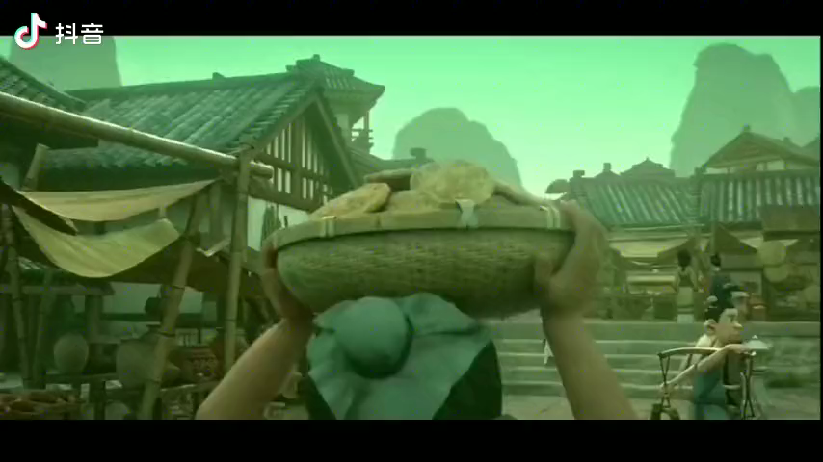
Continue and complete your writing
At the sight of the sudden appearance of Ne Zha, the big guy_______

Slide 5
At the sight of the sudden appearance of Ne Zha, the big guy jumped into the well. Then all the villagers ran away. They tried to hide themselves. Some jumped into the bucket. Some closed their window and doors and some lay on the street like the dead. However, Ne Zha found them out one by one.
At the sight of the sudden appearance of Ne Zha, fear creeping over the villagers, the big guy with his eyes wide open was frozen with shock, shouted at the top of his lungs “Again!” and then jumped into the well. On hearing his scream, all the villagers ran in all directions, pressing and pushing each other in horror. They tried every means to hide themselves as quickly as they could. Some sprang to his feet and squeezed into the bucket without thinking twice. Some closed their windows and doors with fear and some even lay on the street directly, making themselves look like the dead. However, Ne Zha still found them out one by one easily.

Slide 6
emotion
At the sight of the sudden appearance of Ne Zha, fear creeping over the villagers, the big guy with his eyes wide open was frozen with shock, shouted at the top of his lungs “Again!” and then jumped into the well. On hearing his scream, all the villagers ran in all directions, pressing and pushing each other in horror. They tried every means to hide themselves as quickly as they could. Some sprang to his feet and squeezed into the bucket without thinking twice. Some closed their windows and doors with fear and some even lay on the street directly, making themselves look like the dead. However, Ne Zha still found them out one by one easily.
look
speech
action
action
action

Slide 7

How could we make a story vivid (生动）in our continuation writing ?
emotions
looks
?
actions
speeches

Slide 8
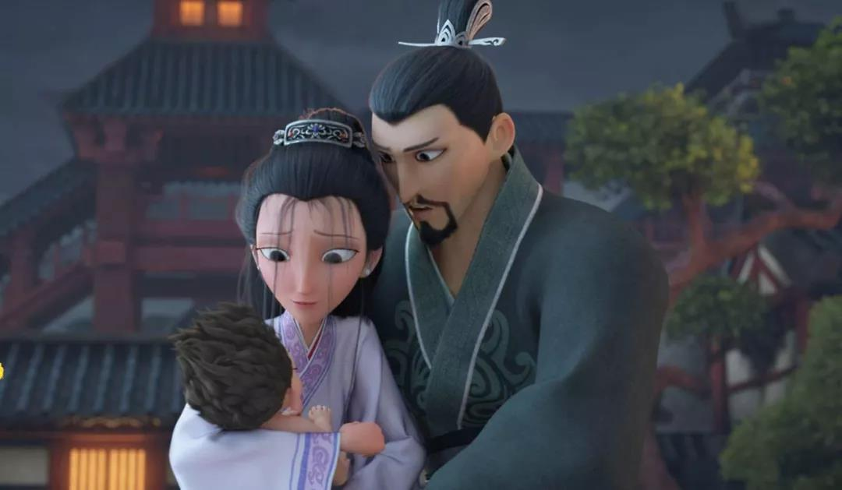
1. Add adverbs(副词）to make the action vivid.
After hearing their son would live no more than 3 years, they held him into their arms.
After hearing their son would live no more than 3 years, they held him______ into their arms with tears rolling down their cheeks.
tightly

Slide 9
aimlessly carefully gently quickly wildly anxiously
Seeing the wolf back off, Paul ______ unlocked the door, and the frightened man climbed into the car in no time, shutting the door behind him heavily.（2017年6月高考浙江卷）
Without hesitation, she waved her yellow blouse ________, shouting, “Help!” （2016年10月浙江高考）
I bent myself down, gave the poor boy a warm hug and kiss him ________ on her forehead.(高三周测二)
He paced up and down, waiting ________ for his wife to be pushed out from the operation room.（高三月考一）
I opened the letter __________, hoping for some clue to identity of the owner of the wallet.（2021年1月汕头一模）
Having wandered ________in the street for hours, she felt a little hungry and wished for something to eat.（高三周测一）
quickly
wildly
gently
anxiously
carefully
aimlessly

Slide 10
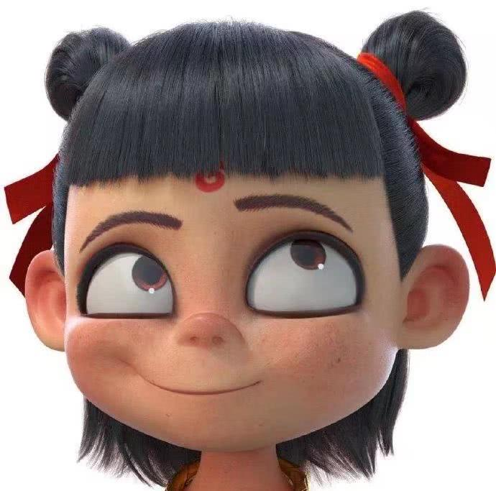
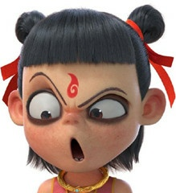
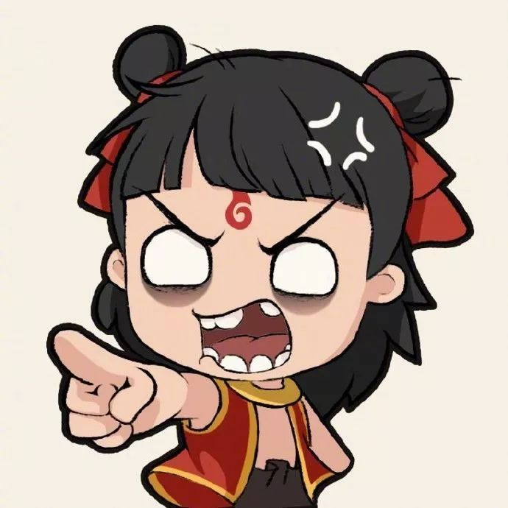
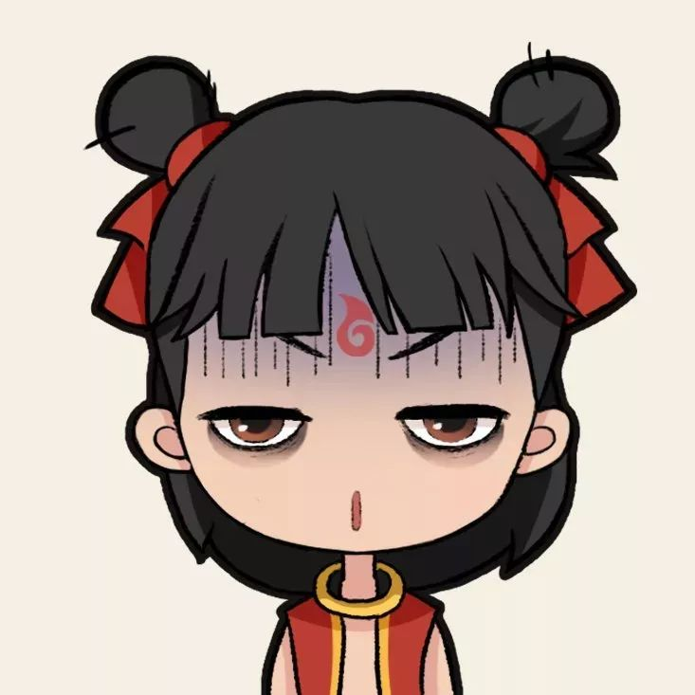
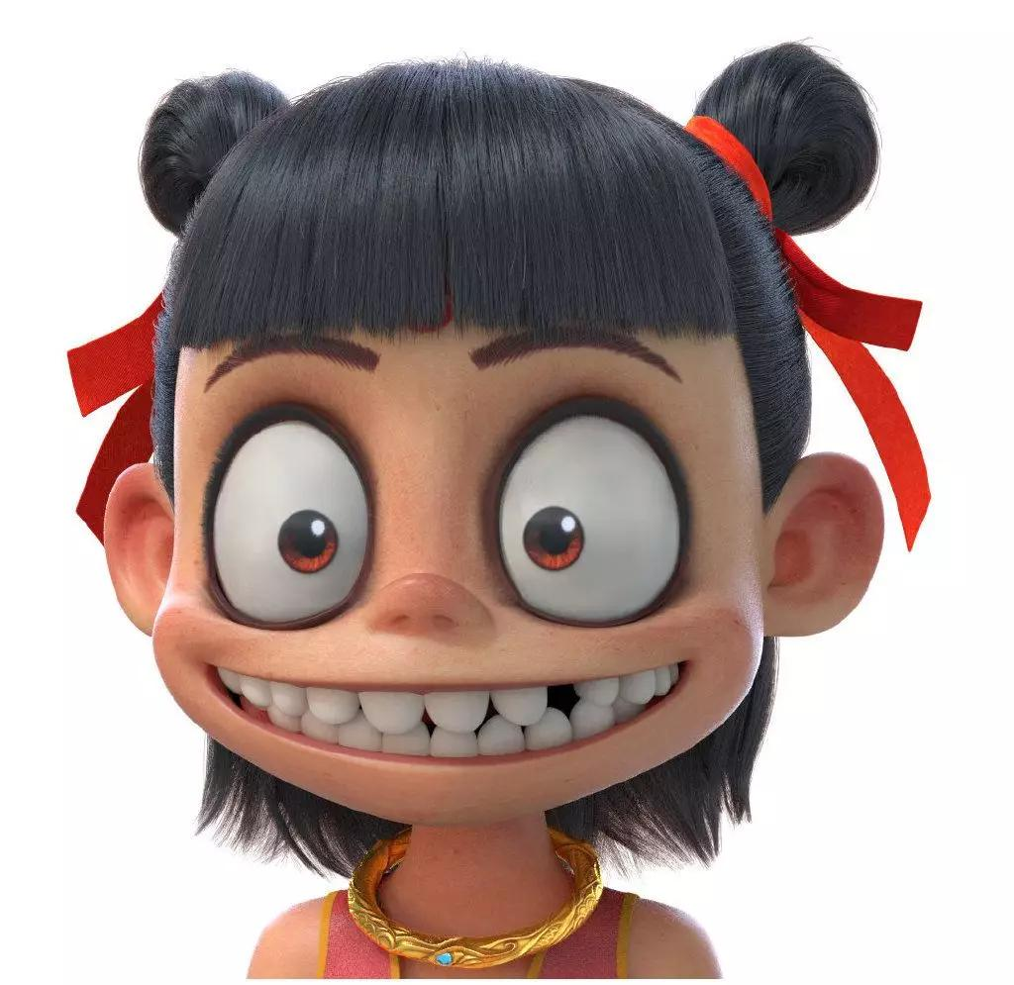
2. Add with+emotional noun（情感名词）to make the action vivid.
He does sth joyfully.
= He does sth with joy.
pride
proud
surprise/amazement
surprised
anger/ dissatisfaction
angry
He looks up
with +
awkwardness/embarrassment
embarrassed
excitement/ satisfaction
excited

Slide 11
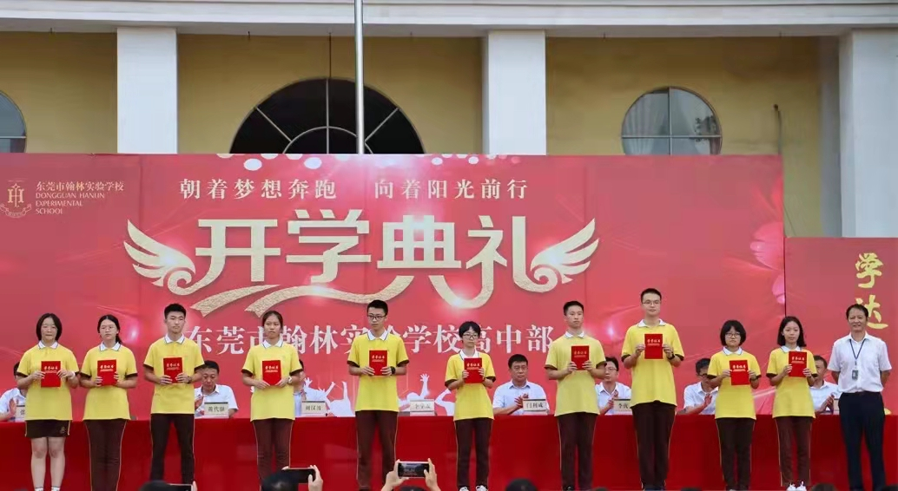
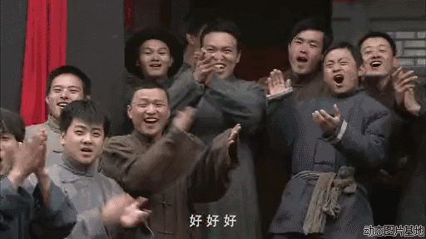
Complete the sentence by adding “with+emotional noun”
When the students heard that their classmates were awarded the first prize for their academic performance, they _________________________________.
clapped their hands with joy/pleasure/
excitement.

Slide 12
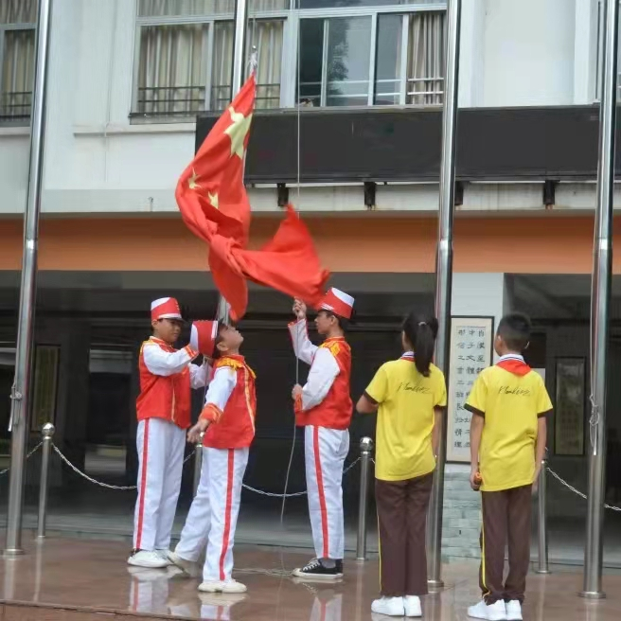
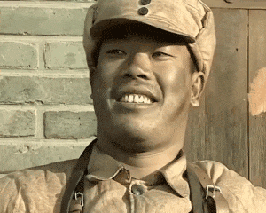
Complete the sentence by adding “with+emotional noun”
Learning that he was chosen as the member of the National Flag Guard (国旗护卫队）, he________________________ .
looked around and beamed with pride

Slide 13
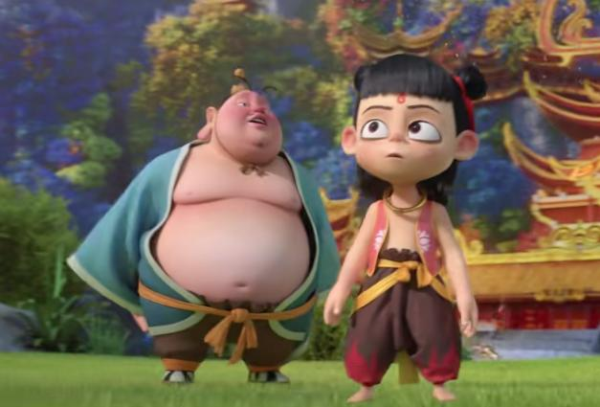

3. adding V1+V2+V3 to make the action vivid and specific
Dividing an action into 3 parts can make the action more specific and vivid .
He went to catch the butterfly.
actions
1.attract
2. step
3.bend
4. put one’s hands around it
structure:A,B and C
Attracted by the beautiful butterfly, ________________________________
________________________________________________________________________________________
he stepped forward
quietly, bent down slowly and put his hands around the butterfly gently.

Slide 14
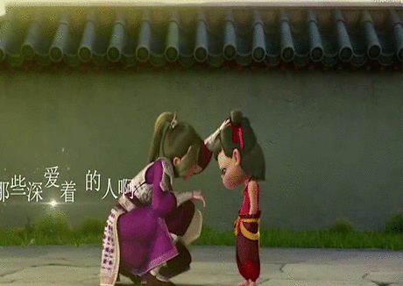
3. adding V1+V2+V3 to make the action vivid and specific
His mother touched his hair and said: ”I love you.“
actions
1.look into one’s eyes
2. touch/stroke
3.say/whisper/murmur
structure: A and B, C-ing
She looked straight into his eyes and stroked his hair gently, whispering into his ears /murmuring,“I love you. ”

Slide 15
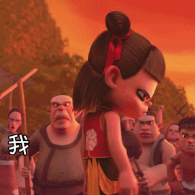
3. adding V1+V2+V3 to make the action vivid and specific
After being misunderstood, he turned around angrily.
actions
1.be misunderstood
2. lower his head
3.turn around
structure:having done sth, A and B
Having been misunderstood, he lowered his head and turned around angrily/with anger.

Slide 16
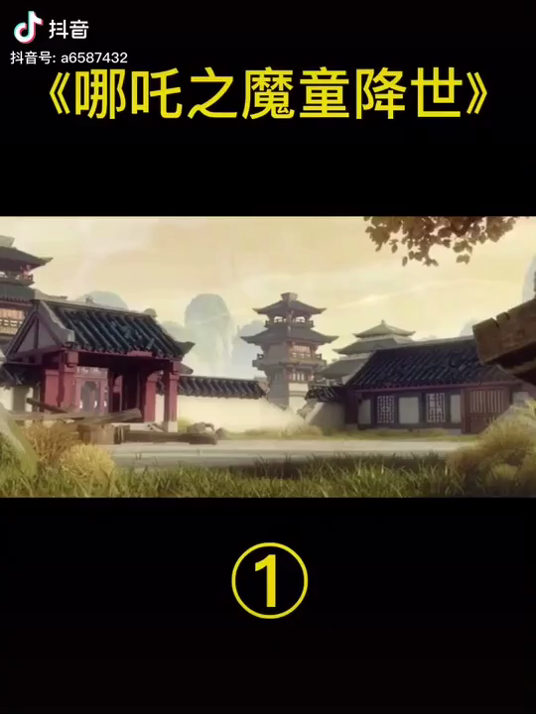
4. Add V-ing (present participle) to make the action vivid.
V-ing forms can be used in the sentence to express active actions happening at the same time, making the sentence more vivid and complete.
What is Ne Zha doing ?
He lies on the wall.
He lies on the wall, ___________________________.
(shake, recite)
shaking his leg and reciting poems .
lazily

Slide 17
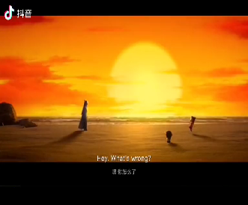
Add V-ing (present participle) to make the action vivid.
V-ing forms can be used in the sentence to express active actions happening at the same time, making the sentence more vivid and complete.
What is Ne Zha doing ?
He felt so moved by Ao Bing’s kindness that he cried.
He felt so moved by Ao Bing’s kindness that he cried, _______________________________ (kick; shout).
violently
wildly
kicking and shouting

Slide 18
Attracted by the beautiful butterfly, He took a step forward quietly ,bent down slowly and put her hands around the butterfly gently.
She looked straight into his eyes and stroked his hair gently, whispering into his ears /murmuring,“I love you. ”
Having been misunderstood, he lowered his head and turned around angrily.
He lies on the wall, shaking his leg and reciting poems lazily.
He felt so moved by Ao Bing’s kindness that he cried, kicking violently and shouting wildly.

Slide 19
EX:
Apply what you have learned to your Continuation Writing.

Slide 20
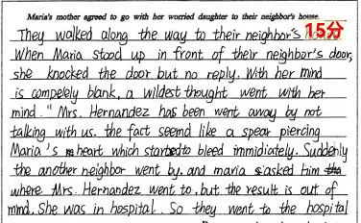
第五次周测
原句：When Maria stood in front of their neighbor’s door,
she knocked at the door but no one replied.
Worried and unsettled, they stopped in front of the door, took a deep breath and knocked at the door gently, hoping that there was nothing wrong indoors. No one answered.

Slide 21
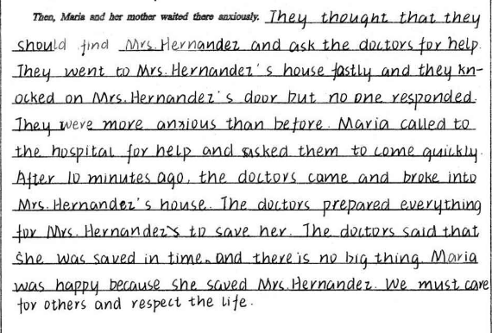
原句：Maria called the hospital for help and asked them to come quickly.
With great fear, Maria called the hospital for help immediately, begging the doctors to come as quickly as possible.

Slide 22
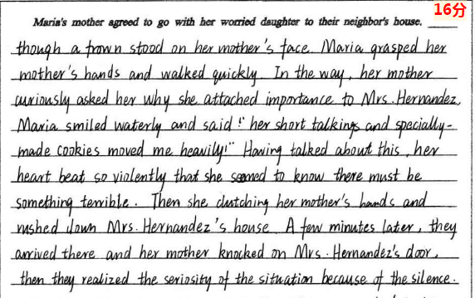
原文：Then she caught her mother’s hands and ran to Mrs. Hernandez’s house.
She was in such a panic that she seized her mother by the hand tightly and dashed towards Mrs. Hernandez’s house, worried.

Slide 23
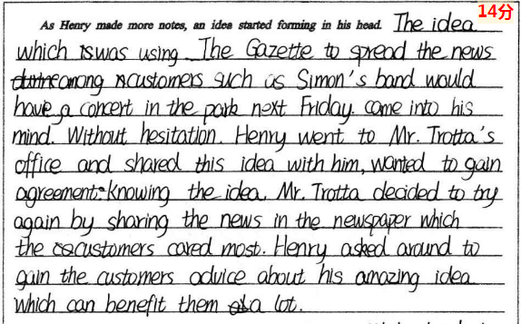

第四次周测
原文：Without hesitation, Henry went to Mr. Trotta’s office and shared this idea with him, wanted to gain agreement.
Without hesitation, Henry went direct into Mr. Trotta’s office and shared this idea with him eagerly, hoping to gain agreement.

Slide 24
summary
How could we make a story vivid (生动）in our continuation writing ?
emotions
looks
actions
speeches

Slide 25

Summary
How could we make description of action vivid ?
Add adverbs(副词）
Add with+emotional noun（情感名词）
A,B and C
V1+V2+V3
A and B, C-ing
having done sth, A and B
Add V-ing

Slide 26
Homework:
Rewrite the composition with the skills we have learned , trying to make you action more vivid and specific.

