Slide 1

感恩遇见，相互成就，本课件资料仅供您个人参考、教学使用，严禁自行在网络传播，违者依知识产权法追究法律责任。
更多教学资源请关注
公众号：溯恩高中英语
知识产权声明

Slide 2
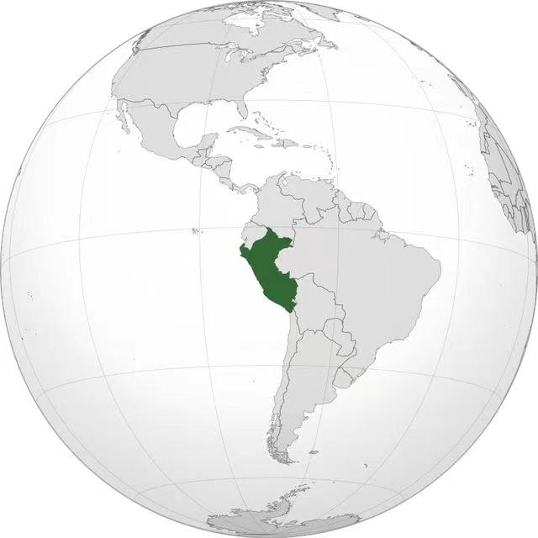
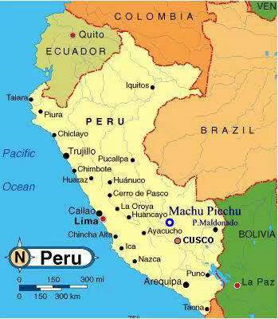
Book1 Unit2 Travelling around
Reading & Thinking
Explore Peru
Peru, South America

Slide 3
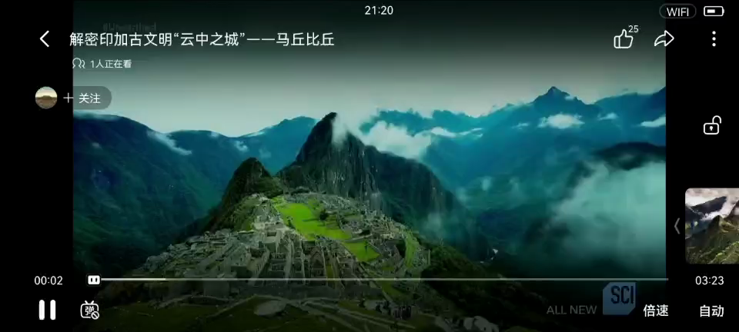
What can you learn about Peru from this video?

Slide 4
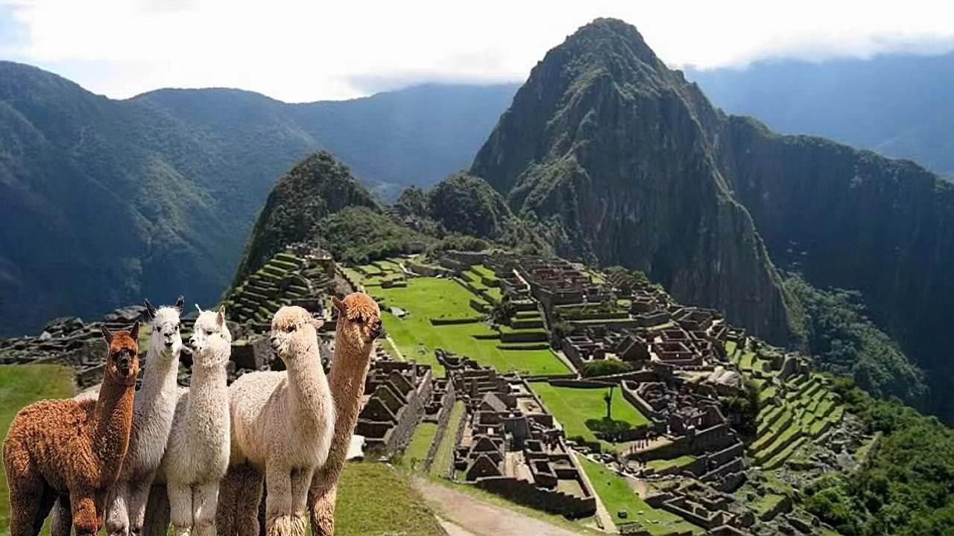
The Lost city of the Inca
High up in the Andes mountains
Machu Picchu

Slide 5

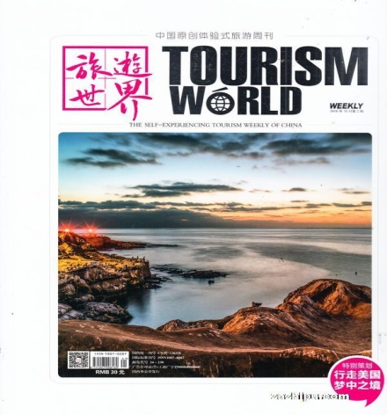

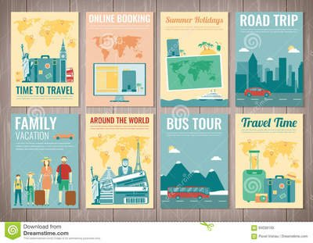

Explore Peru
Apart from video, what other sources of information can you find about Peru?
Sources of information
encyclopedia百科全书 brochure小册子 magazine
books
media
TV websites video blogs
Consult people
Consult friends, teachers, and so on.

Slide 6
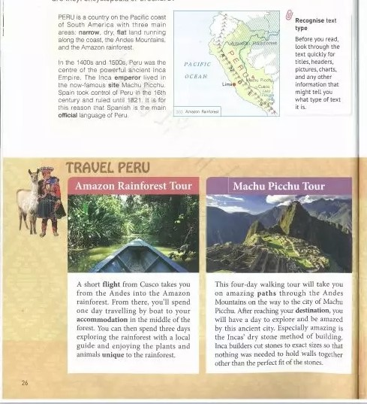
Types of text: encyclopedia or brochure?
encyclopedia
brochure
Recognise text type by looking at the titles, headers页眉, pictures, charts and other information.

Slide 7
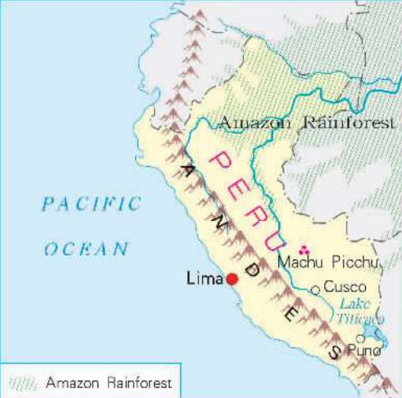
encyclopedia
Peru is a country on the Pacific coast of South America with three main areas: narrow, dry, flat land running along the coast, the Andes Mountains, and the Amazon rainforest.
In the 1400 and 1500s, Peru was the centre of the powerful ancient Inca Empire. The Inca emperor lived in the now-famous site Machu Picchu. Spain took control of Peru in the 16th century and ruled until 1821. It is for this reason that Spanish is the main official language of Peru.
Position
Geography
History
Official language
plain words with a simple map

Slide 8
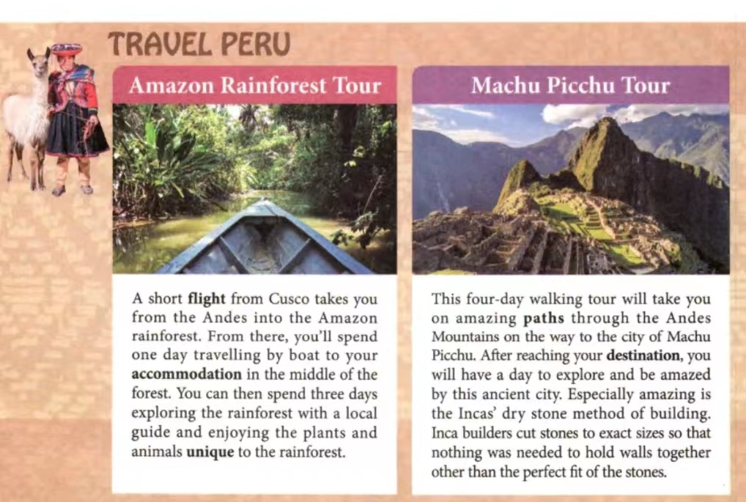
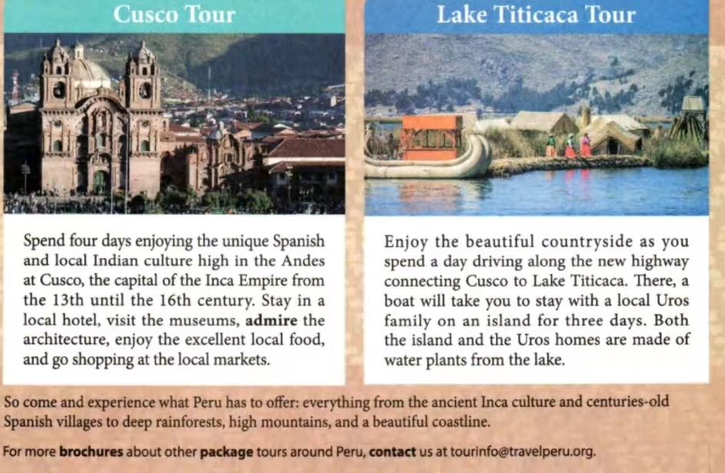
a travel brochure
What is a travel brochure like:
* eye-catching titles and pictures
* brief but well-designed
* vivid and inviting description
* practical information
the footer(页脚)

Slide 9
Travel Peru
So come and experience what Peru has to offer: everything from the ancient Inca culture and centuries-old Spanish villages to deep rainforests, high mountains, and a beautiful coastline.
For more brochures about other package tours around Peru, contact us at tourinfo@travelperu.org.
What’s the purpose of the footer(页脚) in the travel brochure?
To encourage the readers to travel Peru.

Slide 10
Go through the travel brochure and choose a suitable tour to meet the needs of different tourists.
Which tour(s) would you recommend to
those who enjoy history and culture?
B C
Which tour(s) would you recommend to those who want to experience local life?
D
Which tour(s) would you recommend to those who admire natural beauty in the rainforest?
A
Amazon Rainforest Tour.
Machu Picchu Tour.
Cusco Tour
Lake Titicaca Tour

Slide 11
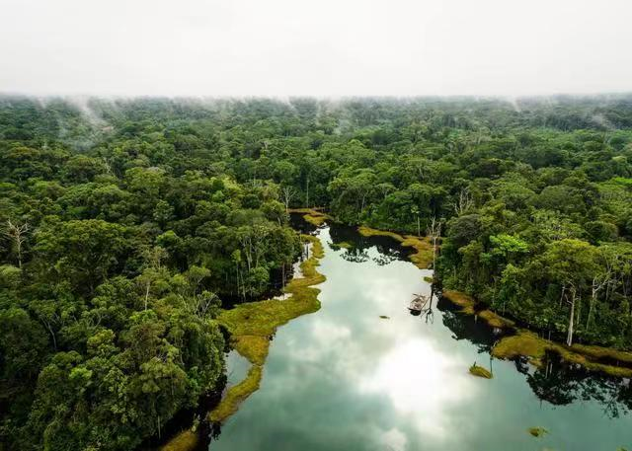
Amazon Rainforest Tour
A short flight from Cusco takes you from the Andes into the Amazon rainforest. From there, you’ll spend one day travelling by boat to your accommodation in the middle of the forest. You can then spend three days exploring the rainforest with a local guide and enjoying the plants and animals unique to the rainforest.
transport
accommodation
activities
by plane/air
by boat
in the middle of the forest
travelling by boat
exploring the rainforest
enjoying the unique wildlife

Slide 12
Machu Picchu Tour
This four-day walking tour will take you on amazing paths through the Andes Mountains on the way to the city of Machu Picchu. After reaching your destination, you will have a day to explore and be amazed by this ancient city. Especially amazing is the Incas’ dry stone method of building. Inca builders cut stones to exact sizes so that nothing was needed to hold walls together other than the perfect fit of the stones.
transport
activity
What makes the ancient city especially amazing?
Vivid description by using adjectives.

Slide 13
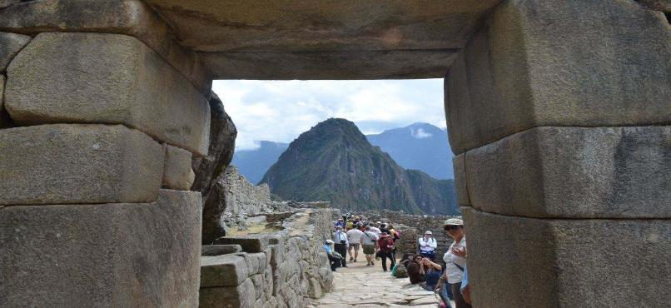
Machu Picchu Tour
Especially amazing is the Incas’ dry stone method of
building. Inca builders cut stones to exact sizes so
that nothing was needed to hold walls together
other than the perfect fit of the stones.
accurate
but/except
match

Slide 14
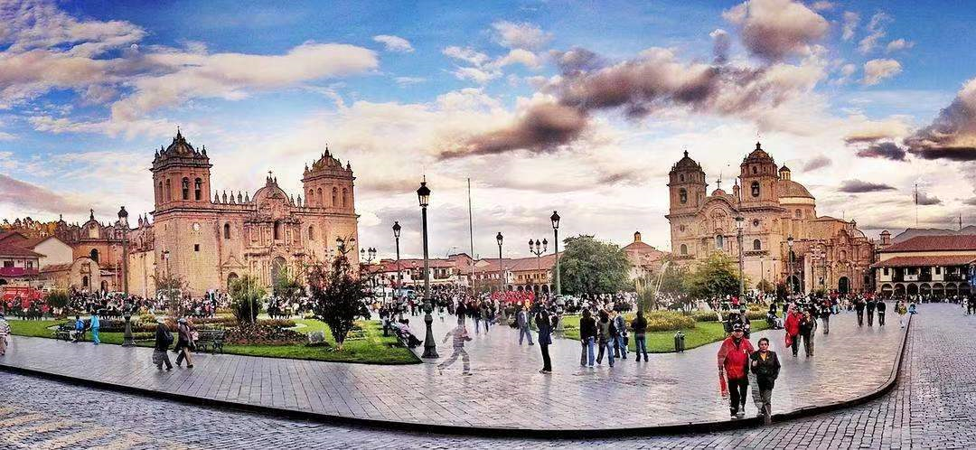
Cusco Tour
Spend four days enjoying the unique Spanish and local Indian culture high in the Andes at Cusco, the capital of the Inca Empire from the 13th until the 16th century. Stay in a local hotel, visit the museums, admire the architecture, enjoy the excellent local food, and go shopping at the local markets.
feature
A unique multicultural city
Historical importance
activities

Slide 15
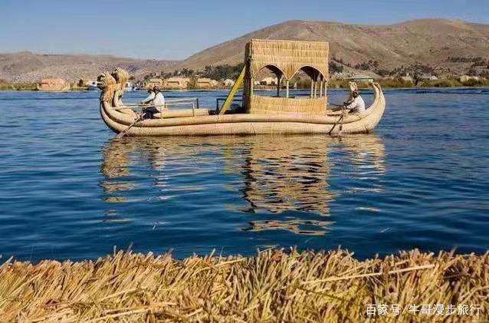
Lake Titicaca Tour
Enjoy the beautiful countryside as you spend a day driving along the new highway connecting Cusco to Lake Titicaca There, a boat will take you to stay with a local Uros family on an island for three days. Both the island and the Uros homes are made of water plants from the lake.
What special activities can visitors
experience there?
Enjoying the beauty of the countryside and
experiencing local life.

Slide 16
Suppose you were a local guide in Peru, please recommend one tour to tourists. Make sure that you make it vivid and appealing.
Tour | Amazon Rainforest Tour | Machu Picchu Tour | Cusco Tour | Lake Titicaca Tour
Feature | *A natural wonder *Accommodate in the middle of the forest | A four-day walking tour architecture | Unique Spanish and local Indian culture | Local life
Activities | *Explore the forest *Enjoy unique plants and animals | *hiking/ walking *explore the ancient city | *stay…visit… admire… enjoy…go shopping | *Enjoy beautiful countryside *Stay with a local family
Your comment

Slide 17
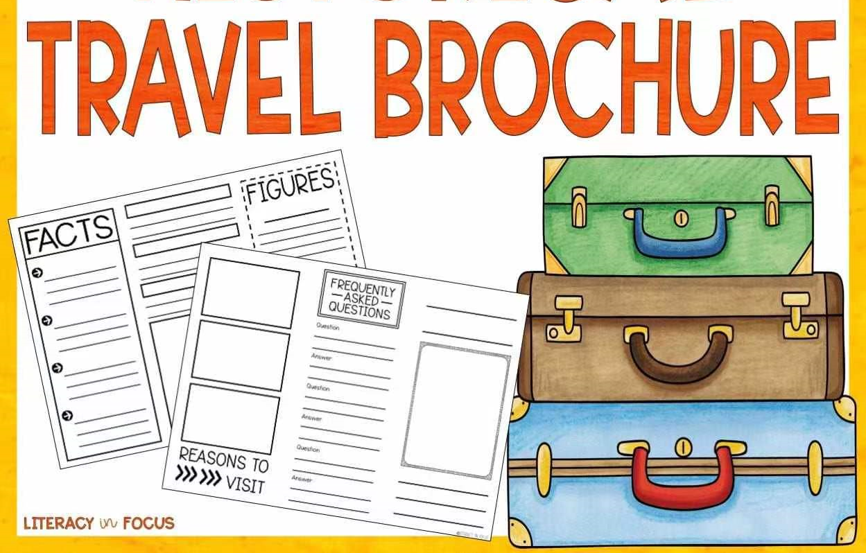
What makes a good travel brochure?
Structure: * An eye-catching Title illustrated with pictures
Content: * list the transport/attractions/activities/accommodation
language:
* brief but well-designed
* vivid and inviting description

Slide 18

Design a travel brochure
I’m Kathy , an exchange student from Britain. I am fond of hiking and always have a great passion for nature. These days I am planning to see beautiful sights in China.The mountains, the sky, the lakes in the countryside are so fascinating.
Which place would you recommend to Kathy?

Slide 19
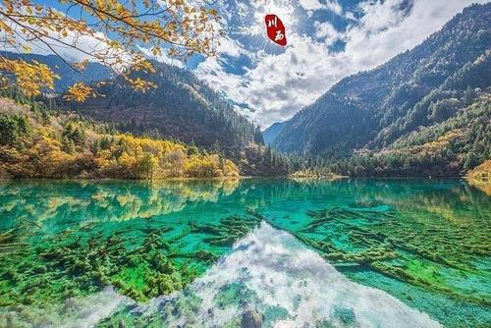
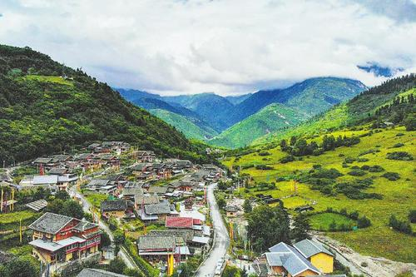
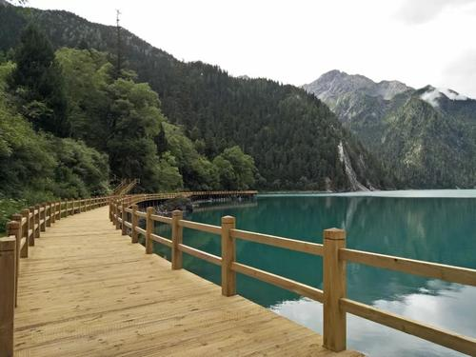
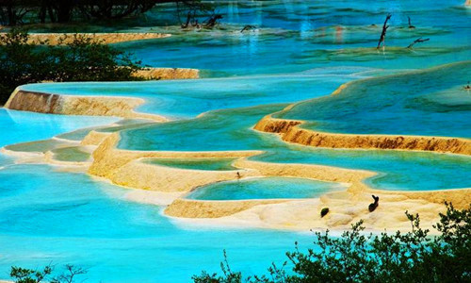
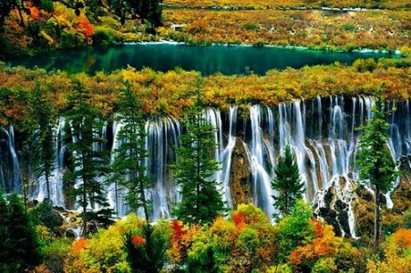
Design a travel brochure (in 80 words or so)
Title: Jiuzhaigou National Forest Park Tour
necessary information | time | accommodation | transport | activity | …
Use vivid expressions to make your description inviting
Sum up your brochure in an inviting tone | So come and experience……
you can spend…exploring and admiring …unique to ...
This hiking/walking tour will take you on amazing paths through….
Especially amazing is …….
A natural wonder with great landscapes and charms
Use the second person “you”
Be vivid and appealing

Slide 20
For reference
Jiuzhaigou National Forest Park Tour
Jiuzhaigou is a natural wonder with great landscapes and charms. This four -day hiking tour will take you to breath-taking sights unique to Jiuzhaigou. After reaching your destination, you can spend two days exploring the forest and admiring beautiful scenery. Besides, you are likely to catch sight of rare plants and animals living there. Especially amazing is the fresh and relaxing air, which you can hardly experience elsewhere. For the last day, you can stay with a local family to enjoy special food and experience local life. If you are interested, please don’t hesitate to come here and you are sure to find it worthwhile.

Slide 21
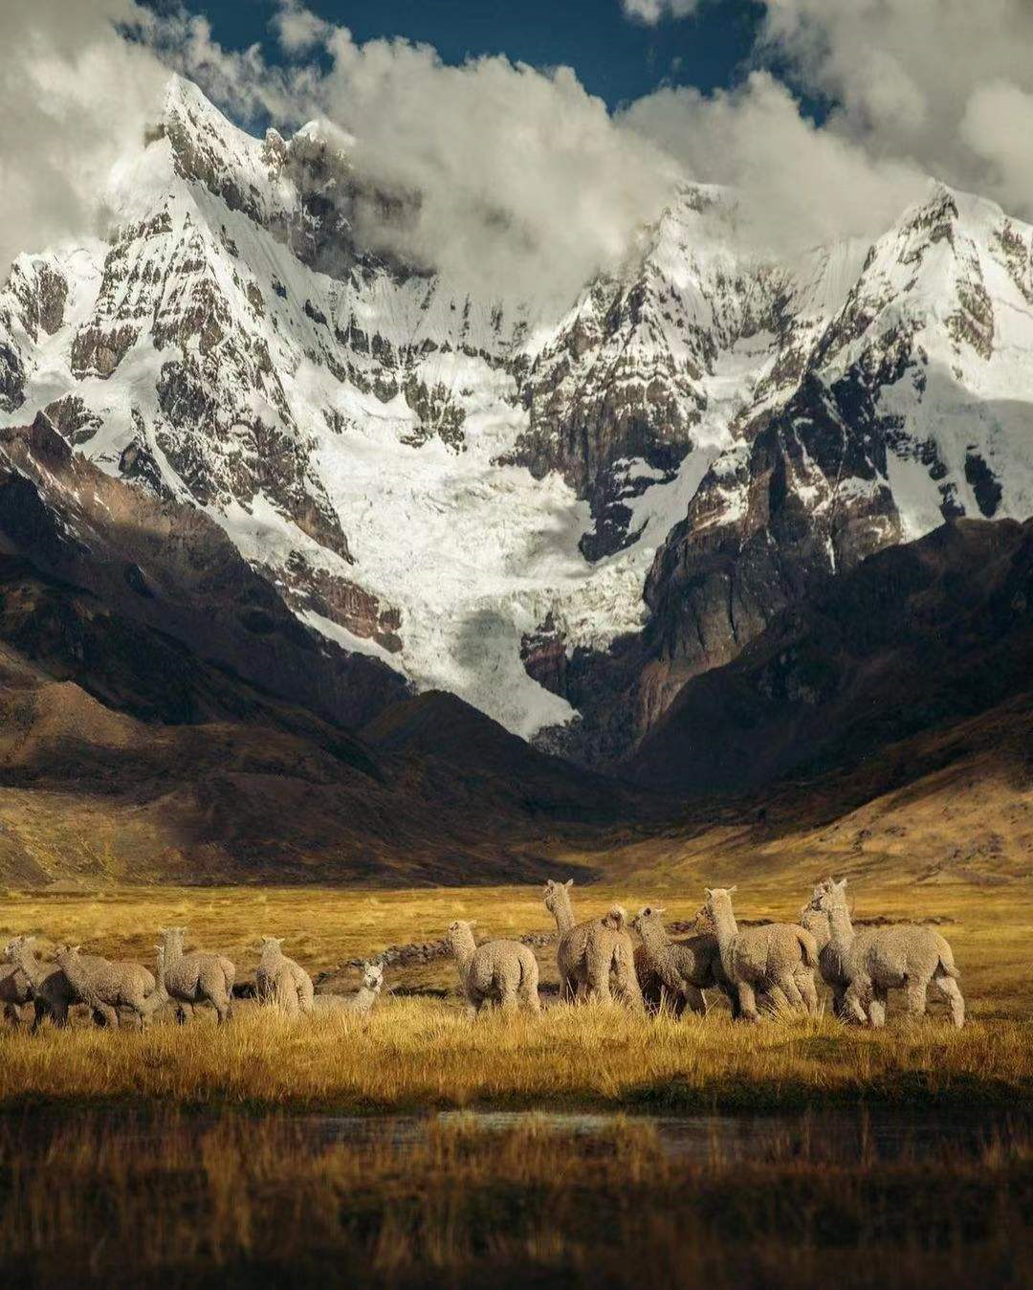
Thank You!

