Slide 1

感恩遇见，相互成就，本课件资料仅供您个人参考、教学使用，严禁自行在网络传播，违者依知识产权法追究法律责任。
更多教学资源请关注
公众号：溯恩高中英语
知识产权声明

Slide 2

The World
September 1st-15th, 2022

Slide 3
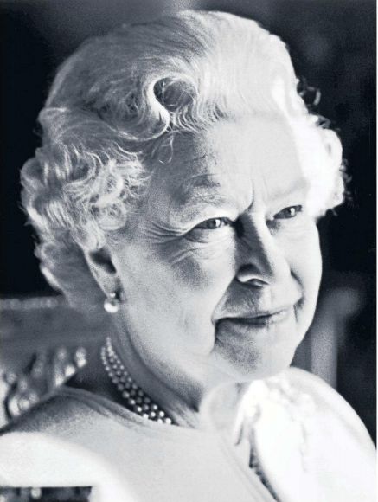
1. Death of the Queen 女王辞世

Slide 4
语篇填空
《泰晤士报》2022年9月9日 P1版面
Her Majesty the Queen, the longest reigning monarch this country has known, has died __________（peace）at Balmoral. As messages of sympathy arrived from around the world the new King, ____ will reign as Charles III, led the tributes to his “beloved mother” as he spoke of the “greatest sadness” for his Family.
The Queen’s death marks the passing of the only sovereign most people in Britain _________ (know). She served her country _______ war, peace, social upheaval and ____________ (technology) revolution, a symbol of continuity and steadfast devotion to duty while the world changed around her.
Elizabeth became Queen ______ she expected to, after her father died of lung cancer at the age of 56 while she was on tour in Kenya. She was 25 and, although already a mother of two, was young enough _____________ (embrace) in those postwar years as a symbol of youth, promise and a brighter future.
She broke records, including _________ becoming the world’s oldest reigning monarch, the longest-reigning of her time and the most travelled. In September 2015 she _______ (pass) Victoria’s record for the longest reign this country has known. Yet the numbers do not say how, by her modesty, herself-sacrifice, her ___________ (commit) and her seriousness of purpose, she became a revered figure around the world.
peacefully
who
have known
through
technological
before
to be embraced
becoming
passed
commitment

Slide 5
词汇讲解
1. reign: to rule as king, queen, emperor , etc. 统治；当政；为王；为君
Queen Victoria reigned from 1837 to 1901.
维多利亚女王自1837年至1901年在位。
2. revere: to feel great respect or admiration for sb/sth. 尊敬；崇敬
So, you want others to respect you, you should Revere him first.
如此，你希望别人尊重你，你就要先尊敬他。
翻译句子
那时，他统治巴勒斯坦。
He reigned over Palestine at that time.
翻译句子
让自己学会敬畏生命，珍惜拥有！
Let yourself learn to revere life and cherish what you have!

Slide 6
句子翻译
She served her country through war, peace, social upheaval and technological revolution, a symbol of continuity and steadfast devotion to duty while the world changed around her.
她在战争、和平、社会动荡和技术革命中为国家服务，在她周围的世界发生变化时，她象征着持续和坚定的奉献。
翻译
Yet the numbers do not say how, by her modesty, herself-sacrifice, her commitment and her seriousness of purpose, she became a revered figure around the world.
然而，这些数字并没有说明她是如何通过她的谦虚、她的自我牺牲、她的尽责和她对目标的认真态度而成为世界各地受人尊敬的人物的 。
翻译

Slide 7
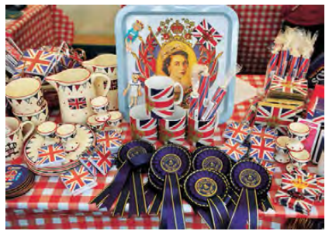
2. Souvenir sales soar after monarch’s
death, but rise in value takes time
女王辞世，纪念品销量飙升
Memorabilia on display at the Royal Yacht Britannia for the queen’s Diamond Jubilee in May 2012 in Edinburgh, Scotland.

Slide 8
语篇填空
（《华盛顿邮报》 2022年9月12日 A11版面）
Lambert of London, a gift shop less ____ a mile northeast of Buckingham Palace, will be out of Queen Elizabeth Ⅱ ________ (souvenir) by the weekend.
“We had a whole burst of online orders last night, and a lot of stuff has gone out the door today,” Michael Blumberg, ___ employee, told The Washington Post in a phone interview Friday. “We didn’t expect her majesty to leave us, so it’ll be a week or so before the new stock ______ (arrive).”
Major events surrounding the royal family often lead to surges in sales for everything from tchotchkes (小玩意儿) ___ fine china and gold coins. Jubilees, __ particular, are worth millions in memorabilia sales. For the queen’s recent platinum __________ (celebrate), the Center for Retail Research found that _________ (spend) on souvenirs, memorabilia and gifts reached over 281 million pounds, or more than $326 million.
But marking of the end of __________ (long) reign by a British monarch opens up new opportunities for retailers and buyers, experts say. And for those ____ have collected rare items over the years, her death marks the start of those items’ expected rise in value.
than
souvenirs
an
arrives
to
in
celebration
spending
the longest
who

Slide 9
词汇讲解
1. surge: a sudden increase in the amount or number of sth 激增
We are having trouble keeping up with the recent surge in demand. 对于近来出现的需求猛增，我们难以应对。
2. reign: the period during which a king, queen, emperor , etc. rules 君主统治时期
In this lecture I shall concentrate on the early years of Charles’s reign. 这一节课我将着重讲查理王朝的早期统治时期。
翻译句子
专家们认为最近通货膨胀的激增有各种各样的原因。
Specialists see various reasons for the recent surge in inflation.
翻译句子
亨利二世统治期间发生了巨大的变化。
Great changes took place during Henry II’s reign.

Slide 10
句子翻译
Major events surrounding the royal family often lead to surges in sales for everything from tchotchkes to fine china and gold coins. Jubilees, in particular, are worth millions in memorabilia sales.
与王室有关的重大事件往往会导致从小摆设到精美瓷器和金币等各种商品的销量飙升。尤其是60周年纪念，纪念品销售价值数百万美元。
翻译
But marking of the end of the longest reign by a British monarch opens up new opportunities for retailers and buyers, experts say. And for those who have collected rare items over the years, her death marks the start of those items’ expected rise in value.
但专家表示，英国君主在位时间最长的结束为零售商和买家带来了新的机会。 对于那些多年来收集稀有物品的人来说，她的去世标志着这些物品有望升值的开始。
翻译

Slide 11
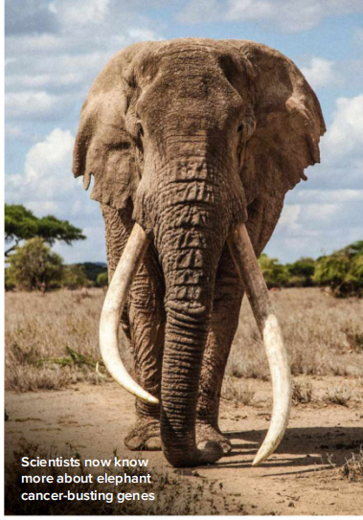
3. Elephants at an advantage
大象抗癌能力强
The key to preventing cancerin humans may be found in elephant genes

Slide 12
语篇填空
（《BBC 野生生物》 2022年9月刊 43页）
from / of
You would expect elephants to die ________ cancer at a similar rate to humans.Their large body size and the fact that they have a similar life expectancy to us ____ (be) the major clues here. Yet while cancer mortality in humans is 25 per cent, in elephants it is just five per cent. New research in Molecular Biology and Evolution, _________ (conduct) by the University of Oxford and six other __________ (institution), has shed light on why that might be, pointing to the role played by a cancer-busting gene known as p53.
While humans possess a single p53 gene, ______ helps regulate and repair mechanisms of the DNA and suppresses uncontrolled cell growth, elephants have 20. Using biochemical _______ (analyse) and computer simulations to analyse elephant DNA, scientists pinpointed how p53 is activated in __ unique way to increase the response to carcinogenic (致癌的) conditions and defend against tumours, helping explain why elephants are at an advantage _____ humans when it comes to ________ (avoid) cancer.
Co-author and trustee of Save the Elephants, Fritz Vollrath, says, “This... demonstrates... ____ important it is that we not only conserve but also study these signature animals in minute detail.”
are
conducted
institutions
which
analysis
a
over
avoiding
how

Slide 13
词汇讲解
1. suppress: to prevent sth from growing, developing or continuing 压制；阻止
The government is suppressing inflation by increasing interest rates. 政府正通过提高利率来抑制通货膨胀。
2. pinpoint: to discover or explain exactly the real facts about something or the cause of a problem 准确解释（或说明）
The report pinpointed the areas most in need of help. 报告精确说明了亟待援助的地区。
翻译句子
这种病毒会抑制人体的免疫系统。
The virus suppresses the body’s immune system.
翻译句子
几乎不可能确定死因。
It was almost impossible to pinpoint the cause of death.

Slide 14
句子翻译
New research in Molecular Biology and Evolution, conducted by the University of Oxford and six other institutions, has shed light on why that might be, pointing to the role played by a cancer-busting gene known as p53.
牛津大学和其他六家机构在《分子生物学与进化》上进行的一项新研究揭示了这种现象的原因，指出了一种名为p53的抗癌基因在其中发挥的作用。
翻译
Using biochemical analysis and computer simulations to analyse elephant DNA, scientists pinpointed how p53 is activated in a unique way to increase the response to carcinogenic conditions and defend against tumours, helping explain why elephants are at an advantage over humans when it comes to avoiding cancer.
利用生化分析和计算机模拟分析大象的DNA，科学家们精确地指出了p53是如何以一种独特的方式被激活，以增加对致癌条件的反应，并抵御肿瘤，这有助于解释为什么大象在抗癌方面比人类更有优势。
翻译

Slide 15
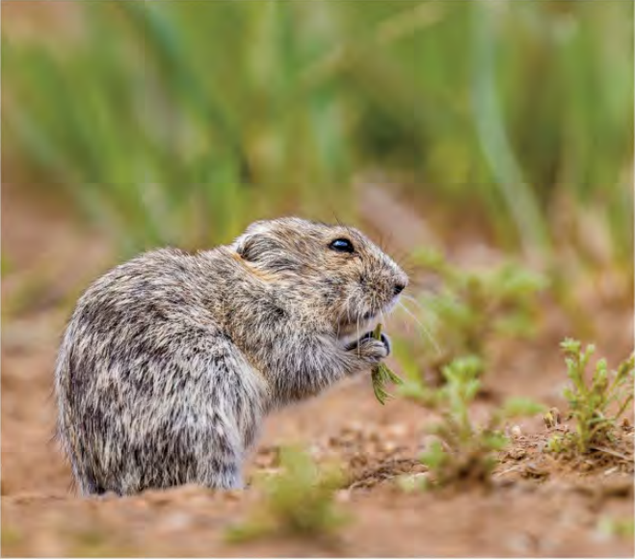
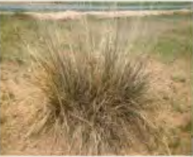
4. Animal Behavior: Cutting Their Risks 田鼠的避险行为
To keep birds of prey at bay, these four-footed lawn mowers engineer their ecosystem.

Slide 16

语篇填空
（《国家地理》2022年9月刊 BREAKTHROUGHS | EXPLORE 板块）
Trimming the grass around their homes may be a chore for many humans, but for Brandt’s voles it’s a matter of life and death, new research shows. The little rodents ________ (find) in grasslands in Mongolia, Russia—and China, where they’re ________ (regular) observed trimming tall grasses near the openings of their burrows so they can watch the skies ___ predators such as shrikes, their chief avian adversary. When shrikes are flying around, Brandt’s voles use their teeth to fell the bunchgrass ______ (dot) their home fields. ___ the rodents neither eat the plant nor bring it into their burrows, scientists observed. ___ a test, the scientists put nets over the voles’ _______ (burrow) so shrikes couldn’t get close—and the voles stopped cutting the grass. The shrikes seem to have adapted also: They began avoiding areas ______ their hunting cover had been mowed by the voles, according to the study. Its findings are a ________ (remind) of how a single species, however small, can alter ___ entire ecosystem.
are found
regularly
for
dotting
But
As
burrows
where
reminder
an

Slide 17
词汇讲解
1. trim: to make sth neater, smaller, better, etc., by cutting parts from it 修剪
Grass shears are specially made to trim grass growing in awkward places.
除草剪刀专门用于修剪缝隙角落里的青草。
2. adversary: a person that sb is opposed to and competing with in an argument or a battle （辩论、战斗中的）敌手，对手
Elliott crossed the finish line just half a second behind his adversary.
埃利奥特跨过终点线时仅比对手落后半秒钟。
翻译句子
我朋友每 8 个星期为我修剪一次头发。
My friend trims my hair every eight weeks.
翻译句子
他的政敌正在给他制造一些麻烦。
His political adversaries were creating a certain amount of trouble for him.

Slide 18
句子翻译
The little rodents are found in grasslands in Mongolia, Russia—and China, where they’re regularly observed trimming tall grasses near the openings of their burrows so they can watch the skies for predators such as shrikes, their chief avian adversary.
这种小型啮齿动物生活在蒙古、俄罗斯和中国的草原上，人们经常看到它们在洞穴开口附近修剪高草，这样它们就可以观察天空中的捕食者，比如它们的主要鸟类对手伯劳。
翻译
The shrikes seem to have adapted also: They began avoiding areas where their hunting cover had been mowed by the voles, according to the study.
翻译
伯劳鸟似乎也适应了：根据这项研究，它们开始避开狩猎掩体被田鼠修剪过的区域。

Slide 19
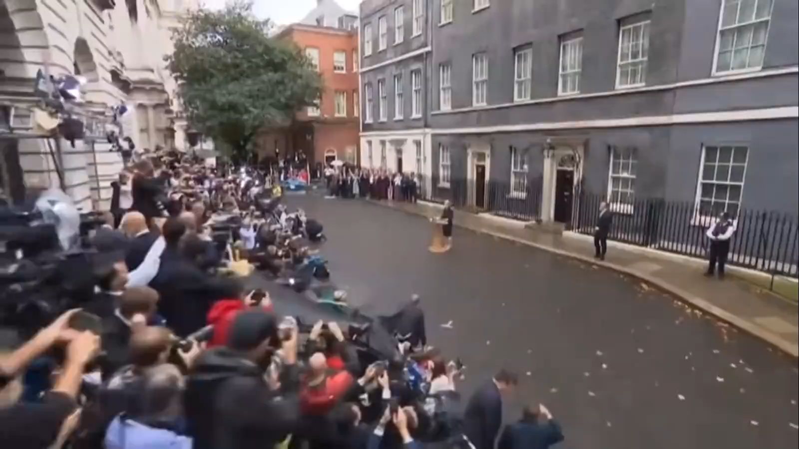
5. Prime Minister Liz Truss’s Statement: 6 September 2022
英国新任首相特拉斯首次演讲

Slide 20

听力填空
Good afternoon, I have just accepted Her Majesty The Queen’s kind ________ to form a new government.
Let me ____________ my predecessor. Boris Johnson delivered Brexit, the Covid vaccine, and stood up to Russian aggression. History will see him as a hugely ____________ Prime Minister.
I’m honoured to ______________________ at a vital time for our country. What makes the United Kingdom great is our fundamental belief in freedom, in ________ , and in _______. Our people have shown ____, courage and determination time and time again.
We now face severe global headwinds caused by Russia’s appalling war in Ukraine and the aftermath of Covid. Now is the time to _____ the issues that are holding Britain back. We need to build roads, homes and broadband faster. We need more _________ and great jobs in every town and city across our country. We need to reduce the ______ on families and help people get on in life. I know that we have what it takes to tackle those challenges. Of course, it won’t be easy. But we can do it...
invitation
pay tribute to
consequential
take on this responsibility
enterprise
fair play
grit
tackle
investment
burden

Slide 21
词汇讲解1
1. tribute: (to sb) something that you say, do or make to show your admiration and respect for someone 致敬；颂词；献礼
This book is a fitting tribute to the bravery of the pioneers.
本书是对先驱们大无畏精神恰如其分的献礼。
2. grit: the courage and determination that makes it possible for sb to continue doing sth difficult or unpleasant 勇气；毅力
You’ve got to admire her grit. 你不得不佩服她的勇气。
翻译句子
他赞扬了组委会。
He paid tribute to the organising committee.
翻译句子
士兵们表现得很有勇气。
The soldiers showed that they had plenty of grit.

Slide 22
词汇讲解2
3. appalling: shocking; extremely bad 令人震惊的；使人惊骇的；极为恶劣的
They have been living under the most appalling conditions for two months.
他们已经在恶劣不堪的条件下生活两个月了。
4. aftermath: the situation that exists as a result of an important (and usually unpleasant) event, especially a war, an accident, etc.（战争、事故、不快事情的）后果，创伤
In the aftermath of an earthquake, it’s understandable to feel hopeless.
地震过后，感到绝望是可以理解的。
翻译句子
囚犯的居住条件极为恶劣。
The prisoners were living in appaling conditions.
翻译句子
战后进行了大量的重建工作。
A lot of rebuilding took place in the aftermath of the war.

