Slide 1


感恩遇见，相互成就，本课件资料仅供您个人参考、教学使用，严禁自行在网络传播，违者依知识产权法追究法律责任。
更多教学资源请关注
公众号：溯恩高中英语
知识产权声明

Slide 2
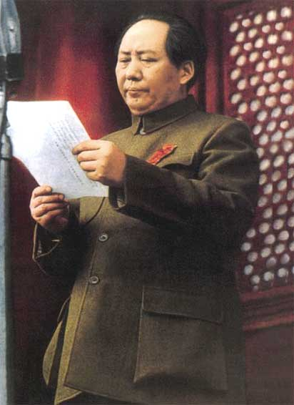
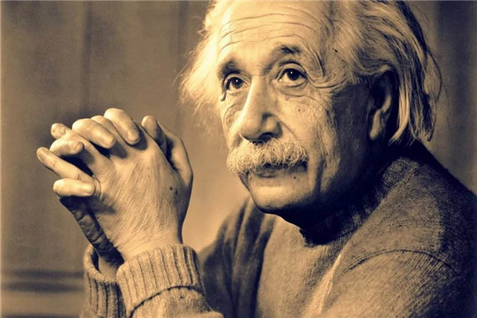
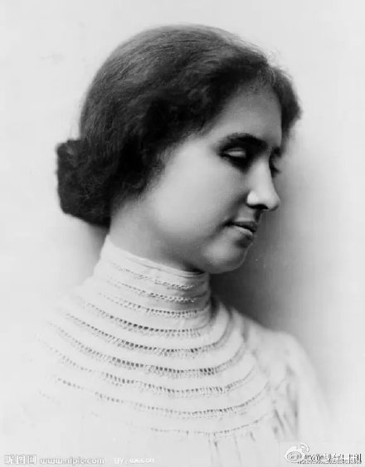
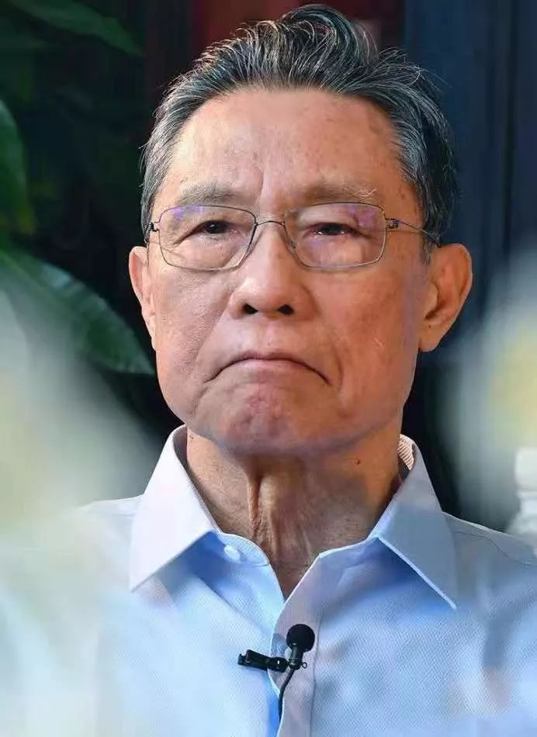
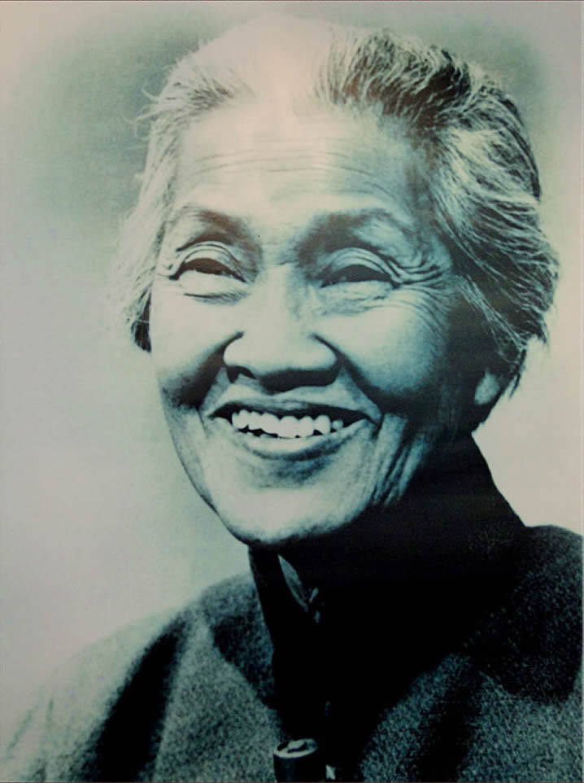
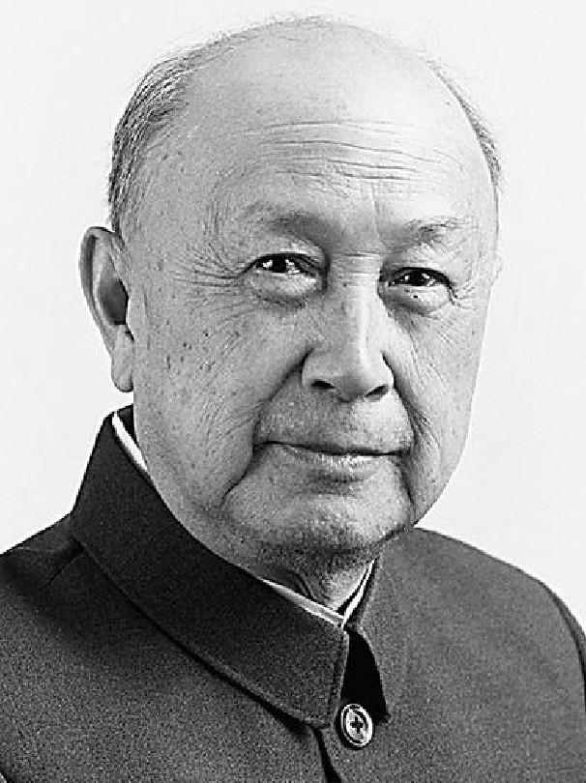
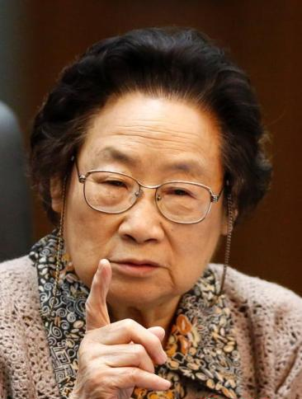
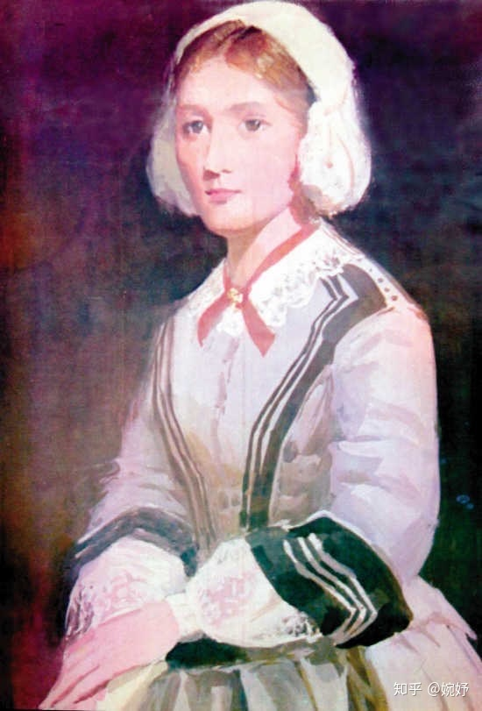
Unit1
People Of achievement
How to write a book report

Slide 3
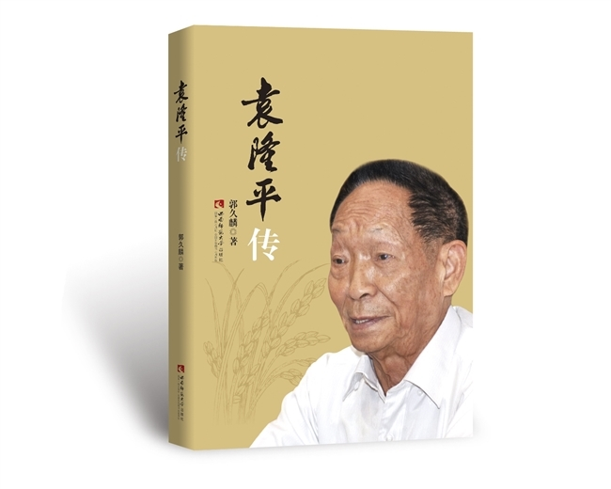
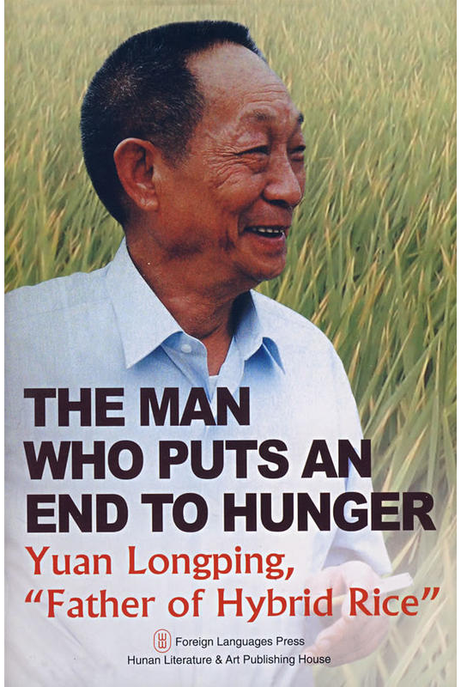
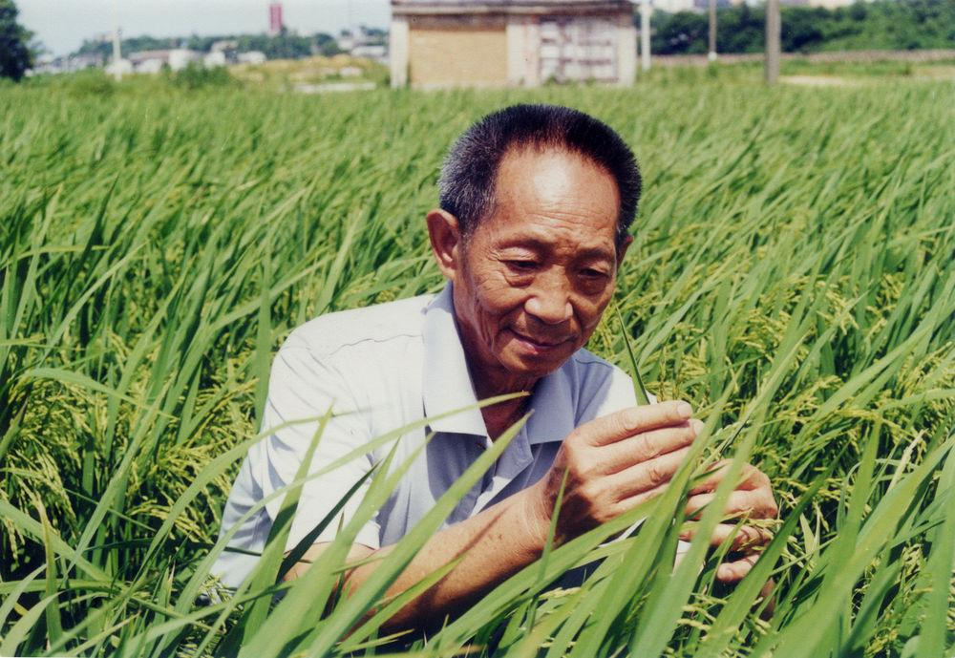
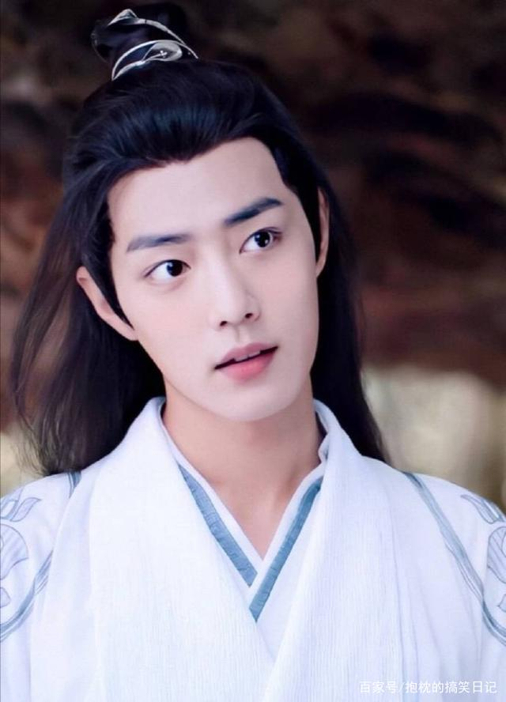
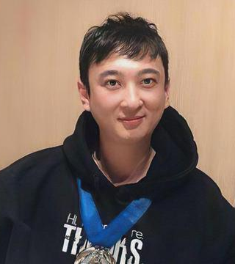
Lead-in
Read
a book about a person--
biography(传记)
What does “people of achievement” mean to you?
Who is he?
Do you know his story?
If you want to know more about a great person, what will you do?

Slide 4

Group work
Share the books you have read about the people you admire.
Q1. What does the book tell?
Q2. How the book makes you
feel or think about the person?
a book report

Slide 5

The Structure of a Book Report
1
2
Your comments on the book
A brief introduction of the book

Slide 6
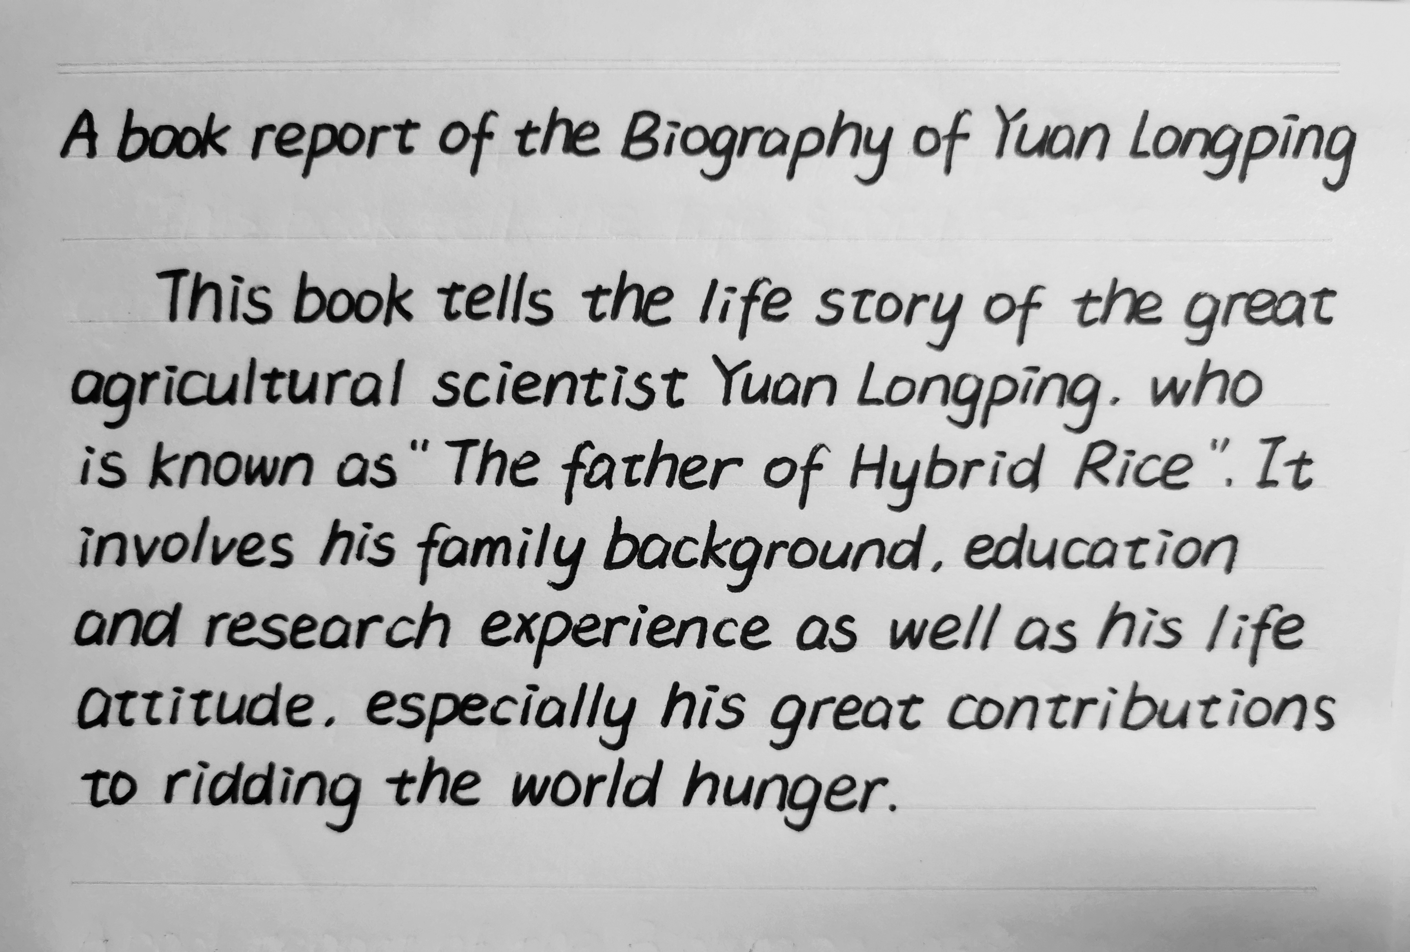
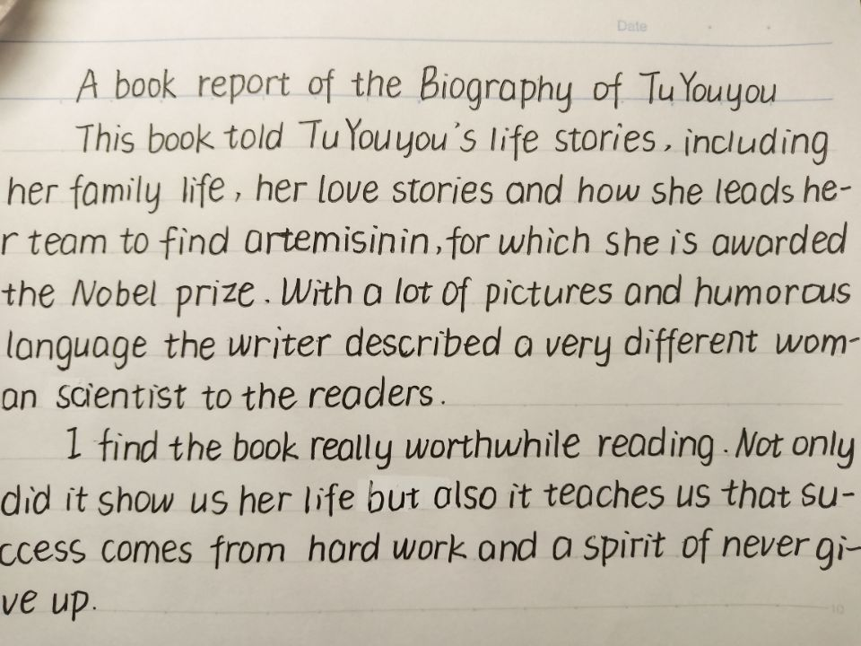
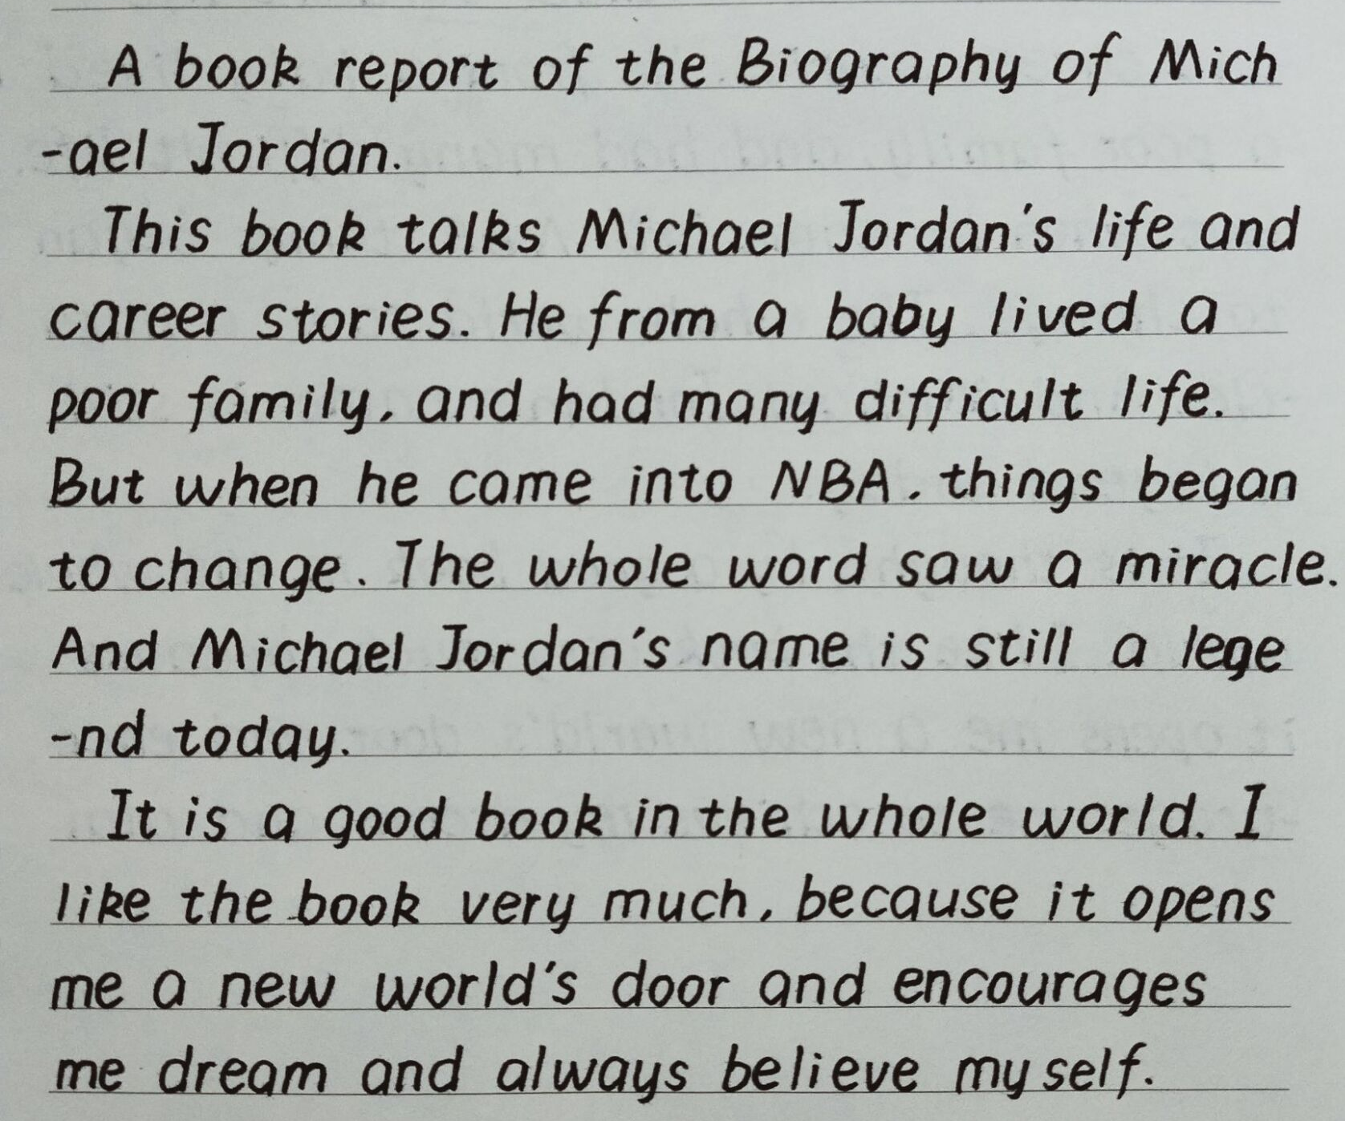
Students’ work

Slide 7
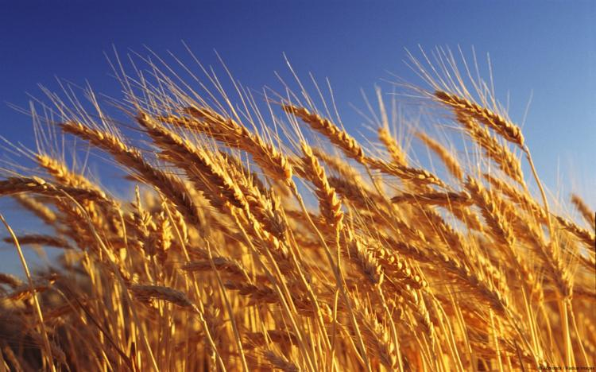
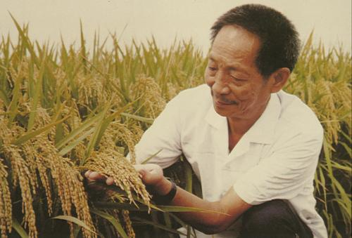
Sample 1
典型问题1：结构不完整
brief introduction

Slide 8
Correction
A book report of the Biography of Yuan Longping
This book tells the life story of the great agricultural scientist Yuan Longping, who is known as “the Father of Hybrid Rice”. It involves his family background, education and research experience as well as his life attitude, especially his great contributions to ridding the world of hunger.
brief introduction
The book is worth reading. It give us a deeper insight of Yuan Longping’s life and how he made great achievements despite so many difficulties, which inspires us to work hard to achieve my goal and make contributions to society.
comments

Slide 9
Sample 2
典型问题2:
时态混乱

Slide 10
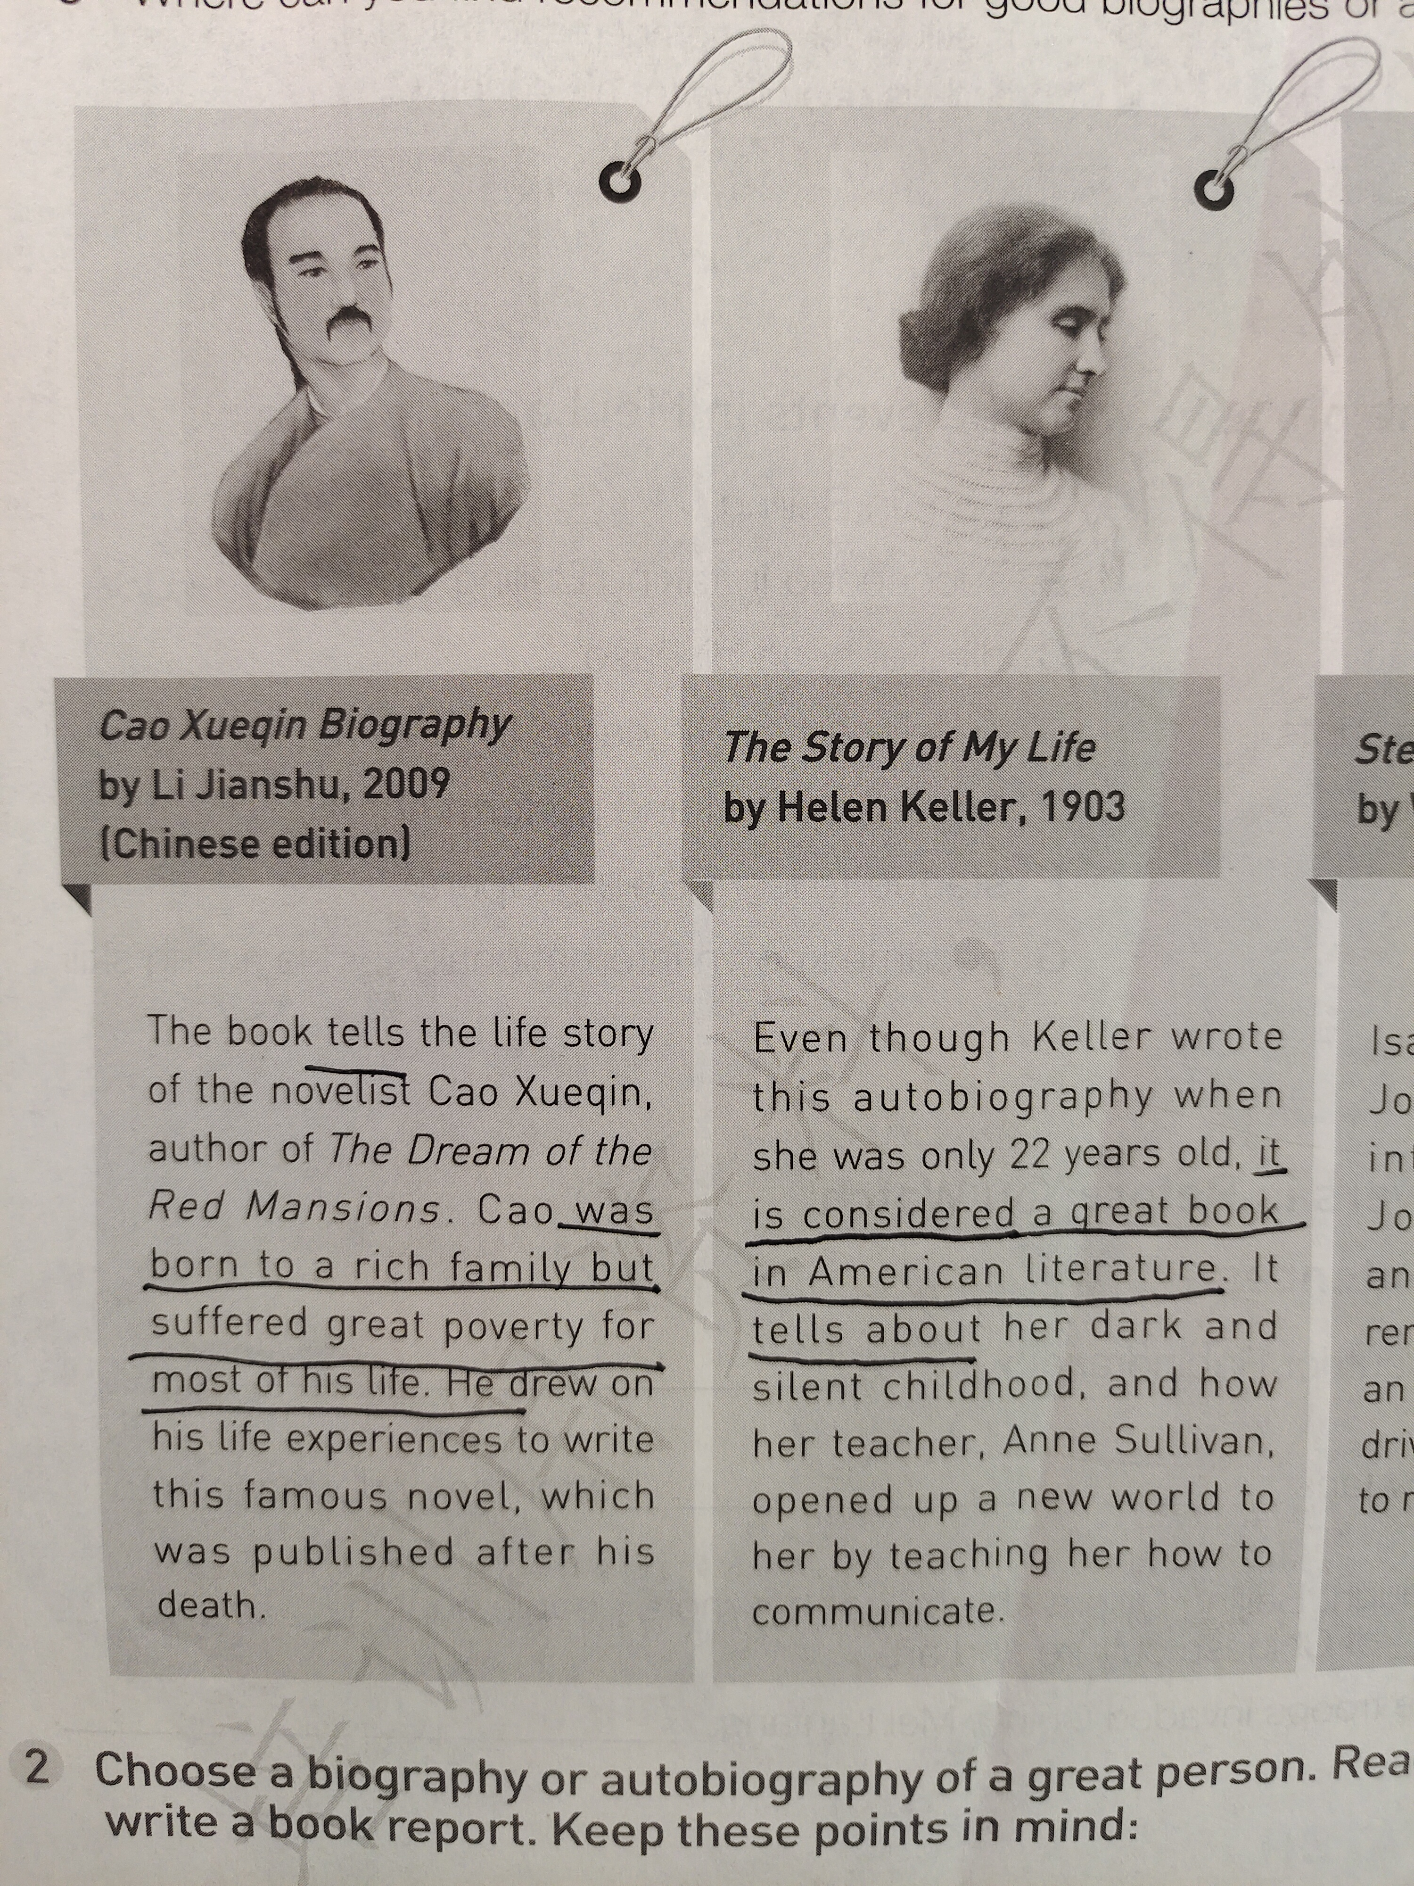
It ____ considered a great book in American literature.
is
tells
It ______ about ...
opened
Her teacher, _______ up a new world to her...

Slide 11

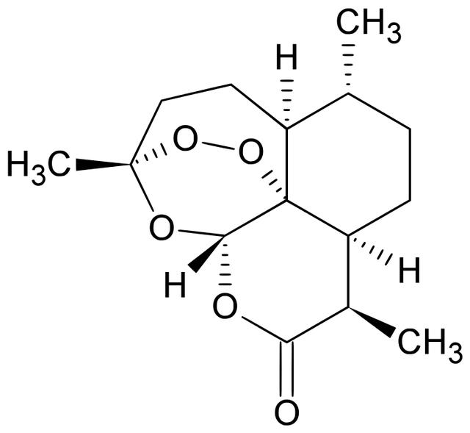
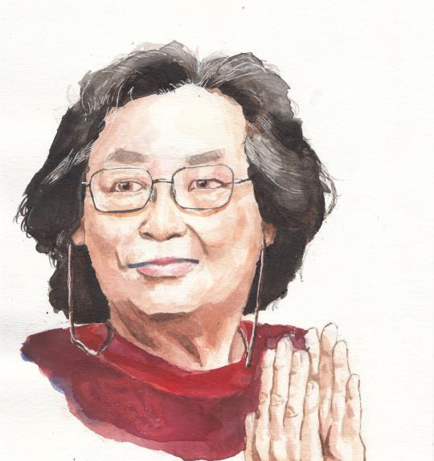
Correction
A book report of the Biography of Tu Youyou
This book told Tu Youyou's life stories, including her family life, her love stories and how she leads her team to find artemisinin, for which she is awarded the Nobel prize. With a lot of pictures and humorous language the writer described a very different woman scientist to the readers.
I find the book really worthwhile reading. Not only did it show us her life but also it teaches us that success comes from hard work and a spirit of never give up.
tells
led
was
describes
does

Slide 12
Sample 3
典型问题3:
语言表达

Slide 13
The book ________ the life story of...
tells
Cao _____________ a rich family but __________ ______________ for most of his life.
was born to
suffered
great poverty

Slide 14
It is ___________ a great book in American literature.
considered
She ____________ a new world to her ____________ her how to communitate.
opened up
by teaching

Slide 15
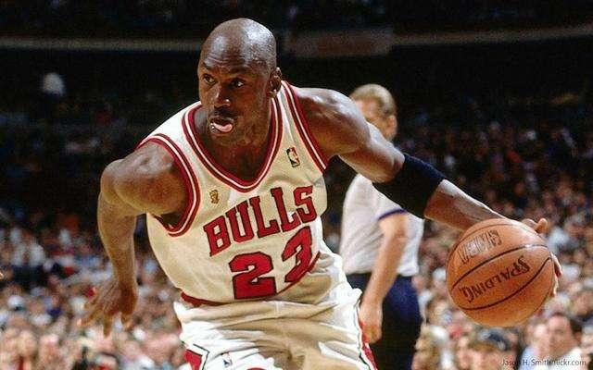
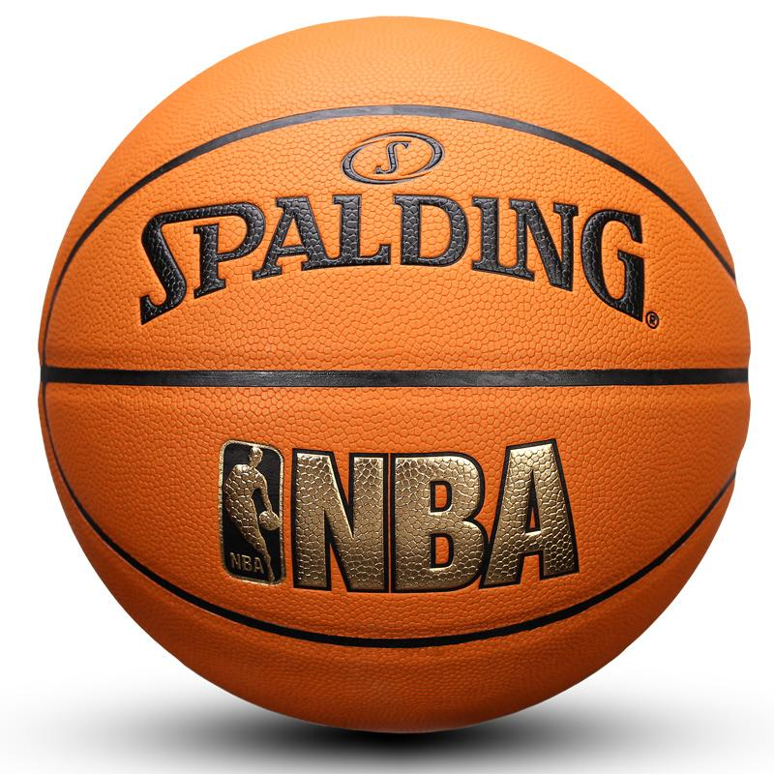
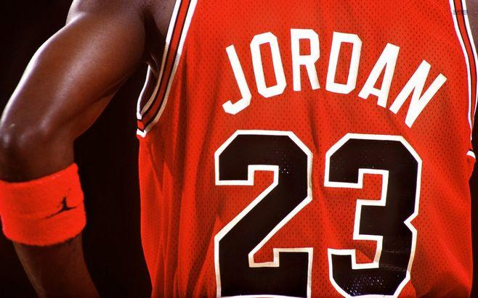
Sample 3
A book report of the Biography of Michael Jordan
This book talks Michael Jordan's life and career stories. He from a baby lived a poor family, and had many difficult life. But when he came into NBA, things began to change. The whole world saw a miracle. And Michael Jordan's name is still a legend today.
It is thought by a good book in the whole world. I like the book very much, because it opens me a new world's door and encourages me to achieve my dream and always believe myself.
tells
He was born to a poor family, and suffered great
poverty.
It is considered a great book
it opens up a new world to
me by encouraging me

Slide 16

Conclusion
教学设计/
结构完整
brief introduction + comments
教学重难点
01
时态正确
02
教学重难点
key
points
correct tense
教学重难点
语言地道优美
03
Authentic language

Slide 17
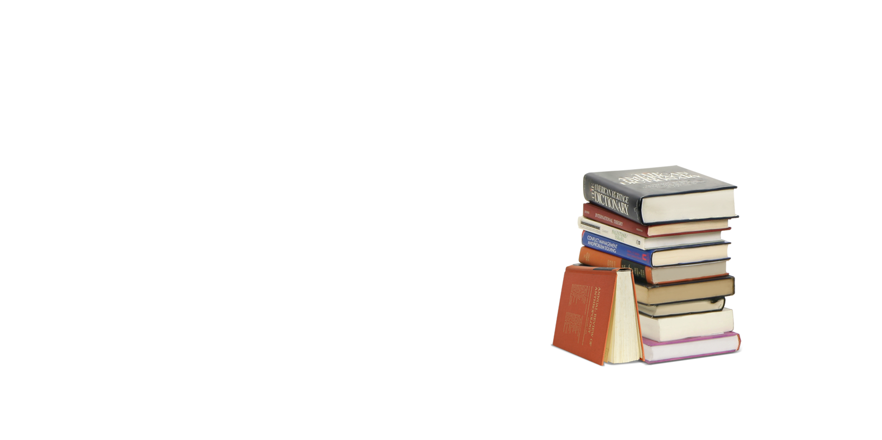
Practice
高考链接
假设你是李华，你校英文杂志Youth向你征稿，请你推荐一本伟人传记，内容包括：
1.这本书的简介；
2.推荐理由。
注意：
1.词数80左右；
2.可适当增加细节，以使行文连贯。

Slide 18
Practice
Dear classmates ,
I would like to recommend you a book named...
______________________________________________
_____________________________________________________________________________________________________________________________________________
_______________________________________________
__________________________________________________________________________________________________________________________________________

Slide 19
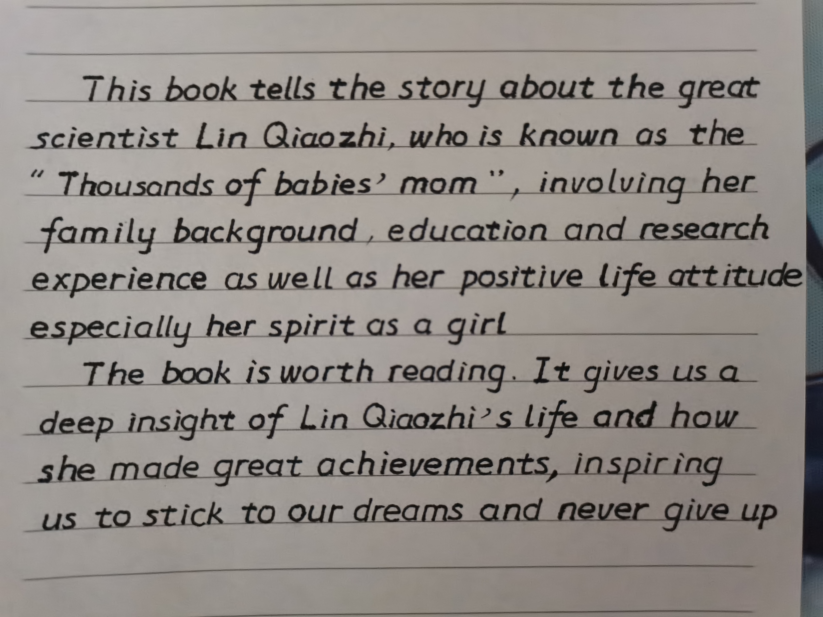
Students' Job

Slide 20
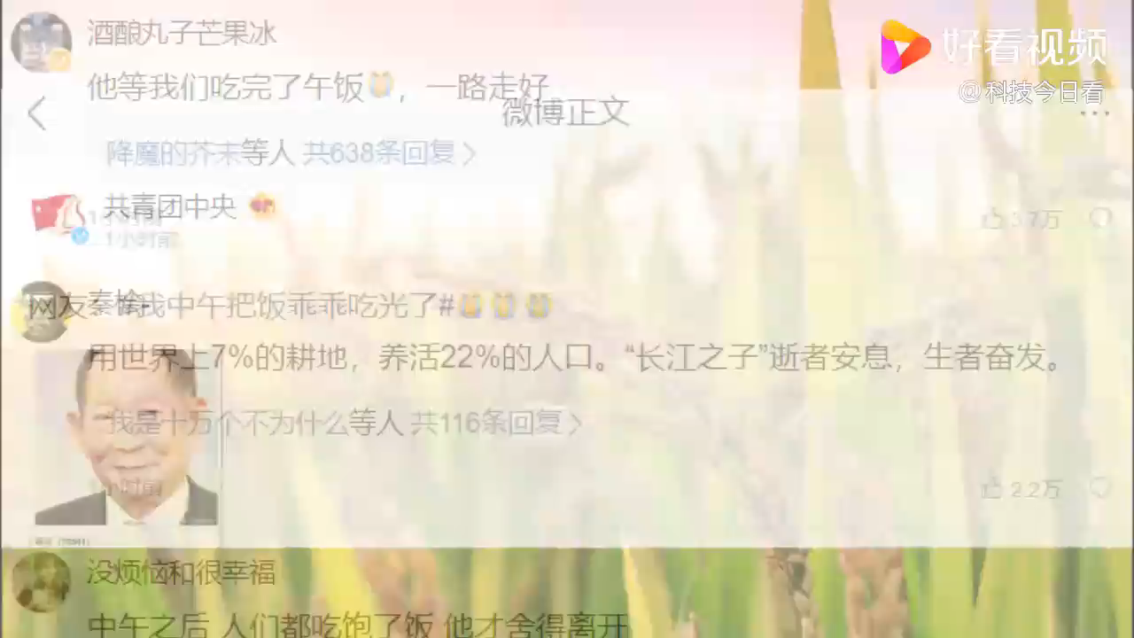
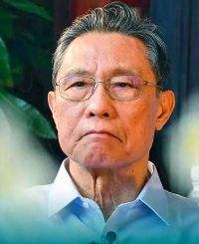
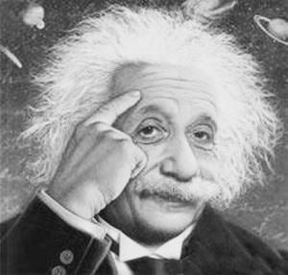
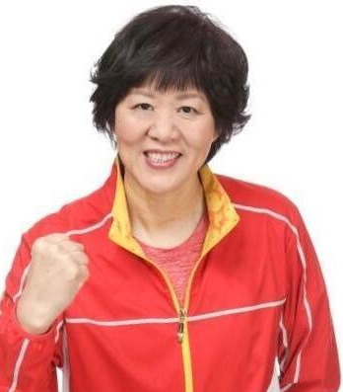
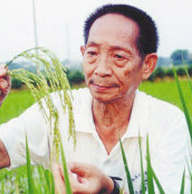
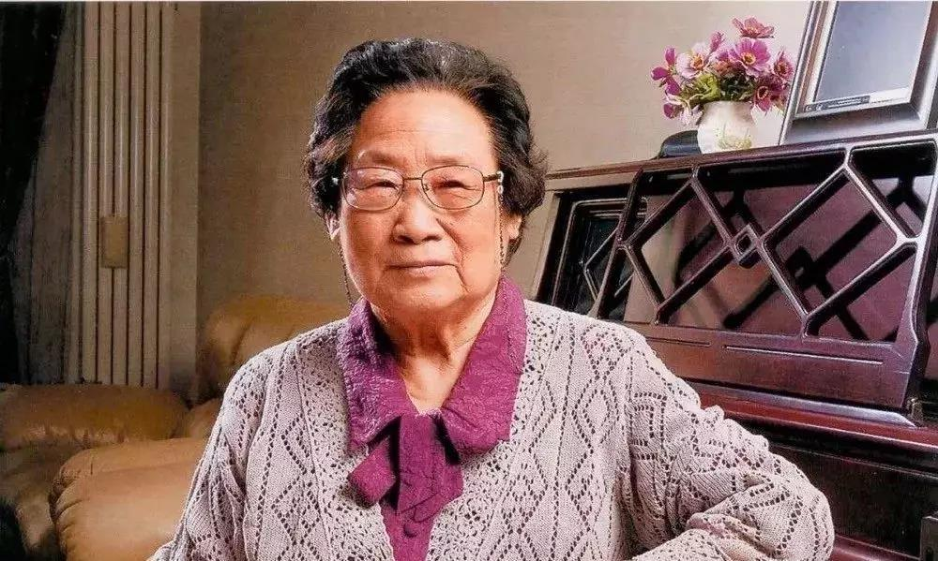
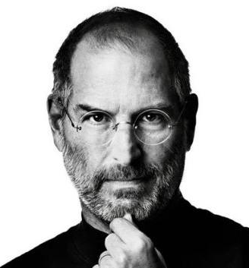
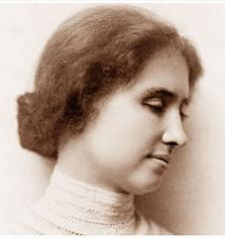
Further thinking
What do they have in common?
Do you want to be a person like them?
What preparations are you going to make?

Slide 21
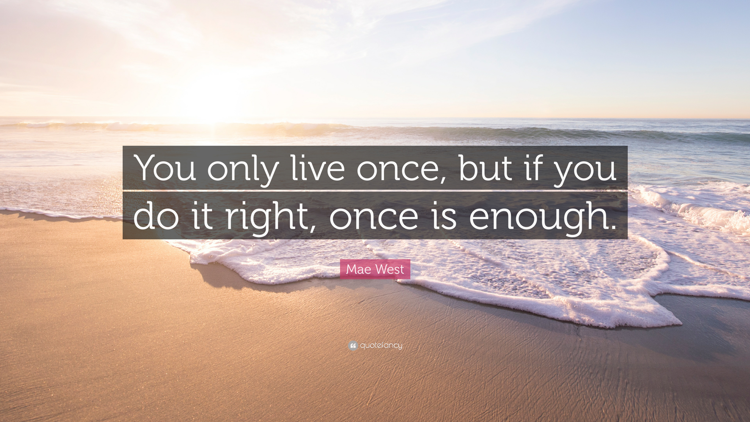
No matter what you choose,
stick to your original aspiration!

Slide 22
Homework
Make a book report in your class and introduce the biography you have read to your classmates.
Thank You!

