Slide 1

感恩遇见，相互成就，本课件资料仅供您个人参考、教学使用，严禁自行在网络传播，违者依知识产权法追究法律责任。
更多教学资源请关注
公众号：溯恩高中英语
知识产权声明

Slide 2

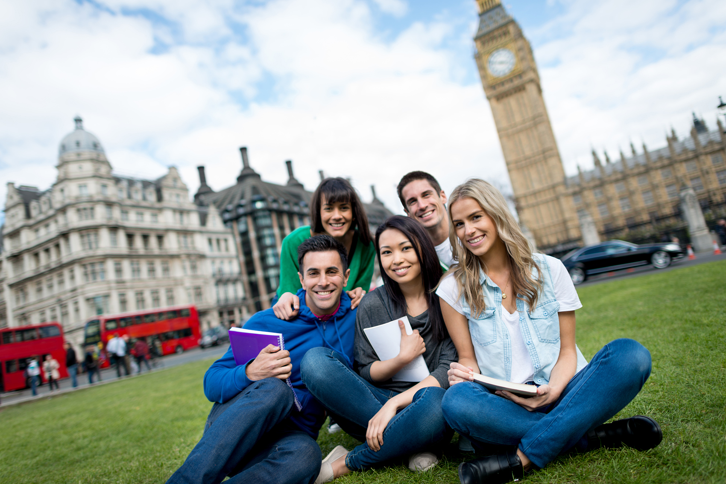
Unit 2 BRIDGING CULTURES
Workbook---Reading and writing

Slide 3
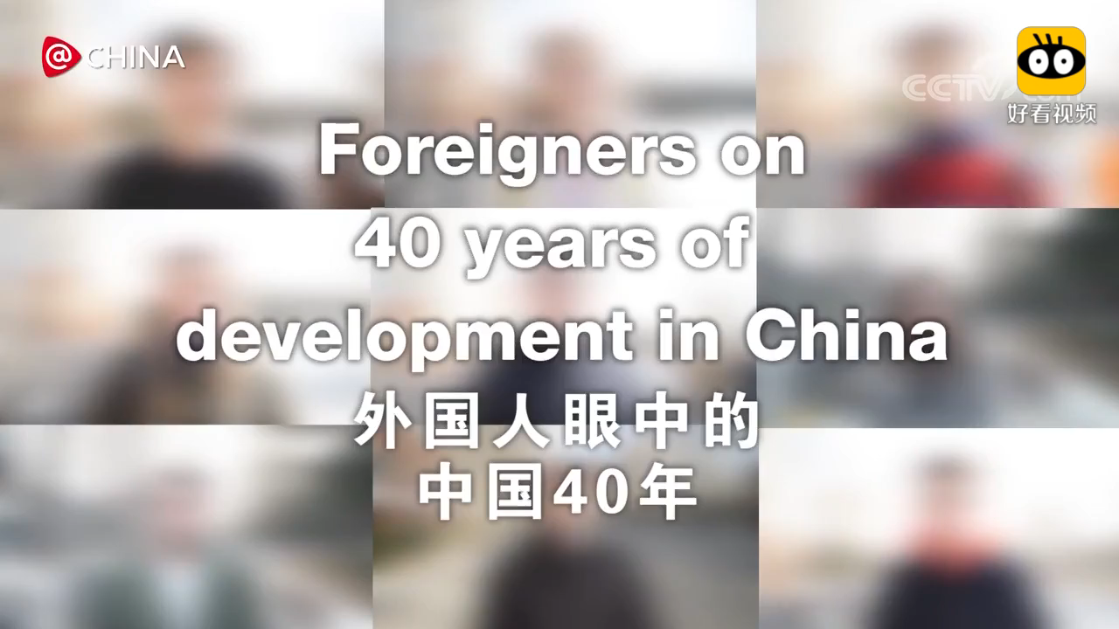
Warming-up
Enjoy a video

Slide 4

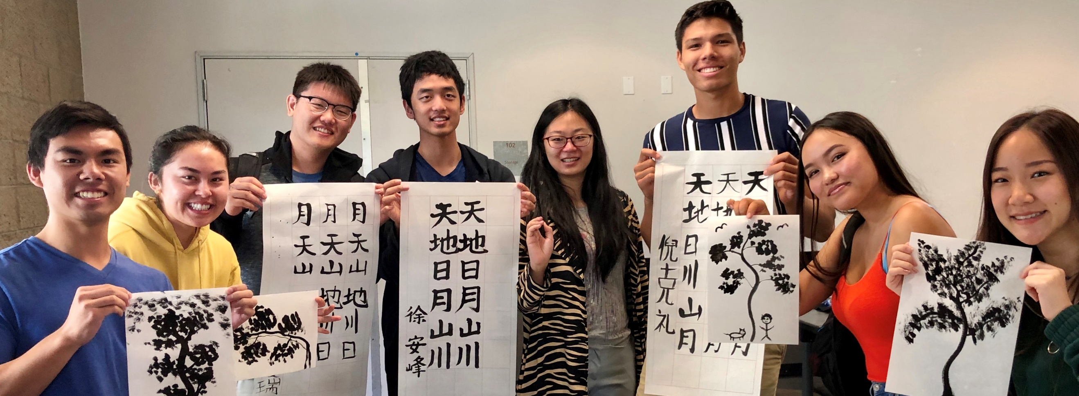
Lead-in
Jim

Slide 5
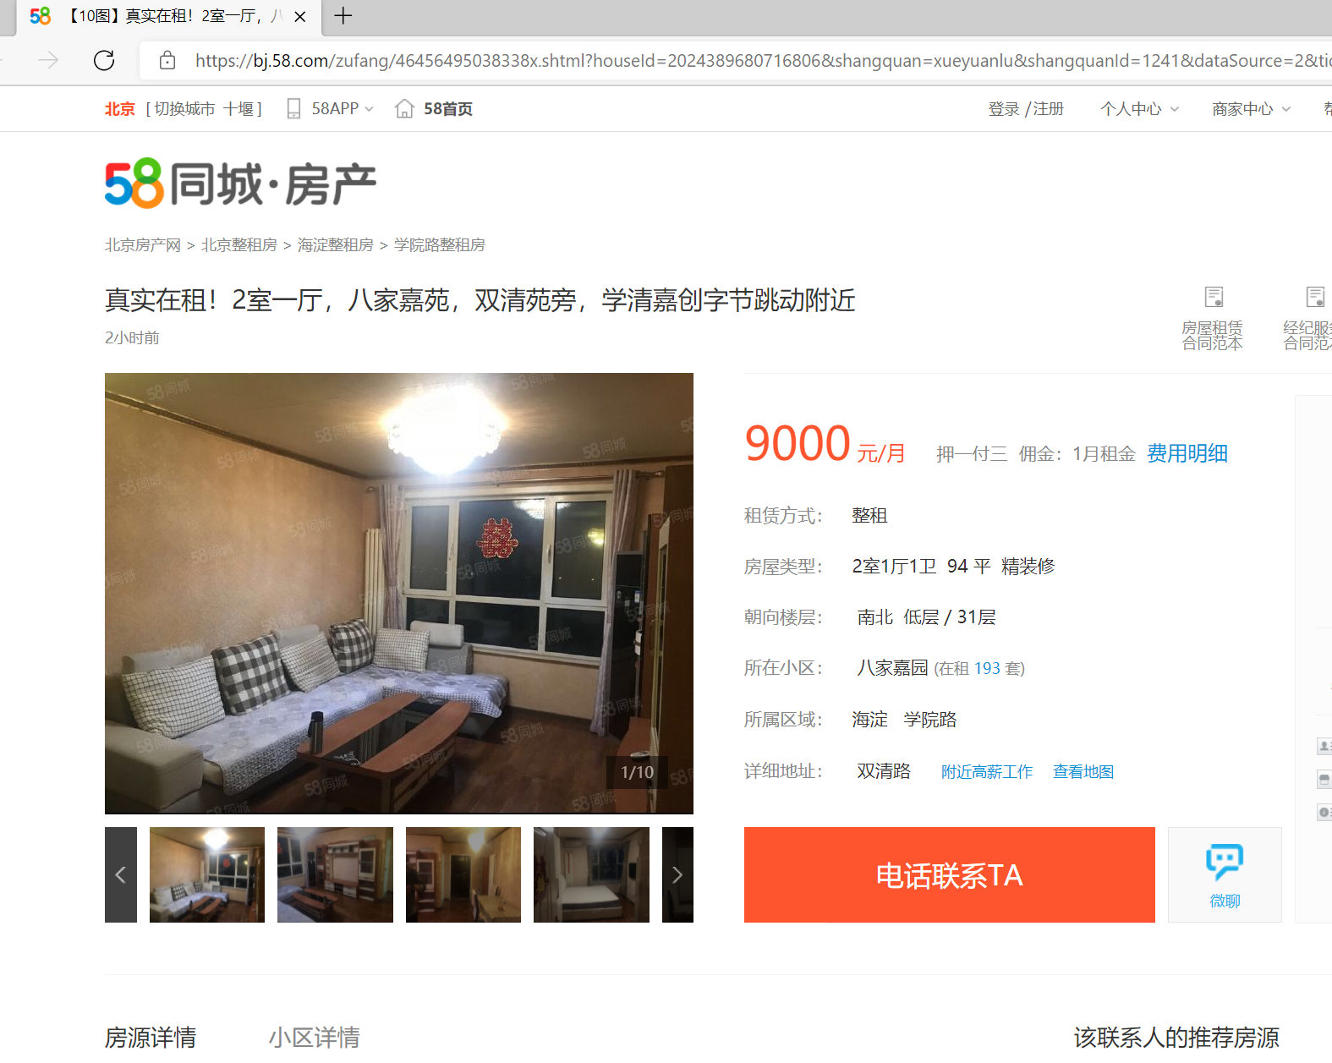


Slide 6


Situation
You are Liu Xing, living in a happy family and you want to be a host family so you follow Jim on his Facebook page and noticed his letter to his aunt…

Slide 7
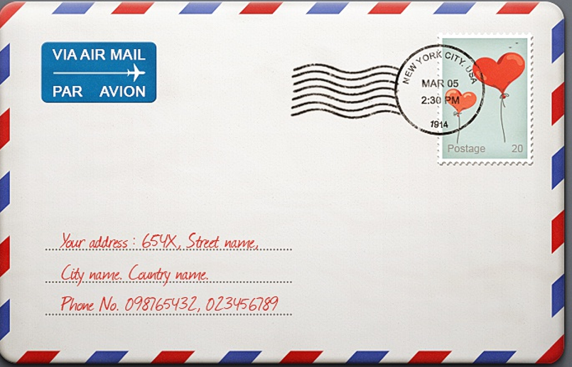
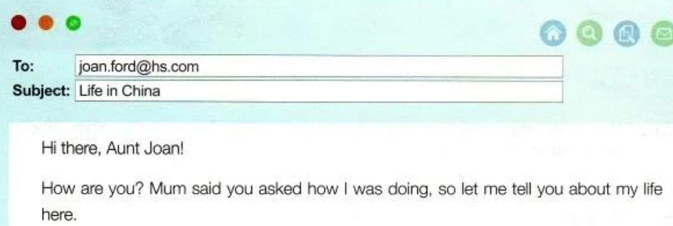
Situation
more information
A letter from Jim to Aunt Joan

Slide 8
Reading

Slide 9
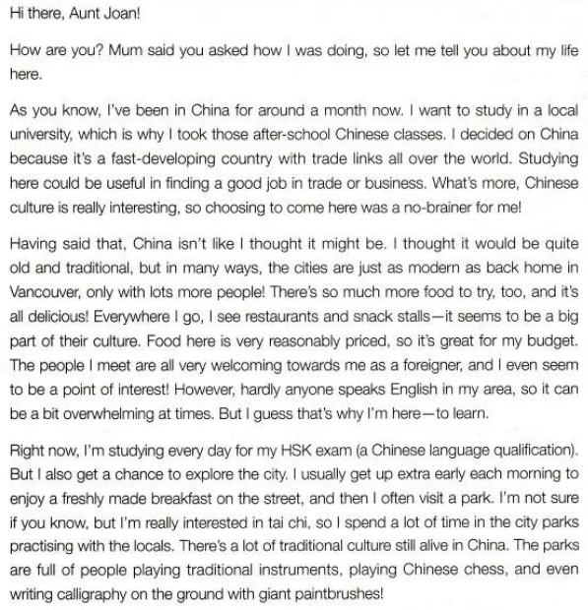
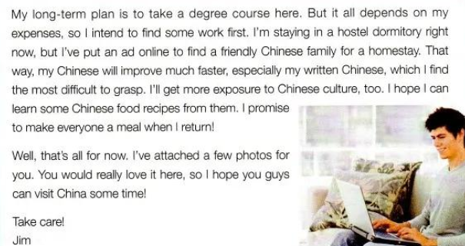
Read for Structure
Para ____:
1-2
Reasons
3-4
Para ____:
Experiences
Para ____:
5-6
Plan and needs

Slide 10
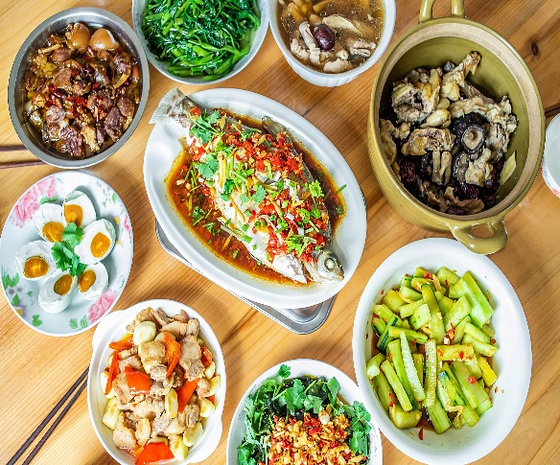
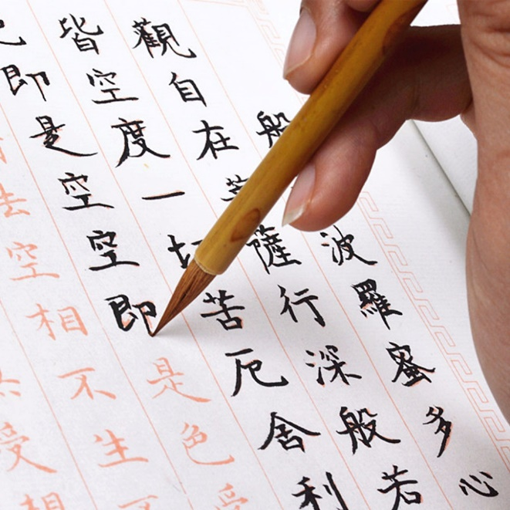
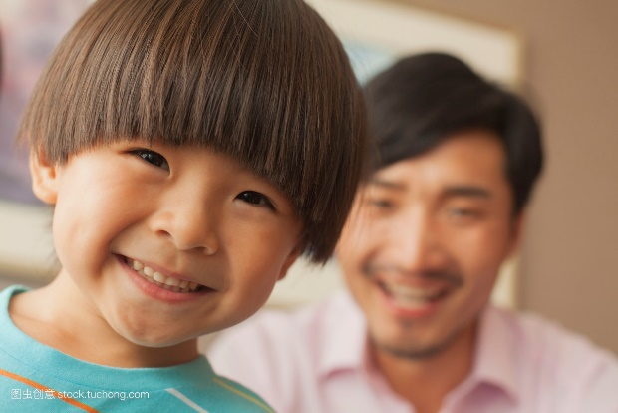
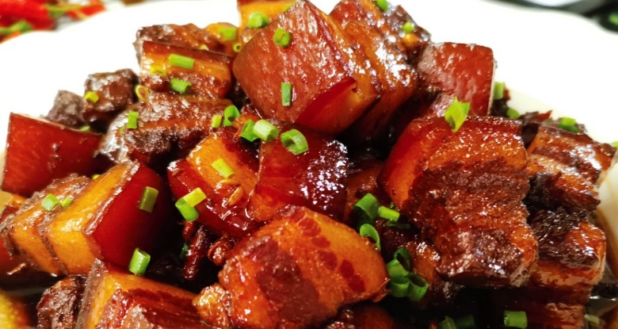
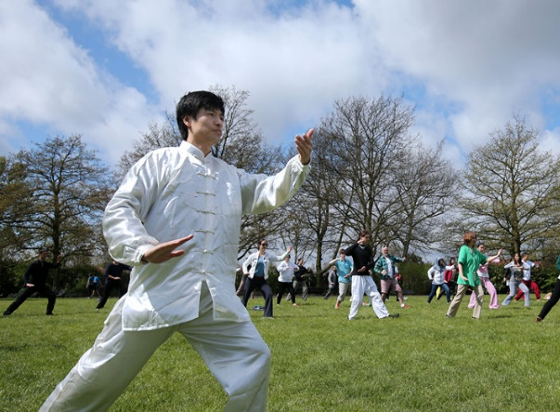
Read for details
What is Jim's plan?
food
Learn Chinese
Which three aspects impressed Jim most?
people
park
Learn Chinese food recipes

Slide 11
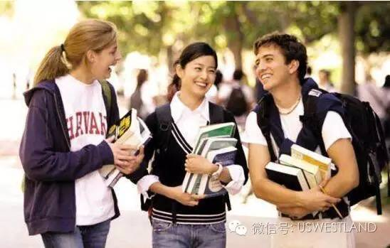
Discussion
Further exploration
How did Jim’s impression of China change
after he arrived?
He had thought China would be quite old and traditional,
but then he found in many ways, the cities are just as
modern as back home.
2. Why does Jim like Chinese park so much?
He practiced tai chi with the locals in the parks. He also gets to know other forms of traditional Chinese culture there.

Slide 12
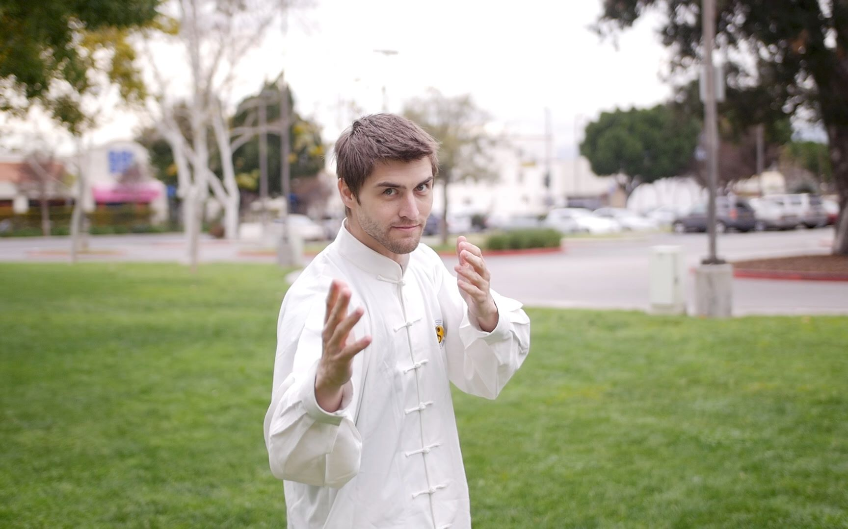
Discussion
Further exploration
3. What are Jim’s plan for the future?
His long-term plan is to take a degree course in China. And he intends to find some work first. Right now, he hopes to find a friendly Chinese family for homestay.
4. What kind of photos do you think Jim has attached to the email?
Maybe some photos of people writing calligraphy..
Maybe people doing tai chi, playing Chinese chess…

Slide 13
Writing

Slide 14
Structure for the letter
para 1: background + purpose
para 2-3 : Body
Outdoor activities
indoor activities
satisfy Jim's
demands
para 4: Ending ---hope/wishes

Slide 15
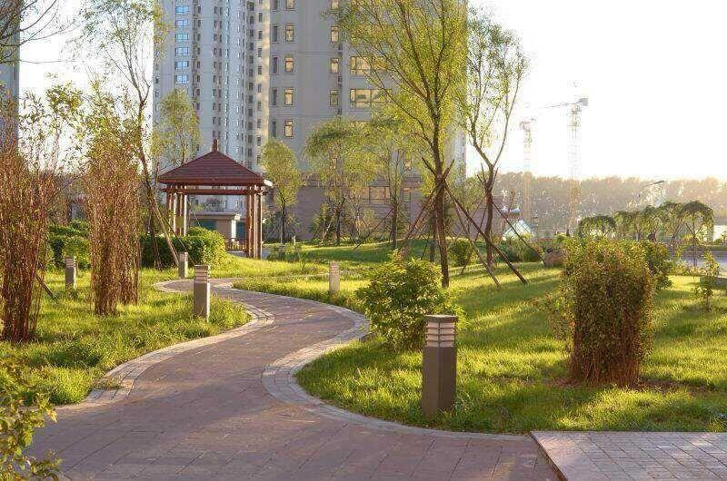
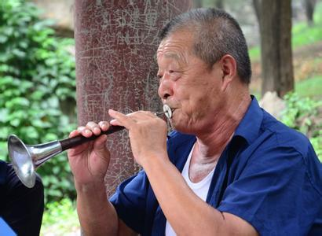
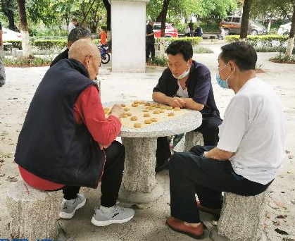
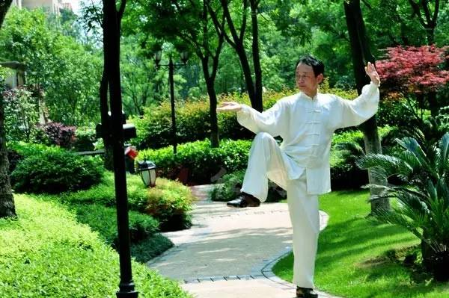


Outdoor Activities
location:
it’s just 5 minutes’ walk to a big park
playing traditional instruments
Chinese chess
tai chi
combination
It’s just 5 minutes’ walk to a big park, ______________________________playing traditional instruments, Chinese chess and tai chi.
which is always full of people

Slide 16
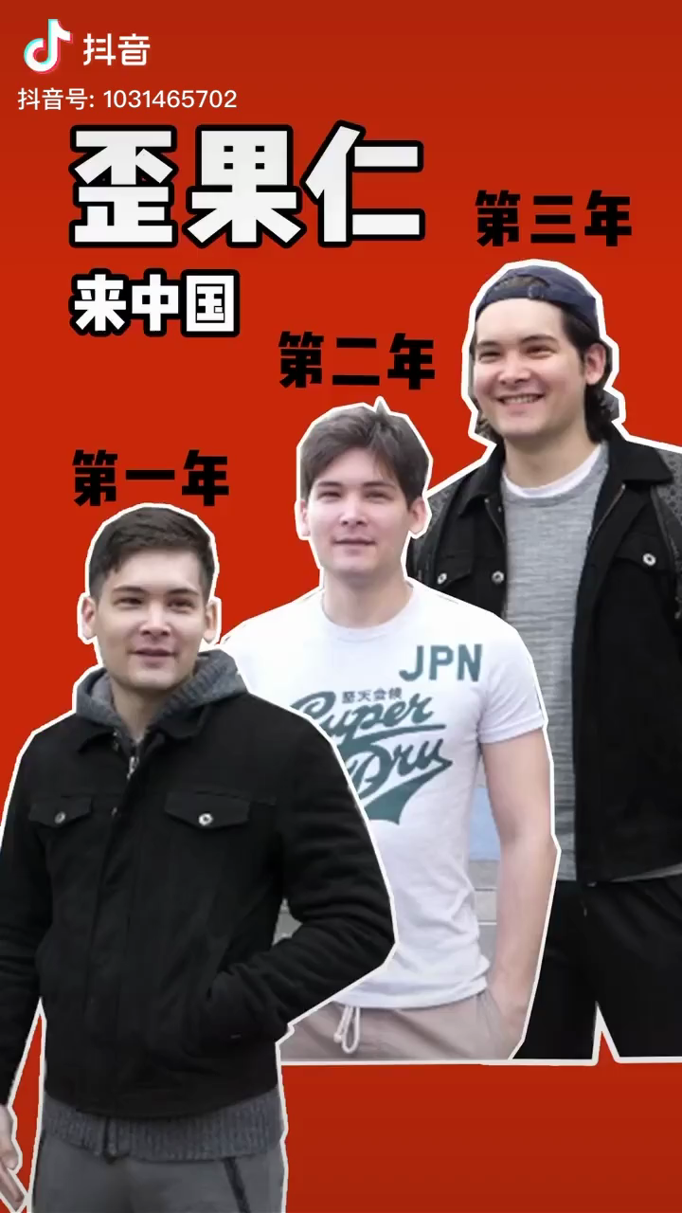
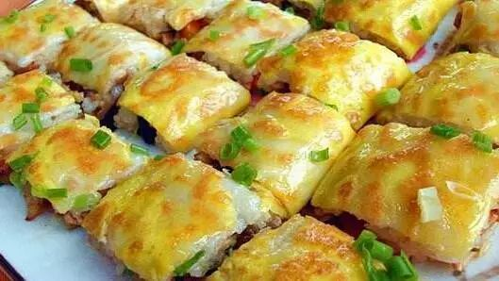
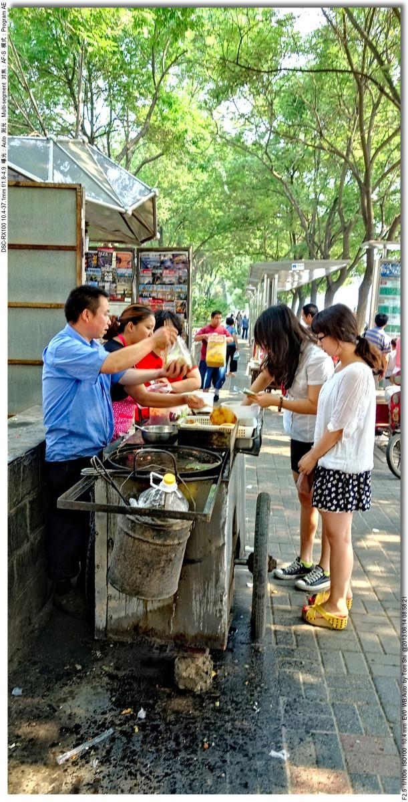
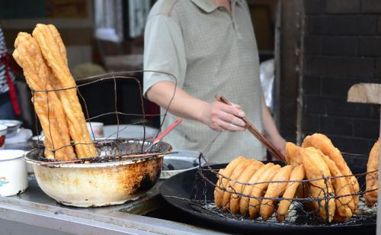
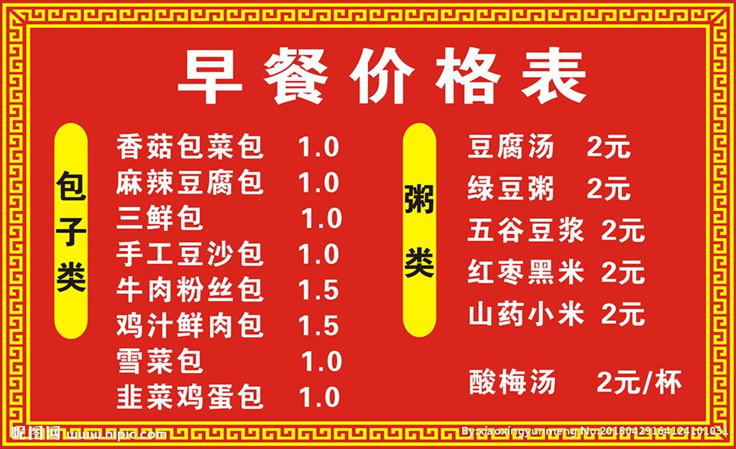
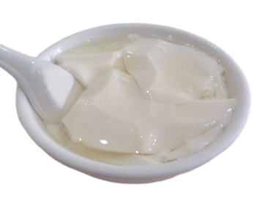
food:
delicious
on the street
freshly made breakfast
reasonable price; budget
combination
There are kinds of delicious freshly made breakfast ________ reasonable price, _________ is great for your budget!
at
which

Slide 17

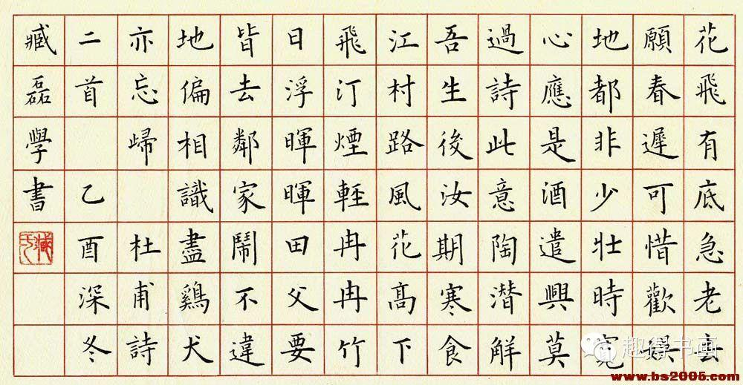
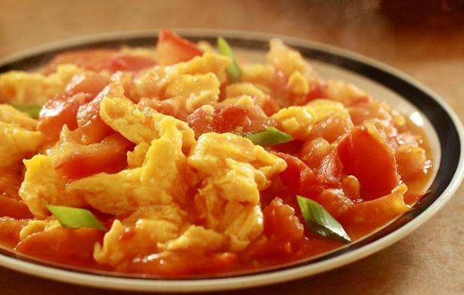
Indoor Activities
people--family member:
friendly
easy-going
good at English
needs:
Group work:
Try to make sentences with the information.
improve Chinese level
learn some Chinese recipies

Slide 18
Writing
Hi Jim!
I saw your ad and I think I can help you. My home is the perfect place for you…
______________________________________________
___________________________________________________ ____________________________________________________________________________________________________
__________________________________________________

Slide 19
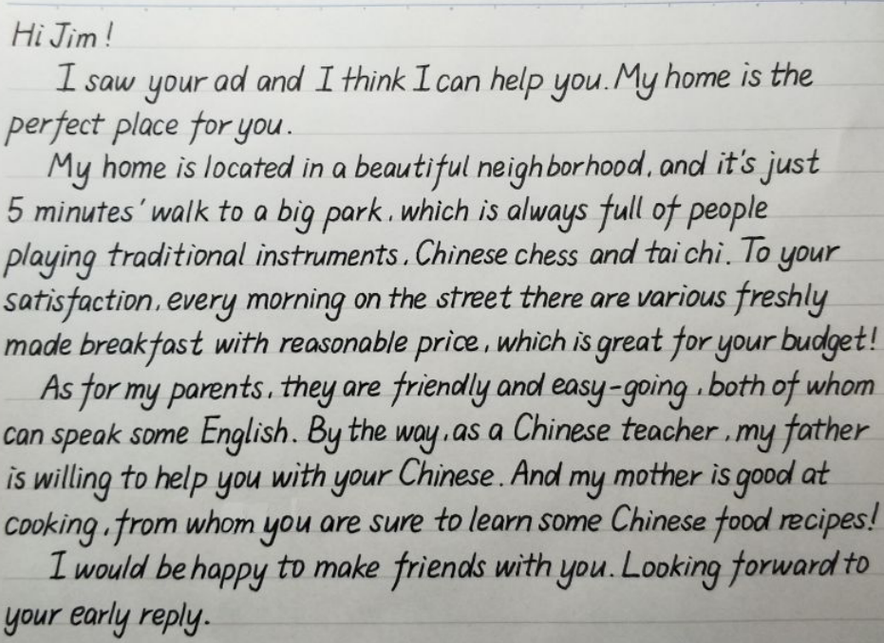
Student’s job

Slide 20
Homework
Share your application with your friends and talk about how we can bridge culture in a more practical way!

Slide 21
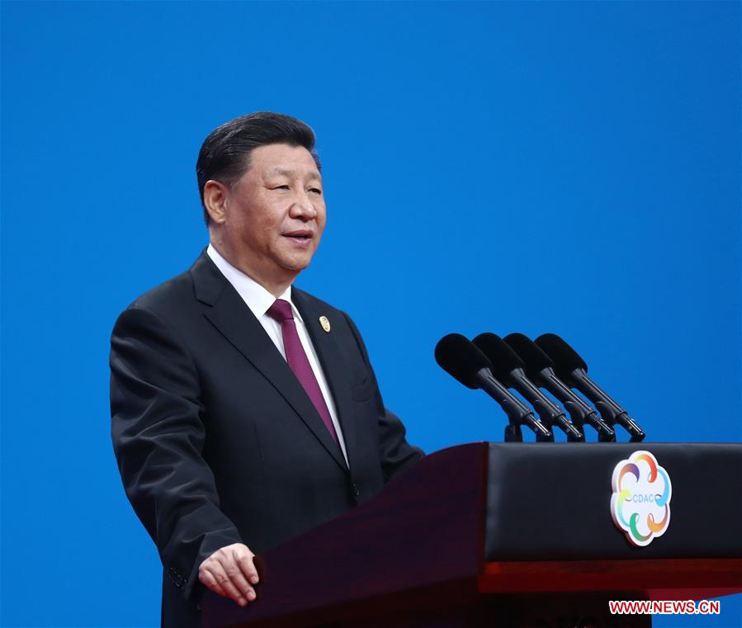

China today is more than the country itself; it is very much a part of Asia and the world. In the time to come, China will open its arms wider to embrace the world and contribute the dynamic achievements of Chinese civilization to a better world in the future.
“今日之中国，不仅是中国之中国，而且是亚洲之中国、世界之中国。未来之中国，必将以更加开放的姿态拥抱世界、以更有活力的文明成就贡献世界。”
--习近平

