Slide 1

感恩遇见，相互成就，本课件资料仅供您个人参考、教学使用，严禁自行在网络传播，违者依知识产权法追究法律责任。
更多教学资源请关注
公众号：溯恩高中英语
知识产权声明

Slide 2
practical writing
A Letter of Introduction
2022年名校协作体高二期初考试
浙江省衢州二中 徐飞

Slide 3
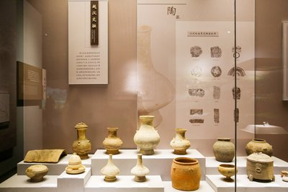
原题呈现
假设你是李华，上周六你参加了在市博物馆举办的文化遗产展览，请你向你的外国朋友Peter介绍本次展览，内容包括：
1 展览内容；2 你的感受。
注意：词数80词左右；可适当增加细节，使行文连贯。

Slide 4

审题
文体：介绍信
交际对象：好友Peter
框架结构：信件一般三段式：写信目的；展览内容+你的感受；结尾。
内容要点：展览内容；你的感受。
语言特点：好友之间相对随意一些，不需要过度礼貌；在写展览内容和你的感受可以均采用一般过去时或者展览内容用一般过去时，你的感受用一般现在时。

Slide 5
学生写作中存在的问题
1 博物馆的展览内容空洞，不具体。
2 语言表达匮乏。
3 信的开头和结尾不切题。

Slide 6
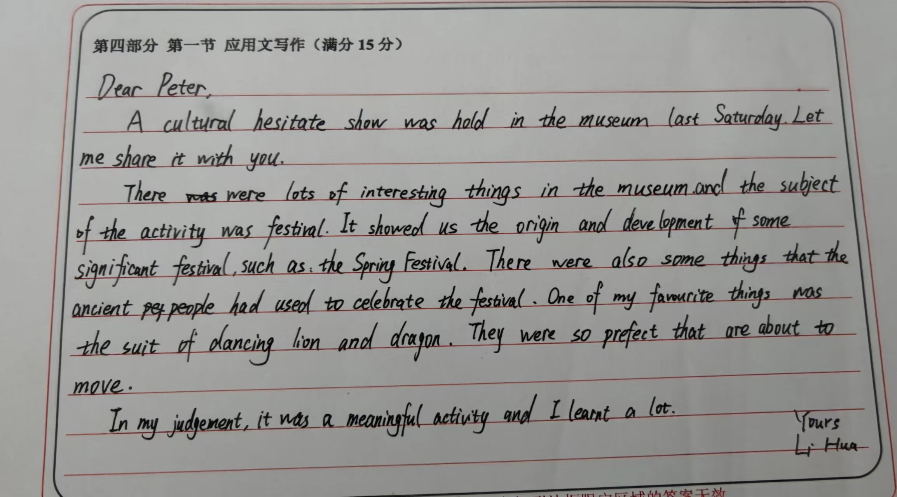
1 展览内容抽象化
表述抽象：lots of things in the museum and the subject of the activity was festival
建议改成: The exhibition was really a visual impact, with a tremendous variety of cultural relics there. Methods of traditional Chinese sewing was displayed on the screen and there were numerous activities for visitors to experience as well.

Slide 7
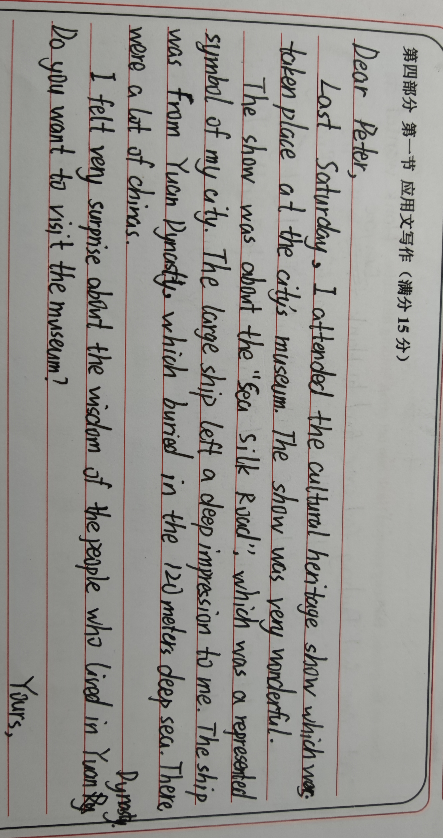
2 语言表达匮乏
学生语言表达匮乏：Last Saturday, I attended the cultural heritage show which was taken place at the city’s museum. The show was very wonderful.
建议改成: Knowing your great enthusiasm for Chinese culture, I am more than glad to share with you my own experience of visiting a local cultural heritage exhibition in the city museum.

Slide 8
3 开头和结尾不切题
思考：
1 Last Saturday witnessed a local cultural heritage exhibition....
这种开头表达通常用在新闻报道中。
2 I am greatly honored to tell you something about....
这种开头表达过于正式，朋友之间应该随意一些。
思考：
1 Looking forward to your earliest reply.
这种结尾表达可以用在绝大多数信件中，没有针对本次展览。如可以说：It was an amazing jounery! If you want to know more, just contact me.
2 I really want you to come with me next time. You won’t regret it!
这个结尾的前提是下次还得有这样的展览。

Slide 9
语料积累 para 1
Try to work out as many expressions as possibie
1 Knowing that_________________（你对中国文化兴趣浓厚），I am writing to share with you some _____________（相关细节）about a local cultural heritage exhibition last Saturday.
2 Knowing that you are interested in..., I am more than happy to ___________（介绍）a local cultural heritage exhibition last Saturday .
4 I’m really ____________ to tell you something about a local cultural heritage exhibition which was held ....
6 _______________（回应）your inquiry about..., I’m proud to introduce a local cultural heritage exhibition to you.
7 Last Saturday, I _______________（参加了）a local cultural heritage exhibition in the city museum. I am writing to introduce it to you.

Slide 10
语料积累 para 2
Translate the following expressions:
1 文化遗产____________ 2 展览___________ 3 各种各样的展览品___________
4 市博物馆____________ 5 在展览中得到充分体现________________
6 数字化______________ 7 数字图像_______________
8具有鲜明的中国文化特色_________
9带领我们进入到了一个古代文明的世界________
10 一场视觉盛宴____________ 11 灿烂的中国文化_______________
12 以...为特点________________
13 让我印象最深刻的是______________
14 是一座促进了解当地文化的桥梁_______________
15 促进了当地文化的传播_________________
16 提升了我们保护文化遗产的意识________________
17 毫无疑问，这样的展览让我对当地的文化有了更深的了解。_________________

Slide 11
语料积累 para 3
1 After the visit, I ______________（对......感到自豪）splendid/brilliant
Chinese culture. Here are some pictures for you.
2 ________________(这儿附上一些展品的照片).Hope you can have a real taste of Chinese culture.

Slide 12
下水作文1
Dear Peter,
Last Saturday, I paid a visit to a local cultural heritage exhibition held in the city museum. Since you are an enthusiast for Chinese culture, I am writing to introduce something to you.
The exhibition featured varieties of exhibits with distinguished elements of Chinese traditional culture, ranging from artistic masterpieces to handcrafts.With the assistance of digital images and videos, some precious intangible cultural heritage was also displayed. This exhibition, in my eyes, not only promotes the spread of local culture but also helps us gain a deeper insight into the importance of protecting cultural heritage.
This is really an amazing journey! Here are some pictures to satisfy you appetite for splendid Chinese culture.

Slide 13
下水作文2
Dear Peter,
Knowing that you have great zeal for Chinese culture, I’ m writing to share with you my splendid experience in a local cultural heritage exhibition last Saturday.
Held by the city museum, the exhibition captivated people from all walks of life, including cultural enthusiasts like me. Ranging from ancient china vases and hand-made crafts to various customs in different districts, the exhibition was definitely a visual feast, which demonstrated how distinctive Chinese culture was cultivated in the 5,000 years of history. It was this exhibition that sparked people’s growing love for our prolonged and vibrant culture and made them proud of our nation.
Enclosed here are some photos of the exhibits. Hope they can satisfy your appetite for Chinese culture and help you gain a deep insight into it.

Slide 14
范文
Dear Peter,
Knowing that you have great passion for Chinese culture, I am writing to share with you some relevant details about a local cultural heritage exhibition last Saturday.
Held in the city museum, the exhibition attracted many visitors. As a cultural enthusiast, it was definitely a feast for my eyes with all the exhibits ranging from artistic masterpieces, hand-made art crafts to a display of local cultural customs. What touches me most, however, is the value the exhibition represents. It not only raises our awareness of cultural heritage protection but also passes the heritage down to our future generations.
Enclosed here are some of the photos of the exhibits. Hope you can have a real taste of Chinese culture.

Slide 15
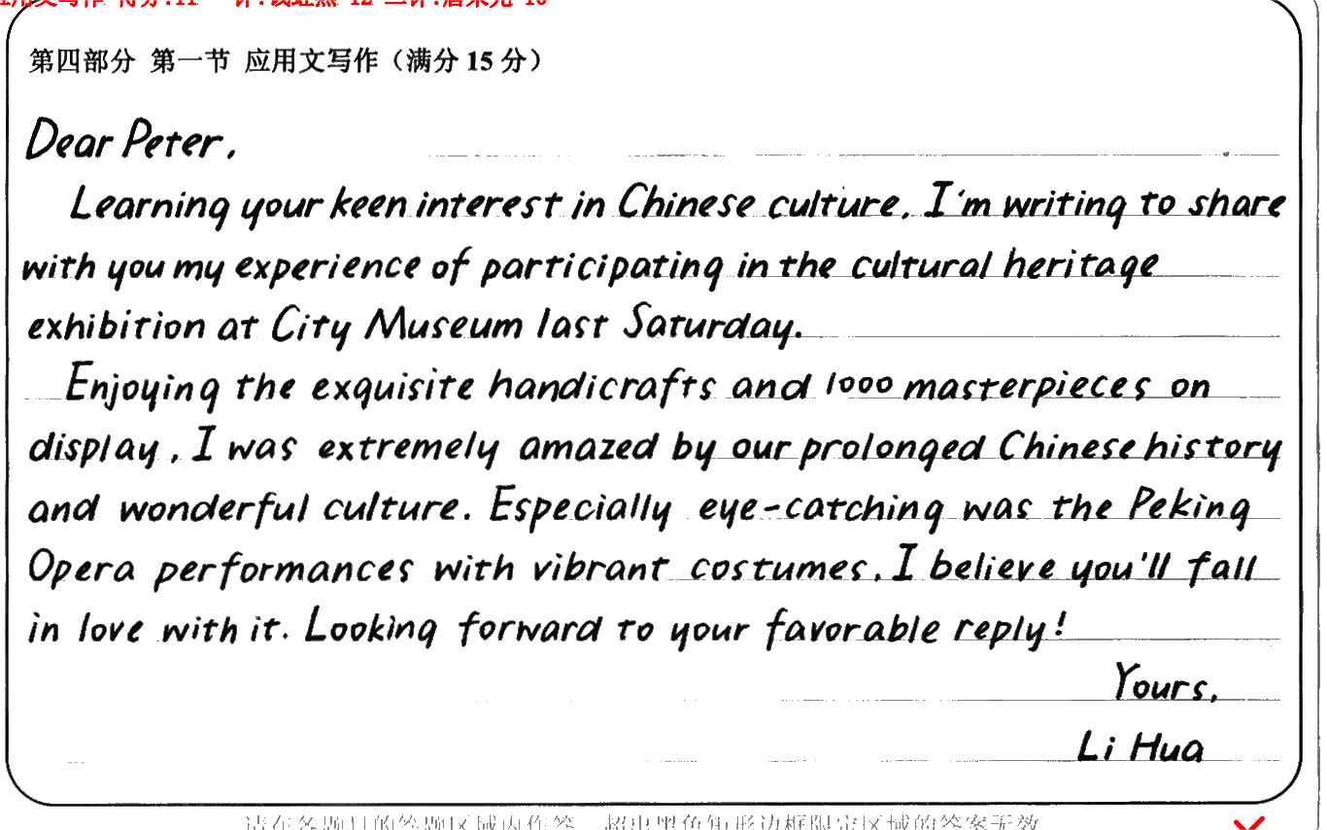
优秀学生习作
学生习作点评：
本文从内容上看要点齐全，展览内容比较详细真实。语言丰富灵活，语法错误少，如非谓语动词的使用： learning your keen interest in...; enjoying the exquisite handicrafts...等。除此以外，考生还用了倒装句，如：Especially eye-catching was the Peking Opera。

Slide 16
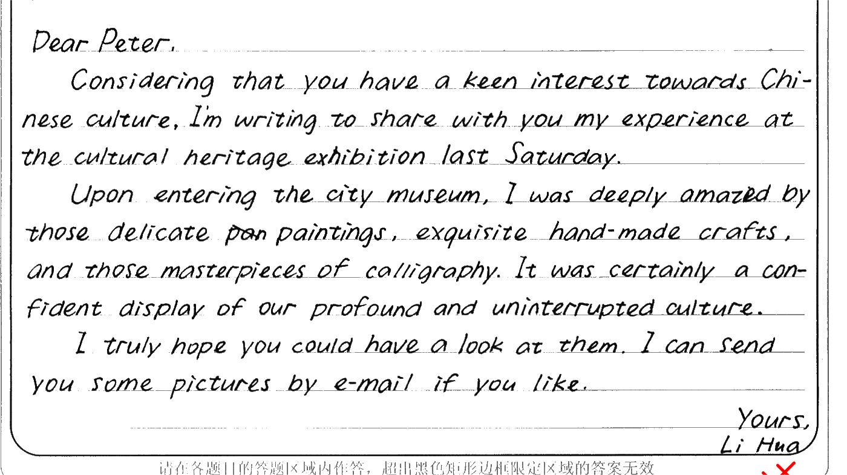
优秀学生习作
学生习作点评：
文章整体读下来，非常顺畅，详略得当。而且本文语言灵活多样，如：have a keen interest; upon entering the city museam,profound and interrupted culture。但是现了少许的语言错误，如a keen interest towards, 应改为keen interest in...;结尾处“I truly hope you could have a look at them.”不是很合理,因为这个展览不一定会一直存在。

Slide 17
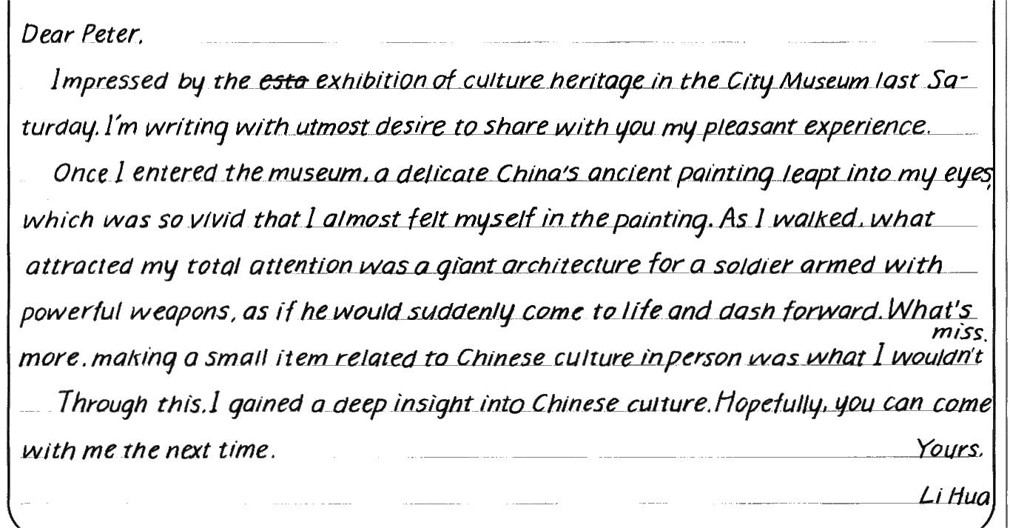
优秀学生习作
学生习作点评：
本文要点齐全，用词丰富，如：impressed by the exhibition of culture heritage in the city museum; with utmost desire to share with you my pleasant experience;a delicate China’s ancient painting leap into my eyes;come to life; gain a deep insight into Chinese culture等。结尾处Hopefully, you can come with me the next time.略有不合适，毕竟这种展览不一定一直在举办。

Slide 18
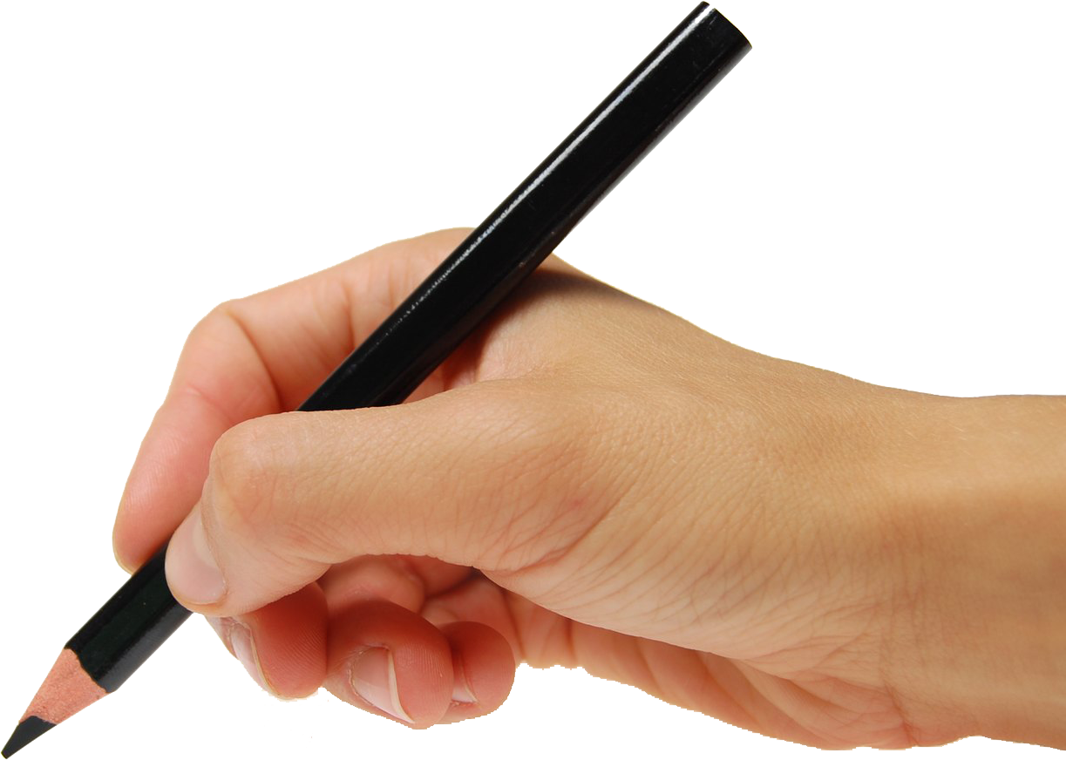
THANK YOU

