Slide 1

感恩遇见，相互成就，本课件资料仅供您个人参考、教学使用，严禁自行在网络传播，违者依知识产权法追究法律责任。
更多教学资源请关注
公众号：溯恩高中英语
知识产权声明

Slide 2
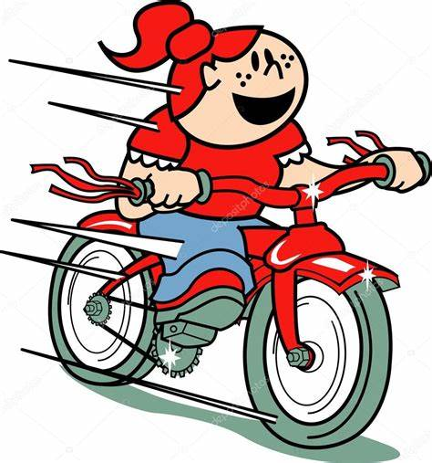
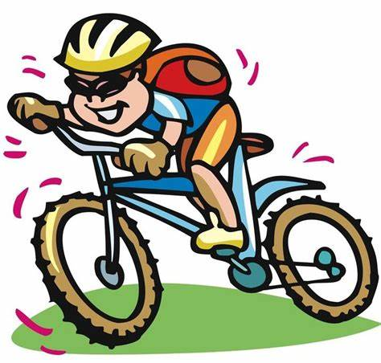
20220928嘉兴基础测试读后续写讲评
Share the bike-ride
陈星可
浙江省天台中学

Slide 3

Text：文本呈现
It wasn't fair.
Aminah always studied hard, so there was nothing unusual about her receiving top marks at the end of the year. But Farhan was often playing with the village boys when he should have been studying. To help motivate him this year, their father had promised to buy him a bicycle if his grades improved.
Aminah was sure that even this generous offer wouldn't change her brother's habits. But when Farhan started staying home and studying, everyone was surprised.
At the end of the school year, Aminah received top marks as she always did. And, as usual, her parents gave her 100 rupees (卢比) as a reward.
For the first time, Farhan got top marks too. True to his word, their father came home with a bicycle. It was well used, and much of the paint had been chipped (脱落) off. But to Farhan, it was the most beautiful bicycle in their country. Farhan’s friends cheered when they saw it. It was understood that something as precious as a bicycle would be shared with everyone.
Well, almost everyone.
After a few days of watching Farhan and the village boys learning to ride,

Slide 4
Text：文本呈现
Aminah and her friends grew bitter. They spent afternoons on the hill just north of the village, sitting in the shade of a mango tree and watching the lazy stream flow at the foot of the hill. They could hear the boys cheering and laughing on the other side of the hill.
“Why doesn’t he let us ride, Aminah?” asked Fatima. Aminah shrugged (耸肩)，trying to act as if she didn't care.
“He and the other boys just want the bicycle all for themselves!” replied Shehnaz. Sarah shook her head. “But Aminah is his sister! He should share with her.” An older sister commanded respect.
As they talked, the boys’ screams grew closer. Aminah looked up and saw her brother on his bicycle at the top of the hill. “Look! I can do it!" Farhan yelled at the top of his lungs. He had finally gotten the hang of it. The boys cheered as he began to speed up.
Suddenly, Farhan lost control of the bicycle, heading in the direction of
the girls, toward the stream.
Farhan looked at Aminah, then at his bicycle, then back at his sister.

Slide 5
语言拓展积累
1.慷慨好意
2.信守诺言（形容词短语）
信守承诺（动词短语）
3.在...的阴凉处 使...相形见绌 4.在山脚下 5.想独自拥有这自行车 6.高声地 7.掌握...的窍门 8.加速 9.朝女孩子们那方向
10.一辆频繁使用的自行车
11.博得尊重
1.a generous offer
2.true to one’s word
keep one’s word/promise
3.in the shade of...
put... in the shade
4.at the foot of the hill
5.want the bike all to oneself
6.at the top of one’s lungs
7.get the hang of...
8.speed up/ accelerate
9.in the direction of the girls
10.a well used bike
11.command respect

Slide 6
Understand the story- Fill in the blanks:
Aminah, an a____________ excellent girl, often received top grades and was awarded 100 rupees at the end of the year. To m_________ Farhan, her brother to work hard, father promised to buy him a bike as a reward if his grades __________(improve). It did work and Farhan got his _________(desire) bike and was eager to learn to ride the bike with the village boys. Paint-chipped and well-used _______ the bike was, Farhan cherished it badly. It even became the envy of Aminah and her friends, _______ also wanted to ride the bike though she pretended not to. One day, _______ Farhan and the village boys were fully enjoying the ride, he lost control of the ______(prize) bike, heading _____ the direction of the girls and towards the stream...
academically
motivate
improved
desired
as
who
while
prized
in

Slide 7
Understand the story-Plot & Emotions:
3.Climax
Aminah and her girl friends also wanted to ride the bike.
envious, frustrated
4.Falling action
2.Rising action
Farhan lost control of the bicycle, heading in the direction of
the girls, toward the stream.
Farhan and the village boys enjoyed riding the bike
proud, cheerful
worried, frightened?
1.Beginning
5.Ending
Motivated, Farhan worked hard and got top grades, for which he was awarded a bike.
Farhan looked at Aminah, then at his bicycle, then back at his sister.
guilty, appreciative?
ambitious, proud, excited
Share the bike-ride

Slide 8
Design the plot- Key words
Tip 1：
全国I卷取消了划线词，貌似减少了限制，其实对文章主线的把握更难了。所以我们要做到心中有划线词，确保在设计情节时不偏离主要人物、主要对象和主要情节。
Tip 2：
划线词要以名词为主，再加上几个动词还有个别的形容词。
Tip 3：名词主要包括
主人公名词：
贯穿全文的描写对象：
有升华或者点题意义的抽象名词：
Aminah, Farhan, Father
bike, 100 rupees
sharing - having all for oneself

Slide 9
Design the plot- 四点定位
四点：
1.第一段的首句，根据主位推进原则，做好与段首句的衔接。
2.第一段的尾句，做好与前一情节和第二段首句的承启。
3.第二段的第一句，做好与首句的衔接。
4.第二段的尾句。做好故事的收尾或者文章主旨的升华。
这里可以以Farhan为主位推进下一个情节：可以继续写Farhan的心理活动、动作，也可以带动术位，写Aminah的反应和动作或者自行车的移动。
从第二段首句可以看出Aminah和自行车有两种可能：一是人和自行车都没事，可能是姐姐救了，也可能是自己想办法搞定；二是人没事，自行车掉进河里。
写Farhan的一些动作，想对姐姐表示感谢：一是可以设置让姐姐和她的朋友骑自行车的环节，来呼应文中的Why doesn’t he let us ride, Aminah... “He and the other boys just want the bicycle all for themselves!”...He should share with her.”；二是Aminah愿意用她的100卢比奖励来帮助修车，换得骑自行车的机会。
这些孩子们开心地骑自行车，或者写Farhan的反思，总结文章的message。

Slide 10
Design the plot- Question and Answer
Suddenly, Farhan lost control of the bicycle,heading in the direction of the girls, toward the stream.
Q1: Aware of the situation, how did Farhan feel? What did he do to avoid knocking into the girls and falling into the stream?
Q2: Seeing her brother in danger, what did Aminah do?
Q3: According to the next first sentence, were Farhan and his bike saved? How did Aminah feel?
Farhan looked at Aminah, then at his bicycle,then back at his sister.
Q1: Looking at the bike and his sister, how did he feel and what did he do?
Q2: What did the other boys and girls say and do about the happening?
Q3: Did Farhan do something to thank his sister fro saving him?
Q4: Any reflections here? （少数人乐乐不如众乐乐）
Farhan was all right, but how and where did the bike end up?

Slide 11
Design the plot- Question and Answer
Suddenly, Farhan lost control of the bicycle,heading in the direction of the girls, toward the stream.
Q1: Aware of the situation, how did Farhan feel? What did he do to avoid knocking into the girls and falling into the stream?
1.So frightened was Farhan that he couldn’t help screaming for help.
2.“I can’t!” Farhan clutched the handlebars. His body was locked.
3. With both of his hands waving madly in the air, the excited cheers suddenly turned into frightened screams.
4.Engulfed by terror, Farhan yelled for help, courgae deserting him.
5.Realizing that the bike would probably knock into the girls, leaving them seriously injured and that he himself and the bike would end up in the stream, Farhan got increasingly nervous while shouting for help. He squeezed the brakes hard, but it didn’t work. He tried to swerve the bike’s direction, but it still rolled/tottered its way down forward.

Slide 12
Design the plot- Question and Answer
Suddenly, Farhan lost control of the bicycle,heading in the direction of the girls, toward the stream.
Q2: Seeing her brother in danger, what did Aminah do?
1.Totally at a loss what to do, she stood still, as if stuck to the ground.
2.The instant Aminah was aware of the terrible scene, she charged at the bicycle, exclaiming at the top of her lungs, “Jump! Leave the bike!”
3.Though frightened by what was happening, Aminah immediately had an idea. She shouted to signal to Farhan to let go of the handlebars and jump off the bike.
4.Without a second thought, she jumped to her feet and dashed towards the bike and held tightly the backseat of the bike, as a result of which the bike slowed down and finally came to a stop altogether.
5.The instant Aminah became aware of what was happening, she dashed towards the stream, attempting to stop Farhan falling over.

Slide 13
Design the plot- Question and Answer
Suddenly, Farhan lost control of the bicycle,heading in the direction of the girls, toward the stream.
Q3: According to the next first sentence, were Farhan and his bike saved? How did Aminah feel?
1.Aminah used every ounce of his strength to stop the bike from rolling on, while Farhan jumped off the bike, and landed on the grass. Luckily, he was safe and sound.
2. Luckily, it worked! Farhan landed on the ground, safe and sound. But the poor bike simply rolled its way down the hill and ended up in the stream, seemingly damaged.
3. The bike slowed down and finally came to a stop altogether. Seeing her brother safe and sound and the bike still in good consition, Aminah heaved a sigh of relief.
4.With joint efforts, the boy and his bike were finally pulled out of the stream, Frahan safe but the bike damaged.

Slide 14
Design the plot- Question and Answer
Farhan looked at Aminah, then at his bicycle,then back at his sister.
Q1: Looking at the bike and his sister, how did he feel and what did he do afterwards?
1.With tears mingled with appreciation and joy, he embraced his sister tightly, “I’m sorry, but thank you!”
2.He wanted to say something, but the retrospective fear made all his words escape. All the boys and girls present gathered around the siblings, really admiring Aminah for her quick thinking and action and congratulated Farhan on his survival and that of his bike.
3.Though extremely depressed at the newly-got bike now broken, he expressed thanks to his sister.
4.Choked by the overwhelming embarrassment, Farhan felt his face was burning, not daring to look up.

Slide 15
Design the plot- Question and Answer
Farhan looked at Aminah, then at his bicycle,then back at his sister.
Q2: What did the people concerned say and do about the happening?
1.All the boys and girls present gathered around the siblings, really admiring Aminah for her quick thinking and action and congratulated Farhan on his survival and that of his bike.
2.When their father learned about the whole thing, he was a bit annoyed, saying that to fix the bike would cost 100 rupees, and the money should be paid by Farhan, which would take quite a while to save.
3. Aminah gathered Farhan into her arms, comforting that his safety muct come as a priority and that they could work hard together to win another bike from dad.
4. Everyone approached Farhan, with concern written on their faces. Just at the very moment, Farhan realized that he should do something.

Slide 16
Design the plot- Question and Answer
Farhan looked at Aminah, then at his bicycle,then back at his sister.
Q3: Did Farhan do something to thank his sister for saving him?
1.At this, Farhan hit upon an idea: Why not share the bike-riding with Aminah and her friends?
2. Farhan turned round and handed out the bike to Aminah, adding that he would like to share the bike ride with them.
3. “Can you teach me how to ride the bike, sis!” Farhan looked up into his sister’s eyes, inviting Aminah and her friends to join the boys.
4. Looking at the broken bike, Farhan had new plan in mind, “ I must work hard to win another bike from dad, Besides, I’ll share the bike with my sister.” And it seemed the bond between the siblings were stronger, than ever before.

Slide 17
Design the plot- Question and Answer
Farhan looked at Aminah, then at his bicycle,then back at his sister.
Q4: Any reflections here? （少数人乐乐不如众乐乐）
1.From the experience, though Farhan had his prized bike damaged, he learned that happiness from gift and honor of rewards lay largely in sharing with others, rather than having it all to himself.
2.Bathed in the mellow and amber-like sunshine, she knew what built/shaped the future was not the bike itself but willingness to share.
3. Farhan was extremely delighted, as the bike not only inspired him to achieve top grades, it also dawned on him that sharing something actually brought more happiness that having it all for himself.
4.“Here is the money for the repairs, but we should share the bike-riding, one day for boys and the next day for girls,” Aminah grinned.

Slide 18
下水作文1及 点评：
Suddenly, Farhan lost control of the bicycle, heading in the direction of the girls, toward the stream. Realizing that the bike would probably knock into the girls, leaving them seriously injured and that he himself and the bike would end up in the stream, Farhan got increasingly nervous while shouting for help. He squeezed the brakes hard, but it didn’t work. He tried to swerve the bike’s direction, but it still rolled/tottered its way down forward. Hearing Farhan’s cry for help, Aminah immediately knew what was happening. Without a second thought, she jumped to her feet and dashed towards the bike and held tightly the backseat of the bike, as a result of which the bike slowed down and finally came to a stop altogether. Seeing her brother safe and sound and the bike still in good condition, Aminah heaved a sigh of relief. 127
1.如何把控自行车部分写得非常细腻，动词squeeze, swerve, roll, totter等的运用也比较得体。
2.分词状语、定语从句和动词谓语连动的运用，增加了情节的紧凑感和句式的高级感。主位推进策略的运用使得行文流畅。
4.高级词汇end up, increasingly, jump to one’s feet,come to a stop altogether和较强的长句子驾驭能力都为文章增色不少。

Slide 19
下水作文及 点评：
Farhan looked at Aminah, then at his bicycle, then back at his sister. He wanted to say something, but the retrospective fear made all his words escape. All the boys and girls present gathered around the siblings, really admiring Aminah for her quick thinking and action and congratulated Farhan on his survival and that of his bike. At this, Farhan hit upon an idea: Why not share the bike-riding with Aminah and her friends? And the rest of the day witnessed the group of boys and girls riding the bike in turn, bursts of laughter echoing in the air all the way. Farhan was extremely delighted, as the bike not only inspired him to achieve top grades, it also dawned on him that sharing something actually brought more happiness that having it all for himself. 122
1. 无灵主语句和主语从句的运用，丰富了表达方式。
2.分词和独立主格结构的运用，实现了情节的有效过渡和表达的简练性。
3.最后的sharing的点题不仅呼应了前文内容，而且充分凸显文章的主旨，在立意上站位较高。
4.高级表达bursts of laughter, retrospective, congratulate ... on...,
hit upon和长句子驾驭能力都显示了较扎实的语言功底。

Slide 20
下水作文2：（基于原文本思路）
Suddenly, Farhan lost control of the bicycle,heading in the direction of the girls, toward the stream. Realizing that the bike would probably knock into the girls and that he himself and the bike would end up in the stream, Farhan got increasingly nervous while shouting for help. He squeezed the brakes hard, but it didn’t work. He tried to swerve the bike’s direction, but it still rolled/tottered its way down forward. Though frightened by what was happening, Aminah immediately had an idea. She shouted to signal to Farhan to let go of the handlebars and jump off the bike. Luckily, it worked! Farhan landed on the ground, safe and sound. But the poor bike simply rolled its way down the hill and ended up in the stream, seemingly damaged. 113

Slide 21
下水作文2 （基于原文本思路）
Farhan looked at Aminah, then at his bicycle, then back at his sister. Though extremely depressed at the newly-got bike now broken, he expressed thanks to his sister. When their father learned about the whole thing, he was a bit annoyed, saying that to fix the bike would cost 100 rupees, and the money should be paid by Farhan, which would take quite a while to save. Just as Farhan was wondering how, Aminah ran into the room and returned with 100 rupees in hand, the reward for her top grades. “Here is the money for the repairs, but we should share the bike-riding, one day for boys and the next day for girls,” Aminah grinned. 103

Slide 22
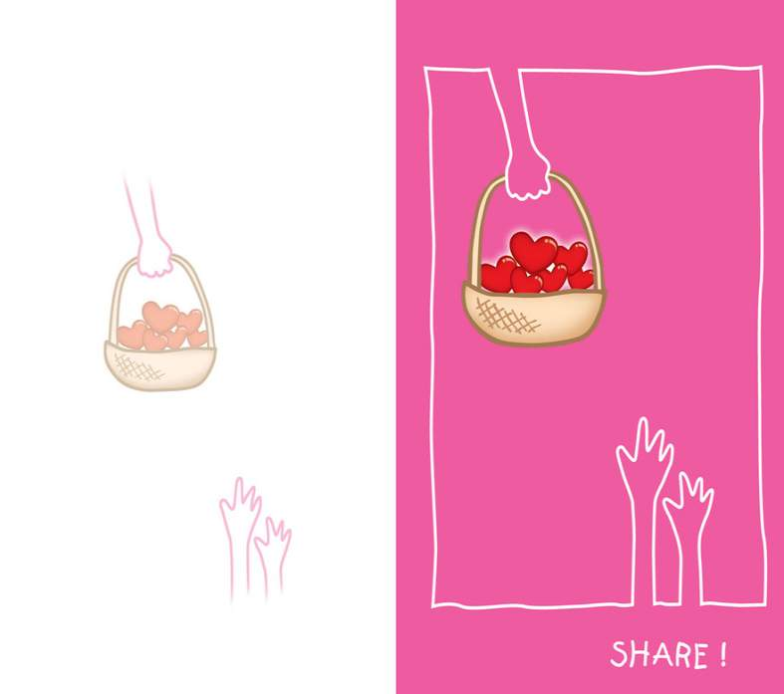
Share your happiness with others,
happiness doubles.
Share your sadness with others,
sadness halves.
Share your love with others,
love spreads.
Thank you

