Slide 1

感恩遇见，相互成就，本课件资料仅供您个人参考、教学使用，严禁自行在网络传播，违者依知识产权法追究法律责任。
更多教学资源请关注
公众号：溯恩高中英语
知识产权声明

Slide 2





B1U1 Reading & Thinking
Compare School Life in Different Places
Shang Jie

Slide 3

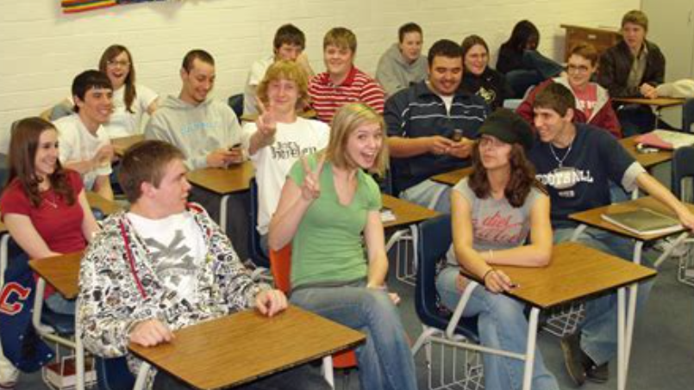
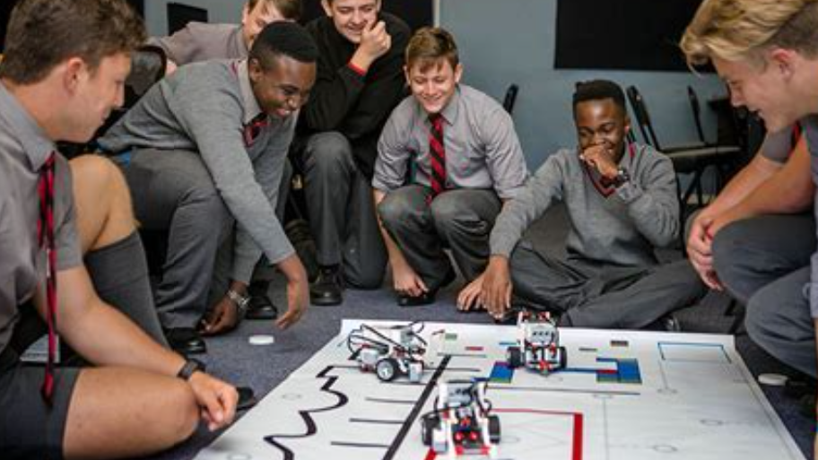
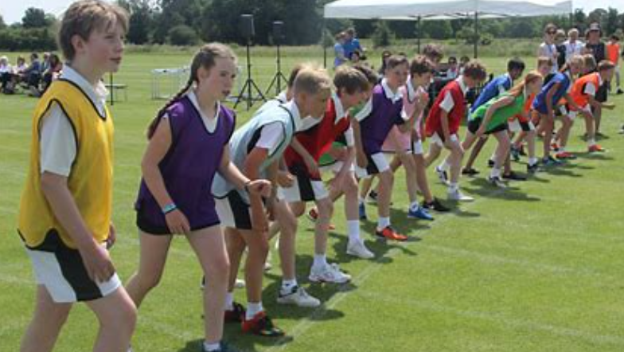

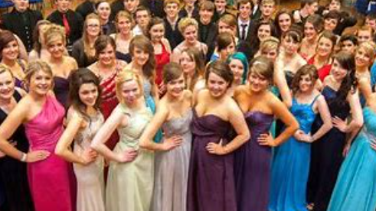

What do you think of senior high school life in the U.S.?

Slide 4
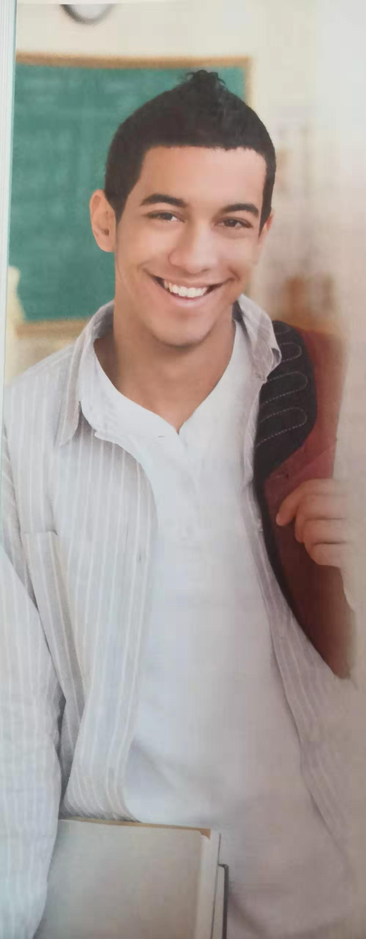
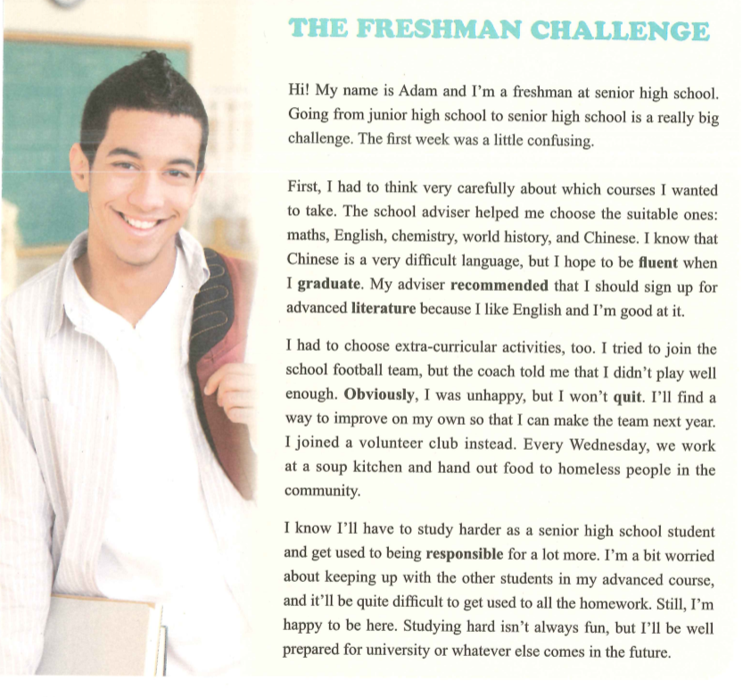
Break The Impression
Adam
An American senior high school student
According to the photo, what is your first impression of Adam?
Guessing: How does he feel about his senior high school life?
difficult things

Slide 5
Read for Main Ideas
Read the text quickly to find the topic sentence of each para.
P14 Ex2 Main Ideas of Each Para.
Senior high school is a challenge.
P1: ____________________
P2: ____________________
P3: ____________________
P4: ____________________
Adam had to
think which courses to take.
Adam had to
choose extra-curricular activities.
Adam will have to
study harder and get used to being responsible for a lot more.

Slide 6
Read for Main Ideas
Read the text quickly to find the topic sentence of each para.
P14 Ex2 Main Ideas of Each Para.
Senior high school is a challenge.
P1: ____________________
P2: ____________________
P3: ____________________
P4: ____________________
Adam had to
think which courses to take.
Adam had to
choose extra-curricular activities.
Tip1: Find main ideas by taking a quick look at topic sentences.
Tip2: Topic sentences sometimes are the first sentence of each paragraph.
Tip3: Use “have to” to show your challenges.
Adam will have to
study harder and get used to being responsible for a lot more.

Slide 7
Read for Structure
Which para. is the main part? Which paras. are the supporting parts?
P1: Challenge
P2
Which courses to take
P3
How to choose extra-curricular activities
P4
How to study & be responsible a lot more

Slide 8
Read for Structure
Which para. is the main part? Which paras. are the supporting parts?
P2
Which courses to take
P3
How to choose extra-curricular activities
P1: Challenge
P4
How to study & be responsible a lot more

Slide 9
Read for Details
P15 Ex4 Read again & Complete the outline
Para. | Challenge | How Adam feels | Solution
1
2
3
4

Slide 10
Read for Details
Para 1
Challenge: _________________
Feeling: ___________________
Solution: __________________
Going from junior high school to senior high school
Confused
/

Slide 11
Read for Details
Para 2
Which courses to choose
Challenge: _________________
Feeling: ___________________
Solution: __________________
Careful/ Serious/
Anxious/ Nervous ...
The school adviser helped him choose the suitable ones
Q: Why did the adviser recommended that Adam should choose Chinese/ English?
Because of his interests & strengths

Slide 12
Read for Details
Para 3
How to choose extra-curricular activities
How to make the football team
Challenge: _________________
Feeling: ___________________
Solution: __________________
Unhappy
Positive/ Determined ...
He will find a way to improve on his own.
He joined a volunteer club instead.
Q: What can you learn from Adam’s experience?
Stay positive & Find other chances

Slide 13
Read for Details
Para 4
How to study & be responsible
Keep up with other students
Get used to all the homework
Challenge: _________________
Feeling: ___________________
Solution: __________________
Worried/Anxious/Nervous
Happy/ Confident ...
He will study harder and be well prepared for the future.

Slide 14
Main
Review the Outline
Details
Supporting Parts
Challenge 1:
Feeling:
Solution:
P2
Which courses to take
Main Part
P3
How to choose extra-curricular activities
Challenge 2:
Feeling:
Solution:
P1: Challenge
P4
How to study & be responsible a lot more
Challenge 3:
Feeling:
Solution:

Slide 15
Post-reading
---- Further Discussion 1: P15 Ex4
determined
According to the text, what kind of person do you think Adam is? Why?
active
Adam is a/an _______ student, because _____ .
kind
helpful
Do you face the same challenges as Adam?
What other challenges are you facing? Compare Adam’s school life with yours.
positive
confident
...

Slide 16



Post-reading
---- Further Discussion 2
Break The Impression
Discuss in groups & Share one of your challenges (+ feelings & solutions)
Challenges
Feelings
... is a really big challenge.
I have to do sth.
I know that ... is very difficult, but I hope to do sth.
I tried to do sth., but ... .
I’m a bit worried about ... .
It will be quite difficult to do sth.
... isn’t always fun.
...
confused/ anxious/ unhappy/
positive/ confident/ determined ...
Solutions + Reasons
sb. recommend that I should do sth., because ... .
I’ll find a way to do sth. so that ... .
I’ll be well prepared for ... .
...

Slide 17
No matter what kind of challenges we meet,
we are expected to ...
To maintain a spirit of youth and vigor.
Young people should be self-confident, self-reliant, and high in spirits.
They should seek to improve and extend themselves, fulfill their dreams, show their worth, and strive to present themselves in the best possible light.
--the State Council Information Office of China <Youth of China in the New Era>
THANK YOU
Notes:
保持青春和活力的精神。年轻人应该自信，自力更生，精神振奋。他们应该寻求改善和扩展自己，实现自己的梦想，展示自己的价值，并努力以最好的方式展示自己。

