Slide 1

感恩遇见，相互成就，本课件资料仅供您个人参考、教学使用，严禁自行在网络传播，违者依知识产权法追究法律责任。
更多教学资源请关注
公众号：溯恩高中英语
知识产权声明

Slide 2
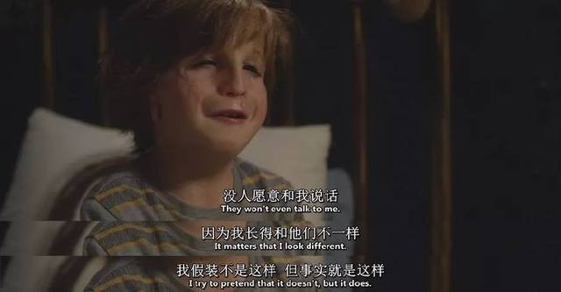
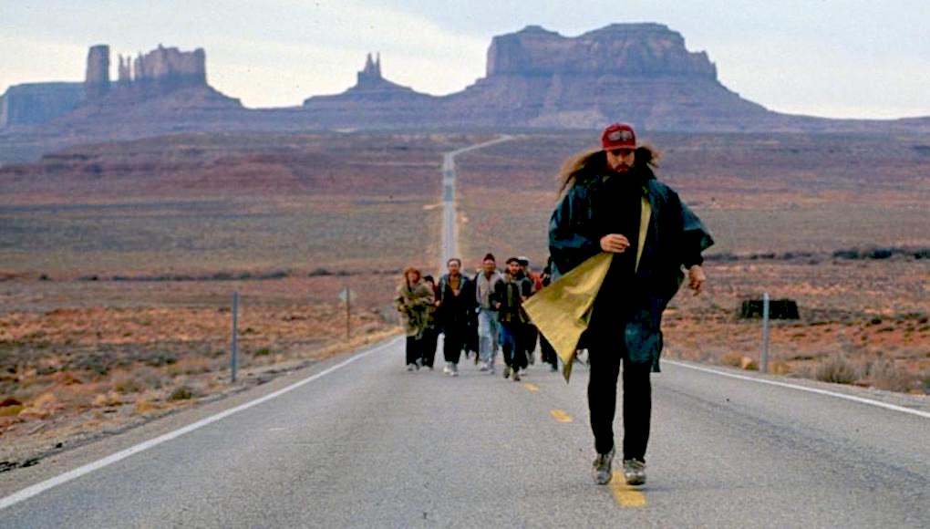
David’s Run

Slide 3





How can we write without the underlined words?
related to
Find out the key words
theme

Slide 4


Circle out the words related to time & place
Circle out the characters
1
It was the day of the big cross-country run. Students from seven different primary schools in and around the small town were warming up and walking the route (路线) through thick evergreen forest.
I looked around and finally spotted David, who was standing by himself off to the side by a fence. He was small for ten years old. His usual big toothy smile was absent today. I walked over and asked him why he wasn’t with the other children. He hesitated and then said he had decided not to run.
What was wrong? He had worked so hard for this event!
I quickly searched the crowd for the school’s coach and asked him what had happened. “I was afraid that kids from other schools would laugh at him,” he explained uncomfortably. “I gave him the choice to run or not, and let him decide.”
I bit back my frustration (懊恼). I knew the coach meant well – he thought he was doing the right thing. After making sure that David could run if he wanted, I turned to find him coming towards me, his small body rocking from side to side as he swung his feet forward.
David had a brain disease which prevented him from walking or running like other children, but at school his classmates thought of him as a regular kid. He always participated to the best of his ability in whatever they were doing. That was why none of the children thought it unusual that David had decided to join the cross-country team. It just took him longer — that’s all. David had not missed a single practice, and although he always finished his run long after the other children, he did always finish. As a special education teacher at the school, I was familiar with the challenges David faced and was proud of his strong determination.
2
5
Q1: Who is the main character? Who is less important?
Q2: What kind of person is …
(personality)?
Q3: How did others think of …(comment/ attitude)?
3
4

Slide 5
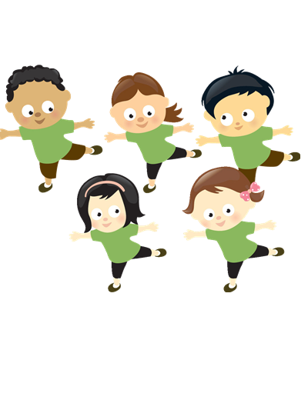
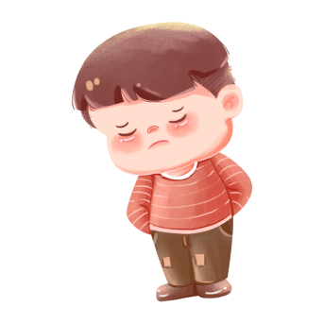





Underline the clues
thought of him as a regular kid
none thought it unusual that he had decided to join the cross-country team
was small for ten years old
usual big toothy smile
had a brain disease which prevent him from walking or running like other children
always participated to the best of his ability in whatever they were doing
had not missed a single practice
Although he always finished his run long after the other children, he did always finish.
I was familiar with the challenges David faced and was proud of his strong determination.

Slide 6
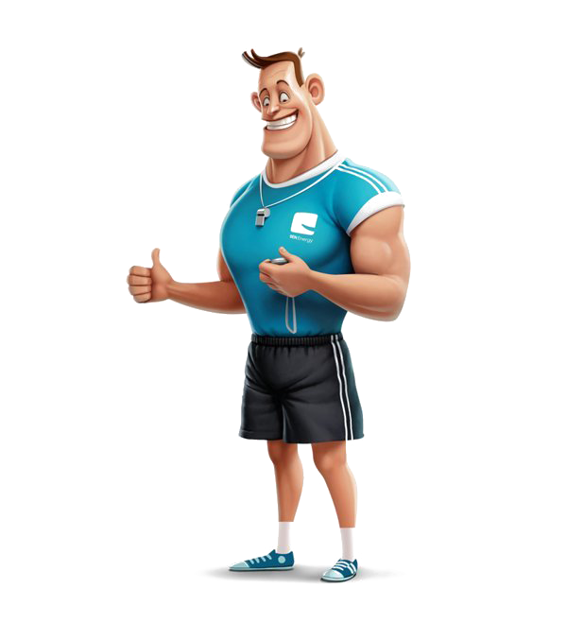



Underline the clues
Was the coach doing the right thing?
Why did the author mention him?
Can this part be deleted?
What challenge is he faced with at present? Why?
How did she feel about his decision? What did she do?
considerate/ understanding
His usual big toothy smile was absent today.
He had worked so hard for this event!
He hesitated and then said he had decided not to run.
encourage
I walked over and asked him why…
I quickly searched …for the coach and asked him what had happened.
I bit back my frustration.
After making sure that David could run if he wanted, I turned to find him…
We sat down next to each other,…
eager to take part in the cross-country run but afraid of being laughed at by students from other schools.

Slide 7




List the key words or phrases
which can show the plot development
which can be used in your writing
Ending
cross-country run
As he finished his run and won continuous thunderous applause from all the students present, the usual big toothy smile blossomed on his face again.
I can tell now he is more than a regular kid.
usual big toothy smile
laugh at
Conversation
to the best of his ability
finish his run
People will not laugh at those who work to the best of their ability. And your efforts put into the previous practices will surely pay off.
strong determination
Process
had not missed a single
practice
With strong determination, David insisted on running at a steady speed toward the finishing line, despite his drenched shirt and heavy breaths.
regular

Slide 8


Design the plot—create a scene
to highlight how determination helped him finish the run
Para 1. We sat down next to each other, but David wouldn’t look at me.
Para 2.I watched as David moved up to the starting line with the other runners .
Scene 1: David’s uneasiness. (action, facial expression, gestures)
Scene 2: I encouraged him. (words + action)
Scene 3:
(words + actions + facial expression, gestures)
David changed his mind and decided to participate.
Scene 1: David appeared and students laughed. (before)
Scene 2: David ran. (during)
Scene 3: David finished his run and others respected him.
(after)

Slide 9
Design the plot—expand the sentence
Para 1. We sat down next to each other, but David wouldn’t look at me.
Para 2.I watched as David moved up to the starting line with the other runners .
Scene 1: David’s uneasiness. (action, facial expression, gestures)
Scene 2: I encouraged him. (words + action)
Scene 3:
(words + actions + facial expression, gestures)
David changed his mind and decided to participate.
Scene 1: David appeared and students laughed. (before)
Scene 2: David ran. (during)
Scene 3: David finished his run and others respected him.
(after)

Slide 10

Use descriptive expression and necessary cohesive structures
Scene 1: David’s uneasiness. (action, facial expression, gestures)
Scene 2: I encouraged him. (words + action)
Scene 3: David changed his mind and decided to participate. (words + actions + facial expression, gestures)
Para 1. We sat down next to each other, but David wouldn’t look at me.
① He rubbed his hands constantly, eyes locked to the starting line where stood the other runners, who are ready to shine themselves.
② Thinking it a good chance to get him back on track, I decided to infuse courage into this poor boy.
③ With a gentle pat on his shoulder, I turned him around, looked straight into his red-rimmed eyes and encouraged, “David, don’t care about others and just do what you want. People will not laugh at those who work to the best of their ability. And your efforts put into the previous practices will surely pay off.”
④ As if greatly inspired by my words, David rose to his feet, bowed to me, turned and strode forward, slowly but firmly.
(120 words)

Slide 11
Use descriptive expression and necessary cohesive structures
Para 2.I watched as David moved up to the starting line with the other runners .
① This time, it seemed that little did he care about the gossip about his unexpected appearance.
② Soon the race began. All the runners shot like arrows including David.
④ But shortly after, as usual, he was left far behind, which invited some jeers from the crowd by the track.
⑤ However, with strong determination, David insisted on running at a steady speed toward the finishing line, despite his drenched shirt and heavy breaths.
⑥ As he finished his run and won continuous thunderous applause from all present, I am glad that the usual big toothy smile blossomed on his face again.
⑦And it was certain that, now, in everyone’s heart, David is a regular kid and more than regular.
(119 words)
Scene 1: David appeared and students laughed. (before)
Scene 2: David ran. (during)
Scene 3: David finished his run and others respected him. (after)

Slide 12

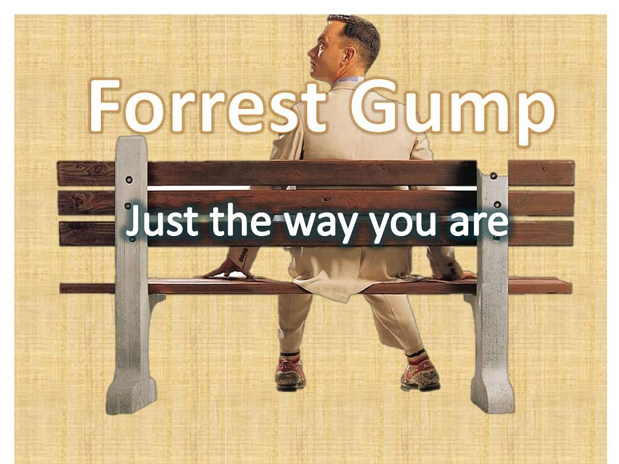
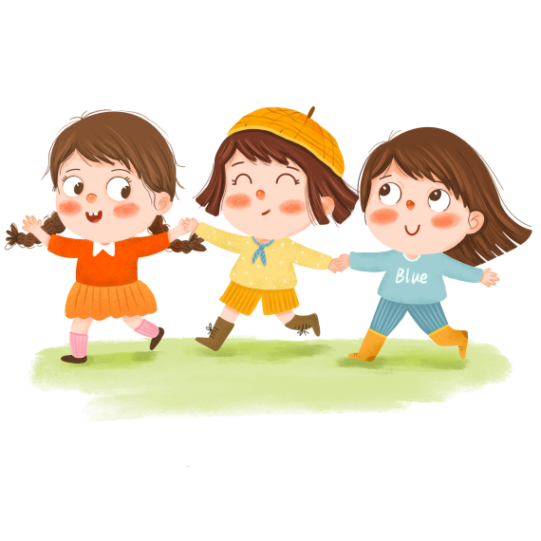
What can you learn from this story?
Nothing is impossible to a determined heart.
Just try and ignore others.
Practice makes perfect.
Have you ever laughed at people with disabilities?
Have you ever laughed at others?
What is the suitable way to get along with others?

Slide 13

A. Exchange your writing with your deskmates and grade each based on the following scale.
Beautiful Handwriting 1’
Logical Plot 4’
Accurate Spelling 1’
Appropriate Collocation (搭配) 1’
Complete and Advanced Sentences 1’
Coherence and Consistency (衔接与连贯) 2’
B. Polish your writing

