Slide 1

感恩遇见，相互成就，本课件资料仅供您个人参考、教学使用，严禁自行在网络传播，违者依知识产权法追究法律责任。
更多教学资源请关注
公众号：溯恩高中英语
知识产权声明

Slide 2


Slide 3
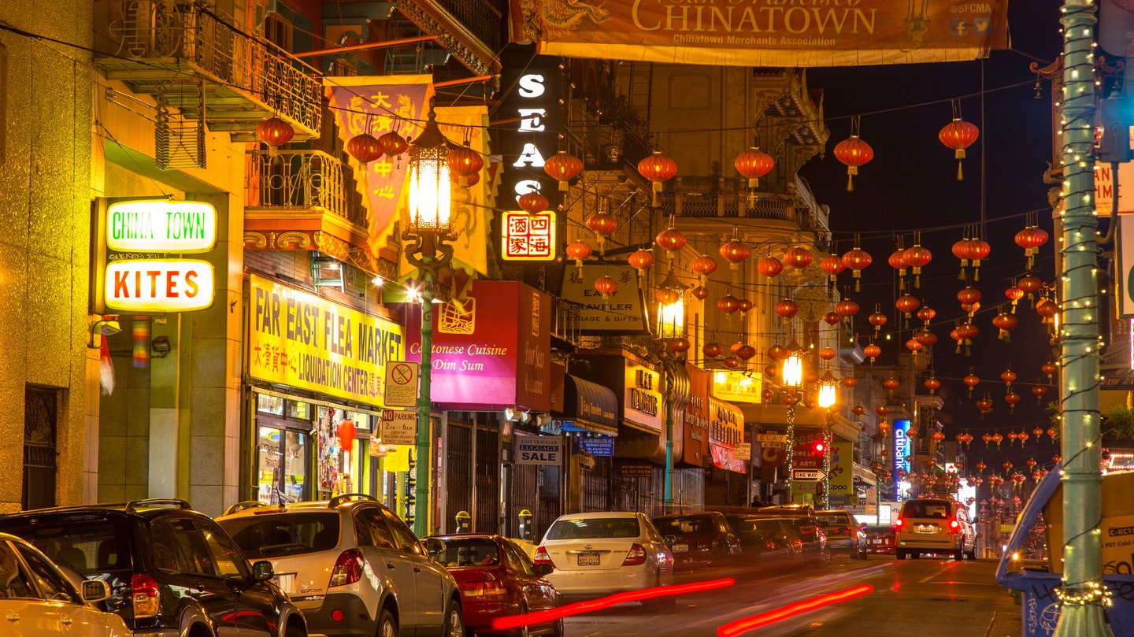
Welcome to Chinatown
Unit 3 Diverse Cultures
Reading for Writing
Introduce a place with distinctive culture identity.
Welcome to Chinatown

Slide 4
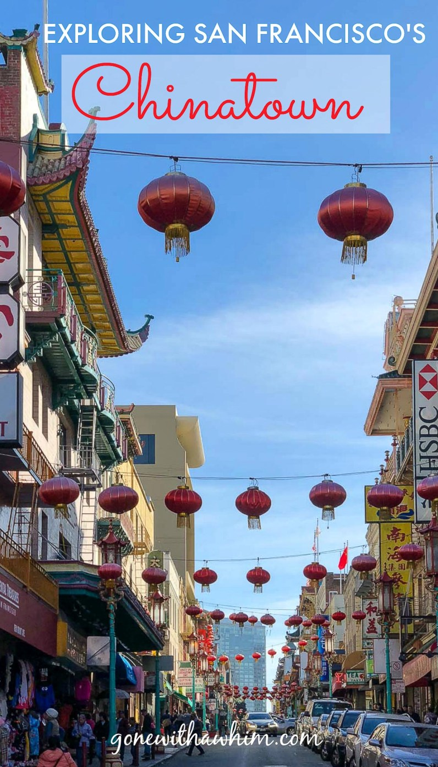
Read for the organization
WELCOME TO CHINATOWN!
Read the instruction to the Chinatown of San Francisco and figure out the outline of the whole passage.
Write for visitors

Slide 5
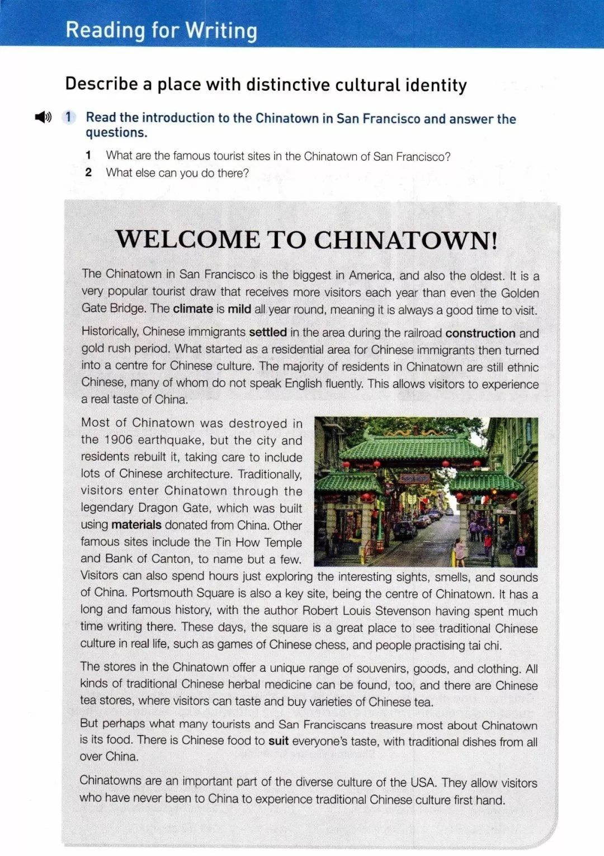

General
introduction
_________
_______________
to San Francisco Chinatown
location
Introduction
climate
history
P1
ethnic groups
languages
Detailed
information
________ _____________ of the Chinatown
Body
Tourist attractions
P2-5
Famous figures
Businesses and industries
Importance
Famous food/drink
______________ of Chinatown
Summary
P6

Slide 6
Describe a place with distinctive cultural identity
cultural identity
Items used to describe a place
___ location | ___ climate | ___ history
___ population | ___ ethnic groups | ___ languages
___ famous figures | ___ legends/stories | ___ famous food/drink
___ tourist attractions | ___ businesses and industries | ___ other names for the city/town
history
ethnic groups
languages
famous figures
legends/stories
food/drink
tourist attractions
other names

Slide 7
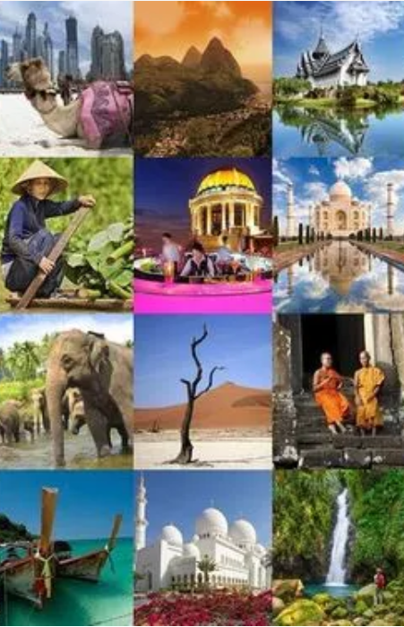
Read for the expressions
WELCOME TO CHINATOWN!
Read the passage again and find out the useful expressions to help your writing

Slide 8

Para | P1 | P2 | P3 | P4 | P5 | P6
Items | Location Climate | History language residents | Famous figures Tourist attractions | Businesses and industries | Famous food/drink | summary
EXP
W O R D S
S S P A T T E R N S
…biggest in America , and also the oldest ;
Historically, …settled in..;
the majority of …;
allow visitors to experience a real taste of …
Traditionally, visitors enter …through the legendary…,
To name but a few; ..spend hours just exploring…;
…offer a unique range of/varieties of/ series of
… can be found;
suit everyone’s taste, with…
An important part of ;
first hand
..is mild all year;
a very popular tourist draw that…
what ..turned into a center for …;
many of whom… speak English fluently;
…,which was built using …
.. Also a key site,being ….
It has a …history, with…having spent much time…;
These days,… is a great place to see traditional…, such as…
There are…., where visitors can…
What many tourists treasure most is….
…it is a good time to visit
WELCOME TO _________________!

Slide 9
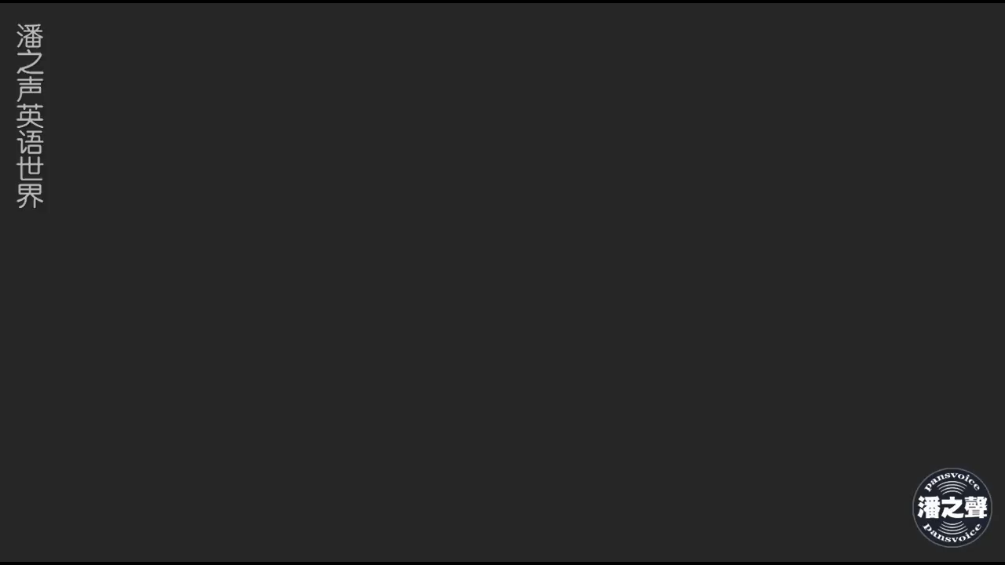

Slide 10

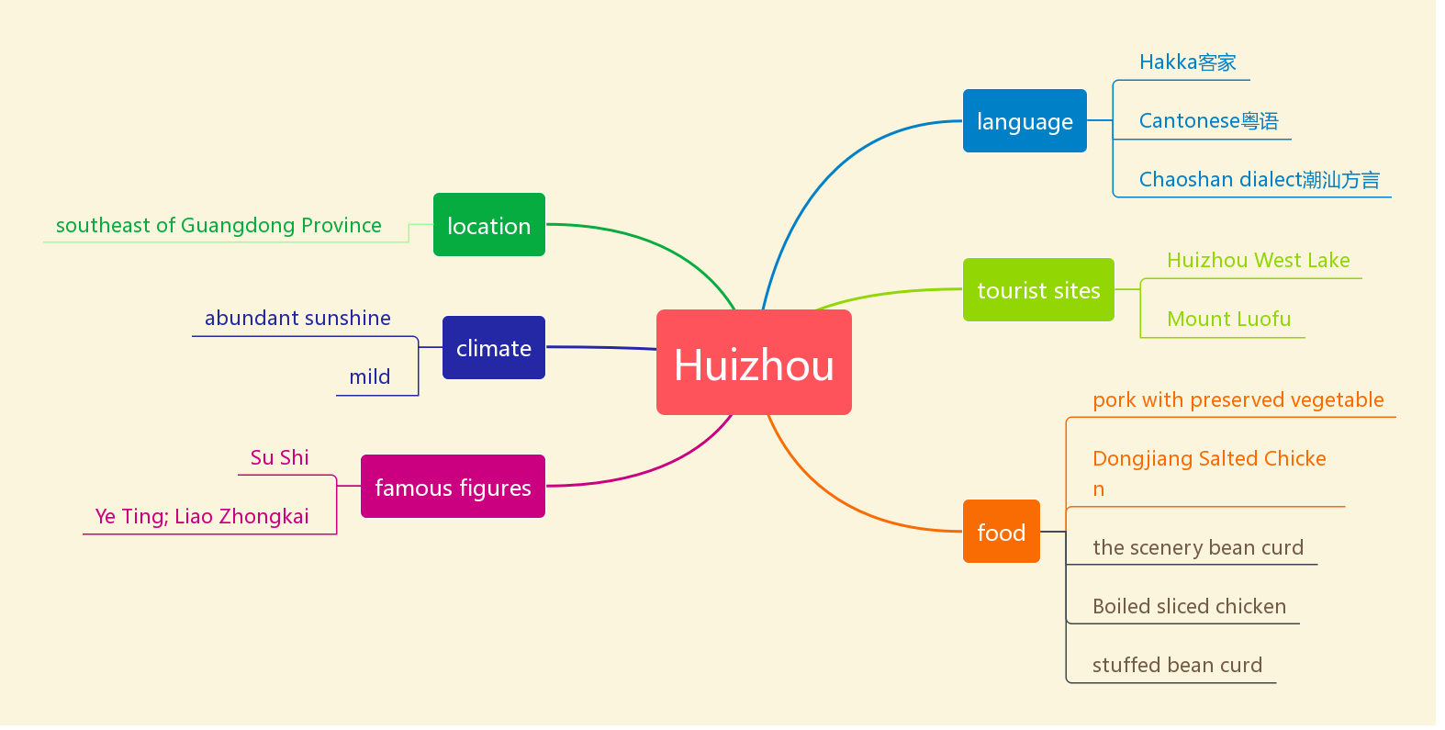
WELCOME TO HANG ZHOU!
The Wu dialect
the digital economy--Alibaba
business
Hangzhou dialect
Be located in/ lie in/stand
classic Hangzhou gardens
Qinghefang Ancient Street
distinctive seasons
West Lake
HANG ZHOU
pleasant weather
Wushan Square
Longjing shrimp
Su Dong Po
West Lake Fish in Vinegar Gravy
Bai Ju Yi; Shen Kuo…
stories
history
Lotus root powder
legend of the white snake
Be a capital of Wu &the Southern Song Dynasty
Beggar’s chicken
Dongpo Pork

Slide 11
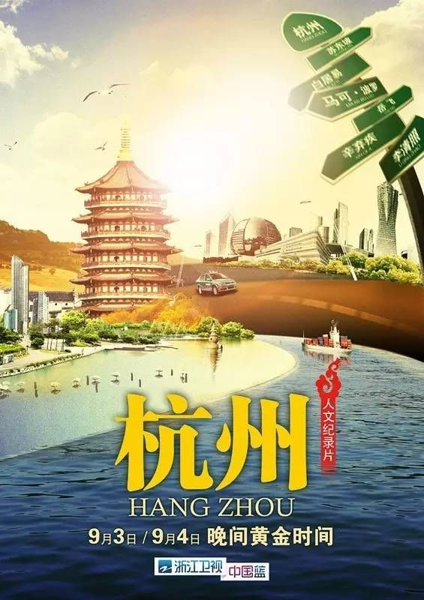
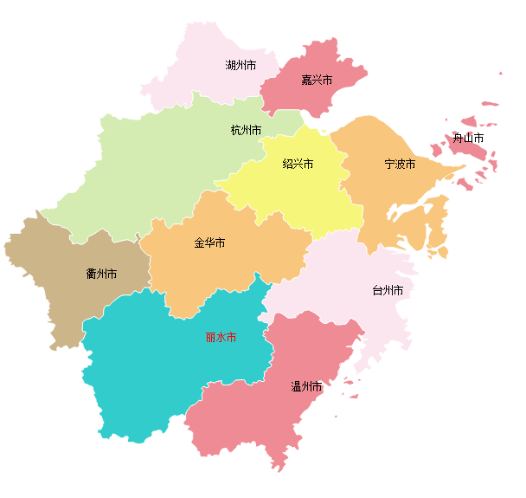
WELCOME TO HANG ZHOU!
Part1 General Introduction
地理位置
素有“人间天堂”的美誉
人文古迹众，秀丽风景多
四季分明，景色宜人

Slide 12

Part1 General Introduction
______________________________________________________
______________________________________________________
______________________________________________________
______________________________________________________
L o c a t e d
Hangzhou is located in the northwest of Zhejiang Province.
Hangzhou is known as a heaven on earth.
It is a very popular tourist draw that receives many thousands of visitors all around the year.
Four seasons are distinctive and weather is pleasant, meaning it is always a good time to visit.
Located in the northwest of Zhejiang Province, Hangzhou City, known as a heaven on earth, is a very popular tourist draw that receives many thousands of visitors all around the year. Four seasons are distinctive and weather is pleasant, meaning it is always a good time to visit.

Slide 13

Part2 details
Historically, Hangzhou was the capital of Wu and the Southern Song Dynasty. What started as a residential area then turned into a center of____________________________. ___________sites, ____________ scenery
_____________landscape allows visitors to experience a real taste of this ___________________ city.
标题内容
标题内容
标题内容
Historical
politic economy and culture
natural
cultural
我们长期为客户提供专业的PPT策划设计制作等全程服务，凭借自身优势和专业化的独特视角为客户提供优质的PPT服务。
我们长期为客户提供专业的PPT策划设计制作等全程服务，凭借自身优势和专业化的独特视角为客户提供优质的PPT服务。
我们长期为客户提供专业的PPT策划设计制作等全程服务，凭借自身优势和专业化的独特视角为客户提供优质的PPT服务。
ancient/unique

Slide 14

Part2 details
tourist attractions/stories/famous figures
select
earns
Traditionally, visitors _________ West Lake as a must-see site, which ________a great reputation for its peace and beauty._____________________________________ to name but a few. Visitors can spend hours just exploring ________________. ______________________ is also a key site, being ________________________________. ________________________________________________________________________________________________________________________________________________________________
business/food/drink
________________________________________________________________________________________________________________________________________________________________
Part3 summary
________________________________________________________________________________________________________________________________________________________________

Slide 15
Complete your writing
Introduction
Located in the northwest of Zhejiang Province, Hangzhou City, known as a heaven on earth, is a very popular tourist draw that receives many thousands of visitors all around the year. Four seasons are distinctive and weather is pleasant, meaning it is always a good time to visit.
Try to make full use of the expression that occurred in the passage.
Refer to the material in BOOK1UNIT2&BOOK2UNIT4
Body
History/tourist attractions/stories/famous figures/business/food
Historically, Hangzhou was the capital of Wu and the Southern Song Dynasty. What started as a residential area then turned into a center of politic economy and culture. Historical sites, natural scenery, cultural landscape allows visitors to experience a real taste of this ancient/unique city.
Traditionally, visitors select West Lake as a must-see site, which earns a great reputation for its peace and beauty. ……
______________________________________________________________________________________________________________________________________________________________________________
Summary
______________________________________________________________________________________________________________________________________________________________________________

Slide 16
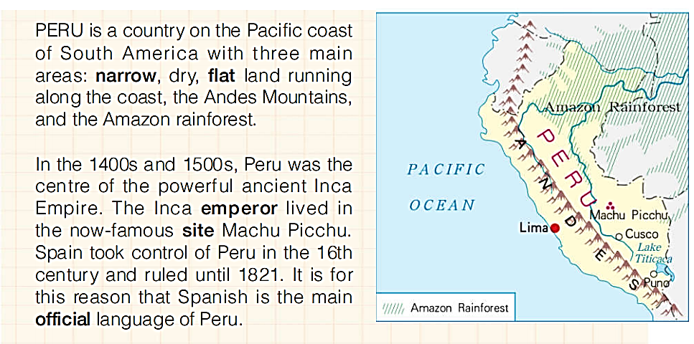
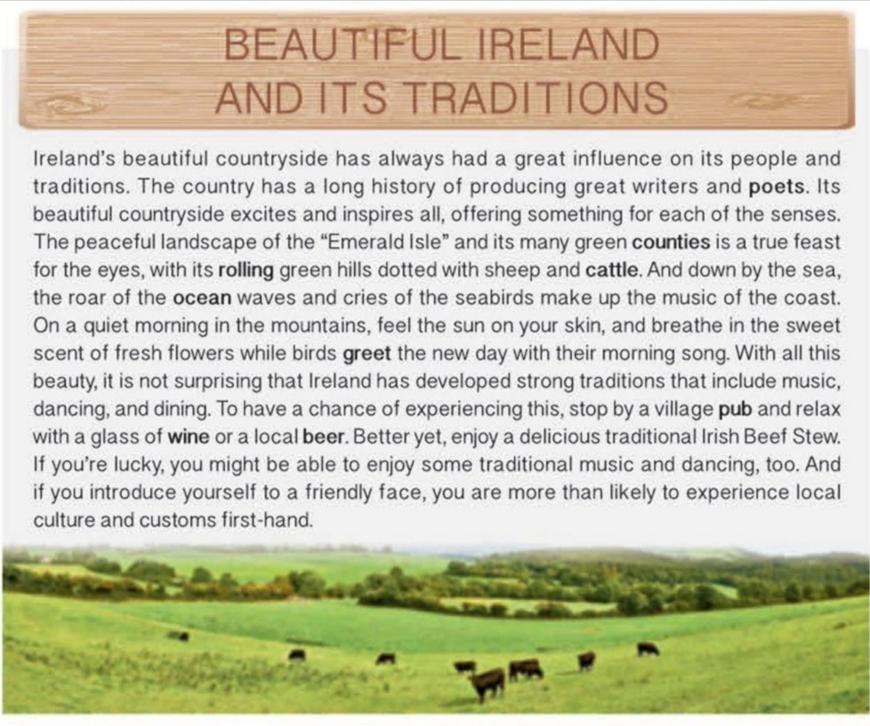
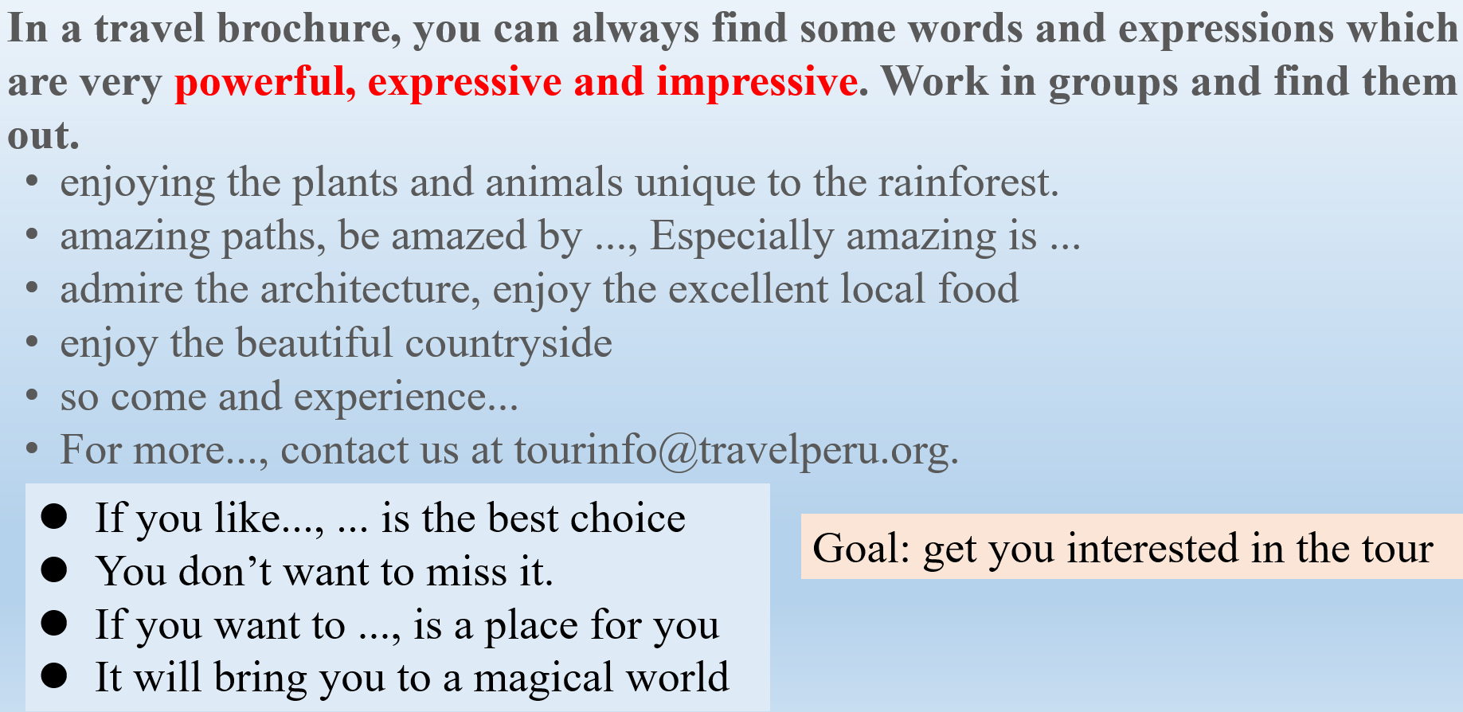
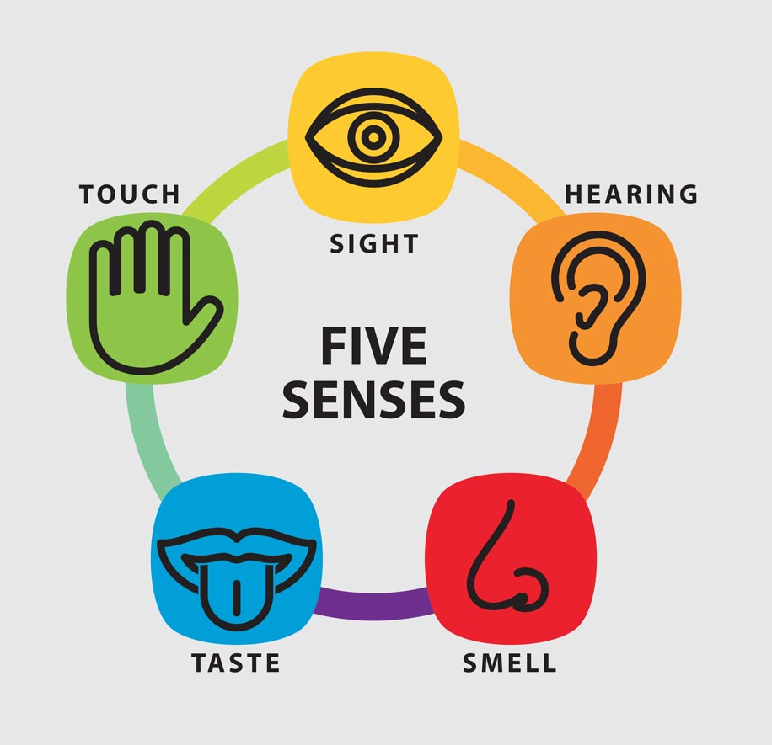
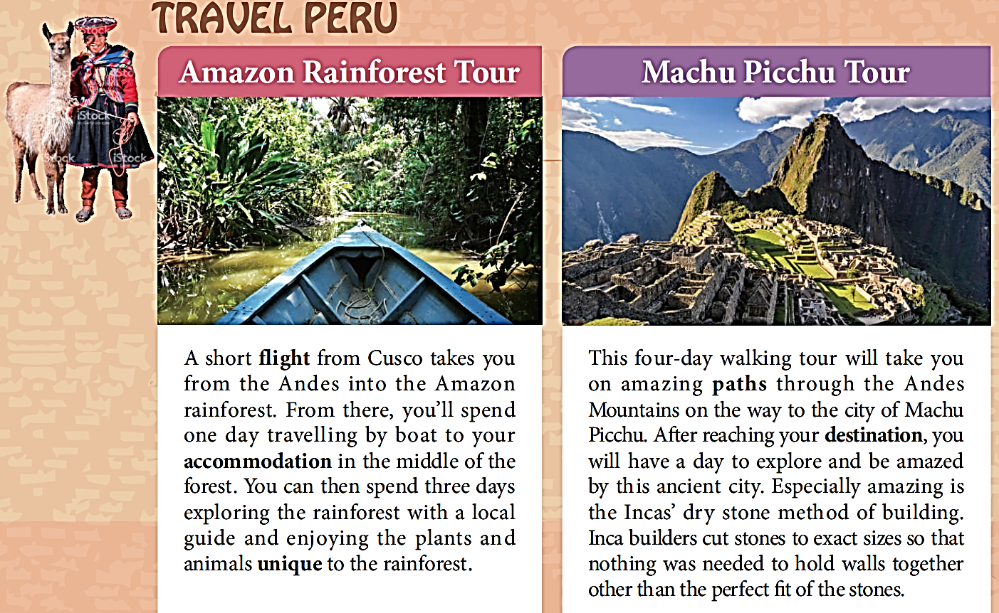
reference
Describe a place
♥Get visitors interested in the place

Slide 17
One sample
Located in the northwest of Zhejiang Province, Hangzhou City, known as a heaven on earth, is a very popular tourist draw that receives many thousands of visitors all around the year. Four seasons are distinctive and weather is pleasant, meaning it is always a good time to visit.
Historically, Hangzhou was the capital of Wu and the Southern Song Dynasty. What started as a residential area then turned into a center of politic economy and culture. Historical sites, natural scenery, cultural landscape allows visitors to experience a real taste of this unique city.
Traditionally, visitors select West Lake as a must-see site, which earns a great reputation for its peace and beauty. It includes many famous places,Tiger-running Spring, the Lingyin Monastery and the Moon Reflected in Three Pools, to name but a few. All of them make the lake like a dazzling pearl lies in the mountains and green trees. So many great poets, such as Su Dong Po, leaving excellent works praising these sights. Visitors can spend hours just exploring the fascinating sights, feeling the mild breeze blowing across the beautiful lake. Just several hundreds meters away from West Lake, Qinghefang Ancient Street is also a key site, which is the only well-preserved part of the ancient city. As a miniature of the city's long history, it is the best place to embody the historical and cultural character of Hangzhou.

Slide 18
One sample
But perhaps what many tourists treasure most about Hangzhou is its food. There is “Queen of green tea“-- West Lake Longjing represents one of the most famous teas in the country. Apart from the tea, Dongpo pork, Beggar's chicken, Fried shrimps with Longjing tea, and West Lake fish are among the most popular dishes to suit everyone’s taste.
Hangzhou is a wonderful oriental city where residents have the top sense of happiness among China. It allows visitors who have never been to the south of China to experience traditional culture of the south of the Yangtze River.

Slide 19
Practice
Dear David,
Hope this letter finds you well. Knowing that you are scheduled to visit China next month, I would like to recommend Hangzhou to you.
Recognized as a heaven on earth, Hangzhou, located in the north of Zhejiang, attracts countless tourists from home and abroad every year. A 30-minute drive will take you from Xiaoshan International Airport to the ancient city to explore its beauty. What will amaze you most is the breathtaking views of the West Lake. Having a taste of local cuisine and wandering along the beautiful lake with the breeze touching your cheek will be a feast for the mouth and the eyes. I bet you’ll have a good time here.
Hopefully, my recommendation will be helpful. Wish you a pleasant journey in China!
假如你是李华，你的英国朋友Jim准备暑假来中国旅游，让你推荐一个城市。请你给他回信，内容包括：
1. 推荐城市；
2. 推荐理由；
3. 你的祝愿。

Slide 20

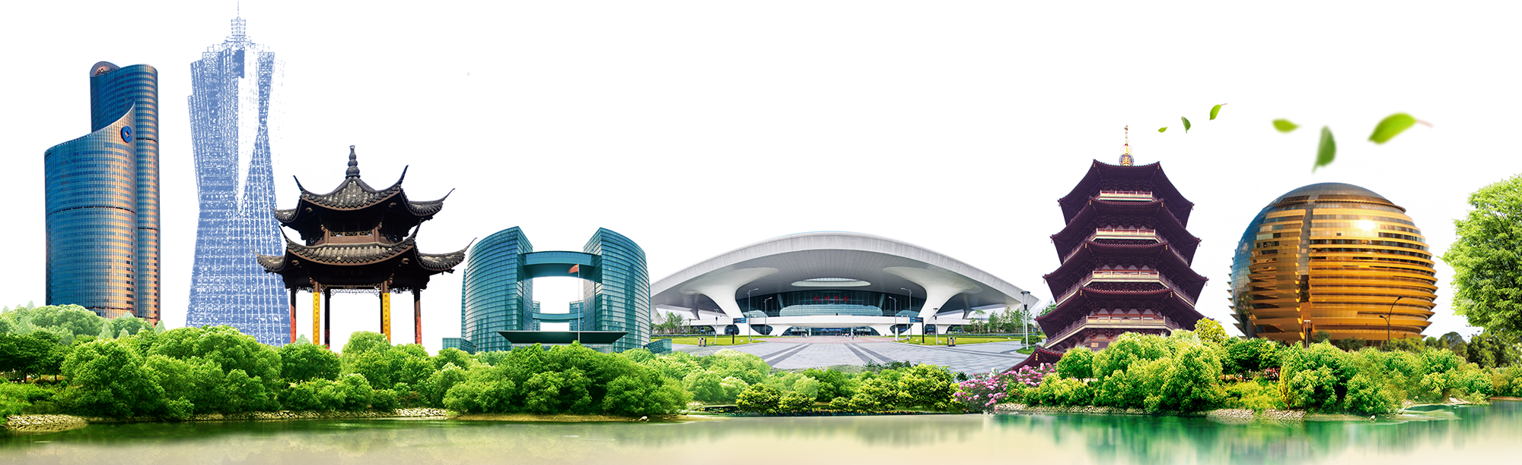
THANK YOU

