Slide 1

感恩遇见，相互成就，本课件资料仅供您个人参考、教学使用，严禁自行在网络传播，违者依知识产权法追究法律责任。
更多教学资源请关注
公众号：溯恩高中英语
知识产权声明

Slide 2
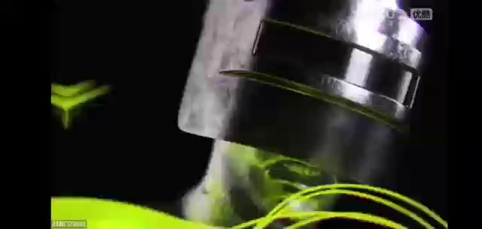

Slide 3

My Experiences With Computer Games
workbook (p71)

Slide 4
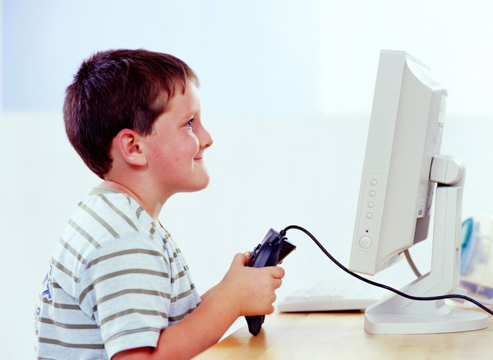
Lead-in
No wonder a growing number of teenagers become crazy or even addicted.
go too far
skip meals
play through the night
Is it so hard to break the addiction?

Slide 5
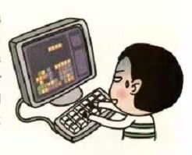
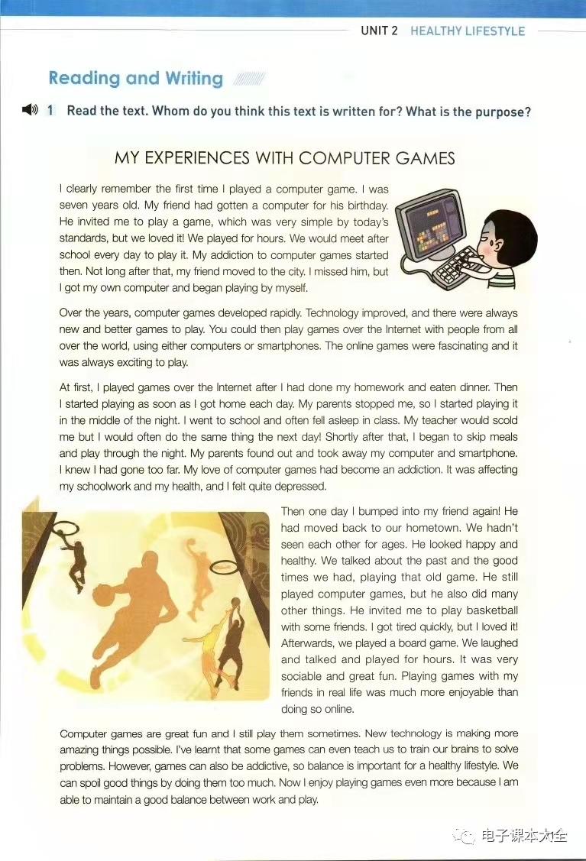
Prediction
Experiences
My Experiences with Computer Games
change

Slide 6
Structure
Divide the passage into 2 parts.
experiences
reflection

Slide 7

Experiences
Read paragraph 2-4 and complete the table.
Time | Experiences
7 yrs old
over the years
at first
then
shortly after that
one day
Feelings / Attitudes
played for hours after school every day
fell in love (addiction started)

Slide 8
Experiences
Time | Experiences | Feelings / Attitudes
7 yrs old
over the years
at first
then
shortly after that
played for hours after school every day
fell in love
(addiction started)
new and better games to play
felt fascinated
(addiction increased)
after I had done...
_________
addicted
as soon as I got home each day; play in the middle of night; fell asleep often
increasingly
became entirely addicted
skip meals and play through the night

Slide 9
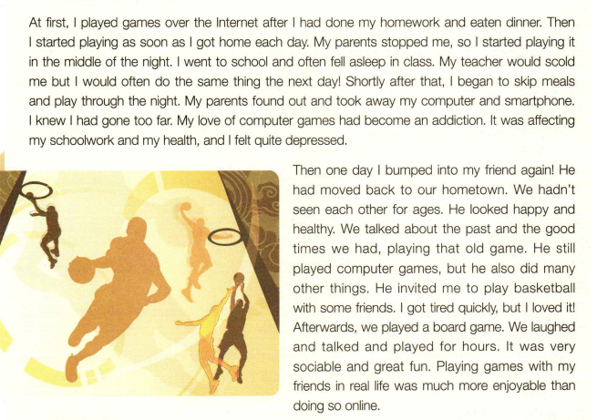
Experiences

Slide 10
Experiences
Experiences | Feelings / Attitudes | Influence
played for hours after school every day
fell in love
(addiction started)
new and better games to play
felt fascinated
(addiction increased)
socially
after I had done...
affected my schoolwork and my health
as soon as I got home each day; play in the middle of night; fell asleep often
became entirely addicted
mentally
felt quite depressed
skip meals and play through night
physically
got tired quickly

Slide 11
Experiences
  In order to help him break the addiction, his parents and teacher....
stop, take away
scold
They were really concerned about him, but what they did was improper.

Slide 12
Experiences

Slide 13
Experiences
Experiences | Feelings / Attitudes | Influence
Change
played for hours after school every day
fell in love
(addiction started)
new and better games to play
felt fascinated
(addiction increased)
after I had done...
socially
as soon as I got home each day; play in the middle of night; fell asleep often
stronger
became entirely addicted
mentally
skip meals and play through night
physically
determined to find an alternative
playing games with friends in real life

Slide 14
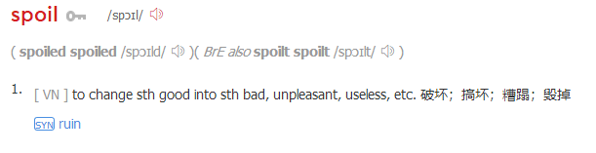
Reflection
We can spoil good things by doing them too much.
By kicking the addiction, he has learnt...
We should hold a proper attitude to computer games;
Balance is important for a healthy lifestyle;
We should maintain a good balance;
Great things always begin from our inside.

Slide 15
Discussion
Share a similar case in your life in which someone spoil good things by doing them too much and put forward your suggestions accordingly.
The experience should include:
※the good thing
※his/her behaviour of the addiction
※the change of his/her feeling/attitude
※the influence of the addiction
※your suggestion

Slide 16
A possible version:
A friend of mine, who cared about her appearance very much, fell in love with losing weight. She ate like a bird and even skipped meals to keep a slim figure. Additionally, she spent large sum of money on purchasing slimming products. she became entirely addicted to it. Gradually, she became tired easily and once even fainted while working, thus resulting in one week in hospital. So I think it is high time she should maintain a balanced diet and have a healthy lifestyle.
good thing
behaviour
feeling
influence
suggestion

Slide 17
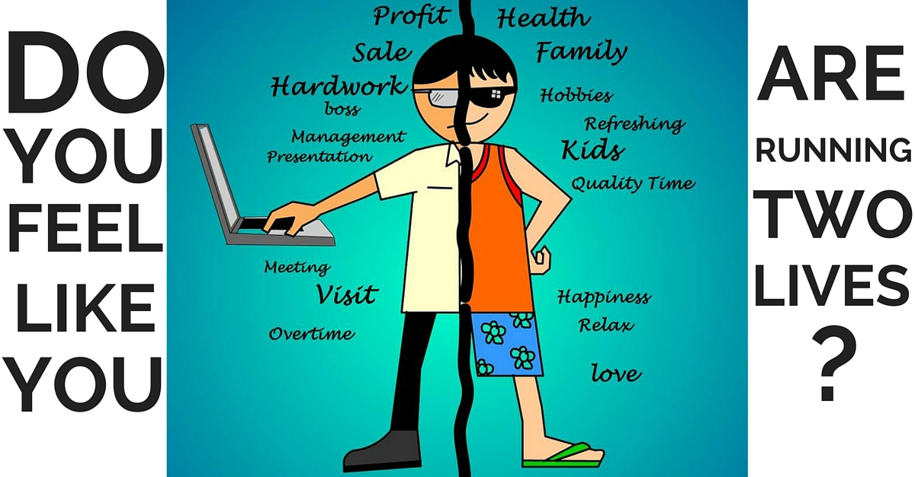
Assignment
Make a poster to appeal to students to break the addiction to smartphones. Your poster should include:
◆ an eye-catching title
◆a beautiful layout
◆vivid pictures

Slide 18

THANK YOU

