Slide 1

感恩遇见，相互成就，本课件资料仅供您个人参考、教学使用，严禁自行在网络传播，违者依知识产权法追究法律责任。
更多教学资源请关注
公众号：溯恩高中英语
知识产权声明

Slide 2

应用文写作之
——告知信
浙江省丽水龙泉市第一中学 兰建珍

Slide 3
第一节:应用文写作（满分15分)
假定你是李华，上周你校举办了一场“全国戏曲进校园” (National Opera on Campus) 活动，你的外国友人Tom对此很感兴趣，请你给他发一封邮件，告知他活动详情，内容包括以下要点:
1.时间地点; 2.活动内容; 3.活动感受。
注意:
1．词数80左右;
2．可适当增加细节，以使行文连贯。

Slide 4
告知信：
Para.1 background(背景信息) ＋ writing purpose（写作目的）
Background(背景信息):上周你校举办了一场“全国戏曲进校园” (National Opera on Campus) 活动，你的外国友人Tom对此很感兴趣.
what? when? where?
主语选择？
1-1-1 Last week
1-1-2 Last week, our school
1-1-3 Last week, an activity named National Opera on Campus
witnessed a meaningful activity called/named National Opera on Campus
in our school.
organised/held/carried out a meaningful activity called/named
National Opera Campus.
was held/carried out/
organized in our school
for all the students.

Slide 5
告知信：
Para.1 background(背景信息) ＋ writing purpose（写作目的）
1-2-1 ...Thrilled/Delighted to learn that you have a great enthusiasm for it, I am writing to share with you something about it.
1-2-2 ...Knowing/Learning that you are keen on it, I am writing to inform you of/ keep you informed of some relevant details about it.
1-2-3 ...I’m more than glad to know that you are keen on it, and I am writing to briefly introduce...to you.

Slide 6
告知信：
Para.1 background(背景信息) ＋ writing purpose（写作目的）
Learning that you show great interest in the National Opera Campus held in our school last week, I am writing to offer you some relevant details about it. 29w

Slide 7
Para.2 “全国戏曲进校园”活动内容：
观看戏曲表演
戏曲知识介绍/讲座
曲目欣赏
学唱戏曲
变脸
脸谱
扮演角色
试穿服饰
京剧、越剧、川剧
戏曲文化展
观看戏曲服装秀
Para.2 1.时间地点; 2.活动内容; 3.活动感受。
watch opera performances
attend lessons / lectures on opera knowledge
admire / appreciate opera music
learn to sing operas
face changing (techniques)
facial make-up in opera
be dressed up as famous characters
try on costumes
Peking Opera, Yue Opera, Sichuan Opera
an opera culture exhibition
watch the opera costume show

Slide 8
目的旨在...
……, aimed at/aiming to/with the intention of /
in the hope of
激发对戏曲的热情/兴趣
spark/sparkle the enthusiasm for opera
arouse/develop/stimulate/ignite/trigger/fuel the interest/curiosity/... in opera
motivate our passion for ...
stimulate the interest in …
promote an atmosphere of opera appreciation
deepen our understanding of/insight into our traditional Chinese culture.
cultivate one’s mind
陶冶情操
1..., which makes it possible for us to cultivate authentic ability;
2...., enabling/allowing/empowering/helping us to savor/relish
the glamor of national opera.
benefits?
3. . Not only...but also...

Slide 9
Way 1: G—S
Para2: 1.时间地点; 2.活动内容; 3.活动感受
2. ___________, our school organized various/diverse activities, ranging
from…to…., _____________________.
2-1 ---To enrich our school life, the activity offered a variety of performances related to opera, ranging/varying from opera culture exhibition to facial make-up, which were a true feast for the eyes/each of which was breathtaking/fascinating.But the highlight of the activity was... 39w
2-2 ---Aimed at deepening..., varieties of /diverse/various performances were on show, featuring the opera culture exhibition, the costume show and music appreciation. What topped the list was... 26w （better）

Slide 10
Para2: 1.时间地点; 2.活动内容; 3.活动感受
Way 2: in the order of time
The activity started with …， after which we …closely followed by … Subsequent to that,...
The highlight of the activity was …
2-3 The activity satrted with opera performances, enabling us to savor/relish the glamor of national opera, which was a feast for the eyes. Subsequent to that, we had such a precious chance to try on some opera costumes, closely followed by an opera culture exhibition, fueling our enthusiasm/ passion for deepening our insight into Chinese culture. 55w

Slide 11
Para3: 1.时间地点; 2.活动内容; 3.活动感受（评价、意义）
3-1 I highly consider the experience to be rewarding, so I hope you would come to China to join us. 评价
3-2 This being a golden chance to relish the unique glamour, I think it really deserves your attention! 评价
3-3 Without such a good chance, we couldn’t have broadened our horizons and gained a deeper understanding of national opera. 意义/评价
3-4 In a word, the activity provided a platform where we could take a glimpse at the profound traditional operas. 意义
3-5 not only...but also...等引导的总结性感受放第二段写也是可以的

Slide 12
下水作文:
Dear Tom,
Learning that you are keen on the National Opera on Campus held in our school, I’m writing to inform you of some relevant details.
To enrich our school life, the activity offered a variety of performances related to opera, ranging/varying from opera culture exhibition to facial make-up, which were a true visual feast. But the highlight of the activity was trying on diverse opera costumes, as if it really brought the magic opera into reality, so appealing and unforgettable!
I highly consider the experience to be rewarding, and I hope you will come to China to join us.
99w
Yours,
Li Hua

Slide 13
应用文参考范文:
Dear Tom,
Last week our school held an activity named National Opera on Campus. Knowing you have a great enthusiasm for it, I am writing to share with you.
The activity was held in school hall at 2:30 p.m. last Wednesday. Besides, it offered a variety of performances related to opera, including singing, movements, as well as facial make-up, which was a feast for the eyes. After appreciating the show, we have a better understanding of opera and feel a sense of pride in Chinese culture.
I sincerely hope you would come to China to experience it. Best wishes! 96w
Yours,
Li Hua

Slide 14
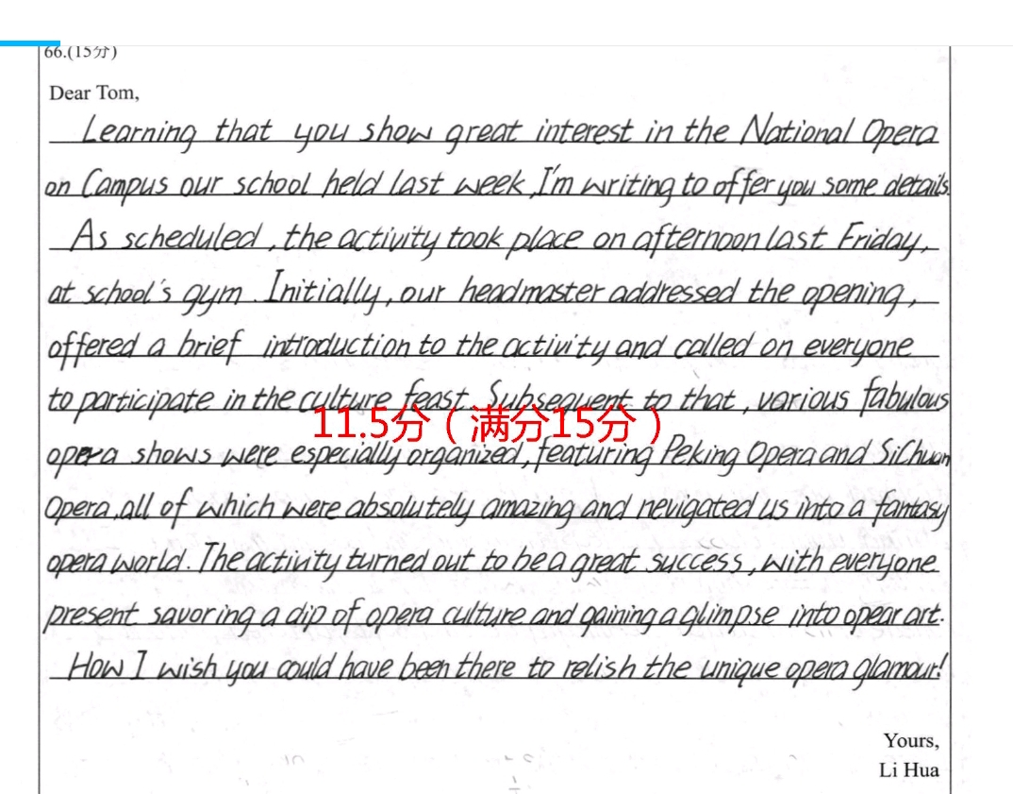
YOUR
YOUR COMMENTS
一起来评一评

Slide 15
  What should the good English practical writing be like?
Checklist:
1. 卷面干干净净？漂漂亮亮？有无涂改？词数是否合适？；
2. 内容要点是否齐全，有无无遗漏；
3. 应用词汇和语法结构的准确性和丰富性；
4. 上下文的连贯性？（行文是否有逻辑性和合理性？）
5. 段与段间、句与句间的衔接是否合理，全文结构是否紧凑？

Slide 16

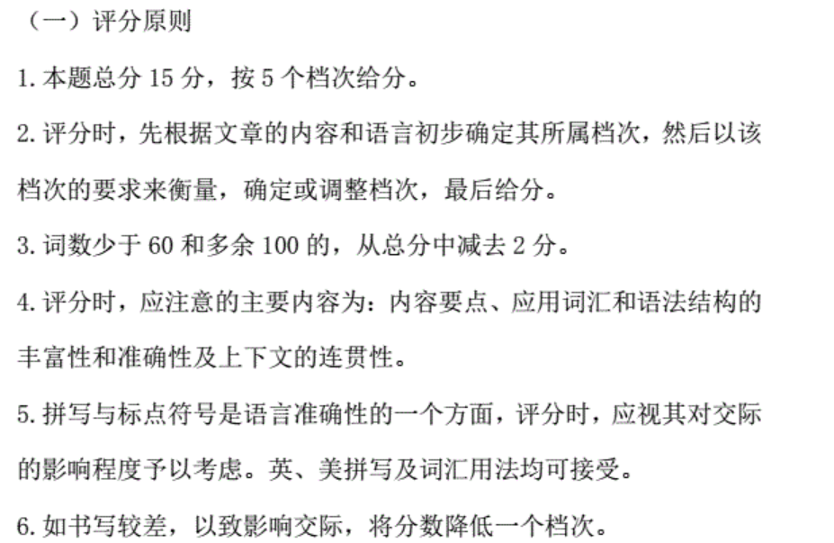

Slide 17
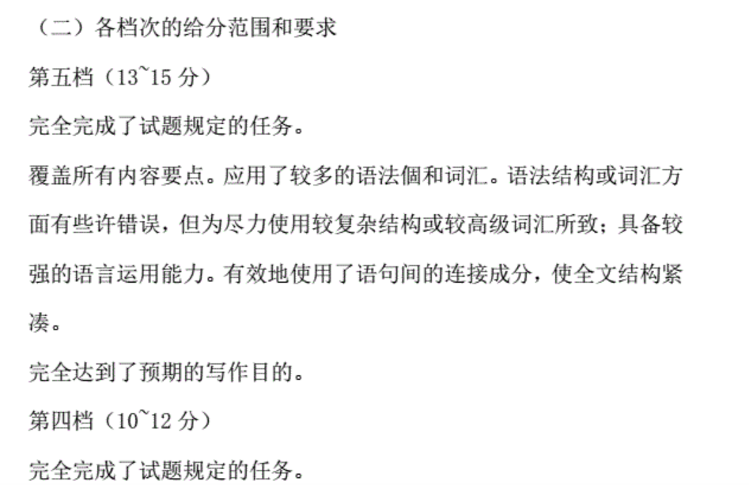
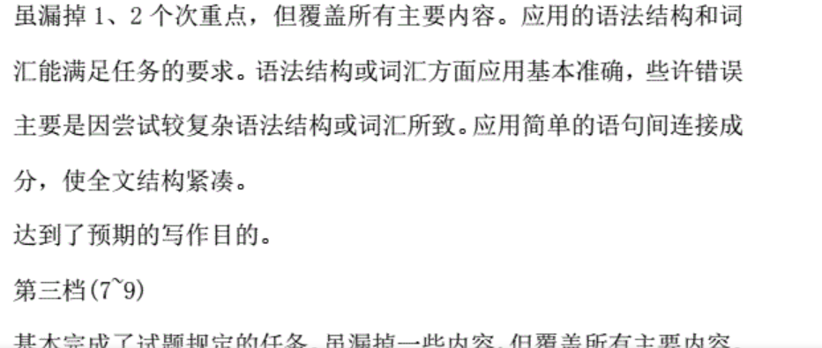

Slide 18
What’s your version?

Slide 19
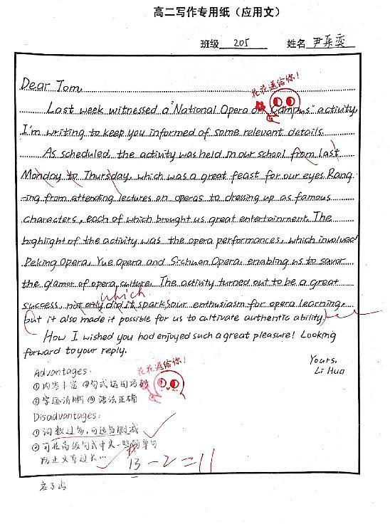
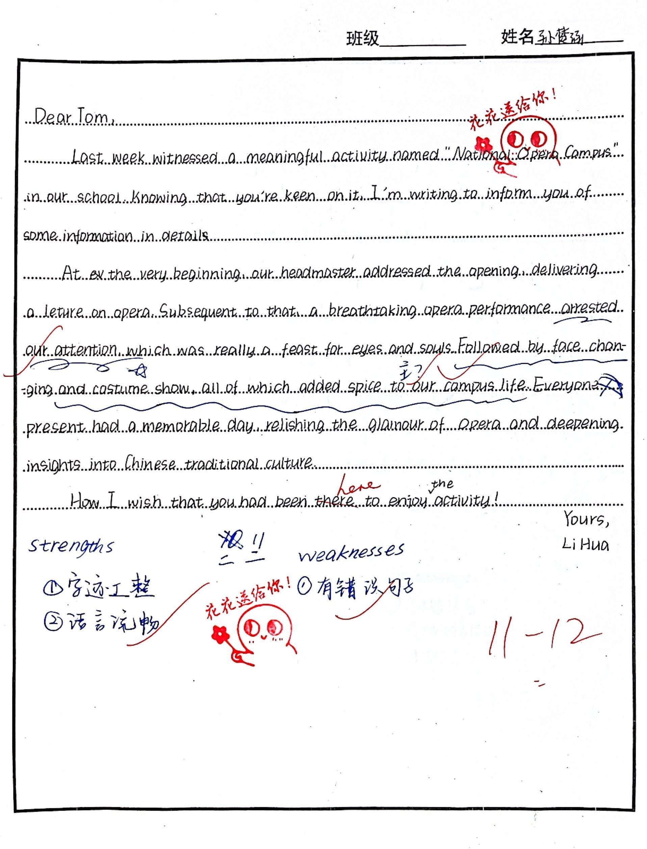

Slide 20
