Slide 1

感恩遇见，相互成就，本课件资料仅供您个人参考、教学使用，严禁自行在网络传播，违者依知识产权法追究法律责任。
更多教学资源请关注
公众号：溯恩高中英语
知识产权声明

Slide 2
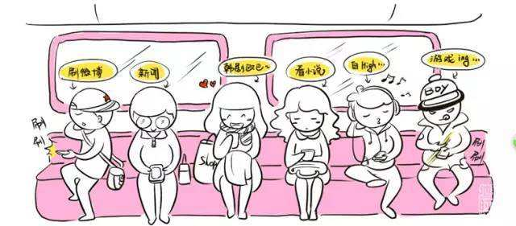
The Face-down Generation
Teenage life
workbook--reading (P74)

Slide 3
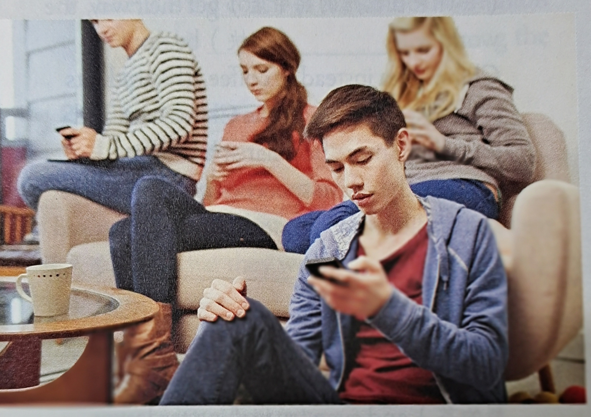
THE FACE-DOWN GENERATION
What do you want to know from the passage?
Notes:
generation:people were born at about the same time.

Slide 4
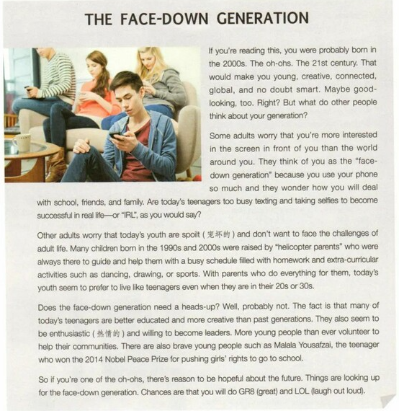
Underline the topic sentence for each paragraph and figure out the structure of the text
√
some
A
B
C
① ②
①
①
other
③
④
②③④
②③④⑤
⑤
⑤
so
Notes:
How do you know? what is the topic sentence for the whole passage?

Slide 5
P1: Introduce the topic
If you’re reading this, you were probably born in the 2000s. The oh-ohs. The 21st century. That would make you young, creative, connected, global, and no doubt smart. Maybe good-looking, too. Right? But what do other people think about your generation?
VS
●By raising a question
To raise readers’ interest
But other people don’t think so.
●By making contrast
Tip: Raising a question and making contrast are good ways to introduce a topic.

Slide 6
Read the following paragraphs and complete the form.
Topic | People have different attitudes to the face-down generation | Reasons
Attitudes | Some adults
 | Other adults
 | The writer
Conclusion

Slide 7
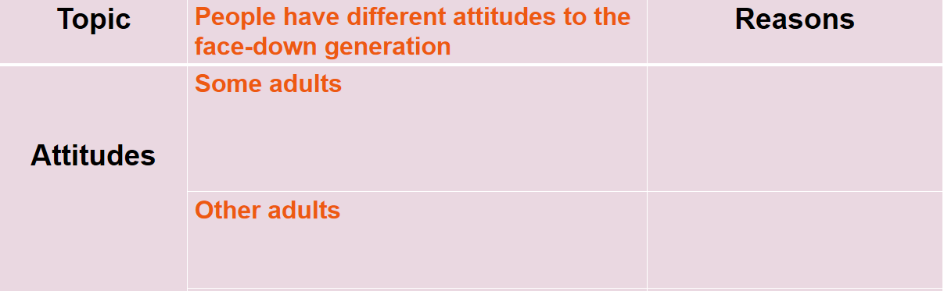
P2: Present the attitude
Some adults worry that you’re more interested in the screen in front of you than the world around you. They think of you as the “face-down generation” because you use your phone so much and they wonder how you will deal with school, friends, and family. Are today’s teenagers too busy texting and taking selfies to become successful in real life — or “IRL”, as you would say?
self-isolated
addicted
unsuccessful
worried
worry that...
think of you as... and wonder...
so much, too busy...to...
Notes:
wonder:to think about sth and try to decide what is true, what will happen, what should do

Slide 8
Read the following paragraphs and complete the form.
Topic | People have different attitudes to the face-down generation | Reasons
Attitudes | Some adults worry that... think of you as...and wonder... so much, too busy...to become... | self-isolated, addicted, unsuccessful
 | Other adults
 | The writer
Conclusion
worried

Slide 9
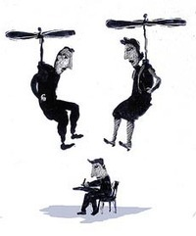
P3: Present the attitude
Other adults worry that today’s youth are spoilt (宠坏的) and don’t want to face the challenges of adult life. Many children born in the 1990s and 2000s were raised by “helicopter parents”. They were always there to guide and help them with a busy schedule filled with homework and extra-curricular activities such as dancing, drawing, or sports. With parents who do everything for them, today’s youth seem to prefer to live like teenagers even when they are in their 20s or 30s.
afraid of challenges
spoilt
dependent
childish
worry that...
worried
self-isolated
addicted
unsuccessful
think of you as... and wonder...
worry that...
?
worried
always, everything

Slide 10
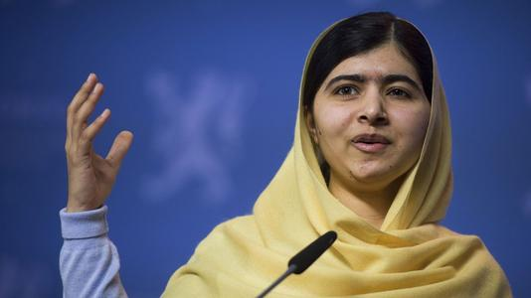
P4: Present the attitude
Does the face-down generation need a heads-up? Well, probably not.
The fact is that many of today’s teenagers are better educated and more creative than past generations. They also seem to be enthusiastic (热情的) and willing to become leaders. More young people than ever volunteer to help their communities. There are also brave young people such as Malala Yousafzai, the teenager who won the 2014 Nobel Peace Prize for pushing girls’ rights to go to school.
Topic | People have different attitudes to the face-down generation | Reasons
Attitudes | The writer
positive
better educated, more creative, enthusiastic, willing to become leaders, kind-hearted, brave, young
thinks they don’t need...
Tip: Examples can make your writing more persuaive.

Slide 11
Read the following paragraphs and complete the form.
Topic | People have different attitudes to the face-down generation | Reasons
Attitudes | Some adults worry that... think of you as...and wonder... so much, too...to... | self-isolated, addicted, unsuccessful
 | Other adults worry that... always, everything | spoilt, afraid of challenges, dependent, childish, helicopter parents
 | The writer thinks they don’t need... | better educated, more creative, enthusiastic, willing to become leaders, kind-hearted, brave, young
Conclusion
worried
worried
positive
There’s reason to be hopeful....
great
Chances are that...

Slide 12
P4: Draw a conclusion
A.raise one’s head B.become better C.search for information
B.become better
So if you’re one of the oh-ohs, there’s reason to be hopeful about the future. Things are looking up for the face-down generation. Chances are that you will do GR8 (great) and LOL (laugh out loud).
internet slang
Thinking:
Thinking:
1.Was the writer born in the 2000s? How do you know?
Are today’s teenagers too busy texting and taking selfies to become successful in real life--or “IRL”, as you would say?
2. How does the writer answer this question? How would you answer the question?
Notes:
do you use internet slang while texting? what do you think of internet slang?

Slide 13
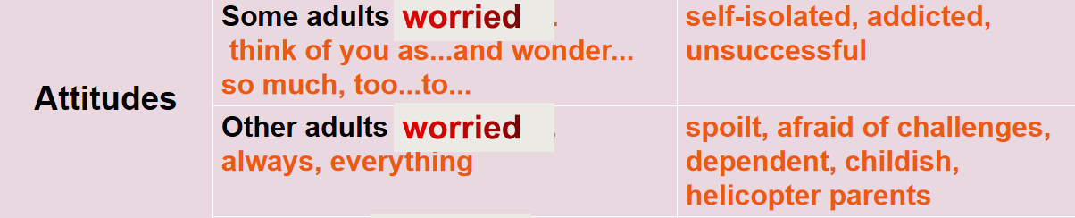
Thinking:
Discussion
As one of the face-down generation, what should you do to change some adults’ attitude to your generation? Consider the worries mentioned in the text.
☆make friends and broaden the circle of your life.
☆take part in extra-curricular activities.
☆spend more time on reading and exercising.
☆live an independent life and try to solve problems on your own
☆devote yourself to studying
☆face the challenges of adult life bravely
☆develop good habits
Good habits formed at youth make all the difference.

Slide 14
Thinking:
Assignment:
Write a passage about the face-down generation：
1.Your attitude
2.Your actions
internet slang
Tip: Raising a question and making contrast are good ways to introduce the topic.
Tip: Examples can make your writing more persuasive.

Slide 15
THANK YOU

