Slide 1

感恩遇见，相互成就，本课件资料仅供您个人参考、教学使用，严禁自行在网络传播，违者依知识产权法追究法律责任。
更多教学资源请关注
公众号：溯恩高中英语
知识产权声明

Slide 2
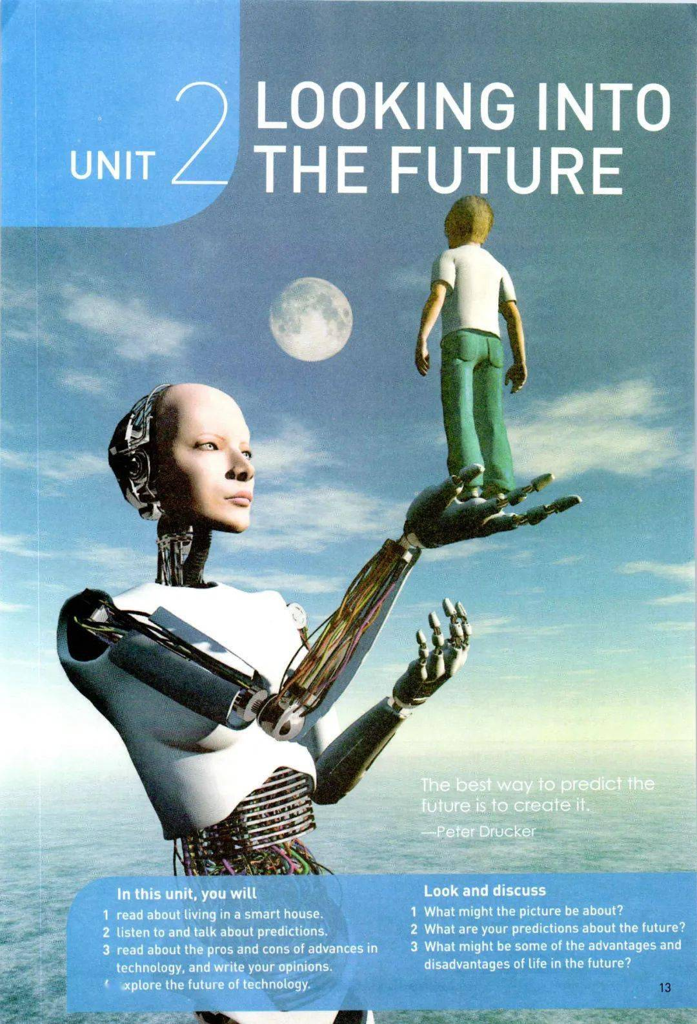
Expanding Your World
Our Greatest Adventure
Longquan No.1 Senior High School
Fan Chunle

Slide 3
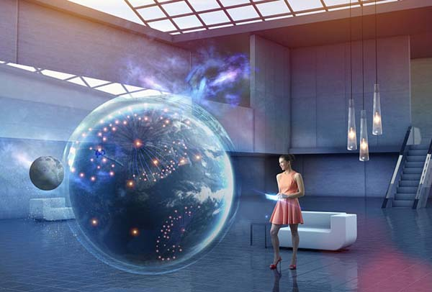
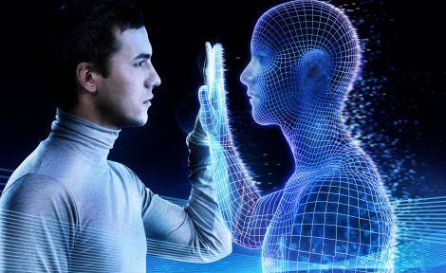
Activity 1 : Prediction
Our Greatest Adventure

Slide 4
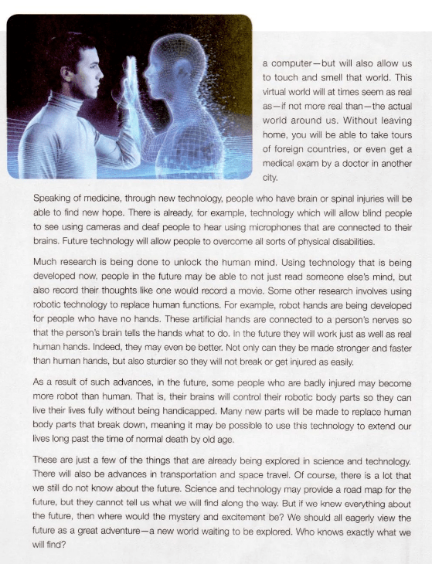

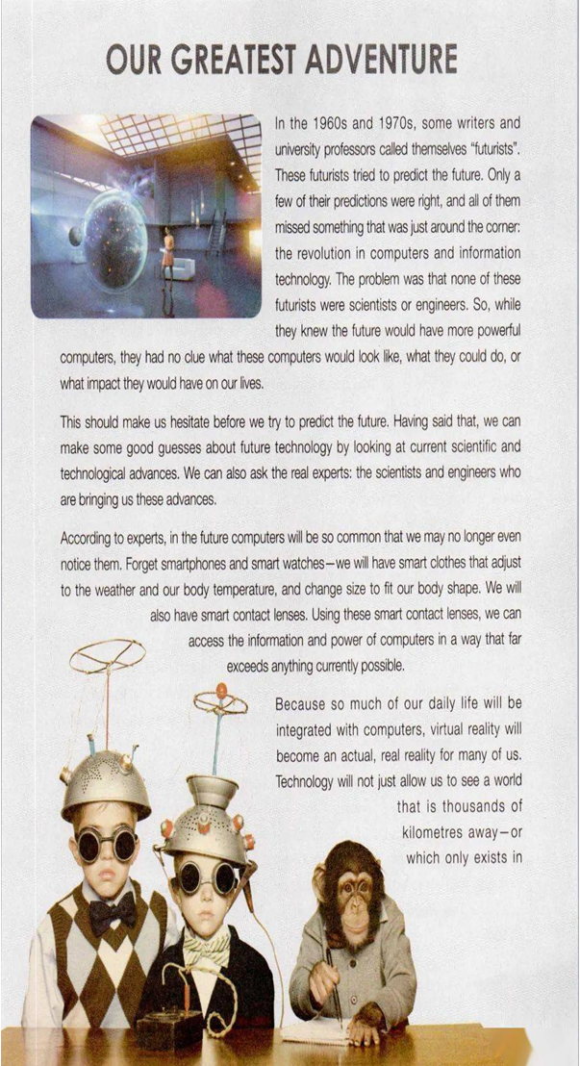
Activity 2 : Read for structure
the problem
solutions
Some good guesses about future technology…
A future full of possibilities

Slide 5
Activity 2 : Read for structure
What’s the structure of the passage?
①②
③④⑤⑥⑦
⑧
?
2. What will be talked about in the following paragraph of
the text?

Slide 6
Activity 3 : Read for details
A
2.
C
1.
D
3.
A. Speaking of medicine, through new technology, people who have brain or spinal injuries will be able to find new hope.
B. There will also be advances in transportation and space travel.
C. This should make us hesitate before we try to predict the future.
D. Some other research involves using robotic technology to replace human functions.
E. That is, their brains will control their robotic body parts so they can live their lives fully without being handicapped.
E
4.
B
5.

Slide 7
Activity 3 : Read for details (Para.1-2)
In the 1960s and 1970s, some writers and university professors called themselves “futurists”. These futurists tried to predict the future. Only a few of their predictions were right, and all of them missed something that was just around the corner: the revolution in computers and information technology. The problem was that none of these futurists were scientists or engineers. So, while they knew the future would have more powerful computers, they had no clue what these computers would look like, what they could do, or what impact they would have on our lives.
1._________________________________________________________ Having said that, we can make some good guesses about future technology by looking at current scientific and technological advances. We can also ask the real experts: the scientists and engineers who are bringing us these advances.
C.This should make us hesitate before we try to predict the future.
reference

Slide 8
Activity 3 : Read for details (Para.4-5)
Because so much of our daily life will be integrated with computers, virtual reality will become an actual, real reality for many of us. Technology will not just allow us to see a world that is thousands of kilometres away--- or which only exists in a computer---but will also allow us to touch and smell that world. This virtual world will at times seem as real as---if not more real than----the actual world around us. Without leaving home, you will be able to take tours of foreign countries, or even get a medical exam by a doctor in another city.
2.______________________________________________________________________________________________________________There is already, for example, technology which will allow blind people to see using cameras and deaf people to hear using microphones that are connected to their brains. Future technology will allow people to overcome all sorts of physical disabilities.
repetition
A.Speaking of medicine, through new technology, people who have brain or spinal injuries will be able to find new hope.
connective

Slide 9
Activity 3 : Read for details (Para.6-8)
Much research is being done to unlock the human mind. Using technology that is being developed now, people in the future may be able to not just read someone else's mind, butalso record their thoughts like one would record a movie. 3.__________________________________________________________________ For example, robot hands are being developed for people who have no hands. These artificial hands are connected to a person's nerves so that the person's brain tells the hands what to do. In the future they will work just as well as real human hands…
As a result of such advances, in the future, some people who are badly injured may become more robot than human. 4._______________________________________
____________________________________________________Many new parts will be made to replace human body parts that break down, meaning it may be possible to use this technology to extend our lives long past the time of normal death by old age.
These are just a few of the things that are already being explored in science and technology. 5._______________________________________________________ Of course, there is a lot that we still do not know about the future…
repetition
D.Some other research involves using robotic technology to replace human functions.
connectives
E.That is, their brains will control their robotic body
parts so they can live their lives fully without being handicapped.
B.There will also be advances in transportation and space travel.
Notes:
利用这篇文章也可以复习和巩固7选5的做题技巧

Slide 10
Activity 4: Further thinking
The best way to predict the future is to create it.
_----Peter Drucker
computer
futurist
futurists
future
technology
computers
futurists
technology
future
… will allow people to overcome all sorts of
physical disabilities
computers
computers
technology
future
Future technology
future technology
technology
Technological advances
… will read people’s mind,record their
thoughts and replace human functions
advances
technology
future
computers
… will bring convenience to our daily life
future
computers
advances
future
computers
… will extend our lives long
Technology
technology
Virtual reality will become an actual,
real reality for many of us
advances
technology
future
future
technology
future
—A new world waiting to be explored
future

Slide 11
Assignment
Make some good guesses about future technology in transportation and space travel by looking at the current scientific and technological advances. (Make an oral report next period)
2. Find more information online about future technology in transportation and space travel to polish your report.

