Slide 1

感恩遇见，相互成就，本课件资料仅供您个人参考、教学使用，严禁自行在网络传播，违者依知识产权法追究法律责任。
更多教学资源请关注
公众号：溯恩高中英语
知识产权声明

Slide 2

The World
October 16th-31st, 2022

Slide 3
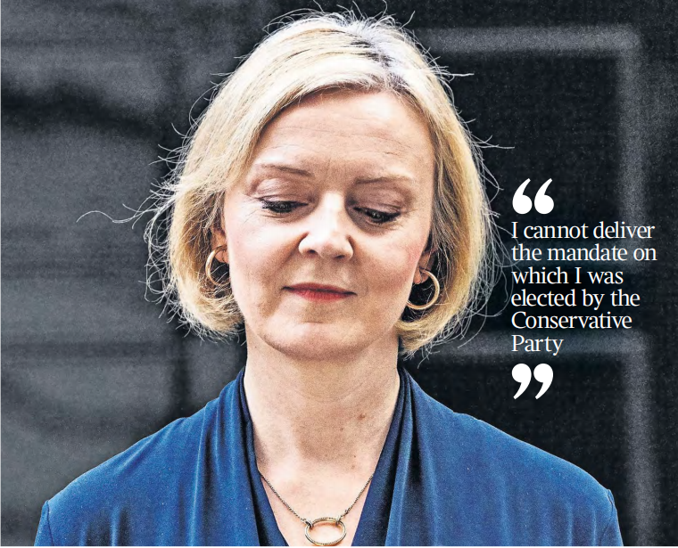
1. Truss quits No 10 特拉斯辞职

Slide 4
语篇填空
（《泰晤士报》2022年10月21日 头条）
Boris Johnson is attempting to make an extraordinary political comeback by challenging Rishi Sunak and Penny Mordaunt for the Tory leadership _________ (follow) the resignation of Liz Truss. Six weeks after leaving office, the former prime minister has asked _____ (ally), donors and the team that helped him to win the 2019 general election to run his campaign for a return to No 10. In _____ is expected to be a three-horse race, Johnson is preparing to take on Sunak, the former chancellor who he blames for his removal _____ office, and Mordaunt, ____ leader of the House of Commons.
Johnson’s return to the political arena would divide the Conservative Party even ______ (far), with at least three MPs prepared to quit the party rather than serve under him again.
Britain will have a new prime minister within a week under a truncated timetable _______ (design) to reassure markets after the turmoil of Truss’s premiership, which is __________ (short) in history.
She accepted yesterday that she could not deliver “the mandate on which I was elected by the Conservative Party” after _________ (tell) by Sir Graham Brady, chairman of the 1922 Committee of backbenchers, that she had lost the support of the parliamentary party. Her resignation came after four tumultuous weeks in which her political authority was shredded by the fallout from a tax-cutting mini-budget, almost all of ______ has been reversed.
following
allies
what
from
the
further
designed
the shortest
being told
which

Slide 5
词汇讲解
1. turmoil: (in~) a state of great anxiety and confusion 动乱；骚动；混乱；焦虑
His statement threw the court into turmoil.
他的陈述使得法庭陷入一片混乱。
2. tumultuous: involving a lot of change and confusion and/or violence 动荡的；动乱的；狂暴的
It’s been a tumultuous day at the international trade negotiations in Brussels.
那是布鲁塞尔国际贸易谈判中纷乱的一天。
翻译句子
她的婚姻一团糟。
Her marriage was in turmoil.
翻译句子
他生活在二战的动乱年代。
He lived during the tumultuous years of the Second World War.

Slide 6
句子翻译
Six weeks after leaving office, the former prime minister has asked allies, donors and the team that helped him to win the 2019 general election to run his campaign for a return to No 10.
翻译
卸任六周后，这位前首相要求盟友、捐助者和帮助他赢得2019年大选的团队组织竞选，帮他重返唐宁街10号。
Johnson’s return to the political arena would divide the Conservative Party even further, with at least three MPs prepared to quit the party rather than serve under him again.
翻译
约翰逊重返政治舞台将进一步分裂保守党，至少有三名议员准备退出保守党，而不是再次在他手下任职。

Slide 7
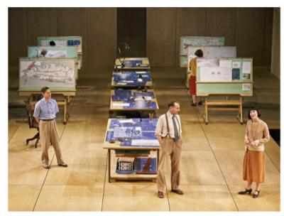
2.King of the City
”伏地魔“扮演城市之王
Samuel Barnett, Ralph Fiennes, and Siobhán Cullen onstage in Straight Line Crazy at the Bridge Theatre in London.

Slide 8

阅读理解
（《时尚》 2022年10月刊 118页）
In January 2022, the actor Ralph Fiennes took a helicopter ride over New York, looking down like a god on the avenues, expressways, and bridges that shape the city’s daily life. He studied the view with care, not as a tourist might, but as preparation to play the man who created much of it all: Robert Moses, once the most powerful urban planner in the world.
“I just wanted to get a sense of the reach of his vision,” says Fiennes from Umbria, Italy, where he’s renting a farmhouse with no Wi-Fi, so he’s at a local cafe, wearing a loose white shirt open at the neck in the heat. “From all the conversations I have had with New Yorkers, they consider his legacy to be extremely negative. But you can’t go to New York and not benefit from the West Side Highway or Riverside Park.You still use the tunnels and bridges that he built. Of course, the Cross Bronx Expressway is horrendous — it’s a divided legacy. And that is very much addressed in the play.”
The play Straight Line Crazy revolves around two key moments in Moses’s life.The first is in 1926, when we see him driving through his plan to open up Long Island and create Jones Beach State Park, changing the coastline from a playground for established families such as the Vanderbilts and the Whitneys into a recreational amenity for everyone. By 1955 that idealism had soured and Moses’s plan to route a highway through Washington Square was thwarted by a mass protest of local residents, determined to protect their community.
When Hare’s play, directed by Nicholas Hytner, opened in London in March 2022, it was a revelation: huge ideas dealt with in witty, robust and vivid ways. And it was an education too, introducing a largely ignorant English theatergoing public to the whole idea of Moses. “But in New York,” says Hare, “everyone already has a view about him.”

Slide 9

阅读理解
1. Why did Ralph Fiennes take a helicopter ride over New York?
A. He admired the view of the city from above as a tourist.
B. He sought inspiration for acting Robert Moses.
C. He tried to learn how to become a urban planner.
D. He inspected the construction of expressways and bridges.
细节理解
2.What does the underlined word “divided” mean in Paragraph 2?
A.controversial B. different C. precious D. attractive
词义猜测
3. In which section of the newspaper might the text appear?
A. Environment B. Sports C. Entertainment D. Business
推理判断

Slide 10
词汇讲解1
1. elite: an elite group contains the best, most skilled, or most experienced people or members of a larger group精英的
The palace is guarded by elite troops loyal to the president. 宫殿由忠于总统的精锐部队守卫。
2. twitch: a sudden quick movement that you cannot control in one of your muscles 痉挛；抽搐；抽动
She has a twitch in her left eye. 她左眼跳了一下。
翻译句子
他想要一支高效、精英的工程团队。
He wanted an efficient and elite engineering team.
翻译句子
他患上了一种神经痉挛病，开始不停地眨眼睛。
He developed a nervous twitch and began to blink constantly.

Slide 11
词汇讲解2
3. amplify: to increase the effects or strength of something 扩大；增强
A funeral can amplify the feelings of regret and loss for the relatives. 葬礼可以渲染生者痛失亲人的哀悼之情。
4. bias: a strong feeling in favour of or against one group of people, or one side in an argument, often not based on fair judgement 偏见；偏心；偏向
Employers must consider all candidates impartially and without bias. 雇主必须公平而毫无成见地考虑所有求职者。
翻译句子
这些故事只是增加了她的恐惧。
These stories only amplified her fears.
翻译句子
有些机构仍然对妇女持有很大偏见。
Some institutions still have a strong bias against women.

Slide 12
句子翻译
By 1955 that idealism had soured and Moses’s plan to route a highway through Washington Square was thwarted by a mass protest of local residents, determined to protect their community.
到1955年，这种理想主义开始恶化，摩西修建一条穿过华盛顿广场的高速公路的计划遭到了当地居民的大规模抗议，他们决心保护自己的社区。
翻译
When Hare’s play, directed by Nicholas Hytner, opened in London in March 2022, it was a revelation: huge ideas dealt with in witty, robust and vivid ways.
海尔的这部由尼古拉斯·海特纳执导的戏剧于2022年3月在伦敦上演，这是一种启示：以机智、有力和生动的方式表达伟大的思想。
翻译

Slide 13
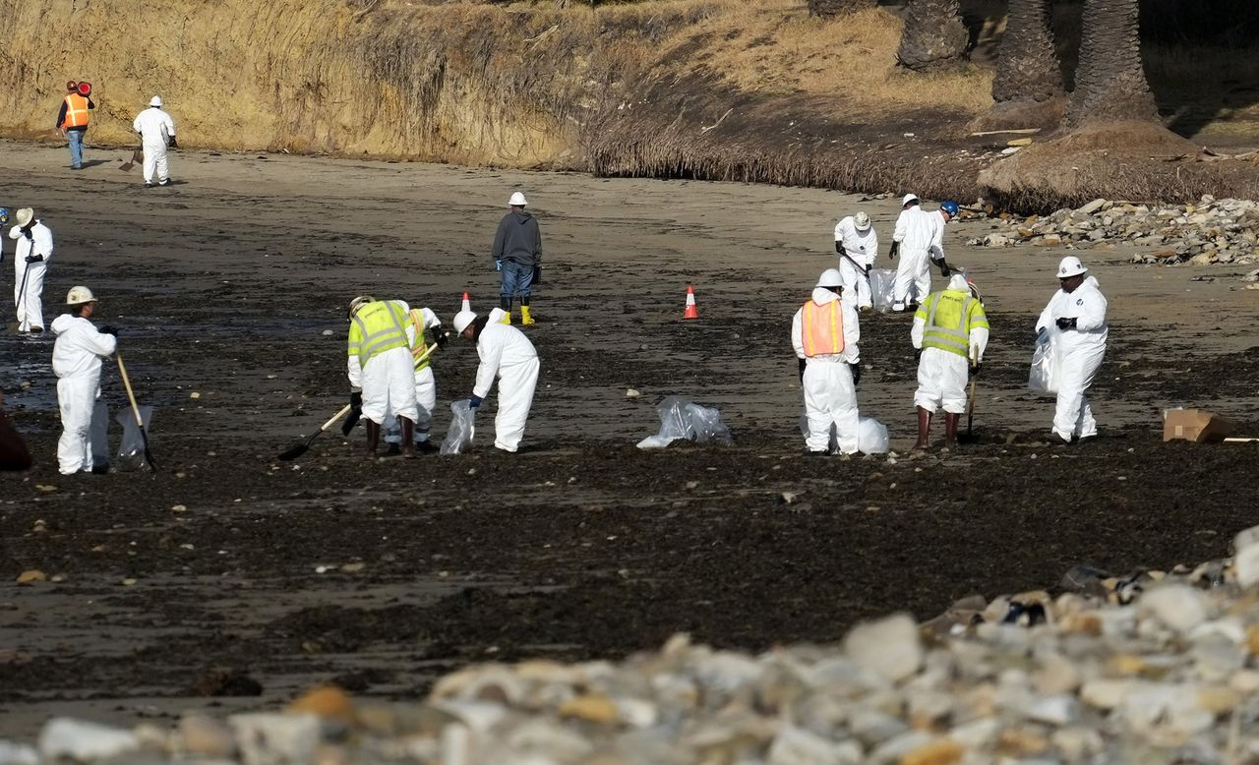
3.Pipeline Operator Agrees to
Settle Lawsuit over Calif. Oil Spill
管道运营商同意就加州石油泄漏诉讼达成和解
The pipeline ruptured off Huntington Beach and spilled 25,000 gallons of oil into the Pacific Ocean.

Slide 14

语篇填空
（《波士顿环球报》 2022年10月22日 A2版面）
to pay
A pipeline operator has agreed ______ (pay) $50 million to thousands of Southern California fishermen, tourism companies, and property owners who sued after ___ offshore oil spill last year near Huntington Beach.
A proposed _________ (settle) between Amplify Energy Corp., ______ owns the pipeline that ruptured in October 2021 and spilled 25,000 gallons of crude oil into the Pacific Ocean, and the businesses and residents was filed Monday in federal court in Santa Ana. Under the proposal, the Houston-based energy company would pay $34 million to ___________ (commerce) fishermen and $9 million to coastal property owners. It also would pay $7 million to waterfront tourism operators. A federal judge still has to sign off on the proposal ___ it to take effect. A hearing __________ (schdule) for Nov.16.
“This is a _____ (real) dramatic first step and a dramatic compensation for these victims of this terrible tragedy,” said Wylie Aitken, counsel for the plaintiffs (原告).” ________________ it may not be 100 percent, it is very substantial and very helpful and a good deal of compensation to _____ (they).”
an
settlement
which
commercial
for
is scheduled
really
Though / Although
them

Slide 15
词汇讲解
1. rupture: to make sth such as a container or a pipe break or burst; to be broken or burst （使容器或管道等）断裂，破裂
The impact ruptured both fuel tanks. 冲撞使两个燃料箱都爆裂了。
2. substantial: large in amount, value or importance 大量的；价值巨大的
Substantial numbers of people support the reforms. 相当多的人支持这些改革措施。
翻译句子
一根水管断裂，漏了满屋子的水。
A pipe ruptured, leaking water all over the house.
翻译句子
我们得到了很多家长的支持。
We have the support of a substantial number of parents.

Slide 16
句子翻译
A pipeline operator has agreed to pay $50 million to thousands of Southern California fishermen, tourism companies, and property owners who sued after an offshore oil spill last year near Huntington Beach.
一家管道运营商同意向数千名南加州渔民、旅游公司和业主支付5000万美元，这些人在去年亨廷顿海滩附近发生海上石油泄漏事故后提起诉讼。
翻译
A proposed settlement between Amplify Energy Corp., which owns the pipeline that ruptured in October 2021 and spilled 25,000 gallons of crude oil into the Pacific Ocean, and the businesses and residents was filed Monday in federal court in Santa Ana.
周一，位于圣安娜的联邦法院提交了Amplify能源公司与企业和居民之间拟议的和解协议。该公司拥有的输油管道于2021年10月破裂，导致2.5万加仑原油流入太平洋。
翻译

Slide 17
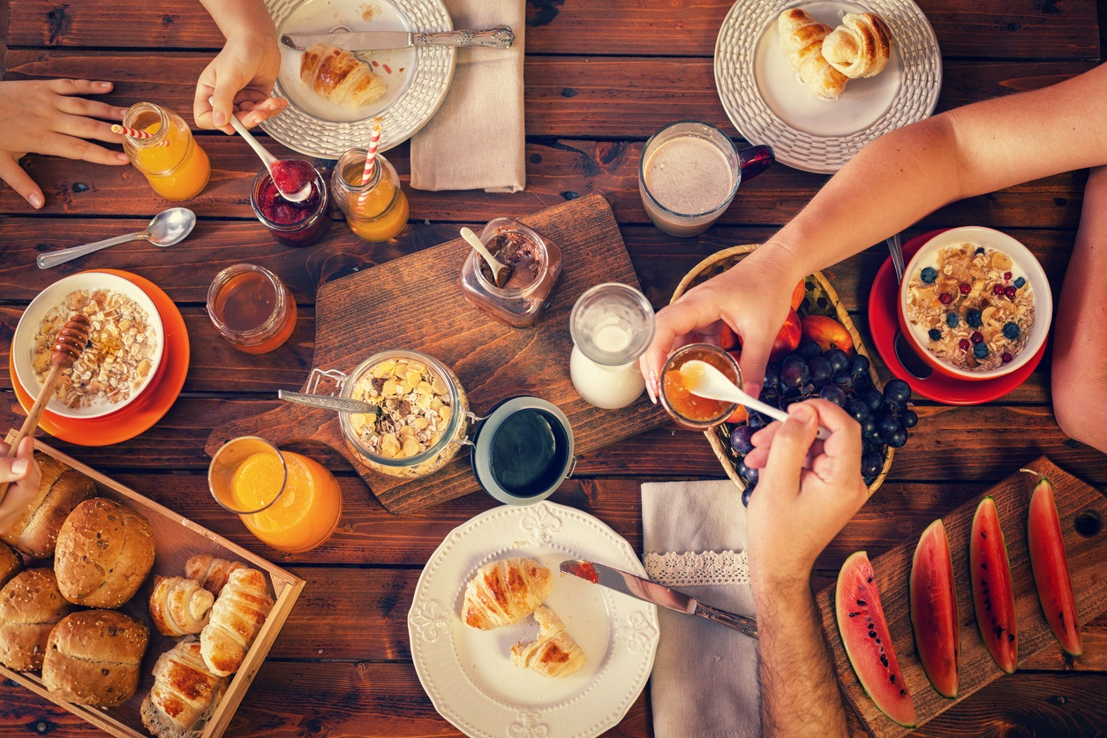
4. The best time to eat is early in the day
早晨——吃东西的最佳时间

Slide 18
语篇填空
《周刊报道》2022年10月21日 22页
If you want to stay healthy and lose weight, eat your meals _________ (relative) early and keep them within a 10-hour window. That’s the conclusion of two new studies into _____ timing affects metabolism, reports NBCNews.com.
The first involved 16 people, all either overweight or obese, _____ tried two different eating regimens for one day each: eating their first meal ____ hour after they woke up and waiting for about five hours before tucking in. Even though the meals were identical, the _______ (delay) eaters had lower levels of leptin—a hormone that helps people feel full—and were more likely _______ (feel) hungry and crave unhealthy foods.
In the second study, 137 __________ (firefighter) in San Diego were told to follow a Mediterranean diet for 12 weeks. About half ____ (eat) their meals within a 10-hour window—typically between 8 or 9 a.m. and 6 or 7 p.m.—while the rest spread them out over about 14 hours. The time-restricted firefighters showed several signs of improved health, including ______ (low) levels of blood pressure, blood sugar, and cholesterol. These benefits appeared to come with no decrease in energy levels or other side effects.
The findings of both studies add ___ evidence that there are optimal times in the day to eat, says Courtney Peterson, from the University of Alabama at Birmingham.
relatively
how
who
an
delayed
to feel
firefighters
ate
lower
to

Slide 19
词汇讲解
1. tuck: to push, fold or turn the ends or edges of clothes, paper, etc. so that they are held in place or look neat 塞进，折叠，卷起
She tucked up her skirt and waded into the river.
她撩起裙子蹚水走进河里。
2. identical: similar in every detail 完全同样的；相同的
The number on the card should be identical with the one on the chequebook.
卡上的号码应该和支票簿上的相同。
翻译句子
她把头发拢起来塞进帽子里。
She tucked her hair (up) under her cap.
翻译句子
这两幅画很相似，虽然不完全相同。
The two pictures are similar, although not identical.

Slide 20
句子翻译
Even though the meals were identical, the delayed eaters had lower levels of leptin—a hormone that helps people feel full—and were more likely to feel hungry and crave unhealthy foods.
尽管两顿饭是一样的，但进食延迟的人体内的瘦素水平较低，瘦素是一种帮助人们产生饱腹感的激素，他们更容易感到饥饿，想吃不健康的食物。
翻译
The time-restricted firefighters showed several signs of improved health, including lower levels of blood pressure, blood sugar, and cholesterol.
这些受时间限制的消防员显示出一些健康状况改善的迹象，包括血压、血糖和胆固醇水平降低。
翻译

Slide 21
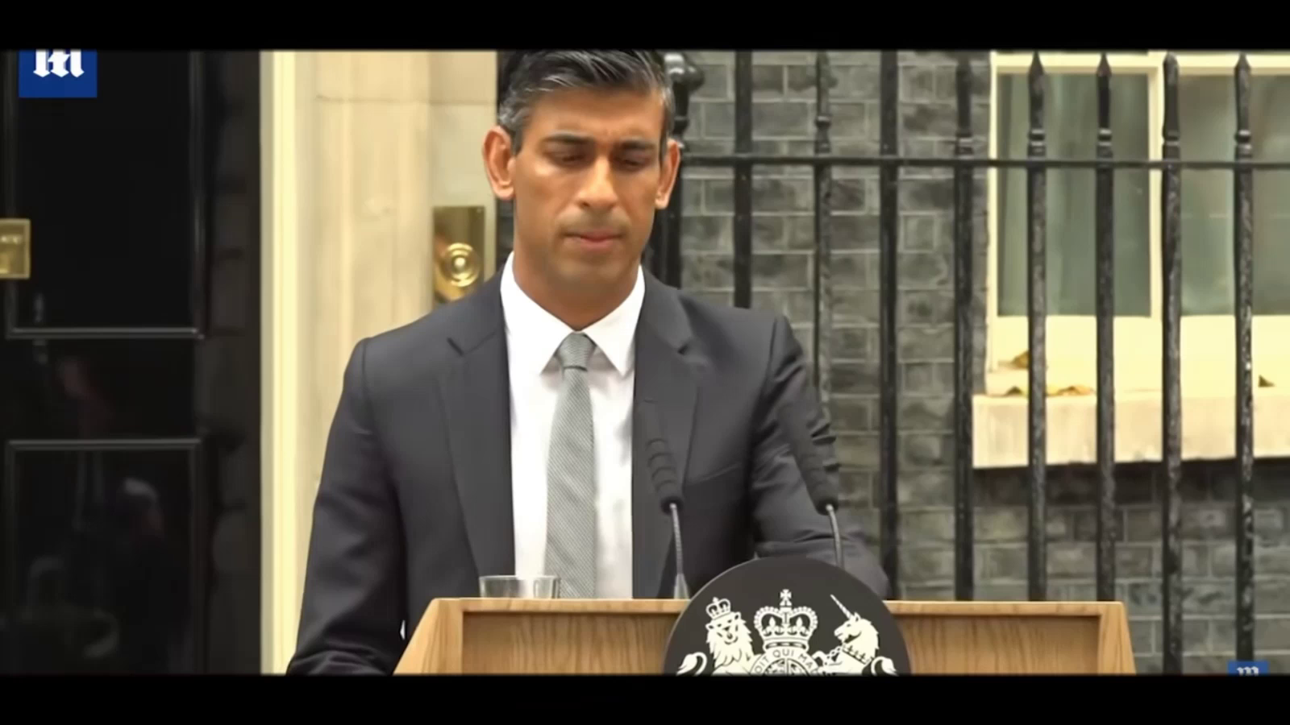
5. Rishi Sunak's first speech as Prime Minister

Slide 22

听力填空
I will deliver on its promise. A stronger NHS, better schools, safer streets, control of our _______, protecting our environment, supporting our Armed Forces, levelling up and building an ________ that embraces the opportunities of Brexit, where businesses invest, ________, and create jobs.
I understand how difficult this moment is. After the billions of pounds it cost us to ______ Covid, after all the dislocation that caused in the midst of a terrible war that must be seen successfully to its conclusions, I fully _________ how hard things are.
And I understand too that I have work to do to ___________ after all that has happened. All I can say is that I am not daunted. I know the high office I have accepted, and I hope to _________ its demands. But when the opportunity to serve comes along, you cannot question the moment, only your willingness.
So, I stand here before you, ready to lead our country into the future, to put your needs above politics, to ________ and build a government that represents the very best traditions of my party.
Together, we can achieve _________ things. We will create a future ______ of the sacrifices so many have made and fill tomorrow, and every day thereafter, with hope.
borders
economy
innovate
combat
appreciate
restore trust
live up to
reach out
incredible
worthy

Slide 23
词汇讲解
1. level up: to make standards, amounts, etc. be of the same high or higher level
把（标准、数量等）拉平；使达到更高水平
One more goal from the visiting team leveled up the score.
客队又进一个球使比分扳平。
2. daunt: to make sb feel nervous and less confident about doing sth 使胆怯；使气馁；使失去信心
I’m somewhat daunted by the size of the task.
我有点儿被这项任务的规模吓着了。
翻译句子
他们将缩小不同司机之间的工资差距。
They will level up the gap between different drivers’ pay.
翻译句子
她是一个勇敢的女人，但对面前的任务却感到信心不足。
She was a brave woman but she felt daunted by the task ahead.

Slide 24
句子翻译
After the billions of pounds it cost us to combat Covid, after all the dislocation that caused in the midst of a terrible war that must be seen successfully to its conclusions, I fully appreciate how hard things are.
翻译
在经历了抗击新冠肺炎疫情花费数十亿英镑和一场必须结束的可怕战争造成的混乱后，我完全理解我们的处境是多么艰难。
I stand here before you, ready to lead our country into the future, to put your needs above politics, to reach out and build a government that represents the very best traditions of my party.
翻译
此刻我站在你们面前，准备好带领我们的国家走向未来，把你们的需求置于政治之上，伸出援助之手，并建立一个代表我党最好传统的政府。

