Slide 1

感恩遇见，相互成就，本课件资料仅供您个人参考、教学使用，严禁自行在网络传播，违者依知识产权法追究法律责任。
更多教学资源请关注
公众号：溯恩高中英语
知识产权声明

Slide 2


Unit4
选择性必修一workbook reading and writing
Animal Body Language
东风高级中学 刘彦麟

Slide 3
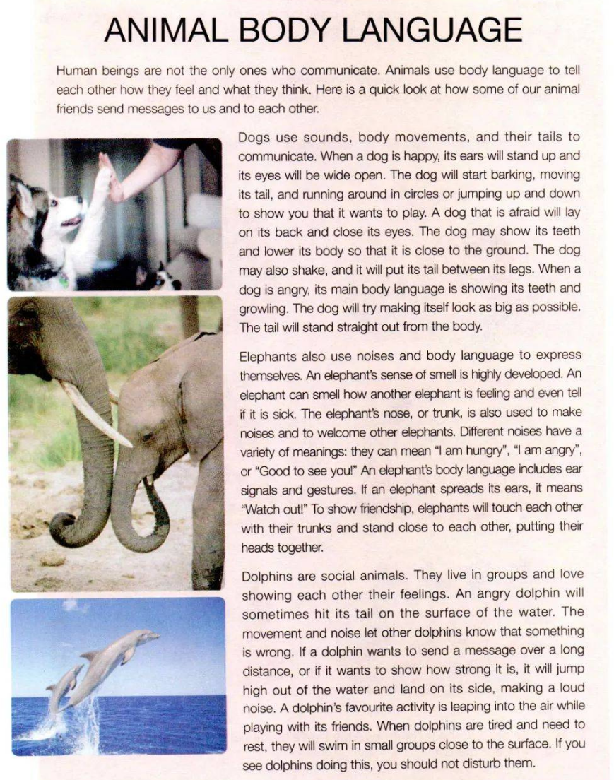
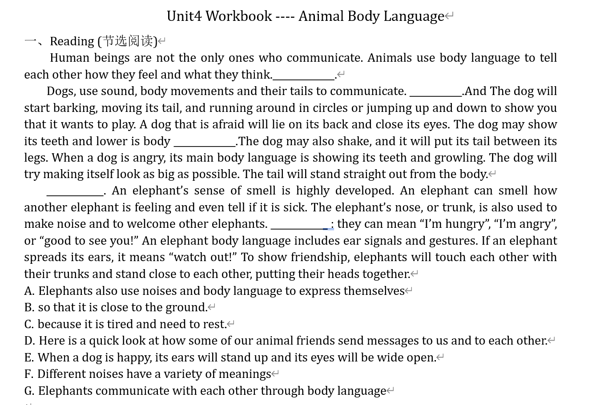


Slide 4
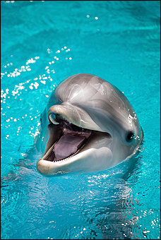
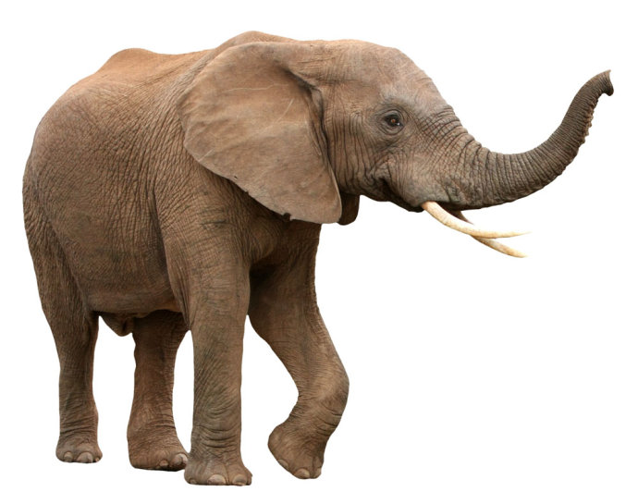
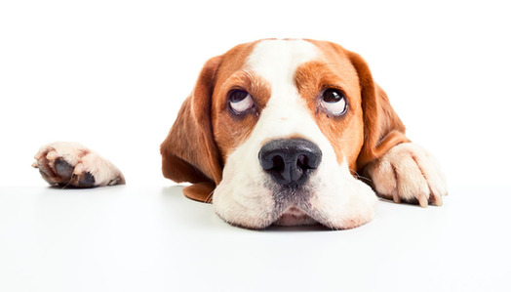
Reading Animal Body Language
Task 1 七选五：
Task 2 Main Idea
Animals such as_________and__________ can use ___________________ to tell each other ________they feel and ________ they think.
D E B A F
dogs
elephants
body language
how
what

Slide 5
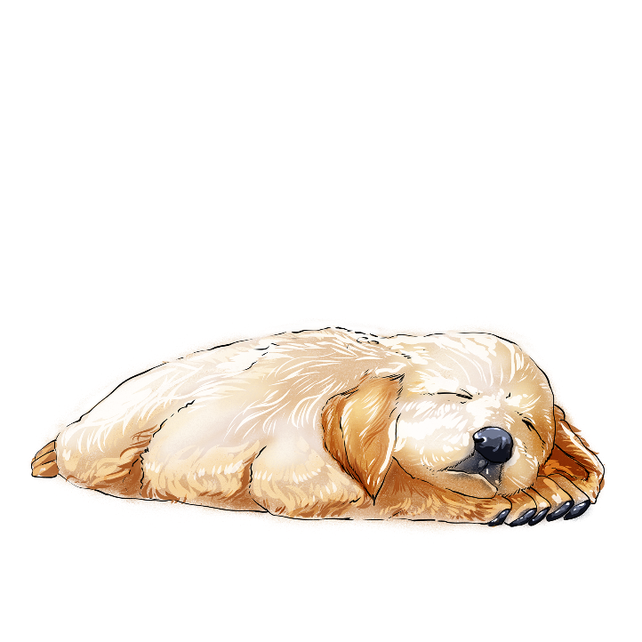



Task 3 Dog’s body language
happy
afraid
angry
ears stand up;
wagging
moving its tail;
eyes are widened;
/ narrowed into a line
eyes will be wide open
barking
barking as a greeting
running around in circles
jumping up and down;
lick my hand tamely
lie on its back;
lower its body/head;
be close to the ground;
put its tail between its legs
close its eyes;
show its teeth;
show its teeth;
make itself look as big as possible
growl(咆哮);
the tail will stand straight
pounce on...(猛扑向)

Slide 6
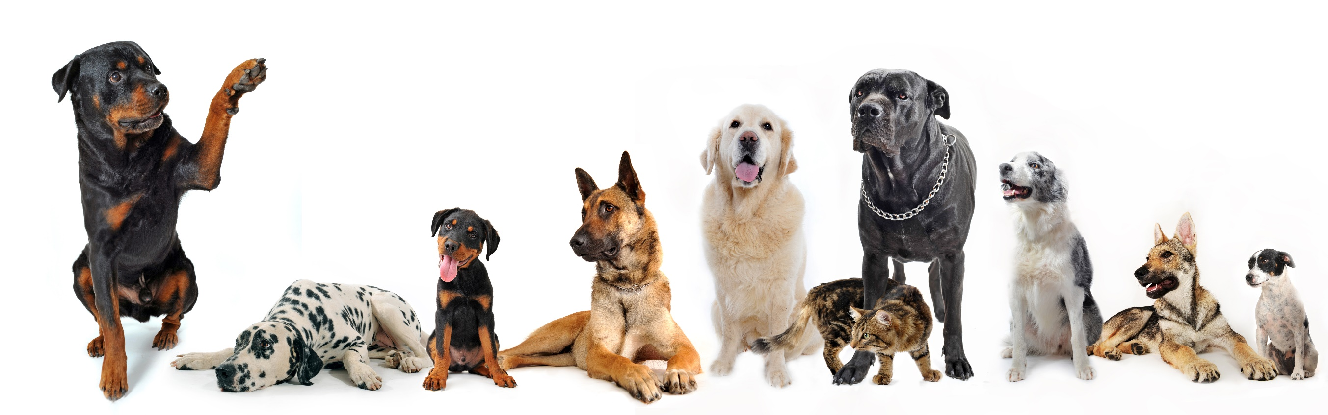
Writing:
Task 1: Describe different emotions and body language of dogs.

Slide 7
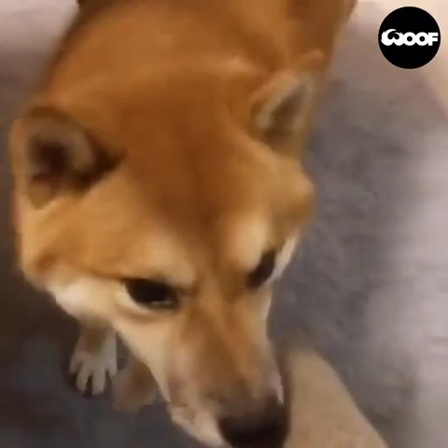
狗狗看到我，高兴地上下跳动，摇着它的尾巴 (jump; wag)
The dog looked at me, jumped up and down happily, and wagged its tail.
____________ me, the dog jumped up and down happily, ___________ its tail.
Looking at me, the dog jumped up and down happily, ________.
Looking at
wagging
with its tail wagging

Slide 8
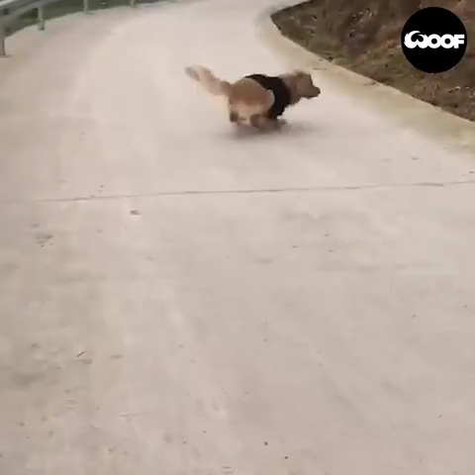
狗狗大叫打招呼，开心地绕圈跑 (bark; circle)
The dog barked as a greeting, and ran around in circles happily.
_______________________, the dog ran around in circles happily.
The dog barked as a greeting, __________around in circles happily.
The dog barked as a greeting, ____________around in circles happily.
Barking as a greeting
running
which ran

Slide 9
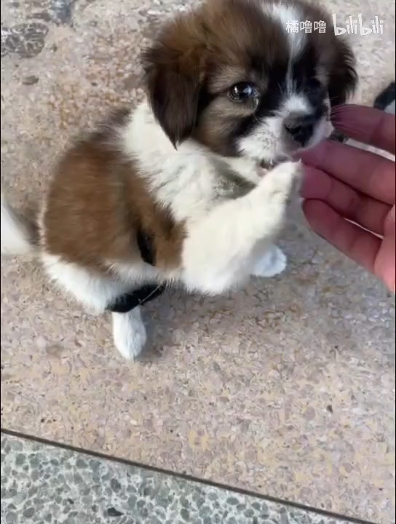
狗狗眼睛睁大，乖乖过来舔我的手和脸，这融化了我的心 (widen; lick; melt))
The dog widened its eyes, came to lick my hand and face, and it melted my heart.
_____________________________, the dog came to lick my hand and face, and it melted my heart.
Eyes widened, the dog came to lick my hand and face, __________ melted my heart.
Widening its eys/ Eyes widened
which

Slide 10
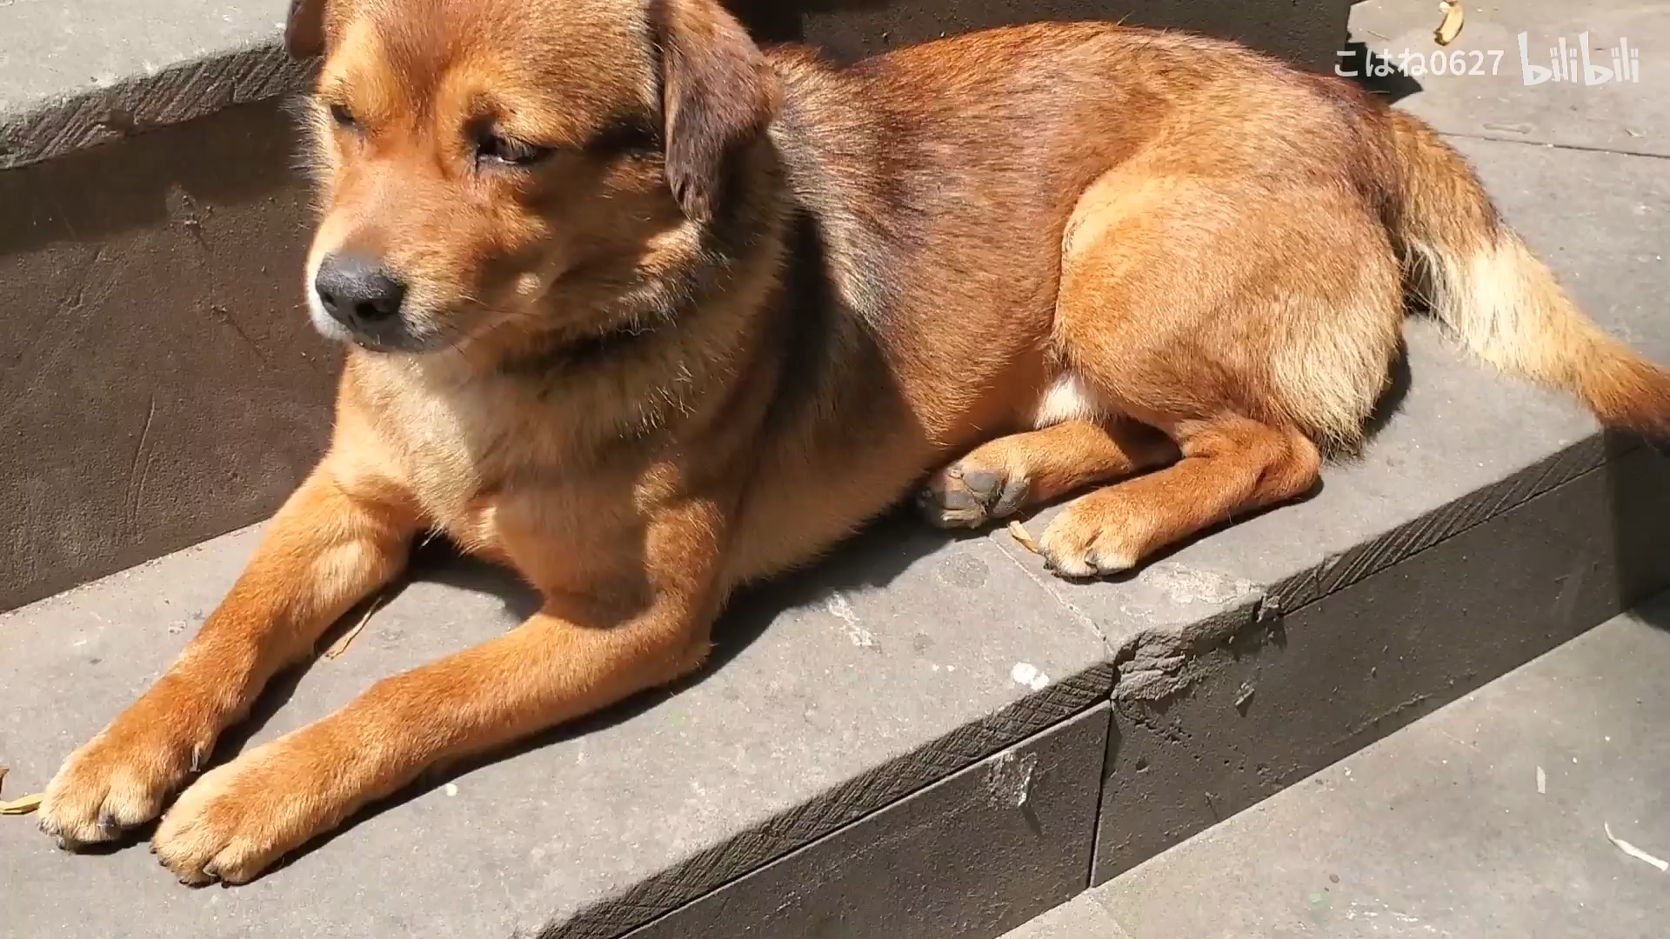
狗狗沐浴在温暖的阳光里，眼睛眯成一条缝(bathe; narrow)
The dog bathed in the warm/mild sunshine, and its eyes were narrowed into a line.
_____________________________, the dog’s eyes were narrowed into a line.
The dog bathed in the warm sunshine, ___________________
Bathing in the warm sunshine
with its eyes narrowed into a line

Slide 11
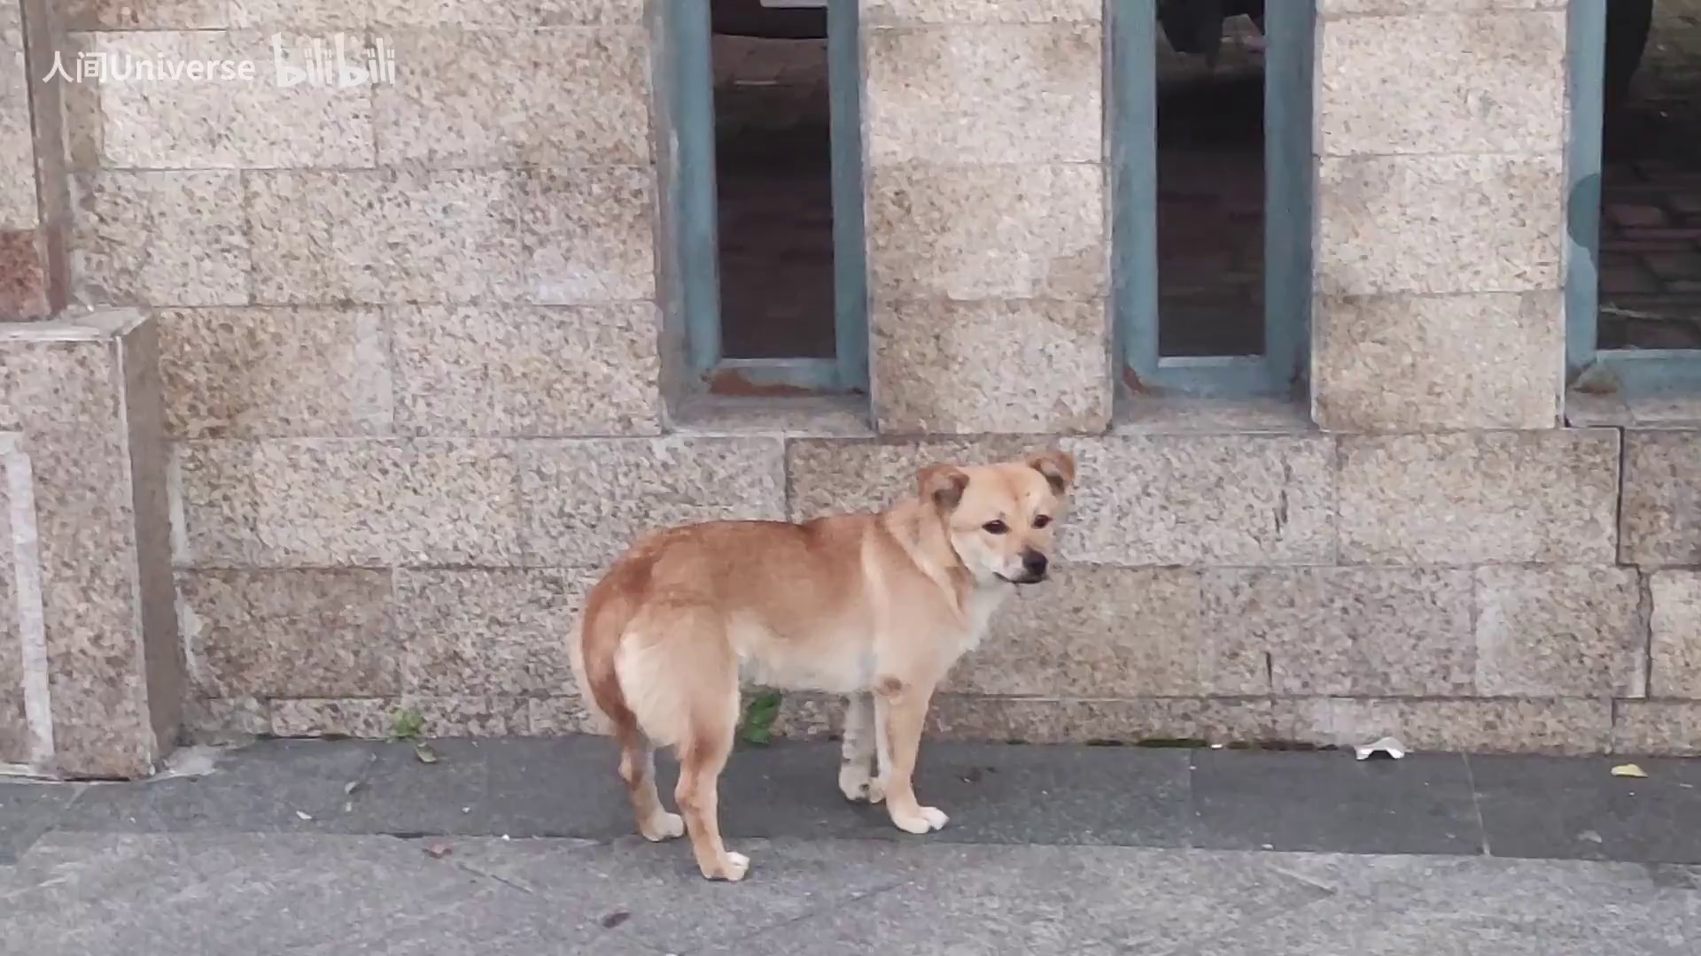
狗狗低下头，夹着尾巴 (lower)
The dog lowered its head, and put its tail between its legs.
The dog lowered its head, _____________ between its legs.
___________________, the dog put its tail between its legs.
with its tail
With head lowered

Slide 12
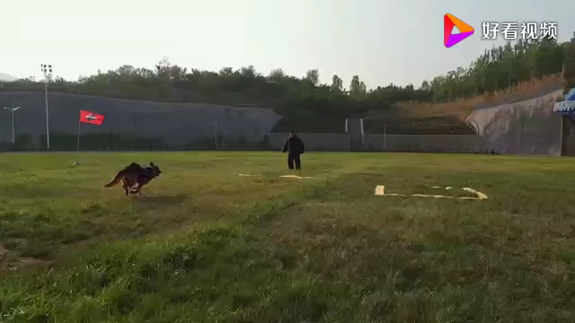
狗狗大声狂吠，露出牙齿，向..猛扑过去 (growl; pounce on..)
The dog growled, showed its sharp teeth, and pounced on...
The __________dog showed its sharp teeth, ____________...
____________________________, the dog growled and pounced on...
growling
pouncing on
With its sharp teeth shown

Slide 13

Writing:
Task 2: Continuation exercise 读后续写练习

Slide 14
(2020年1月浙江高考)
男孩要离家上大学了，父母开车几小时把他送到学校，在校门口父母及Poppy（狗）与男孩依依惜别。回家后，父母感到十分失落，Poppy也非常忧伤，甚至茶饭不思，于是妈妈提议给Poppy寻一只小狗作伴。
Para1: Dad opened the box and a sweet little dog appeared. ______________________
____________________________________________
___________________________________________
____________________________________________
____________________________________________

Slide 15
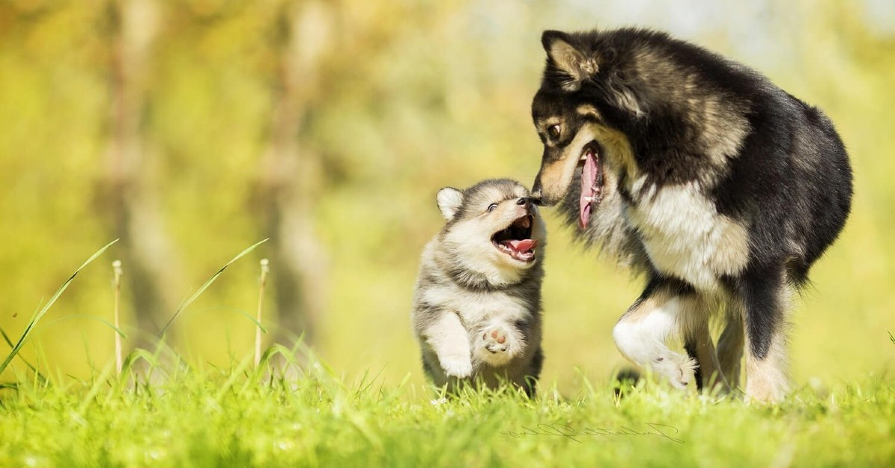

Slide 16
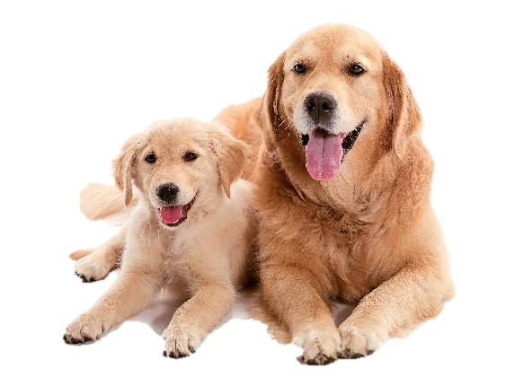
Dad opened the box and a sweet little dog appeared. Poppy stared at the little dog, surprised and curious. The puppy jumped out of the box and barked as a greeting, jumping up and down happily. Eyes widened, Poppy came to lick it gently. The little dog sniffed Poppy, with its tail wagging, and then ran around Poppy, which brought Poppy great joy. They ran together into the yard, bathing in the warm sunshine. The wonderful scene moved dad and mom.

Slide 17
Thank you!

