Slide 1

感恩遇见，相互成就，本课件资料仅供您个人参考、教学使用，严禁自行在网络传播，违者依知识产权法追究法律责任。
更多教学资源请关注
公众号：溯恩高中英语
知识产权声明

Slide 2
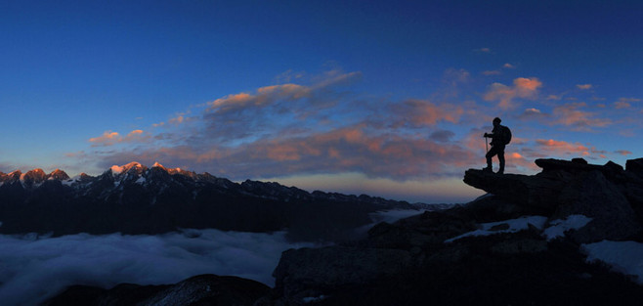
选择性必修2 Unit 1 SCIENCE AND SCIENTISTS
Video Time
Why is it important to Explore?
杭州二中许丽君

Slide 3



To get information about why it is important to explore by watching a video.
To talk about your opinions on exploration.

Slide 4

Before watch
1. What do you think you will see in the video? Tick the items that you think will be mentioned.
□ airplane □ butterfly □ city □ computer
□ diver □ frog □ horse □ polar bear
□ ship □ submarine □ volcano □ whale
animals
explorer
high-tech tools
culture
nature

Slide 5

who
scientists, researchers, explorers (divers)
culture (city)
what
nature (volcano)
to explore
animals (butterfly, frog, horse, polar bear, whale)
how
high-tech tools (airplane, computer, ship, submarine)
why
???

Slide 6




Slide 7

Check your answers from Before You Watch.
□ airplane □ butterfly □ city □ computer
□ diver □ frog □ horse □ polar bear
□ ship □ submarine □ volcano □ whale
√
√
√
√
√
√
√
√

Slide 8


Complete these quotes with the words you hear in the video.
1 Emily Ainsworth: “It's part of human nature to _______ _________and to _________________ about the world.”
2 Juan Martinez: “It's where you find ___________, where you find new things, ________________.”
3 Lee Berger: “We think we know ___________, but we don't. We think we know ___________, but we don't. We think we understand ___________, but we don’t.”
4 Catherine Workman: “_____________ what's out there, _____________ what's out there.”
5 Cory Richards: “And if we have more to care about, then we engage more fully ______________ and more fully _______________________, and we act – you know - _______________.”

Slide 10
Complete these quotes with the words you hear in the video.
1 Emily Ainsworth: “It's part of human nature to _______ _________and to _________________ about the world.”
2 Juan Martinez: “It's where you find ___________, where you find new things, ________________.”
3 Lee Berger: “We think we know ___________, but we don't. We think we know ___________, but we don't. We think we understand ________________, but we don’t.”
be
curious
want to learn more
yourself
where you grow
this place
ourselves
how things work

Slide 11
Complete these quotes with the words you hear in the video.
By knowing
4 Catherine Workman: “_____________ what's out there, _______________ what's out there.”
5 Cory Richards: “And if we have more to care about, then we engage more fully ______________ and more fully _______________________, and we act – you know - _______________.”
we care about
with our world
with our human family
with love

Slide 12
satisfy curiosity and learn more about the world
know about ourselves and new things, help us grow
keep life exciting
why
challenge ourselves
know about the place, ourselves and how things work
know and care
engage and act, with love

Slide 13

Match the descriptions on the left with the words on the right.
1 a first flight
2 used to explore an inaccessible place
3 a new species
4 eight new species
5 a natural alarm clock
A fish
B frog
C polar bear
D butterfly with a tag
E drone

Slide 14
1 a first flight of a butterfly with a tag
2 a drone used to explore an inaccessible place
3 a new species of frog
explorations
4 eight new species of fish
5 a natural alarm clock: a polar bear
Other: ice climbing, snorkelling, spelunking, skydiving

Slide 15


Discuss the following questions in groups.
1 Of the explorations in the video, which seems the most important? Which seems the interesting? Why?
2 Why is it important to explore, in your opinion?
3 How would you like to explore our world? Why?

Slide 16
1 Of the explorations in the video, which seems the most important? Which seems the interesting? Why?
The most important is the one with the butterflies, because butterflies are easily affected by climate and pollution, and so their lives can tell us a lot about how the world is doing.
The most interesting is the cave diving where they found the animal bones. It Just seems so strange and mysterious, and one would not expect to find bones there.

Slide 17
2 Why is it important to explore, in your opinion?
I think it is important to explore because exploration is a part of human growth, both as an individual and society. Through exploration, we develop ourselves. Our interests and curiosity cause us to learn, to improve, and to be better.
3 How would you like to explore our world? Why?
I would like to visit places with my camera and take photos of interesting places and people, as I enjoy photography and love travelling and finding out about new cultures.

Slide 18

Write a passage to express your ideas of “Why is it important to explore?”.

Slide 19
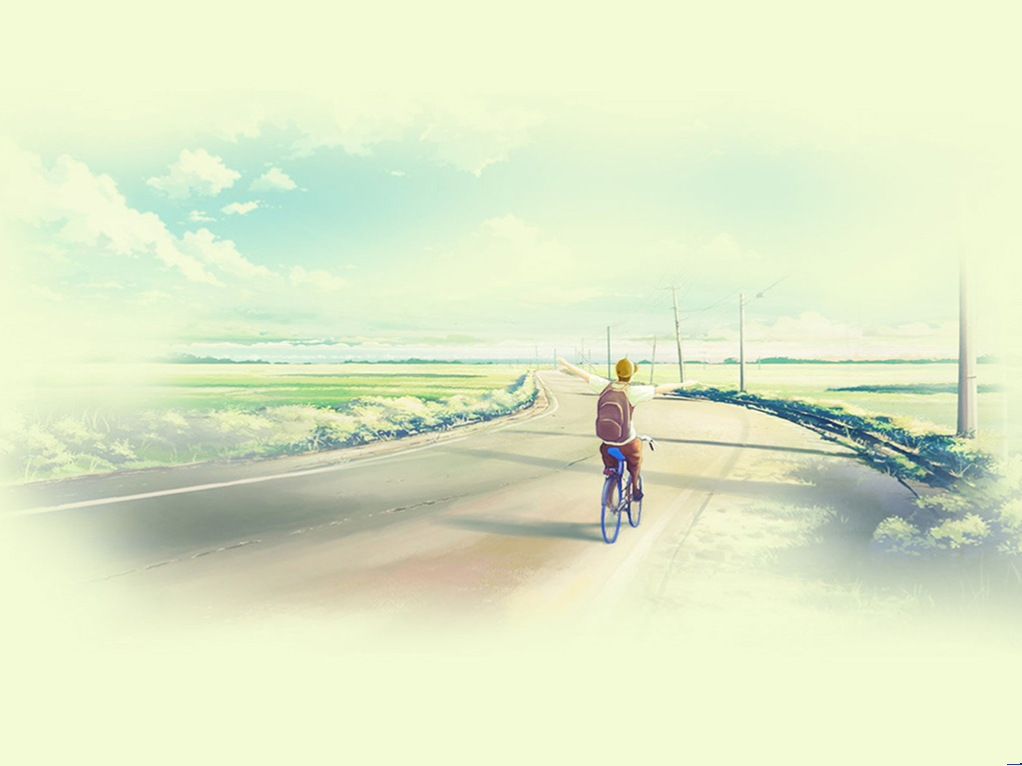

Thank you for your attention

