Slide 1

感恩遇见，相互成就，本课件资料仅供您个人参考、教学使用，严禁自行在网络传播，违者依知识产权法追究法律责任。
更多教学资源请关注
公众号：溯恩高中英语
知识产权声明

Slide 2

The World
October 1st-15th, 2022

Slide 3
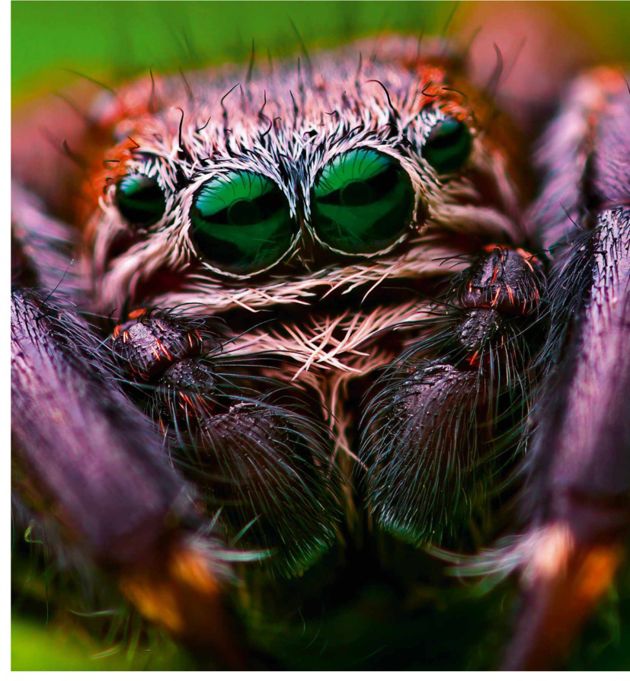
1.Dream Weavers
跳蛛：筑梦大师
Biologists discover jumping spiders experience rapid eye movement sleep by “peering into their heads”.

Slide 4

语篇填空
（《BBC野生生物》 2022年10月刊 13页）
to experience
Jumping spiders have joined an elite group of animals known ____________ (experience) a phase of sleep associated with dreaming in humans. Rapid eye movement (REM) sleep __________ (know) only among vertebrates and octopus until biologists led by Daniela Rößler at Germany’s University of Konstanz quite literally peered into the _____ (head) of sleeping baby jumping spiders.
Most invertebrates have immovable eyes, making REM sleep _____ (trick) to investigate. But jumping spiders can direct their gaze by moving their retinas, which can _______ (see) through the temporarily translucent exoskeletons of spiderlings in the ____ (one) few days after hatching. The biologists report in Proceedings of the National Academy of Sciences that bursts of eye movement are accompanied by limb activity and muscle twitches, ______ are also seen in vertebrates.
In humans, REM sleep is also associated with dreaming. Rößler now plans to investigate _______ the spiders’ brain activity is heightened during bouts of REM. But she is cautious about this line of thought: “It is ___ enormous step to be wondering about dreams. I think this is amplified by our human bias and our own experience and imagining that ‘dreaming’ would look or feel the same in other animals. Animals experience the world __________ (different), so a ‘dream’ is likely very different.”
was known
heads
tricky
be seen
first
which
whether
an
differently
Notes:
differently

Slide 5
词汇讲解1
1. elite: an elite group contains the best, most skilled, or most experienced people or members of a larger group精英的
The palace is guarded by elite troops loyal to the president. 宫殿由忠于总统的精锐部队守卫。
2. twitch: a sudden quick movement that you cannot control in one of your muscles 痉挛；抽搐；抽动
She has a twitch in her left eye. 她左眼跳了一下。
翻译句子
他想要一支高效、精英的工程团队。
He wanted an efficient and elite engineering team.
翻译句子
他患上了一种神经痉挛病，开始不停地眨眼睛。
He developed a nervous twitch and began to blink constantly.

Slide 6
词汇讲解2
3. amplify: to increase the effects or strength of something 扩大；增强
A funeral can amplify the feelings of regret and loss for the relatives. 葬礼可以渲染生者痛失亲人的哀悼之情。
4. bias: a strong feeling in favour of or against one group of people, or one side in an argument, often not based on fair judgement 偏见；偏心；偏向
Employers must consider all candidates impartially and without bias. 雇主必须公平而毫无成见地考虑所有求职者。
翻译句子
这些故事只是增加了她的恐惧。
These stories only amplified her fears.
翻译句子
有些机构仍然对女性持有很大偏见。
Some institutions still have a strong bias against women.

Slide 7
句子翻译
Most invertebrates have immovable eyes, making REM sleep tricky to investigate. But jumping spiders can direct their gaze by moving their retinas, which can be seen through the temporarily translucent exoskeletons of spiderlings in the first few days after hatching.
大多数无脊椎动物的眼睛都是固定不动的，这使得快速眼动睡眠难以研究。但是跳蛛可以通过移动视网膜来引导它们的视线，在孵化后的头几天，这可以通过蜘蛛幼虫暂时半透明的外骨骼看到视网膜。
翻译
I think this is amplified by our human bias and our own experience and imagining that ‘dreaming’ would look or feel the same in other animals. Animals experience the world differently, so a ‘dream’ is likely very different.”
翻译
我认为这被我们人类的偏见和我们自身经验放大了，我们想象“做梦”在其他动物身上看起来或感觉是一样的。动物对世界的体验是不同的，所以‘梦’可能非常不同。”

Slide 8
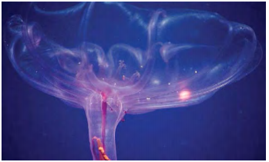
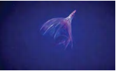
2. Discovered in the deep:
the sea cucumber that lives a jellyfish life
像水母般生活的海参

Slide 9
语篇填空
（《卫报》2022年10月4日 40页）
Wafting through the deep sea is a diaphanous creature that _________ (resemble) a jellyfish, but is in fact something else entirely. Pelagothuria natatrix, meaning swimming sea cucumber, belongs to a group of animals better known for lying around on the seabed like giant, rubbery ______ (worm).This sea cucumber was first named in the late 19th century.
_____ Pelagothuria survives in these challenging conditions is still a mystery, but it likely has something to do _____ its jelly body. Many animals living in the deep sea have bodies made mostly of water with a small amount of collagen mixed in. This gelatinous goo requires little energy _______ (make) and maintain, and so is ideal for animals living at depths ______ food is often scarce. Jelly-based animals are also inherently buoyant, so they needn’t waste precious energy and oxygen __________ (swim) to stay afloat; they can just drift around.Out of _______ (rough) 1,200 species of sea cucumbers, Pelagothuria is the only one ______ (know) to spend most of its time swimming.
This could be how Pelagothuria’s ancestors started out, then evolving to be better and better swimmers until they _______ (adopt) a full-time jellyfish lifestyle. It’s a case of convergent evolution in which distantly related organisms –in this case sea cucumbers and jellyfish – have solved challenges with a similar outcome.
resembles
worms
How
with
to make
where
swimming
roughly
known
adopted

Slide 10
词汇讲解
1. collagen: a protein found in skin and bone, sometimes injected into the body, especially the face, to improve its appearance 胶原蛋白，胶原
This collagen is highly hydrated and it forms a gel that has water-like properties.
这种胶原蛋白是高度水合的，它形成了一种凝胶，有水一样的性质。
2. convergent: moving towards or meeting at some common point
会聚性的； 趋集于一点的
Experiments show that the algorithm is convergent.
实验证实，该算法是趋同的。
翻译句子
面霜中包含的胶原蛋白来自于动物皮肤。
The collagen that is included in face creams comes from animal skin.
翻译句子
聚合型问题只有一个正确答案。
Convergent questions have one correct answer.

Slide 11
句子翻译
Pelagothuria natatrix, meaning swimming sea cucumber, belongs to a group of animals better known for lying around on the seabed like giant, rubbery worms.
Pelagothuria natatrix意思是会游泳的海参，属于一种动物，更出名的是，它像巨大的橡胶蠕虫一样躺在海底。
翻译
Jelly-based animals are also inherently buoyant, so they needn’t waste precious energy and oxygen swimming to stay afloat; they can just drift around.
以果冻为基础的动物天生具有浮力，所以它们不需要浪费宝贵的能量和氧气来游泳以保持漂浮; 它们可以四处漂流。
翻译

Slide 12
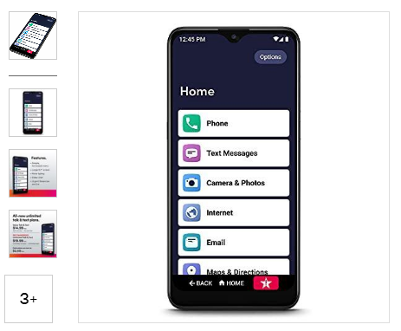
3. Jitterbug smart 3

Slide 13

《读者文摘》
2022年10月 27页

Slide 14

阅读理解
1. What’s the feature of Jitterbuy’s smart 3?
A. One can text messages for free.
B. One can get refund if there is something wrong.
C. This type of smartphones is not so complex.
D. This type of smartphones is what teenagers like.
细节理解
2. When can you buy the smartphone at the lowest price?
A. Every Sunday.
B. Every weekend.
C. On Christmas Day.
D. On Grandparent’s Day.
推理判断
3. Where can you buy the smartphone except?
A. Tmall.
B. Walgreens.
C. BestBuy.
D. RiteAid.
细节理解

Slide 15
词汇讲解
1. exclusive: only to be used by one particular person or group 专用的，专有的，独有的，独占的
Our group will have exclusive use of a 60-foot boat.
我们组将有一条专用的60英尺的船。
2. available: that you can get, buy or find 可获得的；可购得的；可找到的
These are the courses presently available. 这些就是现有的课程。
翻译句子
这家旅馆有通向海滩的专用通道。
The hotel has exclusive access to the beach.
翻译句子
这是唯一可用的房间。
This was the only room available.

Slide 16
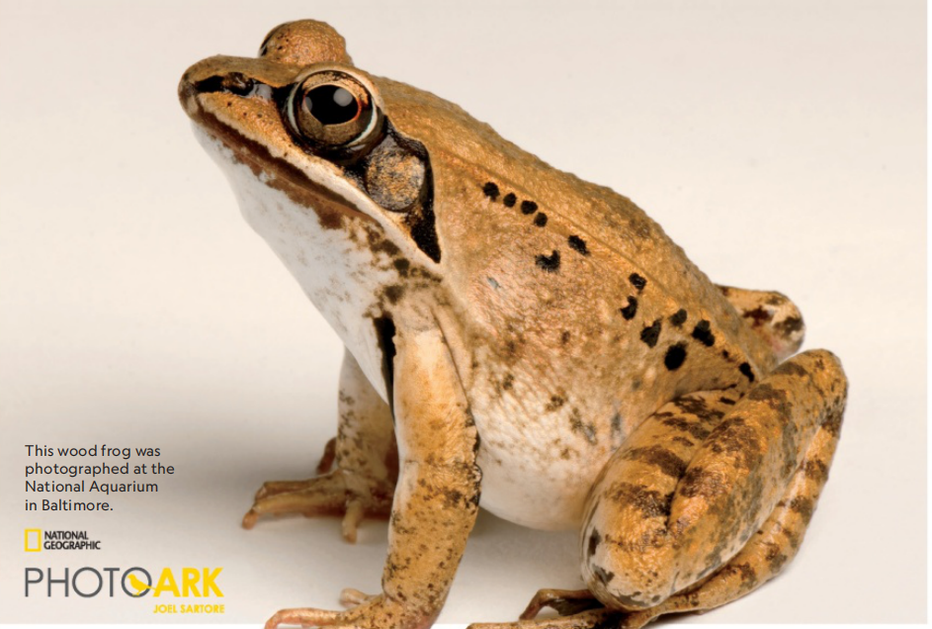
4. These Frogs Melt When Mating Season Starts
在交配季开始时融化的青蛙
This wood frog was photographed at the National Aquarium in Baltimore.

Slide 17

语篇填空
（《国家地理》2022年10月刊 EXPLORE版面 Basic Instincts）
During winters in North America, many amphibians dive or burrow deep to avoid freezing—but not the wood frog. These fig-size croakers stay put aboveground as the water between their cells _______ (freeze), and they spend the season in a kind of cryosleep. When spring arrives, most wood frogs awaken from their ____ (ice) slumber with one thing on their mind: sex. Males find a pond or temporary vernal pool and call to females with sounds “almost like a quacking duck,” says Dartmouth College’s Ryan Calsbeek, ___ biology professor who studies amphibians’ sex lives. ___ more males join in, the cacophony of croaks can be heard throughout the forest. ________ (hear) the come-ons from the ponds around them, females hop toward the croaks they find most seductive. In a recent study using an advanced acoustic camera, Calsbeek determined that female wood frogs, like many humans, can’t resist deep, husky voices. Such croaks tend _______ (come) from large frogs—but once a female is lured to a pond, she’s fair game for all its male frogs, including small sopranos. The victor is the male ___________ grasps and mounts the female, wrapping his forelimbs around her torso, a position _______ (know) as amplexus (抱合). He squeezes until she deposits her eggs _____ the water; he then releases sperm, fertilizing the eggs. It’s female wood frogs’ fate to have several breeding opportunities during their two-to-three-year life span. So _____ (odd) are good that they’ll find at least one big baritone daddy.
freezes
icy
a
As
Hearing
to come
that / which
known
into
odds

Slide 18
词汇讲解
1. burrow: to make a hole or a tunnel in the ground by digging 挖掘（洞或洞穴通道）；挖洞
The larvae burrow into cracks in the floor. 幼虫钻进了地板的缝隙里。
2. stay put: if sb/sth stays put, they continue to be in the place where they are or where they have been put 待在原地；留在原处
I want you kids to stay put while I go into the store.
我进商店去买东西，你们几个孩子待在这里别动。
翻译句子
蚯蚓钻土很深。
Earthworms burrow deep into the soil.
翻译句子
如果孩子们只是呆在原地不动，他们的父母很快就会来找他们。
If the children just stay put, their parents will come for them soon.

Slide 19
句子翻译
In a recent study using an advanced acoustic camera, Calsbeek determined that female wood frogs, like many humans, can’t resist deep, husky voices.
在最近的一项使用先进声学相机的研究中，卡尔斯比克确定，雌性林蛙和许多人类一样，无法抗拒深沉、沙哑的声音。
翻译
It’s female wood frogs’ fate to have several breeding opportunities during their two-to-three-year life span. So odds are good that they’ll find at least one big baritone daddy.
翻译
雌性林蛙在它们两到三年的一生中有几次繁殖机会。所以他们很有可能至少能找到一个拥有浑厚嗓音的伴侣。

Slide 20
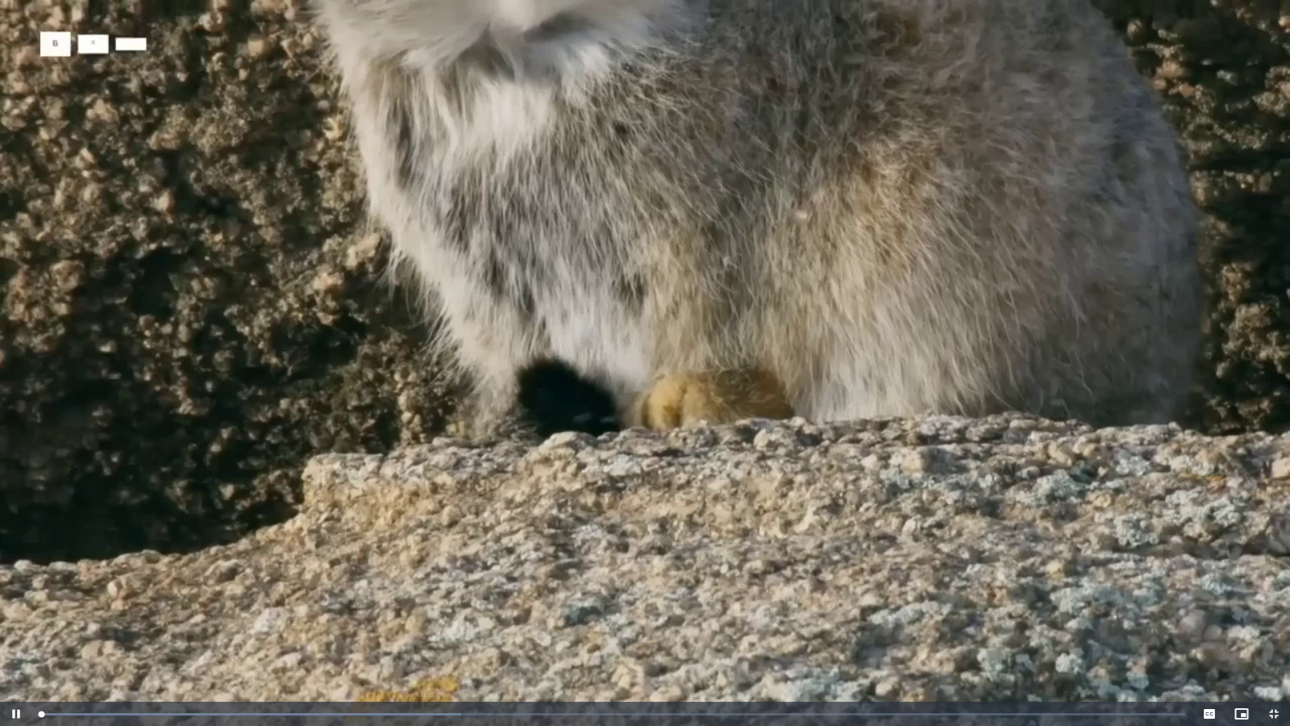
5. BBC 听写填空

Slide 21

听力填空
A Pallas’s cat. He has the _______ fur of any cat in the world. Nonetheless to keep warm, he must catch _____ five rodents a day. Top of the menu are those and gerbils. Relative to body size, Pallas’s cat have one of the shortest legs of any cat, and that helps by giving them ___________ when stalking. But it’s not so good for _____________ deep snow. Never mind, there are plenty more. He just needs to _________ . Unfortunately the longer he’s out in the snow, the colder his _____ become, and he has only one way to get the blood __________ again. That could be one shake too many. Only one hunting in three by a Pallas’s cat is successful. No wonder he has the _________ of being the grumpiest cat in the world.
densest
up to
a low profile
wading through
stay focused
paws
circulating
reputation

Slide 22
词汇讲解
1. wade: to walk with an effort through sth, especially water or mud
跋涉，蹚（水或淤泥等）
Rescuers had to wade across a river to reach them.
救援者必须蹚过一条河才能靠近他们。
2. grumpy: bad-tempered 脾气坏的；性情暴躁的
Some folk think I’m a grumpy old man.
有些人认为我是个性情暴躁的老头。
翻译句子
他蹚进水里把船推出来。
He waded into the water to push the boat out.
翻译句子
你不应该对新来的邻居这么粗暴。
You shouldn’t be so grumpy to someone who’s new in the neighborhood.

Slide 23
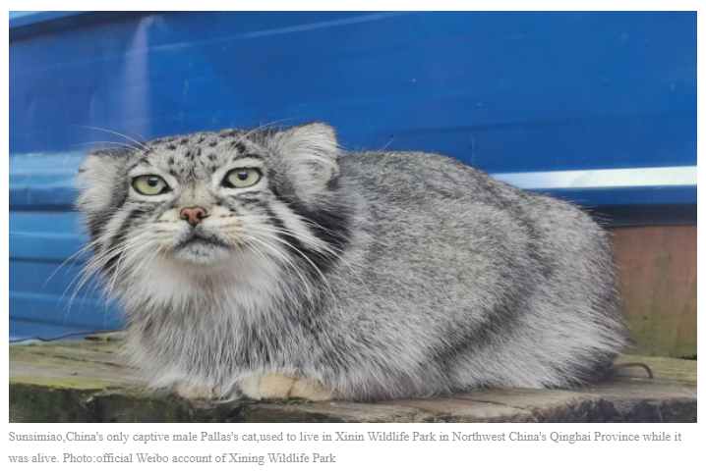
相关新闻
China’s only captive male Pallas’s cat dies of suffocation

Slide 24

相关新闻
China’s only captive male Pallas’s cat, Sunsimiao, died at the age of seven and a half after choking on chicken while eating, according to an obituary released on Monday by Xining Wildlife Park, where Sunsimiao used to live while alive.
Born in 2015, Sunsimiao was rescued from a resident’s home in Xining, Northwest China’s Qinghai Province, by the Qinghai Wildlife Rescue and Breeding Center in 2015. After artificial rearing and growing up, Sunsimiao has been living in Xining Wildlife Park, and has gradually become the country’s most famous and influential Pallas's cat among Chinese netizens.
Sunsimiao together with another Sunshangxiang, another female Pallas’s cat rescued in 2019, gave birth to a baby Pallas’s cat in 2021, which is the first artificially bred Pallas’s cat to survive in China.
Xining Wildlife Park said in Sunsimiao’s obituary that although it had never experienced the vastness of the wild plateau in its life, it has made countless people to understand and pay attention to this species. And it also set up an immortal monument in the study of the artificial breeding of the Pallas’s cat.
The park also said in the statement that it would review the incident and reassess the risks in its current breeding management to avoid the same tragedy happening again.

