Slide 1

感恩遇见，相互成就，本课件资料仅供您个人参考、教学使用，严禁自行在网络传播，违者依知识产权法追究法律责任。
更多教学资源请关注
公众号：溯恩高中英语
知识产权声明

Slide 2

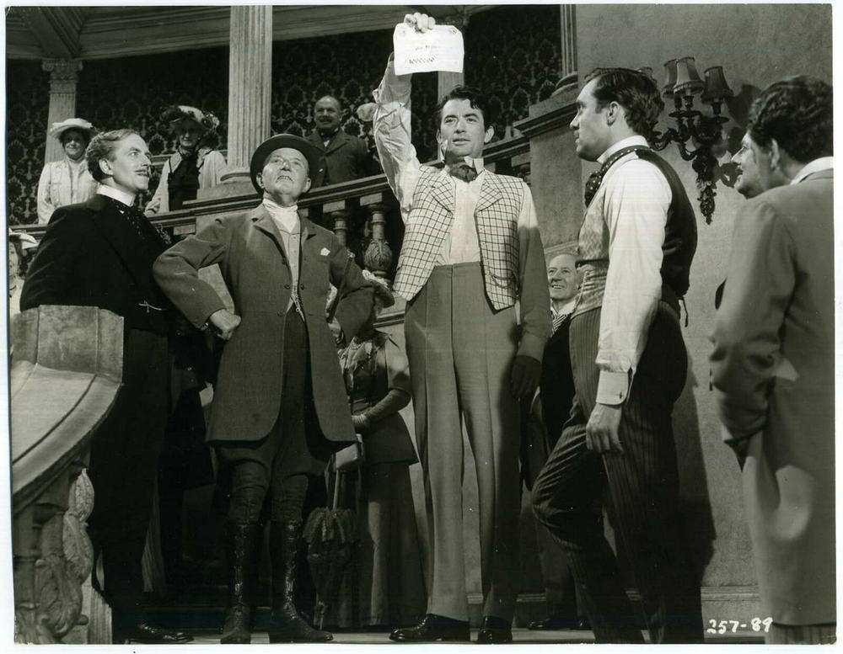
Unit 5
The Million Pound Bank Note

Slide 3

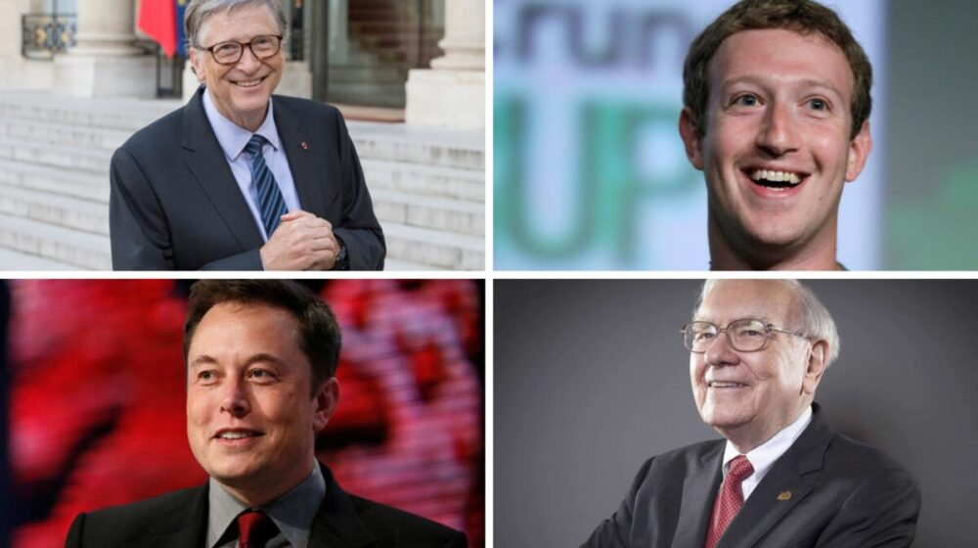
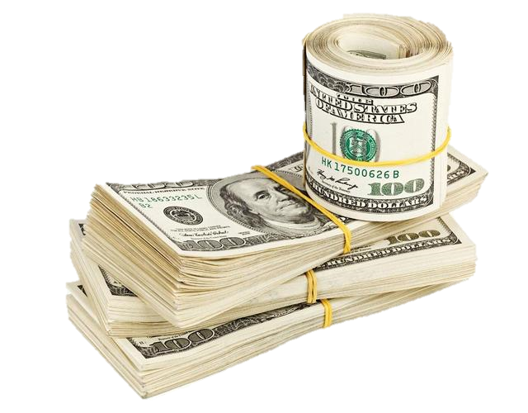
Lead-in
1. Would you like to be a millionaire like the following people？Why or why not?
2. If you had one million, what would you like to do?
buy a big flat
donate
improve knowledge
go shopping
travel
start a business
Do research
spend them on food
conduct financial transactions

Slide 4
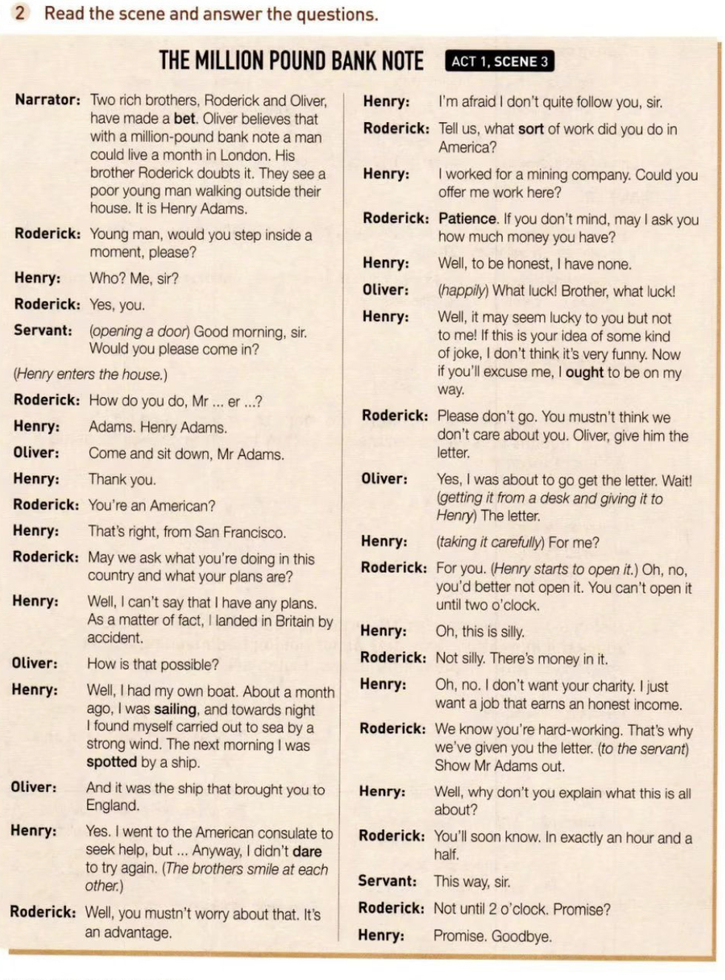
Prediction
A drama or play intends to portray(描述) life or people or to tell a story usually involving conflicts and emotions through action and dialogue. It is performed on a stage. It consists of a plot, settings, characters, actions and dialogue.
As you are reading the title, what ideas had go through your mind if you were the writer?
What is the type of the text?
A. A story
B. A drama/ play
√

Slide 5
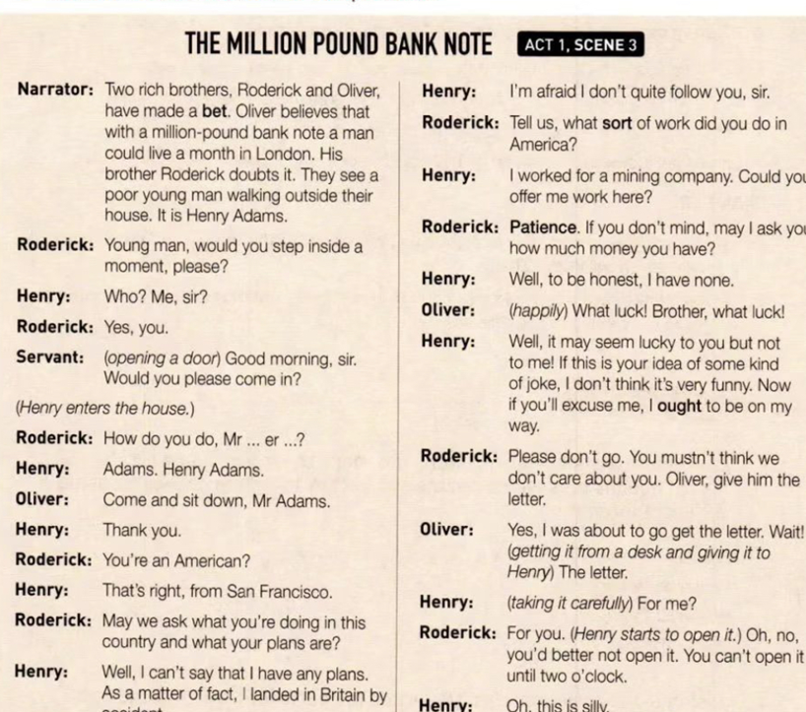
Prediction
1. Act幕, scene场
Setting/ Background
2. narration
旁白
3. stage directions 舞台说明
4. character names 人物
5. lines of dialogues 对话

Slide 6
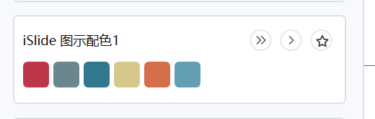
Read for Basic Elements
Where did the story happen?
When did it happen?
In the brothers' house.
Midday.
2
4
1
3
Who are the main characters
What happened?
Henry, Roderick &Oliver (brothers), and the servant.
The brothers made a bet on whether a man could live for a month in London if he had a million-pound bank note.

Slide 7
Read for Plots
4. They gave Henry a letter with ____________
______________________ in it .
one million
pound bank note
the
reason to stay in London
3. Henry told them _____ ___________________________ and _________________.
not
to open it 2 o’clock
Climax
5. They asked him ____
_____________until_________________ .
wanted a job
invited
2. They ________ Henry to their house.
4. Henry went outside with the __________ of opening the envelope later.
Process
promise
1.Two brothers _______________.
made a bet
Story Mountain
Beginning
End

Slide 8



Read for Henry’s Feelings
Lines
Feelings
5. Well, why don’t you explain what this is about?
Puzzled, curious, surprised
angry, upset
4. Well, it may seem lucky to you ……some kind of joke, I don’t think it’s very funny.
puzzled
3. I’m afraid I don’t quite follow you.
anxious
2. Well, I can’t say that I have any plans. …I landed in Britain by accident
1. Who？ Me， sir？
surprised
Place
Outside the house
In the house

Slide 9
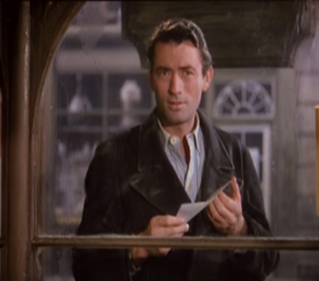
Read for Personalities
What personality do Henry Adams , Oliver and Roderick have?
independent,
honest,
Henry is________________________.
I earned my passage by working as an unpaid hand.
Well, I can’t say that I have any plans.
Well, to be honest, I have none.
Could you offer me some kind of work here?
I don’t want your charity. I just want an honest job.

Slide 10
Read for Personalities
What personality do Henry Adams , Oliver and Roderick have?
hard-working,
frank/ straightforward
Henry is________________________.
Could you offer me some kind of work here?
I don’t want your charity. I just want an honest job.
Well, it may seem lucky to you but not to me!
If this is your idea of some kind of joke, I don’t think it’s very funny. Now if you’ll excuse me, I ought to be on my way.

Slide 11
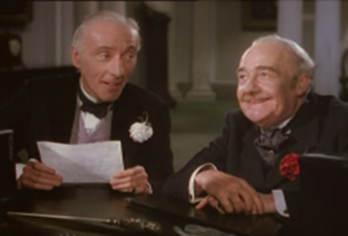
Read for Personalities
What personality do Henry Adams , Oliver and Roderick have?
Oliver and Roderick were ______________________.
polite,
May we ask what you’re doing in this country and what your plans are?
If you don’t mind, may I ask you how much money you have?

Slide 12
Read for Personalities
What personality do Henry Adams , Oliver and Roderick have?
Oliver and Roderick were _________________________.
mischievous,恶作剧的
wise
Two rich brothers have made a bet about one million pounds.
They can know Henry is honest and hard-working through his words and behaviours.

Slide 13
Read for Implied Meaning
Some sentences have an implied meaning which is not clearly stated. This implied meaning often indicates people’s feelings, attitudes, or motives. You can find this implied meaning by looking at the context. You have to read between the lines because the real messages are often hidden beneath the literal meaning.
Explain what the speakers mean by saying these sentences.
1. I went to the American consulate to seek help, but …Anyway, I didn’t dare to try again.
It’s an unpleasant experience./ No one would like to help me.
2. You mustn’t worry about that. It’s an advantage.
Henry’s situation suits their requirement.
3. What luck! Brother, what luck!
Henry is a suitable man for their bet.
4. Oh, this is silly.
Their behaviour and words are very strange./ Don’t make fun of me.

Slide 14
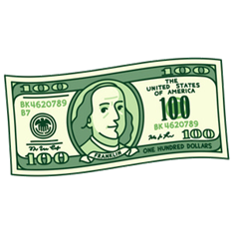
Thinking
2. Why don’t the brothers want Henry to open the envelope before 2 o’clock?
1. Why does Henry refuse the brothers’ charity?
1
2
3
4
4. Is money so important? What do you think of this?
3. What can we learn from the three characters (Henry, Roderick &Oliver)?

Slide 15
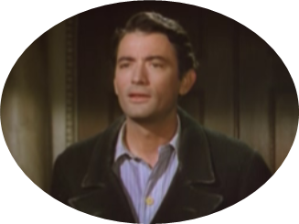
Writing
What will happen to Henry after 2 o’clock?
Write a continuation with Henry as the first-person narrator.
As soon as I was out of sight of that house I opened my envelope and saw that it contained money! ______ _______________________________________________________________________________________________________________________________________________________________________________________________________________________

Slide 16
Writing
Sample
As soon as I was out of sight of that house I opened my envelope and saw that it contained money! My opinion of those people changed. I lost not a moment, but shoved note and money into my vest pocket, and broke for the nearest cheap eating house. Well, how I did eat! When at last I couldn’t hold any more, I took out my money and unfolded it, took one glimpse and nearly fainted (晕厥). Five millions of dollars! Why, it made my head swim. I must have sat there stunned and blinking at the note as much as a minute before I came rightly to myself again. The first thing I noticed, then, was the landlord (店主). His eye was on the note, and he was petrified (惊呆). He was worshiping (崇拜) with all his body and soul, but he looked as if he couldn't stir hand or foot. I took my cue in a moment and did the only rational thing. I reached the note towards him, and said, carelessly: “give me the change, please.”

Slide 17
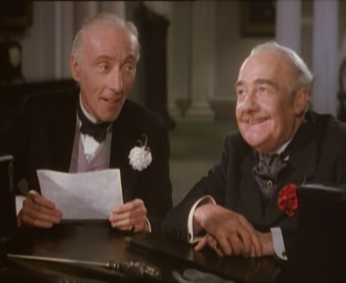
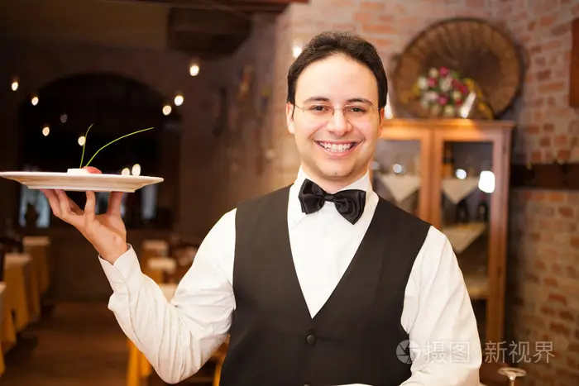
Assignment
Work in groups of four to role-play Act 1, Scene 3.
A
Henry Adams
B
Roderick
Student
C
Oliver
D
Servant & Narrator

Slide 18
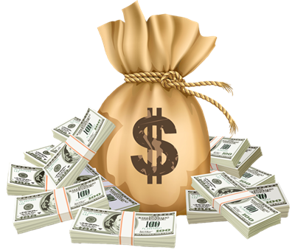
Thank You!
Money is a good servant and a bad master.
-Francis Bacon

