Slide 1

感恩遇见，相互成就，本课件资料仅供您个人参考、教学使用，严禁自行在网络传播，违者依知识产权法追究法律责任。
更多教学资源请关注
公众号：溯恩高中英语
知识产权声明

Slide 2

The World
November 1st-15th, 2022

Slide 3
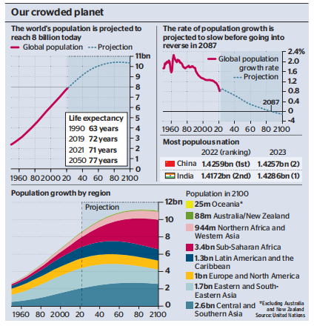
1. World Population Passes 8 billion Milestone Today
世界人口突破80亿

Slide 4
语篇填空
（《泰晤士报》 2022年11月15日 30页）
Some time today Earth’s population is expected to pass eight billion, according to the United Nations, which will announce the milestone in _______ (event) staged in New York and at the Cop27 climate conference in Egypt.
The figure, _________ (expect) today according to projections by the UN Population Fund, has come thanks ___ longer life-spans and the rapid growth of some nations in Asia and sub-Saharan Africa. It came only 11 years after the figure hit seven billion, but amid projections ______ this “unprecedented growth” was now slowing. There will not be nine billion people until 2037, according to the UN. Its officials _______ (seek) to cast it as a cause for __________ (celebrate) while at the same time _______ (issue) warnings of the challenges that lie ahead as humanity reaches a pre-peak population of about 10.4 billion sometime in the 2080s.
Although the population has grown most _______ (rapid) in the modern era, more than trebling in ____ 20th century, average fertility rates have been dropping since 1950. Then the average woman had five children; by last year it was 2.3 and by 2050 it is expected to drop to 2.1. However, fertility rates remain far ______ (high) in some of the least developed nations.
events
expected
to
that
sought
celebration
issuing
rapidly
the
higher

Slide 5
熟词生义
1. stage: 常见义→ n.阶段；舞台
生义 → v.上演；举办；组织
The local theatre group is staging a production of “Hamlet”. 当地剧团在上演《哈姆雷特》。
2. cast: 常见义→ n.全体演员 v.投射；扔；投
生义 → v. 把……描写成；把……表现为
He cast himself as the innocent victim of a hate campaign. 他把自己说成是一场诋毁声誉行为的无辜受害者。
翻译句子
伦敦于2012年举办了奥运会。
London staged the Olympic Games in 2012.
翻译句子
新闻界很快把她描述成“第三者”的角色。
The press were quick to cast her in the role of “the other woman”.

Slide 6
词汇讲解
1. projection: a statement or calculation about what something will be in the future or was in the past, based on information available now 预测；推断；设想
Sales have exceeded our projections. 销售量超过了我们的预测。
2. fertility: the state of being fertile 富饶；丰产；能生育性
Doctors will tell you that pregnancy is the only sure test for fertility. 医生们会告诉你怀孕是测试生育能力的惟一准确的方法。
翻译句子
他拒绝对第四季度收益做出预测。
He declined to make projections about fourth quarter earnings.
翻译句子
吸烟女士的生育能力是非吸烟女士的一半。
The fertility of women who smoke is half that of nonsmoking women.

Slide 7
句子翻译
Some time today Earth’s population is expected to pass eight billion, according to the United Nations, which will announce the milestone in events staged in New York and at the Cop27 climate conference in Egypt.
根据联合国的预测，今天的某个时候，地球人口预计将超过80亿。联合国将在纽约和在埃及举行的Cop27气候大会上宣布这一里程碑式的事件。
翻译
The figure, expected today according to projections by the UN Population Fund, has come thanks to longer life-spans and the rapid growth of some nations in Asia and sub-Saharan Africa. It came only 11 years after the figure hit seven billion, but amid projections that this “unprecedented growth” was now slowing.
根据联合国人口基金的预测，这一数字今天有望达到，这要归功于亚洲和撒哈拉以南非洲一些国家的人口寿命的延长和快速增长。这一数字距离70亿仅过去了11年，但据预测，这种“前所未有的增长”现在正在放缓。
翻译

Slide 8

2. Great Reads from Great Minds
智者之书

Slide 9


《读者文摘》
2022年11月 34页

Slide 10

阅读理解
1. Which book is suitable for people with visual impairment?
A. Mandalas.
B. Beating the Odds.
C. Some of My Seasons.
D. Vignettes from the Twilight of Life.
细节理解
细节理解
2. How many authors can help readers understand the life of the elderly?
A. Two. B. Three. C. Four. D. Five.
3. Where is the text probably taken from?
A. A research about books.
B. A website about science.
C. A review from a paper.
D. An advertisement from a magazine.
推理判断

Slide 11
词汇讲解
1. feisty: strong, determined and not afraid of arguing with people 坚决而据理力争的；活跃的
Ms. Prose depicts Lula as a feisty but daydreamy sort of girl.
普罗斯女士将卢拉描绘成一个个性强且爱做白日梦的女孩。
2. delve: to try hard to find out more information about sth 探索；探究；查考
She had started to delve into her father's distant past.
她开始探究她父亲久已逝去的岁月。
翻译句子
六十六岁的她，从来没有这样精力旺盛过。
At 66, she was as feisty as ever.
翻译句子
然后再讨论一些细节问题。
Then I'll delve into some of the details.

Slide 12
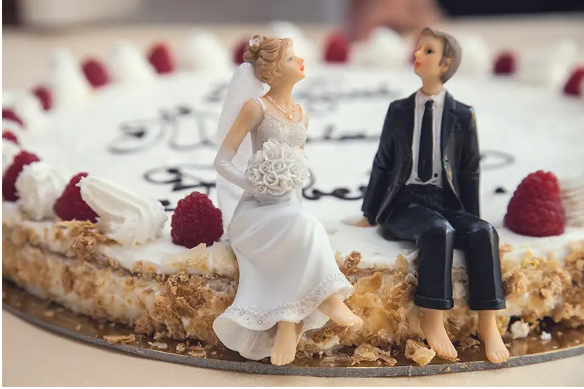
3. Annual marriages predicted to plunge by three quarters
英国年结婚人数预计将骤降四分之三

Slide 13
语篇填空
(《泰晤士报》2022年11月12日 5页 ）
on
British couples will have all but given up _____ marriage in two generations, with only two in 400 adults ________ (get) married each year, it has been claimed.
Researchers at the Civitas think tank believe that by 2062 annual marriage rates _______________(fall) by more than 70 per cent, compared with those today of one couple for every 100 adults. Civitas estimates that 67,000 couples in England and Wales will marry in 2062 __________ (compare)with 213,000 in 2019.
Harry Benson, research director of the Marriage Foundation charity, called on the government to support marriage by increasing ________(benefit) for married couples.
“Marriage may be down, ____ it is far from out,” he said. “Four out of five couples are married. Nine out of ten intact couples ______ teenage children are married. The real scandal here is that those from the poorest backgrounds are twice as likely to not marry as ______ from the richest. This is _____ we have called on the government to take immediate action to close the marriage gap, so that ____ benefits for both the couple and any children they might have can be enjoyed by more and more people.
getting
will have fallen
compared
benefits
but
with
those
why
the

Slide 14
词汇讲解
1. intact: complete and not damaged 完好无损；完整
Most of the house remains intact even after two hundred years.
虽然过了两百年，这房子的大部分还保持完好。
2. scandal : behaviour or an event that people think is morally or legally wrong and causes public feelings of shock or anger 丑行；使人震惊的丑事；丑闻
There has been no hint of scandal during his time in office.
他在任期间没有任何丑闻。
翻译句子
这个花瓶保存得完好无损。
This vase has been preserved intact.
翻译句子
这桩丑闻是在五月份曝光的。
The scandal became known to the public in May.

Slide 15
句子翻译
British couples will have all but given up on marriage in two generations, with only two in 400 adults getting married each year, it has been claimed.
翻译
据报道，在未来两代人的时间里，英国的夫妻几乎都会放弃婚姻，每年每400个成年人中只有两个人结婚 。
This is why we have called on the government to take immediate action to close the marriage gap, so that the benefits for both the couple and any children they might have can be enjoyed by more and more people.
这就是为什么我们呼吁政府立即采取行动缩小婚姻差距，让越来越多的人能享受到夫妻双方和他们可能拥有的任何孩子的利益。
翻译

Slide 16
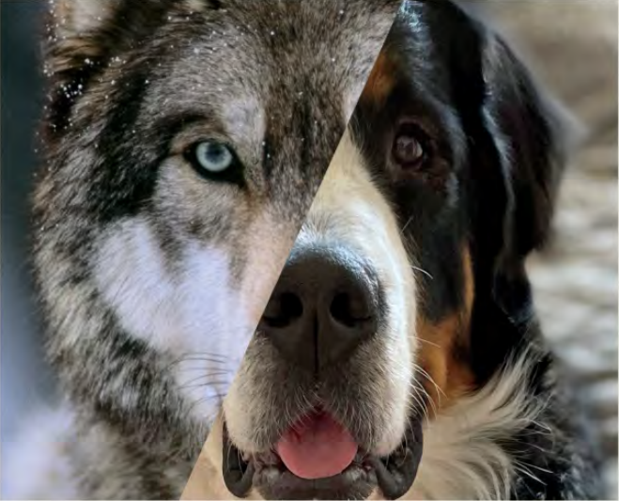
4. Speak Eye to Eye 会撒娇的眼睛
Muscles make faces more expressive in dogs and humans than in wolves, study finds.

Slide 17

语篇填空
（《国家地理》2022年11月刊 BREAKTHROUGHS 板块）
Saying no when Fido gives you his best “puppy-dog eyes” can be extremely difficult. For thousands of years, dogs have been cajoling people by making this ______ (pity), adorable expression— ___ ability that may be the result of selective breeding, a new study says.
Tiny muscles around the eyes and mouth enable terrestrial mammals _______ (form) myriad facial expressions. Those muscles are more similar in dogs and humans _____ in dogs and wolves, says the study by researchers from Pittsburgh’s Duquesne University. In wolves, most of the facial muscles are slow-twitch fibers, ______ adjust less rapidly, while in humans and ____________ (domestic) dogs, most of the muscles are fast-twitch fibers, which react quickly. It’s this musculature difference ____ allows dogs to make puppy-dog eyes and other animated, humanlike expressions that wolves can’t.
______________ (communicate) with facial cues is “fundamental to all humans,” says study lead author Anne Burrows. “So ___ seems reasonable that we would have selected dogs during selective breeding that would gaze into our eyes.” Burrows and colleagues are now investigating whether the evolution of fast-twitching muscles around dogs’ mouths played a role ___ the barks they developed to communicate.
pitiful
an
to form
than
which
domesticated
that
Communicating
it
in

Slide 18
词汇讲解
1. cajole: (~sb into sth/into doing sth) to make sb do sth by talking to them and being very nice to them 劝诱；哄骗；诱骗
It was he who had cajoled Garland into doing the film.
是他劝服嘉兰拍这部片子的。
2. myriad: an extremely large number of sth 无数；大量
Designs are available in a myriad of colors.
各种色彩的款式应有尽有。
翻译句子
他诱骗我同意干那件活儿。
He cajoled me into agreeing to do the work.
翻译句子
他们在抚养孩子的过程中遇到了各种各样的问题。
They face a myriad of problems bringing up children.

Slide 19
句子翻译
For thousands of years, dogs have been cajoling people by making this pitiful, adorable expression— an ability that may be the result of selective breeding, a new study says.
翻译
一项新的研究表明，几千年来，狗一直在用这种惹人疼爱的表情来讨好人们——这种能力可能是选择性繁殖的结果。
It’s this musculature difference that allows dogs to make puppy-dog eyes and other animated, humanlike expressions that wolves can’t.
翻译
正是这种肌肉组织的差异让狗能够有撒娇的眼神和做出其它狼不能做出的生动而类似人类的表情。
Burrows and colleagues are now investigating whether the evolution of fast-twitching muscles around dogs’ mouths played a role in the barks they developed to communicate.
翻译
布伦斯和他的同事们正在研究狗的嘴巴周围快速抽搐肌肉的进化是否在它们用于交流的吠叫中起了作用。

Slide 20
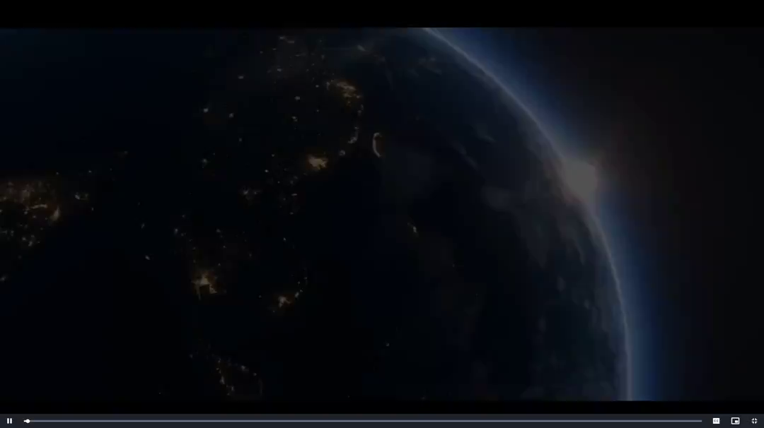
5. THE LINE 沙特“线性城市”构想

Slide 21

听力填空
For too long, humanity has existed within dysfunctional and polluted cities that ___________. Now, a revolution in civilization is taking place.
Imagine a traditional city and consolidating its footprint. Designing to protect and enhance nature, the LINE will _________ 9 million residents and will be built with a footprint of just 34 square kilometers. And we are designing it to provide a healthier, more __________ quality of life. The LINE’s communities are organized in three dimensions. Residents ____________ all their daily needs within 5-minute-walk neighborhoods. And THE LINE’s infrastructure makes it possible to travel end to end in 20 minutes with no need for cars, __________ zero carbon emissions. By leveraging AI technology, services are __________, saving you time and effort.
Designed by world-leading architects, THE LINE is 500m all, 200m wide, 170km long, and housed within an elegant mirror glass facade. Intelligent solutions create _________ and year-round temperate micro-climate with natural ventilation. Energy and water supplies are 100% _________. THE LINE is designed as a series of unique communities offering a wealth of amenities, providing equitable views and immediate access to the surrounding nature. With 40% of the world accessible within 6 hours. _____________ the globe’s key trade routes. A place for commerce and communities to _____, like nothing on Earth seen before.
The LINE. The city that delivers new wonders for the world.
ignore nature
be home to
sustainable
have access to
resulting in
autonomous
efficiency
renewable
At the heart of
thrive

Slide 22
词汇讲解
1. dysfunctional: not working normally or properly 机能失调的；功能障碍的
These are the characteristics that typically occur in a dysfunctional family.
这些就是出现在缺陷家庭中的典型特征。
2. equitable: fair and reasonable; treating everyone in an equal way
公平合理的；公正的
He has urged them to come to an equitable compromise.
他已经催促他们达成合理的妥协。
翻译句子
我们要更加关注来自有缺陷家庭的子女。
We should pay more attention to children from dysfunctional families.
翻译句子
我们以公平合理方式照顾贫民。
We take care of the poor in a way that is equitable.

Slide 23
句子翻译
The LINE’s communities are organized in three dimensions. Residents have access to all their daily needs within 5-minute-walk neighborhoods. And THE LINE’s infrastructure makes it possible to travel end to end in 20 minutes with no need for cars, resulting in zero carbon emissions.
翻译
线性城市的社区是以三维形式建设的。居民可以在社区内步行5分钟满足他们的日常需求。线性城市的基础设施使得人们可以在20分钟内从城市一端到达另一端而不需要汽车，从而实现零碳排放。
THE LINE is designed as a series of unique communities offering a wealth of amenities, providing equitable views and immediate access to the surrounding nature.
翻译
线性城市被设计为一系列独特的社区，提供丰富的便利设施，公平的景观设施和与周边自然环境的亲密接触。

