Slide 1

感恩遇见，相互成就，本课件资料仅供您个人参考、教学使用，严禁自行在网络传播，违者依知识产权法追究法律责任。
更多教学资源请关注
公众号：溯恩高中英语
知识产权声明

Slide 2
Learning objectives:
1. 学生通过快速阅读，运用语篇衔接手段中的词汇衔接(词汇复现和同现关系)，获取文本话题；
2. 学生基于问题链的探究，通过自主阅读，了解大火对城市造成的破坏以及灾难中人们的表现，感悟写作手法及表意手段，挖掘语篇主题意义；
3. 课后学生能运用本堂所学的写作手法报道龙泉的洪涝灾害，培养语言表达能力及批判性思维能力。

Slide 3
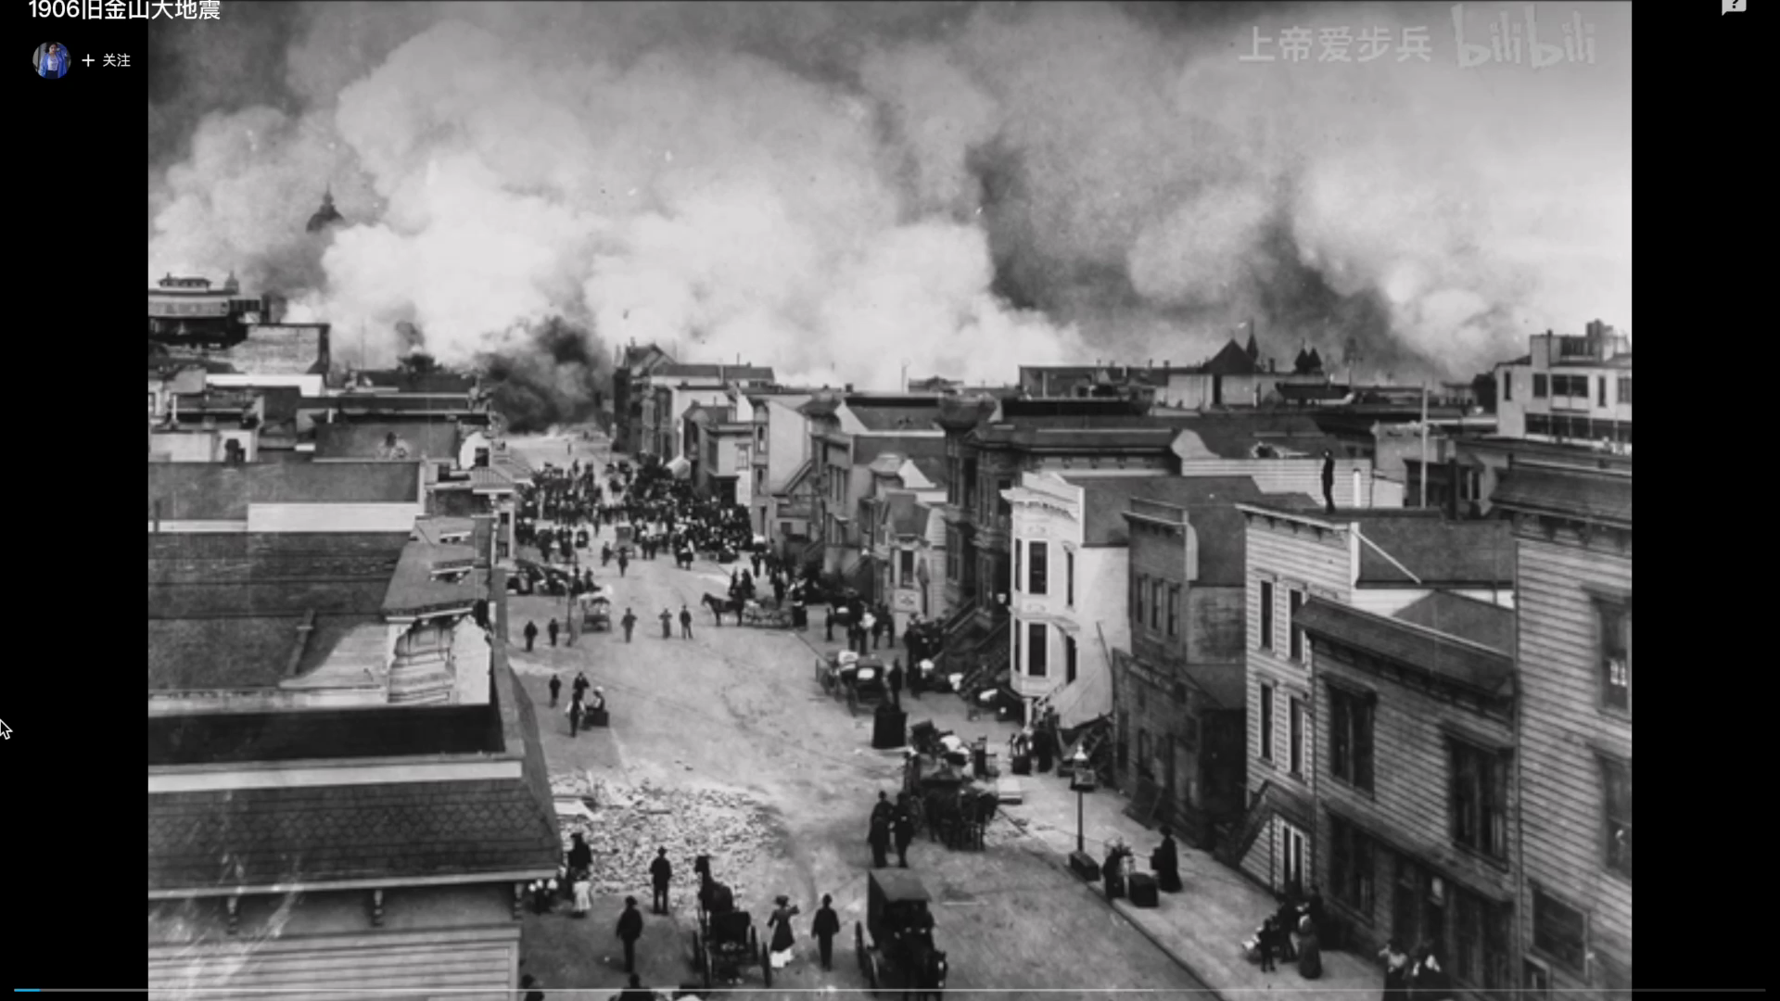
What event does the the video show?
The 1906 earthquake in San Francisco
about 3,000 people were killed;
28,000 buildings were destroyed

Slide 4
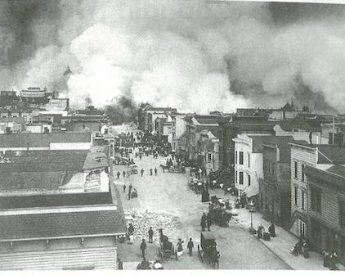
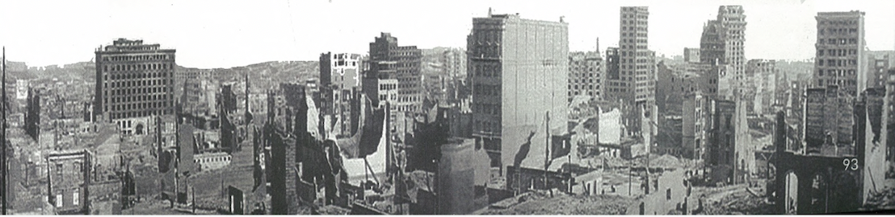
Unit 4 Natural Disasters
Eyewitness
a person who has ______________a crime, accident and can describe it afterwards.
seen/witnessed

Slide 5
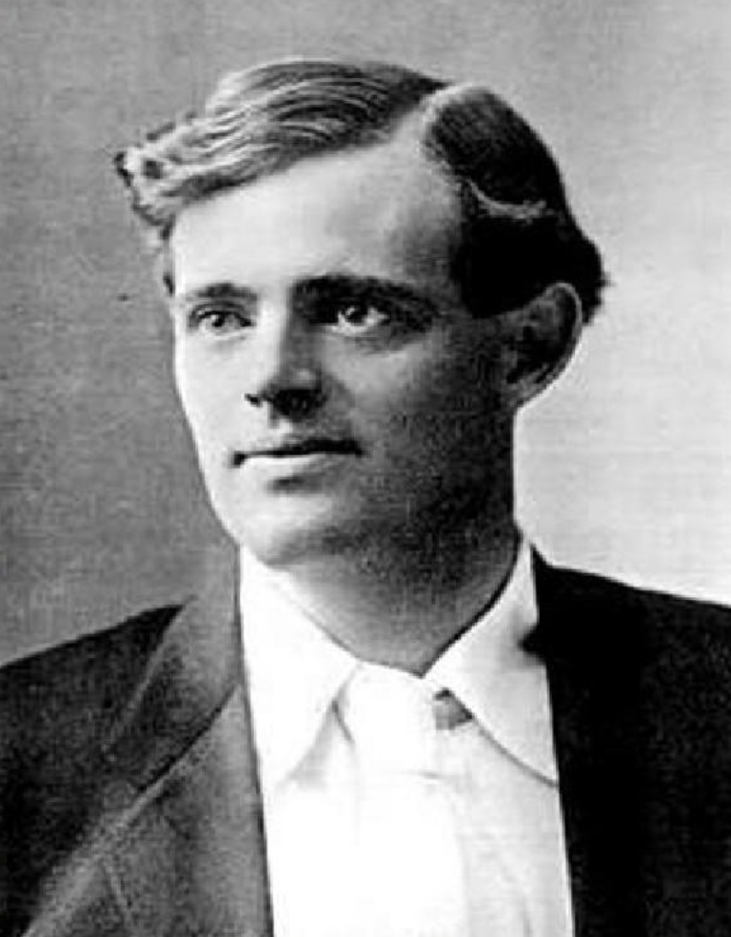
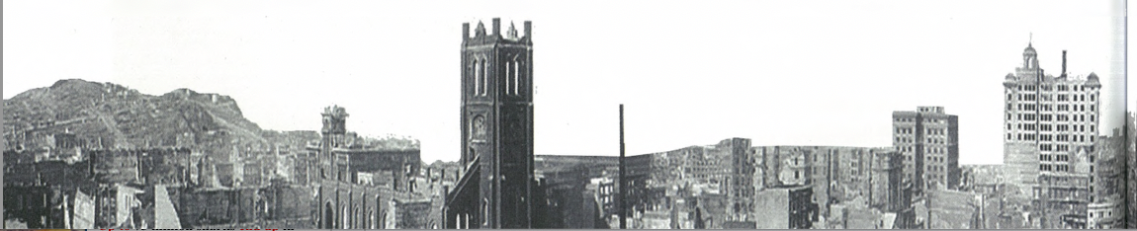
Reading for writing
The Story of an Eyewitness
Jack London
What?
a famous American novelist and journalist
How?
Jingning High School
Mao Liqin
Why?

Slide 6
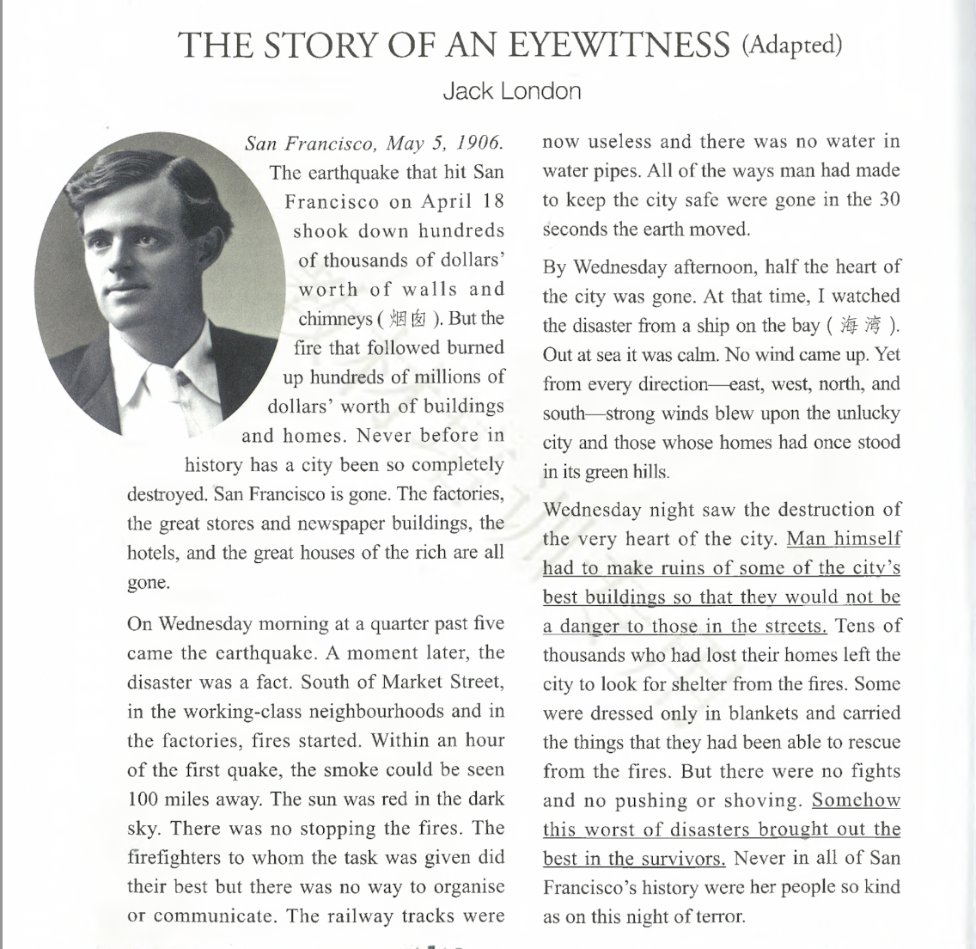
What was described?
①
disaster
the earthquake
③
the
fire
the disaster
No wind
strong winds
people
④
Man
②
Tens of
the
disaster
the earthquake
thousands who
fires
Some
Reading tip:
Find out the repeated key words or pronouns which are usually the topic of that paragraph.
fires
the smoke
they
fires
the first quake
fires
firefighters
survivors
people

Slide 7
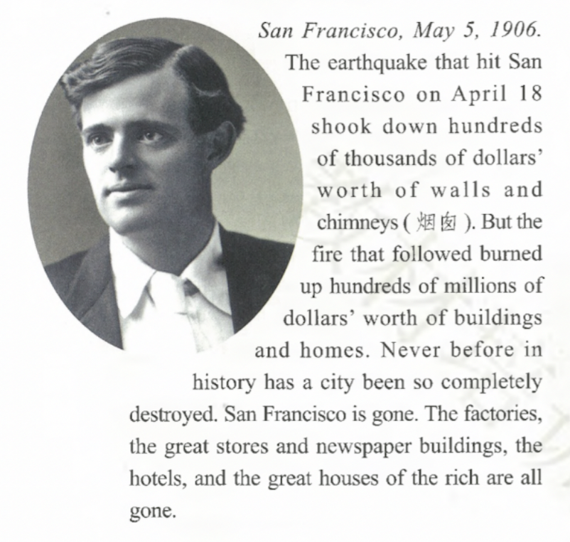
Which disaster was more destructive,
the earthquake or the fire?
Why?
numbers
contrast
Fires are more destructive

Slide 8
How destructive
was it?
Reading tip:
Try to find the language that impress you deeply.
Partial Inversion
Repetition
Why was it so
destructive?

Slide 9
Why was it so
destructive?
Repetition
Helpless

Slide 10
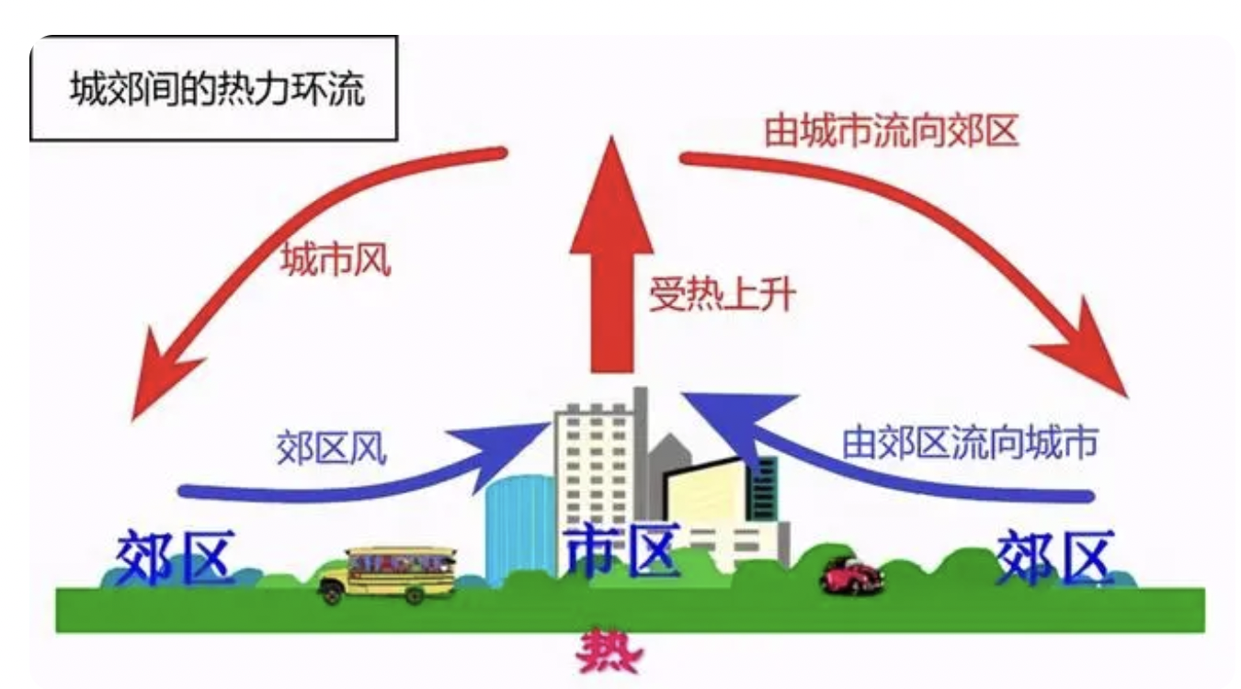

destructive fires
Fires
Vivid description
It seemed as if the world was at an end.
Numbers
Contrast
The smoke could be seen 100 miles away.
The sun was red in the dark sky.
Out at sea it was calm. No wind came up. Yet from every direction — east, west, north, and south — strong winds blew upon the unlucky city and those whose homes had once stood in its green hills.

Slide 11
kind people
people
To show strong emotion
Firefighters had to destroy some buildings that weren’t completely damaged because they worried they would fall down and hurt or injure more people.
Man himself had to make ruins of some the city’s best buildings so that they would not be a danger to those in the street.
But there were no fights and no pushing or shoving.
Somehow this worst of disasters brought out the best in the survivors.
Never in all of San Francisco’s history were her people so kind as on this night of terror.
Her people were never so kind as on this night of terror in all of San Francisco’s history.
Parallelism
Contrast
Partial Inversion

Slide 12
Thinking
What message was conveyed by the author?
Positive attitude
Hope
Never before in history has a city been so completely destroyed.
Partial Inversion
contrast
Never in all of San Francisco’s history were her people so kind as on this night of terror.

Slide 13
Reflecting: What have we learnt?
Theme: In time of disaster, people should u______ and show the wisdom to stay p_______ and rebuild for a bright future.
unify
positive
What | How
content
language
Why
significance
repetition
To impress readers deeply
destructive fires
contrast
To present vivid pictures
parallelism
people in the disaster
partial inversion
To show strong emotion

Slide 14
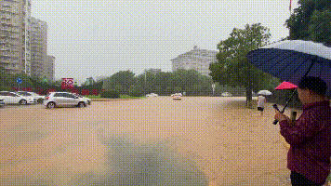
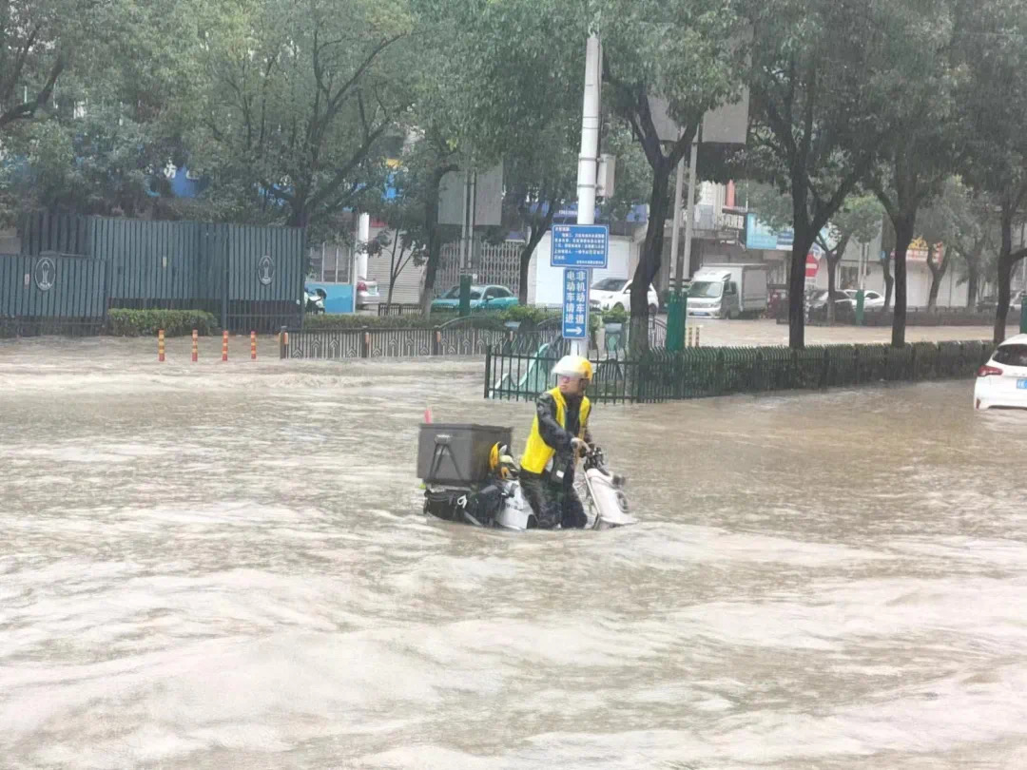
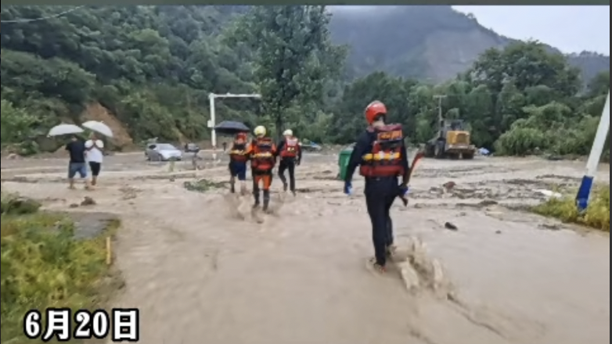
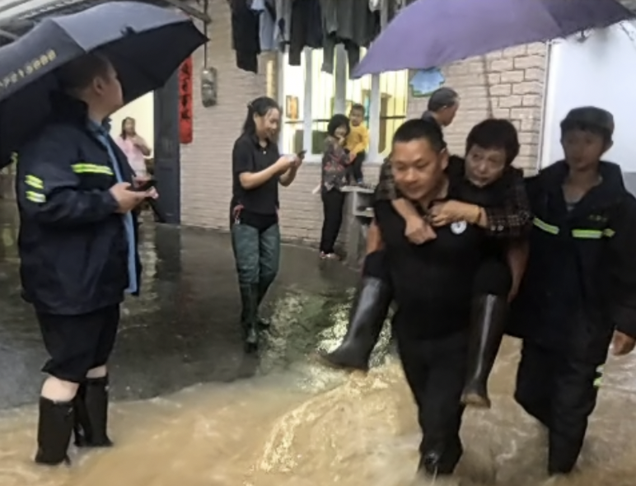
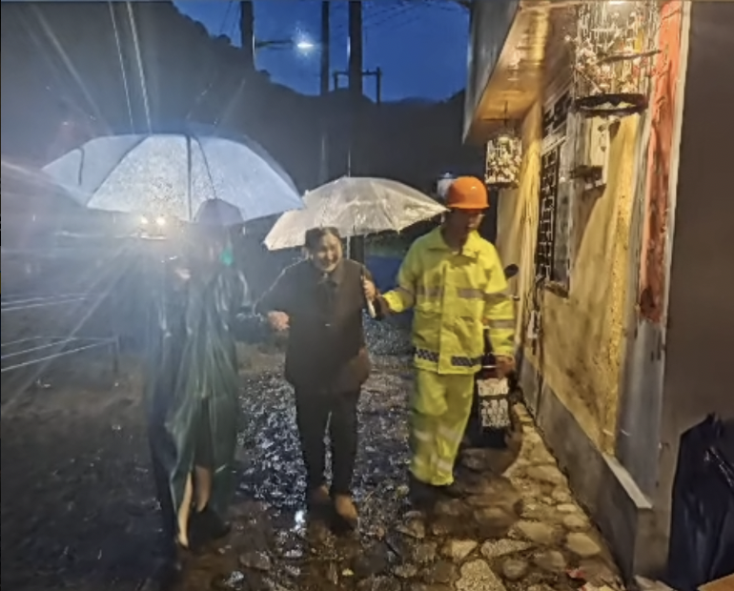
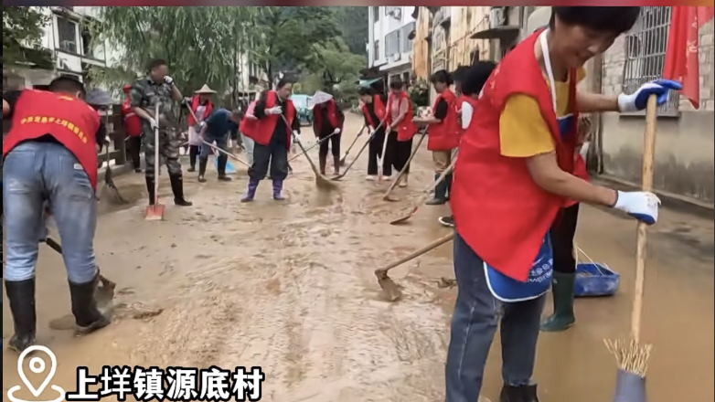
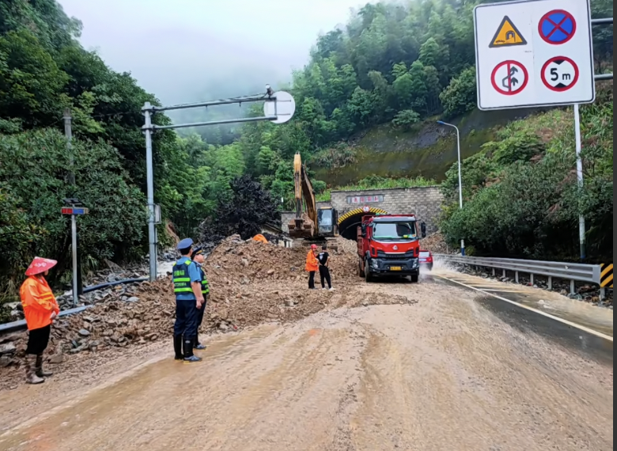
Assignment
The flood that hit Longquan on June 20, 2022 caused great damage to the city…

Slide 15
Assignment
If you are an eyewitness of the flood, write a short report of floods and try to use the figure of speech learnt in this class.
What | How
content
language
significance
repetition
To impress readers deeply
destructive floods
contrast
To present vivid pictures
parallelism
people in the disaster
To show strong emotion
partial inversion

Slide 16
Checklist
1. Is the text well-organised?
2. Does the writer use numbers, contrast, repetition and
partical inversion to show destructiveness?
3. Are there any grammar or spelling errors?
4. Is the handwriting easy to read?

