Slide 1

感恩遇见，相互成就，本课件资料仅供您个人参考、教学使用，严禁自行在网络传播，违者依知识产权法追究法律责任。
更多教学资源请关注
公众号：溯恩高中英语
知识产权声明

Slide 2
湖北省高中名校联盟2023届高三第二次联合测评
试卷讲评及二次开发
Presented by :
湖北东风高中刘彦麟 马丽君

Slide 3






TABLE OF CONTANTS
index
听力部分
阅读理解部分
难点：
3,12,13,20
难点：
23,24,27,33,
七选五
完形填空
语法填空
难点：
37, 40,
难点：
41, 43, 47
难点：
57, 61,
2

Slide 4
听力
Now… Let’s talk about
3

Slide 5

听力
Text1
1.Where does the conversation take place?
A.In a clothing store
B.In a furniture store
C.In a bookstore
M: Hello. I’ve got a couple of things I’d like to try on.Where are your changing rooms? ( 1)
W: They are over there in the corner. There is someone in there right now. Just have a seat on the chair and look through these fashion magazines.
try on 试穿；changing rooms 更衣室；look through 浏览
4

Slide 6
2.What is the probable relationship between the speakers?
A.Teammates
B.Referee and player
C.Coach and player
听力
Text2
W: Why did you blow the whistle? I didn’t do anything, I swear! That’s so unfair !
M: I’m sorry, but you cant touch the ball with your hands. Those are the rules! Free kick ! (2)
referee n.裁判；blow the whistle 吹哨；free kick 任意球
4

Slide 7
2.What is the probable relationship between the speakers?
A.Teammates
B.Referee and player
C.Coach and player
听力
Text2
W: Why did you blow the whistle? I didn’t do anything, I swear! That’s so unfair !
M: I’m sorry, but you cant touch the ball with your hands. Those are the rules! Free kick ! (2)
referee n.裁判；blow the whistle 吹哨；free kick 任意球
4

Slide 8
听力
Text3
3.What is wrong with the boy’s Jacket?
A.The zipper is broken
B.There is a hole in it.
C.Its style is ugly
M: Mom, I need a new jacket. Look what happened to this one. I can’t zip it up anymore. ( 3 )
W: Oh, what a shame! You can wear your dad’s for now.
M: But Mom!That’s the ugliest thing I’ve ever seen!
zip it up 拉上拉链；zipper n.拉链
4

Slide 9
听力
Text5
5.What can we tell from the woman’s words?
A.She is hopeful
B.She is doubtful
C.She is nervous
M: I bet you if we take the side roads, we can avoid all this traffic and still make it to the movie on time. What do you think ?
W: I wouldn’t get your hopes up.You’ll just be disappointed. We’re probably not the first people with that idea.
make it to 成功到达；get one’s hopes up让某人抱有期待；
I wouldn’t get one’s hopes up 我不会让你抱有太大希望
4

Slide 10
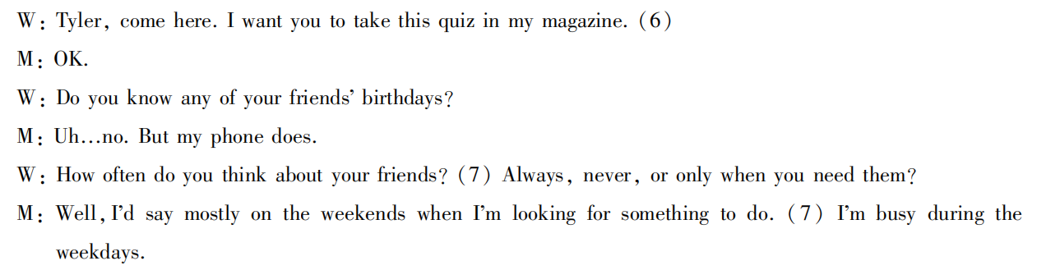
听力
Text6
6.What does the woman ask the man to do?
A.Prepare for a test B.Read a magazine C.Answer some questions
7.When does the man think about his friends?
A.When he needs advice
B.When he needs to study
C.When he wants to hang out
quiz n.知识竞赛
4

Slide 11
听力
Text7
8.Where does the man want to go?
A.On a shiing trip
B.On a camping trip
C.On a trip to Europe
9.How does the woman feel about the idea at first?
A.Enthusiastic B.Frightened C.Unwilling
10.Why does the woman change her mind in the end?
A.Her friend will be there
B.It is the perfect time of the year.
C.The man will buy her something
4

Slide 12
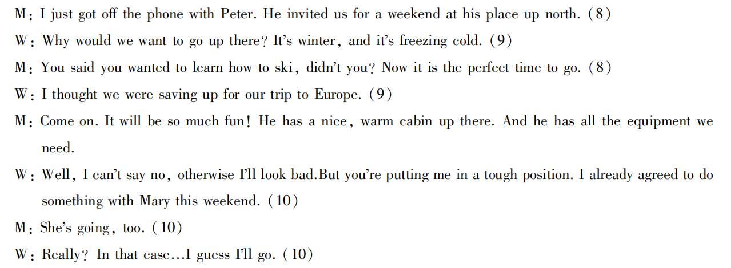
听力
Text7
get off the phone 挂电话
freezing cold非常寒冷
save up for为...攒钱
in that case 既然那样的话
4

Slide 13

听力
Text8
11.What is the man going to do? A. Get a job.
B. Go to school
C. Go travelling alone. 12. When will the man be back? A. In a year. B. In half a year. C. In about two months. 13. What is the woman doing in the conversation? A. Helping her friend check in at the airport. B. Driving her friend to the airport. C. Carrying her friend’s luggage.
4

Slide 14
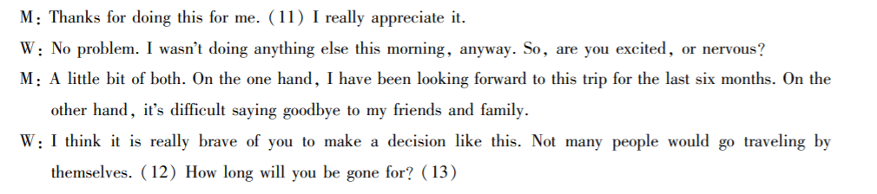
听力
Text8
4

Slide 15
听力
Text10
17.How many polar bears are there around the Arctic Circle?
A.Between 1800 and 2500
B.Between 22000 and 31000
C.Between 50000 and 52000
18.What is the main cause of the polar bears’ invasion?
A.Global warming B.Garbage C.The lack of food
19.What did the town officials advise the residents to do ?
A.Shoot the animals
B.Feed the bears
C.keep their garbage inside
20.Why will relocating the bears be so difficult?
A.The bears are hard to find
B.There is nowhere for the bears to go
C.The bears are extremely dangerous
4

Slide 16
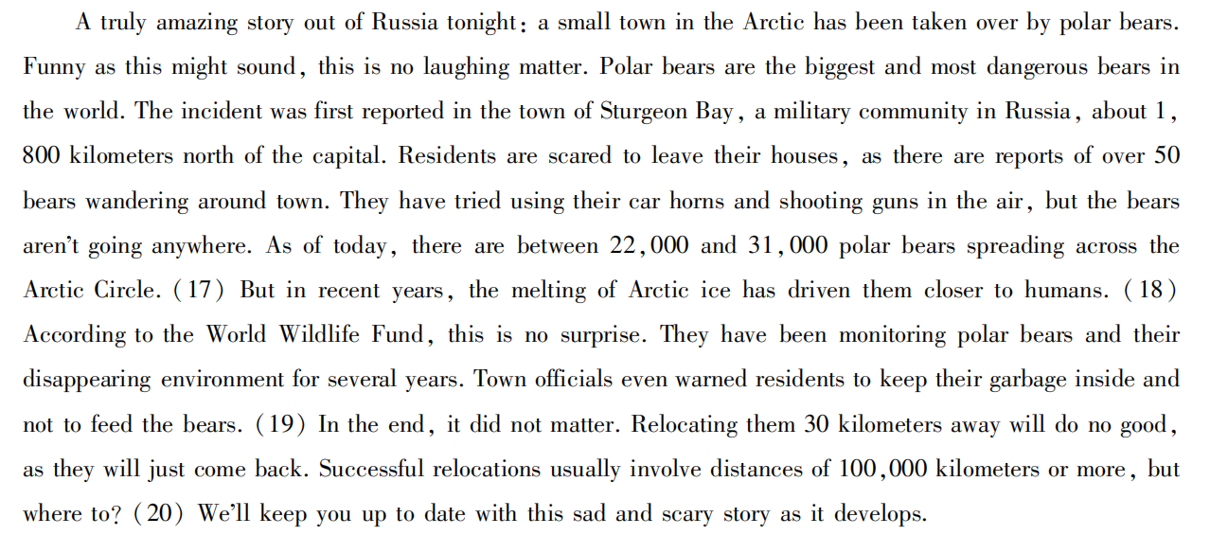
1. 接管
2. 害怕做某事
3. 向空中射击
4. 不足为奇
5. 提醒某人做...
6.搬迁；迁移
7.让你了解最新的...
4

Slide 17
阅读理解
3

Slide 18
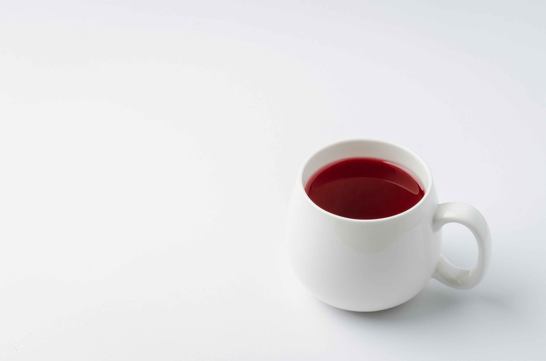
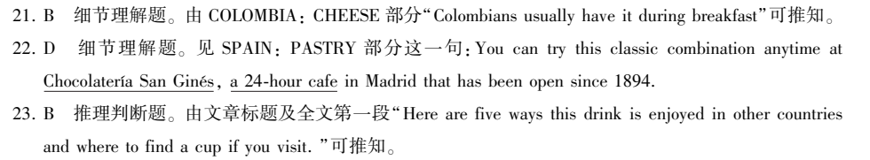
A篇 （应用文）
Four hot chocolates from around the world
There is nothing more comforting on a snowy winter ________ a steaming mug of ______________. Here are five ways this drink __________(enjoy) in other countries and where to find a cup if you visit.
than
hot chocolate
is enjoyed
4

Slide 19
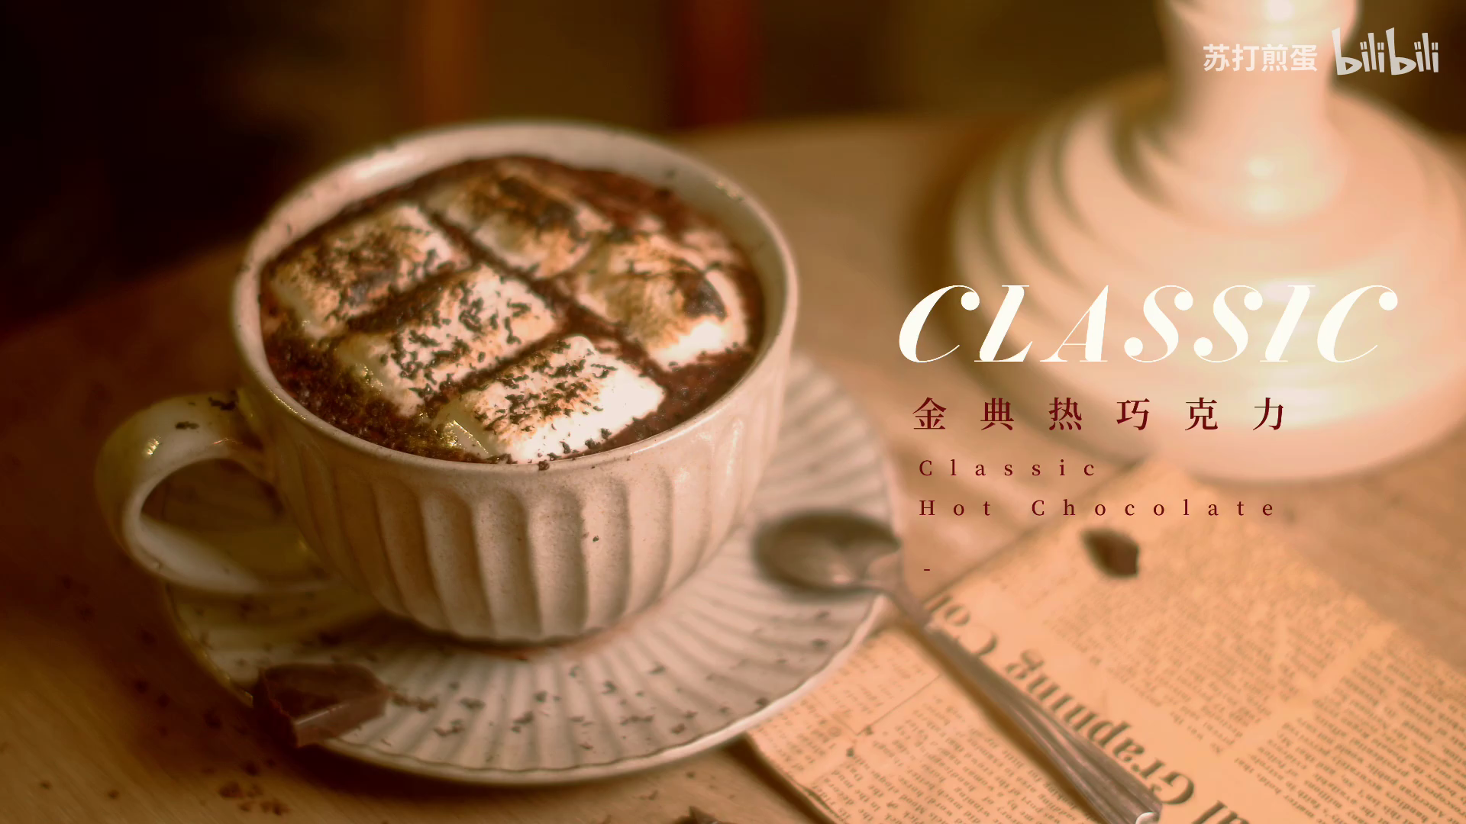
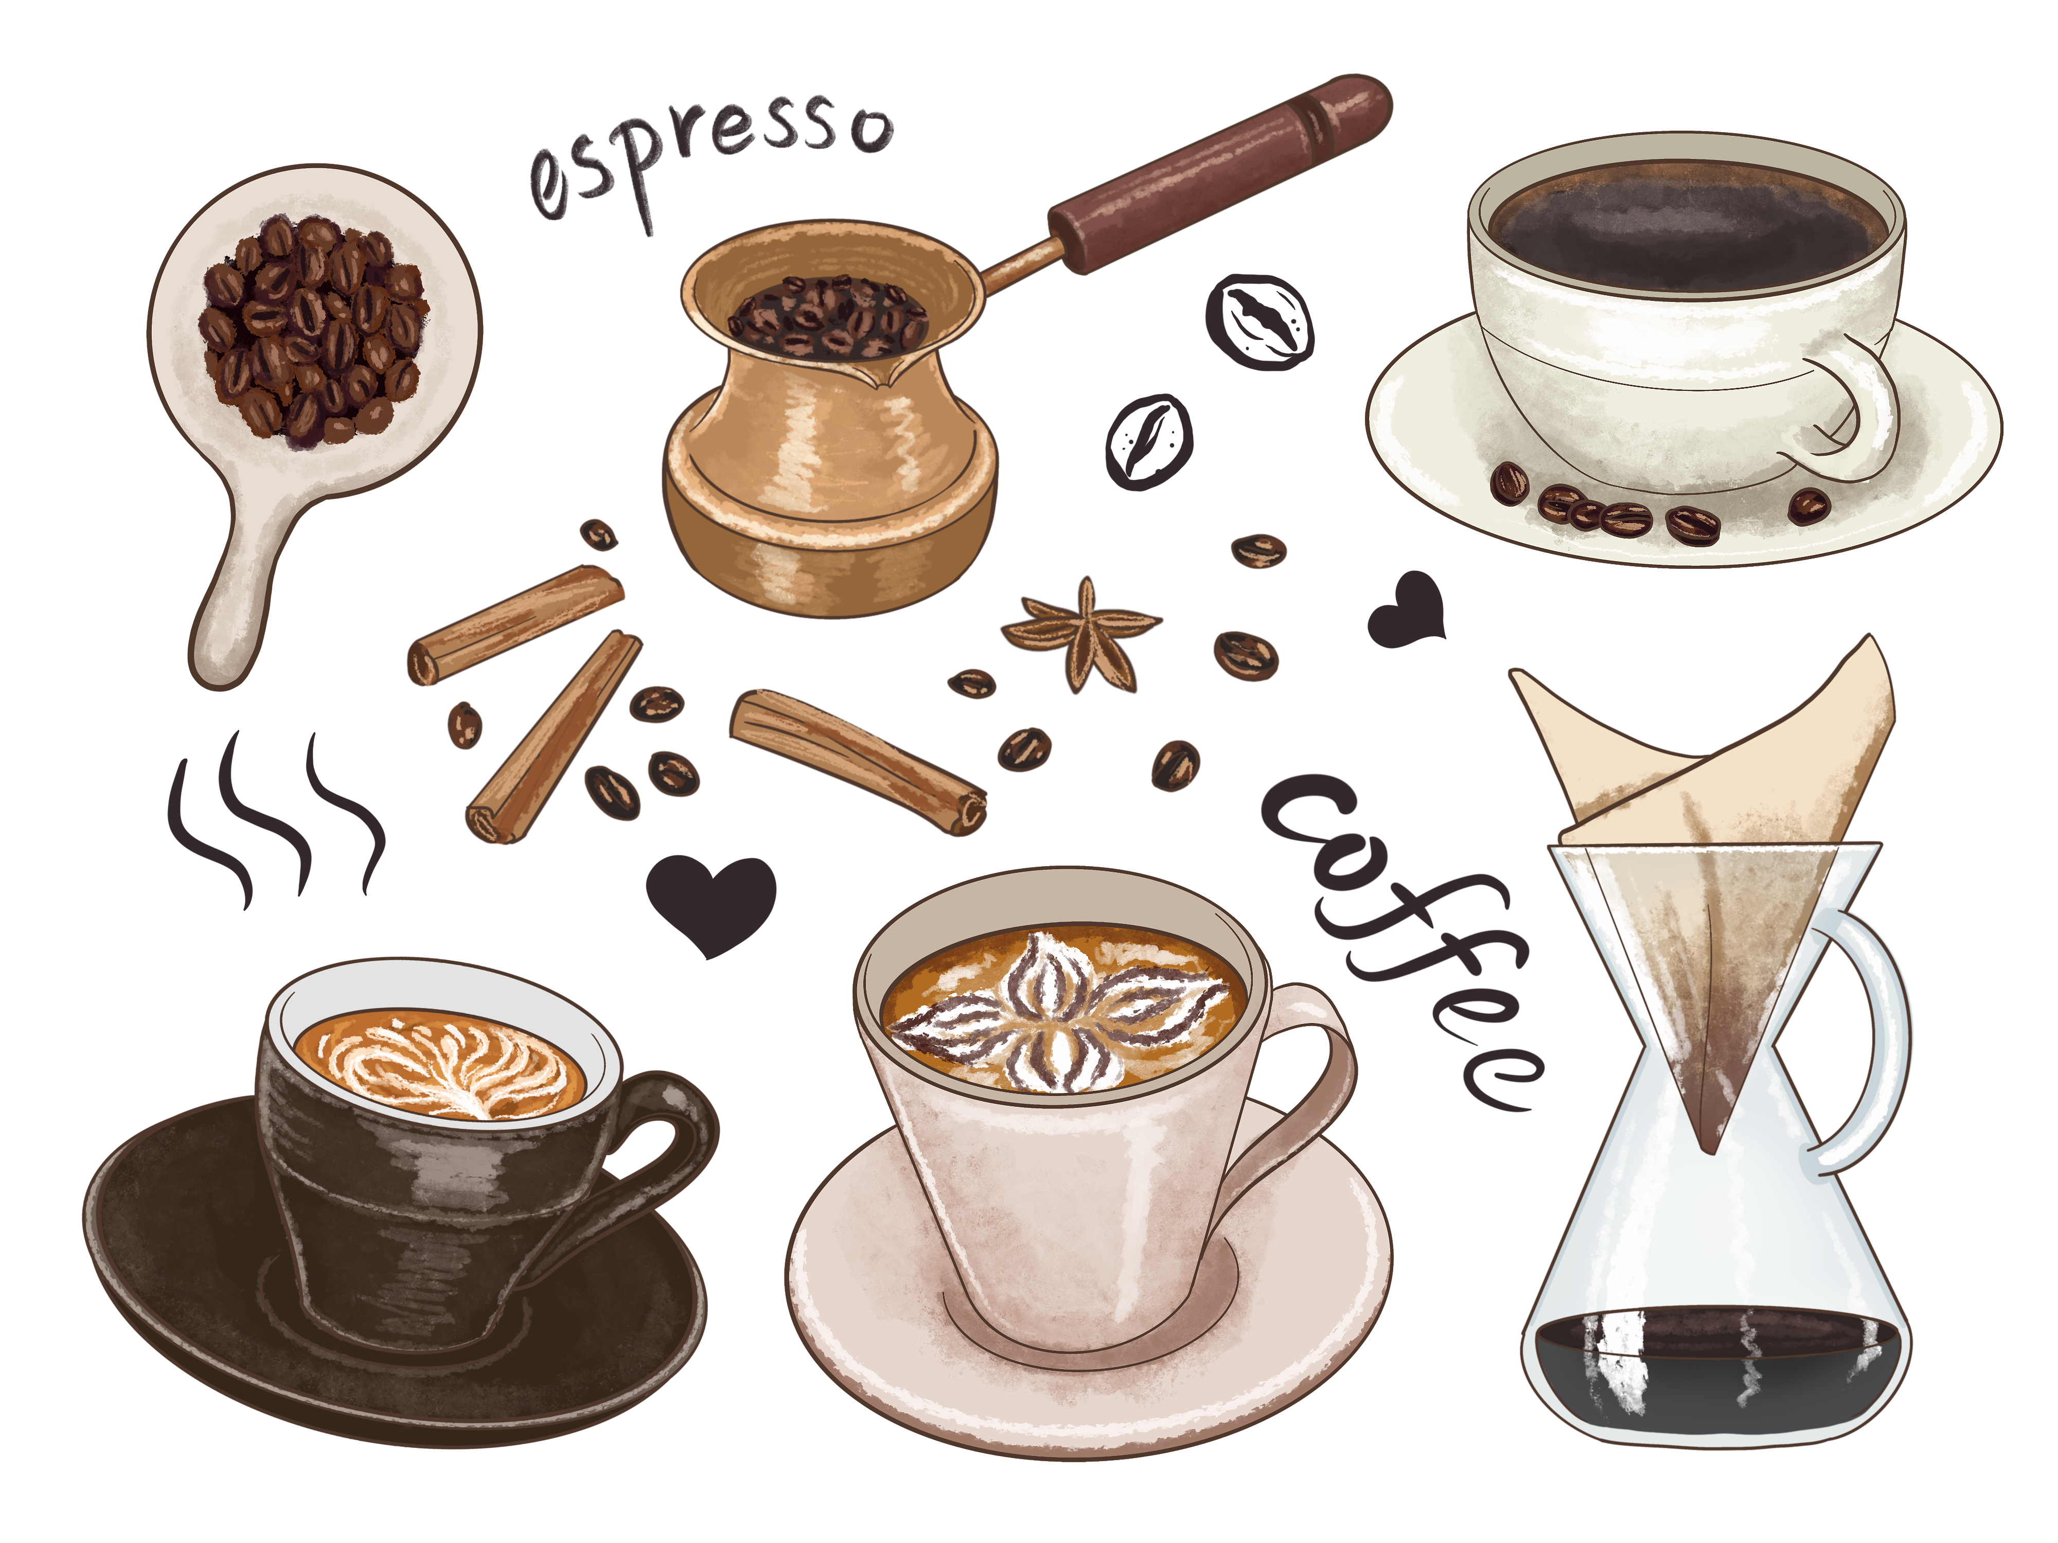
Language Appreication
1. There is nothing more comforting on a snowy winter afternoon than a steaming mug of hot chocolate.
2. For an authentic cup, head to Mexico City's Dischoso Cacao, a hip cafe dedicated to showcasing the country's cocoa and hot chocolate.
word bank
mug 马克杯 hip 时髦的
authentic 正宗的 recipe 食谱
showcase 展示 thickness 醇厚
dedicate to 致力于
5

Slide 20
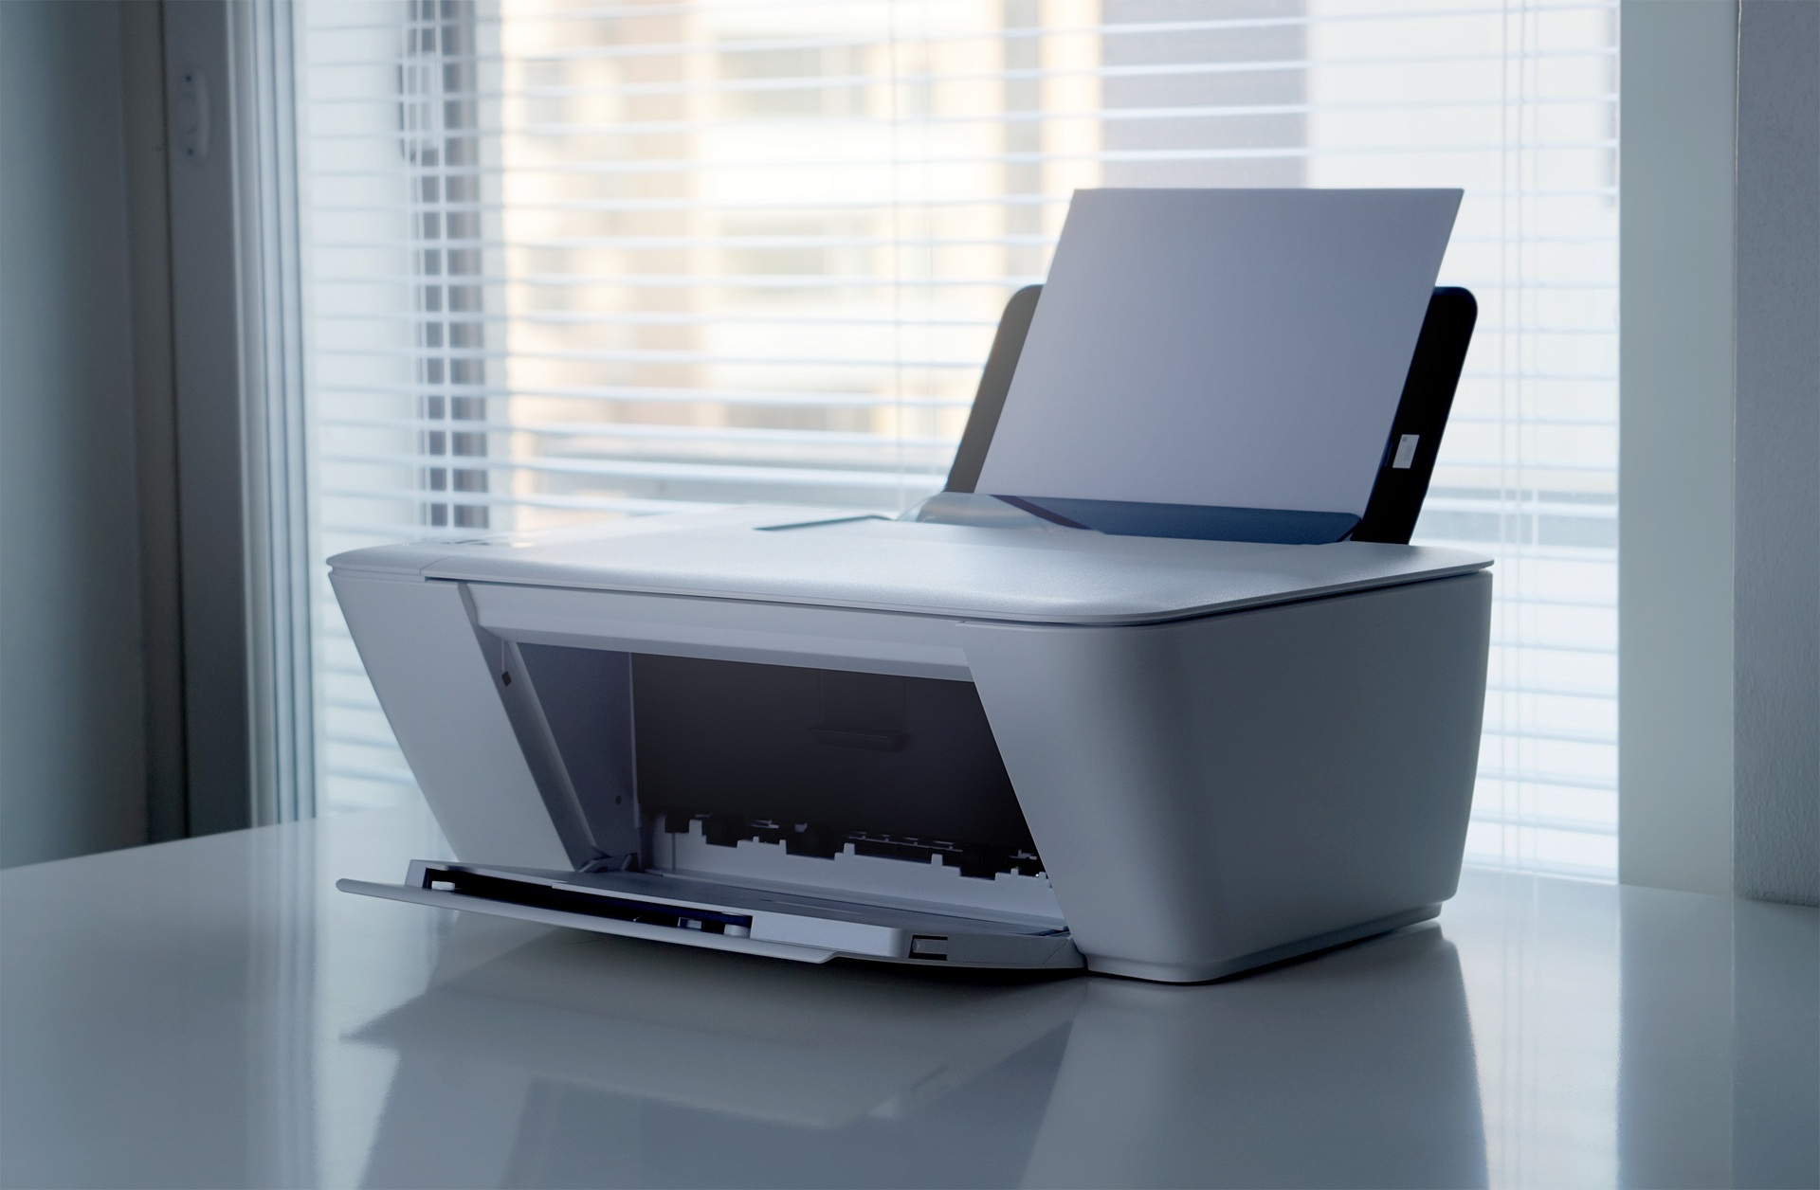
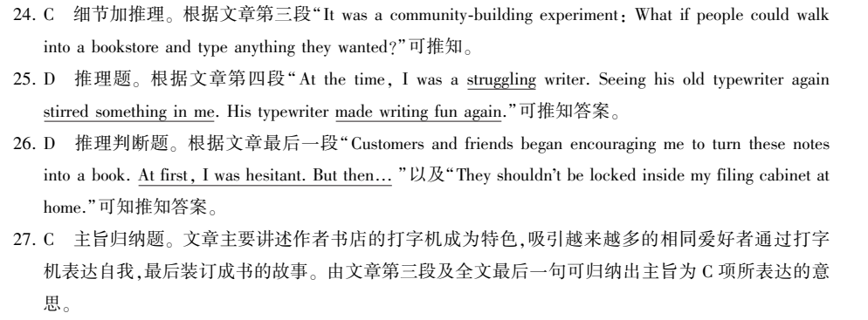
B篇 （记叙文）
Para1-3
My wife and I opened a bookstore ___________was a dream we'd shared. On the morning of the opening day, I set out a __________and wondered what if people could type anything they wanted.
注意区别 provide convenience 和provide a way for people to express themselves.
which/that
typewriter
4

Slide 21

memory
Para 4 My _____________ about my first typewriter and grandfather.
Para 5 The typewriter, _____part of our bookstore's _________(identify), had attracted many people to write down notes about themselves, all of ________inspired me to publish a book.
难题点拨：
27. What message does the text intend to convey ?
A. Nothing is impossible to a willing heart.
B. Everyone can be a writer of his own life.
C. It only takes typewriter to be an author.
D. Books are the ever-burning lamps of accumulated wisdo.
冷知识：author的词根是auth（auct的变体）意思是“增加、创造”
那么author从字面上来看就是“有创造能力的人”而writer就更好理解了
字面上看就是“写东西的人”
as
identity
which
全文线索为________________。作者在书店里放打印机的初衷是什么呢？
伏笔what if在文末得到答案了吗？
心之所愿，无所不成。
人人都能成为自己人生的作家
(你)距离作家, 只是一台打字机
书籍是积累智慧的长明灯
4

Slide 22
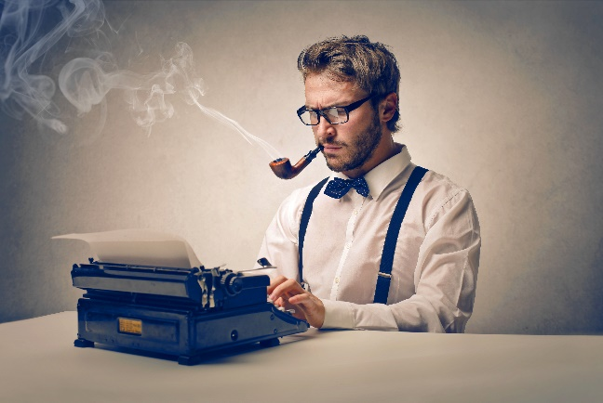

记叙文的title题要注意把握文章线索词以及作者想通过这篇文章表达的深意
Language Appreication
1. People walked inside, paged through new book, and discussed favorite authors.
2. Seeing his old typewriter again stirred something in me.
3. There is a way for people to publish directly into the world in permanent ink——spelling errors and all.
word bank
page through 翻阅
come alive 恢复生机
stir 搅拌/激发
identity身份/特征
5

Slide 23

Life
Life is like a book just like you cannot expect all the chapters or pages of your book to be that great, in the same way, you should not expect each and every chapter of your life to be that great. It is important to understand there will be a few chapters that will be very amazing and you love living them.
5

Slide 24
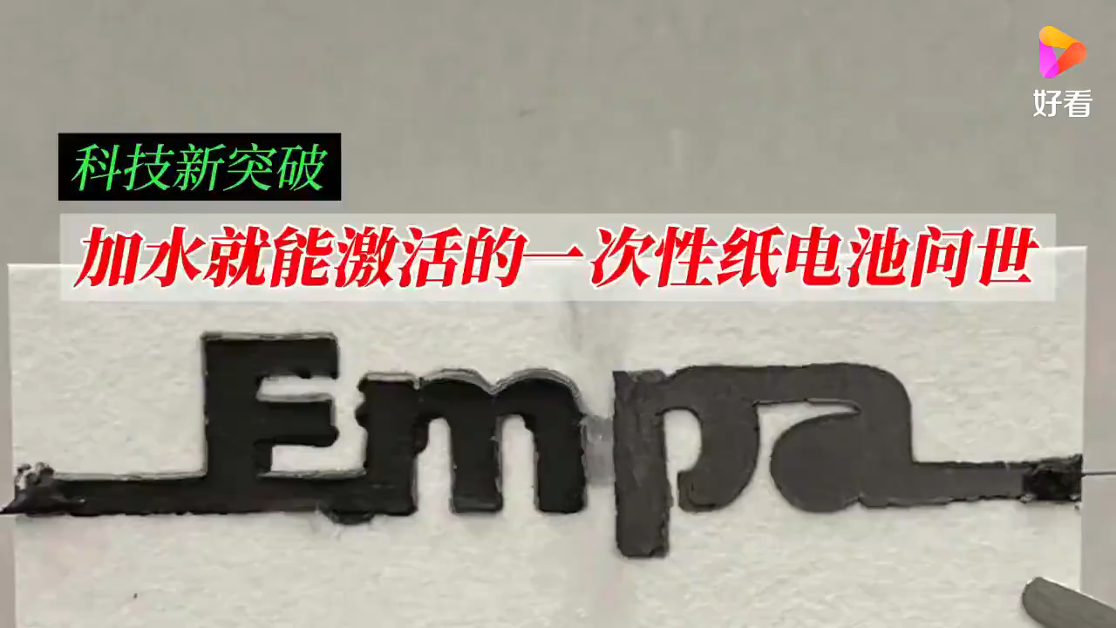
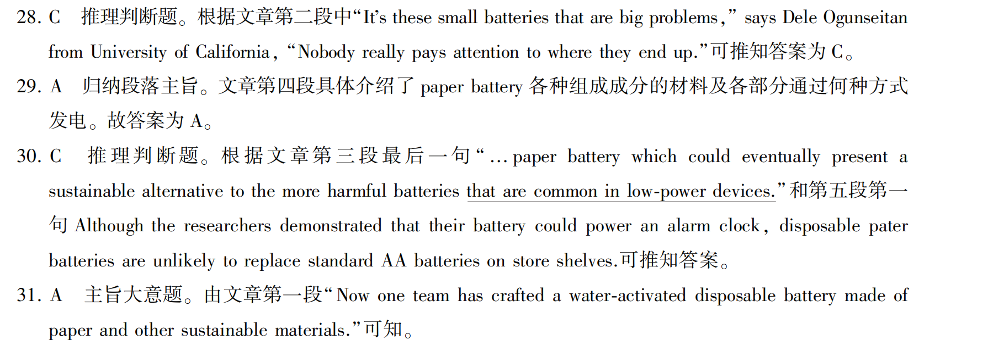
C篇 （科普文） Paper battery
4

Slide 25
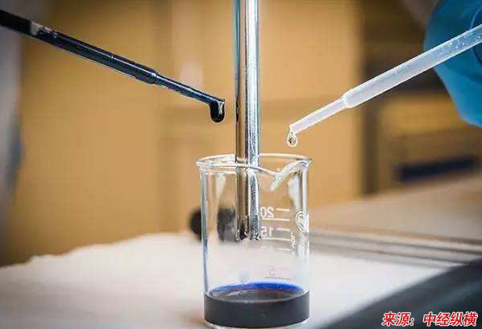
主旨段 (para1)
(背景) Thrown away electronics____________ (pile) up fast, pushing researchers to explore creative ways __________(reduce) the resulting trash, known as e-waste.
(主题) Now one team has crafted a water-activated disposable battery ________(make) of paper and other sustainable materials.
are piling
to reduce
made
难题点拨：
31. Which of the following might be the best title? A. Paper battery——just add water
B. Paper battery——replace standard ones
C. Paper battery——a mainstream product
D. Paper battery——the solution to pollution
科普文选title题要把握文章主旨段，弄清楚文章主体和文章目的。
本文以环保为背景导入，展开对主体“纸电池”的介绍——背景、构成、工作原理、不足、前景。
选题A和D对于文章中心归纳各有偏重。相对于D，A选项中的water既是其工作核心痛点，又有just强调仅仅加水的环保层面
4

Slide 26
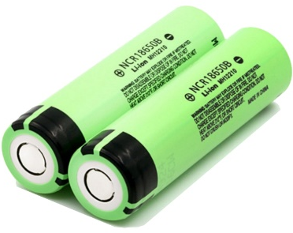
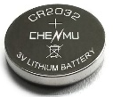
Language Appreication
1. This week they published a paper describing a new water-activated paper batter which could eventually present a sustainable alternative to the more harmful batteries that are common in low-power devices.
2. Picture a future where these batteries are inserted in environmental sensors.
3. Crucially, he says his team created the battery without compromising on sustainability criteria.
word bank
craft 制作/手工艺
e-waste 电子垃圾
activate 激活
disposal 处理
sustainable 可持续的
alternative 备选/替代
infuse 充满/浸渍
shelf-stable 耐储藏
dissolve 分解
insert 嵌入
crucially 关键地
compromise 妥协
5

Slide 27
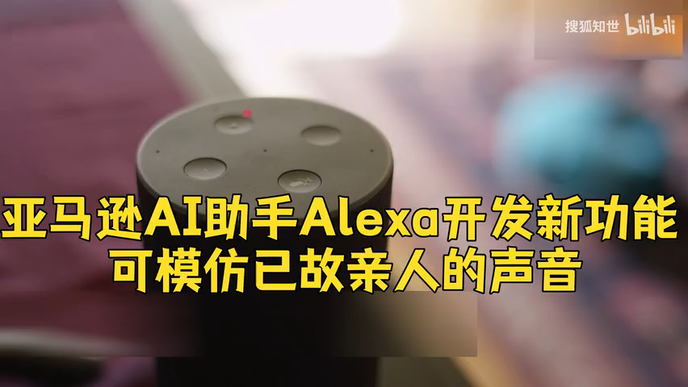
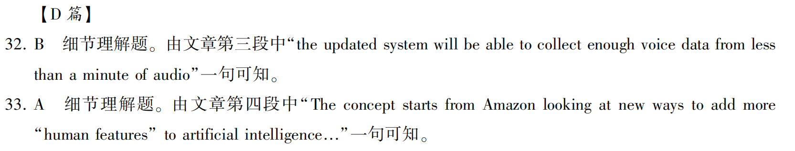
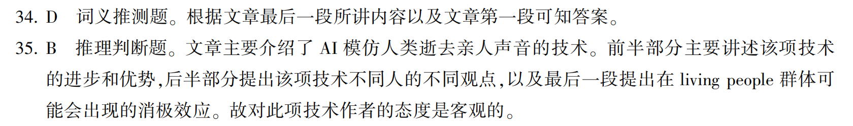
D篇 （通讯）
Amazon’s Alexa will be able to revive the voice of deceased relatives, ________(allow) users to feel as if they are speaking to lost ones beyond the grave.
allowing
4

Slide 28
难题点拨：
33. Why dose Amazon update Alexa’s voice? A. To make it more human-like.
B. To cure people’s pain of loss
C. To remind people of lost good memories
D. To demonstrate Amazon’s powerful technology.
细节理解题要注意主因和连带效果之间的区别
33题根据原文可知“这一概念始于亚马逊为人工智能添加更多”人类特征“的新方法。”这是根本原因
后文“尤其在新冠很多人失去
至亲，不失为一种纪念的方法”
这是连带效果
Language Appreication
word bank
1. Amazon’s Alexa will be able to revive the voice of deceased relatives, allowing users to feel as if they are speaking to lost ones beyond the grave.
2. While AI can’t rid that pain of loss, it can definitely make their memories last.
3. For some, they will view this as creepy or outright terrible, but for others it could be viewed in a more profound way.
revive 复原
decease 死亡
signature 签名/特征
artificial intelligence
人工智能
creepy 令人毛骨悚然
outright 完全地
Inpersonate 扮演
4

Slide 29
七选五
3

Slide 30

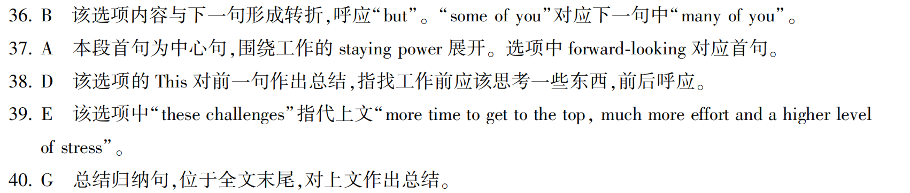
You will be leaving this school at the end of this year. Here are some things you might consider when ____________(choose) you career.
choosing
说明文重点看每段的主旨句，第二段的主题在于对“未来某些工种是否会被高科技替代”的方面，因此A选项中的forward-looking 和prospect正好切题。而G选项更倾向于总结句适合在末尾段。
难题点拨：区分A和G
We need to be forward-looking at our future prospect.
G. Thinking about a life-long career at this stage in your life is surely challenging.
4

Slide 31
完形填空
3

Slide 32
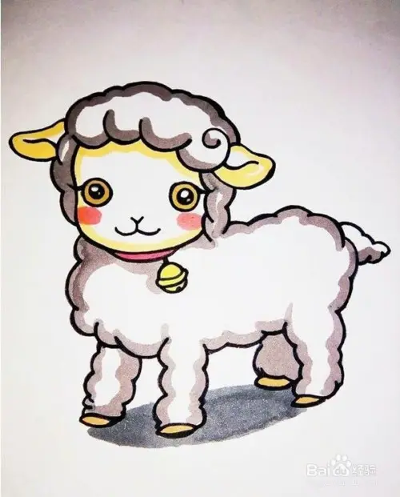
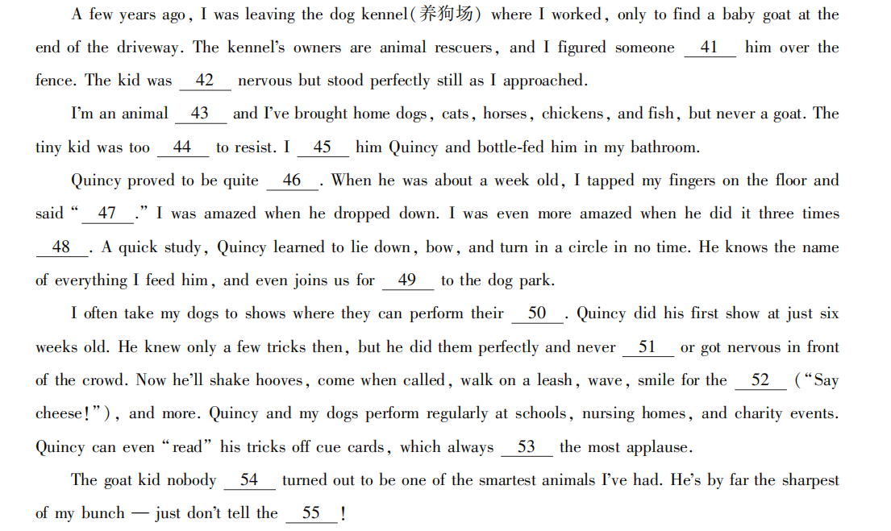

完型填空
这篇文章主要讲述了作为动物爱好者的我收养了一只被遗弃的小羊，随着慢慢熟悉起来，我发现小羊很聪明的故事。

Slide 33
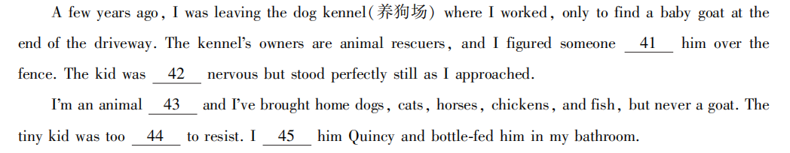
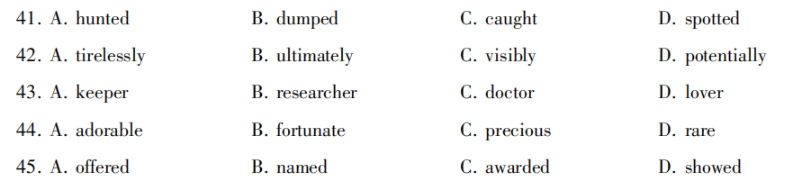
完型填空
上文讲到因为被抛弃，所以小羊明显感到很紧张
由下文brought home 和but never a goat可知，这只小羊被丢弃了，作者带回了家
丢弃/抛弃
最终
明显
潜在地
Tip:瞻前顾后；上下求索

Slide 34
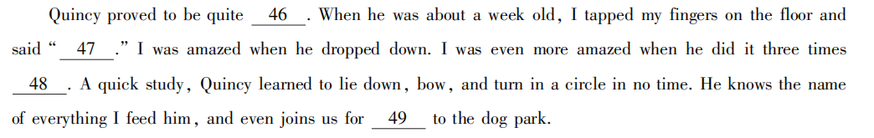
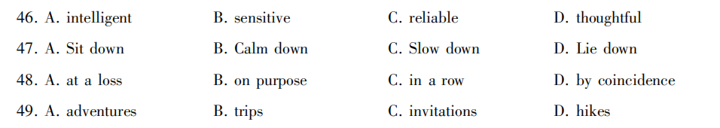
词汇复现
连续不断=on end
巧合
这里是说小羊加入了作者日常遛狗的活动
Tip:词汇复现

Slide 35
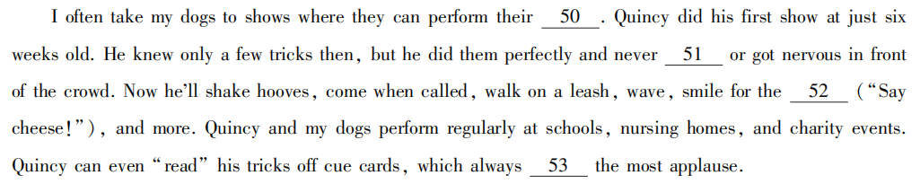
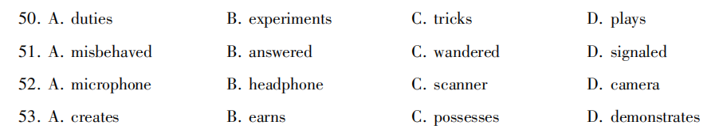
词汇复现
习惯性搭配
捣蛋
向...发信号
Tip:上下文语境和习惯性搭配

Slide 36

最后一段为总结段，往往会与第一段进行收尾呼应
与第一段dump呼应
这里作者小幽默了一下，小羊来之前，狗狗是最聪明的
Tip:反义词复现：nobody occupied 与 dump呼应

Slide 37
语法填空
Now… Let’s talk about
3

Slide 38
语法填空
In central China, there is a mysterious forests region. According to Chinese mythology, Shennong, one of the ancestors of the Chinese nation, also known as Yandi, once tested a variety of herbs himself 56.__________(find) the right one that would save the sick. Another widely circulated tale around the place is that wild men were once spotted.
神农，中国的祖先之一，尝百草为了找到可以治病的适合的草药。
主语
谓语
to find
非谓语作目的状语
4

Slide 39
Legend has it 57._______ during Shennong’s journey to find the right herb, he came across a steep mountain covered with dense forests.
Legend has it that…“据传说…”it在句子中充当形式宾语，that…是真正的宾语。
类似的结构有：Rumour has it that he was murdered.
有传言说他被杀害了。
语法填空
that
4

Slide 40
语法填空
加油站：it代替宾语从句
that
We all thought it a pity ____ the meeting should have been cancelled.
I took it for granted _____ they would always help me.
I’ll see to____ that my parents will be taken good care of.
I would appreciate it ___ you could help me.
I hate it _____ people speak to me with their mouths full of food.
I like it ________she sings a song to me.
that
it
if
when
when
4

Slide 41
He built a wooden ladder, and climbed up the mountain, 58.___________(discover) 400 kinds of medicinal herbs. In memory of his contribution to the health of society, the mountain was named Shennong-jia, which 59.________ means “Shennong ladder.”
58.动词discover 和谓语动词 built ＆ climbed 之间没有连词，所以应用非谓语形式和前文形成逻辑上的因果关系，故现在分词做结果状语
59.副词literally(按照字面意思)，修饰动词means
语法填空
discovering
literally
4

Slide 42
Shennongjia 60___________(locate) in the northwestern part of Hubei Province, bordering the Yangtze River in the south and facing the Wudang Mountains in the north.
60. 句子缺少谓语动词，因为描述神农架的地理位置，故而用一般现在时。神农架位于湖北省的西北部，南部毗邻长江，北部面向武当山。
is located
语法填空
located
变形：Shennongjia, ___________(locate) in the northwestern part of Hubei Province, borders the Yangtze River in the south and faces the Wudang Mountains in the north.
4

Slide 43
It is a place 61.________ the Daba Mountain Range and the Qinling Mountains meet.
meet: If two areas meet, especially two areas of land or sea, they are next to one another. (尤指两片地域或海域) 相接；
先行词为 place, 因后续的从句里面不缺少名词性成分, 故而选择表地点的关系副词 where
区分：It is a place _______ attracts people around the world.
It is a place _________many people visit every year.
语法填空
当定语从句中先行词为地点，原因和时间时，用关系副词还是关系代词，要先判断从句是否缺少名词性成分(主语/宾语)
where
that/which
that/which
4

Slide 44
语法填空
巩固训练
1. Gone are the days _________ we stayed together.
2. Gone are the days __________ we spent together.
3. Is this the school ___________ Xiao Hua studies?
4. Is this the school ____________ you visited yesterday?
5. There are many reasons ______ people learn a foreign language.
6.The reason ______gave us is unbelievable.
7. It was a time _______ people were divided .
when
that/which
where
which/that
why
which/that
when
4

Slide 45
an
It spans 62_______ area of around 3,250 square kilometers, with the highest peak, the Shennong Peak, reaching 3,106.2 meters in height, and the lowest point, the Shizhu River Valley, only 398 meters 63_________ sea level.
62. 不定冠词 a/an 的固定搭配 span/cover an area of...
语法填空
above
不定冠词常见的固定搭配
have a gift for有······的天赋
have a holiday度假
get a lift／ride 搭便车
pay a visit to 参观
lend sb. a hand 帮助某人
as a result 因此
as a rule通常，照例
in a hurry 匆忙地
at a distance 离一段距离
a waste of····的浪费
What a pity！真遗憾！
be／go on a diet 节食
a collection of 一批····.·
a knowledge of 知道
have a good time 玩得高兴
make a living 谋生
4

Slide 46
语法填空
One of the first things many people learn about Shennongjia 64._________(be) the tale of the wild man, but after visiting the area, they find that the pristine natural landscape and biological 65.__________(diverse) in that area add more mysteries to this solitude region.
64. 主语为“one of the first things”结构, 根据语义推出one 作主语中心语，根据时态一致原则，选用一般现在时
is
diversity
易错点：定语从句中的主谓一致
1.He is one of the boys who ________(have) helped me.
2.He is the only one of the boys who _______(have) helped me
have
has
4

Slide 47
Thank You
5

