Slide 1

感恩遇见，相互成就，本课件资料仅供您个人参考、教学使用，严禁自行在网络传播，违者依知识产权法追究法律责任。
更多教学资源请关注
公众号：溯恩高中英语
知识产权声明

Slide 2

湖北省高中名校联盟2023届高三第二次联合测评
How to write a report in English?
“新闻报道”类英语应用文
写作指导
湖北省东风高级中学 赵萍

Slide 3

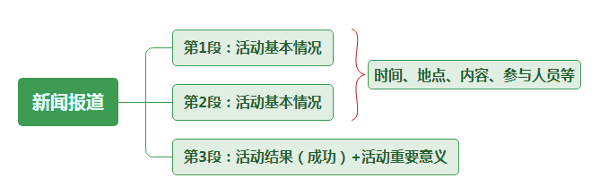
布局思维导图
(活动的目的、举办方、时间、地点等)
(活动的参与人员、内容等)

Slide 4

(湖北省高中名校联盟2023届高三第二次联合测评)假定你是李华，上周日你校举办了一场师生足球友谊赛,参赛人员为高三学生代表队对战教师代表队。请为校英文报写篇报道,内容包括:
1.比赛目的; 2.比赛过程; 3.活动反响。
注意:
1.写作词数应为80左右;
2.请按如下格式在答题卡的相应位置作答。
A Teacher-Student Football Friendly
__________________________________________________________________________________________________

Slide 5

Para 1：
提出主题

Slide 6
Para.1 提出主题
(活动的目的、举办方、时间、地点等)
必备词汇: 目的
be aimed at .../ be targeted at ...
with the purpose/aim/target/objective of doing sth
in an effort/attempt to do sth
be meant/intended/aimed to do sth

Slide 7

Translation 1:
为了丰富学生们的校园生活， 我们学校于上周日举办了一场师生足球友谊赛。
________________________________________, our school organised a friendly football match between students and teachers last Sunday.
①In an effort to enrich students' school life
②With the objective of enriching students' school life
③Aiming to enrich students' school life

Slide 8
句型升级：
______(某时间或地点) saw/witnessed ______(某活动)，which is aimed at _______(活动的目的).
翻译：为了丰富学生们的校园生活， 我们学校于上周日举办了一场师生足球友谊赛。
Last Sunday witnessed a friendly football match between students and teachers in our school, which is aimed at enriching students’ school life.

Slide 9
Para 2：
介绍活动

Slide 10
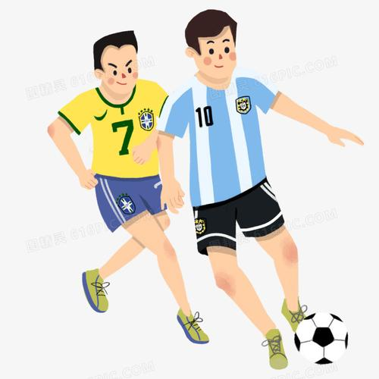
Para.2 介绍活动
(比赛过程：活动的参与人员、内容等)
必备词汇:
take an active part in / participate in参加
football field 足球场
be made up of two rounds 由两轮组成
dominated(占有优势，主导) the game
take the lead 领先
in high spirits 情绪高涨
gain a narrow victory 险胜
end in a draw(平局) of 2:2 以2:2平局结束

Slide 11

Translation 2:
①沐浴在阳光下，来自高三的运动员与他们的老师在场上竞争，而剩余的学生激动地围着场地观看。
____________________, players from Grade 3 competed against their teachers in the football field ____________ ________________________, who were watching excitedly.
Bathed in sunshine
surrounded
by all the rest students

Slide 12
②两支队伍都斗志昂扬，奋力拼搏。尽管老师们一开始处于领先优势，学生们并没有失去信心，而是努力追赶对手。
Both teams were playing at their best _________________. Although the teachers ____________________ in the game at first, the students did not _______________ and tried to _________________ their opponents.
in high spirits
took the lead
lose heart
catch up with

Slide 13
③这场比赛充满了活力和激情，最终以2:2平局。
The match _______________ great excitement and passion, __________________ of 2:2.
was filled with
ending in a draw

Slide 14
Para 3：
活动总结

Slide 15
enrich our school/
campus life
relieve stress from our study
promote friendship between teachers and students
raise the awareness of building up our body
broaden our horizon
/view
Brainstorming:
What is the meaning of a teacher-student football friendly?

Slide 16
Para.3 活动总结
(活动的反响、重要意义等)
必备词汇:
well-received adj. 深受欢迎的
enrich one’s school/campus life 丰富某人的校园生活
broaden one’s horizon/view 拓宽某人的视野
relieve stress from our study 缓解学习压力
promote friendship between ... and ... 增进...与...的友谊
raise one’s awareness of doing sth 提高某人做某事的意识
offer sb an opportunity to do sth 给某人提供做某事的机会

Slide 17

Translation 3:
这场激动人心的比赛不仅缓解了学生们紧张的学习压力，而且增进了他们与老师之间的关系。
The exciting game not only ________ _____________________________________, but also _______________ _____________________________.
relieved the students' intense pressure from study
strengthened their relationship with the teachers

Slide 18
句型升级：
Not only +部分倒装，but also + 并列句.
翻译：这场激动人心的比赛不仅帮助学生缓解了紧张的学习压力，而且增进了他们与老师之间的关系。
Not only did the exciting game relieve the students’ intense pressure, but their relationship with the teachers was also strengthened.

Slide 19
范文欣赏

Slide 20
A Teacher-Student Foothall Friendly
Last Sunday witnessed a friendly football match between students and teachers in our school, which is aimed at enriching students’ school life.
Bathed in sunshine, players from Grade 3 competed against their teachers in the football field surrounded by all the rest students, who were watching excitedly. Both teams were playing at their best in high spirits. Although the teachers took the lead in the game at first, the students did not lose heart and tried to catch up with their opponents. The match was filled with great excitement and passion, ending in a draw of 2:2.
Not only did the exciting game relieve the students’ intense pressure, but their relationship with the teachers was also strengthened.

Slide 21
考场佳作欣赏

Slide 22
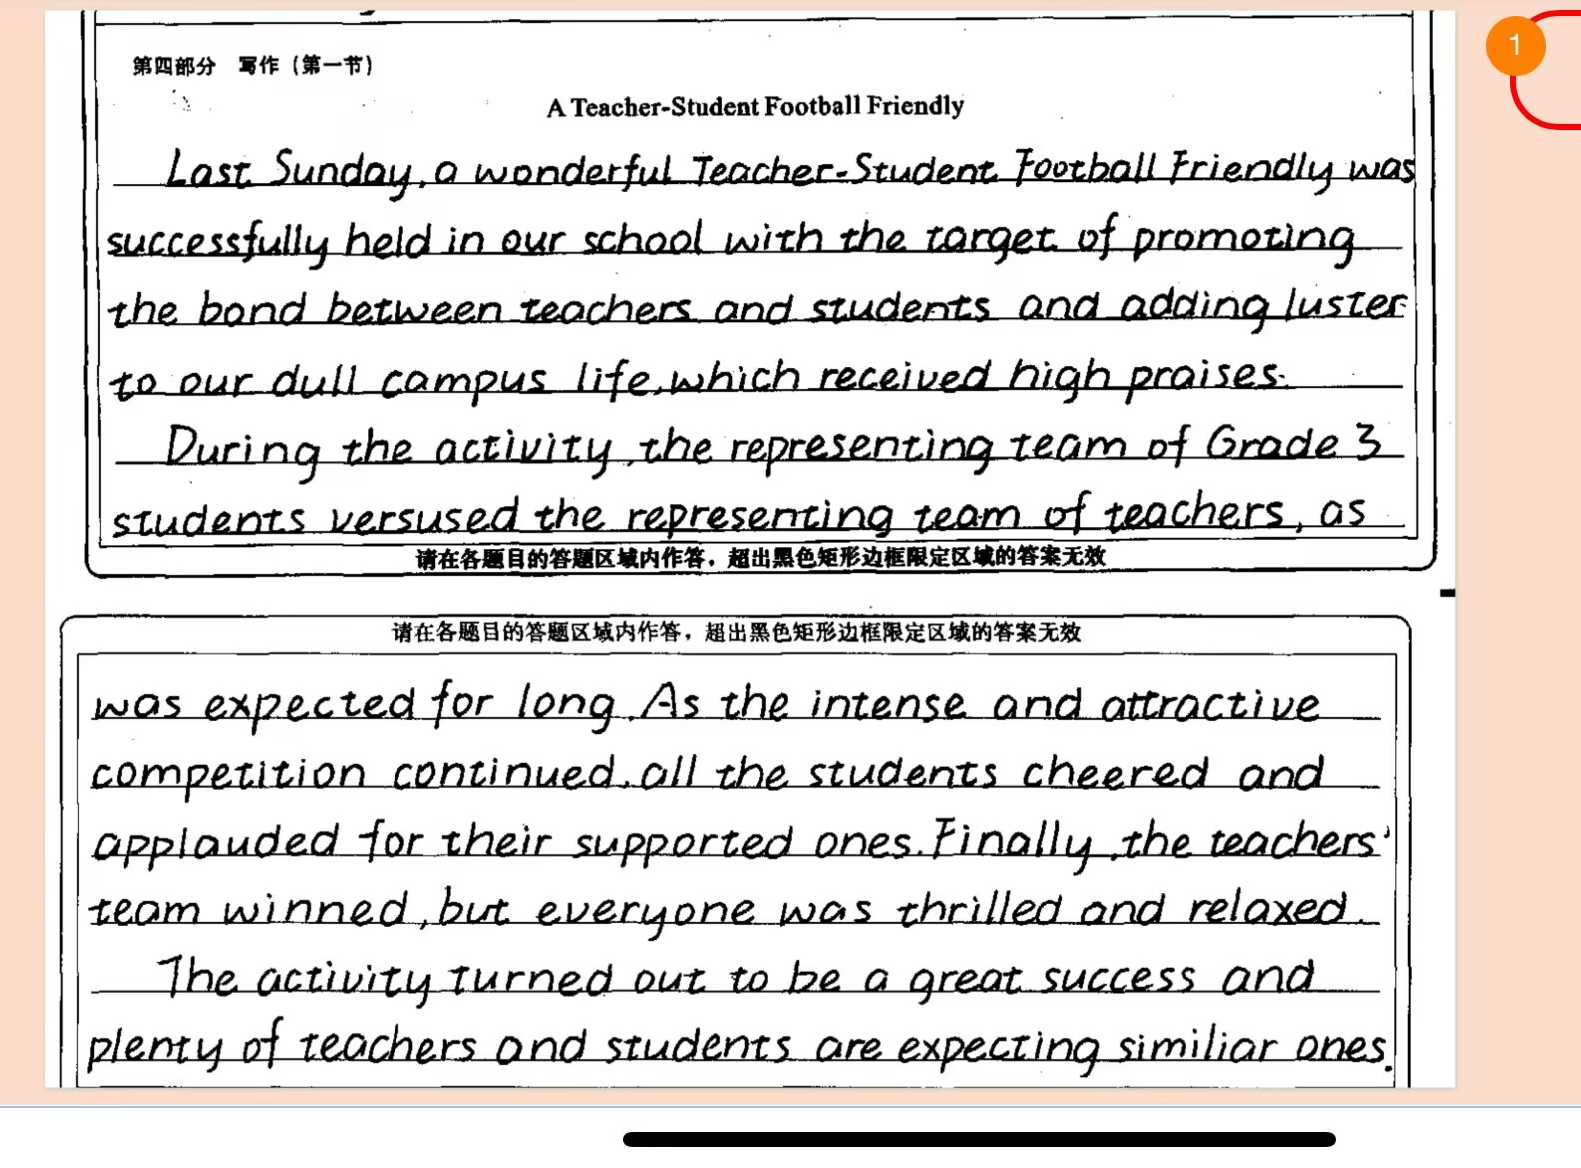
Para.1 活动的目的、举办方、时间、地点等
Para.2 活动的参与人员、过程和现场氛围等
Para.3 活动的反响、重要意义等

Slide 23
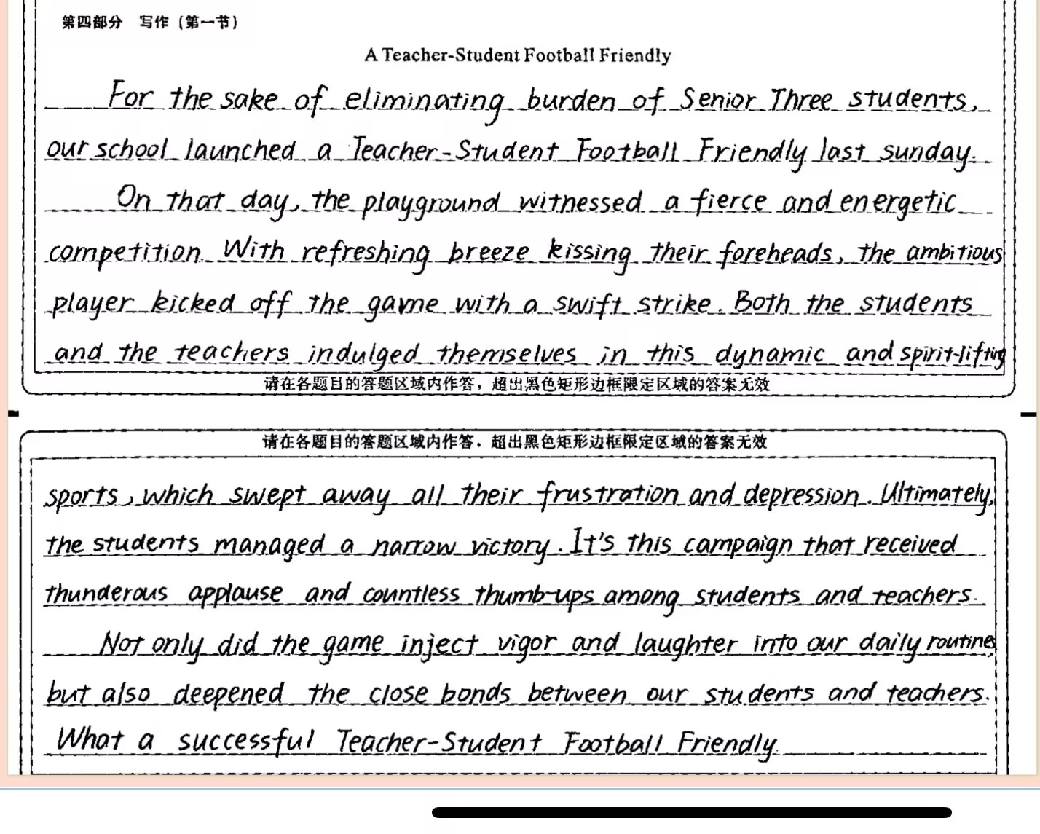
亮点一：
高级词汇与短语的表达
亮点二：
高级句型的应用

Slide 24
高分作文特点：
书写美观，卷面干净；内容完整，条理清晰；语言优美，句型高级。
Conclusion---应用文写作评分四大依据： (1) 对内容要点的覆盖情况以及表述的清楚程度和合理性。 (2) 使用词汇和语法结构的准确性、恰当性和多样性。 (3) 上下文的衔接和全文的连贯性。 (4) 单词拼写和标点符号是写作规范的重要方面，书写较差以致影响交际的，将分数降低一个档次。

Slide 25
写作随堂练

Slide 26
假定你是李华，上周六下午你校在学校举行了消防逃生演练(fire drill)。请你就此给校英文报写一篇报道，演练内容包括：
1. 消防讲座；2. 逃生演练；3. 你的评价。
注意：
1. 词数100左右；2. 可适当增加细节，以使行文连贯。
A Fire Drill in Our School
__________________________________________________________________________________________________

Slide 27
A Fire Drill in Our School
In an effort to raise our safety awareness, a fire drill was conducted in our school last Saturday afternoon.
At first, we were privileged to attend a lecture given by some firefighters invited to our school that afternoon, who showed us what to do in case of a fire, how to prevent the fire and how to use different kinds of fire-fighting equipment. Then a fire drill was held. As soon as the alarm rang, all of us students ran downstairs one by one. We finally got together at the playground safely where our teachers were waiting for us.
Through the drill, not only did we learn how to escape in an emergency, we also became aware of the importance of remaining calm in face of danger.

Slide 28


