Slide 1


感恩遇见，相互成就，本课件资料仅供您个人参考、教学使用，严禁自行在网络传播，违者依知识产权法追究法律责任。
更多教学资源请关注
公众号：溯恩高中英语
知识产权声明

Slide 2
B1U4 Natural Disasters
—— Opening Page & Listening and Speaking
Shang Jie

Slide 3
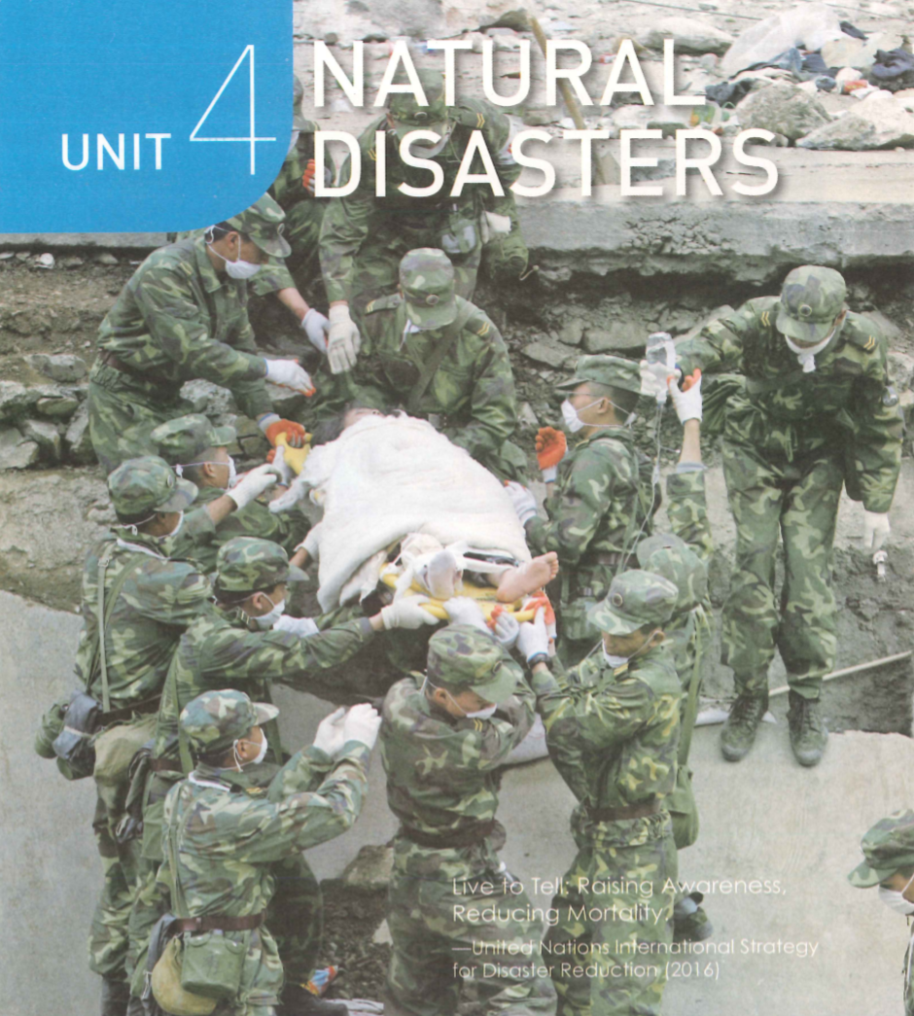
Opening Page P47
Look & Discuss:
What’s going on in this photo?
What kind of natural disasters can you think of?
A disaster rescue operation:
A team of soldiers are rescuing an injured survivor from the ruins of a collapsed building.

Slide 4
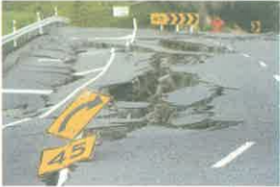
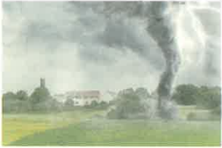
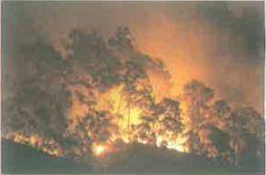
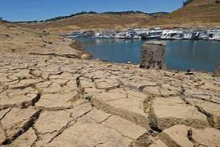
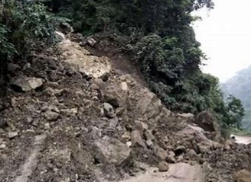
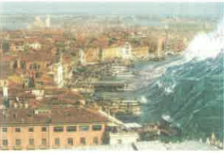
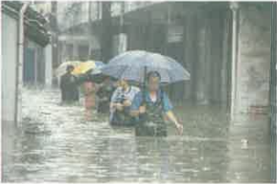
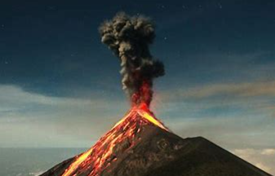
Pre-listening
Look & Give the names of the natural disasters
earthquake
tornado
wildfire
drought
landslide
tsunami
flood
volcanic eruption

Slide 5
Pre-listening
Look & Give the names of the natural disasters
earthquake
tornado
wildfire
drought
To give more details about natural disasters to the public, we need …
News Reports!
landslide
tsunami
flood
volcanic eruption

Slide 6

Pre-listening
Watch & Think: How to report natural disasters?

Slide 7
Pre-listening
Watch & Think: How to report natural disasters?
Discuss in pairs & Fill in the KWL form
 | What do you already know? | What do you want to know? | What have you learnt?
Natural Disasters News Reports
Name of disasters; ...
What should be included in the news report?
...

Slide 8


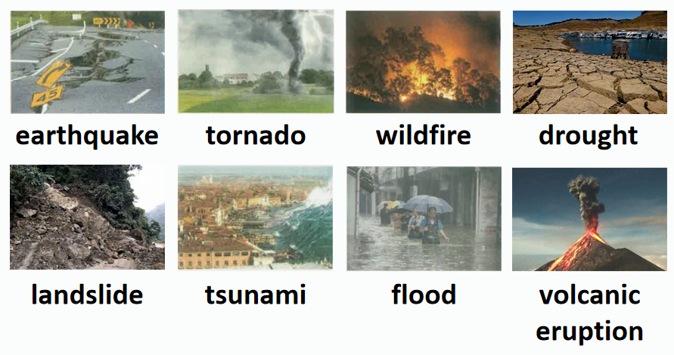
While-Listening P48 Ex2
---- Listen for gist
Listen to the news report and tick the disasters that you hear
News Report 1
News Report 3
News Report 4
News Report 2

Slide 9
While-Listening P48 Ex2
---- Listen for gist
Listen to the news report and tick the disasters that you hear
News Report 1
News Report 3
Q: What important factors are included in these reports?
News Report 4
News Report 2

Slide 10
While-Listening
What important factors are included in these reports?
Content of News Report
Reports | Time | Place | Disaster | Damage | Rescue

Slide 11
While-Listening
---- Listen for details
Tenses in News Reports
Listen again and fill in the form
Reports | Time | Place | Disaster | Damage | Rescue
News report 1 | 16 April | Ecuador | ______ | The disaster damaged ____________. About 230 people _________ and more than 1,500 ________. | ________ and _______________ are helping the survivors.
News report 2 | ____ | ______ | floods | _______________ have been destroyed, but no one ___________. | _______ and _____ are working day and night. They are also bringing _____.
Volunteers
many buildings
rescue workers
earthquake
were killed
were injured
Rescue workers
Homes and lands
soldiers
27 March
central China
has been killed
food & water

Slide 12
While-Listening
---- Listen for details
Tenses in News Reports
Listen again and fill in the form
Reports | Time | Place | Disaster | Damage | Rescue
News report 3 | ____ | southern Memphis | ______ | __________ were destroyed and at least ______ person has died. | The police advise ____________.
News report 4 | ____ | ______ | ______ | ________ was injured. A library, a supermarket, and ___________ were damaged.
Four homes
12 August
tornado
one
avoiding the area
No one
21 July
Seoul
landslide
several cars

Slide 13
Post-Listening
Activity1: Read like news reporters
News Report 1
Good morning, it's 17 April. A strong earthquake hit Ecuador yesterday. The 7.8-magnitude earthquake damaged many buildings, and early reports said that about 230 people were killed and more than 1,500 were injured. Volunteers and rescue workers are helping the survivors.

Slide 14
Post-Listening
Activity1: Read like news reporters
News Report 2
Good evening. Today is 27 March. More news about the floods in central China. The government is helping more than 12,000 people in Hunan and Jiangxi get away from the rising water. Homes and land have been destroyed, but no one has been killed. Rescue workers and soldiers are working day and night to make sure that people are safe. They are also bringing food and water to those whose homes were lost in the disaster.

Slide 15
Post-Listening
Activity1: Read like news reporters
News Report 3
Breaking news, Saturday 12 August. A tornado was just seen in southern Memphis. Eyewitnesses said that at 9:25 a.m., the tornado destroyed four homes. A police officer tells us that at least one person has died. More tornados are possible, and the police advise avoiding the area.

Slide 16
Post-Listening
Activity1: Read like news reporters
News Report 4
And in Seoul, a landslide damaged a library and a supermarket in a southern neighbourhood. The landslide was caused by the heavy rain that has fallen in Seoul over the past week. According to the police, no one was injured in the landslide, but several cars were damaged. Those are the top news for today, Wednesday 21 July.

Slide 17
Post-Listening
Brief Summary: How to report natural disasters?
Content
Tense
Time
Place
Disaster
Simple Past
(Eg: A strong earthquake hit Ecuador yesterday. )
Simple Past/Present Perfect
(Eg: ... about 230 people were killed./ Homes and land have been destroyed. )
Damage
Present Continuous
(Eg: Rescue workers and soldiers are working day and night. )
Rescue
Other Features
Greetings: Good morning/ Good evening/ Breaking news ...
Concise/Specific/Objective

Slide 18
Post-Listening
Activity2 P49: Prepare in groups & Report natural disasters
Earthquake
Wenchuan, China
Wildfire
Alberta, Canada
Flood
Colombo, Sri Lanka
14:28 Monday, 12 May
Magnitude 7.8 (8.0)
At least 8,500 killed (by 13 May)
Rescue workers (medical teams, troops,volunteers, etc.) organized quickly
Began on 1 May
2,400 homes destroyed
Almost 88,000 people evacuated
Hundreds of firefighters arrived
Planes, helicopters used to fight the fire
No deaths, no injures
Began in May
82 killed, 500,000 affected
Rescue teams provide food and water
Shelters set up by the government

Slide 19
Post-Listening
Marking Criteria: Report natural disasters
Content
5 points
Tense
3 points
Time
Place
Disaster
Simple Past
(Eg: A strong earthquake hit Ecuador yesterday. )
Simple Past/Present Perfect
(Eg: ... about 230 people were killed./ Homes and land have been destroyed. )
Damage
Present Continuous
(Eg: Rescue workers and soldiers are working day and night. )
Rescue
Other Features
2 points
Greetings: Good morning/ Good evening/ Breaking news ...
Concise/Specific/Objective

Slide 20
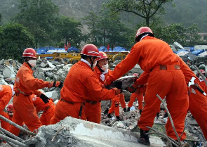

Post-Listening
Activity2 P49: Prepare in groups & Report natural disasters
Reporting Time
Earthquake
Wenchuan, China

Slide 21
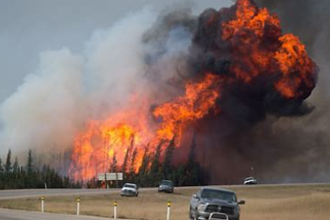
Post-Listening
Activity2 P49: Prepare in groups & Report natural disasters
Reporting Time
Wildfire
Alberta, Canada

Slide 22
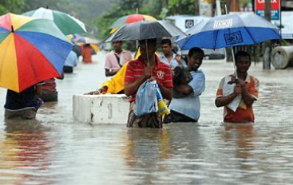
Post-Listening
Activity2 P49: Prepare in groups & Report natural disasters
Reporting Time
Flood
Colombo, Sri Lanka

Slide 23
Post-Listening
Activity2 P49: Prepare in groups & Report natural disasters
Sample
Good morning. Today is 13 May. A huge earthquake hit Wenchuan, China yesterday. It has killed at least 8,500 people by now. The earthquake measured 7.8 on the Richter scale. Injured survivors have been moved to safety by rescue workers, including medical workers, troops, and volunteers, who organised quickly.
Earthquake
Wenchuan, China

Slide 24
Post-Listening
Activity2 P49: Prepare in groups & Report natural disasters
Sample
A wildfire which began on 1 May
in Alberta, Canada, has destroyed
2,400 homes. Almost 88,000 people
have been evacuated. Hundreds of
firefighters along with planes and
helicopters have arrived to help fight
the fire. Luckily, there have been no
deaths or injuries.
Wildfire
Alberta, Canada

Slide 25
Post-Listening
Activity2 P49: Prepare in groups & Report natural disasters
Sample
A flood in Colombo, Sri Lanka, has
killed 82 people. The flood, which
began in May, has affected nearly
500,000 people. Rescue teams
are providing food and water, and
shelters have been set up by the
government.
Flood
Colombo, Sri Lanka

Slide 26
Post-Listening
Homework
Work in pairs & finish the KWL form
 | What do you already know? | What do you want to know? | What have you learnt?
Natural Disasters News Reports
Read the article from China Daily & Make a short news report Typhoon damages crops in Guangdong https://www.chinadaily.com.cn/a/202207/04/WS62c2aa16a310fd2b29e6a443.html

Slide 27
THANK YOU
Live to Tell:
Raising Awareness, Reducing Mortality.
---- United Nations International Strategy for Disaster Reduction (2016)

