Slide 1

感恩遇见，相互成就，本课件资料仅供您个人参考、教学使用，严禁自行在网络传播，违者依知识产权法追究法律责任。
更多教学资源请关注
公众号：溯恩高中英语
知识产权声明

Slide 2
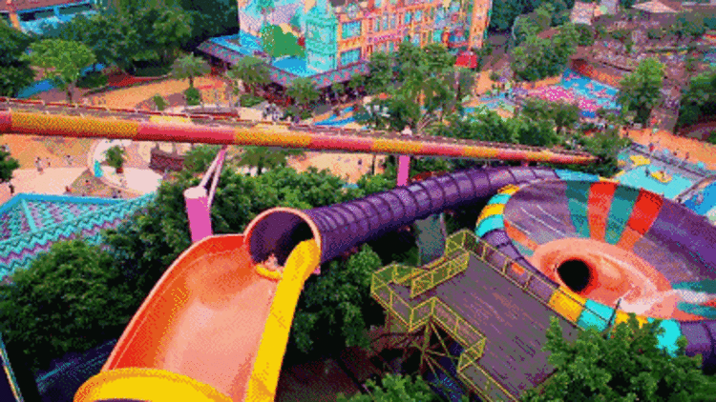
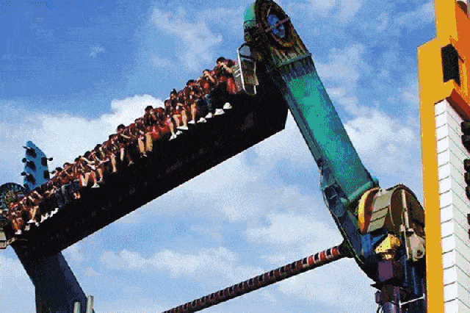
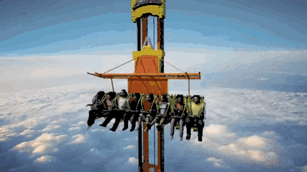
Unit 3 Fascinating Parks
Explore theme parks and write about a park
Zhuji High School Jeanie

Slide 3
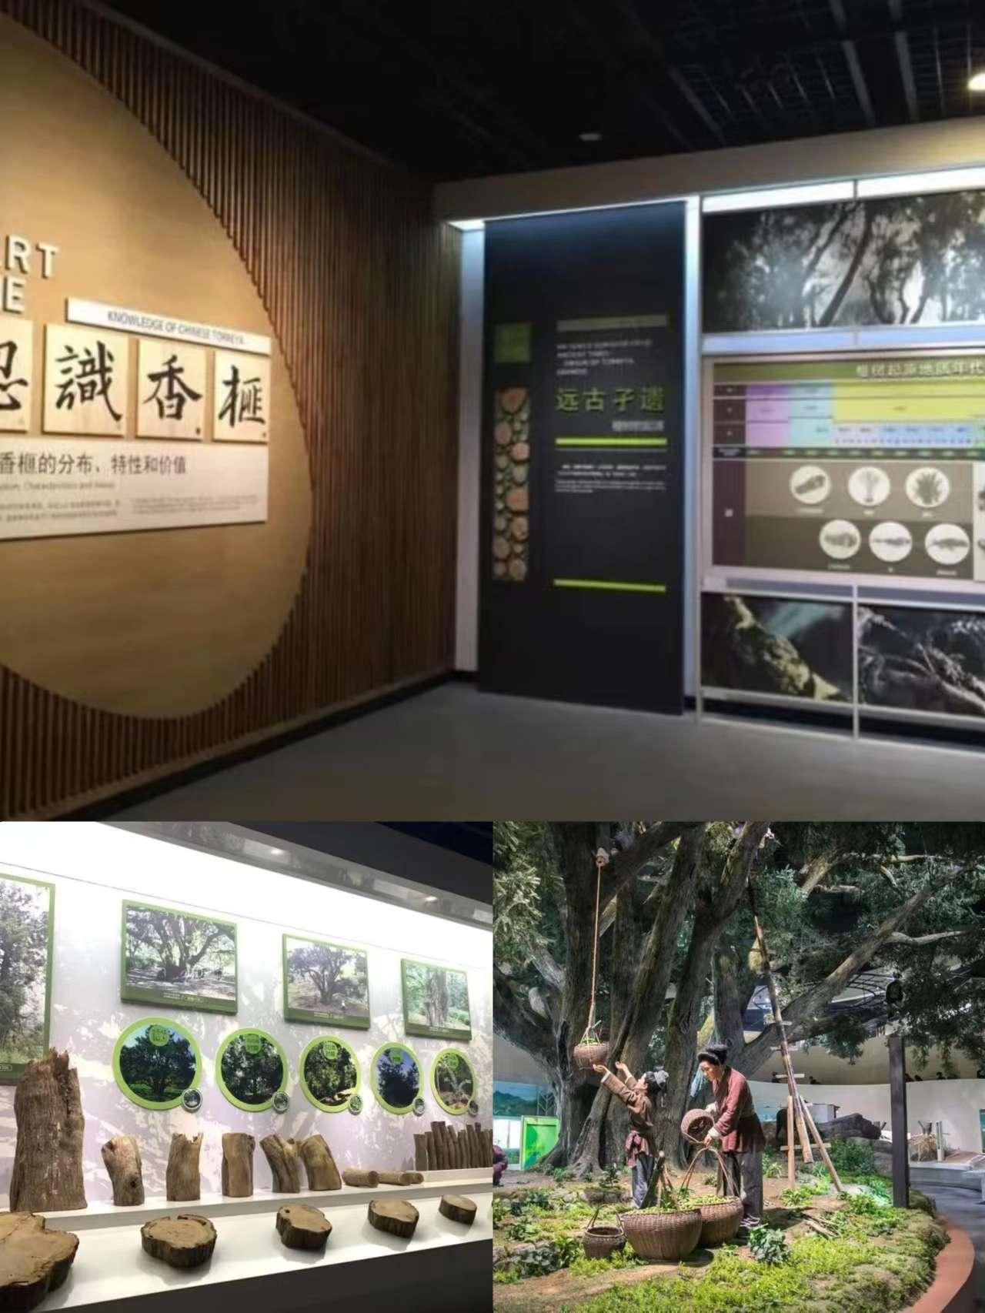
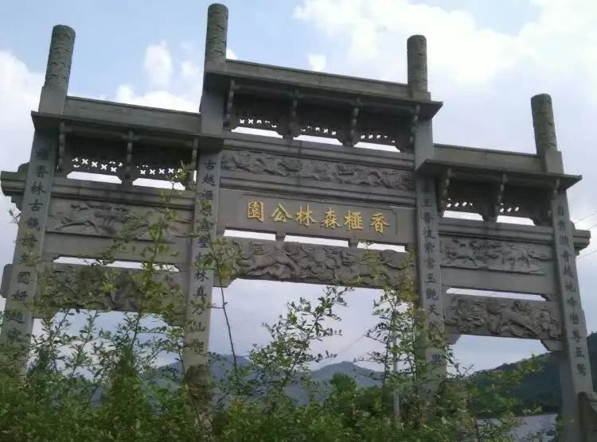
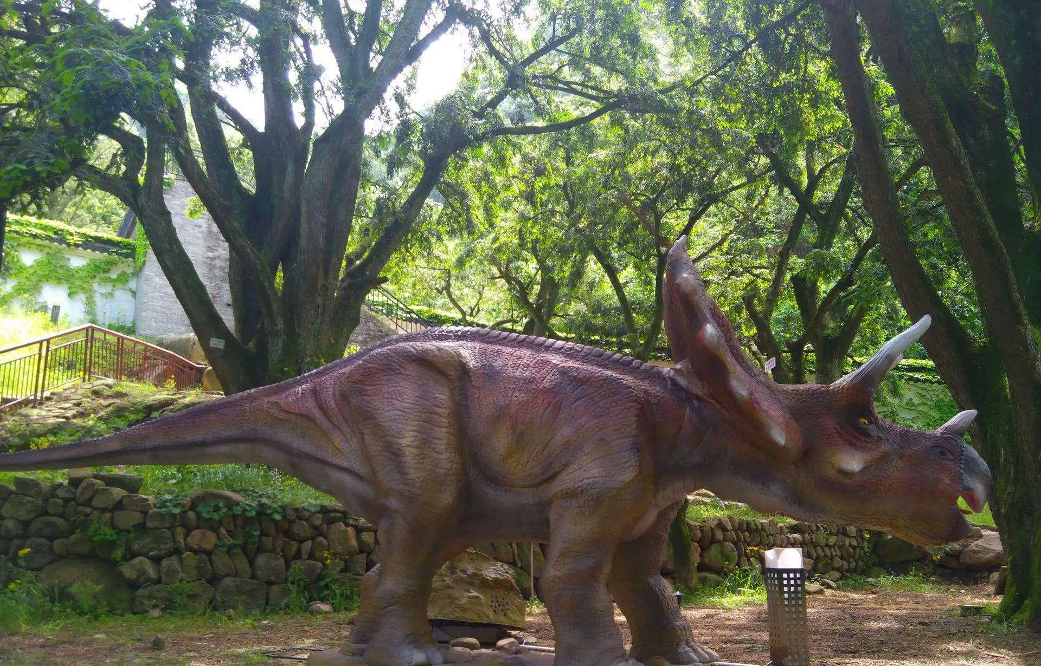
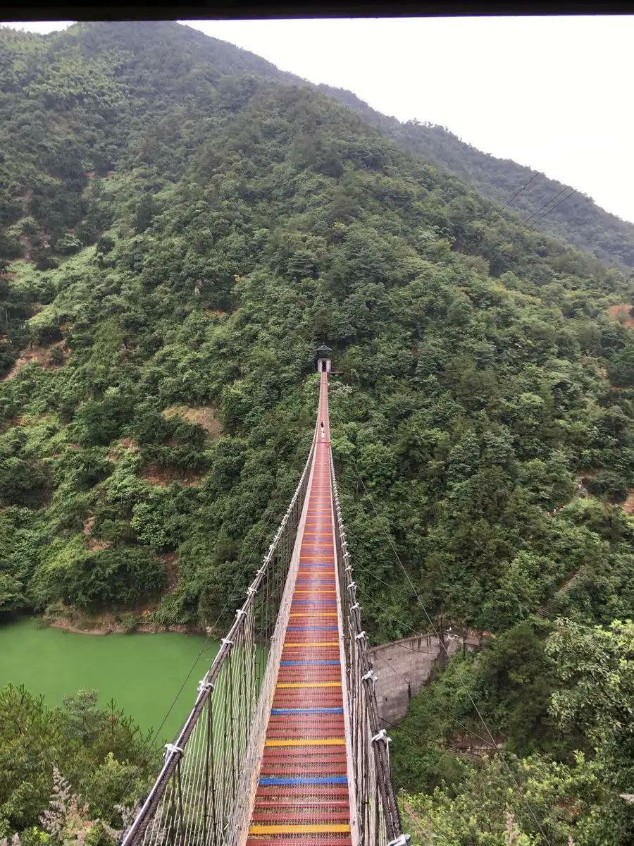
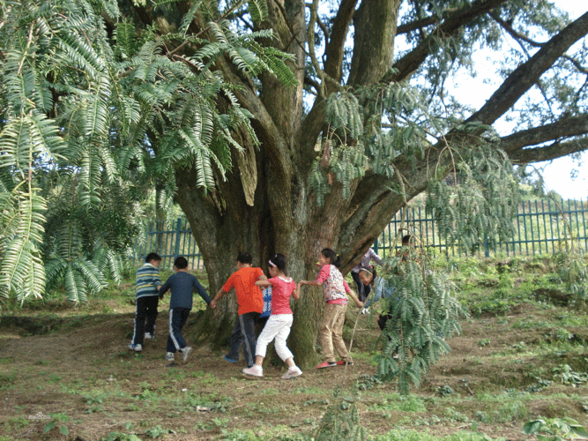
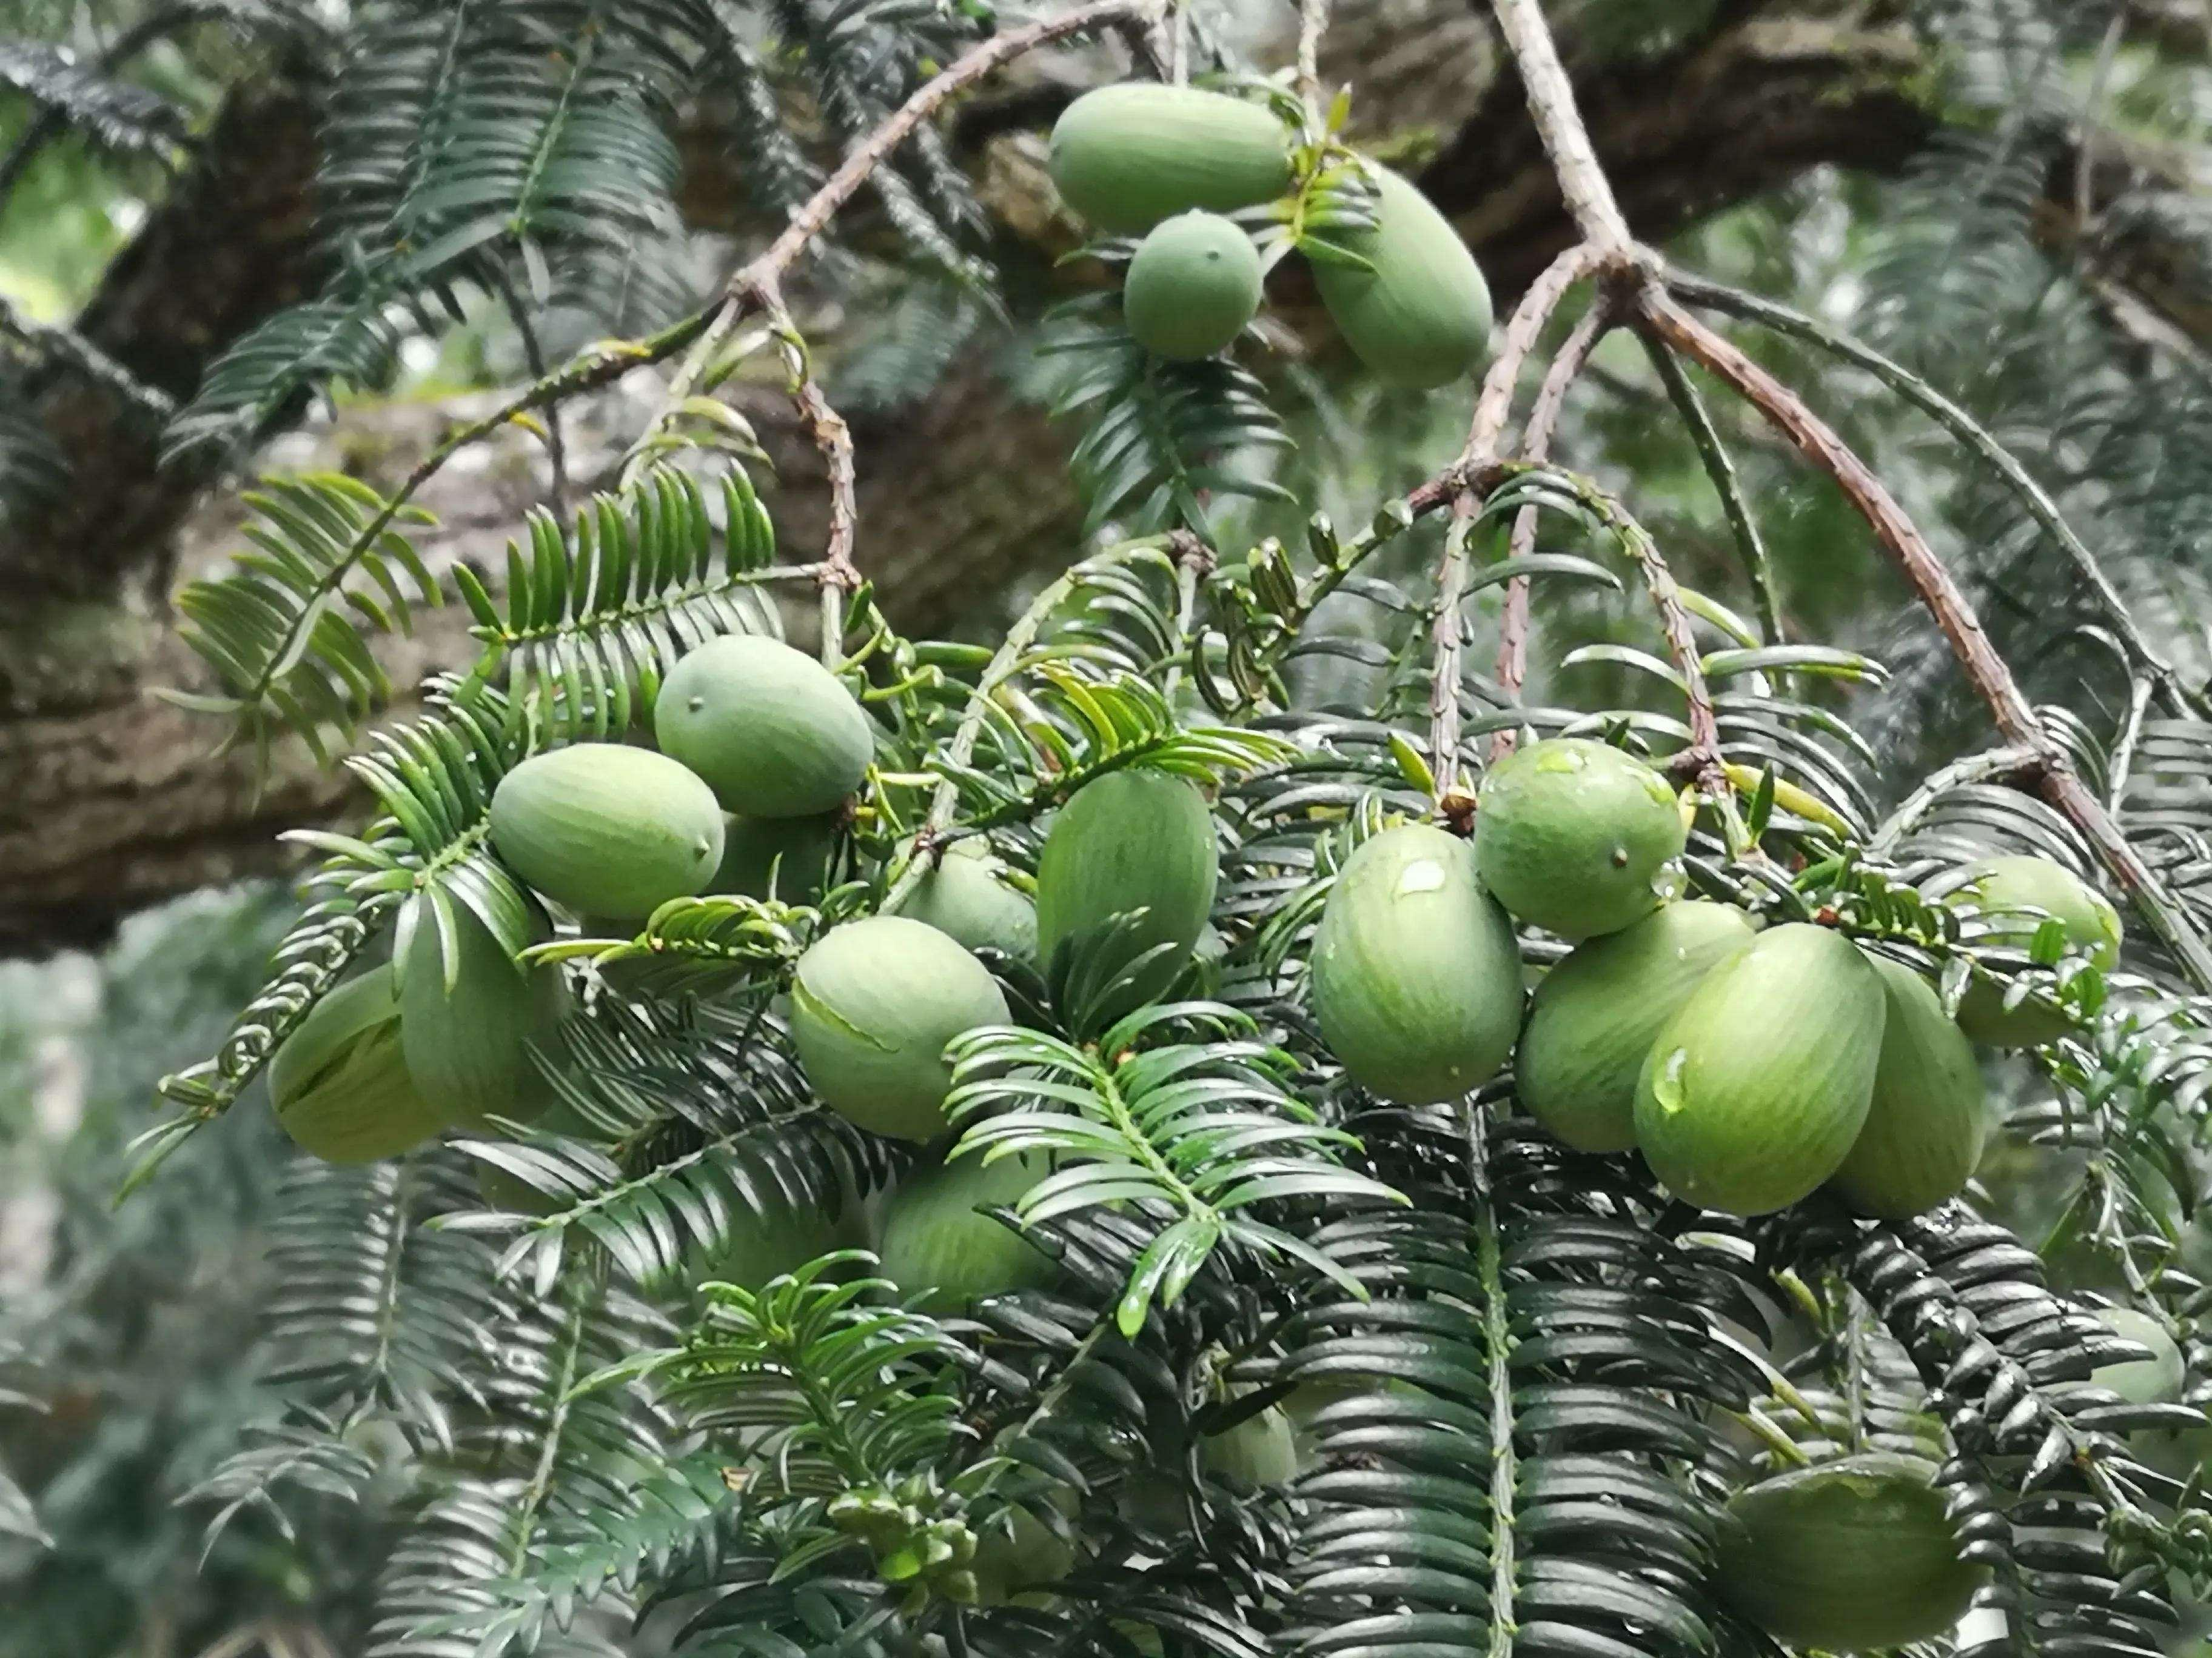
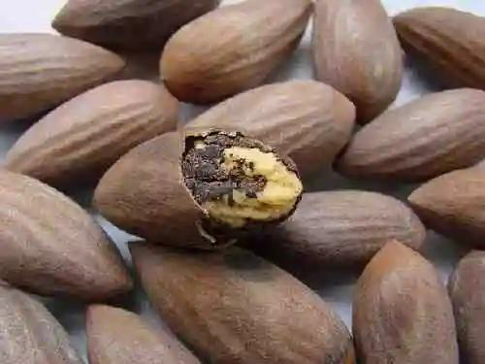
A theme park
The Torreya Forest Park
in the northeast Zhuji
admire the ancient torreya trees of enormous size
meet adorable dinosaurs
experience the scary swinging suspension bridge
pick and try tasty torreya nuts
learn more about the torreya trees by visiting its mesuem
fun
more than fun

Slide 4

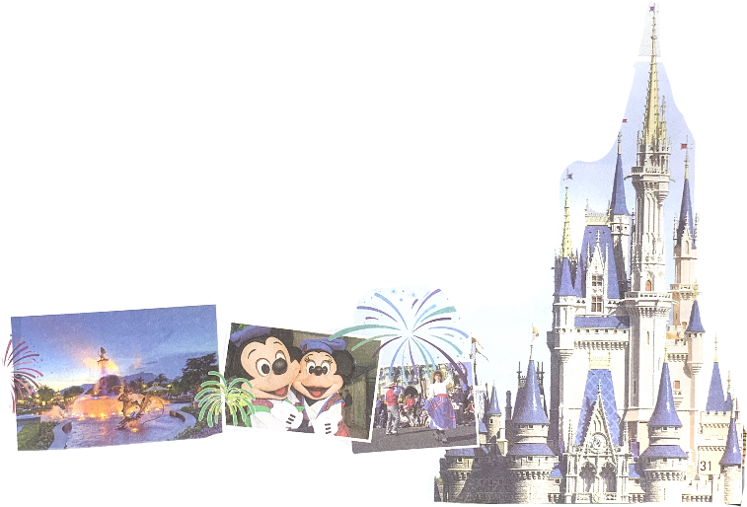

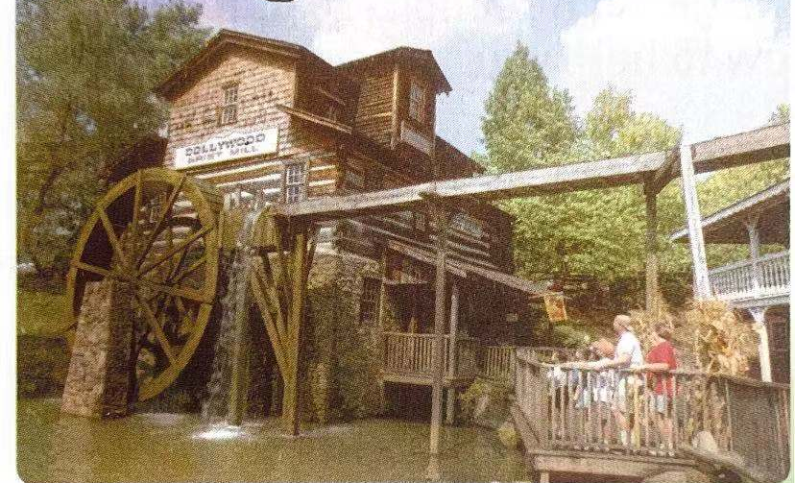
Prediction
Explore theme parks and write about a park
How would the writer organize the passage?
What aspects would the writer include to write about a theme park?
How could the writer show a theme park is fun and more than fun?
3
2
1
Notes:
Location
Theme
activities

Slide 5
Read to check
1
Theme parks
2
3
4
Disneyland
Dollywood
Chimelong Ocean Kingdom

Slide 6
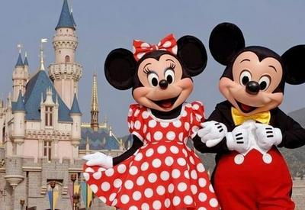
Read for writing
Disneyland | language (patterns/wording) | Writing techniques
Location
Theme
Fun
More than fun
... , which can be found in ...
1. Adopt a clear structure.
2. Use plenty of theme-related adjs to stir up readers’ interest
3. Use various verbs to engage readers’ body and mind.
4. Use if-clauses and imperatives to recommend the park
It will bring you into a magical world
Travelling..., visiting.., or meeting... are all possible .
As you wander..., you may see adorable..
...also has many exciting ...to amuse you, from enormous... to scary....
... childhood dreams come true
Recomm-endation
If you want to have fun and more than fun, come to Disneyland!

Slide 7
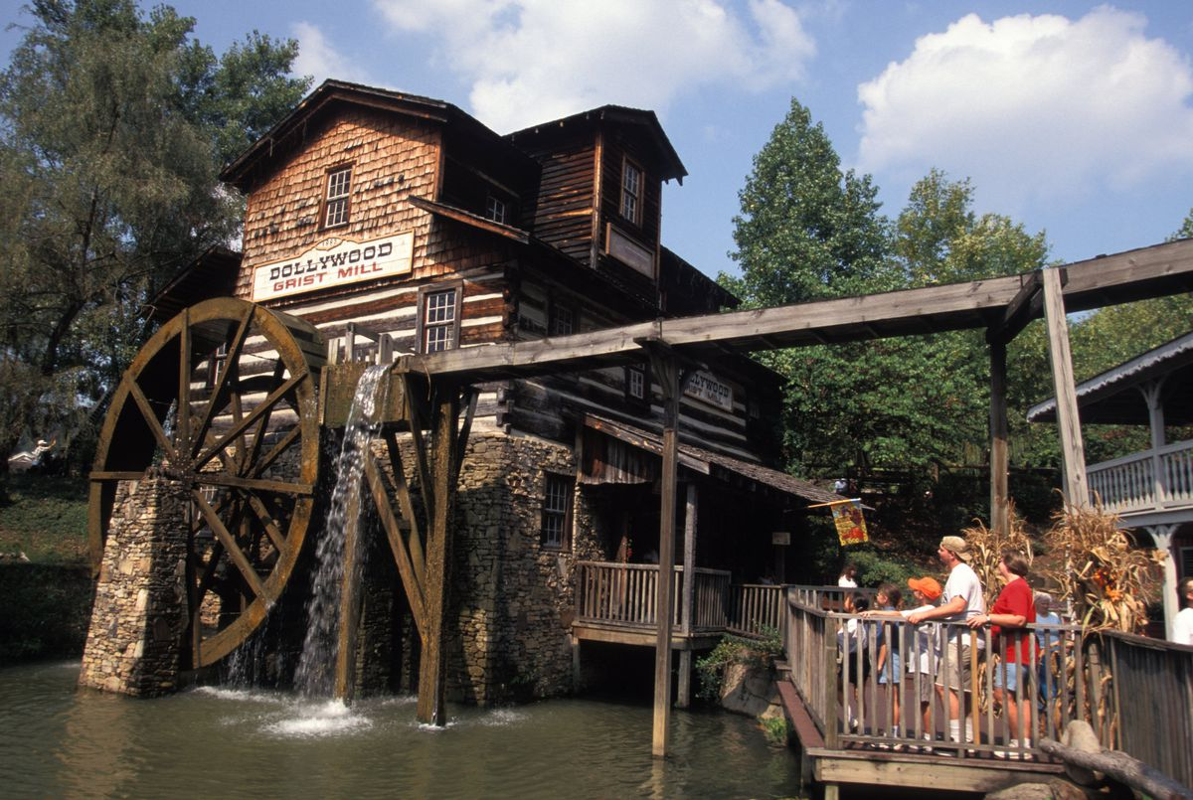
Dollywood | language (patterns/wording) | Writing techniques
Location
Theme
Fun & more than fun
Recomm-endation
. , in ...Mountains, is unique...
1. a clear structure.
2. theme-related adjs
3. various verbs
4. imperatives
USA’s traditional southeastern culture
hearing
famous country music all year around
the old-fashioned way of making objects
a rare experience of trying old-time candy
a special treat of riding the only steam engine
a superb old wooden roller coaster ( longest, smallest)
sight
5. five-sense
description
taste
touch
Come ... to have fun learning...

Slide 8
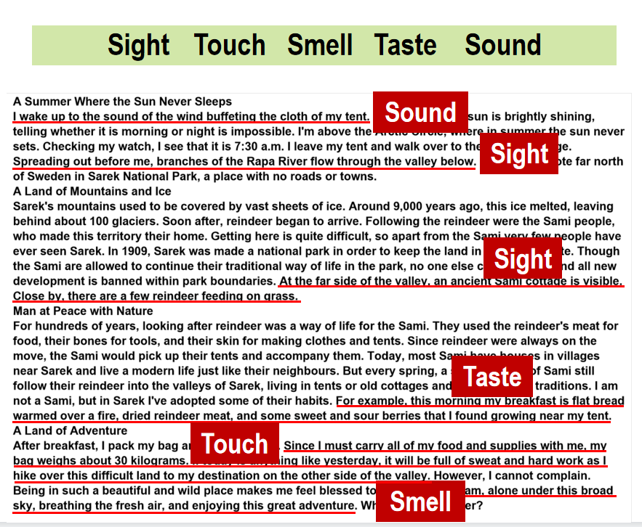
Reading and Thinking
SAREK NATIONAL PARK
- EUROPE’S HIDDEN NATURAL TREASURE
The five-sense description can make the details more appealing.

Slide 9
Chimelong | language (patterns/wording) | Writing techniques
Location
Theme
Fun & more than fun
Recomm-endation

Slide 10
Chimelong | language (patterns/wording) | Writing techniques
Location
 | In Zhuhai, China | 1. a clear structure. 2. theme-related adjs 3. various verbs 4. imperatives 5. five-sense description
Theme | one of the leading ocean-themed parks
Fun & more than fun | walk under ...Aquarium —the world's largest see up to 20,000 fish/ a whale shark 68 metres in length Watching the dolphin and sea lion shows see all kinds of interesting animals more rides than you can imagine:join..., get..., see the splendid Journey of Lights Parade and fireworks display plenty of restaurants with tasty food for every appetite
Recomm-endation | If it is ocean entertainment that you are looking for, come to ...
6. cite numbers
7. comparatives and superlatives (最高级)

Slide 11
Summary
How to introduce and recommend a park
(structure/content/language/ techniques)
a theme park | language (patterns/wording) | Writing techniques
Location | , which can be found in ... (attributive clause); ..., in ...Mountains, in Zhuhai, China; (prep phr) | 1. a clear structure. 2. theme-related adjs 3. various verbs 4. imperatives 5. five-sense description 6. cite numbers 7. comparatives and superlatives
Theme | It will bring you into a magical world. it shows and celebrates USA’s traditional southeastern culture. is one of the leading ocean-themed parks
Activities [ fun and more than fun ] | Travelling..., visiting.., or meeting... are all possible . ; As you wander..., you may see adorable.. ; ...also has many exciting ...to amuse you, from enormous... to scary.... famous country music all year around; the old-fashioned way of making objects; a rare experience of trying old-time candy; a special treat of riding the only steam engine; a superb old wooden roller coaster；has more rides than you can imagine； with tasty food for every appetite， .... ...
recommendation | If you want to have fun and more than fun, come to ... Come ... to have fun learning... If it is ocean entertainment that you are looking for, come to ...

Slide 12
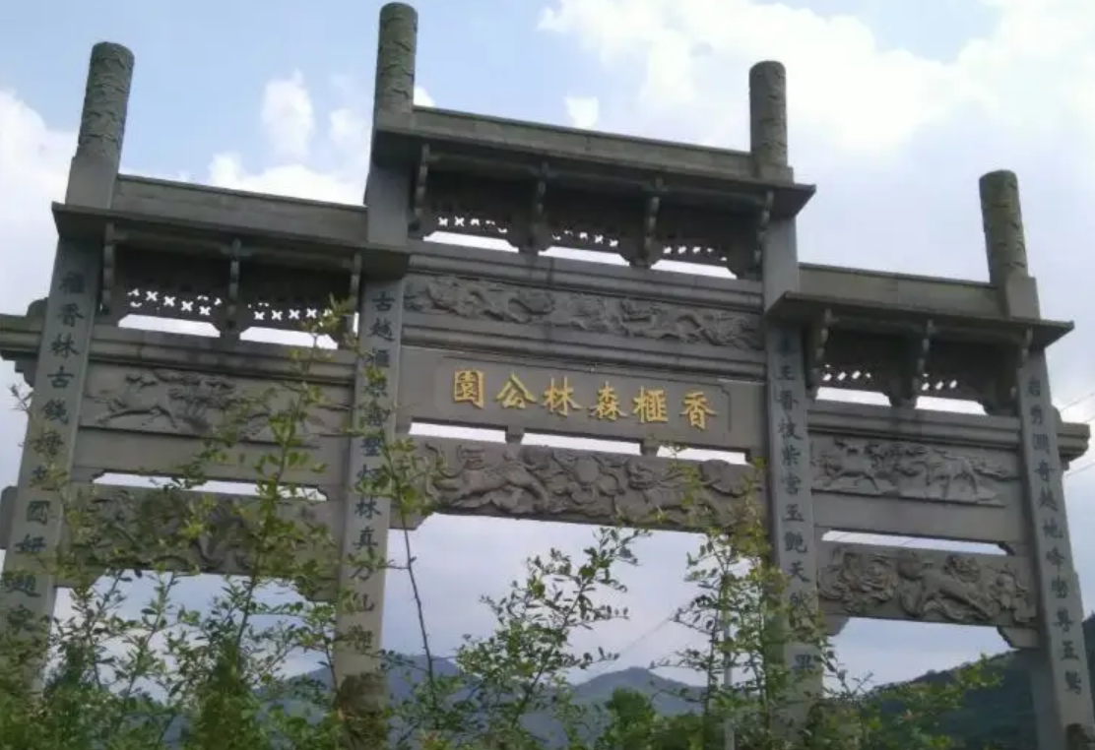
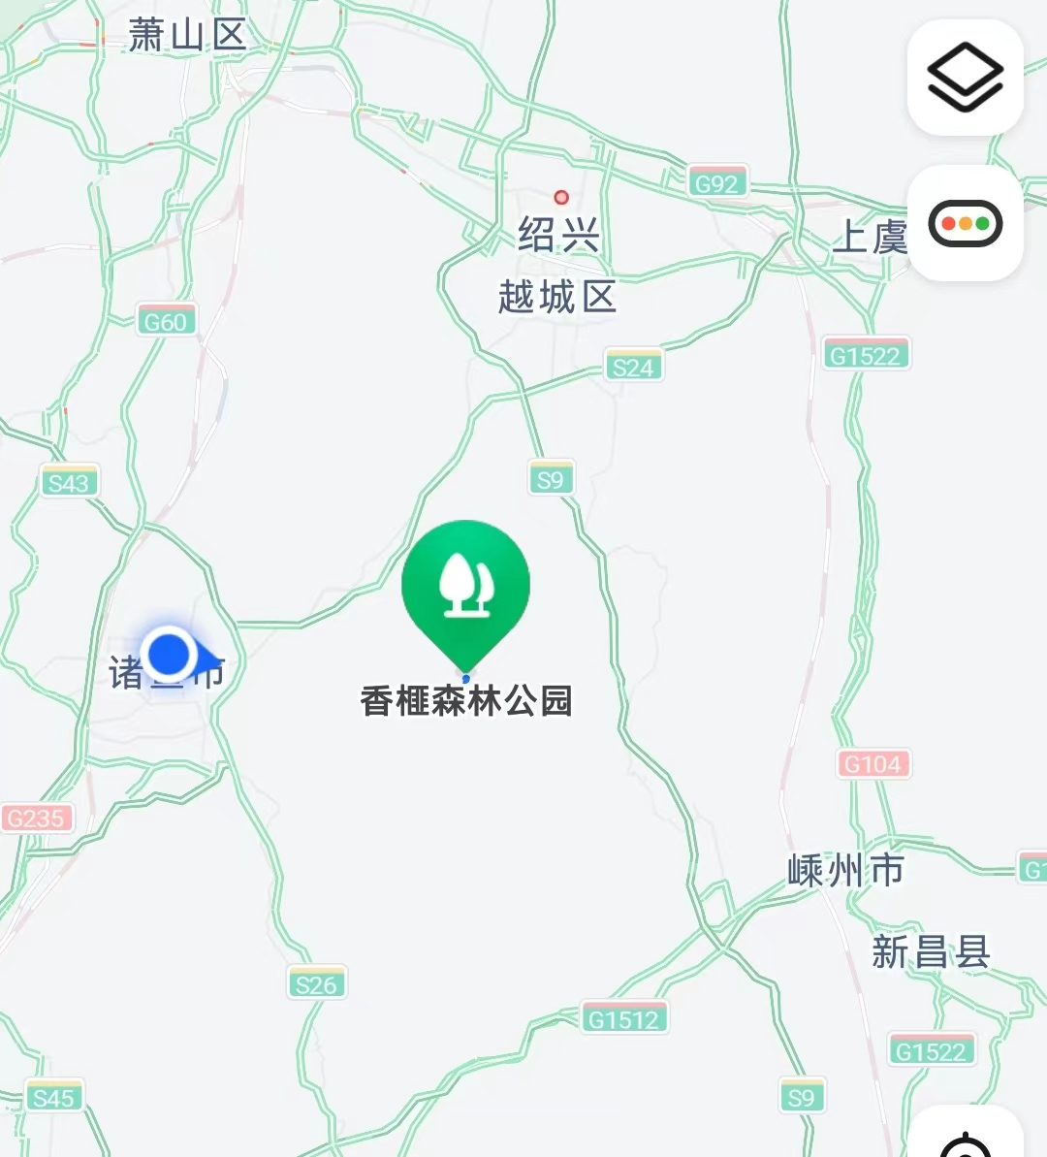
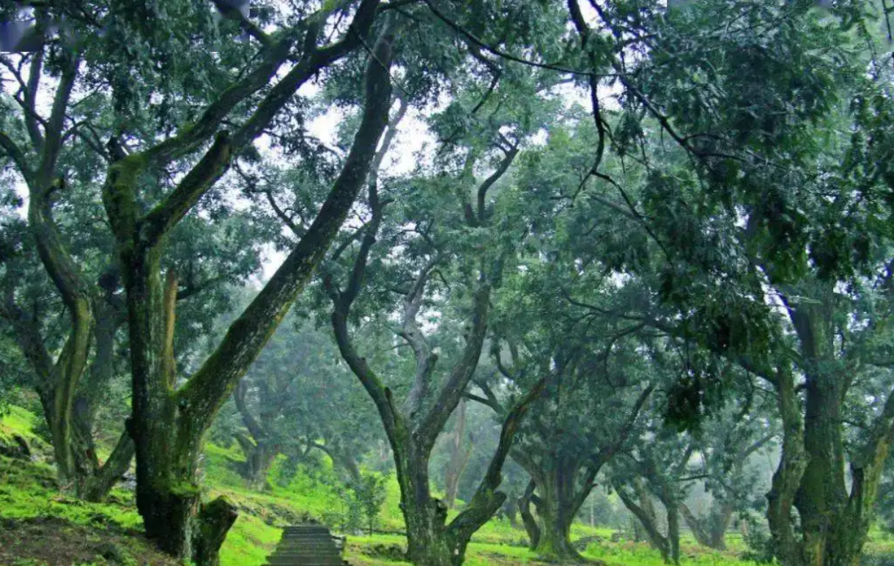
Try to introduce and recommend a theme park.
Location / Theme
... , which can be found in ...
..., in ...Mountains in southeastern USA, is unique because it shows ....
... in Zhuhau, China, is one of the leading ocean-themed parks ...
The Torreya Forest Park; Guiji Mountains, northeast Zhuji, forest-themed
The Torreya Forest Park in the beautiful Guiji Mountains in northeast Zhuji, is a forest-themed park.
The Torreya Forest Park, which lies in the beautiful Guiji Mountains in northeast Zhuji, is a forest-themed park featuring many ancient torreya trees dating back to more than 1300 years ago.

Slide 13
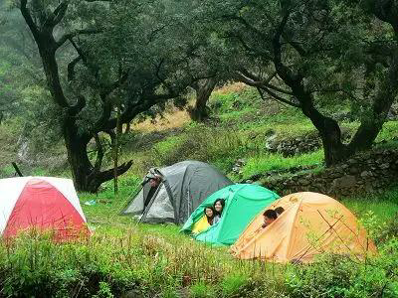
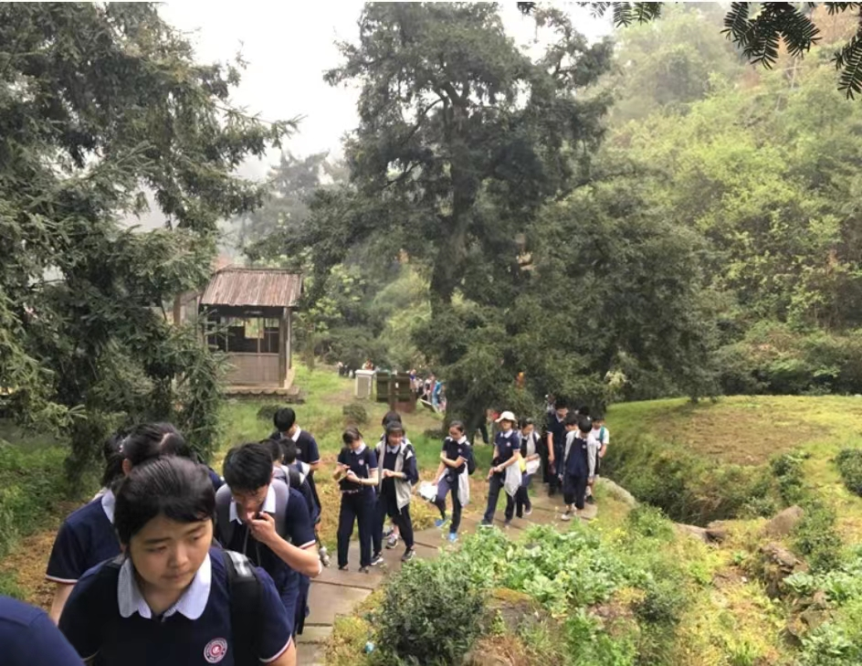
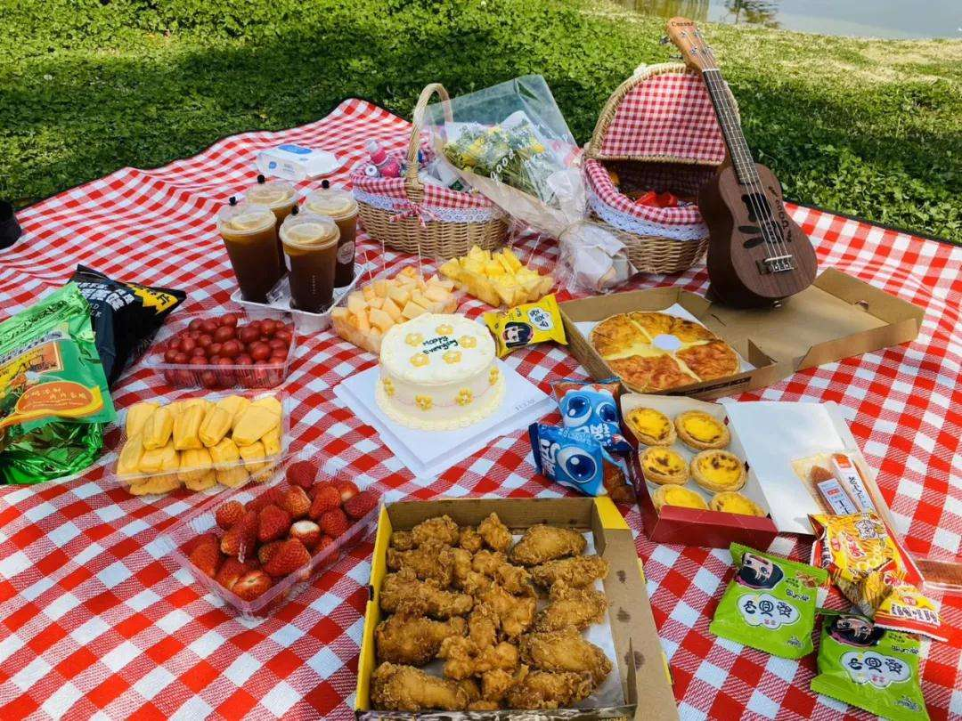
Try to introduce and recommend a theme park.
Fun activities
Travelling..., visiting.., or meeting... are all possible .
... has many ...to amuse you, from ... to ....
has more rides than you can imagine：do..., do..., or do ....
Camping on the grass, hiking in the forest or picnicking in the shade are all possible here.
The park has many exciting activities to amuse you, from camping on the grass to hiking in the forest.
The park has more attractions than you can imagine: camp on the grass, hike in the forest, or picnic in the shade.
camp
hike
picnic

Slide 14
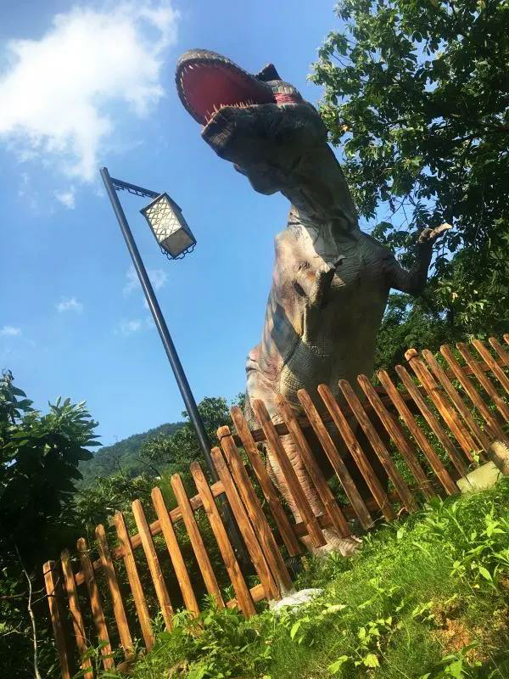
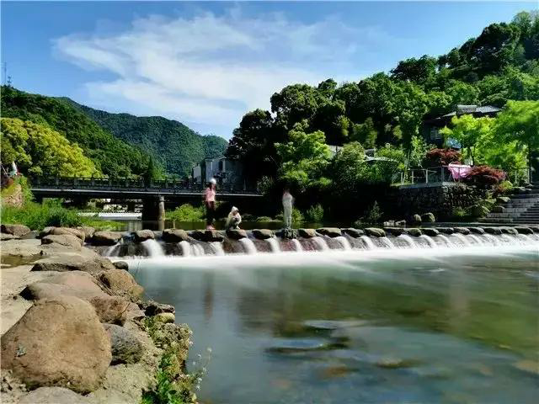
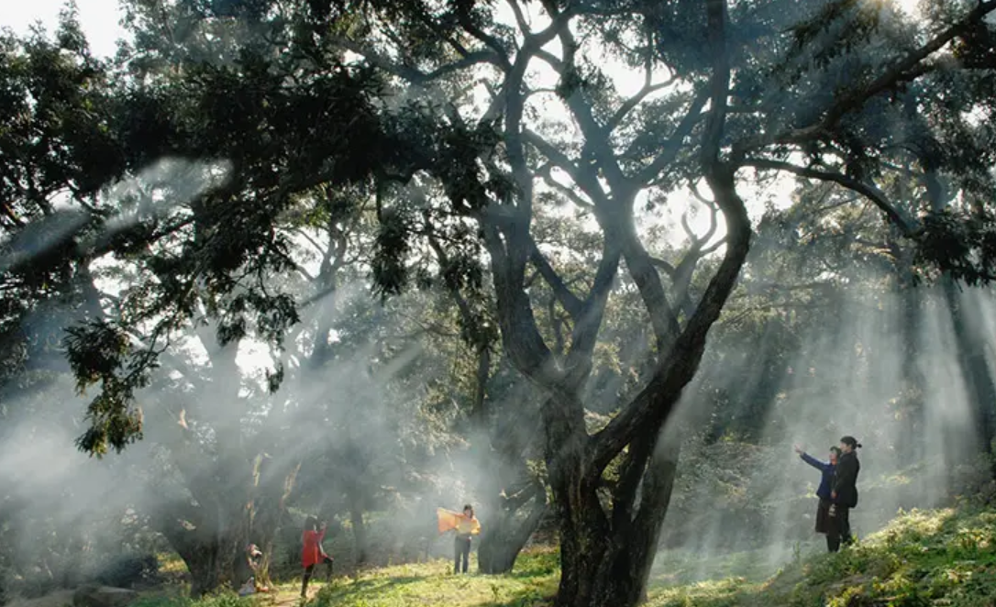
Try to introduce and recommend a theme park.
Fun activities
As you wander... , you may see ...
You can do... while doing ...
As you wander in the park, you will meet adorable dinosaurs and you can even touch their enormous bodies!
You can breathe in fresh air and enjoy breathtaking natural scenery while admiring those ancient torreya trees.
dinosaur
scenery
fresh air

Slide 15
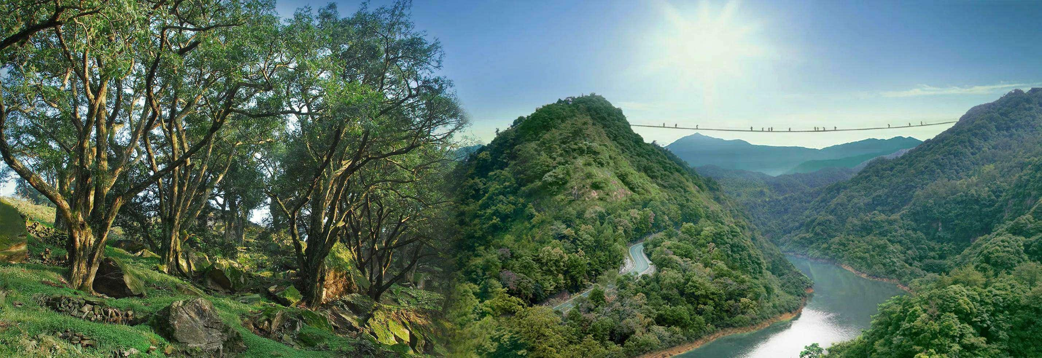
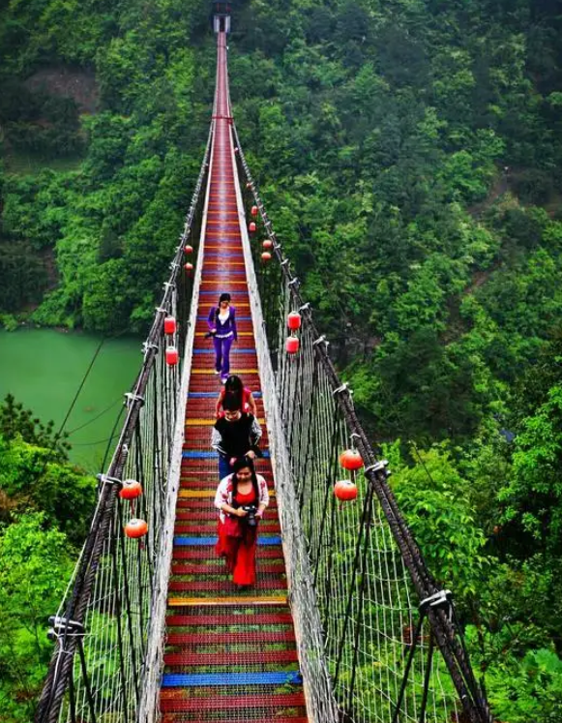
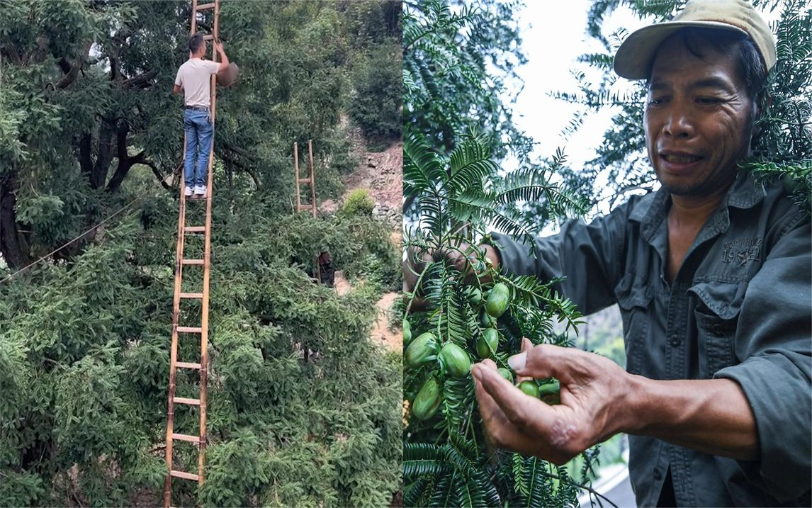
Try to introduce and recommend a theme park.
Fun activities
Doing ... is a rare/exciting/... experience.
Doing ... is a special treat.
Walking on the scary suspension bridge across two peaks is indeed an exciting experience.
Joining locals picking torreya nuts is a special treat.
suspension bridge
pick torreya fruit

Slide 16
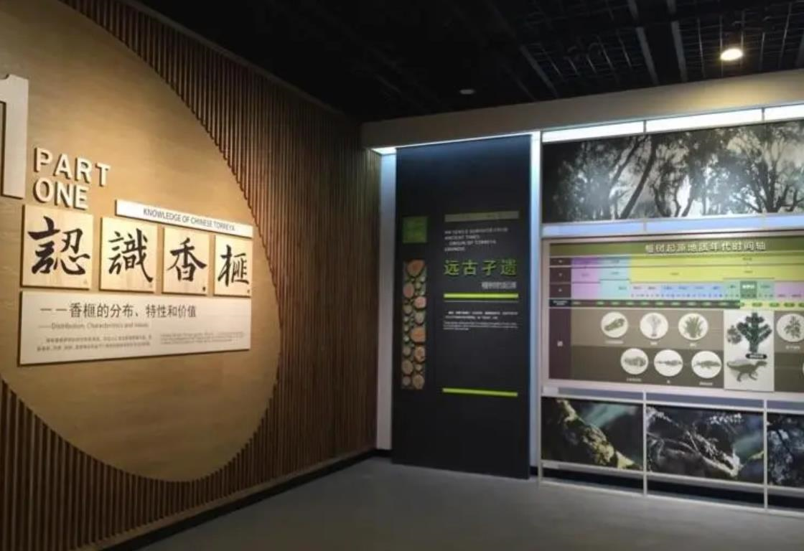
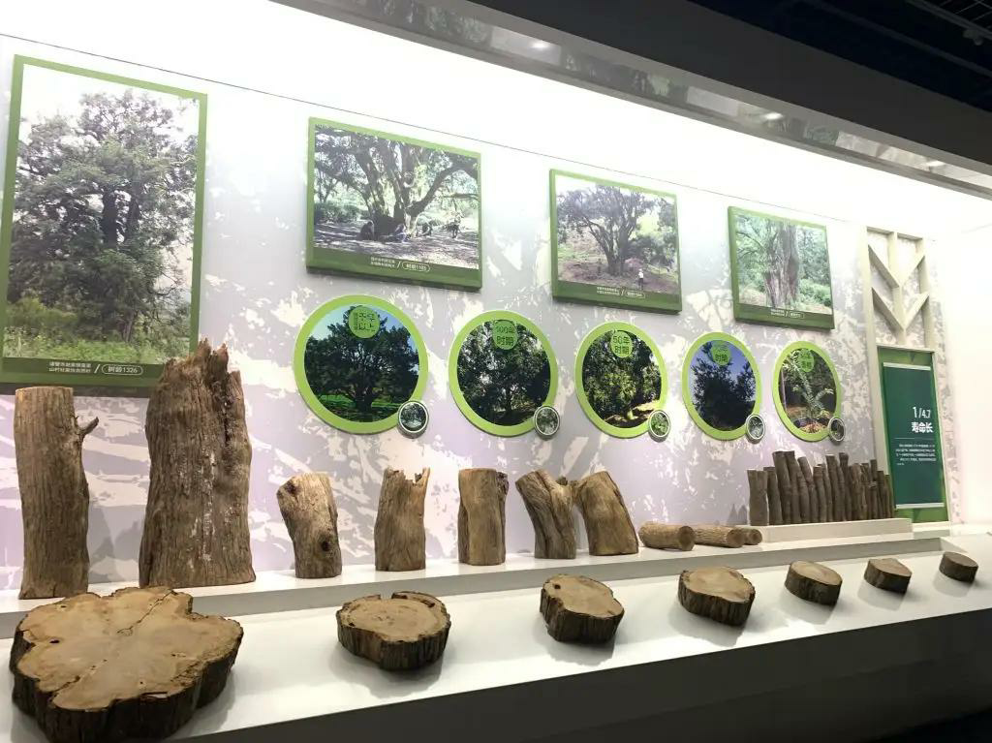
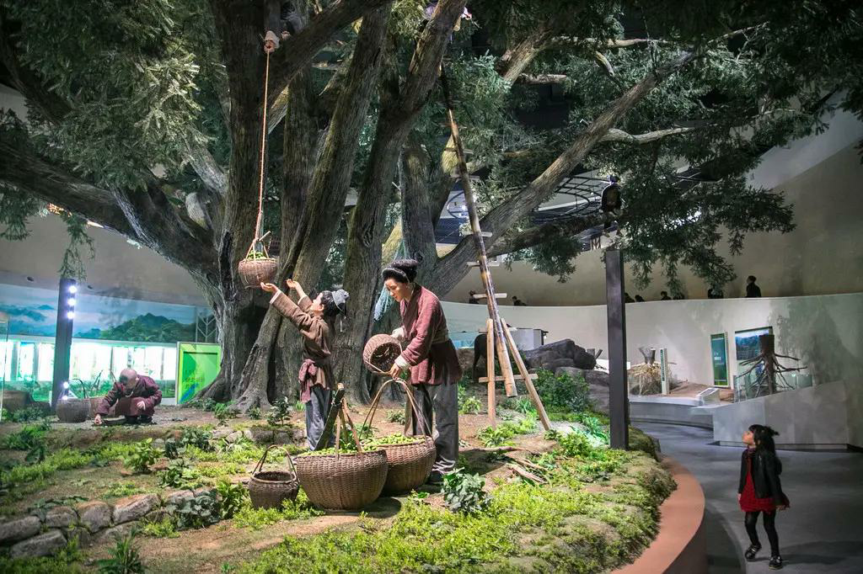
Try to introduce and recommend a theme park.
More-than-fun activities
Doing ... is both educational and fun.
... have fun learning about....
Visiting the torreya museum in the park is both educational and fun.
In the torreya museum in the park, you can have fun learning about detailed knowledge of torreya trees.
Torreya museum

Slide 17
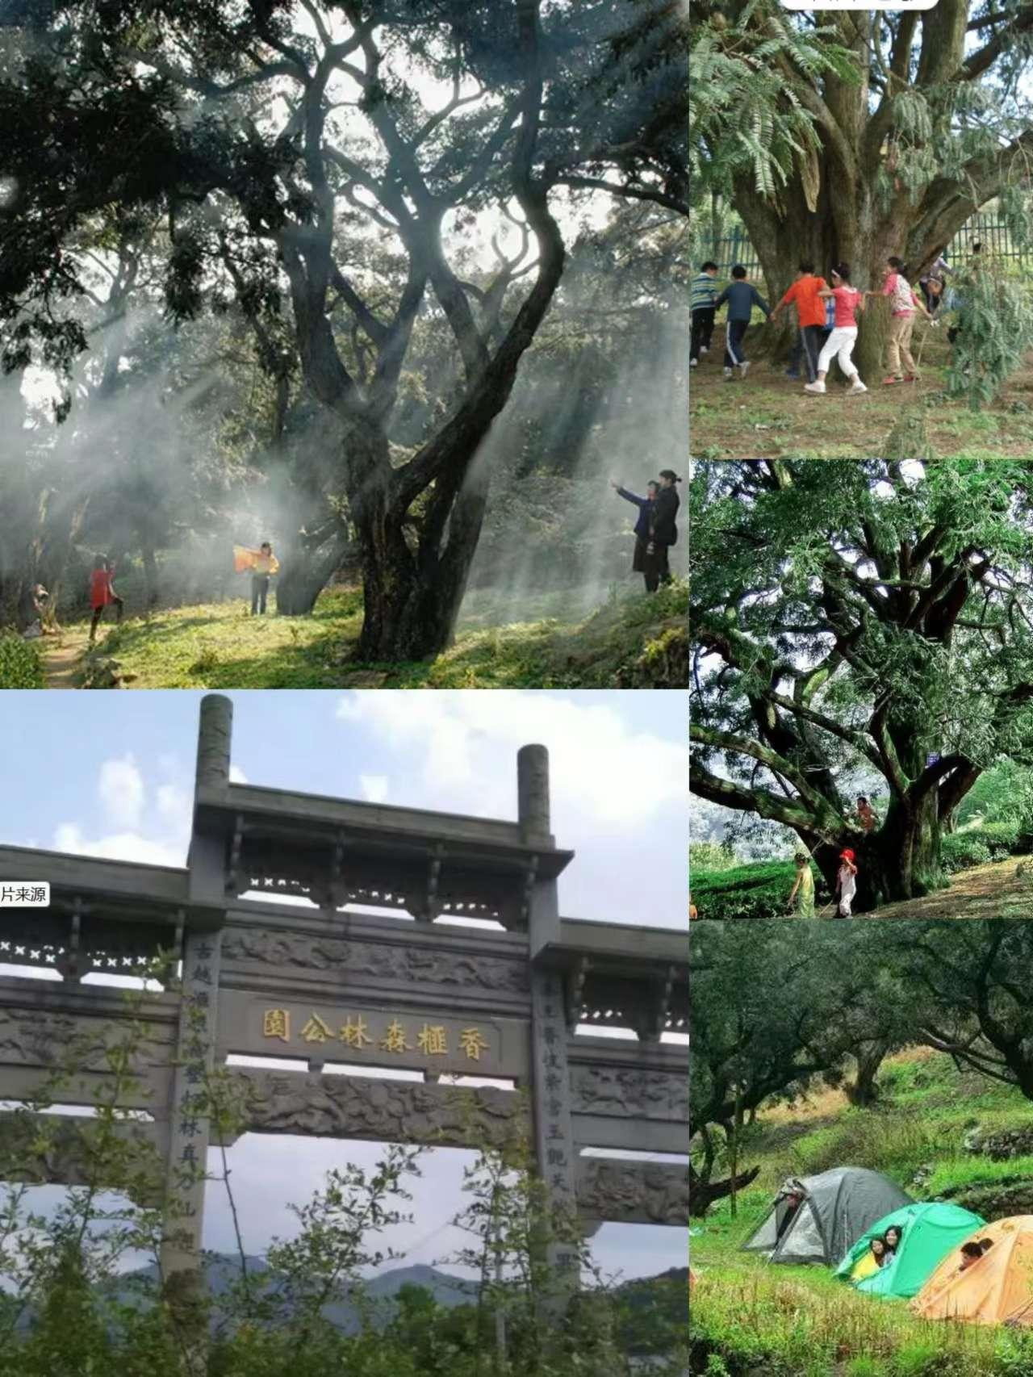
Try to introduce and recommend a theme park.
Recommendation
If you want to have fun and more than fun, come to ...
Come ... to have fun learning all about ...
If it is ocean entertainment that you are looking for, come to ...
If you want to have fun and more than fun, come to the Torreya Forest Park.
Come the Torreya Forest Park to have fun learning all about those ancient torreya trees.
If it is forest entertainment that you are looking for, come to the Torreya Forest Park.

Slide 18
Try to introduce and recommend a theme park.
The Chinese Torreya Forest Park, which lies in the beautiful Guiji Mountains in the northeast Zhuji, is a forest-themed park featuring many ancient torreya trees. The park has many exciting activities to amuse you, from camping on the grass to hiking in the forest. You can breathe in fresh air and listen to bird singing while admiring the old torreya trees. As you wander in the park, you will meet adorable dinosaurs and you can even touch their enormous bodies! Walking on the scary suspension bridge across two peaks is indeed an exciting experience. If you come in late October, joining locals picking torreya fruit and tasting torreya nuts is a special treat. And visiting the torreya museum in the park is both educational and fun. If you want to have fun and more than fun,come to Zhuji’s Torreya Forest Park
Topic
Location
Theme
Activities
Recommendation
smell
hearing
sight
touch
taste

Slide 19
Homework
Write about a theme park you wish to share .
(structure/ content/ language/ techniques)
a theme park | language (patterns/wording) | Writing techniques
Location | , which can be found in ... (attributive clause); ..., in ...Mountains, in Zhuhai, China; (prep phr) | 1. a clear structure. 2. theme-related adjs 3. various verbs 4. imperatives 5. five-sense description 6. cite numbers 7. comparatives and superlatives
Theme | It will bring you into a magical world. it shows and celebrates USA’s traditional southeastern culture. is one of the leading ocean-themed parks
Activities [ fun and more than fun ] | Travelling..., visiting.., or meeting... are all possible . ; As you wander..., you may see adorable.. ; ...also has many exciting ...to amuse you, from enormous... to scary.... famous country music all year around; the old-fashioned way of making objects; a rare experience of trying old-time candy; a special treat of riding the only steam engine; a superb old wooden roller coaster；has more rides than you can imagine； with tasty food for every appetite， .... ...
recommendation | If you want to have fun and more than fun, come to ... Come ... to have fun learning... If it is ocean entertainment that you are looking for, come to ...

Slide 20
Checklist
Is the introduction clear?
Does the writer include all the important points about the park?
Does the writer describe attractions engaging five senses?
Does the writer use theme-related adjectives and verbs?
Does the writer use some good sentence patterns ?
Does the writer use correct grammar, punctuation, and spelling?

Slide 21
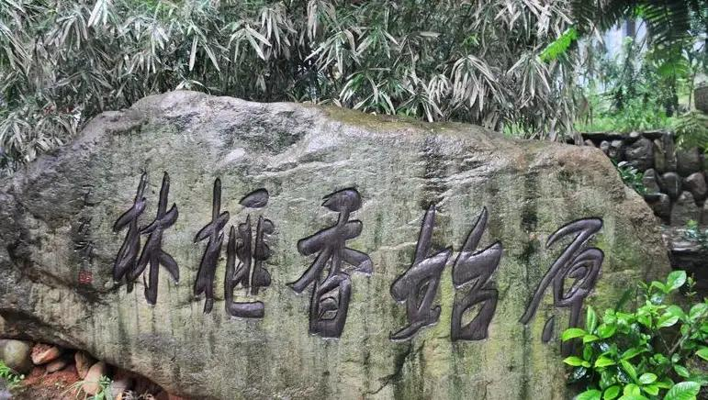
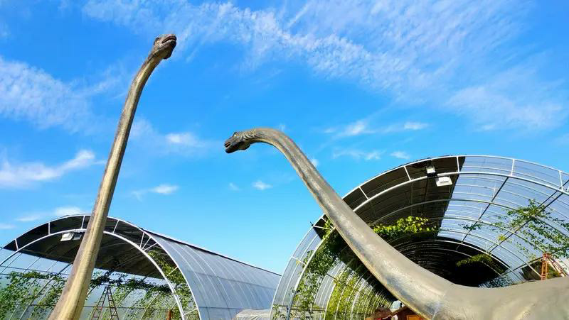
Thank you!

