Slide 1


感恩遇见，相互成就，本课件资料仅供您个人参考、教学使用，严禁自行在网络传播，违者依知识产权法追究法律责任。
更多教学资源请关注
公众号：溯恩高中英语
知识产权声明

Slide 2
活动类应用文
(2022.1浙江卷）假定你是李华，在“中国—爱尔兰文化节”活动中结识了爱尔兰朋友Chris，现在他已回国。请你给他写一封邮件，
内容包括：1. 回忆活动经历 2. 分享个人收获 3. 希望保持联系
（2022 山东 模拟卷）假定你是李华，是校英语报的小记者。近期你校组织开展了为期一周的“劳动最光荣”（Labor Is the Most Glorious）活动，请你写一篇报道介绍一下这次活动，内容包括：1. 活动目的；2.活动内容；3.收获
（2020 全国II卷）上周末，学校组织学生们参加了一次采摘活动。
请你为班级英语报写一篇短文，介绍这次活动，内容包括:1.农场情况；2.采摘过程；3.个人感受。
假设你是中学生李华，上周你校成功举办了英语周活动(English Week)。请你为校英文报写篇报道，内容包括: 1.参加人员；2.活动内容；3.活动意义。

Slide 3
活动
目的 | 经过 | 收获
1. 句型 To/ In order to/ Aiming to do sth.,… Aimed at/ With the aim of/ For the purpose of/ For sake of doing sth., … 2. 具体目的（适配度） cultivate cultural literacy/ awareness broaden/ widen our horizons open our eyes to… render us a brand-new dimension to probe into… deepen/ promote/ enhance our understanding of… get deeper insights into … gain/ obtain/ enrich the knowledge about … experience the charm/ fascination of … ignite/ kindle our passion/ enthusiasm for … arouse our interest in … befriend with like-minded people strengthen the mutual trust/exchange cement the ties/bonds of our friendship dabble in areas beyond knowledge | 时态根据具体情况而定 Time order 按时间顺序写（略写） Highlight (亮点)是什么（详写） First,/ To begin with…. Then…. Lastly,….The highlight will be/ includes…. The activity began/ started with…, followed by….We ended the day by…. What impressed us most was that…. There are many activities to be held, ranging from…to…./ The various activities held ranged from…to…. | 句型 Through this activity, not only did we…, but also we… Upon reflection, I/ we really appreciate the activity, for it…. The activity has passed, but … will stay in my mind/ be carved in my heart forever. …turned out to be a great success/ hit/ caused a sensation/ was quite popular with…. By immersing everyone in the charm of …, the activity ….

Slide 4

假定你是某国际学校学生李华，你的爱尔兰笔友Kelly对你提到的学校“多元文化日”
(Multicultural Day)活动很感兴趣。请回信告知他关于该活动的相关信息。
内容包括：
1.活动时间；
2.活动目的和内容。
注意：
1.写作词数应为80左右；2.请按如下格式在答题卡的相应位置作答。
Dear Kelly,
Yours,
LiHua
告知信
类型
时态
人称
要点
一般过去时或一般将来时或一般现在时
审题
第一人称+第二人称

Slide 5
为什么告知？
Para. 1 写作目的——告知信息
Para. 2 活动时间——
活动目的和内容——
Para. 3
过去时间/ 将来时间
具体时间（日期、几天前/后）
具体活动内容（不可笼统）
活动评价？
希望所给信息有用
+ 如需其他信息请联系
你肯定会喜欢？
邀请你来参加？

Slide 6
活动类别 | 文化类别 | 具体内容
an exhibition/ a display/ a show | ethnic costumes/ clothing | kimino, hanbok, hanfu, sari, kilt…
a concert | music culture traditional musical instrument | jazz, gagaku, Peking Opera… erhu, Djembe/ drum…
a party/ meeting (have a taste/ bite of) | food/ cuisine | fish and chips in the UK masala dosa in India sushi in Japan lasagne, pizza, spaghetti in Italy jiaozi in China
a lecture/ salon (freely discuss/ express one’s insights into/ interpret 解读) | literature/ literary classics | Journey to the West, Shakespeare’s sonnets (十四行诗) and plays…
a photography show/ exhibition | architecture/ landmark | The Great Wall, the Forbidden City, The Eiffel Towel, Pyramids…
a hands-on experience of | art forms | calligraphy, water and ink painting, oil painting…
a movie night | movies | Hollywood, Bollywood…

Slide 7
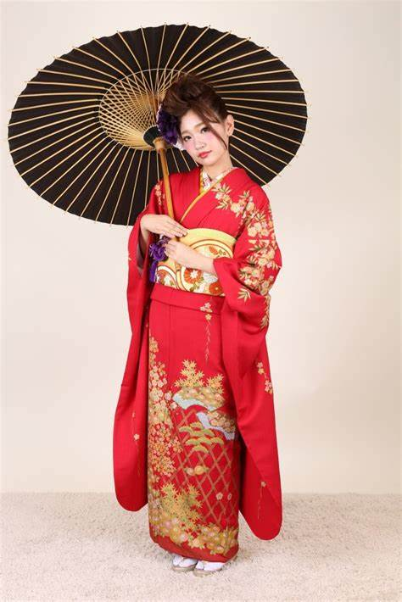
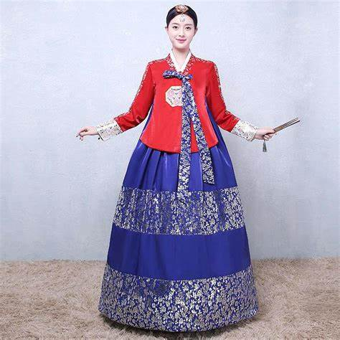
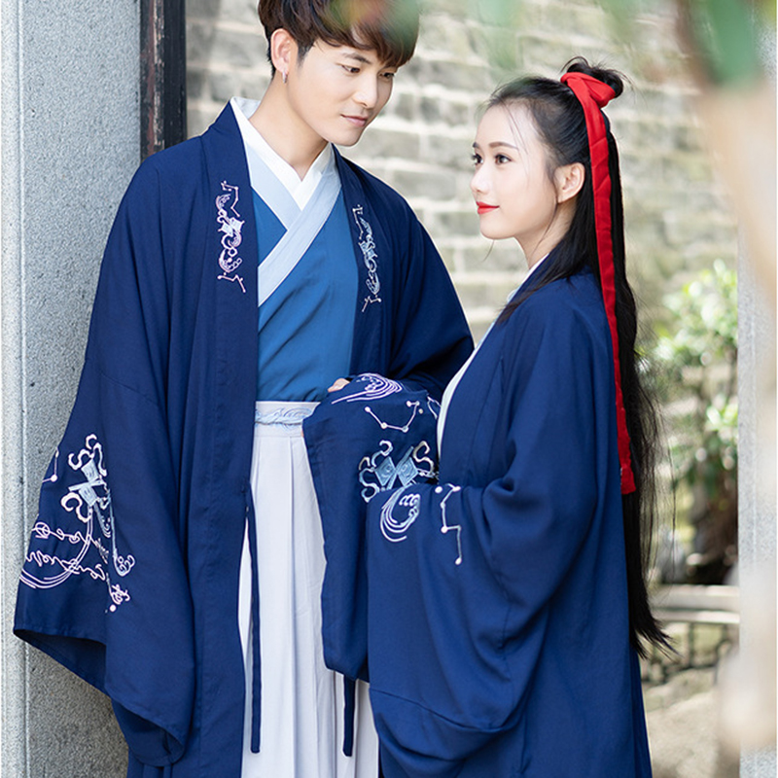
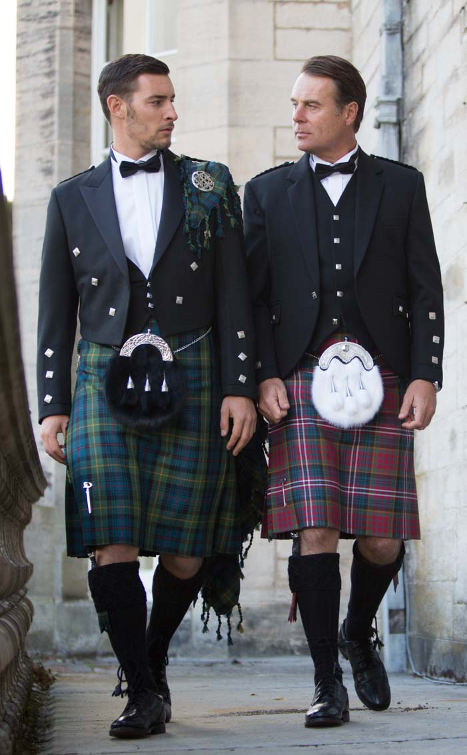


Traditional clothing
Janpanese kimono
Korean hanbok
Chinese hanfu
Scottish kilt
African robe
Indian sari

Slide 8
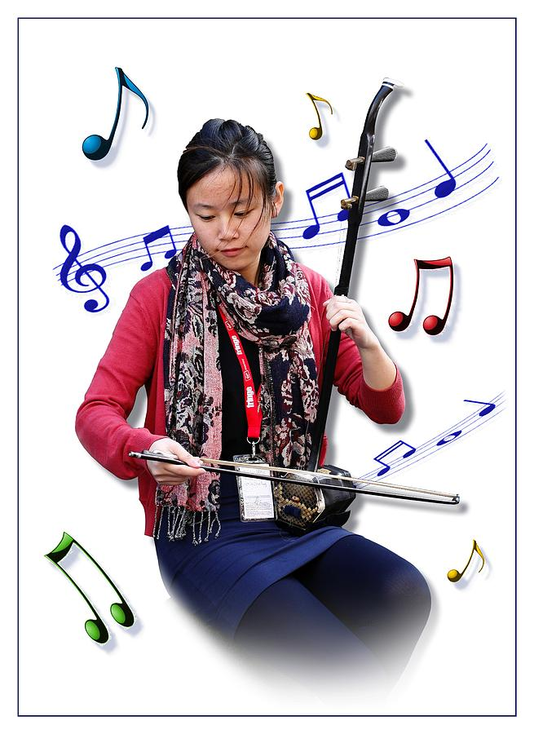
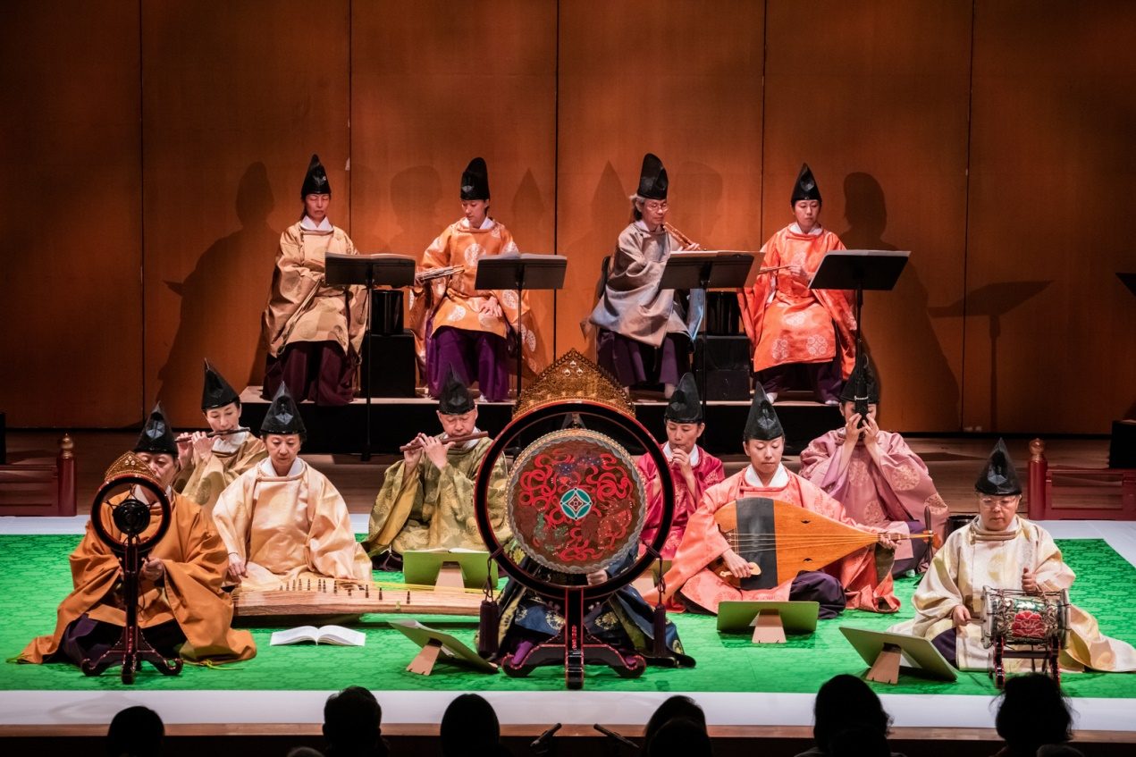
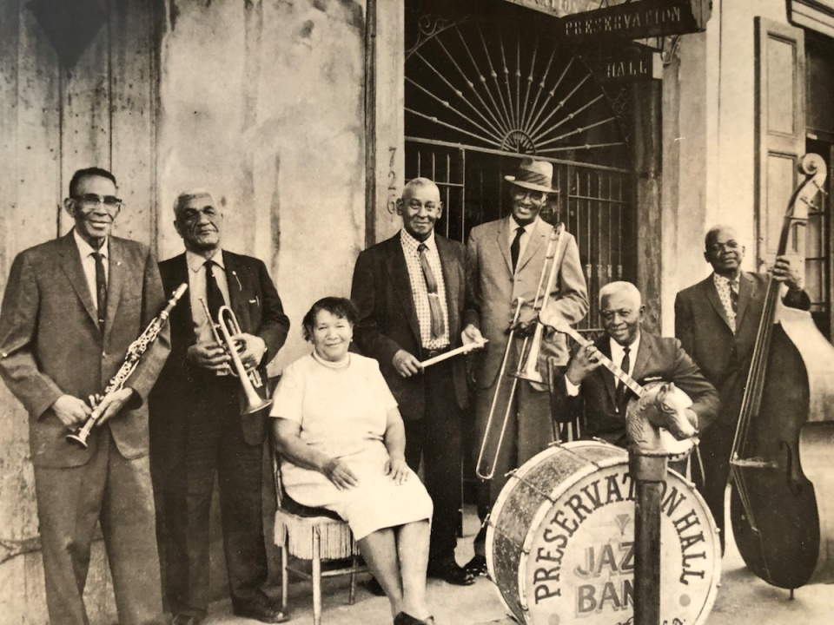
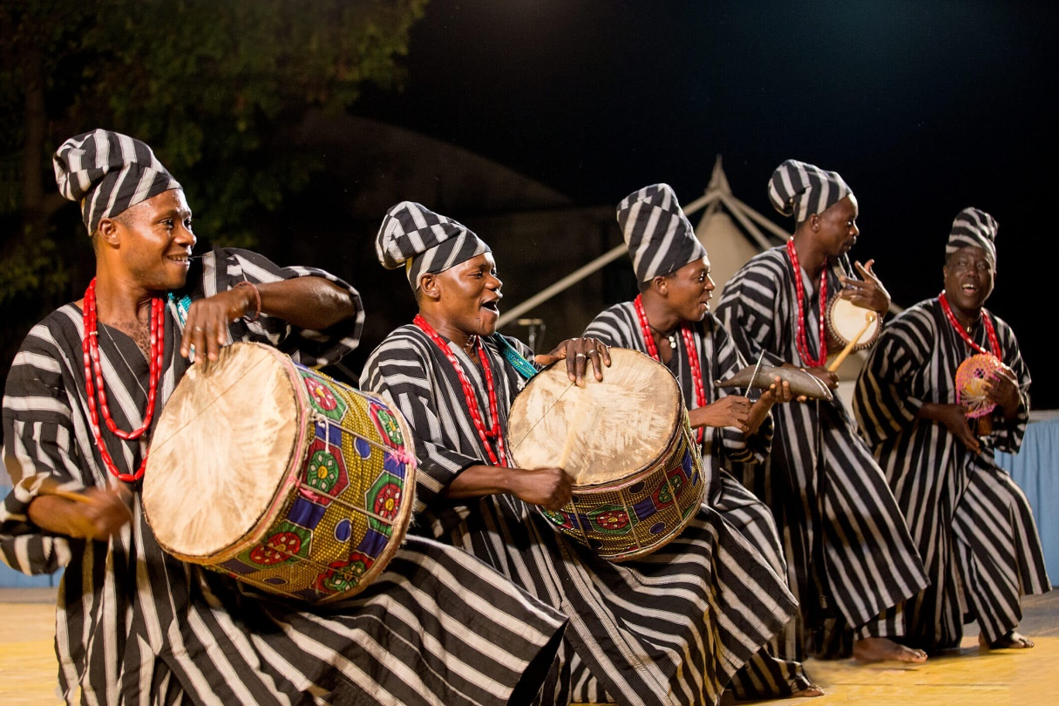
music
erhu
gagaku
jazz
Djembe

Slide 9
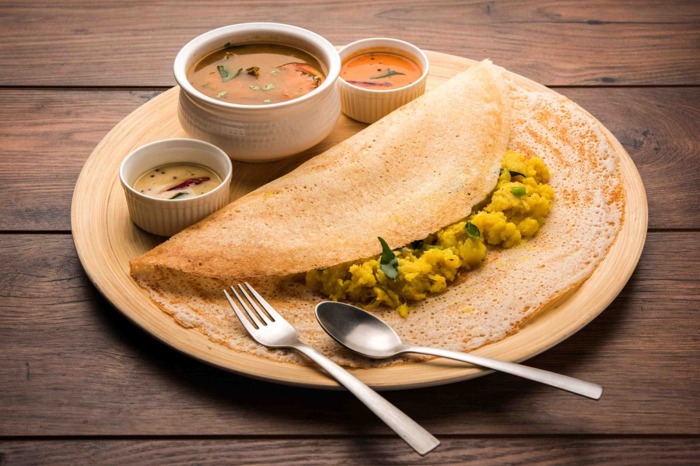
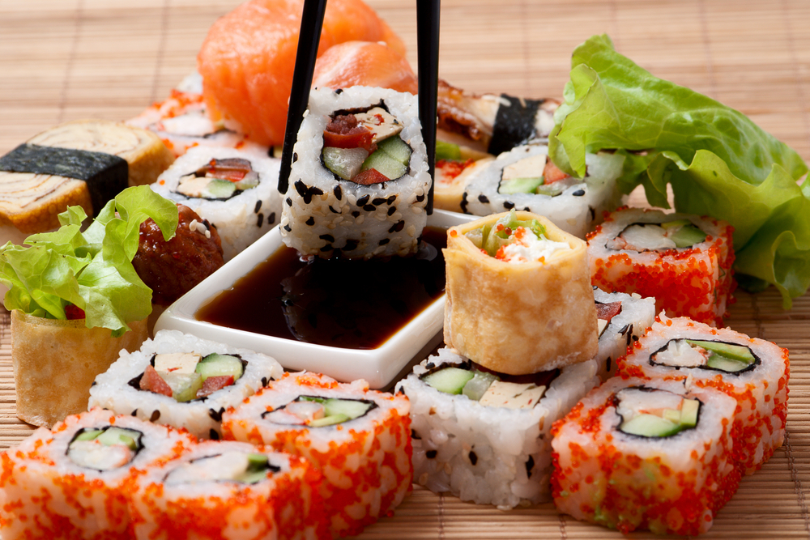
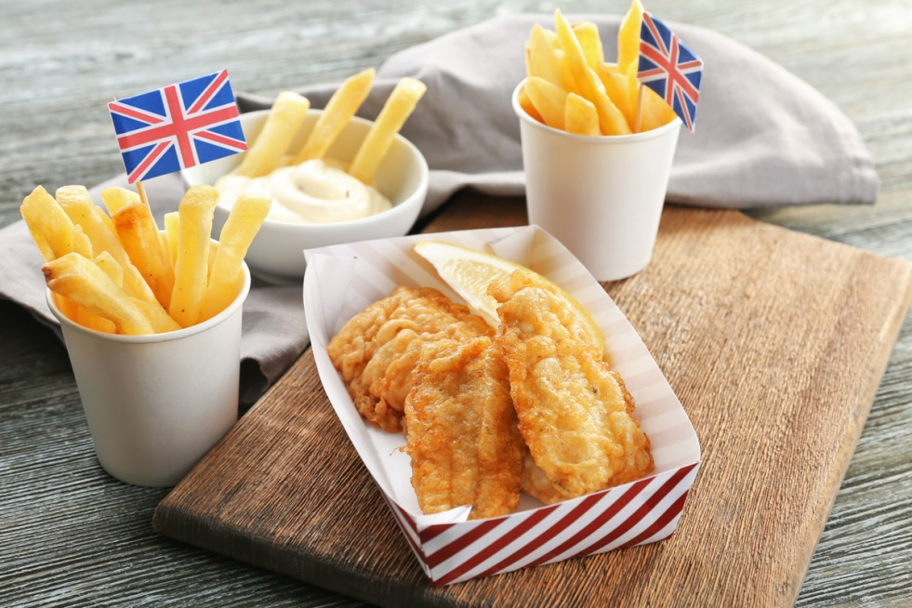
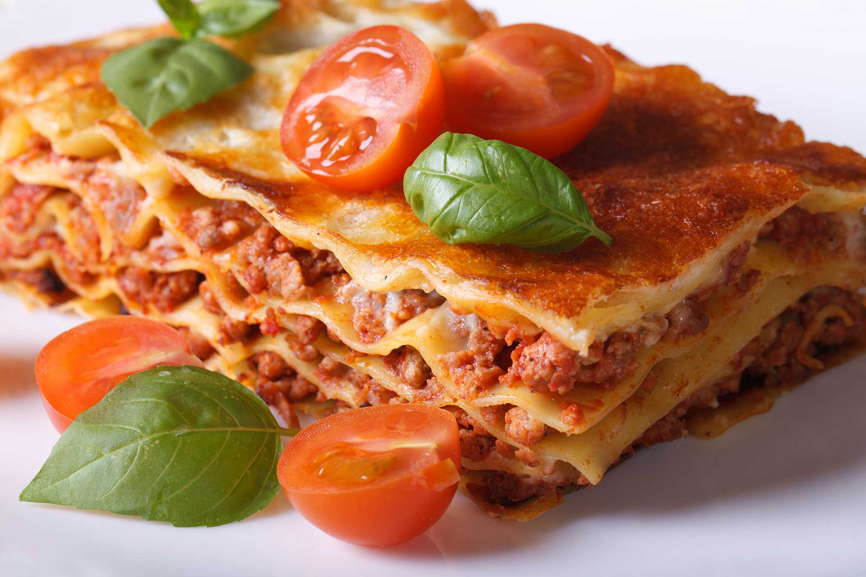
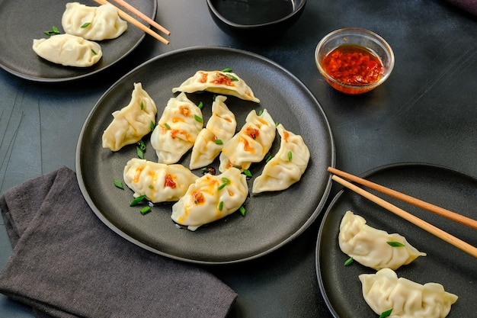
Traditional food
fish and chips in the UK
masala dosa in India
sushi in Japan
lasagne, pizza, spaghetti in Italy
jiaozi in China

Slide 10

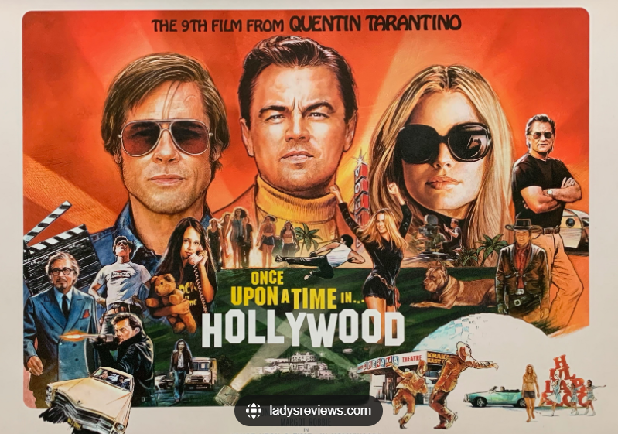
movies

Slide 11
范文修改稿(一般现在时——每年举办) (100 words)
Dear Kelly,
Knowing you are interested in Multicultural Day in our school, I’m delighted to share with you some information.
The Day started five years ago and annually it takes place on 22 October. Aiming to deepen mutual understanding (加深相互理解)/ facilitate interaction (促进交流) among students from different cultures, various activities are held on the day, ranging from watching foreign movies to learning different languages to Culture Salon. The Day has been a hit on campus, always leading students to a splendid multicultural world.
Hope this brief introduction has given you a general idea of the day. And you can contact me anytime you like.
Yours,
Li Hua

Slide 12
学生佳作(一般将来时——计划举办) (99 words)
Dear Kelly,
Having known you take an interest in the Multicultural Day in our school, I’m writing to tell you some information concerning it/ introduce some details to you.
The Multicultural Day will take place on May 2nd. Aimed at promoting cultural interaction among students from different cultural backgrounds, there will be a diversity of activities, ranging from tasting special food like American turkey and Chinese roast duck to learning the customs of grand festivals in different countries. The Day will definitely gain popularity and provide a platform for students to have a glimpse of different cultures.
For more/ further information, just contact/ reach me anytime you like.
Yours,
Li Hua

Slide 13
老师下水 (一般过去时——已经举办) (99 words)
Dear Kelly,
Knowing your interest in the Multicultural Day held on November 31st in our school, I’m delighted to brief you on it.
The Day was designed/ intended to enhance mutual understanding among students from different cultures. To achieve this aim, a great variety of activities were organized, ranging from an exhibition of traditional clothing/ costumes displaying hanfu, sari and so on, to typical food collection/ party where students were given a chance to savor/ taste/ have a bite of (品尝) sushi, pizza, and other delicious food/ flavors (风味). With such abundance of activities, the Day was quite popular.
I’ve attached some photos to the letter. Hope you will like it.
Yours,
Li Hua

