Slide 1

感恩遇见，相互成就，本课件资料仅供您个人参考、教学使用，严禁自行在网络传播，违者依知识产权法追究法律责任。
更多教学资源请关注
公众号：溯恩高中英语
知识产权声明

Slide 2
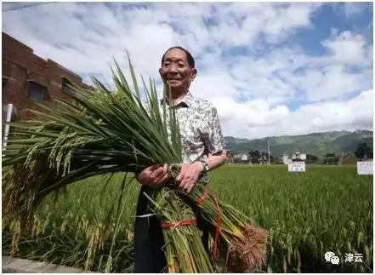
U5 Working the Land Reading and Thinking
A Pioneer for All People

Slide 3
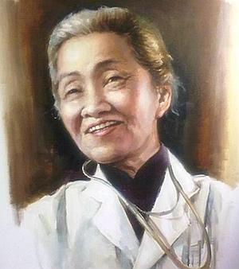
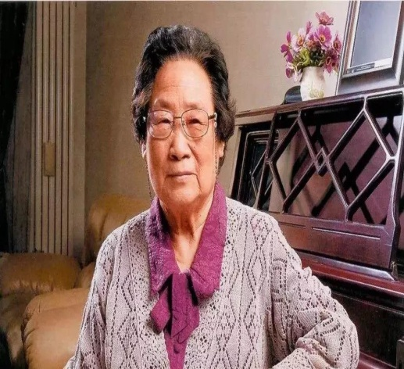
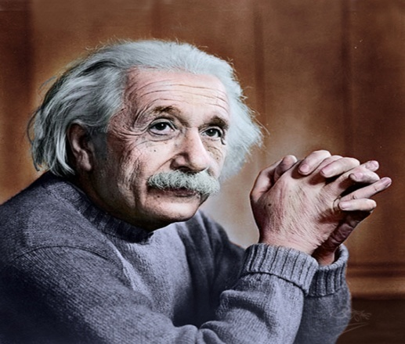
Great people we’ve learnt
【必修 三】 Unit 2 Mother of Ten Thousand Babies
(Biography)
【选必一】 Unit 1 Tu Youyou Awarded Nobel Prize
(News Report)
【选必一】 Unit 1 The Man Who Changed Our
Understanding of the Universe (Biography)

Slide 4
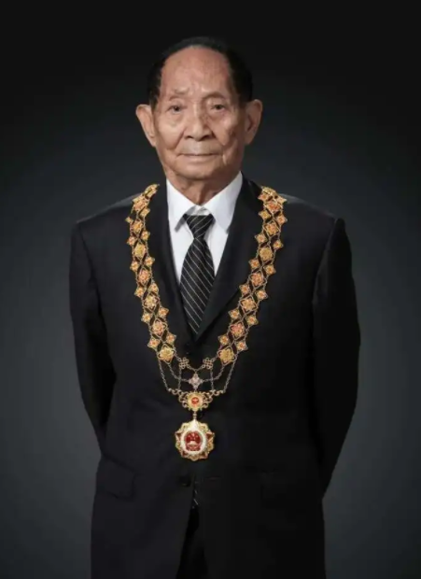
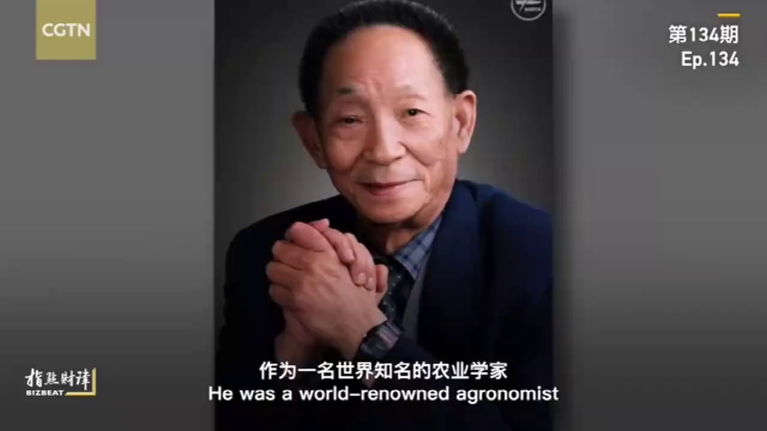
Video-sharing
What do you know about Yuan Longping?
Yuan Longping, Born in ________,
“The father of ______________
A Chinese ________
Winner of _______________________
Two dreams are _________
1930
Hybrid Rice
scientist
The Medal of the Republic( 共和国勋章）
to pursue high yield and promote it to the whole world

Slide 5
Lead-in
My lifelong pursuit is to keep all the people away from hunger.
--Yuan Longping

Slide 6
Make a prediction
Based on the title and picture, can you predict the content in the passage ?
A PIONEER FOR ALL PEOPLE
A person who is the first to study a new area of knowledge.

Slide 7
Make a prediction
Based on the title and picture, can you predict the content in the passage ?
A PIONEER FOR ALL PEOPLE
Who is the pioneer?
What does he do?
What is his achievement？
Why does he do so?
How does he do...?
...

Slide 8
Read for gist（主旨） and genre（文体）
Read the text. Match the main idea with each paragraph.
Para.1 A. Yuan conducted research and developed hybrid rice.
Para.2 B. Yuan is old but still working hard to fulfil his dreams.
Para.3 C. Yuan considers himself a farmer.
Para.4 D. Yuan decided to study agriculture.
Para.5 E. Yuan’s innovation has helped to feed more people.
Para.6 F. Yuan cares little for fame or wealth.
Process(How)
Vision/Dream(What)
Introduction：Identity（Who）
Reason/Motivation（Why）
Achievement(What)
View of life (what )

Slide 9

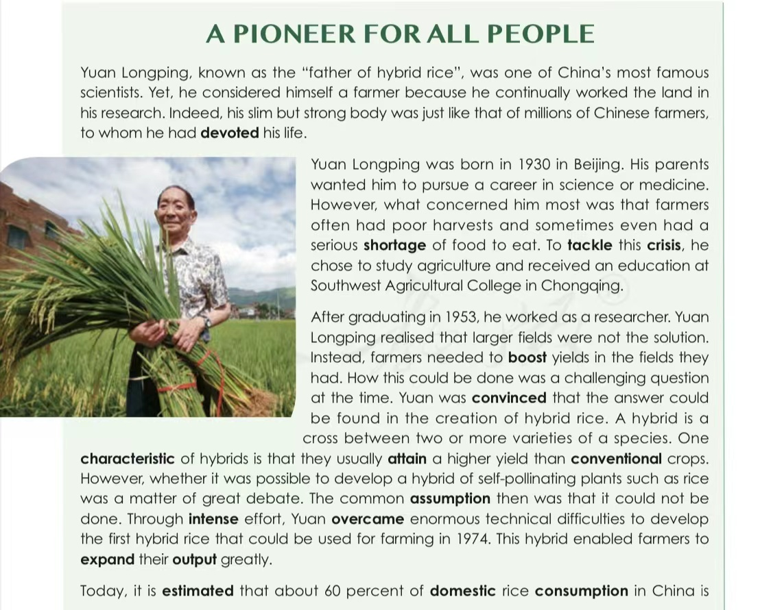
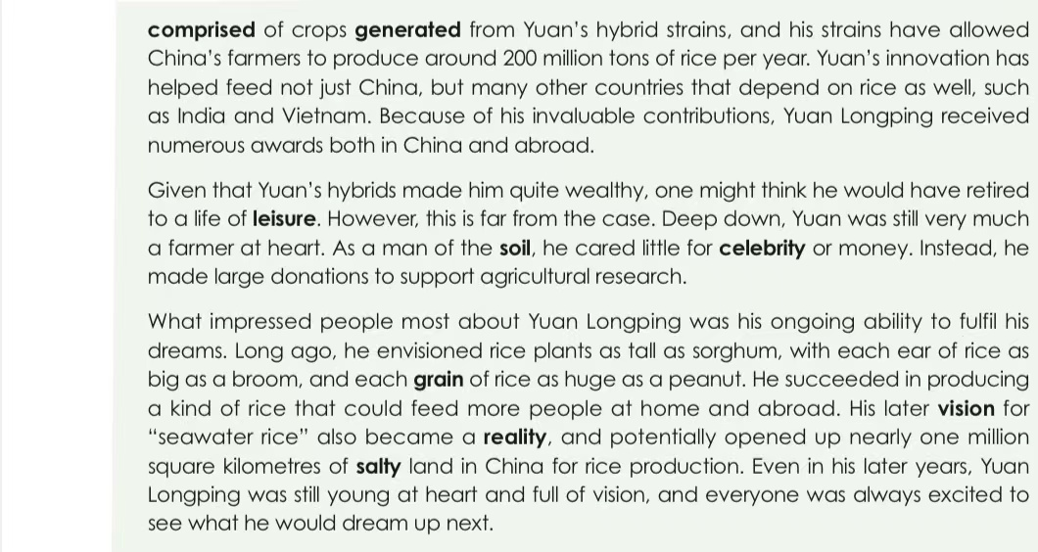
Read for gist（主旨） and genre（文体）
introduction：identity（Who）
What is the type of the passage?
Biography
reason/motivation（Why）
process(How)
achievement(What)
view of life (what )
vision/dream(What)

Slide 10
Content of biography（人物传记）
funny story
general introduction
appearance
quality
life experience
family life
work experience
occupation
contributions
identity
education
achievements
Biography

Slide 11
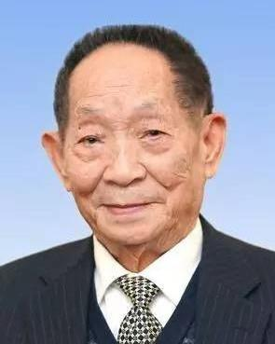
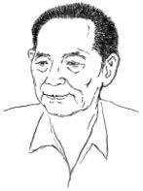
Read for para.1 &2
Birthdate
Birthplace
In 1930 in Beijing
Appearance
Slim but strong
A scientist & “Father of Hybrid Rice”
VS. A farmer
Identity
Major
Agriculture
Why did Yuan decide to study agriculture?

Slide 12
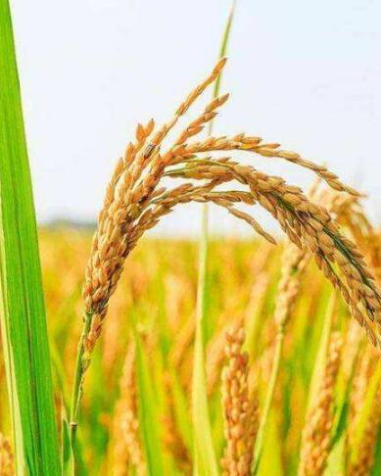
Para.3 Research process
tough/unprecedented（史无前例的) job
How did Yuan Longping develop hybrid rice?
developed
overcame
hybrid
rice in 1974
convinced
technical difficulties
What is the main advantage of hybrid rice?
realized
the creation of hybrid rice
larger fields✘
boost yields✔
enabled farmers to expand their output greatly
设计人员

Slide 13
Para.3 Research process
What qualities of Yuan contribute to the success?
developed
overcame
hybrid
rice in 1974
convinced
technical difficulties
realized
the creation of hybrid rice
larger fields✘
boost yields✔
Devotion to overcoming difficulties
设计人员
Critical thinking

Slide 14
Para.4 Achievement
How does the author show the achievement of Yuan Longping ?
What achievements has Yuan Longping achieved?
___________domestic rice consumption
produce __________tons of rice per year
feed ________
countries
60 percent
200 million
many other
numbers
Emphasize Yuan's invaluable countributions

Slide 15
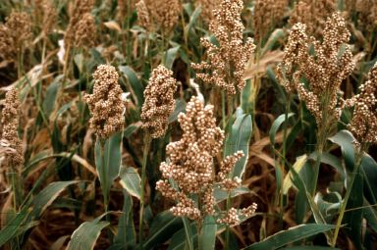
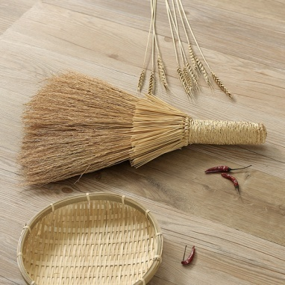
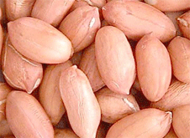
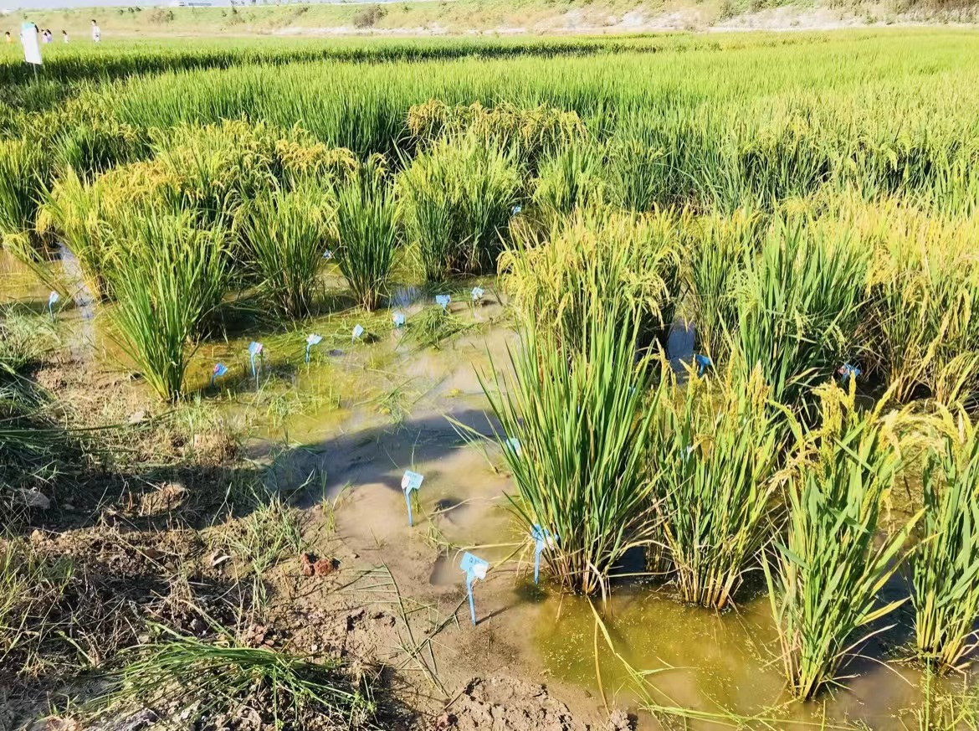
Para.6 Vision
as tall as sorghum
as big as a broom
as huge as a peanut
Mr.Yuan is old but still working hard to fulfil his dreams.
his former vision:
his latest vision:
“seawater rice ”
… make the impossible into possible
... make dreams into reality
Notes:
Passagetiona

Slide 16
Group work
Find out the the writing technique（写作技巧） used in each paragraph, and figure out the personalities of Yuan Longping.
Para | What (content) | How (contrast) | why (personality)
1 | Introduction: Identity
2 | Motivation
3 | Process
5 | View of life

Slide 17
Analyze the writing technique in Para.1
Yuan Longping, known as the "father of hybrid rice", is one of China's most famous scientists. Yet, he considers himself a farmer because he continually works the land in his research. Indeed, his slim but strong body is just like that of millions of Chinese farmers, to whom he has devoted his life.
Q1: What transitional expression（转折词）can you find？
Q2: What is the contrasting information mentioned in Para.1?
Q3: What kind of person Yuan is? and why?

Slide 18
Group work
Find out the the writing technique used in each paragraph, and figure out the personalities of Yuan Longping.
Para | What (content) | How (contrast) | why (personality)
1 | Introduction: Identity | Father of hybrid rice VS (yet) farmer | modest ; devoted
2 | Motivation
3 | Process
5 | View of life
Tip for reading :While reading, pay attention to the transitional expressions to show contrast.(转折词）.

Slide 19
Analyze the Para.2
Yuan Longping was born in 1930 in Beijing. His parents wanted him to pursue a career in science or medicine.However, what concerned him most was that farmers often had poor harvests and sometimes even had a serious shortage of food to eat. To tackle this crisis, he chose to study agriculture and received an education at Southwest Agricultural College in Chongqing.

Slide 20
Group work
Find out the contrast in each paragraph, and figure out the personalities of Yuan Longping.
Para | What (content) | How (contrast) | why (personality)
1 | Introduction: Identity | Father of hybrid rice VS (yet) farmer
2 | Motivation
3 | Process
5 | View of life
modest ;
devoted
caring;
sympathetic;
determined
his parents’s expectation VS(however)
his own decision

Slide 21
Analyze Para.3
After graduating in 1953, he worked as a researcher. Yuan Longping realised that larger fields were not the solution. Instead, farmers needed to boost yields in the fields they had. How this could be done was a challenging question at the time. Yuan was convinced that the answer could be found in the creation of hybrid rice. A hybrid is a cross between two or more varieties of a species. One characteristic of hybrids is that they usually attain a higher yield than conventional crops. However, whether it was possible to develop a hybrid of self-pollinating plants such as rice was a matter of great debate. The common assumption then was that it could not be done. Through intense effort, Yuan overcame enormous technical difficulties to develop the first hybrid rice that could be used for farming in 1974. This hybrid enabled farmers to expand their output greatly.

Slide 22
Group work
Find out the contrast in each paragraph, and figure out the personalities of Yuan Longping.
Para | What (content) | How (contrast) | why (personality)
1 | Introduction: Identity | Father of hybrid rice VS (yet) farmer
2 | Motivation
3 | Process
5 | View of life
modest ;
devoted
caring;
sympathetic;
determined
his parents’s wish VS(however)
his own decision
brave; creative; innovative; confident;devoted
the general assumption
VS(instead) his strong belief

Slide 23
Analyze Para.5
Given that Yuan's hybrids have made him quite wealthy, one might think he would retire to a life of leisure. However, this is far from the case. Deep down, Yuan is still very much a farmer at heart. As a man of the soil, he cares little for celebrity or money. Instead, he makes large donations to support agricultural research.

Slide 24
Group work
Find out the contrast in each paragraph, and figure out the personalities of Yuan Longping.
Para | What (content) | How (contrast) | why (personality)
1 | Introduction: Identity | Father of hybrid rice VS (yet) farmer
2 | Motivation
3 | Process
5 | View of life
modest ;
devoted
caring;
sympathetic;
determined
his parents’s wish VS(however)
his own decision
brave; creative; innovative; confident;devoted
the general assumption
VS(instead) his strong belief
retire to a life of leisure VS
continue to work the land; (however)
make him wealthy VS (instead)
care little for celebrity or money & donate...
plain; simple; caring; selfless；generous

Slide 25
Further thinking
Can you give your own definition of “a pioneer”? And why is Yuan Longping called a pioneer？
From my point of view, a pioneer is someone who... and..., I consider/ regard.... a pioneer. For one thing,... for another ,...
have great qualities like a strong will （意志力），
determination and kindness etc.
...influence others in a positive way/ set good examples for others ..
be helpful to the development of human beings.

Slide 26
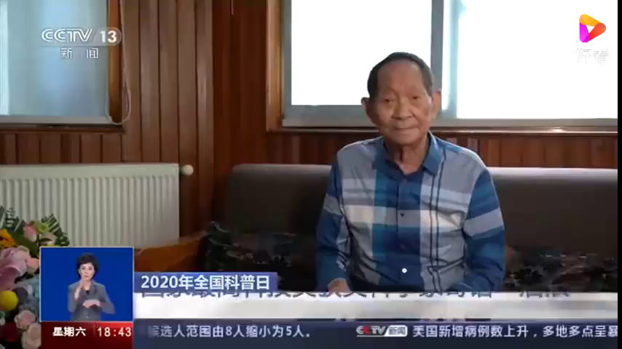
Video sharing
What can we learn from this pioneer?

Slide 27
Chance favors the prepared mind.
Video sharing

Slide 28
Video sharing
Chance favors the prepared minds.

Slide 29
Further thinking
As a student，How to be well prepared to be a pioneer in our own life?
Knowledge
Personality
Learn from the pioneer!
Be a pioneer in our own fields!

Slide 30
Assignment
Recommend another pioneer with 80 words and share it with your classmates.

Slide 31
Thank you !

