Slide 1

感恩遇见，相互成就，本课件资料仅供您个人参考、教学使用，严禁自行在网络传播，违者依知识产权法追究法律责任。
更多教学资源请关注
公众号：溯恩高中英语
知识产权声明

Slide 2
Welcome to
Phyllis’ Class!

Slide 3

Talking about what the Internet can do for people
What do you do with the Internet?
chat with other people
share your life
write a blog post
enjoy streaming movies and music
buy and sell items
search information that you want
...
If you go through hard times, would you use the Internet to help you?

Slide 4
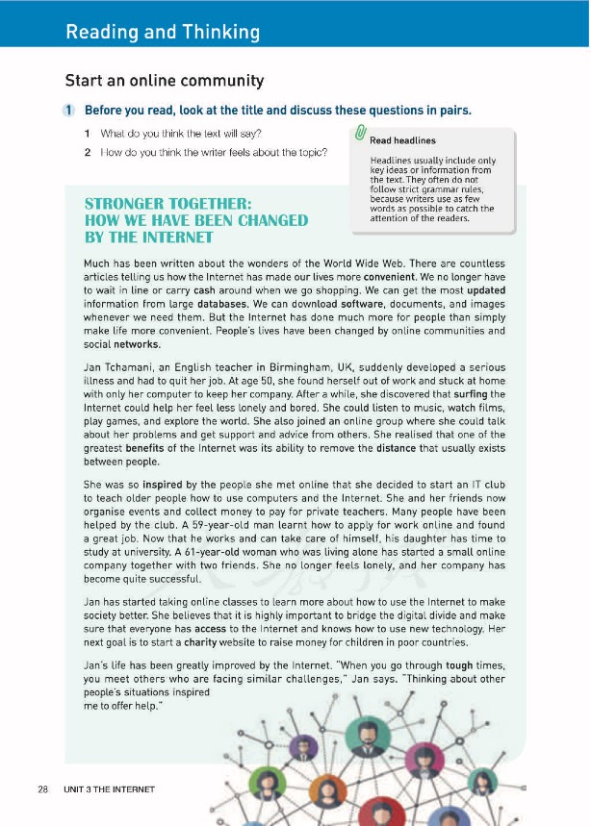


People’s lives have been changed by the Internet.
What might be mainly talked about in the passage?
In what ways does the writer tell us that lives have been changed by the Internet?
By showing examples.
What is mainly talked about in the passage?
By making conclusions

Slide 5
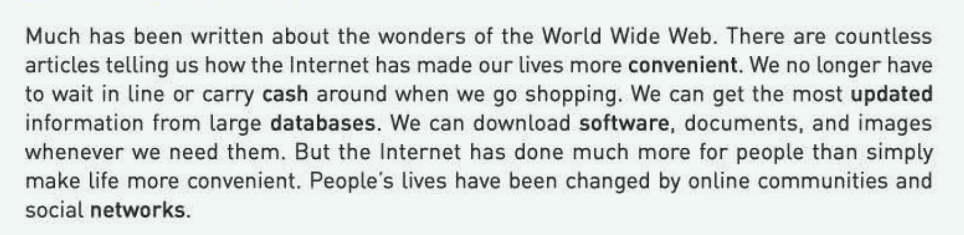
Para. 1
Q1: What “wonders” have the Internet created?
Q2: How is the word “but” used here?
Q3: How do you think the writer feels about the topic?
surprised
convenient
positive
supportive
To introduce a positive contrast and lead to the main idea.

Slide 6
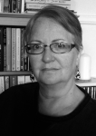
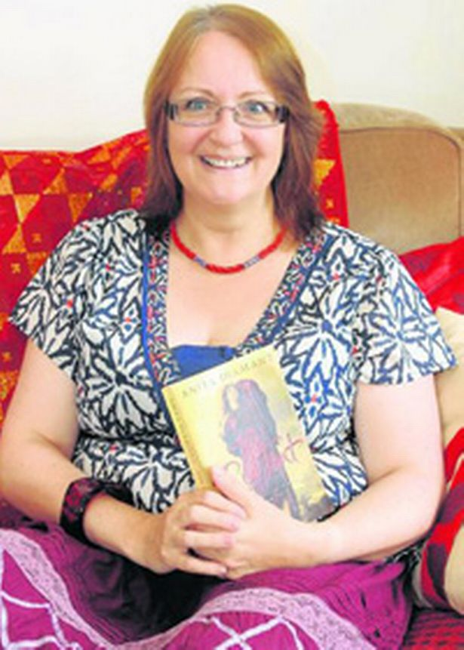
Para. 2
Why has Jan changed so much?
Change

Slide 7
Para. 2
Using the Internet, and especially meeting kind people on the Internet.
accompanied/befriended and happy/loved
Why has Jan changed so much?
lonely/isolated and bored
She realised that…
She also joined…
She could...
…, she found herself…
an
…,she discovered that…

Slide 8
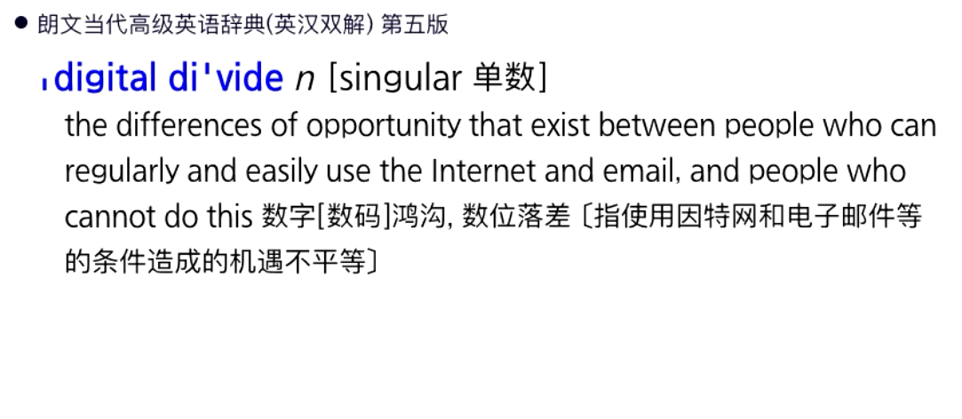
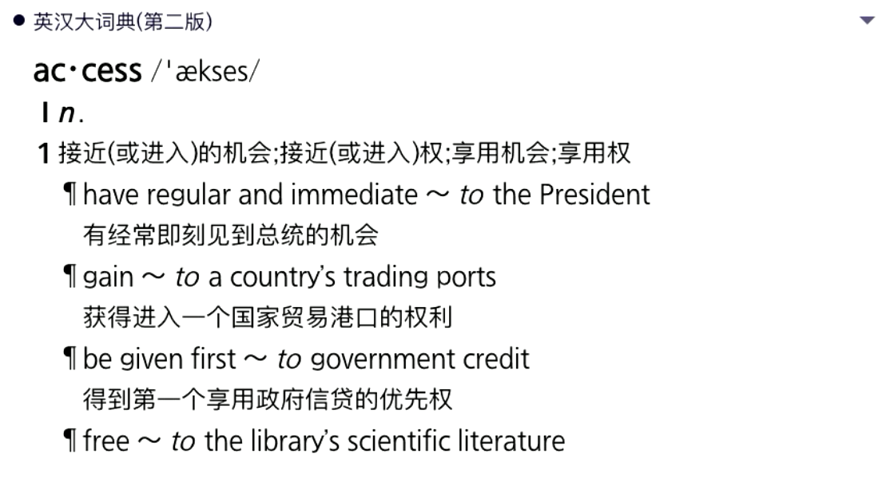
Paras. 3-4
Her next goal…
Her belief/motivation/determination
receiver
She believes…
giver
She started… to learn
The children in poor countries…
She and her friends now organise... and collect…
…,she decided to…
an
A 59-year-old man…
She was so inspired by…
A 61-year-old woman…

Slide 9
Para. 5
“When you go through tough times, you meet others who are facing similar challenges.
Thinking about other people’s situations inspired me to offer help.”
What can we learn from her experiences?

Slide 10

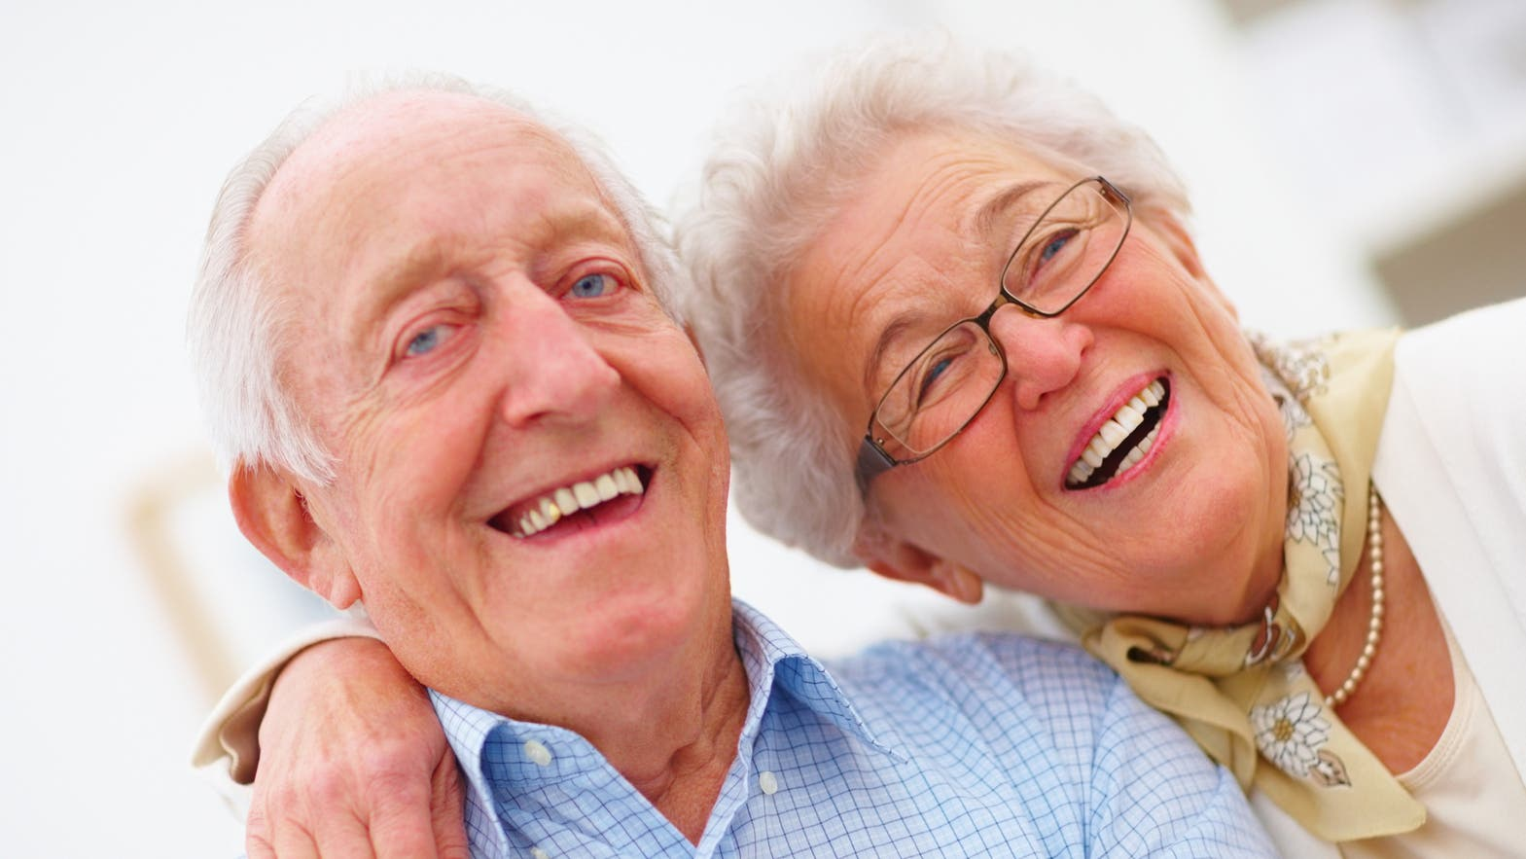

From what aspects does the writer explain the changes?
The Internet and people
The changes to Jan herself
The changes to the society
ongoing
The changes to others
The ____________ of the changes
The changes

Slide 11
Do you have any problems with the Internet?
The Internet can be a double-edged sword.
Social communication
Independent learning
Electronic business
Personal Relationships
Culture transmission
Online Security
Global issues

Slide 12
How to make us and the Internet stronger together?
Final task: Get ready for the group discussion!
Social communication
Independent learning
Electronic business
Personal Relationships
Culture transmission
Online Security
Global issues

Slide 13

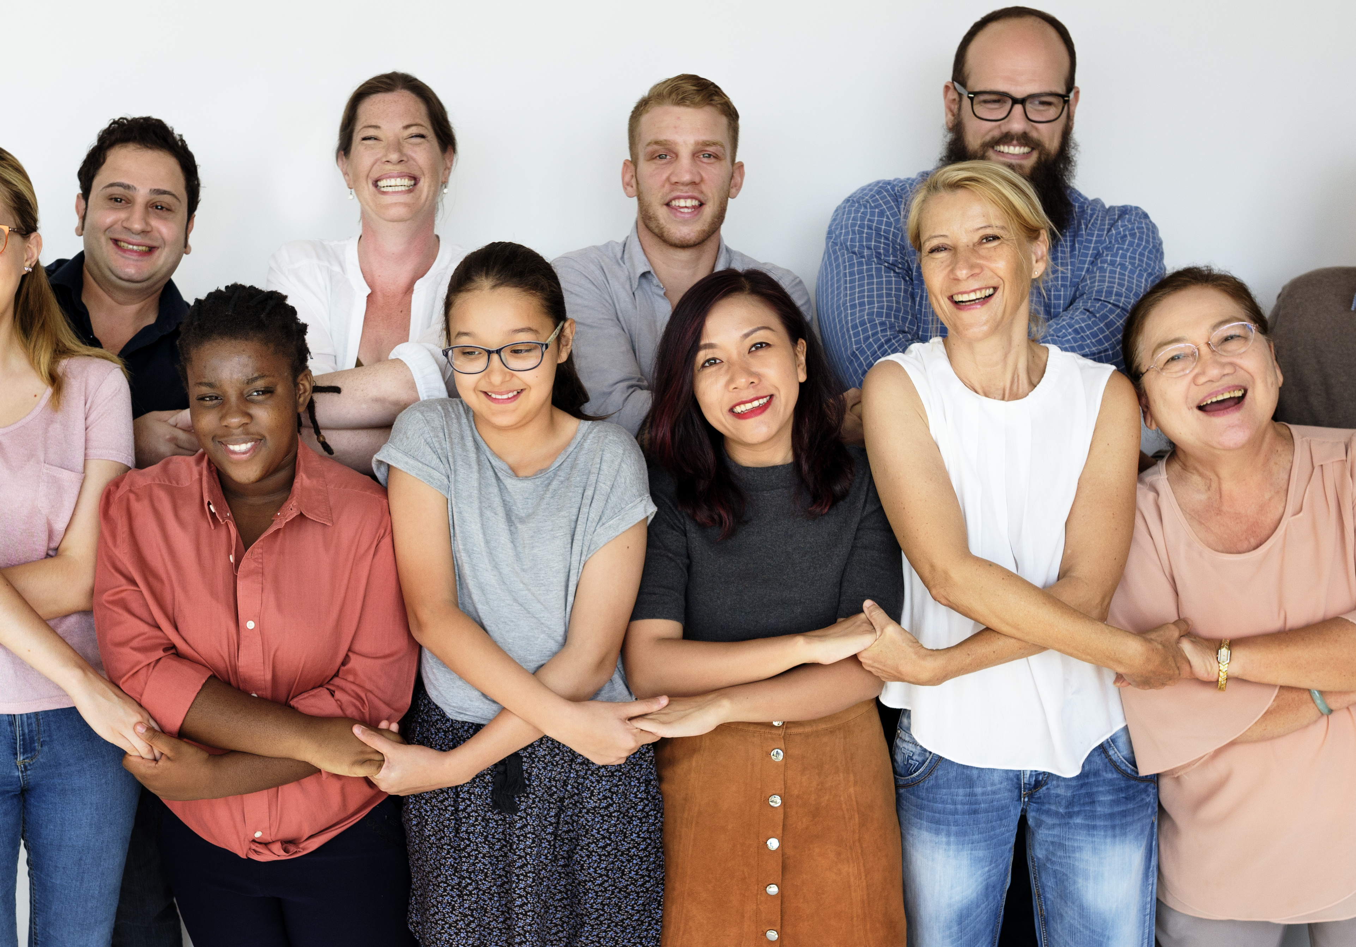


The
Internet
The
Internet
People
People
Stronger together, the Internet and people make
the nation
a company,
and the world
go around and
go forward.

Slide 14

Assignment
Write a blog post about your own experience with the Internet, using what has been learned and discussed so far.

Slide 15


