Slide 1

感恩遇见，相互成就，本课件资料仅供您个人参考、教学使用，严禁自行在网络传播，违者依知识产权法追究法律责任。
更多教学资源请关注
公众号：溯恩高中英语
知识产权声明

Slide 2

应用文 ——主题 的突出

Slide 3
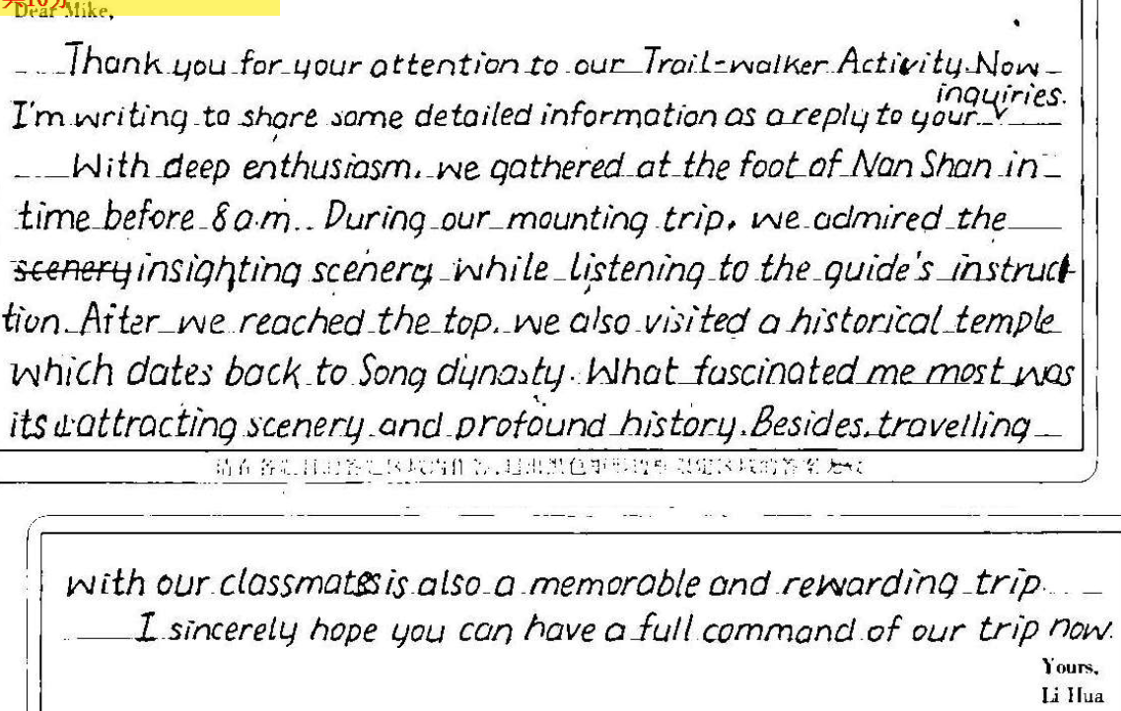

What do you think of the writing below? Is it good enough?
假定你是李华，你的英国朋友Mike通过社交媒体获知你校举行的“南山登顶”毅行活动（Trail-walker Activity），写信向你了解相关情况。请给他写一封回信，内容包括：
1. 时间地点
2. 活动过程
3. 你的感受
主题要准确
Circle out theme-related words
登山活动
“毅行”登顶活动

Slide 4



“毅行”登顶活动
What aim does this activity
want to achieve?
活动过程
假定你是李华，你的英国朋友Mike通过社交媒体获知你校举行的“南山登顶”毅行活动（Trail-walker Activity），写信向你了解相关情况。请给他写一封回信，内容包括：
1. 时间地点
2. 活动过程
3. 你的感受
walked
climbed
mounted
peak
top/ mountaintop
summit
determination
perseverance persistence willpower
reflect
你的感受
内容要相关
Choose relevant and logical points

Slide 5

类型
时态
人称
要点
告知信
一般过去时
审题
第一人称+第二人称
假定你是李华，你的英国朋友Mike通过社交媒体获知你校举行的“南山登顶”毅行活动（Trail-walker Activity），写信向你了解相关情况。请给他写一封回信，内容包括：
1. 时间地点
2. 活动过程
3. 你的感受
为什么告知？
P1 写作目的——告知信息
P2 时间: 地点:
过程——
感受——
P3
Mount/ Mountain Nan
具体过去时间
起点;途中;终点
必写：培养坚毅的个性
其他：解压；加深同学友谊；
增强团队精神……
希望所给信息有用
如需其他信息请联系
询问是否有类似活动
How to connect them?

Slide 6
因果要对应
Give reasonable cause and effect
经过
感受
Though we were tired, we kept on walking/ none of us gave up until reaching the top of the mountain.
We realized how perseverance would influence our study and life, and we will work harder in the future.
During the activity, we offered help to those students too tired to move forward and helped everyone make it to the top.
The activity showed our team spirit and strengthened mutual trust/ friendship among students.
The flowers and plants along the trail as well as the beautiful scenery on top of the mountain all kept us spellbound.
Immersed in the natural beauty, we felt refreshed/ relieved/ freed/ released from the study burden.

Slide 7
表达要突出主题
Use theme-related expressions
Exhausted/ Worn-out/ Drained of energy as we were due to the long/ endless and rough/ rocky trail as well as the unexpected rain, we still kept on forging ahead/ striving forward until reaching the top of the mountain.
身体困难
环境困难
意志体现
Though we were tired, we kept on walking/ none of us gave up until reaching the top of the mountain.

Slide 8
Practice: Polish your writing.
表达要突出主题
Use theme-related expressions
因果要对应
Give reasonable cause and effect
内容要相关
Choose relevant and logical points
主题要准确
Circle out theme-related words

Slide 9
A revised possible version: underline theme-related expressions
Dear Mike,
In response to your inquiry about the Trail-walker Activity held annually by my school, I’m writing to elaborate on some details.
It was launched at 8:00 am last Saturday this year. All students set out from the school gate and then climbed up Mountain Nan, covering approximately 10 kilometers. Though the rocky trail and unexpected rain added to great difficulty, we persisted in mounting to the peak despite our painful legs. Therefore, the activity was fulfilling and rewarding, freeing us from heavy study burden and also significantly enhancing our willpower.
How about your school life? Looking forward to your reply.
Yours,
Li Hua
(100 words)

Slide 10
A revised possible version: underline theme-related expressions
Dear Mike,
In response to your inquiry about the Trail-walker Activity held annually by my school, I’m writing to elaborate on some details.
It was launched at 8:00 am last Saturday this year. All students set out from the school gate and then climbed up Mountain Nan, covering approximately 10 kilometers. Though the rocky trail and unexpected rain added to great difficulty, we persisted in mounting to the peak despite our painful legs. Therefore, the activity was fulfilling and rewarding, freeing us from heavy study burden and also significantly enhancing our willpower.
How about your school life? Looking forward to your reply.
Yours,
Li Hua
(100 words)

Slide 11
已写应用文回顾 （找主题）
假如你是李华，是某国际学校的图书馆学生助理，请你代表图书馆用英语拟一则告示，向新入学的高一学生简要介绍图书馆的相关信息，内容包括：
藏书介绍；
借阅规则。
Notice
Sept. 1, 2022
Dear freshmen,
Welcome to our library!
In our library, we stock all manner of domestic and foreign books to quench your thirst for spiritual content. Not only the latest books or new journals but the vintage in history and content are available here. We also offer both the online and offline versions to cater to your varied needs. It is open on weekdays, each day from 9:00 am to 10:00 pm. Only students enrolled in this school can apply for a special card in the library to read or borrow books, but remember, do not mark, deface or damage any library property.
Please get a card and embark on a fun journey of reading!
The School Library
介绍国际学校图书馆

Slide 12
已写应用文回顾 （找主题）
（2022全国I卷）假定你是校广播站英语节目“Talk and Talk”的负责人李华，请给外教Caroline写邮件邀请她做一次访谈。内容包括：
节目介绍；
访谈的时间和话题。
Dear Caroline,
Representing our school radio station, I feel greatly honored to invite you to attend our program—Talk and Talk.
Established ten years ago, Talk and Talk provides a perfect platform for teachers to share their insightful ideas with students. Now, faced with difficulty in learning English well, plenty of students feel it an urge to know how to deal with it. As our distinguished English teacher, your aid can definitely benefit us students.
If you are available at 6:00 p.m. this Sunday, we Talk and Talk staff are all waiting for your coming. Looking forward to your reply.
Yours sincerely,
Li Hua
广播站英语访谈节目邀请

Slide 13
未写应用文审题训练（找主题）
假定你是国际学校学生李华，4月22日“世界地球日”即将来临，请你代表学生会写一封倡议书，呼吁大家关爱地球。内容包括：
1. 现状说明
2. 具体措施
3. 发出倡议
Dear fellow students,
As carbon emissions rocket and extreme weather frequents, our earth is experiencing unprecedented challenges.
So we firmly advocate all of us to live an environmentally friendly life. Taking public transport instead of cars never fails to be a good choice. Additionally, by no means should anyone leave the electronic devices on while not using it. Moreover, it’s highly suggested to replace low-efficiency devices with energy-efficient ones such as LED.
It’s high time that we spared no effort to stop the situation from worsening. Let’s do it!
The Student Union
倡议书——呼吁大家关爱地球

Slide 14
未写应用文审题训练（找主题）
假如你是李华，高考即将来临，但你最近越来越紧张，无法集中精力复习，请给你校英语报负责学生心理专栏的老师Karen写封邮件，寻求帮助。内容包括：
自我介绍；
你的困难；
请求帮助。
Dear Karen,
I am Li Hua, a senior 3 student. With the College Entrance Exam approaching, I encountered some difficulties in my learning, so I am writing to ask you for a favor.
The high expectation from teachers and my parents pushes me in enormous stress, making me hard to fall asleep every night. Worse still, I find it difficult to concentrate on my study, for which I am extremely nervous and unsettled.
I will appreciate it if you could offer me some suggestions on how to overcome these problems. Looking forward to your earliest reply.
Yours,
Li Hua
考试临近紧张求助 心理老师

