Slide 1


感恩遇见，相互成就，本课件资料仅供您个人参考、教学使用，严禁自行在网络传播，违者依知识产权法追究法律责任。
更多教学资源请关注
公众号：溯恩高中英语
知识产权声明

Slide 2

The World
December 1st-15th, 2022

Slide 3
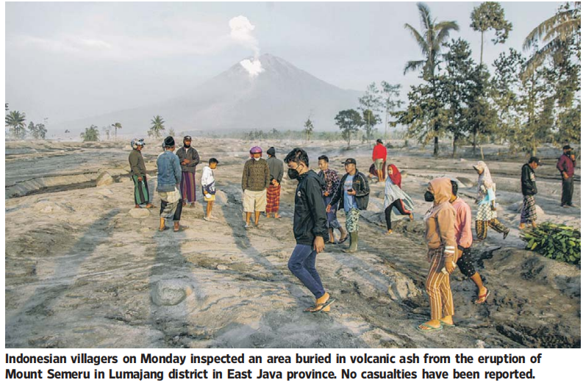
1. WORLD WATCH

Slide 4

语篇填空1
（《华尔街日报》2022年12月6日 A22版面）
A mudslide unleashed by torrential rain buried a bus and two other vehicles in central Colombia, killing at least 27 people and leaving others _______ (trap) as rescuers tried to reach _____ in the wreckage on Monday.
The mudslide late Sunday _______ (divide) a highway in two in the town of Pueblo Rico in the district of Risaralda.
____ dead included three children, President Gustavo Petro tweeted. Several more people were rescued and taken to hospitals. More than 70 search-and-rescue workers _____ (use) backhoes and other equipment tried to reach the rest.
trapped
them
divided
The
using

Slide 5

语篇填空2
（《华尔街日报》2022年12月6日 A22版面）
More than six years after the ________ (deadly) peacetime attack on Belgian soil, the trial of 10 men _______ (accuse) over the suicide bombings at Brussels airport and a subway station started in earnest under high security on Monday.
Among the accused is Salah Abdeslam, the only ________ (survive) among the Islamic State extremists ________ in 2015 struck the Bata-clan theater in Paris, city cafes and France’s national stadium. He ___________ (bring) to the court in an armored police vehicle and identified himself when called upon by the presiding judge.
The 10 defendants face _______ (charge) including murder, attempted murder and membership in, or participation in the acts of, a terrorist group, over the attacks at Belgium’s main airport and on the central commuter line on March 22, 2016.
___ all, 32 people were killed. Around 900 people were hurt or suffered mental trauma. If convicted, some of the accused could face up to 30 years in prison.
deadliest
accused
survivor
who/that
was brought
charges
In

Slide 6

语篇填空3
（《华尔街日报》2022年12月6日 A22版面）
Improved weather conditions Monday allowed rescuers to resume __________ (evacuate) efforts and a search for possible victims after the highest volcano on Indonesia’s most _______ (dense) populated island erupted, ________ (trigger) by monsoon rains.
Mount Semeru in Lumajang district in East Java province spewed thick columns of ash nearly 5,000 feet into the sky Sunday. Villages and nearby towns _____________ (blanket) with falling ash, blocking out the sun, but no _________ (casualty) have been reported.
Hundreds of rescuers were deployed Monday in the worst-hit villages of Sumberwuluh and Supiturang, ______ houses and mosques were buried to their rooftops by tons of volcanic debris.
Heavy rains had eroded and finally collapsed the lava dome atop the 12,060-foot volcano, causing ___ avalanche of blistering gas and lava down its slopes toward a nearby river.
evacuation
densely
triggered
were blanketed
casualties
where
an

Slide 7
词汇讲解1
1. unleash: ~sth (on/upon sb/sth) to suddenly let a strong force, emotion, etc. be felt of have an effect 发泄；突然释放；使爆发
The officers were still reluctant to unleash their troops in pursuit of their enemy.
军官们仍不愿发兵追击敌人。
2. preside: ~ (at/over sth) to lead or be in charge of a meeting, ceremony, etc.
主持（会议、仪式等）；担任（会议）主席
The PM presided over a meeting of his inner Cabinet. 首相主持了一次核心内阁会议。
翻译句子
政府的提案引发了新闻界的抗议浪潮。
The government’s proposals unleashed a storm of protest in the press.
翻译句子
他们问我是否会主持委员会会议。
They asked if I would preside at the committee meeting.

Slide 8
词汇讲解2
3. spew: to flow out quickly, or to make sth flow our quickly, in large amounts
（使）喷出；涌出
The volcano spewed out more scorching volcanic ashes, gases and rocks. 火山喷出更多灼热的火山灰、气体和岩块。
4. deploy: to move soldiers or weapons into a position where they are ready for military action 部署，调度（军队或武器）
The president said he had no intention of deploying ground troops. 总统称并不打算部署地面部队。
翻译句子
飞机发动机喷出火焰。
Flames spewed from the aircraft’s engine.
翻译句子
沿边境至少部署了5000枚导弹。
At least 5000 missiles were deployed along the border.

Slide 9
句子翻译
A mudslide unleashed by torrential rain buried a bus and two other vehicles in central Colombia, killing at least 27 people and leaving others trapped as rescuers tried to reach them in the wreckage on Monday.
翻译
周一，暴雨引发的泥石流在哥伦比亚中部掩埋了一辆公共汽车和另外两辆汽车，造成至少27人死亡和多人被困，救援人员正试图从废墟中救出他们。
Improved weather conditions Monday allowed rescuers to resume evacuation efforts and a search for possible victims after the highest volcano on Indonesia’s most densely populated island erupted, triggered by monsoon rains.
翻译
周一天气条件的改善使救援人员得以恢复疏散工作，并搜寻可能的受害者。此前，印尼人口最密集岛屿上最高的火山因季风降雨而爆发。

Slide 10
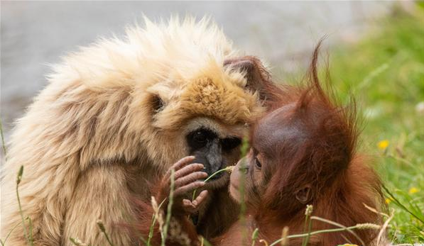
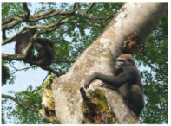
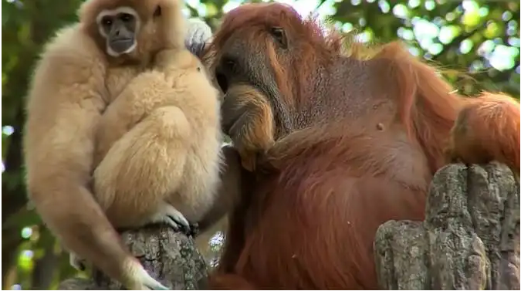
2. Friendship among the apes
猩猩之间的友谊

Slide 11
语篇填空
（《周刊报道》2022年12月2日 21页）
Chimpanzees and gorillas can be pals.
That’s the conclusion of a two- decade study_________ analyzed social inter-actions between the two primate species in the Republic of Congo, says NPR .org. Researchers in Nouabalé- Ndoki Park observed gorillas ________ (follow) the calls of chimps to ripe fig trees and then feeding alongside them. They also saw ____ young of the two species playing with each other. And when bands of the two groups __________ (encounter) each other, gorillas and chimps would scan the other side and approach _________ (individual) they knew. Chimps even mimicked gorillas ___ beating their chests.
The researchers ___________ (theorize) that these quasi-friendships might form to help avoid predators, ____ they concluded the more likely incentive was to find food. The close relationships did sometimes result in aggressive displays and spats, but those ______ (rare) escalated to serious violence. Co- author Jake Funkhouser, from Washington University, says the findings indicate “a depth of social _________ (aware) and myriad social transmission path ways not previously imagined.”
that/which
following
the
encountered
individuals
by
had theorized
but
rarely
awareness

Slide 12
词汇讲解
1. incentive: something that encourages you to do sth. 激励；刺激；鼓励
Neither side would have a real incentive to start a war. Ergo, peace would reign.
双方都没有发动战争的真实动机。因此，和平将会到来。
2. escalate: to become or make sth greater, worse, more serious, etc.
使）逐步扩大，不断恶化，加剧
Conditions are still very tense and the fighting could escalate at any time. .
形势依然很紧张，战斗随时可能升级。
翻译句子
没有使人们节约燃料的鼓励办法。
There is no incentive for people to save fuel.
翻译句子
这场交战逐步扩大为全面战争。
The fighting escalated into a full-scale war.

Slide 13
句子翻译
And when bands of the two groups encountered each other, gorillas and chimps would scan the other side and approach individuals they knew.
翻译
当两组不同种类的猩猩相遇时，大猩猩和黑猩猩会扫视另一边的情况，然后接近他们认识的猩猩。
The researchers had theorized that these quasi-_x0002_friendships might form to help avoid predators, but they concluded the more likely incentive was to find food.
翻译
研究人员认为理论上这种准友谊可能是为了帮助躲避捕食者，但他们得出的结论是，更有可能的动机是寻找食物。

Slide 14

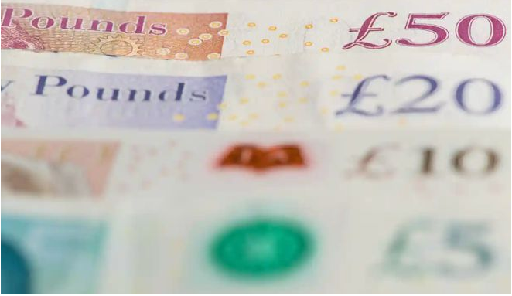
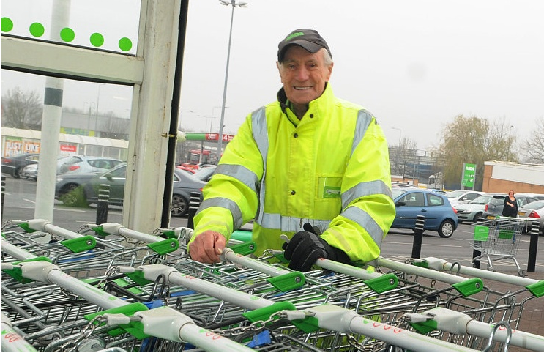
3. Women in fifties face £7,000 pay gap
50岁的女性面临7000英镑的收入差距

Slide 15
语篇填空
（《泰晤士报》2022年12月5日 17页）
Older women workers face the highest gender pay gap in the country with those aged more than 50 paid ____ average £7,000 less than their male counterparts.
Research being published today reveals a 24 per cent difference between the median gross annual pay of full-time working men and women aged in their ______ (fifty). That gap rose to 26 per cent for women workers aged older than 60.
A survey for Rest Less, an organisation __________ provides work advice to the over-50s, found that women aged between 50 and 59 earned an average salary of £30,603. That was £7,274 less than men in ____ same age group. The research team __________ (compare) this year’s data with the previous ten years and found that while the national gender pay gap across all ages _____________ (narrow) from 24 per cent in 2012 to 19 per cent this year, ____ remained at its highest for those in their fifties and sixties.
The organisation attributed much of the gender pay gap for older women to the burden of caring responsibilities, which __________ (primary) still fall on women. “Women can miss out on salary progression during their careers, which compounds as time goes on, _________ (widen) the gender pay gap as we age,” Stuart Lewis, the chief executive of Rest Less, said. He added that the gender pay gap for older workers “can have devastating long-term conse-quences on women’s retirement provision and ________ (finance) independence into later life”.
on
fifties
that/which
the
compared
had narrowed
it
primarily
widening
financial

Slide 16
词汇讲解
1. attribute: to say or believe that sth is the result of a particular thing 把…归因于；认为…是由于
The committee refused to attribute blame without further information.
如果没有进一步的情况，委员会拒绝归罪于任何人。
2. devastating: causing a lot of damage and destruction 破坏性极大的；毁灭性的
Oil spills are having a devastating effect on coral reefs in the ocean.
海上溢油对海洋里的珊瑚礁有着毁灭性影响。
翻译句子
她认为她的成功来自勤劳和一点运气。
She attributes her success to hard work and a little luck.
翻译句子
他在这次事故中受到致命伤害。
He received devastating injuries in the accident.

Slide 17
长难句分析
The research team compared this year’s data with the previous ten years and found that while the national gender pay gap across all ages had narrowed from 24 per cent in 2012 to 19 per cent this year, it remained at its highest for those in their fifties and sixties.
The research team
分析：本句结构较为复杂：本句主语是_________________，句子中的 “compared and found” 为________；found后面是that 引导的宾语从句，而宾语从句是有while 引导的一个_____________。
谓语
状语从句
研究小组将今年的数据与前十年的数据进行了比较，发现尽管全国各年龄段的性别收入差距已从2012年的24%缩小至今年的19%，但五六十岁人群的性别收入差距仍然最高。
翻译

Slide 18
句子翻译
A survey for Rest Less, an organisation that provides work advice to the over-50s, found that women aged between 50 and 59 earned an average salary of £30,603. That was £7,274 less than men in the same age group.
为50岁以上人群提供工作建议的组织Rest Less进行的一项调查发现，年龄在50岁至59岁之间的女性的平均工资为30603英镑。这比同年龄段的男性少了7274英镑 。
翻译
The organisation attributed much of the gender pay gap for older women to the burden of caring responsibilities, which primarily still fall on women.
该组织将老年女性的性别收入差距很大程度上归因于照顾孩子的责任，而这些责任主要仍落在女性身上。
翻译

Slide 19
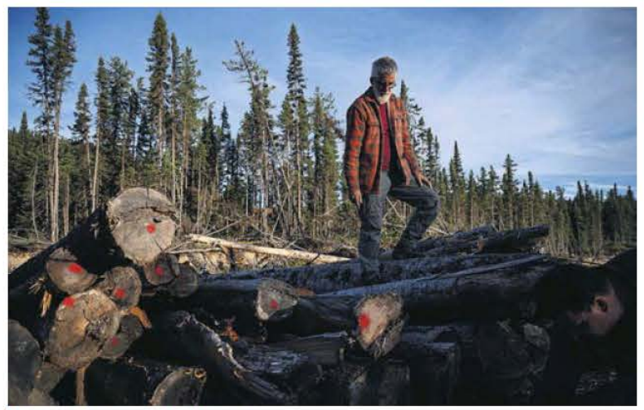
4. Burning trees for energy puts nature and climate goals at risk, 650 scientists warn
“焚树取能”危及自然气候
Canada is one of the largest providers of biomass wood, and clearcutting is harming its forests.

Slide 20
语篇填空
（《卫报》 2022年12月5日 4页）
to stop
More than 650 scientists are urging world leaders ______ (stop) burning trees to make energy ahead of Cop15, the UN biodiversity summit, ________ it destroys valuable habitats. Countries need to stop using forest bioenergy to create heat and electricity urgently because it undermines international climate and nature targets, the scientists say. Instead they should use renewable energy _______ (source) such as wind and solar.
Bioenergy has “wrongly been deemed ‘carbon neutral’ and many countries are ___________ (increase) relying on forest biomass to meet net zero goals”, according to the letter, _________ (address) to world leaders including the US president, Joe Biden; the UK prime minister, Rishi Sunak; and the EU president, Ursula von der Leyen. “The best thing for the climate and biodiversity is to leave forests ________ (stand) and biomass energy does ____ opposite.”
The letter says that if ______ (globe) leaders agree to protect 30% of land and sea by 2030 at the Cop15 meeting in Montreal, they must also commit ___ ending reliance on biomass energy. Commitments made at Cop15 and at climate conferences could be undermined if this practice _________ (continue).
because
sources
increasingly
addressed
standing
the
global
to
continues

Slide 21
词汇讲解
1. undermine: to make someone less confident, less powerful, or less likely to succeed, or to make something weaker, often gradually（常指逐渐地）削弱信心、权威等，损害
The contract clearly specifies who can operate the machinery. 合同明确规定谁可以操作机器。
2. deem: to have a particular opinion about sth 认为；视为；相信
They would take any action deemed necessary . 他们会采取认为必要的任何行动。
翻译句子
这场危机已损害了他的地位。
This crisis has undermined his position.
翻译句子
他说如果联合国认为有必要，他就支持动用武力。
He says he would support the use of force if the UN deemed it necessary.

Slide 22
句子翻译
Countries need to stop using forest bioenergy to create heat and electricity urgently because it undermines international climate and nature targets, the scientists say. Instead they should use renewable energy sources such as wind and solar.
科学家们说，各国需要立即停止使用森林生物能源来产生热量和电力，因为这破坏了国际气候和自然目标。相反，他们应该使用风能和太阳能等可再生能源。
翻译
The letter says that if global leaders agree to protect 30% of land and sea by 2030 at the Cop15 meeting in Montreal, they must also commit to ending reliance on biomass energy. Commitments made at Cop15 and at climate conferences could be undermined if this practice continues.
信中说，如果全球领导人在蒙特利尔举行的Cop15会议上同意到2030年保护30%的陆地和海洋，他们还必须承诺结束对生物质能的依赖。如果这种做法继续下去，在Cop15和气候会议上作出的承诺可能会遭到破坏。
翻译

Slide 23
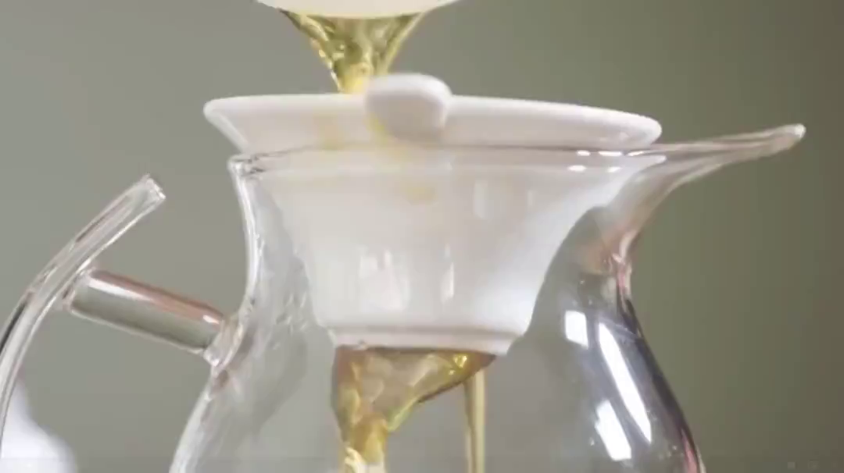
5. Chinese Tea 中国茶

Slide 24

听力填空
Tea is the most popular drink in the world. And there are ________ ways we make and ________ it. But if you wanna drink tea in the oldest way we still know of, you’ll first need to hike deep into the remote Tea Mountains of Southwest China and ________ leaves and buds from tea trees that are hundreds of years old. It’s a long way to go for ________ Chinese tea, but one person is doing it.
“My name’s Shunan Tang. I’m the owner of Tea Drunk, which is a ________ in New York City. We _________ in historic Chinese tea. Historic tea is really representing a pinnacle of tea culture. And these teas are usually not mass produced. And they’re trying to be as authentic to the tea as possible. It’s almost like a __________ of music played versus a practice or an _______ piece of art work versus the copies.”
The masterpiece tea, so to speak, comes from ancient tea trees that grow in the wild. They only ____ for 15 days out of the year. So Shunan must race each spring to find the trees and ______ them in time with the help of local farmers.
...
countless
consume
handpick
authentic
tea house
specialize
masterpiece
original
bud
harvest

Slide 25
词汇讲解
1. pinnacle: the most important or successful part of sth 顶点；顶峰；鼎盛时期
She was still a screen goddess at the pinnacle of her career.
她仍然是一位处于事业巅峰期的银幕女神。
2. so to speak: used to emphasize that you are expressing sth in an unusual or amusing way 可以说；可谓
They were all very similar. All cut from the same cloth, so to speak.
他们都十分相像。可以说就跟一块布上剪下来的似的。
翻译句子
她达到了事业的巅峰。
She has reached the pinnacle of her career.
翻译句子
我本来不该告诉你的，但我还是要这么做，因为好歹你是家里的一员。
I ought not to tell you but I will, since you’re a family member, so to speak.

Slide 26
句子翻译
But if you wanna drink tea in the oldest way we still know of, you’ll first need to hike deep into the remote Tea Mountains of Southwest China and handpick leaves and buds from tea trees that are hundreds of years old.
翻译
但如果你想用我们所知道的最古老的方式喝茶，你首先需要徒步深入中国西南部偏远的茶山，从数百年的茶树上手工采摘叶子和嫩芽。
Historic tea is really representing a pinnacle of tea culture. And these teas are usually not mass produced. And they’re trying to be as authentic to the tea as possible. It’s almost like a masterpiece of music played versus a practice or an original piece of art work versus the copies.
历史悠久的茶确实代表了茶文化的顶峰。而且这些茶通常不是大批量生产的。他们试图尽可能地保持茶的原汁原味。这几乎就像演奏的音乐杰作与练习作品之间的对比，或者是原创艺术作品与复制品的对比。
翻译

