Slide 1

感恩遇见，相互成就，本课件资料仅供您个人参考、教学使用，严禁自行在网络传播，违者依知识产权法追究法律责任。
更多教学资源请关注
公众号：溯恩高中英语
知识产权声明

Slide 2
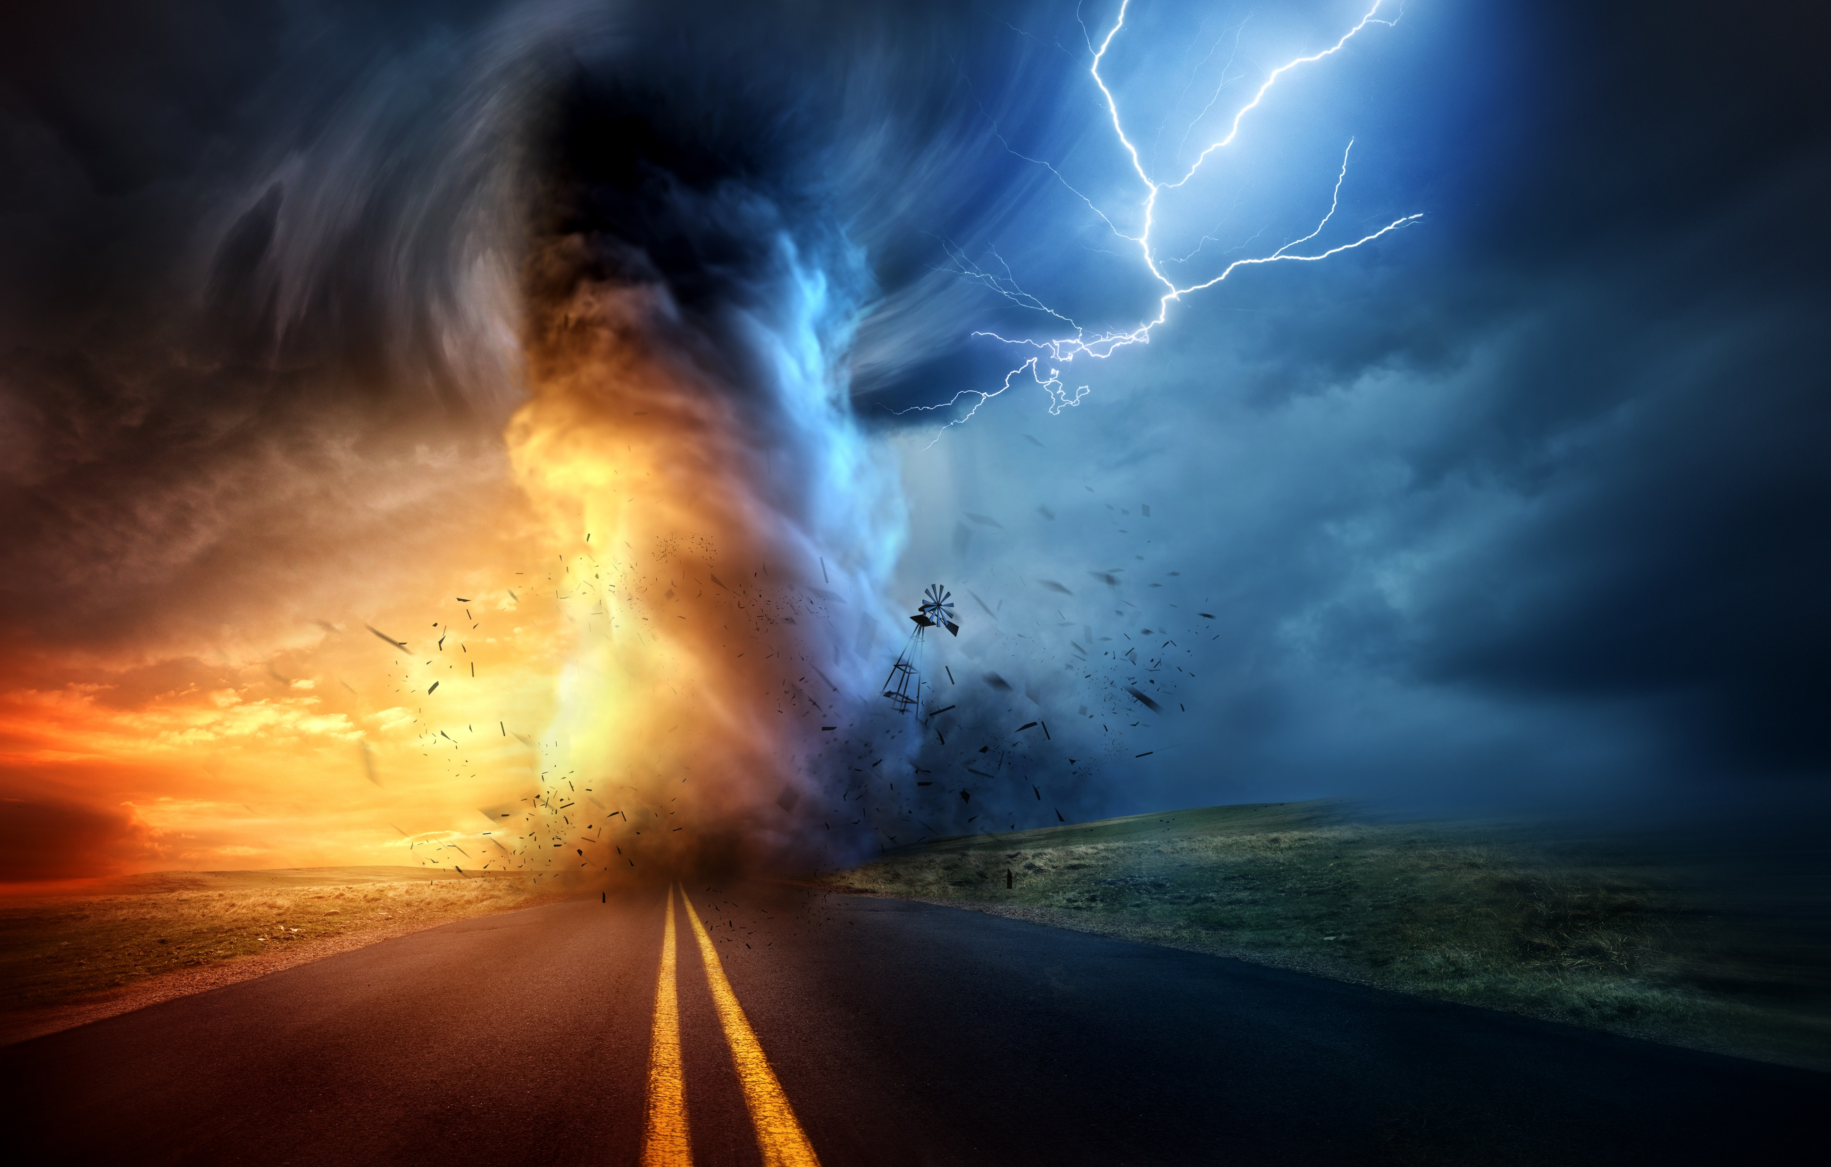
惊险类写作指导
——划船遇到龙卷风
东风高级中学刘彦麟编

Slide 3
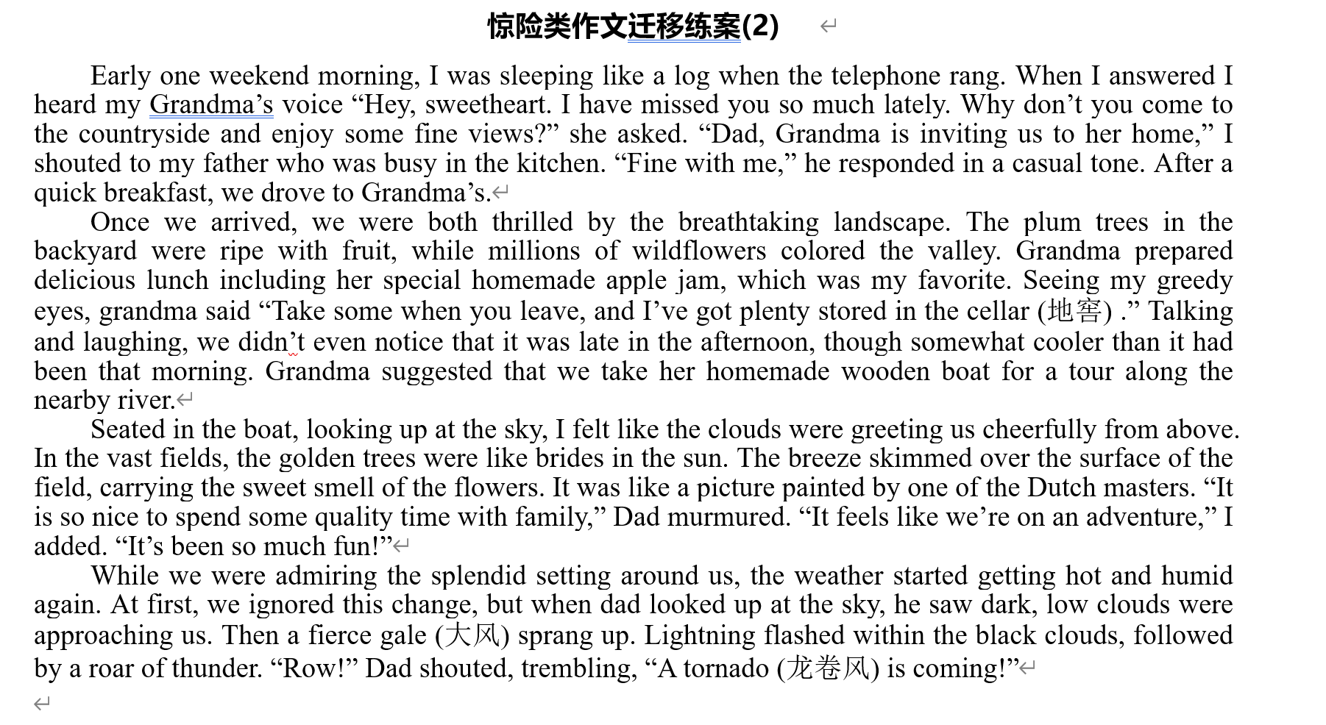

Slide 4






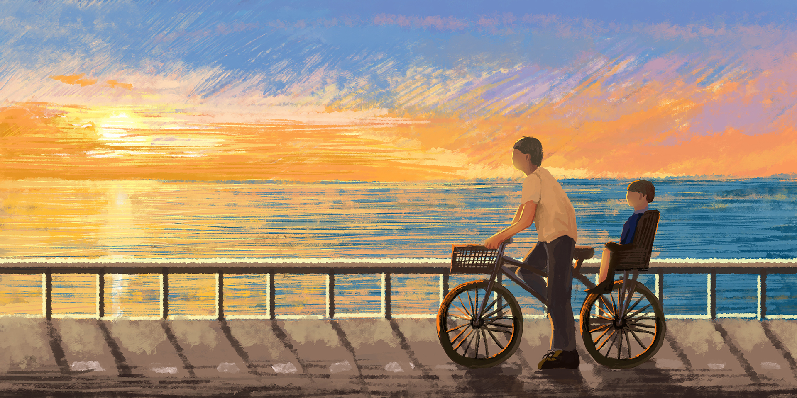
Step1: 先读再写
精读原文，串联文本信息，理清因果关系，完成故事地图。
人物：
时间变化：
地点变化： + +
事件：Late in the afternoon, my father and I were taking my grandmother’s homemade boat for a tour along the nearby river when suddenly a tornado came.
冲突：“我”和爸爸如何逃脱龙卷风
dad, me，grandma

Slide 5





Step2: 关注时空和人物情感变化，敏锐捕捉到一到两个伏笔（契诃夫法则）
空间变化：
情绪变化：
Para1 on the river
Para2 at home
Para1 panicked, scared, urgent, tense, alarming,
Para2 relieved, safe, at ease, comfortable, fortunate, blessed

Slide 6
环境变化： the breathtaking landscape.
The plum trees(李树) in the backyard were ripe with fruit, while millions of wildflowers colored the valley.
Seated in the boat, looking up at the sky, I felt like the clouds were greeting us cheerfully from above. In the vast fields, the golden trees were like brides in the sun. The breeze skimmed over the surface of the field, carrying the sweet smell of the flowers. It was like a picture painted by one of the Dutch masters.
While we were admiring the splendid setting around us, the weather started getting hot and humid again.
When dad looked up at the sky, he saw dark, low clouds were approaching us. Then a fierce gale (大风) sprang up. Lightning flashed within the black clouds, followed by a roar of thunder.
Para1 ?
Para2 ?

Slide 7
伏笔
原文伏笔 | 后文可能的对照
We were both thrilled by the breathtaking landscape. The plum trees in the backyard were ripe with fruit, while millions of wildflowers colored the valley……. | 如此美景，在龙卷风后会是怎样的一番景象呢？例如：lie in ruins, broken/cracked windows, bricks like autumn leaves scattered everywhere.
Grandma prepared delicious lunch including her special homemade apple jam, which was my favorite. Seeing my greedy eyes, grandma said “Take some when you leave, and I’ve got plenty stored in the cellar (地窖) .” | 逃回奶奶家后，地窖cellar可否用上？ “我”喜欢的apple jam还会出现吗？
take her homemade wooden boat | homemade wooden boat 还会出现吗？在逃生时是否重要？
Dad murmured. “It feels like we’re on an adventure,” I added. “It’s been so much fun!” | 爸爸一语成谶，后文还会有交代吗？
…… | ……

Slide 8
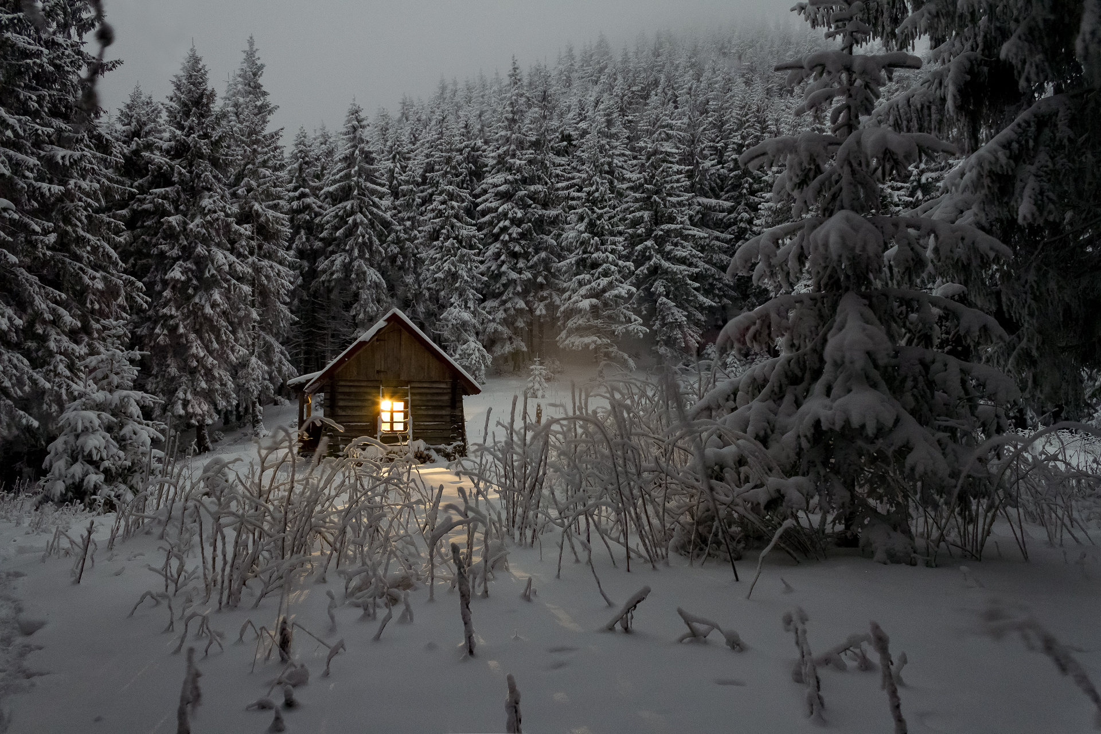
Step3:认真研读两个段首提示句，分析内在逻辑(第二段首句暗示了第一段内容)，合理规划情节。
Para1：There was no time to think. We rowed as fast as we could.
雷电大作，风雨交加。
我和爸爸克服困难，奋力划船。（我的情况;爸爸的情况）
我们终于成功赶回奶奶家。
Para2: Grandma opened the door for us.
全家人一起躲避龙卷风。
龙卷风终于过去。
家人之间的感情升华。

Slide 9
Step4 语言素材
para1:龙卷风场面描写
寒风：chilly / biting/ sharp/ howling/ roaring/ freezing/icy wind
天上：beat against拍打 pour down 倾盆 furious wind 怒风
Black clouds rolled overhead. 乌云翻滚
The thunder was accompanied with lightning 雷电交加
A flash of lightning swept across the sky. 一道闪电划过天空
A flash of lightning lit up the whole sky. 一道闪电照亮天空
The thunder roared and the lightning flashed. 电闪雷鸣
船：paddle船桨 oar橹 toss/shake/rock颠簸
at the mercy of the storm船在暴风雨中失控
动作：seize/grasp/grab/抓 row划 stumble 踉跄
stretch out/reach for 伸手
struggle/spare no effort/strive/strain every nerve to do 奋力做

Slide 10
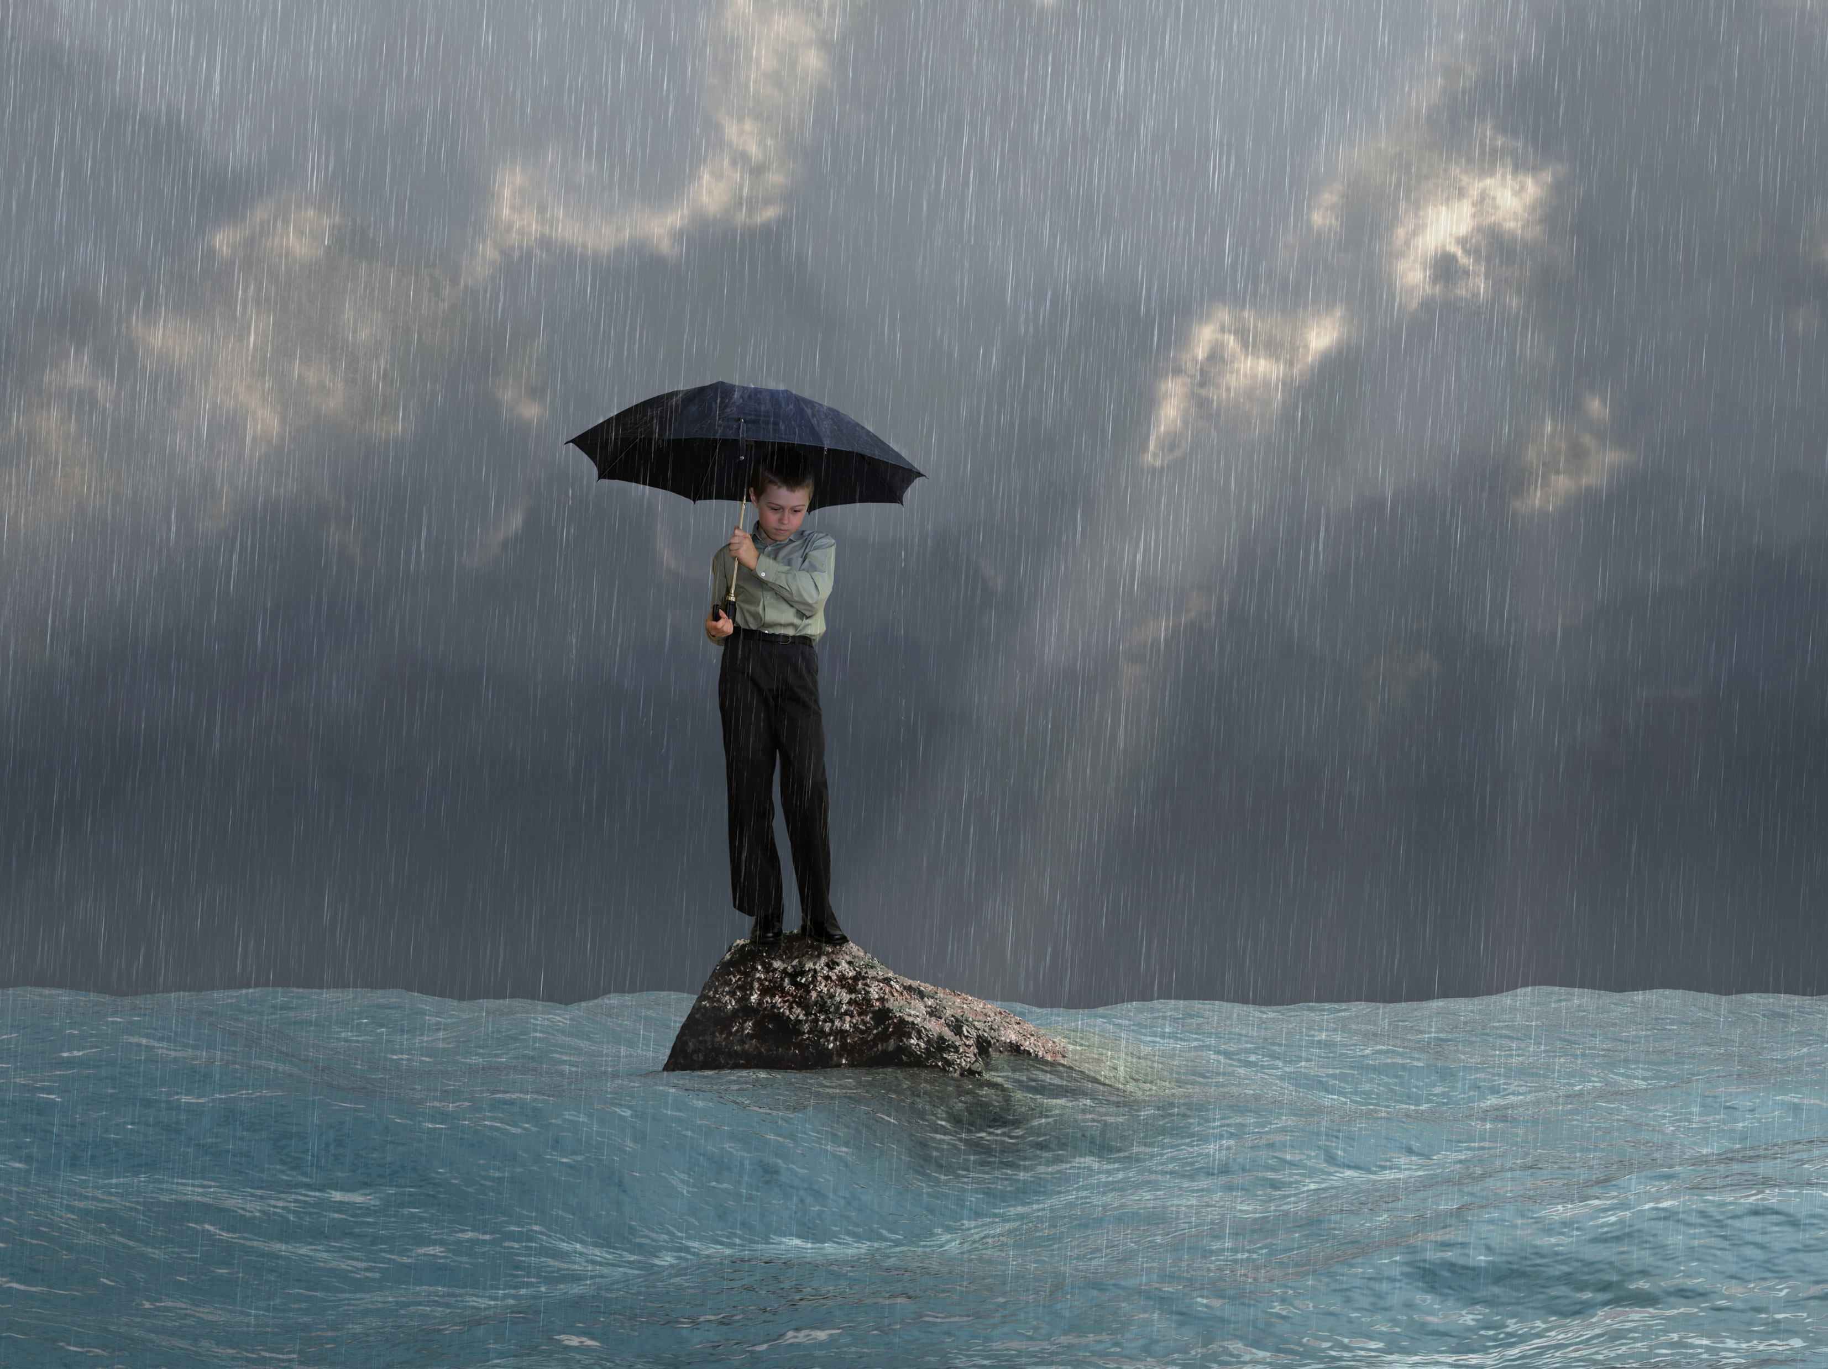
人：sweat-soaked hair 汗湿的头发
tears mixed with sweat汗泪交加
collapse into/onto...瘫坐在...
fingers went numb 手指麻木
exhausted and somewhat hopeless 精疲力尽且有些绝望
with a blank expressions 面无表情
feel sick with despair 因绝望而难受
push the limits of the endurance 挑战极限

Slide 11
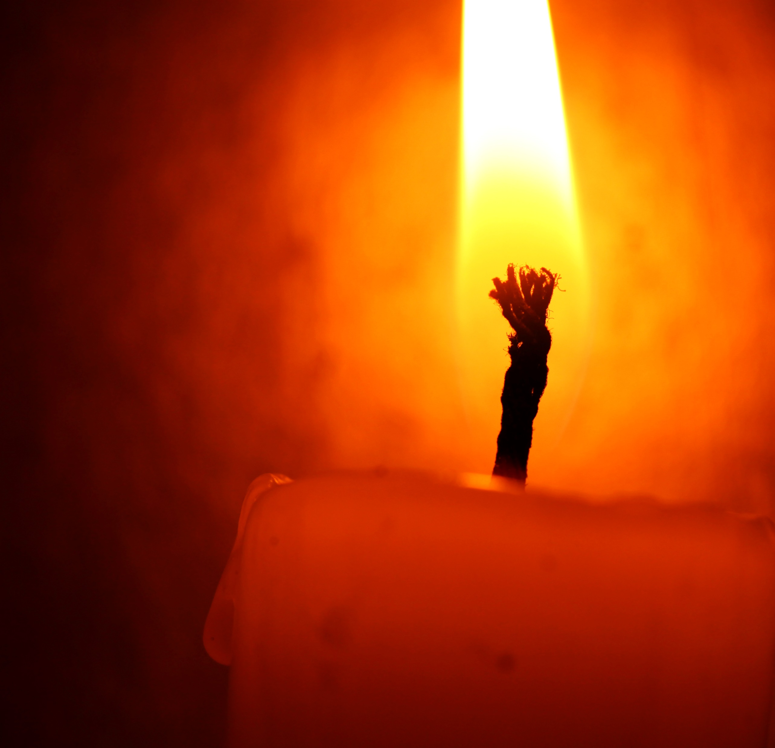
para2:室内情景描写
环境：the electricity goes off ; rip through the roof
the windows were broken into pieces.
threatened to put the world to an end
The air was filled with the sweet scent of apple jam.
The warm candlelight drove away my fear.
人：fight their way into; feel one’s way in the darkness;
hug, hold, stroke; struggle; trip over; press the door,
throw/take oneself into one’s arms; with great caution;
情绪：shake/tremble with fear; stand rooted to the spot;
be struck with fear; in a cold sweat; at a loss; safe and sound
sigh/gasp with relief; a mixture of warmth and relief washed
over me; The sweet memories of the past crowded in.

Slide 12
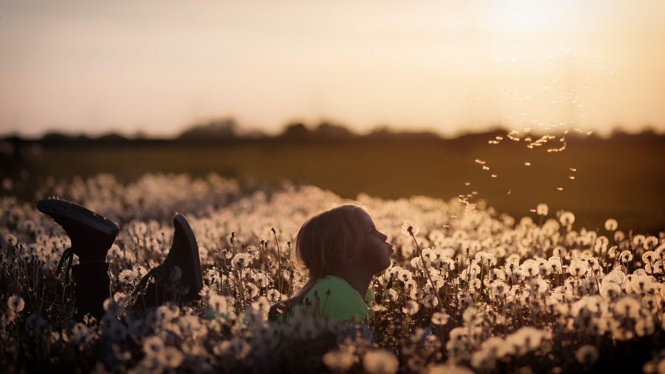
para2:主题升华
Blessed with the love of a good family, I believe things would get better in the days to come and every effort would pay off.
It dawned sb that…nothing is more important than….
As is often the case in our life, something unique and valuable is often left out by us until it is too late. Since then, I've spent more time with my family, seizing every opportunity to say “I Love You” to my beloved ones.

Slide 13
Step5 好句欣赏
① A strong sense of panic swept over me.
② My heart raced and my hands sweated at the very thought of the approaching tornado.
③ Instantly, my back was soaked in sweat.
④ Tears mixed with sweat poured down my cheeks, blurring my vision.
⑤ All of a sudden, a flash of light pierced the darkness, brightening our pale faces.
⑥ So panicked was I that I could hear nothing but my wildly pounding heart beat.
⑦ The roaring thunder was approaching as if it would seize us the next moment.
⑧ Exhausted and terrified, I felt my arms aching and my lung burning.
There was nothing we could do except rowing.

Slide 14
The wind was howling like the swirling storm inside. I couldn’t keep going on, and God knew I tried.
Fortunately, the thunder died away in heavy rain while the tornado disappeared.
Straining every nerve to row, we eventually saw my grandmother’s house.
What a narrow escape!
The cellar was small and dark, and we could still hear the scary sound outside, but the delicious apple jam really comforted me.
We went out, only to find the breathtaking landscape replaced by ruins.
Having Lived through a horrible night, we were greeted by the first ray of sunshine, with golden light pouring in through the broken windows
Bathing in the warm sunshine, it suddenly dawned on me that nothing was better than the whole family safe and sound.

Slide 15
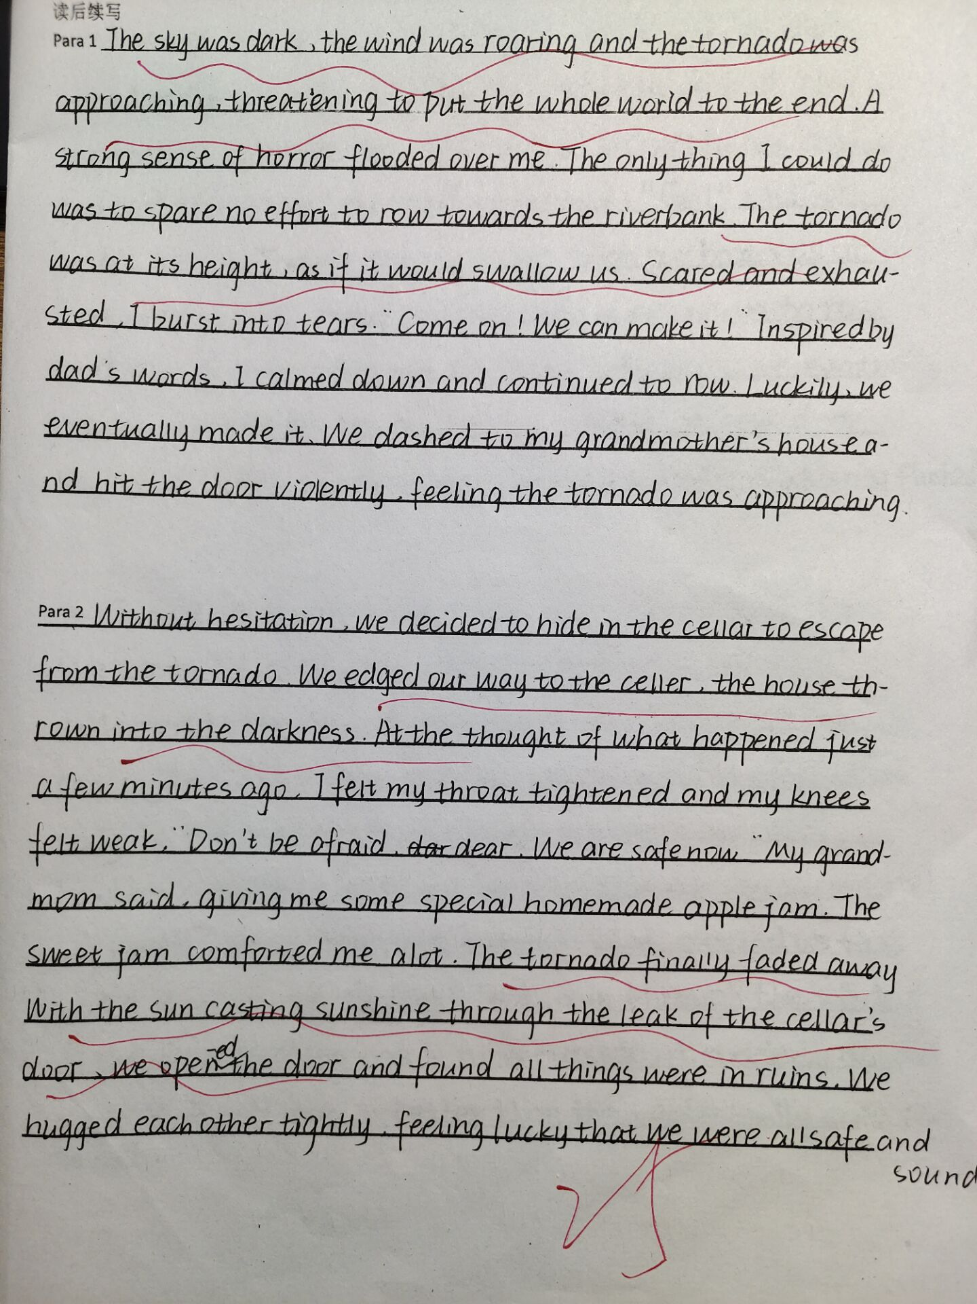
学生习作
1.叙事性完整，故事冲突得到解决，注意了上下文的衔接。
2.人物情绪起伏生动合理,
注意了伏笔并与与原文呼应cellar, apple jam。两段之间的衔接紧密。
3.表达准确恰当，流畅自然，没有阅读障碍。比喻拟人等描写生动，语言风格与原文的协同性较好。
4.主题升华合理，情感处理到位。

Slide 16
范文：
There was no time to think. we rowed as fast as we could. Although I didn’t dare to look，I could feel the tornado getting closer as hail(冰雹) started to fall, hitting the creaky(嘎吱响) old boat. Chased by the nightmare, I couldn’t afford to let up(放松) for a moment. I didn’t even wipe the sweat away as it streamed in my eyes and blurred my view. Finally Grandmother’s house appeared before my eyes. We jumped out of the boat and ran towards it. Out of breath, we buzzed the doorbell again and again.
Grandmother opened the door for us. We dripped(滴落) water on the floor as we went inside, our shoes and clothes soaked through. Grandmother said we need to find a safer place to live through the tornado, and we followed her into the cellar. Dad helped close off the entrance while I still trembled in the dark corner, cold and frightened. We stayed down there, waiting for the tornado to pass. We didn’t wait very long, for it was over in a matter of minutes. However, after this experience, I appreciated every day with my family.

Slide 17
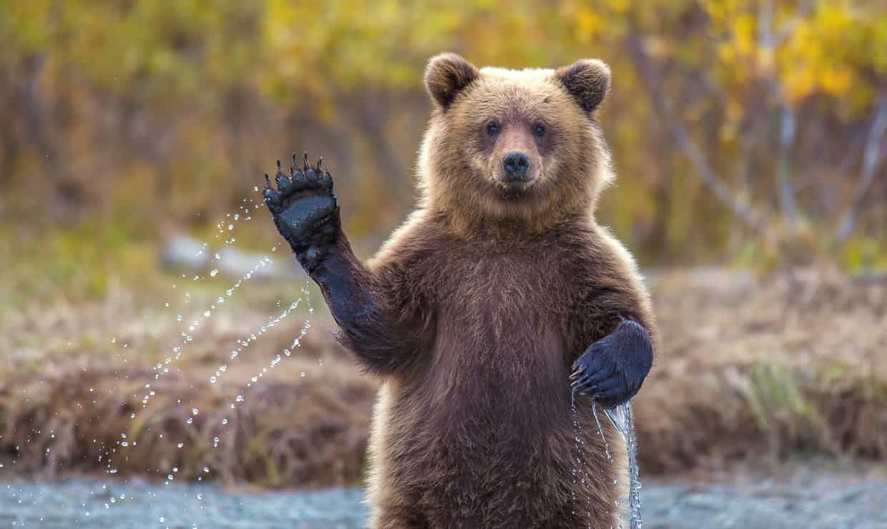
迁移性写作练习

Slide 18

阅读下面材料，根据其内容和所给段落开头语续写两段，使之构成一篇完整的短文。
(2021·湖北省七市(州)教科研协作体高三3月联考)Grady and his family go camping every summer. As it was becoming hotter, here came the camping time.
Having planned the camp long, the family finally decided the destination—the Great National Forest. With food, necessity and cookers loaded onto the car, the family squeezed into the car. The car door closed, heat was shut outside.
In the car, Jared, Grady's younger brother was playing with a toy dinosaur, making great noise. Grady's mother talked excitedly with his father. On settling in the car, Grady put on the earphone and turned on the music. He neither wanted to join his brother nor joined any talk. After what seemed to be hours, the car stopped where they headed. Grady threw down his backpack and slammed the car door.
Back

Slide 19
“This will be a lengthy week”he said unhappily to no one in particular. He looked around the campground. Hundreds of tall and green fir trees, some as tall as church towers, covered the mountainside like a green carpet. The sun would be setting soon. Grady thought maybe the heat wouldn't be unbearable. But actually now in the mountain, the hot stickiness of July was closely attached to him.
Grady hated camping, but it was something his family stuck to every summer. His father liked cooking over an open air, telling stories about how to survive things like bear attacks and bites of bees. His mother and Jared liked to hike and take pictures of animals. Jared had a collection of bug pictures that he had pinned to the walls in his half of their room. Grady thought they were just scary and proof that Jared was a strange kid.
They set up camp—two tents, one for his parents and one for himself and Jared. While everyone else started preparing dinner, Grady, looking for some place to cool down, set off for the nearby stream, which was deep enough to swim in.
Back

Slide 20
注意：
1．续写词数应为150左右；
2．请按如下格式在相应位置作答。
As Grady got close to the stream, an adorable bear cub caught his eye.
________________________________________________________________________________________________________________________________________________________________________________________________________________________________________________________
Turning around, he saw an angry bear moving swiftly towards him.
________________________________________________________________________________________________________________________________________________________________________________________________________________________________________________________-
Back

Slide 21
1. 读懂材料
2. 理清人物事件
本文以人物为线索展开，讲述了Grady(格雷迪)和他的家人每年夏天都去露营。经过长期的营地计划，这家人最终决定了目的地——大国家森林。Grady讨厌野营，帐篷搭好后，当其他人都开始准备晚餐时，Grady走向了附近的小溪。
3．根据段落开头语，确定续写内容
(1)由已给段首句可知，第一段描写Grady由于好奇靠近小熊。
(2)由第二段首句“他转过身来，看见一只愤怒的熊迅速向他走
来。”可知，第二段可以描写Grady遇到了一只愤怒的大熊后
逃生的过程。
Back

Slide 22
As Grady got close to the stream an adorable bear cub caught his eye.The little furry creature measured no more than two feet, with a pair of dark round eyes on its cute face. It was playing joyfully at the edge of the stream. Though Grady didn’t like animals, he couldn’t resist such a lovely bear cub. Driven by curiosity, Grady walked on tiptoe, moving closer to have a look at it. So absorbed was the bear cub in playing that it wasn’t aware that someone was approaching. Grady was about to reach out his hand to stroke its soft fur when he heard a sound behind him.
Turning around, he saw an angry bear moving swiftly towards him. Shocked and dumb, Grady was rooted to the ground for seconds. Then he dashed to the camp desperately, shouting loudly for help. Fortunately, his father heard the shout in time to come to his rescue. To their surprise, realizing that danger was away, the giant panda stopped chasing and returned to the stream, picked up her baby and held it in arms tightly. What a heartwarming scene! Attracted by the noise, mom and Jared arrived just in time to capture the beautiful moment.

Slide 23


