Slide 1

感恩遇见，相互成就，本课件资料仅供您个人参考、教学使用，严禁自行在网络传播，违者依知识产权法追究法律责任。
更多教学资源请关注
公众号：溯恩高中英语
知识产权声明

Slide 2
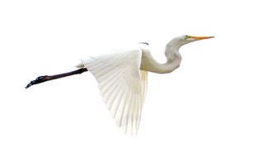




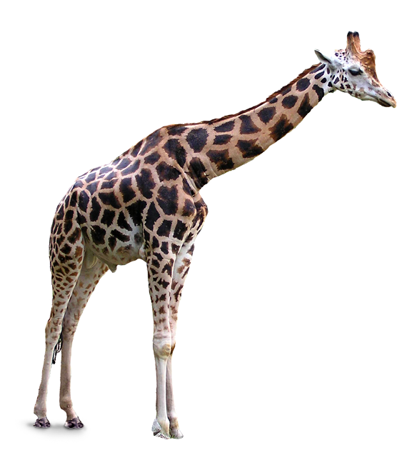

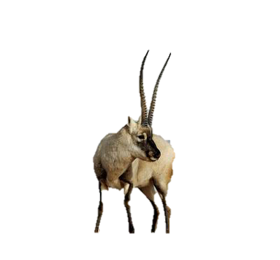
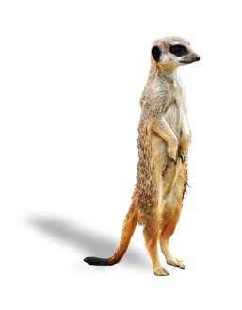
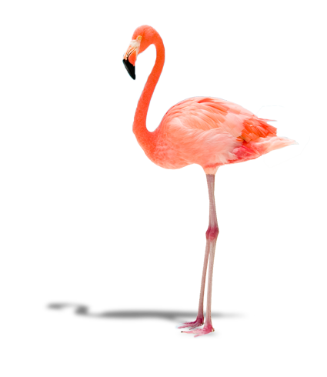
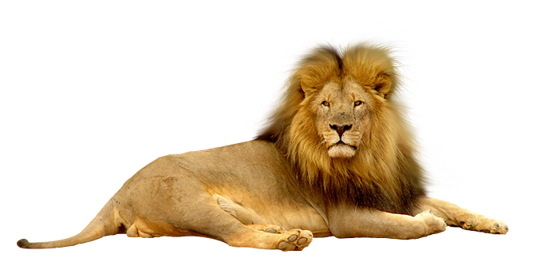



B2U2 Reading and Thinking
A DAY IN THE CLOUDS
东莞市长安中学
吴嘉丽

Slide 3
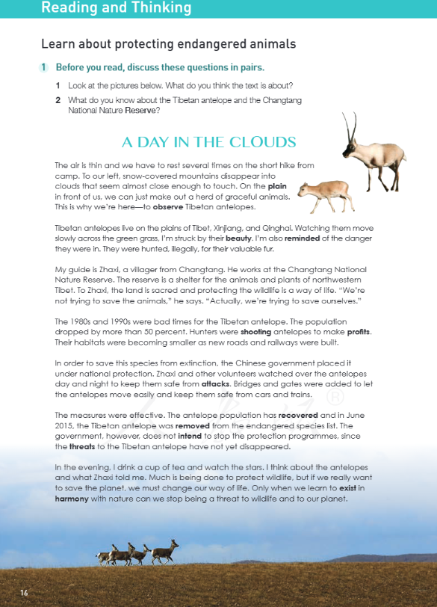
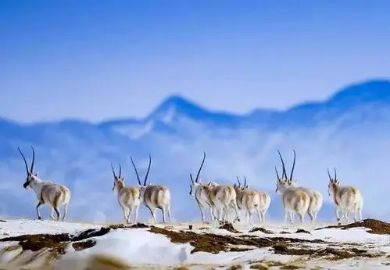
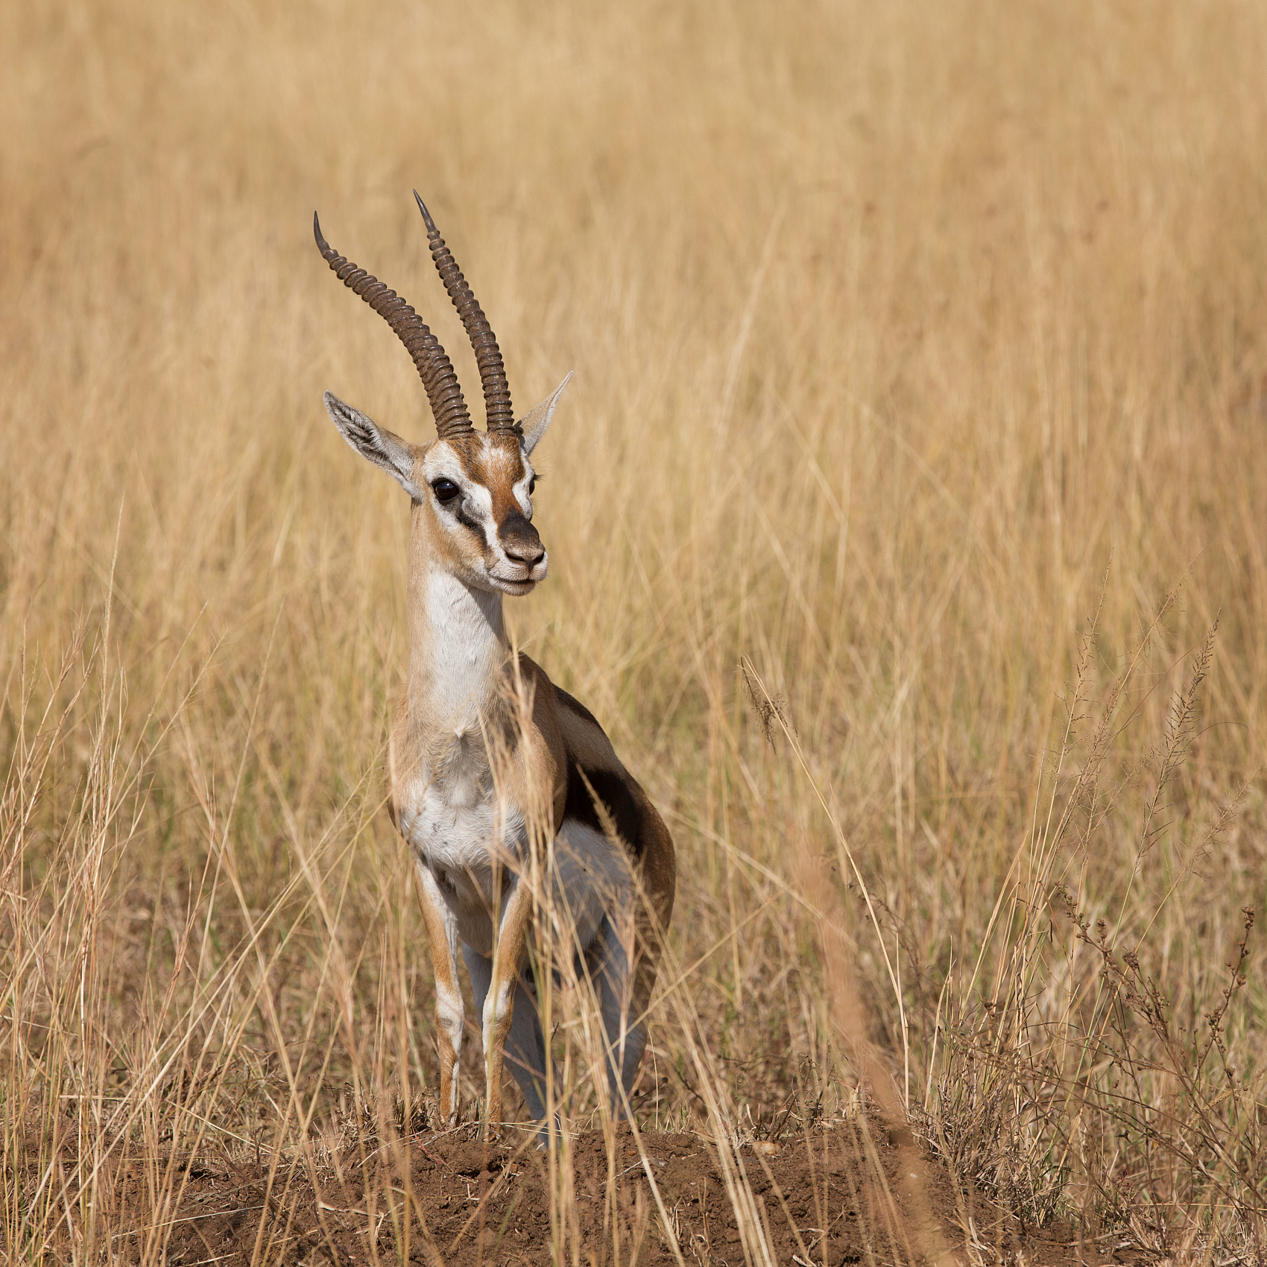
Pre-reading
Before you read, think about the following questions:
1. Look at the pictures below.
What do you think the text is about?
The text must be about antelopes

Slide 4
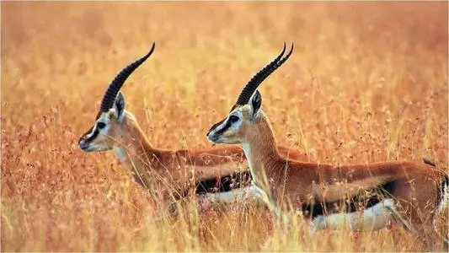
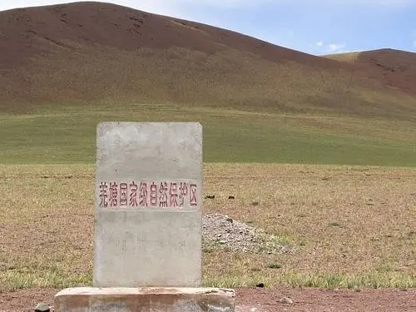
2. What do you know about the Tibetan antelope?
The Tibetan antelope was an endangered animals
3. Have you ever heard of the Changtang National Nature Reserve?
The Changtang National Nature Reserve is in western China and it was created to protect the area and the wildlife that live there.

Slide 5
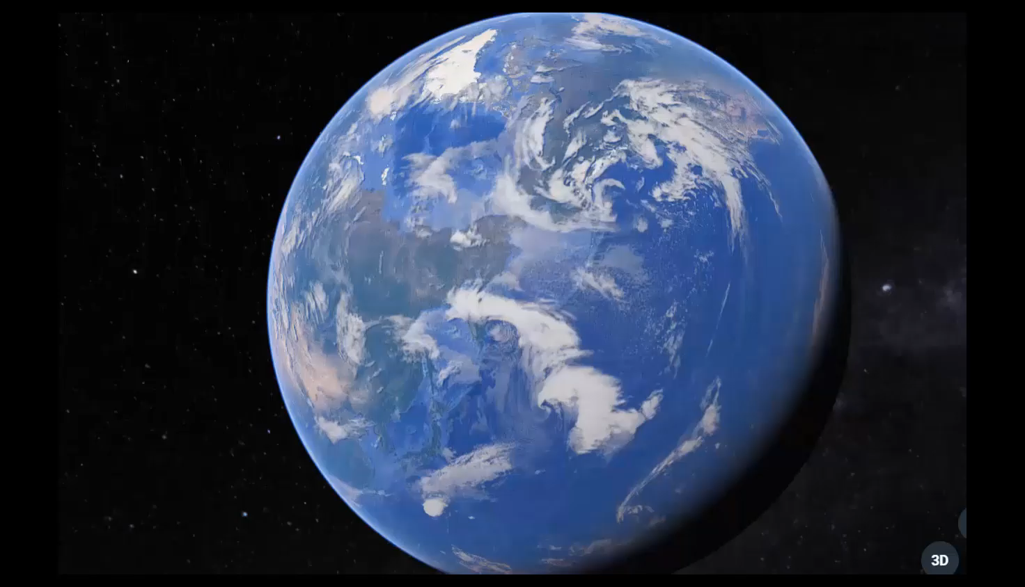

Slide 6
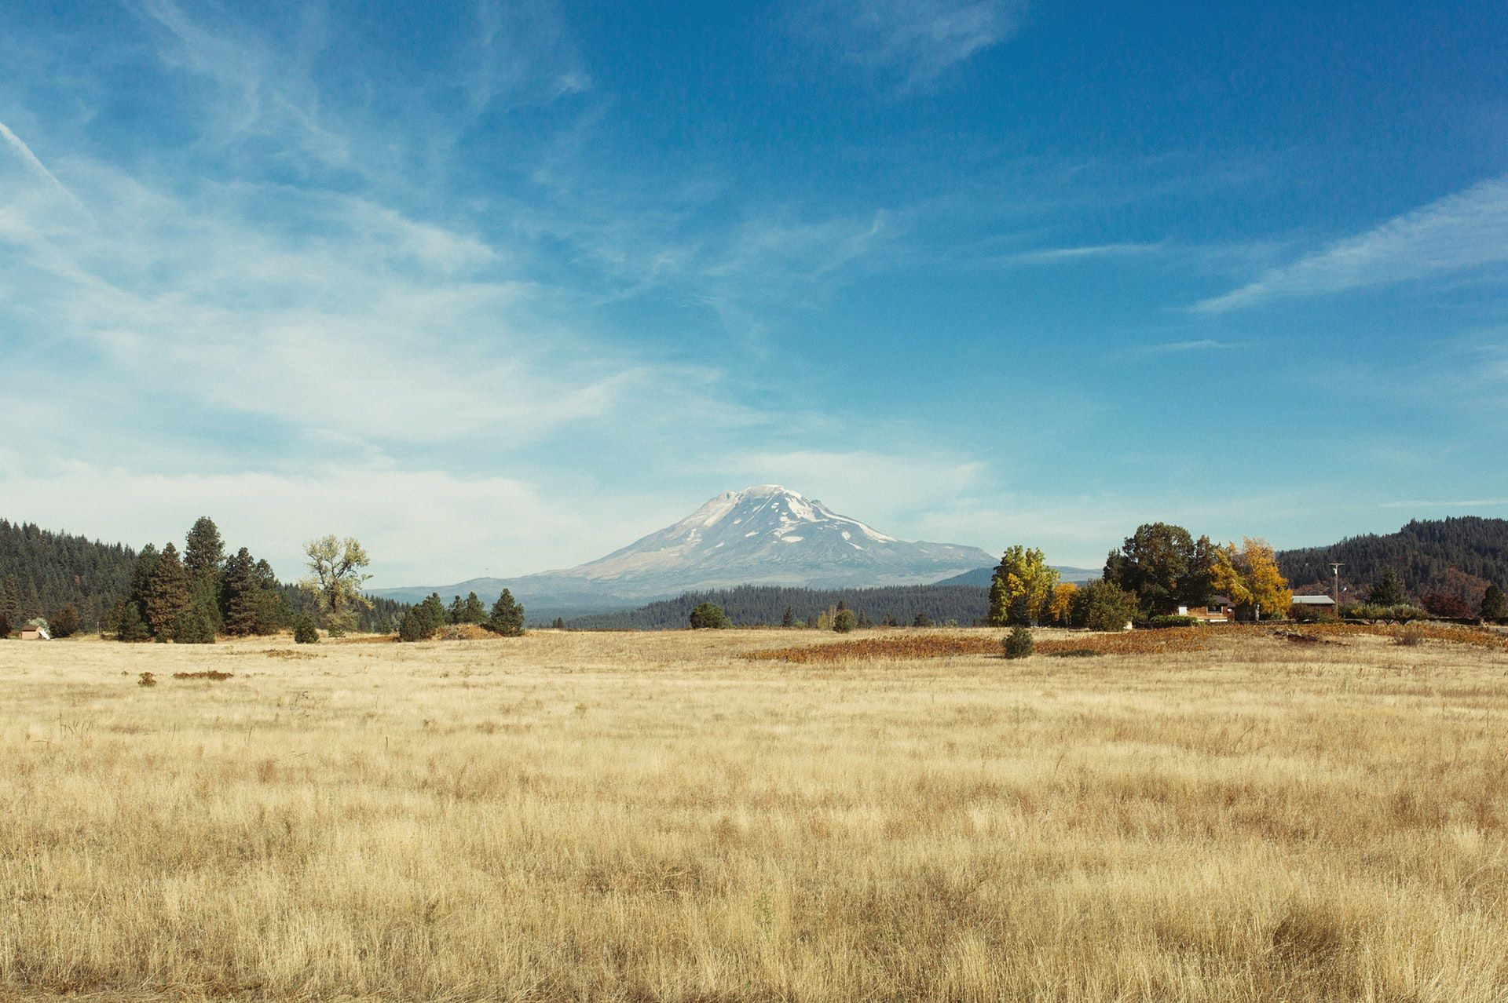
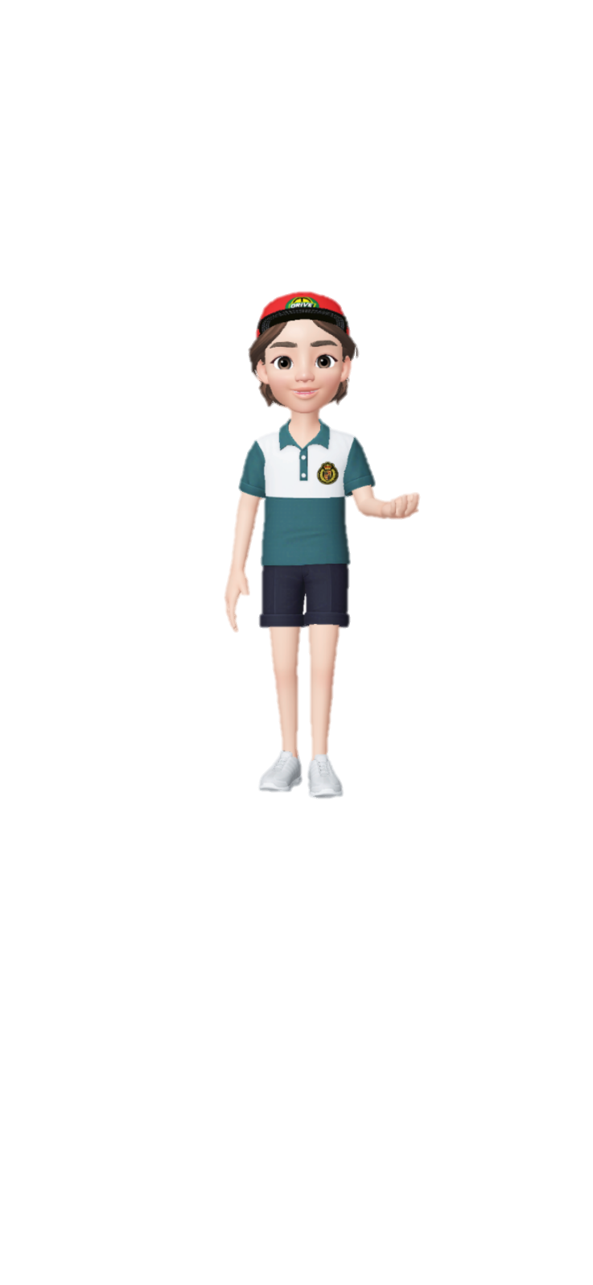

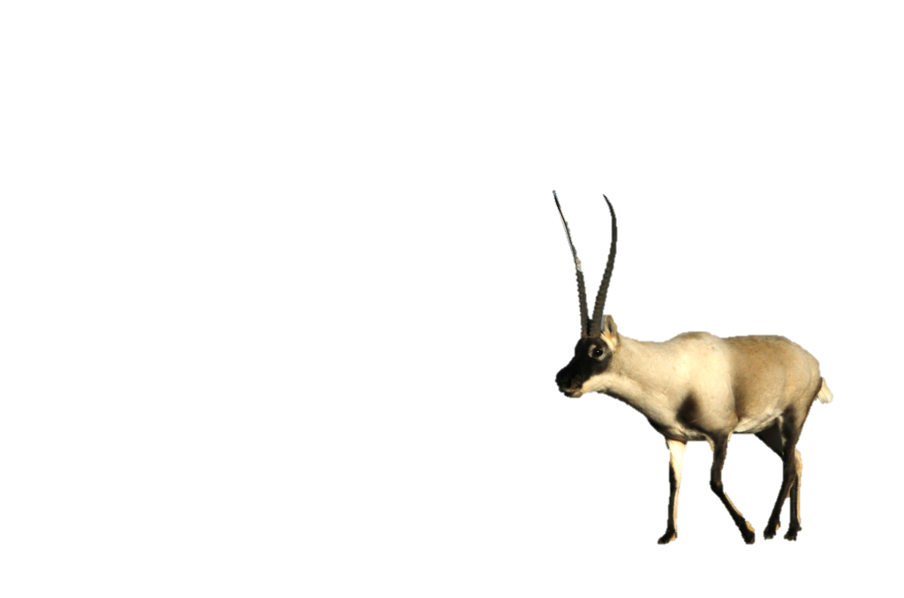
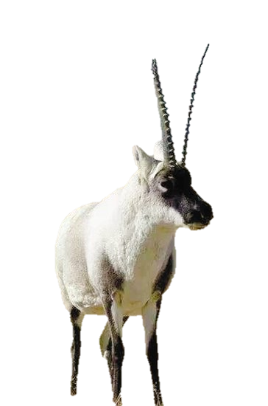
A DAY IN THE CLOUDS

Slide 7

A DAY IN THE CLOUDS
____：Changtang National Nature Reserve
Tibet
Where
Observers (we)
____(guide)
antelopes
______
who
Zhaxi
live on
observation
____
____
____
Tibet
Xinjiang
Qinghai
(Para.1-2)

Slide 8
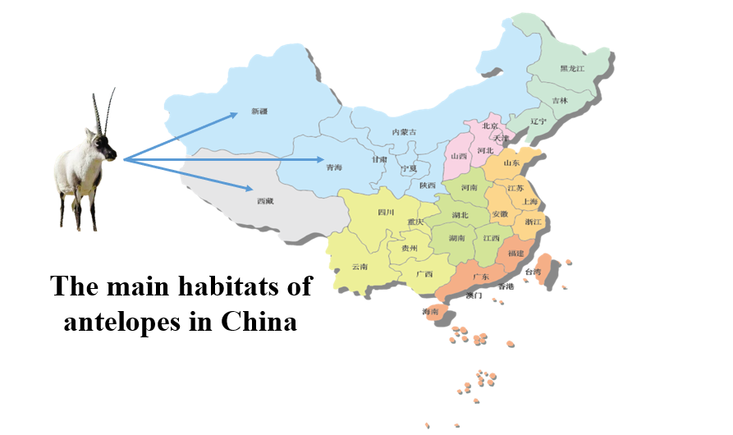

Slide 9
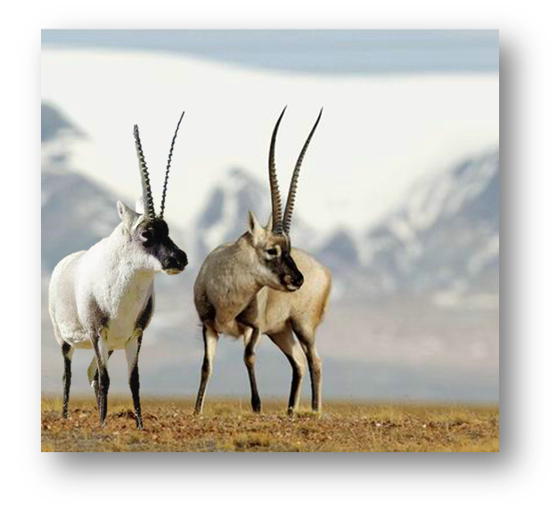
The story of antelopes
1980s-1990s
What happened to the Tibetan antelope in the 1980s-1990s?
1
2
What did people do to protect the Tibetan antelope?
1990s-till now
(Para.4-6)

Slide 10
The story of antelopes
volunteers :attacks×
_____& ______:cars & trains ×
profits
Hunters for_______
roads & railways
Bridges
Gates
causes
population
Recovered
__________:↓ 50%
Smaller habitats ↓
Population : _____________;
________ from endangered
species list
results
Removed
1980s-1990s
1990s-till now
Bad times
____________for the antelopes
National protection
Safe time: ____________
by the government

Slide 11
Read the text again and answer the questions.
-->to observe Tibetan antelopes.
1. Why did the writer visit Tibet?
-->In the1980s and1990s the antelope population dropped by more than 50%, as they were shot
by hunters for profit.
2. What happened to the Tibetan antelope in the
1980s and 1990s?
-->Watch over the antelopes ; Bridges and gates were built
3. What did people do to help protect the Tibetan antelope?

Slide 12
Reflection(para 7)
Do you think the threats to the antelopes have come to an end?

Slide 13

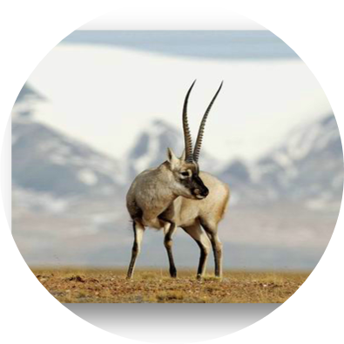
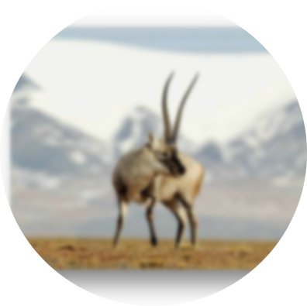

Slide 14
Only when we learn to exist in harmony with nature can we stop being a threat to wildlife and to our plant

Slide 15
Give a speech calling on wildlife protection
Government
03
Hunters
WWF
02
04
To your classmates
01
05
Public

Slide 16
Useful expressions
suggestions
purpose
1
(1)It is necessary/good for us to …
(2)We’d better do …
(3)I suggest/advise that …(should) do…
(4)It would be a good idea to…
to help…
to protect…from…
so that/ in order to…
to punish those who do harm to wildlife.
01
02
protect
wildlife
02
is
to
03
2
protect
human
04
4
3

Slide 17

Sample ( A speech for classmates)
Dear classmates,
The beauty of world is largely because of its rich biodiversity.However, due to the deep influence of humans, some species disappeared in the world, which will lead to various chain reactions, affecting the survival of other species, including us humans.
Hence, it is necessary for us to protect wildlife. We can start from small things, for example, improving our awareness of for biodiversity and wildlife protection.
Only when we learn to exist in harmony with nature can we stop being a threat to wildlife and to our planet.Caring for animals, caring for the community, caring for the world, makes our only planet earth a better place.

Slide 18
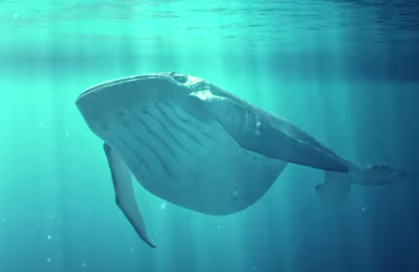
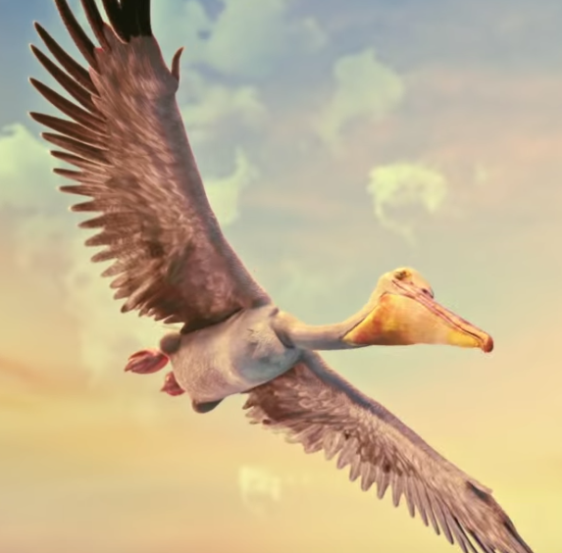
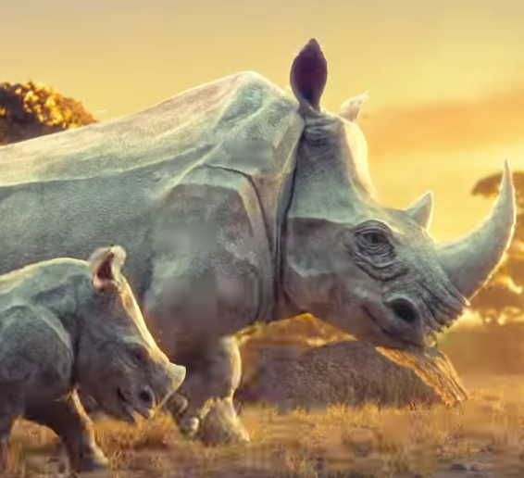
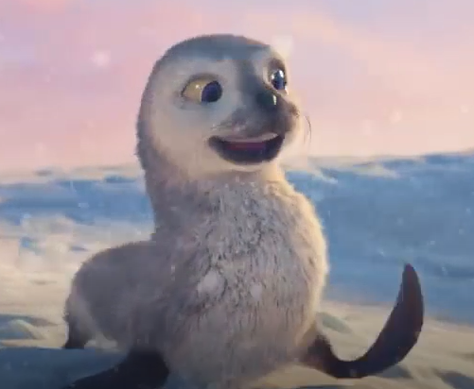
Homework
Design a wildlife protection poster in a group of four. Try your best to do something to protect the wildlife!
Whales
Sea gull
Rhino
Seal

Slide 19
