Slide 1

感恩遇见，相互成就，本课件资料仅供您个人参考、教学使用，严禁自行在网络传播，违者依知识产权法追究法律责任。
更多教学资源请关注
公众号：溯恩高中英语
知识产权声明

Slide 2


Slide 3
01
变“有形的手”为“无形的手”
02
变“单一的线”为“立体的面”
目录
03
变“段首提示”为“语篇衔接
CONTENTS
04
变“简单叙事”为“综合评议”
01
变“概念理解”为“技能技巧”

Slide 4
1
变“有形的手”为“无形的手”
—— 利用词汇衔接实现语义的连贯
Part

Slide 5

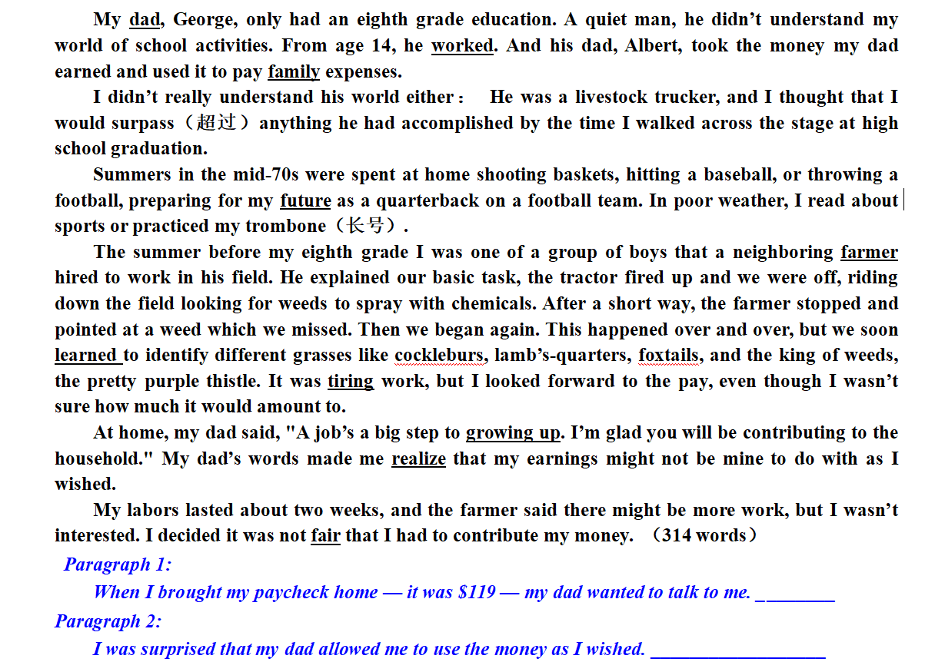
2021.06 Zhejiang Gaokao continuation writing
2022.12
Please sort out the underlined words:

Slide 6
如何画出关键词？如何平衡限定性与开放性、逻辑性思维与创造性思维？
2022.12
Please sort out the underlined words:
①时空线（明线） | ②情节线（明线） | ③情感线（暗线）
时间： 空间： | 人物： 事物： 动作： | 正面： 负面：
dad, farmer,
family, future
tiring
worked, learned, growing up, realize
（not）fair
What other key words do you think should be underlined? And why?
What other key phrases or topic sentences do you think should be underlined? And why?
当文本没有明确的明线时，暗线则可能成为主线。显性线索（明线）多为时间线索、地点或空间线索、情节线索等，隐性线索（暗线）可以表现为主题词、关键词、中心句、中心话题或语言功能等（戴咏梅，2005）。

Slide 7
变“有形的手”为“无形的手”
2022.12
 | 浙江 | 新高考Ⅰ卷 | 变化启示
划线词 | 10个 | 无 | 1. 增加读的难度 2. 语言协同难度加大，语义连贯（语义链）要求更高
注意 | 1. 所续写短文的词数应为150左右； 2. 至少使用5个短文中标有下划线的关键词语； 3. 续写部分分为两段，每段的开头语已为你写好； 4. 续写完成后，请用下划线标出你所使用的关键词语。 | 1. 续写词数应为150左右； 2. 请按如下格式在答题卡的相应位置作答。 | 1.没有形式上的语义连贯； 2.但要注重培养语篇分析能力和熟练掌握读写全过程的衔接与连贯手段。
以“有形的手”控制，划线词在续文中以“同词”的形式复现。
变划线词为关键词；形成相关语义场的空间更大。以“无形的手”操控语篇的连贯性，体现思维的灵活性。

Slide 8
基于语义连贯理念的“词汇衔接”
2022.12
词汇衔接是创造语篇骨架的核心手段，主要体现在语篇的语义层面上，是语篇连贯性的黏合剂。在读后续写中利用词汇衔接手段，创生出衔接性、关联性和创新性强的优质词汇，能够对语篇在形式、内容、意义上的连贯产生促进作用。
  He led me to the crowded shop and to a bench with a large professional karaoke box on it. He placed his large hand lovingly on his treasure and said, "I have 800 karaoke songs in here. You can take your pick and I'll record them for you. That should get you started."
  Many teenagers don't know about tattoo inks well and think tattoo inks are safe to use. Tattoo inks are made to be injected into the skin.
语义连贯
  同词或同源词
  的重复
  话题词汇的同现
  同/近义词复现
  Everything faded into mist. The past was erased, the erasure was forgotten, the lie became truth.
词汇同现
词汇复现
  词汇衔接
  Focusing on the positive has been shown to have benefits to one's health and well-being, jusst as focusing on the negative has been proven to have a harmful effect.
  As the sun was rapidly sinking, everything changed colors. The white clouds had turned red, the hills were violet, the woods purple, the valleys black.
  反义词
  关系
  上/下义词复现

Slide 9
你在本篇写作中使用了多少种词汇衔接的方法?
2022.12
词汇_{又称语汇}，是一种语言中所有词和词组的总和。词是语言的建构材料，也是最小的能够独立运用的语言单位。词汇中的任何词语都是通过一定的句法关系和语义关系与其他词语建立起一定的联系的，并在语境中传递_{（主题）}信息。（ 2017版新课程标准P ₂₁）
  话题词汇的同现
  同词或同源词
  的重复
词汇同现
  词汇衔接
词汇复现
  同/近义词复现
  反义词
  关系
  上/下义词复现
How many methods of lexical cohesion did you use in your writing?
你在本篇写作中使用了多少种词汇衔接的方法?

Slide 10
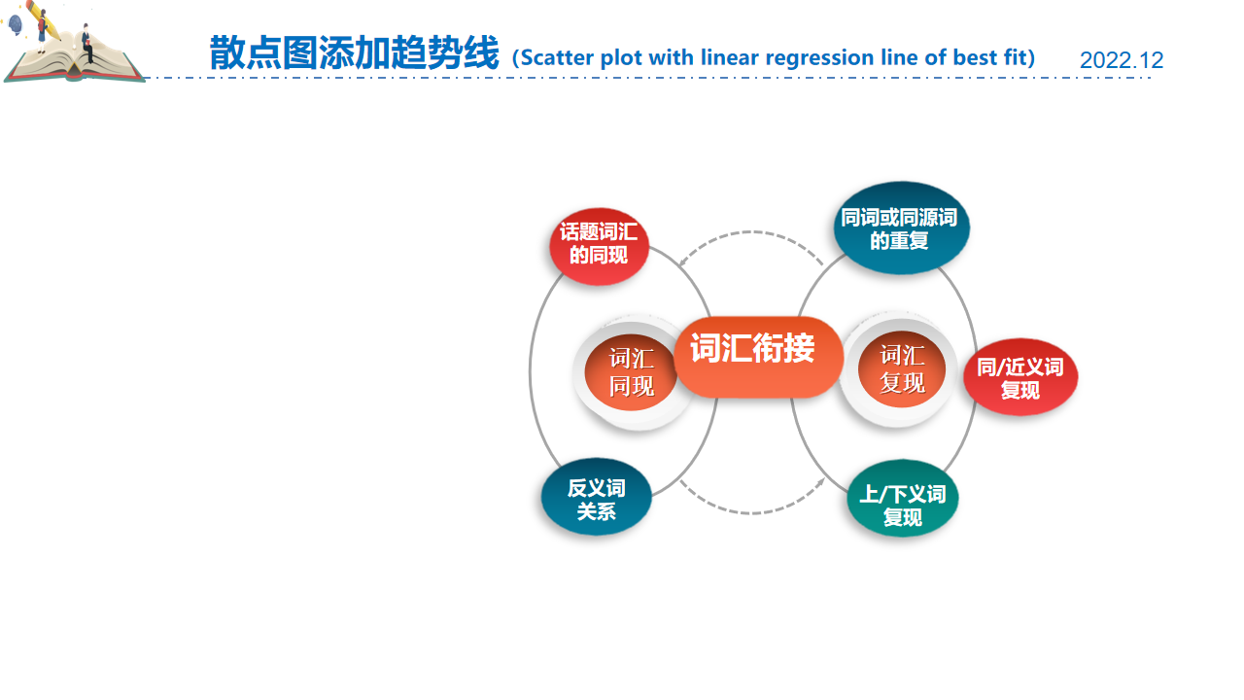

Discussion:
2022.12
“work”在原文和续文中如何衔接？这些衔接是否贯增强语义，语境和主题的关联性，促成语义和逻辑的连贯性？
根据词汇衔接的方式和思维活动来解读文本，把握文章主题句 “A job is a big step to growing up” 通过人生第一份工作，学会承担责任，体谅父母，理解父爱。续文的结尾建议：“改变主意，我要继续打工挣钱，更珍惜父爱”，落实叙事结构的呼应部分，是写作者必须具备的解读文本和拓展主题的能力。
  同词或同源词
  的重复
Better yet, the idea of going back to the farmer and working more popped into my mind.

Slide 11

Discussion:
2022.12
“money”在原文和续文中如何衔接？这些衔接是否增强语义，语境和主题的关联性，促成语义和逻辑的连贯性？
“money”是本文的主题词汇，围绕父子两代人对劳动报酬的支配代沟，不断地铺垫伏笔和激化矛盾，运用“近义词复现”和 “搭配”等词汇衔接手段 pay family expenses→looked forward to the pay→contribute to thehousehold → allowed me to use the money as I wished 建立了一个贯穿语篇的语义链和逻辑主线。
At exactly that moment, I realized why my father let me have the money—it was his expectation for my future, his encouragement and quiet love.

Slide 12
同/近义词的复现可增强续文的连贯性、协同性和语言的丰富性
2022.12
When I brought my paycheck home-it was $119-my dad wanted to talk to me. “Good for you, breadwinner!” He said, an absolute gaiety spreading across his face. I, however, was glued to the spot, worry clouding my eyebrow. It seemed to me that keeping the money myself in front of this fuddy-duddy was just a Utopian dream. The old guy was so thrilled that he started to recall his old days during Great Depression. It was then that I first understood how great he was for contributing his money to the household. Then, he gripped my wrist, with his eyes full of love. “Now that you have grown up, and I'm sure you will manage your money successfully!”
I was surprised that my dad allowed me to use the money as I wished. I jumped a mile. my mouth wide open in amazement. After a pregnant pause, we began to laugh together, ideas of buying new shoes, a football and a basketball flooded into my mind. Even, an inner voice popped up, urging me to roll up my sleeves to eam more pay. At exactly that point, I came to understand why he let me have the money—it was his expectations for my future, spending the money you earned means shouldering the choice you made, right or wrong. My daddy taught me that at such a vital part of my life, crowning the second half of my life, which I could never thank more.
  同/近义词复现
my dad（原文）
同义词和近义词的复现不仅增强续文的连贯性和协同性，且而词汇表达的丰富性赋予了文章地道性、生动性和耐读性。
fuddy-duddy_{老顽固}
old guy
My daddy
对父亲3种不同的称呼，真实形象生动地反映作者情感态度的变化，与故事情节的推进相互呼应。

Slide 13
2
变“单一的线”为“立体的面”
—— 利用词汇衔接实现语境的协同
Part

Slide 14

情境模式层面的协同效应
2022.12
When I bought my paycheck home—it was $119—my dad wanted to talk to me. He told me to wait in the living room for a while. Silence reigned the room. I sat on the sofa, eyes glued to the money I earned. I kept digging in my mind for words to argue with my dad if he announced that the money wasn’t mine. Just then, the door opened and in came my dad. The moment he sat down besides me, I gripped the paycheck more firmly, ready to argue. However, he gently placed his right hand on my shoulder and said. “I know you have grown up a lot through your work…” Then there was a long pause. He withdrew his hand and slowly continued “You deserve the money and the money is yours now.”
I was surprised that my dad allowed me to use the money as I wished.
  话题词汇的同现
本段场景是在屋内。作者利用上下义的衔接手段，添加了living-room， the room，sofa和the door 等场所和景物，加上给读者描绘了清晰的空间语境，增强了真实感和画面感，并很好地达成了语篇的连贯性。
协同既发生在语言层面（语音、词汇、句法等），也体现在情境模式层面。情境模式指为理解文本所构建的表征，含人物、时间、地点、因果、交流意图等五个核心维度（Zwann ＆ Radvansky 1998）

Slide 15

相关意义的词汇出现在同一语篇中，构成以某一话题为中心的词汇链
2022.12
When I bought my paycheck home—it was $119—my dad wanted to talk to me. He told me to wait in the living room for a while. Silence reigned the room. I sat on the sofa, eyes glued to the money I earned. I kept digging in my mind for words to argue with my dad if he announced that the money wasn’t mine. Just then, the door opened and in came my dad. The moment he sat down besides me, I gripped the paycheck more firmly, ready to argue. However, he gently placed his right hand on my shoulder and said. “I know you have grown up a lot through your work…” Then there was a long pause. He withdrew his hand and slowly continued “You deserve the money and the money is yours now.”
I was surprised that my dad allowed me to use the money as I wished.
  话题词汇的同现
对这笔钱的期待，与后面的“无法自己支配”的现实形成强烈对比，激化矛盾，形成冲突，激活读者兴趣。
“eyes glued, kept digging for words, gripped firmly”系列动作描写突显心理活动，为“argue”的爆发做积淀，然而父亲的”gently placed his hand， withdrew his hand and slowly continued“的亲情动作轻松化解危机，本段中动作描写和心理描写各种语境和谐交融，语篇气韵生动，很好地达成了语篇的连贯性。
语言层面的协同（语音、词汇、句法）和语境层面的协同（人物、时间、地点、因果、交流意图）可以通过词汇衔接的手段形成统一语篇，使语篇达成整体的连贯性。

Slide 16
3
变“段首提示”为“语篇衔接”
—— 利用词汇衔接实现情节的严谨
Part

Slide 17

利用段首句信息，确定人物、事件为话语中心内容
2022.12
利用段首句信息，确定人物、事件为话语中心内容（主位），运用词汇衔接在情节内容与发展方向上为续写延展推进，确保整个故事情节发展的一致性和延续性、语篇的连贯性。
“Good for you, breadwinner!” He said, an absolute gaiety spreading across his face. I, however, was glued to the spot, worry clouding my eyebrow.

Slide 18
依照上义词，激活下义词是“写长法”的重要手段
2022.12
上义词是对事物的概括性、抽象性说明；下义词是事物的具体表现形式或更为具体的说明。在续写中，下义词更能准确地塑造人物形象或推动故事情节发展，是“写长法”的重要手段。
  上/下义词复现
surprised上义词
I jumped a mile. my mouth wide open in amazement. After a pregnant pause, we began to laugh together, ideas of buying new shoes, a football and a basketball flooded into my mind.

Slide 19
反义互补的词汇衔接有助于合理地激化冲突和化解矛盾
2022.12
as I wished 同词复现，但出现在反义互补的表达 “allowed me to use the money as I wished”和“might not be mine to do with as I wished”，突显矛盾的冲突与和解，且在续文中，细化具体了“wish”, 表现出作者的惊喜。
  上/下义词复现
wish上义词
I jumped a mile. my mouth wide open in amazement. After a pregnant pause, we began to laugh together, ideas of buying new shoes, a football and a basketball flooded into my mind.

Slide 20
基于词汇衔接的语义拓展，有助于合理发挥想象力和创造力
2022.12
续文“bought many thingsI wanted”与原文“I wished” 近义词复现，实现情节的严谨发展。 “football”与原文同词复现, 且在深入理解词汇衔接的基础上拓展了语义“ a basketball bat and a pair of sneakers”，合理发挥了想象力和创造力。
want近义词
  上/下义词复现
wish上义词
On that day, after calculating my budget, I went to the local store and bought many things I wanted—a new football, a basketball bat and a pair of sneakers and so on.

Slide 21
4
变“简单叙事”为“综合评议”
—— 利用词汇衔接实现主题的升华
Part

Slide 22
拉波夫叙事结构
2022.12
点题
(Abstract)
叙述者在叙述前对故事的简要概括。
“What was the narration(of the story)about?”。
除此以外，像小说的标题、电影的片名、戏剧的剧名都可以作为点题。
回应
(Coda)
结局(Result or resolution)
用一两句话来接应主题，使读者对叙述有一个完整的了解，对故事的主题进行点明或升华。是主人公从发生的事情里学会的道理或发出的感叹，是故事的价值和现实意义的体现。
它将读者拉回现实，是连接故事和现实的纽带，使人们对某个方面有更深的理解和思考。
进展(Complicating Action)
对故事核心矛盾的一个交代，标志着叙事的结束，包括人物的下场、目的的实现与否等。
“How did the narrator close the story?”
指向(Orientation)
故事本身的发生、事态的发展。进展是叙述结构中的核心部分。
“How did the story evolve?”
叙述者在故事的开头对时间、地点、人物、活动和情景等的描述
“When and where did the story happen? ”
“Who was involved in?”
评议
(Evaluation)
对故事中各因素的评论。是对事件的看法、态度和心理，包含对故事的起因、结果以及过程中事件要点的评议。评议往往渗透在叙事结构当中，在相对单调的叙事过程中增强故事的感染力，生动刻画人物的形象，有助于读者形成对人物和事件的看法。
So, what?

Slide 23
同词复现，赋予新义(拓展语义，激活联想，升华主题)
2022.12
  同词或同源词
  的重复
对人物认知变化的评议：原文本的surpass 的语境意义是“surpass anything，长大后超越父亲只是一个卡车司机的成就”，在续文中赋予surpass新的语境意义“something I never surpass，父爱无法超越”，由具象到抽象，由事及理，彻底感受到父爱的伟大与崇高。
...At exactly that moment, I realized why my father let me have the money—it was his expectation for my future, his encouragement and quiet love. And that was something I never surpass.

Slide 24
同词复现，拓宽语义，升华主题
2022.12
  同词或同源词
  的重复
对事件认知变化的评议：原文本的future 的语境意义是“在橄榄球队当四分卫的未来”，在续文中拓宽future的语境意义“ his expectation for my future, 对孩子未来的期许”，通过让孩子劳动获得报酬而自由支配愿望，即使家里生活捉衿见肘，也要让孩子追梦人生未来。
...At exactly that moment, I came to understand why my father let me have the money—it was his expectation for my future, his encouragement and quiet love. And that was something I never surpass.

Slide 25
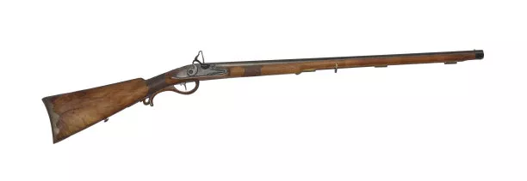
运用词汇衔接，熟稔“伏笔”与“铺垫”的续写技巧
2022.12
“伏笔”与“铺垫”有三个方面的不同:
1．从形式来看，用作伏笔的，言语不多，有隐含性，不注意看不出来，所以，伏笔一般是“细节”；用作铺垫的，语句较多，可以铺陈，如情节高潮的前奏，如一些表现人物的景物环境描写，它没有隐含性，一看就知道是为了下文的铺垫。
2.从运用来看，伏笔与下文照应的“点”有一段距离，甚至是文首与文尾；而铺垫一般是紧接着，如前面写环境景物，接着就写人物。
3.从作用来看，伏笔主要是谋篇布局即结构上的技巧，使文章前后照应，结构严谨；铺垫是写作手法中的烘托手法，主要是对内容起作用，比如推动情节，突出人物，铺垫的特点是为主要情节蓄积酝酿的过程。
使用“伏笔”与“铺垫”应注意以下几点：
有伏笔必有照应，如果你在开头提到了枪，那么在第二或第三段就要提到开枪，不伏不应是败笔，只伏不应同样也是败笔；伏笔要埋伏得巧妙，切忌刻意、显露，伏笔一般做到别人无法轻易觉察到，要做到如风行水上，自然成文；伏笔要有照应，但前后不宜紧贴，如果伏笔前后贴得过近，反而会使文章显得呆板，读起来反而会显得枯燥。
铺垫的作用是主要情节的基石，能增加情节张力，制造悬念使情节具有合理性；铺垫的原则是引而不发、自然合理。
俄国作家契诃夫对伏笔的解释：
“例如在前面写到客厅的墙上挂着一支猎枪（伏笔），那么这支猎枪在最后一定要射出子弹（照应）。”

Slide 26
找准伏笔，利用同词复现或反义关系的衔接手段，使续文前后照应
2022.12
  同词或同源词
  的重复
对情感变化的评议：铺垫是“打基础”，使用的笔墨往往较多；伏笔是“作暗示”，通常只是一两笔，点到为止。与“回应”配合，使文章前后照应，结构严谨，波澜起伏。由原文“not understand ” 到续文结尾的“came to understand”，消除代沟，情感与父亲和解并理解。
...At exactly that moment, I came to understand why my father let me have the money—it was his expectation for my future, his encouragement and quiet love. And that was something I never surpass.

Slide 27
找准文章主题句，同义复现，强化并突出主题
2022.12
对主题思想的评议：精准把握文章主题句“A job is a big step to growing up工作是人生成长一大步”，“年少不知工作苦，读懂已是过来人”，明白工作艰辛和意义，理解父爱，收获人生成长的重要一课。
...However, he gently placed his right hand on my shoulder and said. “I know you have grown up a lot through your work…” Then there was a long pause. He withdrew his hand and slowly continued “ You deserve the money and the money is yours now.”
At exactly that point, I came to understand why he let me have the money—it was his expectations for my future, spending the money you earned means shouldering the choice you made, right or wrong.

Slide 28
5
变“概念理解”为“技能技巧”
—— 利用词汇衔接实现能力的提升
Part

Slide 29
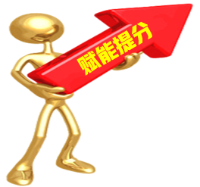


词汇衔接的三个“一定”
2022.12
根据衔接连贯理论，通过词汇的有效衔接（词汇同现或词汇复现）实现语义连贯和逻辑衔接。
第一段结尾
①一定要有与第二段段首句中的同词或同义词。
②实现无缝衔接
第一、二段开头
①一定要把段首句的名词或动词（尤其是后半句），用在写作开头，实现语义连贯。
②力争高分开头
第二段结尾
①一定要呼应原文中体现主题或伏笔的关键词。
②实现主题升华

Slide 30
词汇衔接的三个“一定”
2022.12
原文（第一段 第二段） | My dad, George, only had an eighth grade education. A quiet man, he didn’t understand my world of school activities. From age 14, he worked. And his dad, Albert, took the money my dad earned and used it to pay family expenses. I didn’t really understand his world either： He was a livestock trucker, and I thought that I would surpass_{（超过）}anything he had accomplished by the time I walked across the stage at high school graduation.
第一段 | When I brought my paycheck home — it was $119 — my dad wanted to talk to me. “Good for you, breadwinner!” He said, an absolute gaiety spreading across his face. ..... .... Then, he gripped my wrist, with his eyes full of love. “Now that you have grown up, and I'm sure you will manage your money successfully!”
第二段 | I was surprised that my dad allowed me to use the money as I wished. I jumped a mile. my mouth wide open in amazement. After a pregnant pause, we began to laugh together, ideas of buying new shoes, a football and a basketball flooded into my mind. ... ....At exactly that moment, I came to understand why my father let me have the money—it was his expectation for my future, his encouragement and quiet love. And that was something I never surpass.

Slide 31
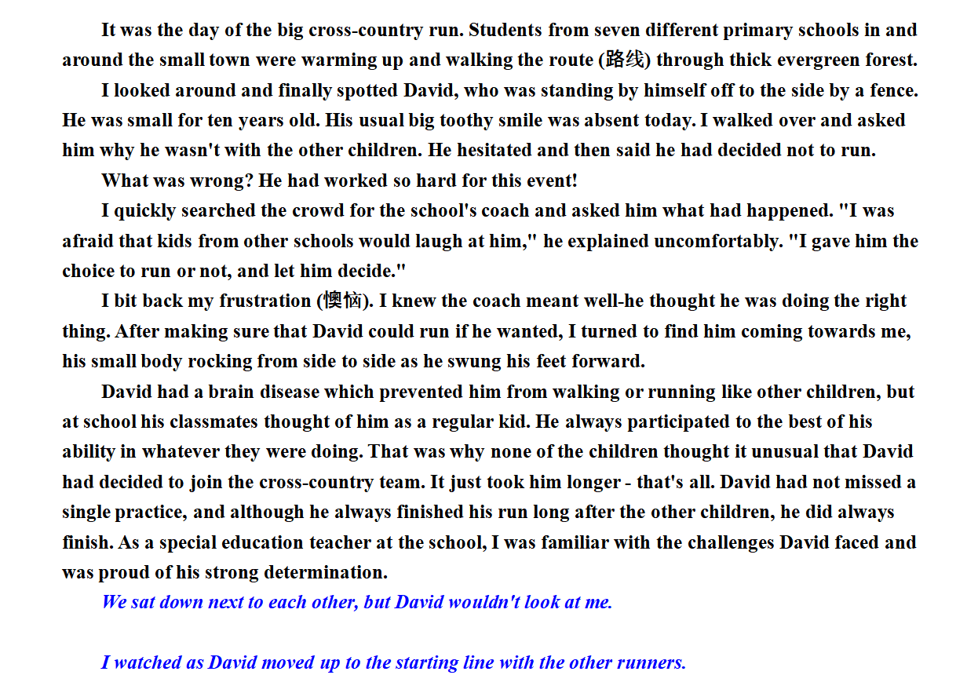
2022.06 National Gaokao continuation writing. David's Run
2022.12

Slide 32
Self-evaluation and mutual-evaluation form
2022.12
Specific item | Self-evaluation | Mutual-evaluation
1.你在读原文是画出哪些关键词词汇/词组/句子？有什么依据吗？
2.你在本篇写作中使用了多少种词汇衔接的方法使续文中哪些词汇/词组/句子与原文或续文的上下文有衔接？这些衔接是否促成了连贯? (在续文的相关表达下划线）
3.你是如何利用段首句信息，运用词汇衔接的三个“一定”，实现实现情节发展的严谨性？
4.你是如何对故事的起因、过程及结果进行渗透性评议，增强故事的感染力和思想性？
5.从词汇衔接的角度，文中有哪些词汇运用的失误？(将续文的相关不妥当的表达圈出）修改后，语篇各个部分与语义、主题和语境更关联?（用红笔修改）

Slide 33


故事就像是雪花，看上去差不多，但是每一片都不一样。
—— 乔恩 · 弗兰克林

