Slide 1
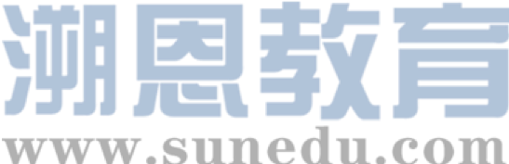

感恩遇见，相互成就，本课件资料仅供您个人参考、教学使用，严禁自行在网络传播，违者依知识产权法追究法律责任。
更多教学资源请关注
公众号：溯恩高中英语
知识产权声明

Slide 2
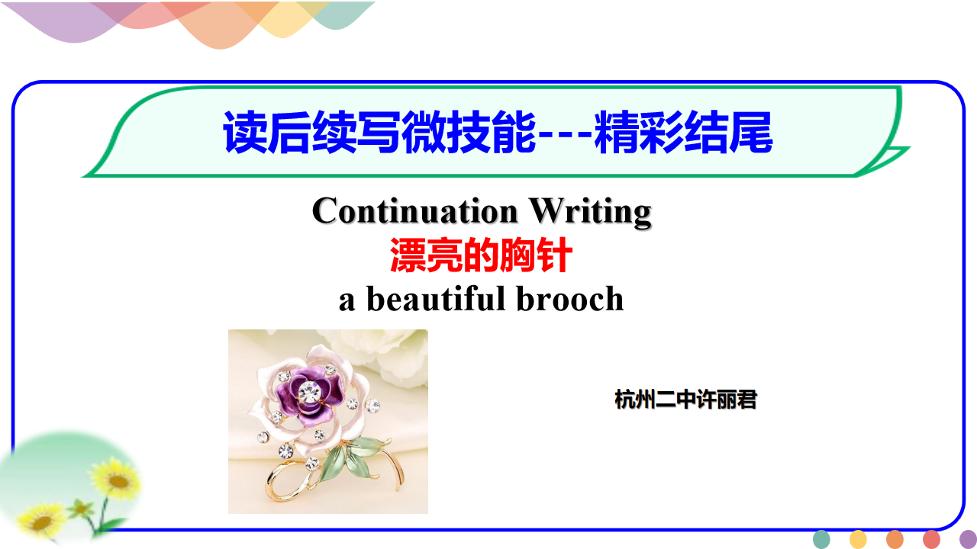

Slide 3
【试题展示】2021年湖北随州题
阅读下面短文，根据所给情节进行续写，使之构成一个完整的故事。
In 1945, a 12-year-old boy saw a beautiful brooch (胸针) in a shop window that set his heart racing. But the price—five dollars—was too high for Reuben Earle. Five dollars would buy almost a week’s food for his family.
Reuben couldn’t ask his father for the money. Everything his father made through fishing went to his mother, Dora. Slim and beautiful, she was the center of the home and the glue that held it together. The housework was never-ending, and she struggled to feed and clothe their five children, but she was happy as her family and their well-being were all she cared about.
Nevertheless, he opened the shop’s door and went inside. Standing proudly and straight in his flour-sack (面粉袋改做的) shirt and washed-out trousers, he told the shopkeeper what he wanted, adding, “But I don’t have the money right now. Can you please hold it for me for some time?”
“I’ll try,” the shopkeeper smiled. “People around here don’t usually have that kind of money to spend on things. It should keep for a while.”
Reuben respectfully touched his worn cap and walked out. He would raise the money and not tell anybody, for he thought Mum would get surprised when she saw that brooch. On hearing the sound of hammering（捶打） from a side street, Reuben suddenly had an idea that he could raise money by selling the used nail bags. People built their own homes in Bay Roberts, using nails bought in bags from a local factory. Sometimes the used bags were thrown away at the construction site, and Reuben knew he could sell them back to the factory for five cents a piece. That day he sold two nail bags and hid the money in a rusty soda tin.

Slide 4


※【段首提示语】
注意：
1. 续写词数应为150左右;
2. 请按如下格式在答题卡的相应位置作答.
Paragraph 1:
Every day after school, Reuben started his plan. ___________________________
Paragraph 2:
Finally, the time came! ____________________________________________.

Slide 5

※文本分析：Read for main idea:
通过原文和续写段首语可知：
本文主要讲述了一个小故事：12岁男孩Reuben想为自己的母亲买一枚胸针，可手头没有足够的钱，他找到店主，店主答应为他保留一段时间，而Reuben开始卖钉子袋来筹钱购买胸针。他想尽了各种挣钱的方法，甚至还去送报纸赚钱，圣诞夜来临前一天，他打开存钱的饮料罐，倒出所有的零钱，到商店把一直期待的漂亮的胸针买回家送给妈妈。
续写中的人物塑造、情节发展和环境描写需紧扣故事主题。

Slide 6
※【主题解读：explore the theme】
主人公在故事中经历磨难和巨大的挑战，随着故事的不断推进，主人公经过自己的努力，达成了自己的目标，用行动向妈妈表示自己的爱。
1
2. 故事体现了爱的行动远胜于言语, 本文中体现的是一个爱妈妈的少年通过自己的努力，用自己的方式向妈妈表达感情。
2
3
3. 故事的主题是：世上没有实现不了的梦想，只要你立志为之努力奋斗，梦想最终一定会实现。

Slide 7
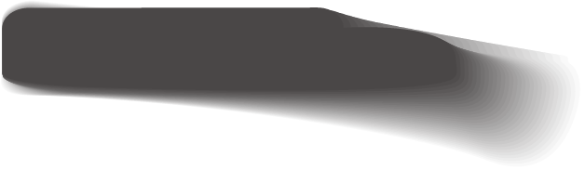
【线索分析：1. 人物线索（read for the characters）】
【主要人物：】
小男孩Reuben——爱妈妈，肯吃苦，意志坚强
【次要人物：】
妈妈Dora——需要通过妈妈来衬托儿子，文章对妈妈的描述：
正是因为妈妈是全家的主心骨，妈妈为全家人操劳，她最关心的是全家人的幸福，她为这个家付出了很多，值得儿子报答妈妈。
Slim and beautiful, she was the center of the home and the glue that held it together. The housework was never-ending, and she struggled to feed and clothe their five children, but she was happy as her family and their well-being were all she cared about.
在续写中，应根据主次人物的特点进行合理的人物刻画。

Slide 8
【2. 情节线索（1）结构分析：Read for the Structure 】
冲突（conflict）：Reuben没有钱给妈妈买漂亮的胸针；
01
行动（action）：Reuben捡拾大街上造房子留下的钉子袋，甚至送报纸赚钱；
02
结构分析
解决（resolution）：Reuben攒够了钱，迫不及待地买回胸针，送给妈妈，得到妈妈的喜爱。。
03
原文展示了故事的“冲突”部分，续写两段分别为故事的“行动”和“解决”部分。

Slide 9
※【（2）情感分析（Read for emotion）】
故事围绕Reuben捡拾并卖掉钉子袋赚钱买胸针展开。存钱是故事的情节线索之一。根据原文，Reuben没有钱购买非常漂亮的胸针，但他想尽办法，不仅捡拾钉子袋卖掉赚钱，还跑去送报纸，存够了钱之后，在圣诞节前夕，终于买回了妈妈漂亮的胸针，送给妈妈。
Reuben的心理变化是故事的另一个情节线索。从看到商店橱窗中的胸针开始，他的心理变化如下：
eager（看到胸针）
disappointed（没钱购买）
Reuben’s emotion
expecting（捡拾钉子袋）
delighted（送给妈妈）
excited（买到胸针）
hopeful（存够钱）

Slide 10
※【3. 环境线索（Read for the clue）】
解决
（resolution）
*发生在送妈妈胸针的家中
行动
（action）
*发生在Reuben捡拾钉子袋的大街
冲突
（conflict）
*发生在卖胸针的商店里

Slide 11
※【思路分析】
根据故事的主题、情节、人物和环境分析，原文呈现了故事的“冲突”部分：Reuben没有钱购买漂亮的胸针送给妈妈。续写两段分别是故事的“行动”和“解决”部分：
冲突（conflict）
Reuben没有钱购买漂亮的胸针送给妈妈
行动
（action）
Reuben捡拾钉子袋，送报纸赚钱
解决（resolution）
Reuben存够了钱，在圣诞节前夕为妈妈买回了漂亮的胸针

Slide 12
※【首尾分析】
构思续写部分情节结构
通过续写两段的段首句，可以确定每段故事的情节发展、场景和人物。
Paragraph 1: Every day after school, Reuben started his plan.
根据第一段段首句可知，本段故事场景为每天放学后，Reuben就开始进行他的筹钱计划。后文可以讲述他的筹钱过程以及最终结果，可以具体描写一下筹钱过程中Reuben付出的努力。
Interaction
Paragraph 2: Finally, the time came!
根据第二段段首句可知，本段故事场景为终于，是时候打开储钱罐了！本段开头暗示Reuben已经筹到了足够的钱，后文就可以描写他买下胸针的激动心情以及将胸针送给母亲Dora的过程。另外，母亲收到胸针后开心、感动的反应也可以是描写的重点。
根据故事主题和情节结构分析，段尾应该是母亲开心地收下礼物，询问Reuben钱是怎么存起来的。Reuben告诉妈妈自己为存钱所做的一切，感悟世上没有实现不了的梦想。
Imaginary plot

Slide 13
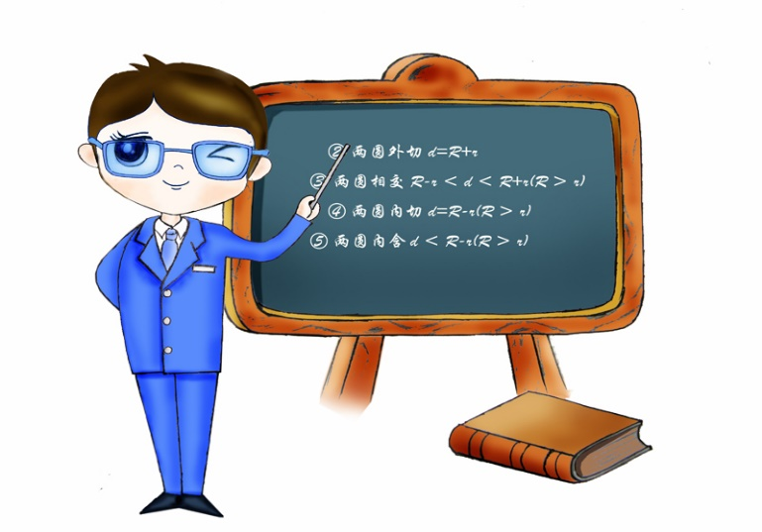

【情节分析Predicting the ending】
续写第一段具体情节构思：
展开细节时，可以尝试回答如下问题并考虑多种可能性：
2
a) How did Reuben save money?
b) What else did Reuben do to save more money?
c) How did Reuben feel when facing the challenge, such as coldness and hunger？
根据以上问题，续写第一段的具体情节可以是：Reuben捡拾钉子袋存钱→为了存更多的钱，Reuben送报纸→每天又冷又饿→但储钱罐里的钱慢慢多起来了。

Slide 14
【情节分析Predicting the ending】
2
续写第二段具体情节构思：
展开细节时，可以尝试回答如下问题并考虑多种可能性：
a) How much money did Reuben earn through his own efforts?
b) What did Reuben do after he saved enough money?
c) What did his mother Dora feel after getting the gift from her son?
根据以上问题，续写第二段的具体情节可以是Reuben打开储钱罐，数钱，一共五美元二十分（开心）→Reuben即刻去商店买回胸针→送给妈妈（感动）→妈妈问Reuben如何存钱→Reuben告知经过，并总结人生哲理。只要立志，就一定能达成目标（自豪）。

Slide 15
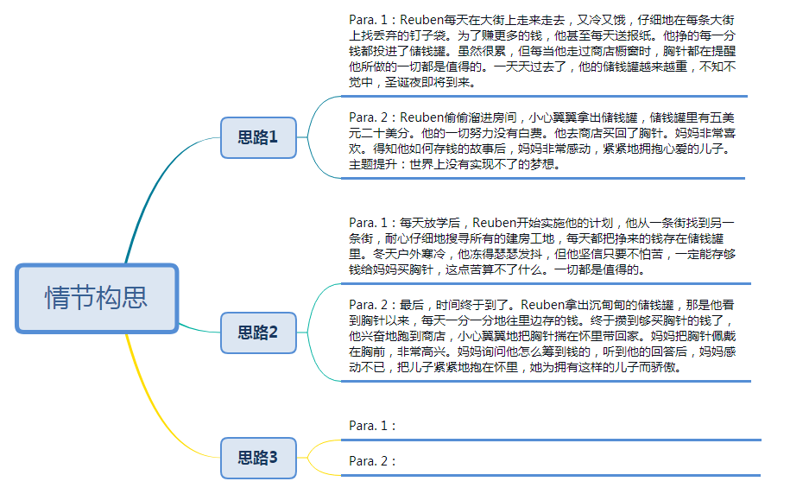

【Plot development可参考情节1-2：】

Slide 16
【Plot development情节构思3】
Para. 1: 每天放学后，Reuben搜遍家附近所有的大街，只要有在造房子的人家，他都仔细去搜寻一遍，每天他都把捡来的袋子卖掉换成钱，藏在他的储钱罐里，他会掂一掂重量，但存钱实在是太艰难了，Reuben知道，他必须坚持，哪怕每天只有一分钱，他一定要买到那枚胸针，因为他要让妈妈开心，感谢妈妈对这个家的付出。
Para. 2：最后，时间到了！在新年到来的前一天，Reuben打开储钱罐，仔仔细细地数着这辛辛苦苦赚来的每一分钱，够了。他捧起罐头，跑向商店，用事先准备好的手帕包好胸针，回到家，给了妈妈一个大大的惊喜，把胸针佩戴在妈妈胸前。妈妈急切地问他钱从哪儿来？告诉妈妈后，Reuben自豪地说：“只要我立志得到它，它就一定属于我”。妈妈听着他的一番话，非常感动，不仅因为儿子的懂事孝顺，而且因为儿子追求自己的目标永不罢休。

Slide 17
【Writing Sample：】
Paragraph 1：
Every day after school, Reuben started his plan. Cold and hungry, Reuben wandered around, searching for nail bags carefully. To save more money, the determined boy even delivered papers on the early morning. Every coin he won went to a tin, his treasured “bank”, and all the tiredness disappeared magically. Each time he passed by, the brooch in the shop window would remind him what he did was worthwhile. Day by day, his tin became heavier. Six weeks passed before he knew it. Then approached the Christmas Eve.

Slide 18
【Writing Sample：】
Paragraph 2:
Finally, the time came! Reuben stole into his room and cautiously took out the tin, poured all the coins out and began to count. Five dollars and twenty cents! He counted it a second time, and no mistake. His hard work eventually paid off! Holding the tin firmly, Reuben rushed for the shop without a second’s delay. Wearing the beautiful brooch and knowing the story behind it, Dora was too overjoyed to utter a word. She just threw her arms tightly around her beloved son. “Merry Christmas, mom,” the son announced proudly. “You too,” the proud mother echoed. Well, no dream is out of reach for a willing heart.

Slide 19

【技能拓展-精彩结尾(Writing Skills)】
1. 我们平常看文章，尤其是记叙文，一般会先看看开头，然后马上看看结尾，用这种方法来判断它是不是有趣。结尾不光告诉我们文章要表达什么，结尾也可以反应作者的艺术品味。
3. 是不是故事最后必须是哲理性结尾？结尾的回应应该是：照应开头的人、物、事件、情景、状态。
1
3
2
4
2.精彩的结尾能够起到点睛的作用，给读者留下深刻的印象，也能唤起读者的思考与共鸣，增强文章的感染力。在结束故事的基本要求之上，可以灵活运用画面定格、情感升华、主题提炼等多种方式结尾，对故事的主题进行深化，使人物的情感得到升华。
4. 换句话说：主题的呈现形式是丰富多彩的，如果原文的描写只是表达一件难忘的事情，并没有什么人生哲理，那我们的主题也就是让这件事有个圆满的结果，其结尾应该体现这一点。结尾点题，这个题要根据原文作者的表达意图（purpose）来定。

Slide 20
※【技能拓展-精彩结尾(Writing Skills)】
像本文中体现的是一个爱妈妈的少年通过自己的努力，用自己的方式向妈妈表达感情。
1. 采用主题提炼的方式结尾:
世上没有实现不了的梦想...
Reuben骄傲地抬起头，说虽然存钱的过程非常艰辛，但能给妈妈买漂亮的胸针，给妈妈带来快乐，是他最大的幸福…
Three Possible Endings：
2.情感升华式结尾
3. 用画面定格式方式结尾
妈妈抱住Reuben的头，留下了幸福的泪水。

Slide 21
【技能拓展-精彩结尾(Writing Skills)】
如果结尾只是说妈妈很开心，就非常遗憾了，还必须和这个描写照应：对生活的乐观和对孩子的热爱。具体可以描写：
4.主题升华：Well, no dream is out of reach for a willing heart.
2.妈妈的疼爱：She just threw her arms tightly around her beloved son.
01
03
妈妈的开心：Wearing the beautiful brooch and knowing the story behind it, Dora was too overjoyed to utter a word.
04
3.对话：“Merry Christmas, mom,”, the son announced proudly. “You too,.” the proud mother echoed.
02
。

Slide 22
Thanks for your attention!

