Slide 1

感恩遇见，相互成就，本课件资料仅供您个人参考、教学使用，严禁自行在网络传播，违者依知识产权法追究法律责任。
更多教学资源请关注
公众号：溯恩高中英语
知识产权声明

Slide 2

A news report
---Constructing a News report with the Inverted Pyramid
2023.1 浙江高考应用文

Slide 3
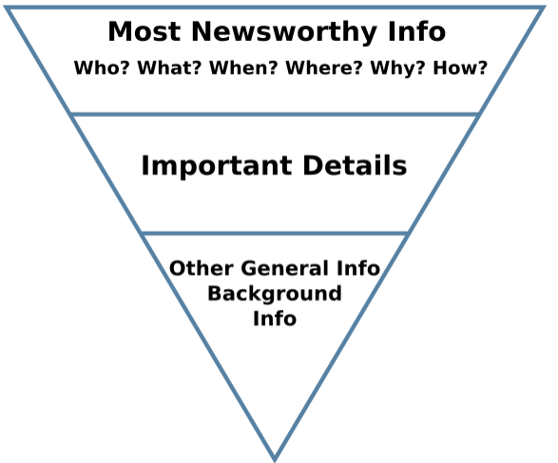
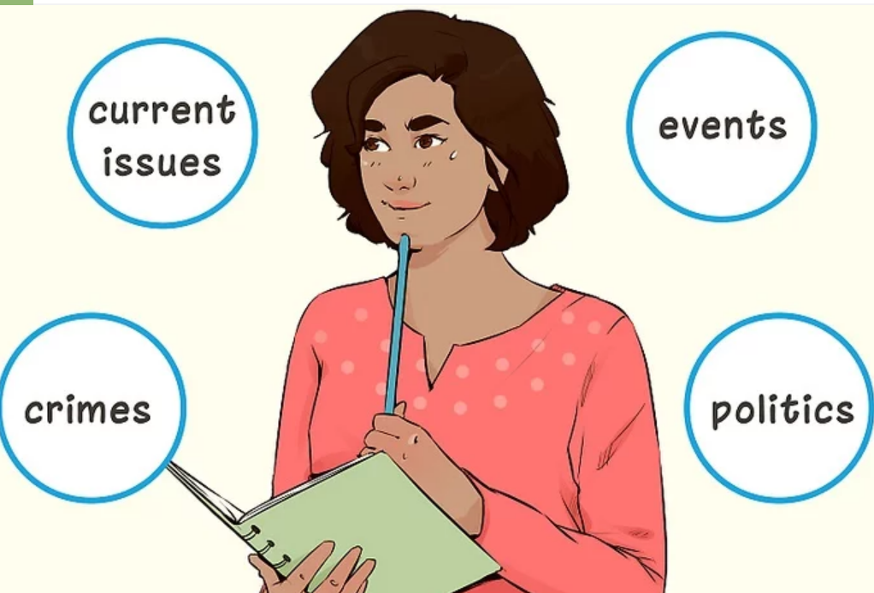
What is a news report?
An inverted pyramid
A news report is a fact-based story, on a particular event or incident happening /happened. News report gives all the information about incidents that already happened or currently taking place along with covering answers of 5Ws and 1H i.e. What, Where, When, Who, Why, and How.

Slide 4


Structure& content
01
（2023 浙江高考）上周末你参加了学校学生会组织的“认识你身边的植物”活动，请你给校英文报写一篇报道。1.活动的过程；2.收获与感想。
注意：1.写作词数应为80左右；2.请按以下格式在答题纸的相应位置作答。
Getting to Know the Plants Around Us
__________________
Getting to Know the Plants Around Us
summary of the event
details of the event
comment on the event

Slide 5
Structure& content
01
（2023 浙江高考）上周末你参加了学校学生会组织的“认识你身边的植物”活动，请你给校英文报写一篇报道。1.活动的过程；2.收获与感想。
Getting to Know the Plants Around Us
上周末(when)你(who)参加了学校学生会组织的“认识你身边的植物”活动(what)
summary of the event

Slide 6
Structure& content
01
（2023 浙江高考）上周末你参加了学校学生会组织的“认识你身边的植物”活动，请你给校英文报写一篇报道。1.活动的过程；2.收获与感想。
Getting to Know the Plants Around Us
活动的过程
Where
details of the event
How

Slide 7
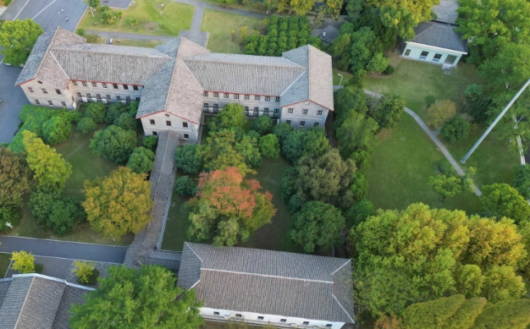
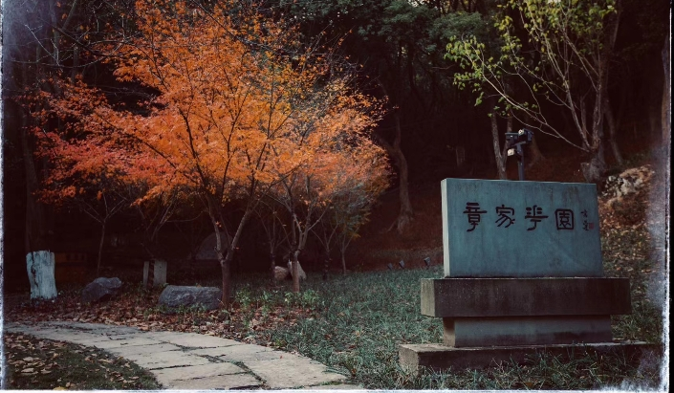

Where
on campus
off campus
lecture hall/...

Slide 8

How
join in a competition about plant-related idioms
attend a lecture to learn more about plants
identify the different plants
use a digital camera to photograph plants
...
observe and label plants
recite poems about plants
draw pictures to show plants’ features
collect seeds and leaves

Slide 9

How
version1
version2
version3
① gather together
② observe & sort
plants
③ take photos
④ discuss & share
① gather together
② watch a video
③ explore plants
④ document
observations
① gather together
② attend a lecture
③ join in a
competition to
name plants
④ (winners) get
seeds to
...

Slide 10
Structure& content
01
（2023 浙江高考）上周末你参加了学校学生会组织的“认识你身边的植物”活动，请你给校英文报写一篇报道。1.活动的过程；2.收获与感想。
Getting to Know the Plants Around Us
收获与感想
comment on the event

Slide 11
02
Language
Getting to Know the Plants Around Us
headline
catchy
para.1 summary of the event
上周末(when)你(who)参加了学校学生会组织的“认识你身边的植物”活动(what)
concise
lead
para.2 details of the event （活动过程where+how）
detailed
body
para.3 comment on the event (活动收获与感想what)
sincere
closing
factual

Slide 12
02
Language
（2023 浙江高考）上周末你参加了学校学生会组织的“认识你身边的植物”活动，请你给校英文报写一篇报道。1.活动的过程；2.收获与感想。
（2023 浙江高考）上周末(when)你(who)参加了学校学生会组织的“认识你身边的植物”活动(what)，请你给校英文报写一篇报道。1.活动的过程；2.收获与感想。
para.1 活动概况：
v 举办 vt. launch
hold host
v 参加 (短语) participate in join in take part in be involved in enter for sign up for be engaged in
Getting to Know the Plants Around Us
Last week witnessed an activity entitled “Identify the Plants around You”. Many students signed up for it and had an unforgettable experience.
summary of the event

Slide 13
02
Language
（2023 浙江高考）上周末你参加了学校学生会组织的“认识你身边的植物”活动，请你给校英文报写一篇报道。1.活动的过程；2.收获与感想。
para.2 活动过程：
observe /share/discuss
label plants
take photos by camera
identify different plants
explore outdoors
think about plant-related idioms
collect seeds and leaves of trees
sort out /name plants
document observations
write a report on...
join in a competition related to..
...
Having been given a lecture on plant-related common knowledge by a famous local botanist, we began our exploration on campus with a plant identification competition. As scheduled, we were divided into two groups. Within the appointed time, members from each group first photographed, named and labeled plant species through careful observation and then attached details ranging from each plant’s unique physical features to its location. Eventually, group A, whose members distinguished a wider range of plant species on campus, won the competition. To our delight, each winner got an exquisite plant album as a prize.
Getting to Know the Plants Around Us
活动的过程

Slide 14
02
Language
（2023 浙江高考）上周末你参加了学校学生会组织的“认识你身边的植物”活动，请你给校英文报写一篇报道。1.活动的过程；2.收获与感想。
para.3 收获与感想：
总体评价
It was a hit.
It is an enjoyable and educational experience.
We had fun and more than fun.
meaningful
unforgettable
well-received
beneficial
speak highly of
sing high praise for
...
para.3 收获与感想：
认知方面
deepen one’s insight into...
deepen one’s understanding of...
raise one’s awareness of...
catch a glimpse of
broaden one’s horizons
expand one’s scope of knowledge
cast light on sth
...
para.3 收获与感想：
情感方面
immerse sb in the charm of...
arouse/boost one’s enthusiasm
fuel/ignite one’s passion
enrich one’s school life
bring color to...
stimulate one’s interest
evoke (/ɪ’vəʊk/勾起) our love for
...
Getting to Know the Plants Around Us
It was an enjoyable and educational experience. Not only did we get closer to nature but we expanded our knowledge and interest in plants.
收获与感想

Slide 15
possible version
Getting to Know the Plants Around Us
Last week witnessed an activity entitled “Identify the Plants around You”. And many students signed up for it.
As scheduled, we were challenged with a plant identification competition. Divided into two groups, we explored the campus separately. Within the appointed time, we photographed, and labeled plant species through careful observation and then attached details ranging from their features to locations. Fortunately, our group won the game by distinguishing a wider variety of plant species.
The activity was educational, through which, not only did we expand our knowledge but we got closer to nature.
(100 word)

Slide 16
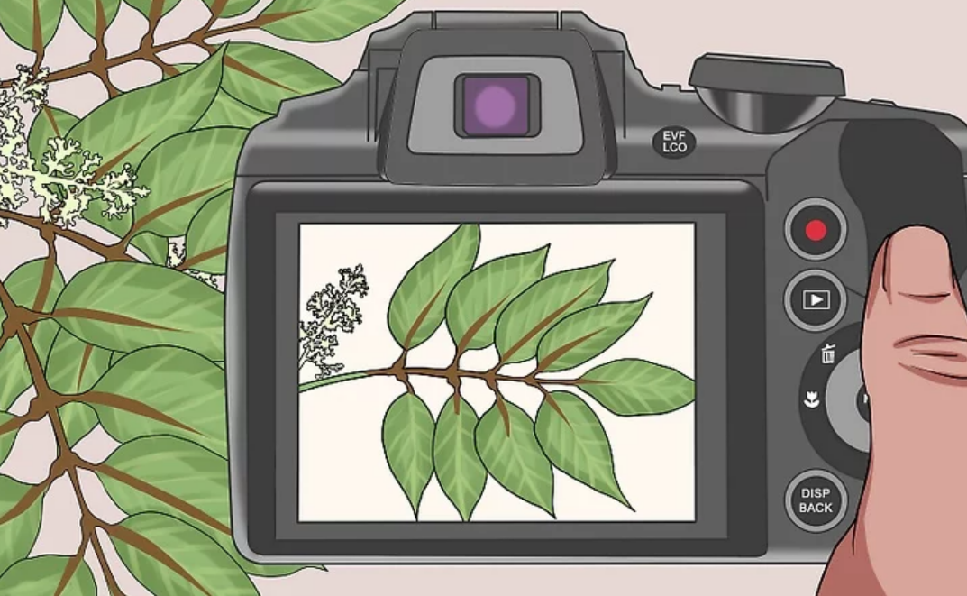
The end

